Slide 1


Intro to SQL Joins

Slide 2

CONTENTS
01.
Combining Tables
02.
Referential Integrity
03.
Joins
04.
SQL queries

Slide 3

Combining Tables
Combining Data Vertically
Table A
Table B
Combining Data from Multiple Tables
This is similar to data concatenation
SQL uses set operators to join tables vertically

Slide 4
Combining Tables
Combining Data Horizontally
Table A
Table B
Combining Data from Multiple Tables
This is similar to data merge
SQL uses join operators to implement this

Slide 5
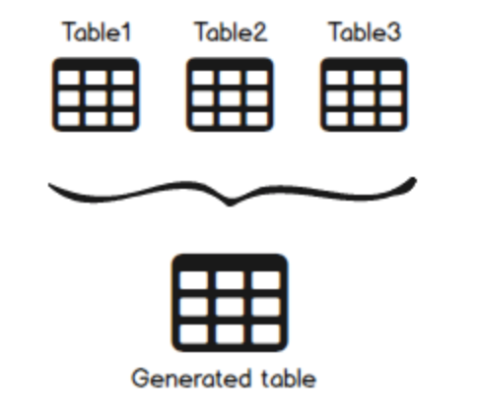
SQL Joins
Tables in a database are highly normalized
To extract information present in multiple tables
Why do
we need
SQL Joins

Slide 6
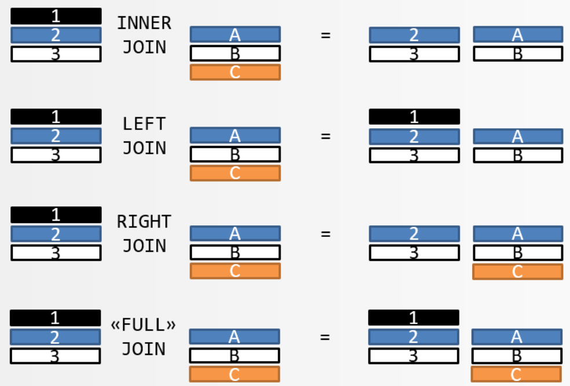
SQL Joins
Types
Of
Joins

Slide 7
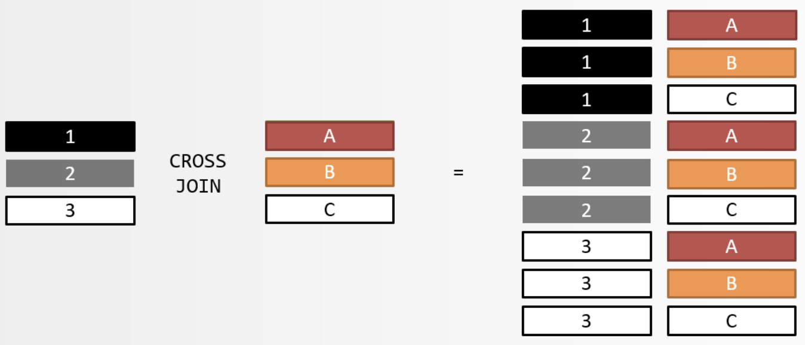
SQL Joins
To be discussed later
Types
Of
Joins

Slide 8
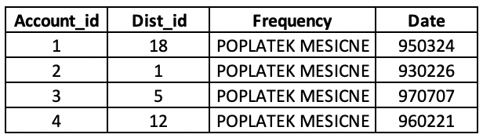
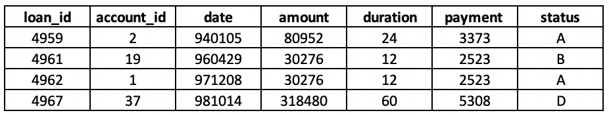

Types of SQL Joins
Returns only matching rows
Can be performed on multiple tables at a time
Inner Join
Result - joined on key account_id

Slide 9



Types of SQL Joins
Returns all matching rows, along with nonmatching rows from one or both tables
Can only be performed on two tables at a time
Outer Join
Left Join
Full Join
Right Join

Slide 10
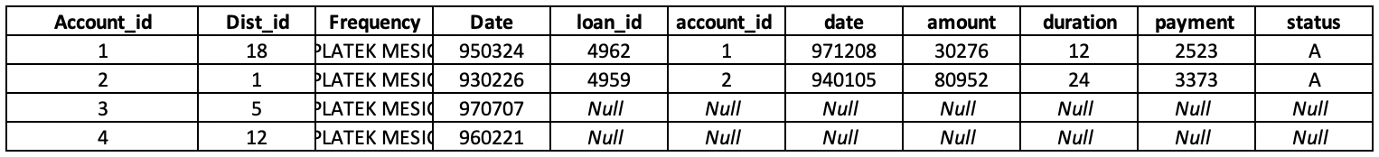
Types of SQL Joins
Returns all matching rows, along with nonmatching rows from one or both tables
Can only be performed on two tables at a time
Left Outer Join
Result - joined on key account_id

Slide 11
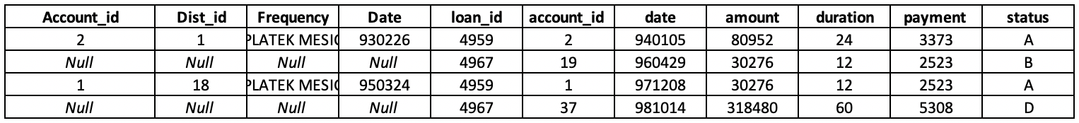
Types of SQL Joins
Returns all matching rows, along with nonmatching rows from one or both tables
Can only be performed on two tables at a time
Right Outer Join
Result - joined on key account_id

Slide 12
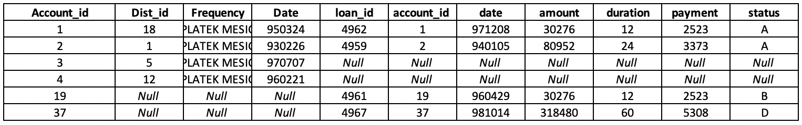
Types of SQL Joins
Returns all matching rows, along with nonmatching rows from one or both tables
Can only be performed on two tables at a time
Full Outer Join
Result - joined on key account_id

