Slide 1


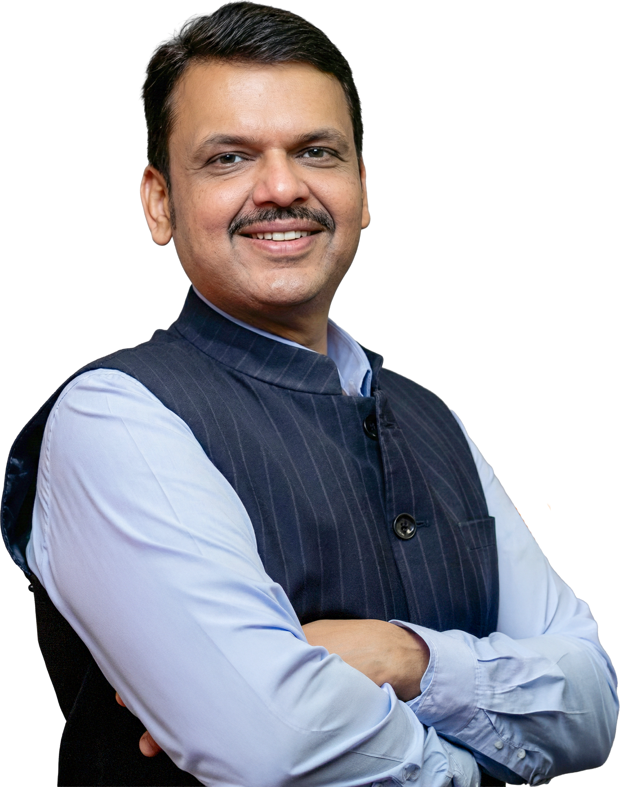

VIKASIT NAGPUR HACKATHON 2026
FLOWGUARD+
Project Name: FLOWGUARD+ - Physics-Driven Urban Drainage Health & Flood Prevention
Theme: Open Innovation for Vikasit Nagpur
Domain: Smart City | Urban Infrastructure | IoT | Flood Prevention
Tagline: Don’t wait for the flood - monitor the drain before it fails.
Pipeline: Detect → Localize → Quantify → Prioritize
Team: [Your Team Name] | Hackathon: [Vikasit Nagpur Hackathon 2026]

Slide 2
SOLUTION
The problem: a drain can silently lose capacity long before a flood becomes visible. Manual inspection is periodic and reactive.
The idea: continuously compare EXPECTED hydraulic behaviour vs ACTUAL sensor observation for every monitored segment.
Residual = Actual − Expected. Small / transient → HEALTHY. Significant / persistent → ANOMALY. Consistent degradation → POSSIBLE CAPACITY LOSS.
Output: localize the suspected affected segment, estimate its capacity loss, and prioritize inspection & maintenance.
THE SILENT FAILURE CYCLE - TODAY’S REALITY
THE DRAINAGE FINGERPRINT
HEALTHY DRAIN
SILENT CAPACITY LOSS
HEAVY RAIN
WATER BACKUP
FLOODING
EXPECTED BEHAVIOUR vs ACTUAL OBSERVATION
Residual = Actual − Expected
FlowGuard+ intervenes at “SILENT CAPACITY LOSS” - before the rain arrives.
HEALTHY
Residual small & normal
PREVENTIVE + LOCALIZED
PHYSICS-BASED
MAINTENANCE-FOCUSED
ANOMALY
Residual significant & persistent
CAPACITY LOSS
Consistent degraded performance
Residual persistence = anomaly confidence

Slide 3
TECHNICAL APPROACH
Stack: ESP32 + HC-SR04 ultrasonic sensing | hydraulic baseline model | residual & persistence analytics | prioritization engine | municipal dashboard
SENSING + HYDRAULIC ANALYSIS
DIAGNOSIS + ACTION
01 REAL DRAIN
07 PERSISTENCE CHECK
02 ESP32 + HC-SR04 NODE
08 CAPACITY-LOSS ESTIMATION
03 REAL-TIME SENSOR DATA
09 SEGMENT LOCALIZATION
04 HYDRAULIC BASELINE
10 FLOOD CONSEQUENCE
05 EXPECTED vs ACTUAL
11 MAINTENANCE PRIORITY
06 RESIDUAL ANALYSIS
12 MUNICIPAL DASHBOARD
EDGE LAYER ESP32 + water-level sensing
ANALYTICS LAYER hydraulic model + residual + anomaly detection
DECISION LAYER localization + flood consequence + priority

Slide 4
PRACTICAL IMPLEMENTATION
Live proof, not simulation: a miniature transparent drainage channel with controlled inflow, ultrasonic water-level sensing and real-time expected-vs-actual analysis on ESP32.
CONTROLLED INFLOW
MINI DRAIN
HC-SR04 SENSING
ESP32 EDGE
EXPECTED vs ACTUAL
LIVE DEMO - 3-STEP EXPERIMENT
CHALLENGES → MITIGATIONS
STEP 1 CLEAN DRAIN Expected ≈ Actual → HEALTHY
Sensor fouling / silt
redundant nodes, cleaning protocol, self-check
STEP 2 OBSTRUCTION INSERTED Same inflow, behaviour deviates → ANOMALY DETECTED
Flow variability
physics-based baseline adapts per segment
Scale & cost
low-cost ESP32 nodes, gradual roll-out
STEP 3 PERSISTENT DEVIATION Residual stays elevated → CAPACITY LOSS SUSPECTED
Field validation
phased pilots with Nagpur Municipal Corporation
Hardware: ESP32 + HC-SR04 + mini drain + controlled inflow + removable obstruction
WHY IT’S DIFFERENT:
Others warn when water becomes dangerous. FlowGuard+ monitors why drainage capacity is becoming dangerous.

Slide 5
IMPACT AND BENEFITS
78% NETWORK HEALTHY
50 SEGMENTS MONITORED
4 INSPECTIONS RECOMMENDED
2 HIGH-IMPACT SEGMENTS
CAPACITY LOSS → FLOOD RISK (illustrative: 80 mm rain)
MAINTENANCE PRIORITY - WHAT TO FIX FIRST
Drain condition | Capacity | Consequence
Healthy | 100% | Low
Degraded | 65% | Medium
Severely degraded | 40% | High
Priority | Segment | Capacity loss | Consequence | Action
#1 | S03 | 42% | HIGH | Inspect now
#2 | S08 | 31% | HIGH | Inspect soon
#3 | S12 | 55% | LOW | Monitor
Less capacity + same rainfall → more water accumulation → higher flood consequence.
Limited municipal resources → data-driven inspection priority → inspect here first.
Key idea: a drainage problem becomes dangerous when reduced capacity meets heavy rainfall.
BENEFITS:
Preventive drainage health | lower flood damage | data-driven municipal ops | aligned with SDG 11 (Sustainable Cities) & SDG 13 (Climate Action)

Slide 6
RESEARCH & REFERENCES
1. Open-channel hydraulics: Manning’s equation and normal-depth analysis to define expected water-level behaviour per segment.
2. Physics-driven diagnostics: residual (model–observation gap) analysis to expose hidden degradation that level-only monitoring misses.
3. IoT sensing: HC-SR04 ultrasonic water-level sensing with ESP32 edge processing - validated on our prototype.
4. Nagpur context: Vikasit Nagpur 2026 / Nagpur Smart City themes on resilient urban drainage and flood prevention.
5. Validation: miniature transparent channel with controlled inflow and removable obstruction (illustrative values marked *).
Note:
all KPI / impact figures are prototype illustrations, not real-time Nagpur telemetry.

