Slide 1


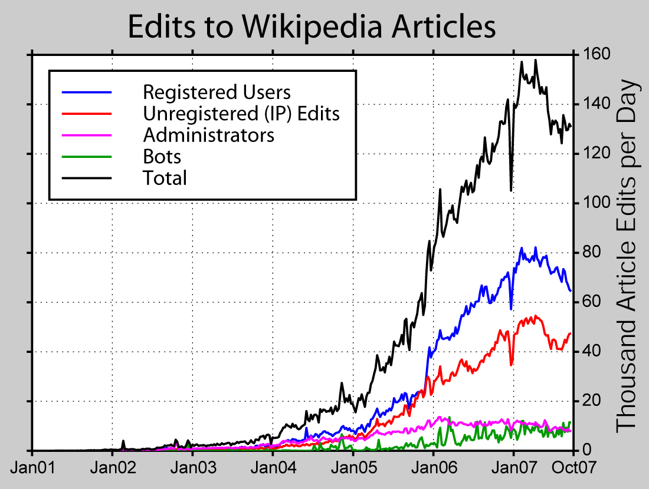

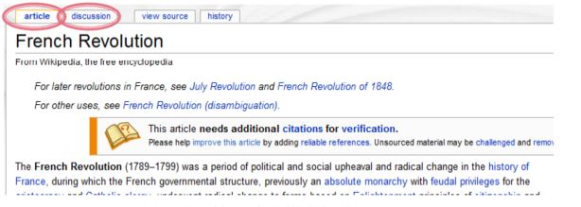
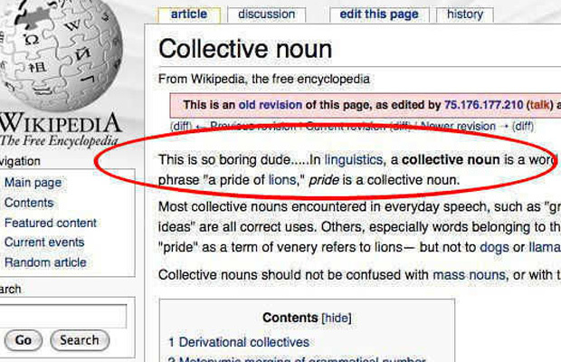
Privacy In Open Source A Case Study: Wikipedia Abu Saleh Md Noman School of Informatics and Computing, Indiana University
What is there in Wikipedia?
Results
Methods
Wikipedia is the largest online Encyclopaedia that is free and open for all.
Large database of contributors (both registered and anonymous).
Every article is evolved through edits. Complete edit history is saved. Each page has talk and discussion page.
Complete edit history: data dump available in Wikimedia (XML).
Random sampling (Random article feature of Wiki)
Mwdumper, a java tool for converting XML to SQL.
Analysis performed in MySQL, Visualization in ‘Listen to Wikipedia’.
Why Wikipedia Data?
Dataset public and ideal for longitudinal study.
Myriads of editors from different background
Harmless dataset, no personal information.
Type of Edit:
Discussion
A typical article
Anonymous user in shadow
Targeted article type
Number of edits by year*
Registered users account for most edits while anonymous users cause most vandalism→(~80% of IP editors are not vandals!).
Counter-vandalism unit of Wiki reverts most of these vandalisms.
Bias in study: restrict scope of analysis. Also, statistical testing are not performed.
A detailed comprehensive study can reveal further trend and require rigorous data mining.
Future Work:
Bag-of-words based ML classifier to identify vandals.
Demographics of vandals, % of dynamic IPs, % of self-reverted vandalism etc..
Other privacy issues of editors and factors influencing privacy loss.
HTTP://WEB.STANFORD.EDU/CLASS/CS345A/SLIDES/06-PROJECTS.PDF
https://en.wikipedia.org/wiki/Wikipedia:IPs_are_human_too
Research Question
Summary of vandalism study:
90% of vandalism done by unregistered IP users.
What anonymous and registered people are doing (type of edits)?
How people are reacting to those (edit over edits)?
Year | # of Articles | # of Edits | # of Vandalism | # Caused By Anonymous Users
2010 | 100 | 670 | 34 | 25
2011 | 80 | 584 | 29 | 18
2012 | 120 | 1015 | 59 | 45
Study on user page, however, show different result. A study on a particular user page revealed 53:47(%) ratio!
Why Is it Important?
Data mining the type of contribution associated with the type of editor.
Prevention of vandalism/foul edits.
‘Vandalism is the act of editing the project in a malicious manner that is intentionally disruptive’
Pattern in version history
Metadata [1], edit category
Classification [2], effect of editor
Motivation on edit types [3] etc.
However, this issue has not
Been well studied
Number of Vandalism Reports
What is Vandalism?
Community Reaction:
If i<j<k in chronological order and i=k; then article j is a revert.
Out of 150 randomly sampled articles, 32 were vandalized. ~25% of them were corrected in less than 90 seconds. The mean response time was 5 minutes.
References
[1] Maass, D. (2013). Data Mining Revision Controlled Document History Metadata for Automatic Classification.
[2] Daxenberger, J., & Gurevych, I. (2013, October). Automatically Classifying Edit Categories in Wikipedia Revisions. InEMNLP(pp. 578-589).
[3] Anthony, D., Smith, S. W., & Williamson, T. (2009). Reputation and reliability in collective goods the case of the online encyclopedia wikipedia.Rationality and Society,21(3), 283-306.
Activity (%)
https://www.google.com/search?q=wiki+vandalism+study&rlz=1C1CHWA_enUS629US629&espv=2&biw=1920&bih=893&site=webhp&source=lnms&tbm=isch&sa=X&ved=0ahUKEwiMp9-ukprMAhVFg4MKHaWUBCsQ_AUIBigB
Community bias?
Thanks to Wikimedia project for the data and free tools available for use. * I thank Robert Rohde for his existing work on vandalism which is reused in this study.

