Slide 1


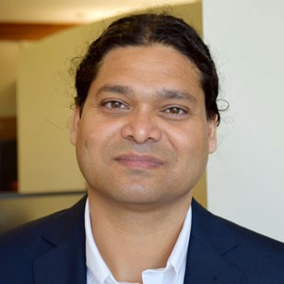
Techies Against Facebook Understanding Negative Sentiment Toward Facebook via User Generated Content
Abu Saleh Md Noman Sanchari Das Sameer Patil

Slide 2
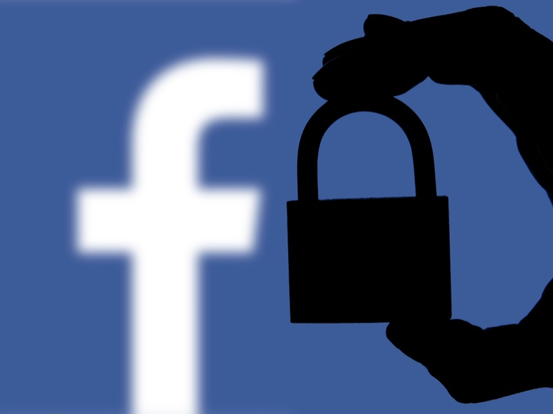

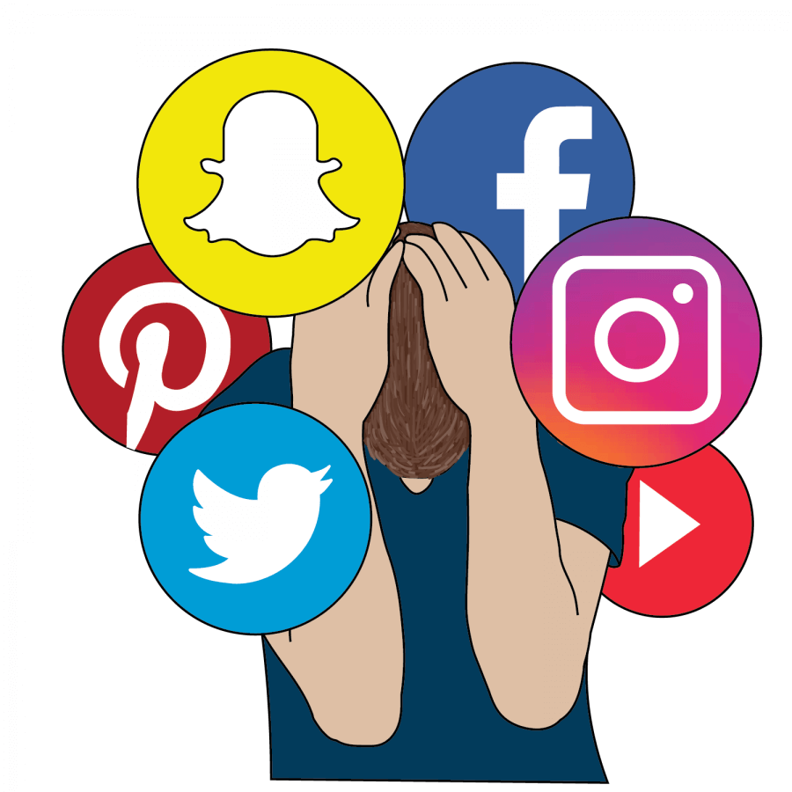
Despite having multiple benefits, user concerns are growing
Privacy & security
Cyberbullying
Addiction
1
Notes:
- Benefits like real-time info sharing, staying connected with FnF, marketing/promoting business
- However, off late user concerns are growing such as: 1) Cambridge analytica, exposing almost 30m user data 2) cyberbullying, abusive comments, trolls 3) Physical and mental health

Slide 3
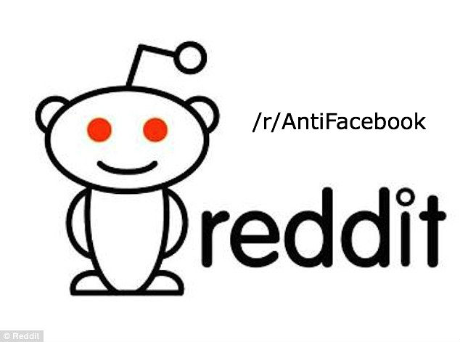
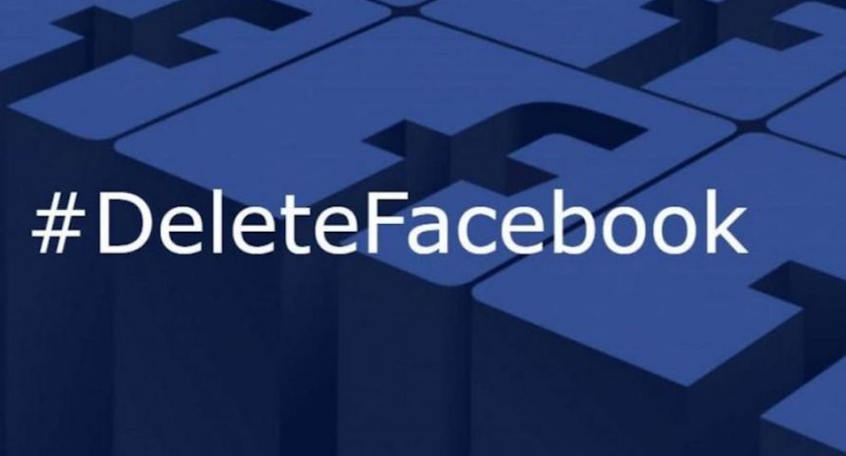
Ongoing movements against Facebook
2

Slide 4
“What factors lead technically savvy individuals to hold negative views toward social media services?”
3
Notes:
Why tech-savvy? – early adopter – deeper understanding of operational details
Why FB? – FB is the largest social media platform with maximum interoperability. So if user interaction with this is negatively affected then it is concerning from both users perspective as well as FB system designers point of view

Slide 5


Our work has two major distinctions
Naturalistic data
Tech savvy population
4
Notes:
Extensively studied use and benefits of SNS
Also studied Fb non-use and underlying factors
Questionnaire based surveys or interviews while…
Average population or the regular users

Slide 6


Scraping
Filtering
Sampling
Sentiment Coding
Thematic coding
5

Slide 7
940 posts
78,597 comments
01/2004 – 02/2018
237 posts
11,365 comments
01/2004 – 11/2017
5

Slide 8
Filtering and sampling
>= 100 Character
2000 from Slashdot (2010-2018)
1000 from Schneier (2006-2017)
Contains ‘Facebook’/ ‘FB’
Score >= +2
7

Slide 9
Sentiment coding
Overall agreement 92.8% (κ=0.87)
1022 Slashdot, 320 Schneier
8
Notes:
Criticism annoyance frustration

Slide 10
Thematic coding
Overall agreement 97.3% (κ=0.96)
10 themes (NOT mutually exclusive)
9
Notes:
Generated codes via initial open coding followed by axial and selective coding where we grouped the similar codes together to come up with 10 different themes.
Not exclusive
While we categorized each NS comments into these 10 themes we also saw if the individual comments are explicit Non-use related where users talk about different Non-use practices then we categorized them as Explicit Non-use only

Slide 11
Themes | #Comments (Slashdot) | #Comments (Schneier)
Privacy & Security | 432 (42.27%) | 212 (66.25%)
User Experience | 341 (33.36%) | 41 (12.81%)
Personal Disposition | 147 (14.38%) | 94 (29.37%)
Advertisements | 104 (10.17%) | 14 (4.37%)
Uninteresting Content | 39 (3.81%) | 28 (8.75%)
Miscellaneous | 35 (3.42%) | 34 (10.62%)
Alternate Options | 18 (1.76%) | 18 (5.62%)
Politics | 30 (2.93%) | 1 (0.31%)
Fake Accounts & Bots | 5 (0.49%) | 22 (6.87%)
Psychosocial Well-being | 9 (0.88%) | 7 (2.18%)

Slide 12
Themes | #Comments (Slashdot) | #Comments (Schneier)
Privacy & Security | 138 (44.37%) | 111 (68.94%)
User Experience | 118 (37.94%) | 18 (11.18%)
Personal Disposition | 42 (13.5%) | 68 (21.86%)
Advertisements | 21 (6.75%) | 5 (3.1%)
Uninteresting Content | 8 (2.57%) | 12 (7.45%)
Miscellaneous | 11 (3.53%) | 14 (8.69%)
Alternate Options | 8 (2.57%) | 10 (6.21%)
Fake Accounts & Bots | 2 (0.64%) | 8 (4.96%)
Politics | 5 (0.01%) | 0 (0%)
Psychosocial Well-being | 1 (0.32%) | 3 (1.86%)
Notes:
This table shows the distribution of the frequencies of NS comments which were marked as Explicit Non-use only as we also wanted to see how the themes appear in this subset. As you can see, the top 5 themes remain the same.

Slide 13
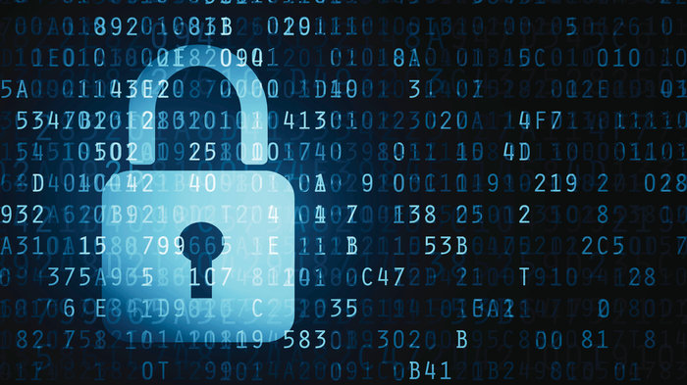
Privacy and security
“Facebook is actively developing new, innovative ways to invade your privacy, and this particular bit of data mining technology has become reliable enough that they felt it would be good PR [Public Relations] to create a feel-good, help-the-disabled feature out of it.”
- Schneier on Security
12
Notes:
Surveillance
Third party data sharing
Identity theft
Data breach such as data mining from fb chats

Slide 14

User experience
“If Facebook continues to make its site user-unfriendly, I’ll simply stop using Facebook. I’ve already dropped back on my usage because I cannot view my timeline the way I want to view it. . . ”
- Slashdot
13
Notes:
Unfreidnly user interface
Poor Organiztion of news feed
Defferent fb features such as Unwanted game requests/autoplay video feature etc

Slide 15

Personal disposition
“It keeps me vaguely in the loop of events and makes me available for my friends and family to contact me. But I keep my privacy options up-to-date and don’t use FB as authentication for anything else. Nor do I use many FB apps or games.”
- Slashdot
16

Slide 16
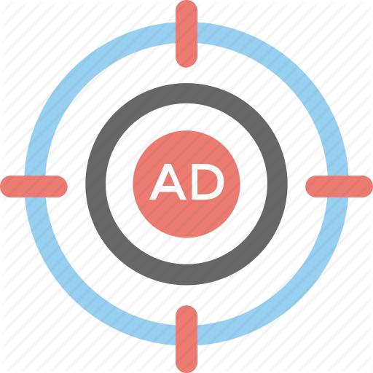
Advertisements
“…Facebook probably mines the unencrypted messages to help form an ‘advertising profile’ for you so they can better target ads at you when you’re on Facebook.”
- Schneier on Security
14
Notes:
Although some of the users indicated they like this feature but A lot of people were disgusted by the fact that fb invades their privacy to make personalized or targeted ads for their benefit (some of them even claimed the share of it)

Slide 17

Uninteresting content
“I wouldn’t be surprised if readership is falling. After I had to open a Facebook account last year, it looked interesting for about a week, then it became an annoyance, now it seems to be troll land…”
- Slashdot
18

Slide 18
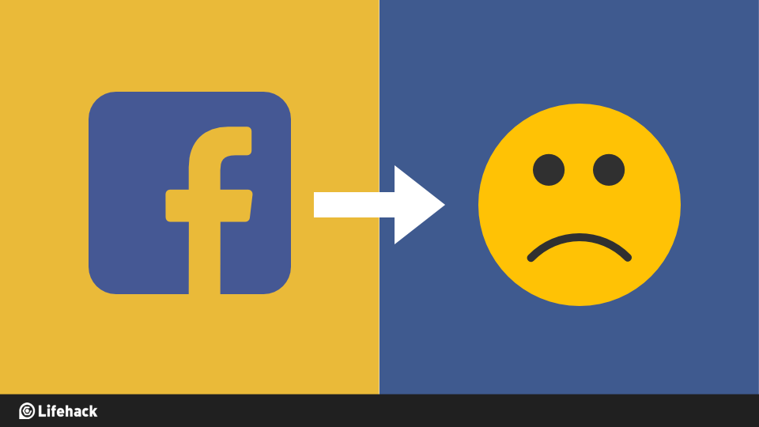
Psychosocial well-being
“The problem with social media (not just FB) and depression is not that people do nothing but stare at FB and get depressed. The problem (or, one of them) is that if you’re already depressed, viewing social media can make it worse…”
- Schneier on Security
15
Notes:
A lot of previous works have addressed this issue on how fb is linked to psychological impacts such as depression, anxiety and addiction. People talked about the problematic use of Fb and the toll it takes on their physical and mental health.

Slide 19

Alternate options
“But I tell ya what – Facetwat is not on my phone. (yes, Facetwat is my derisive mashup of Facebook and Twitter.)…You wanna reach me? Email me. Text me. iMessage me…”
- Slashdot
17

Slide 20

Politics
“And this is why you don’t go on Facebook ever. Well that, and I literally couldn’t give less of a damn about the kind of leftist drivel that populates most of any social media.”
- Schneier on Security
19

Slide 21

Fake accounts and bots
“Technologists and inventors need to work on cutting Facebook of at the knees. Disposable identities, fake searches, encrypted fake traffic, photos of non-existent people, artificial-intelligence tools for generating fake blogs and comments, fake clicks, a tsunami of false information…”
- Schneier on Security
20

Slide 22

Miscellaneous
“Years ago I deleted the Facebook app due to excessive battery drain.”
- Schneier on Security
“I don’t use Facebook . . .If an employer wants my years of experience they will take me as I am. If they are going to reject me because I don’t waste time on Facebook, then I probably wouldn’t last long there.” - Slashdot
21

Slide 23
Notes:
Taken together these factors seemed to raise NS toward FB, degrade user experience and increase people’s tendency to reduce or stop using FB altogether. In this line chart we show…

Slide 24
Notes:
While this graph provides a quick sense of temporal patterns, we should note that the absolute numbers cannot be taken as statistically meaningful owing to our random sampling and size of the dataset.

Slide 25
Findings that confirm prior works
Uninteresting Content ‘Banality’
Alternate options ‘Channel effect’
Personal disposition ‘Context collapse’
Baumer et al. (2013)
Lampe et al. (2013)
Lampe et al. (2013)
23

Slide 26
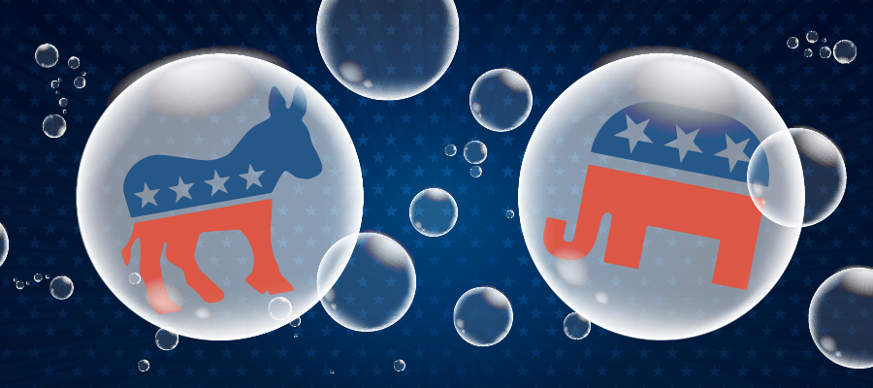
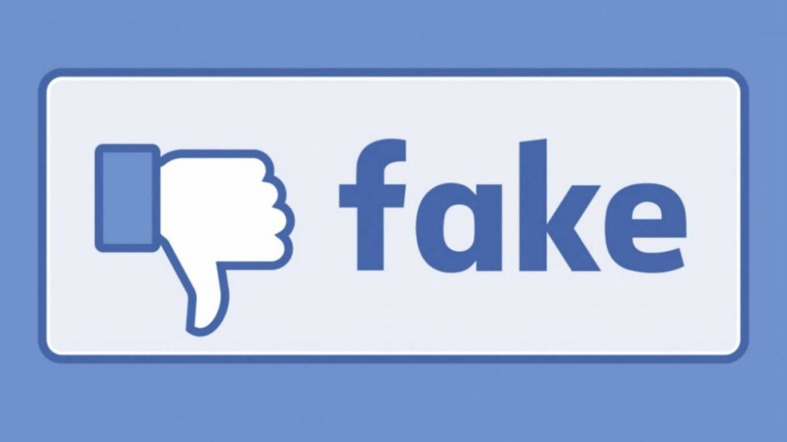
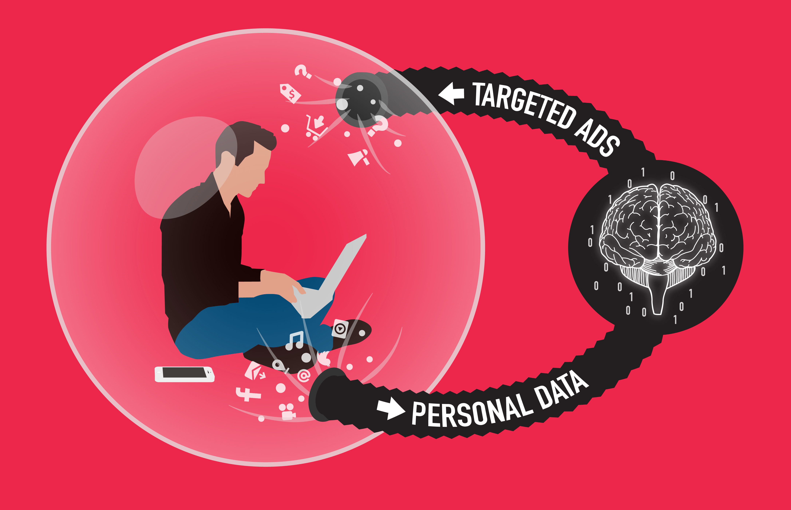
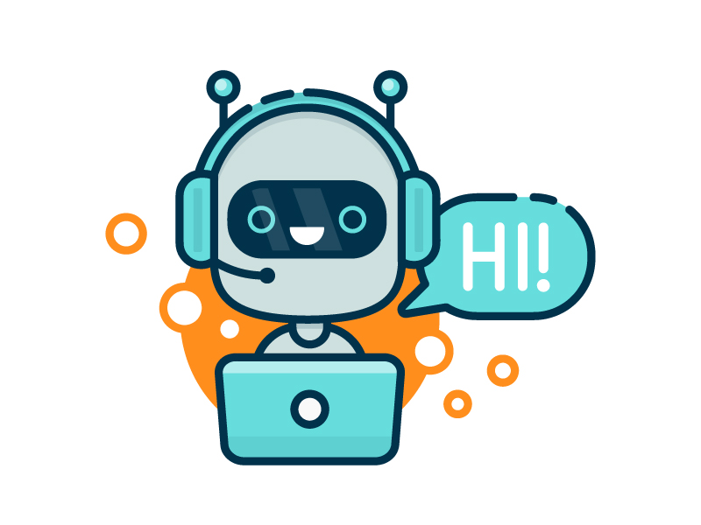
Additional drivers of negative sentiment
24

Slide 27
Studying negative sentiment for broader understanding
Negative Sentiment
Reduced Usage
Complete Abandonment
Lurking
25
Notes:
Negative sentiment can be a higher level aspect connected to non-use. Intenion and sentiment can be strong indicator of behavior and thus NS may strongly imply non-use even not explicitly mentioned.

Slide 28
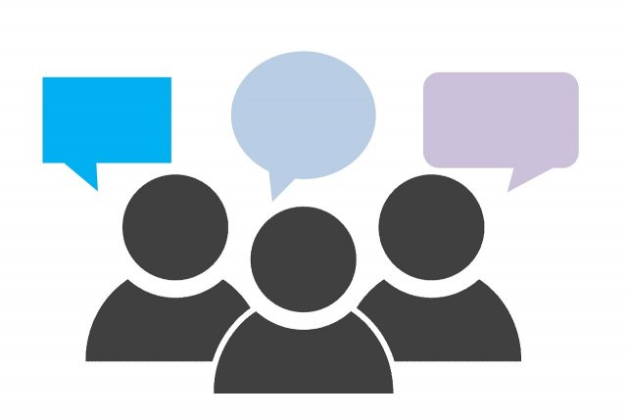
Naturalistic data can be useful
Unsolicited naturalistic user generated content can be useful for uncovering user sentiment and practices.
26
Notes:
Naturalistic data can be useful for researchers and system designers alike. Such unprompted data are in their intended natural setting and can help uncover user sentiment and practices.

Slide 29

Taking expert users opinion into account
Tech-savvy users can help designers uncover problematic operation details
27
Notes:
Tech-savvy users can help designers uncover problematic operation details ahead of time since they have more technical expertise than regular users
If not addressed properly

Slide 30
Naturalistic data
Tech-savvy user
Negative sentiment
amdnoman, sancdas, patil | @indiana.edu
@0008Snoman

