Slide 1
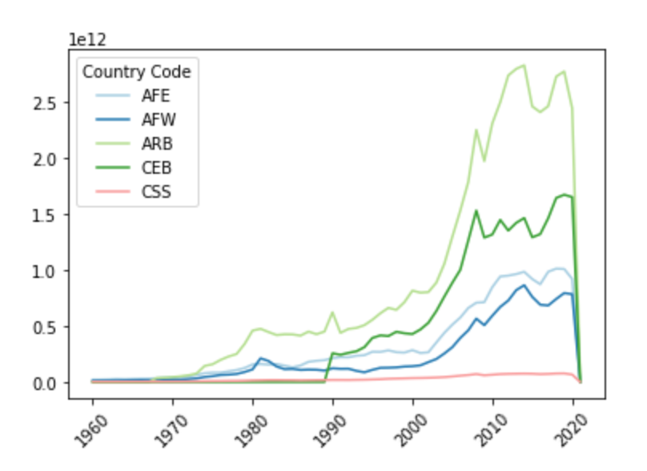
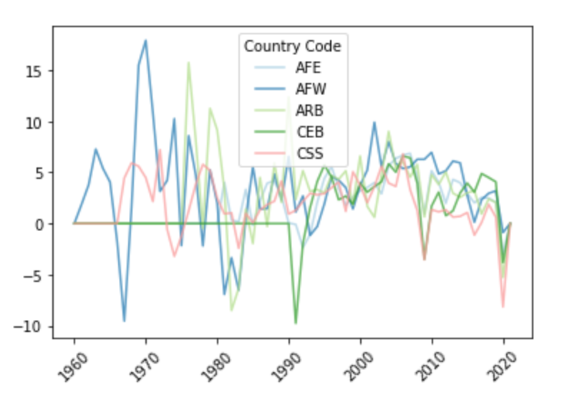
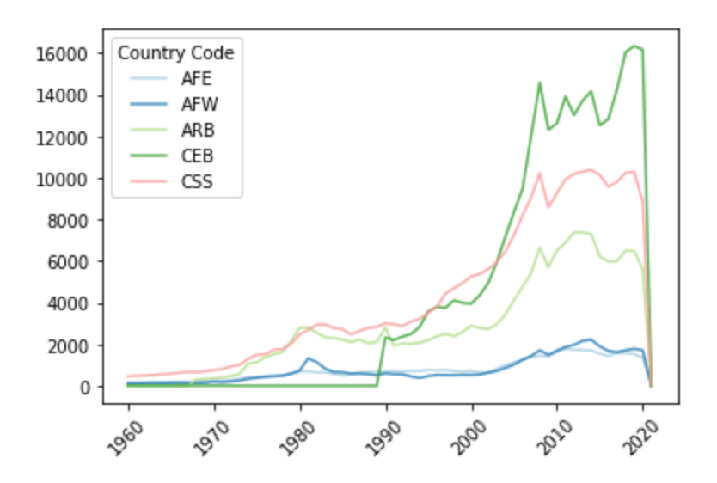
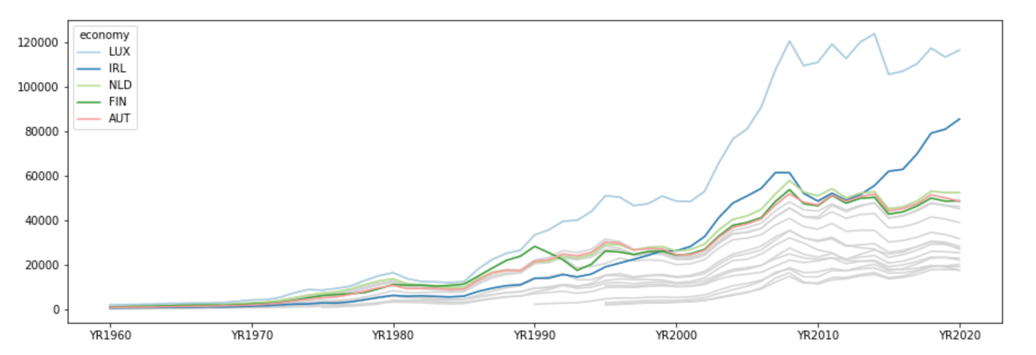
Assignment 3
World Bank Data (Climate Change)
GDP Growth and Emission of CO2
In this assignment I explored public data from the World Bank, and specifically country-by- country indicators related to climate change: https://data.worldbank.org/ topic for this assignment which I supposed to choose is related to climate change. So, I choose one of the datasets which is World Development Indicators Dataset csv file which contains dataset of climate change from 1960 to 2021.
I made clustering on GDP and CO2 and found very interesting results that helps me understand more about GDP Growth and emission of CO2.
In general, I investigated measurements of environmental change and patterns in more detail here as I dealt with the live dataset and this task prepped my abilities also. World climate is changing rapidly and one of the main causes to this is emission of CO2 gas also CO gas which is the most dangerous gas also known as silent killer gas. This effects our environment very badly. I did some visualizations on this you will find my findings later on this report.
Moreover, I made visualizations of GDP (Gross Domestic Product) and CO2 gas and I found very interesting facts. I did visualization on some of the dataset between a gap of 10 years,
So, that I made assumptions clearly. Here are the results which I found.
GDP (current US$)
GDP growth (annual %)
Rapid Growth of GDP according to US$
These graphs show GDP of different countries on different years. Above Graph shows GDP of
(current US$) and (annual) Side Graph shows GDP of per capita (current US$). As you can see how drastically GDP increased in all these
years and made effect in the economy of all these countries. According to the latest facts
GDP decreased by -3.6% of the overall world in 2020 as you can see also in the graphs
above. How lines are dropping rapidly.
These graph shows the data from 1960 to 2021 with 10 years of time span. As you can see that there is too much difference between GDP Growth of current US$ and annual US$. How drastically increase in the growth of GDP has took place in last 20 years.
Below Graph shows economy growth between 1960 to 2020 with 10 years of gap. You can see the results of every 10 years time span. It shows economy of 5 major European countries of Europe.
Conclusion:
How much future warming Earth will encounter relies upon how much carbon dioxide and other ozone depleting substances we radiate in coming many years. Today, our exercises consuming petroleum products and clearing timberlands add around 11 billion metric huge loads of carbon to the air every year. According to the fact that US Environment Science team explored which is indicated that our yearly outflows and refractoriness keeps on expanding and polluting our environment and it is increased day by day. They found that every year it increases 5.9 degrees and our environment hotter up to 5.9 degrees every year which is not good for us and if this continues, we cannot survive on this planet as well. When summer arrives in Asian pacific region every year heat is increasing and survival on those sides are difficult now. So, if we want to live on this beautiful planet, we need to do something to save our environment. May be we need to grow more trees and make our world green and save ourselves from these kind of dangerous gasses.
Notes:
B curve the same for most SN Ia, other bands have distinct features, such as twin peaks etc.
Type II 30 times fainter, 3 magnitudes fainter than Ia

