Slide 1
PHARMACY POS
Members Noman shoukat Muhammad Arif

Slide 2
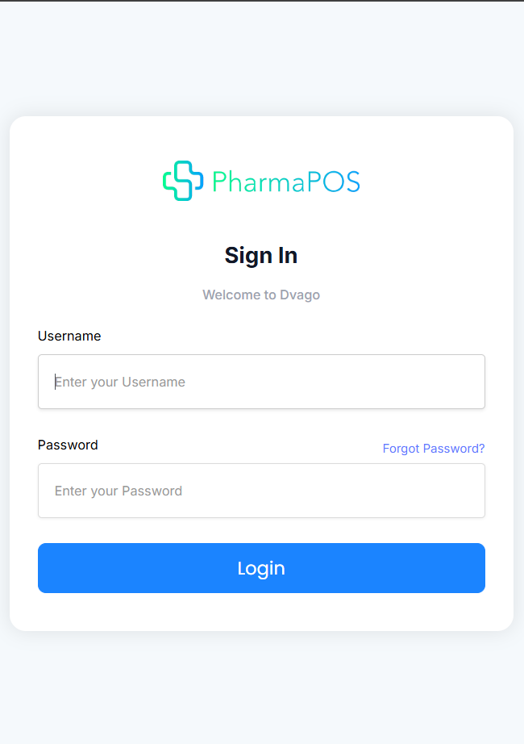
LOGIN
User can login in to Pharmacy POS where they can manage inventory and reporting.

Slide 3
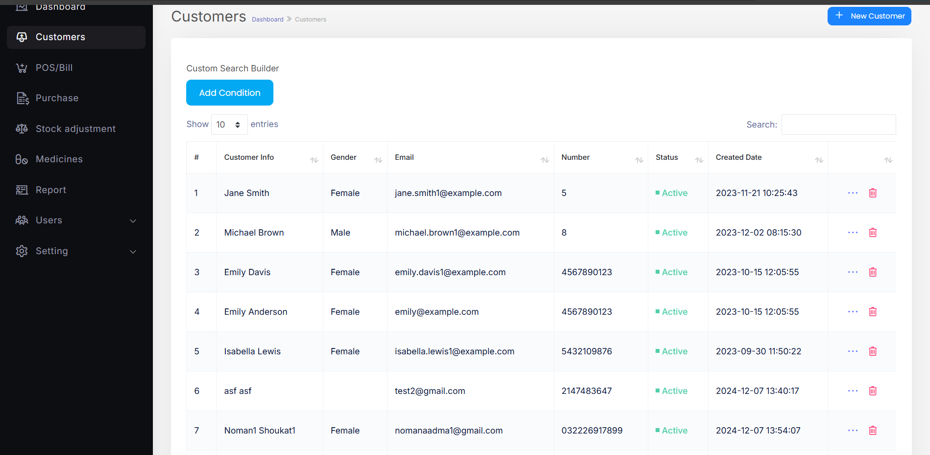
CUSTOMER
User can create customers and view all the customer listing and also search on the bases of there status, gender and created date etc…

Slide 4
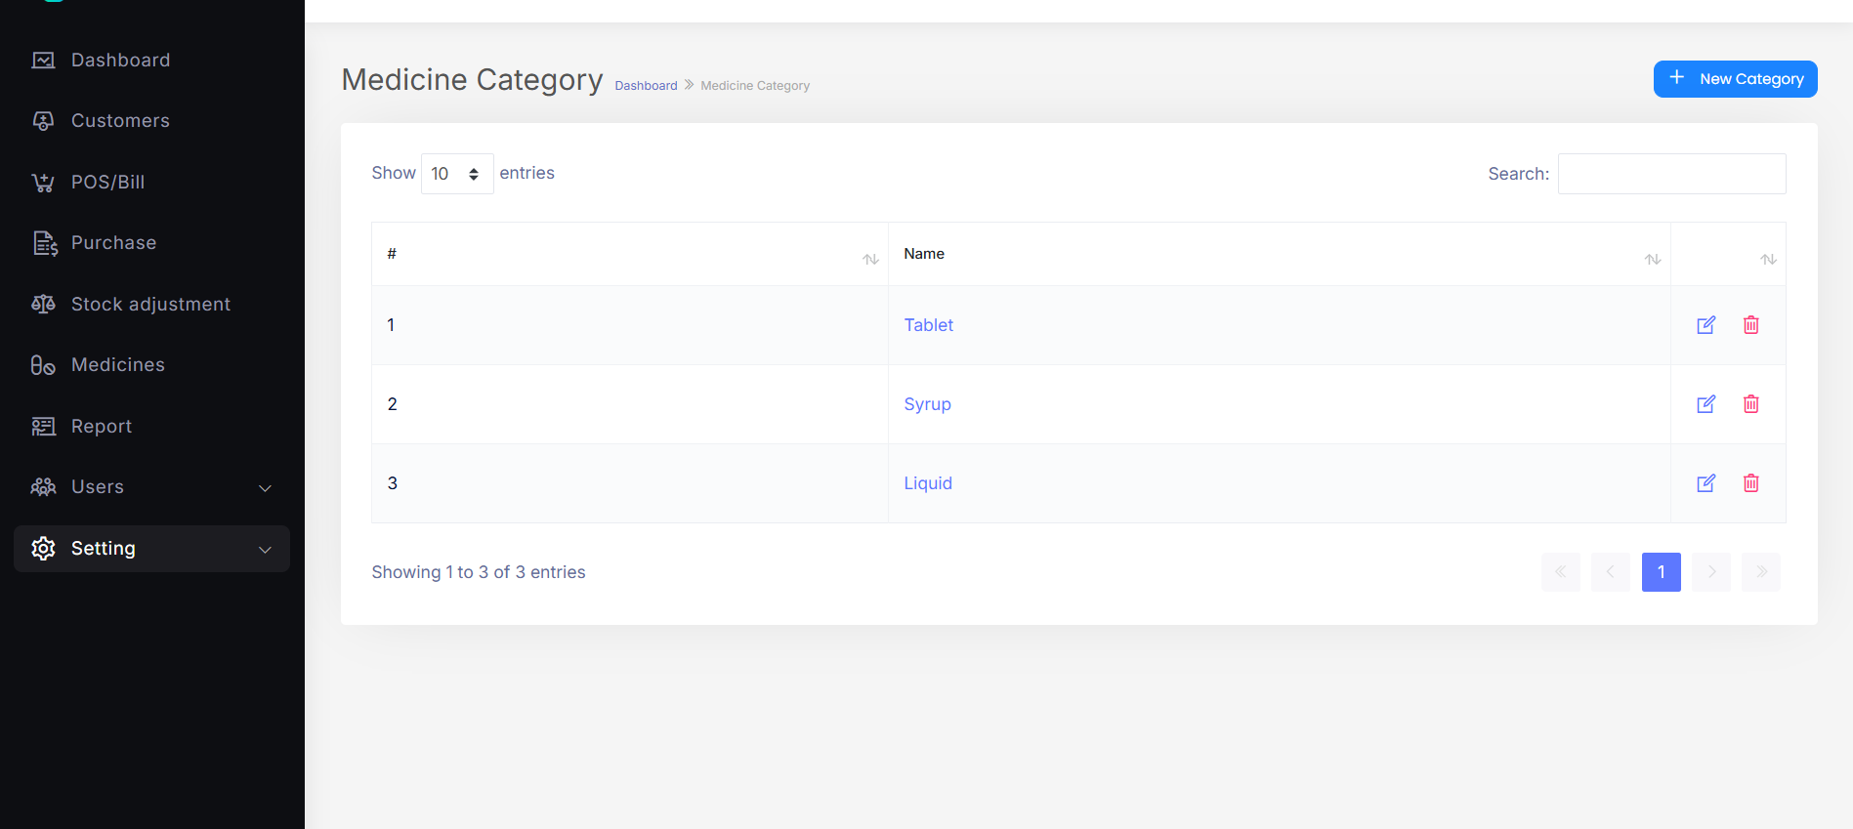
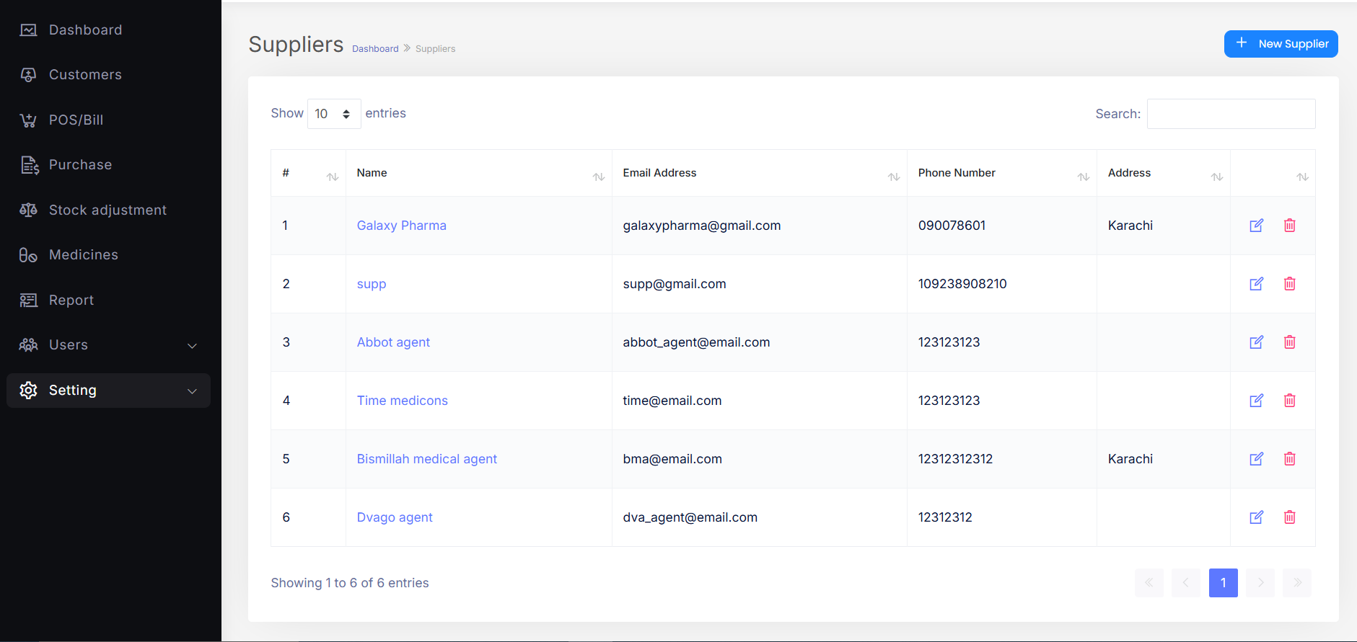
SETTINGS
Supplier
The Settings screen offers options to manage and view supplier details, payment methods, and medicine categories, with the ability to add new entries. It also includes system information settings, allowing users to update the POS system logo and customize system details.

Slide 5
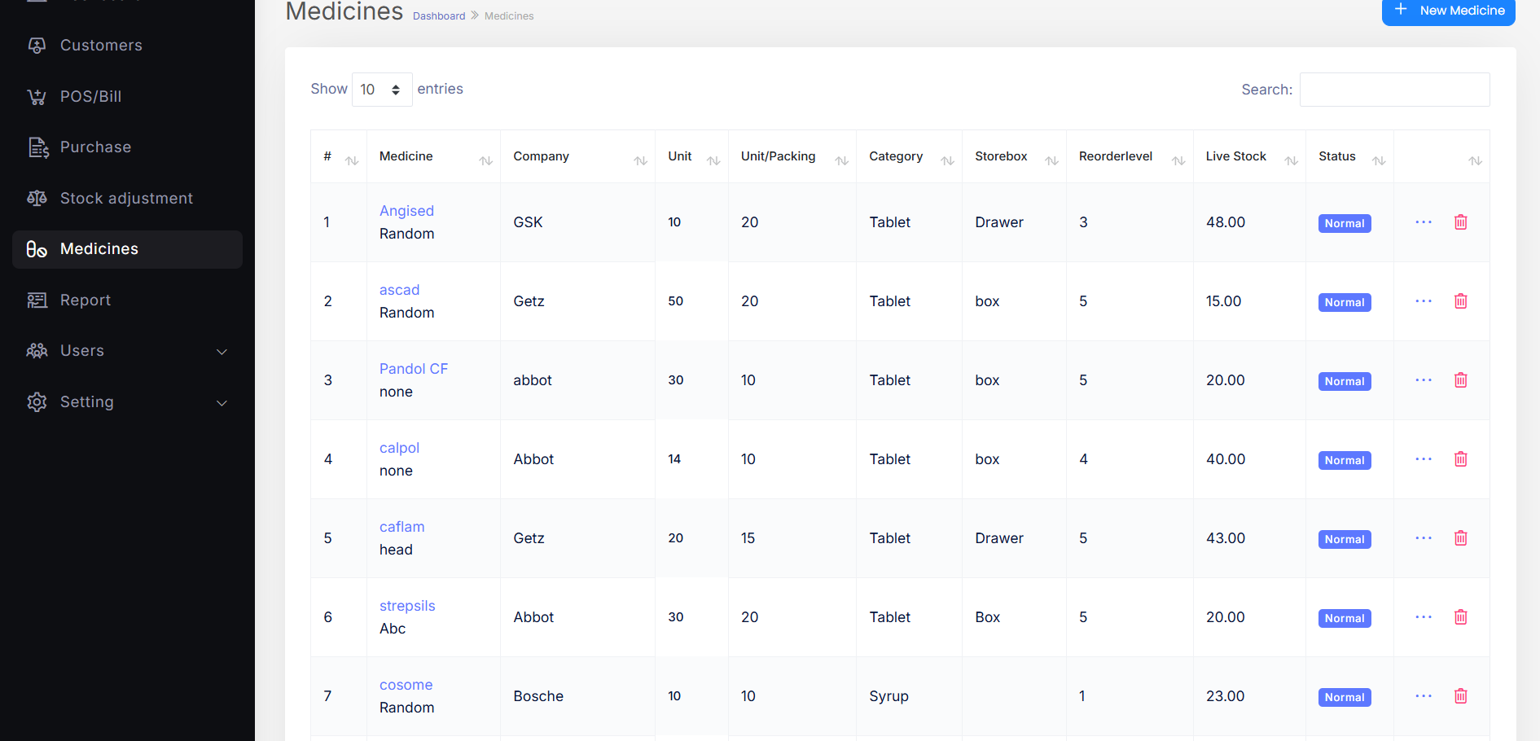
MEDICINE
Users can view all medicines along with their live stock status and unit quantities, and also add new medicines directly from this interface for streamlined inventory management.

Slide 6
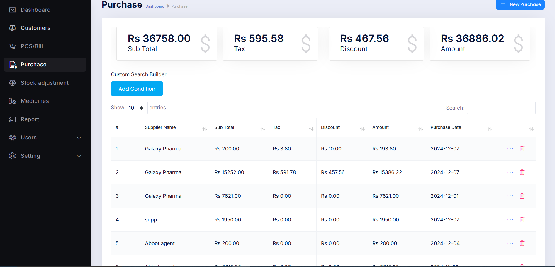
PURCHASE
Users can manage inventory purchases by tracking supplier details, total cost, and selling price, as well as creating new purchase records. Advanced filtering options enable streamlined searches and analysis for efficient inventory management.

Slide 7
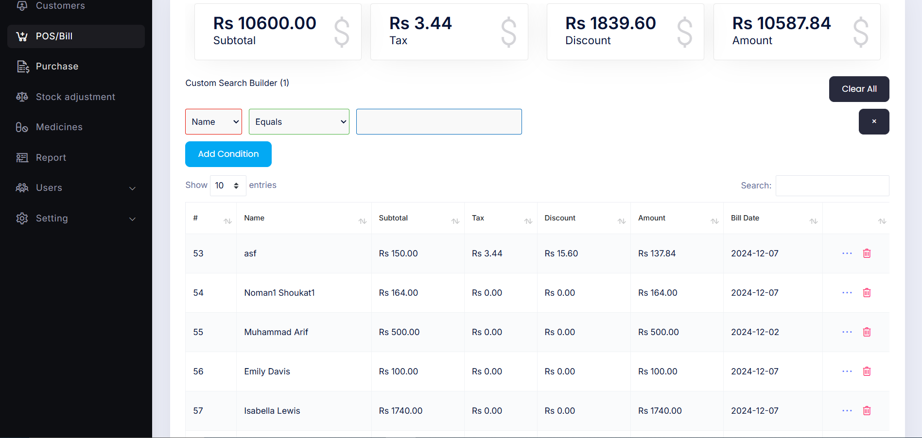
POS BILL
Users can efficiently manage their medical expenses by creating bills and tracking them, with advanced filtering options like date ranges (e.g., the past week, last 30 days, etc.), ensuring seamless record management.

Slide 8
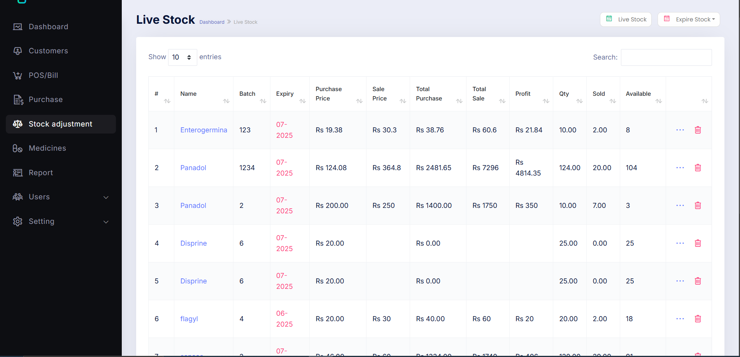
STOCK INFO
Users can monitor live stock levels and track expired inventory with ease, while utilizing advanced search functionality for specific items to ensure efficient stock management.

Slide 9
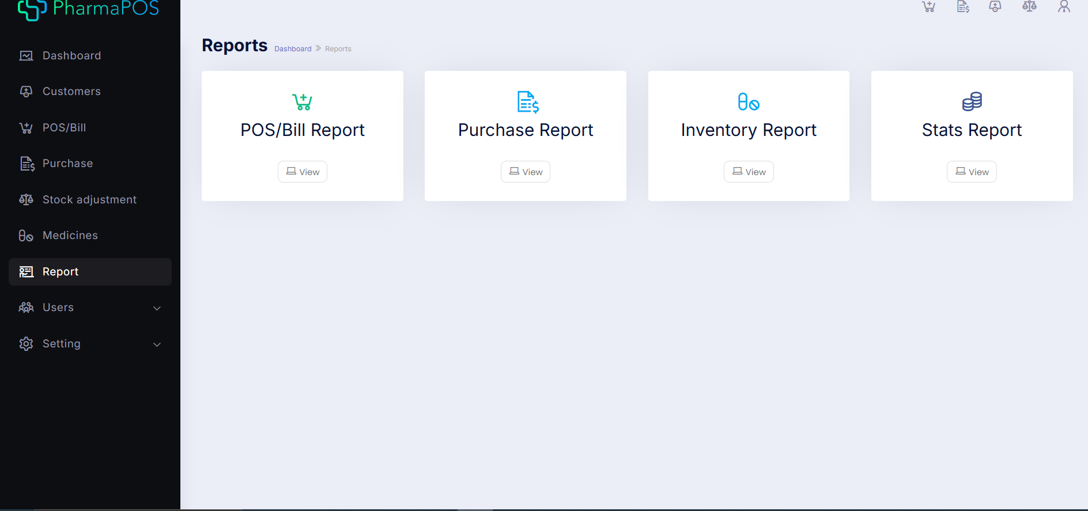
REPORT
The Reports screen provides users with a comprehensive overview of all reports. POS bill reports and other options seamlessly redirect to their respective screens. Additionally, the Expenses and Income section offers a detailed summary of financial transactions.

Slide 10
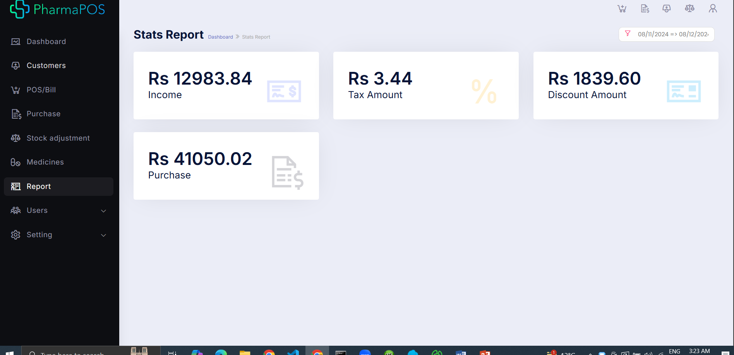
STATS REPORT
The Stats Report provides a comprehensive overview of key financial metrics, including expenses, taxes, discounts, purchase amounts, and more, for detailed financial analysis.

Slide 11
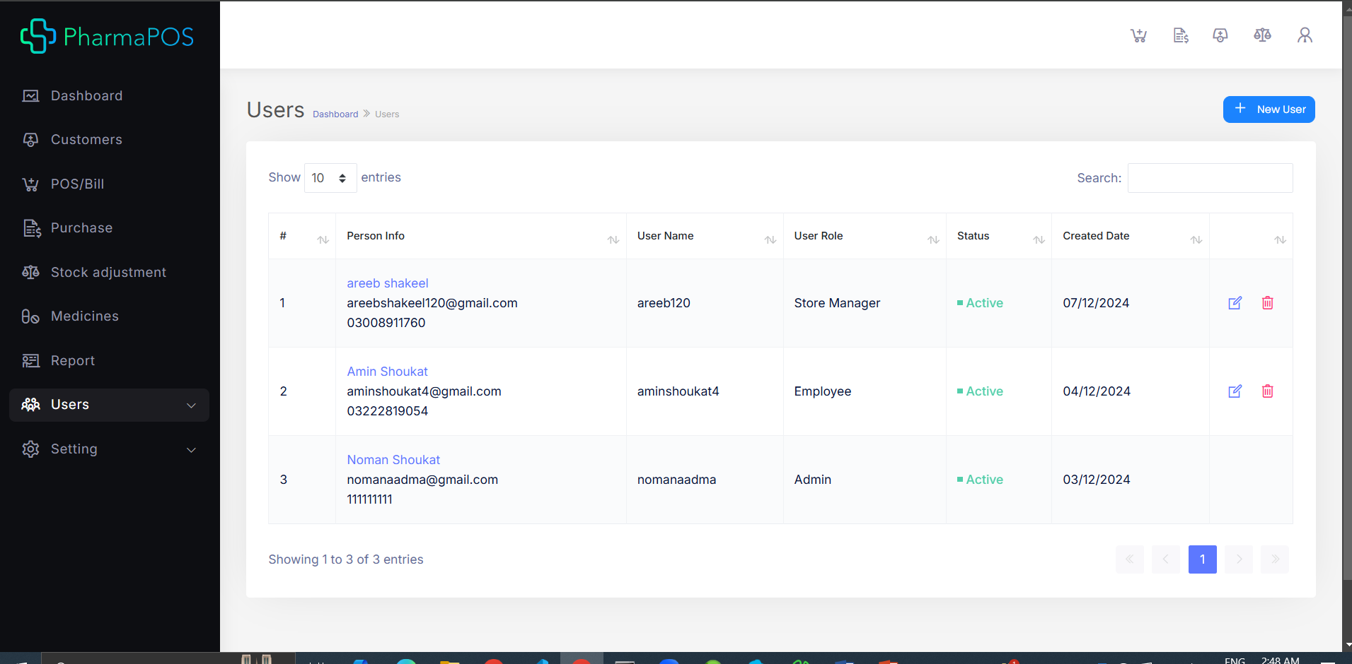
USER LIST
The User List displays all admin users, allowing administrators to add new users and assign specific roles efficiently.

Slide 12
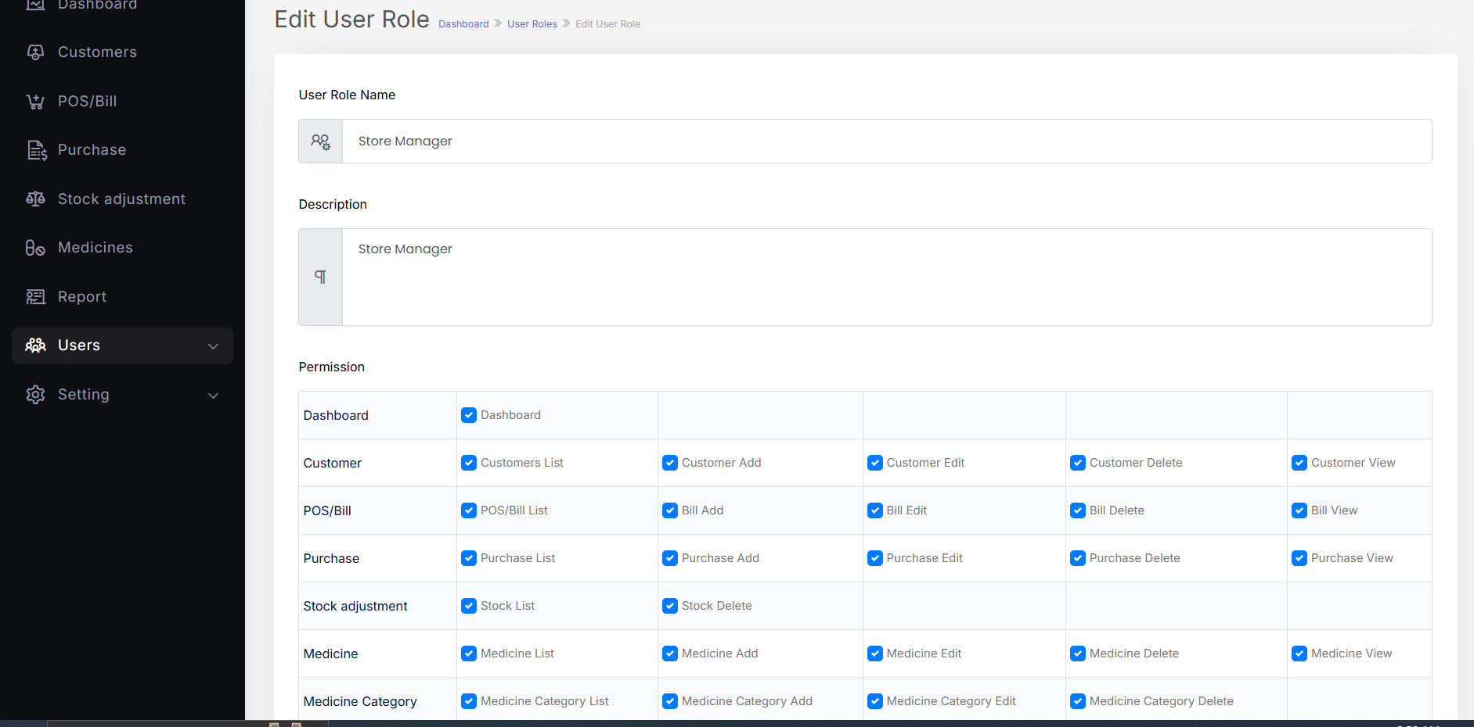
USER ROLE
The User Role screen provides a comprehensive view of all roles, their associated permissions, and the ability to add new roles, ensuring effective access management.

Slide 13
THANK YOU

