Slide 1
K Means Clustering

Slide 2
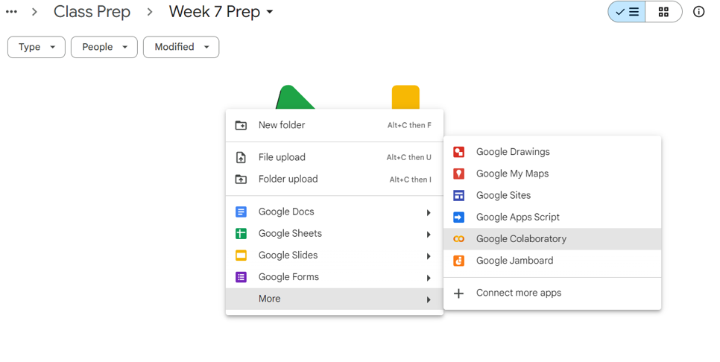
Launching Colab
Log in with your university email account
Create a folder and enter into the folder
Select the option – “Google Colaboratory” as shown in the image

Slide 3
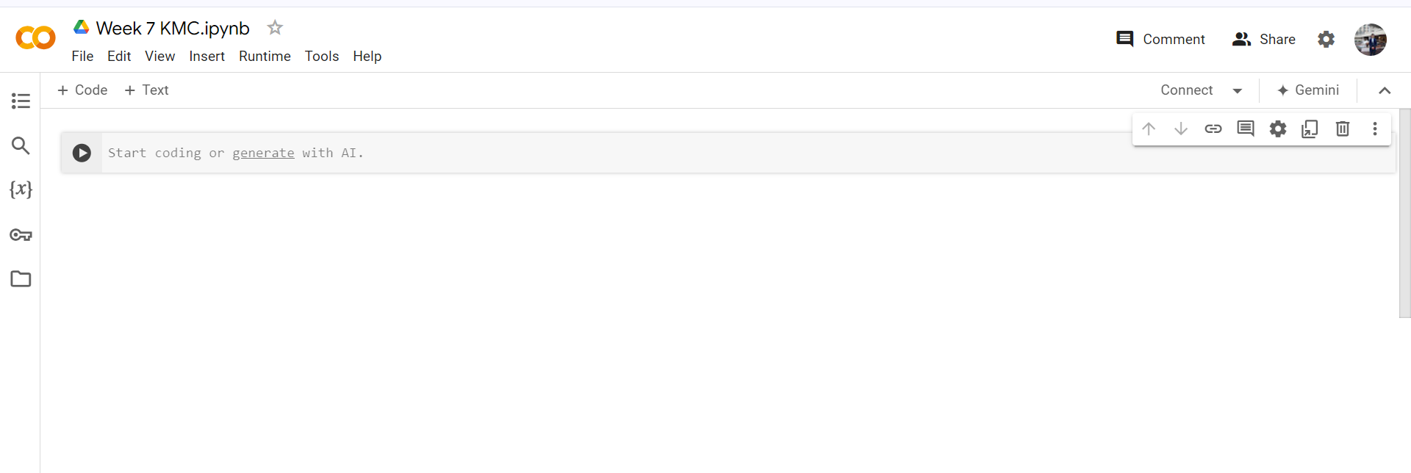
Launching Colab
Once the colab file opens, give it a suitable filename

Slide 4
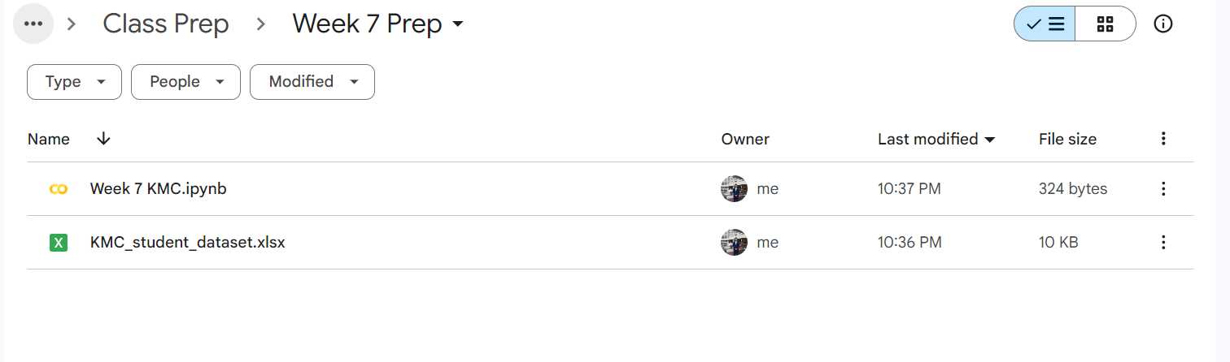
The Dataset
An excel file has been shared with you – see elms
Download the excel file first
Now go to the folder you created
Upload the excel file there – right click – file upload
You should have something like this now

Slide 5
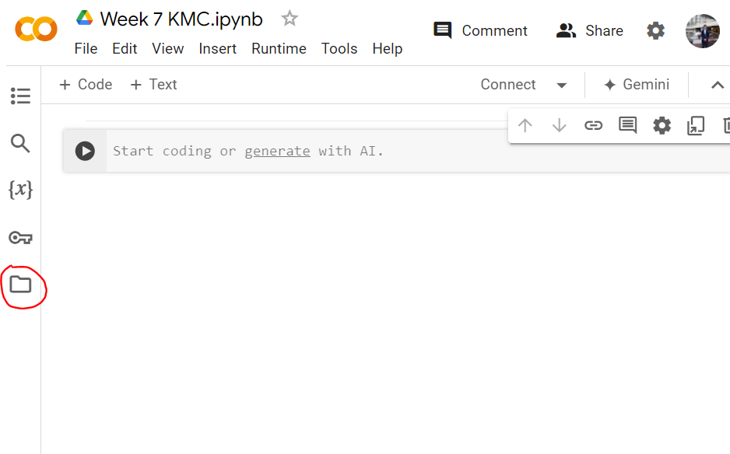
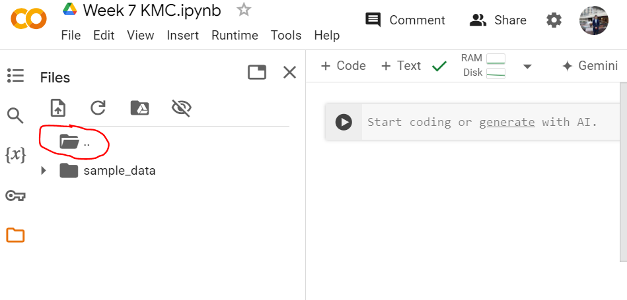
Accessing the dataset from colab
Click on the folder icon
Then click on the folder with three dots next to it

Slide 6
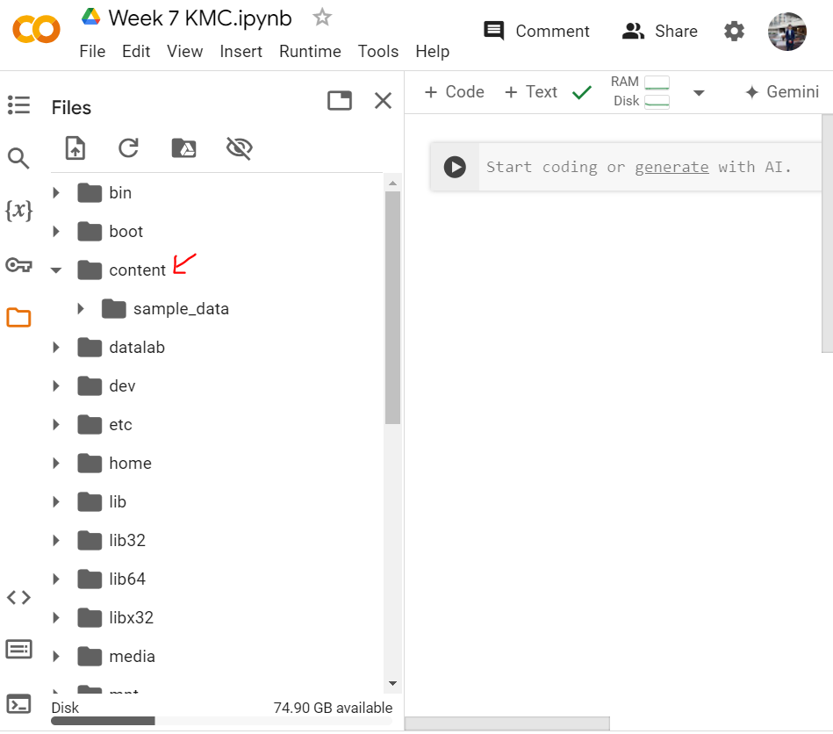
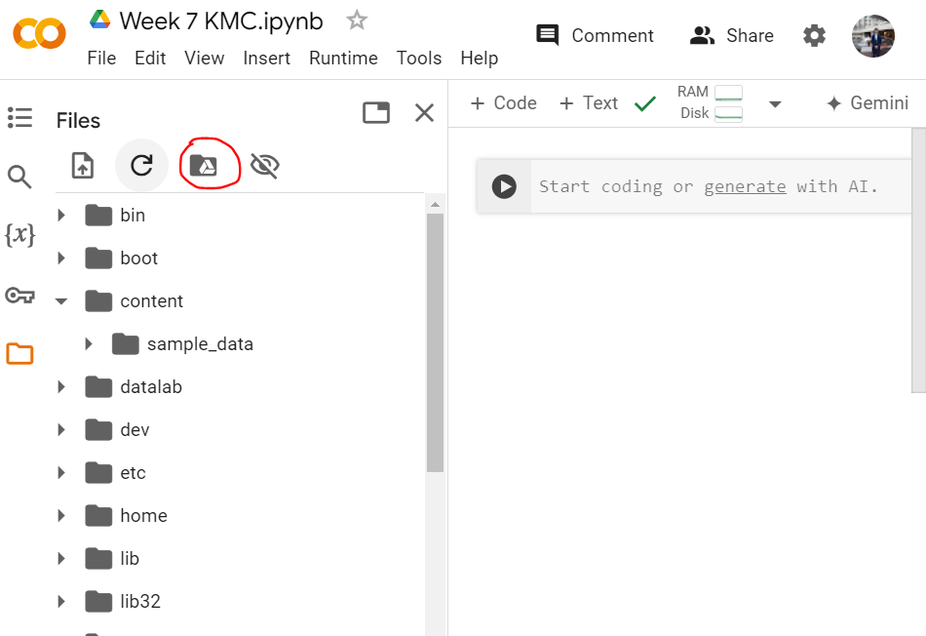
Accessing the dataset from colab
Click on content
Then click on the mount google drive icon
Then give all the permissions (even if they ask for your properties!)

Slide 7
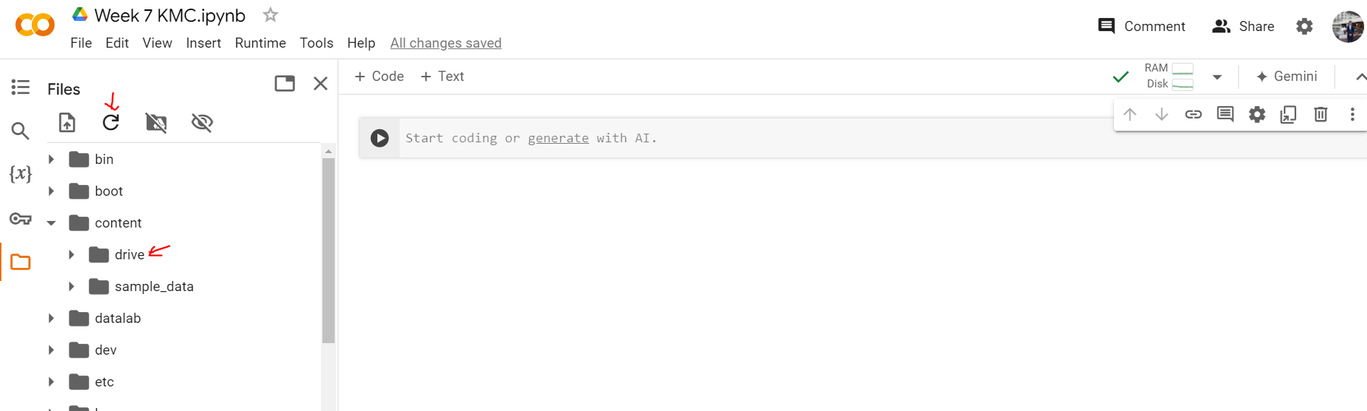
Accessing the dataset from colab
You will that a folder named “drive” will appear.
If it does not appear, click on the refresh icon.

Slide 8
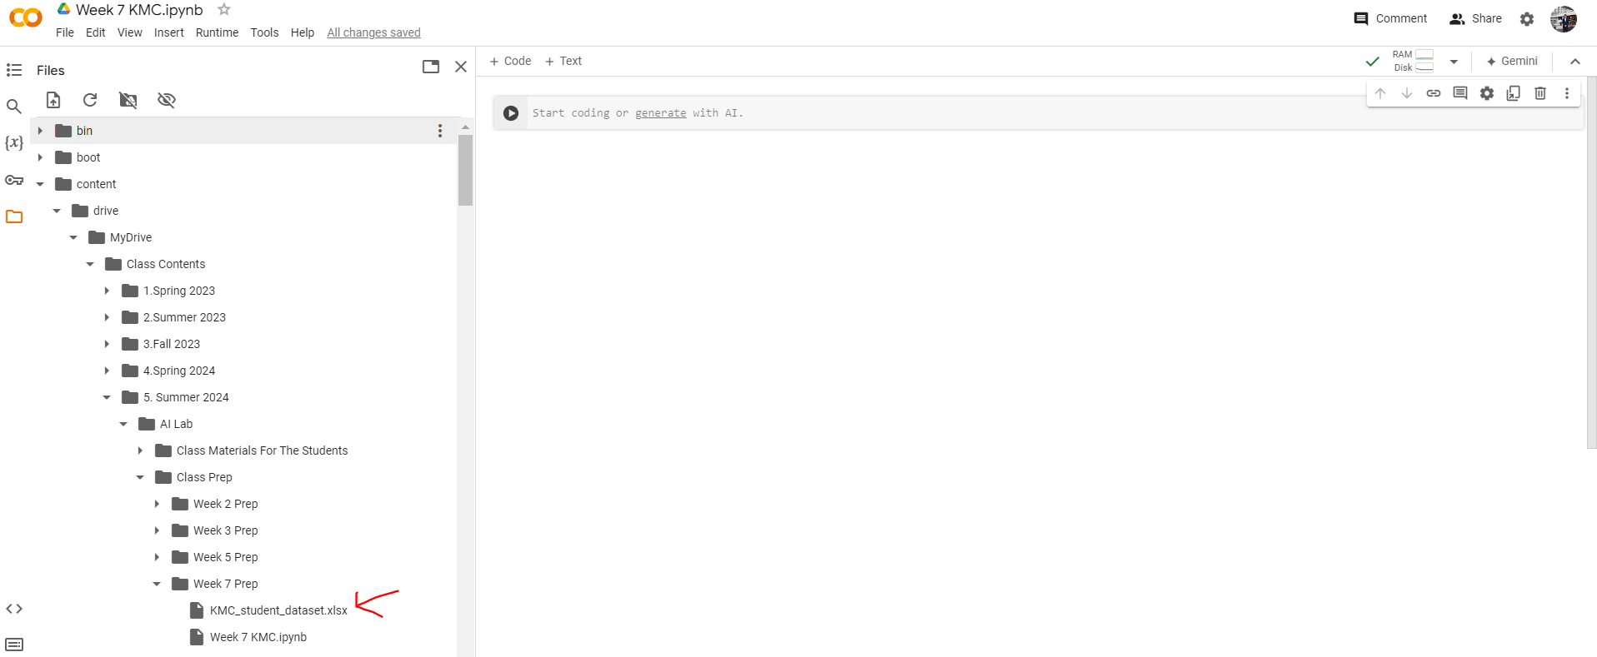
Accessing the dataset from colab
Now find and click on the dataset that you had uploaded moments ago.
See the following image for reference

Slide 9
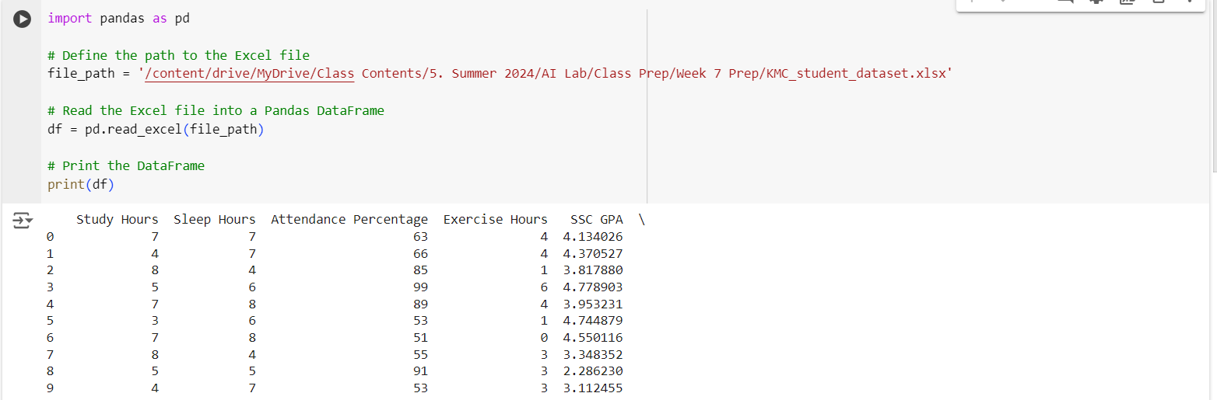
Accessing the dataset via python
You have already learned about the library – pandas
You need to use the library here as well
Basically you will read the excel file and print its contents.
Write down the following code snippet (use your own file path – do not copy the one in image!)

Slide 10
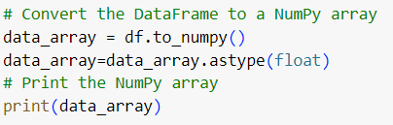
Converting the data frame into NumPy
Remember the numpy library?
It makes the mathematical operations easier for us
Now, convert the dataframe into a numpy array
This is actually a matrix

Slide 11
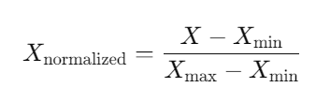
Normalization
Observe the columns.
You will find that some of the values are larger than the others
This will impact the decision making of the ML Algorithm (KMC)
So we need to bring them all down to the same scale (0-1)
Solution - Normalization

Slide 12
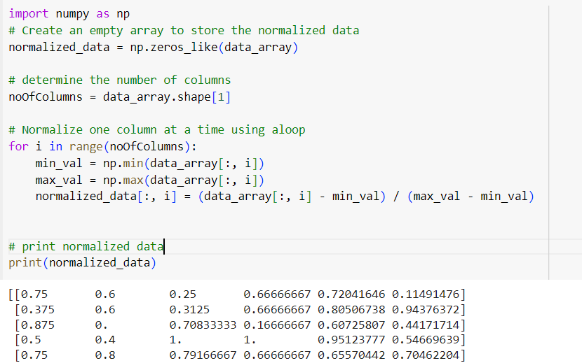
Normalization
Here is the code for normalization
Take out your notebooks, I will explain how I wrote this code

Slide 13
Now, Some Theory
Let us understand using an example:
Cluster the following eight points (with (x₁,x₂) representing locations): into three clusters A1(2,10), A2(2,5) , A3(8,4), A4(5,8), A5(7.5), A6(6,4), A7(1,2) and A8(4,9)
Assume that k=3
So there will be three clusters
Let us at first plot these points in a graph

Slide 14
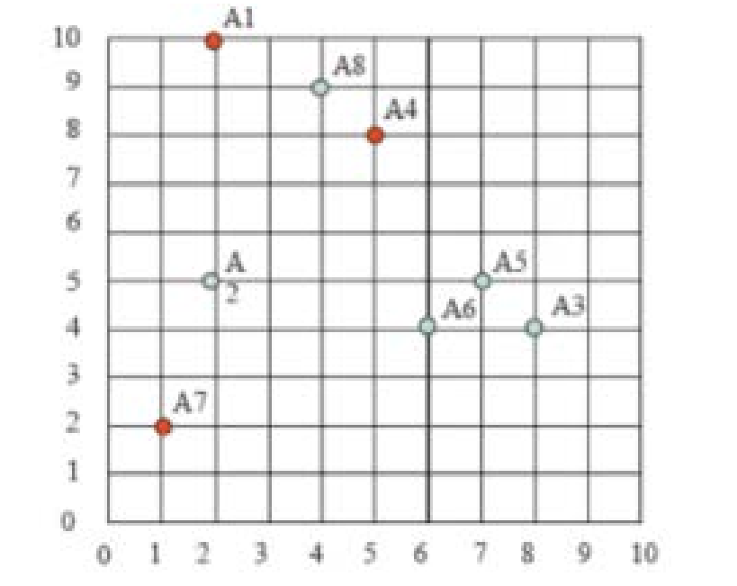
After Plotting
After plotting it should look like this
Can you group (i.e) cluster the points into three?

Slide 15
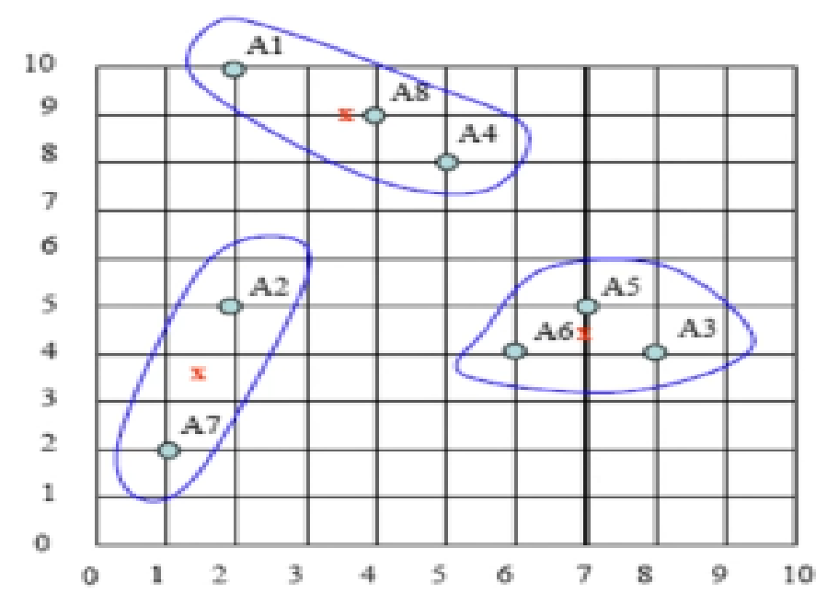
After Plotting
After plotting it should look like this
Can you group (i.e) cluster the points into three?
Now let’s see what the KMC algorithm does for us!

Slide 16
KMC
Step 1
At first KMC selects k centroids.
Let k = 3.
So there will be three centroids.
We can select any three random points as centroids.
Let us select A1(2,10), A4(5,8) and A7(1,2) as centroids (RANDOMLY)

Slide 17
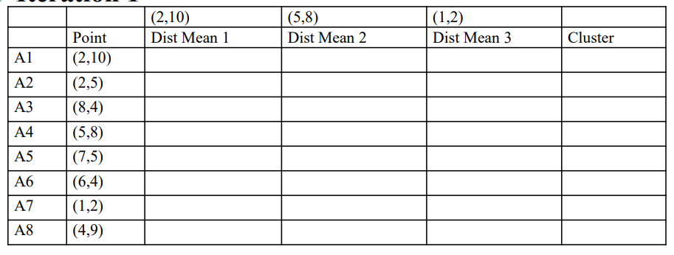
KMC
Step 2
Next let us calculate how far all the other points are from these three centroids.
In your notebook, you should sketch a table like this.

Slide 18
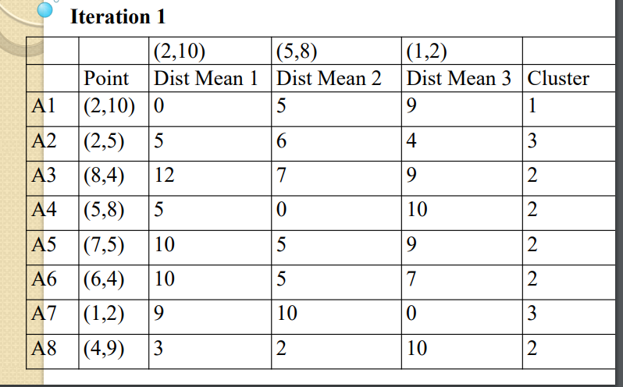
KMC
Step 3
Calculate the Manhattan distance of all the points from the centroids.
And based on the smallest distance, assign each point to a cluster.

Slide 19
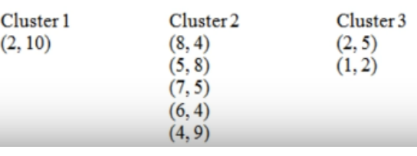
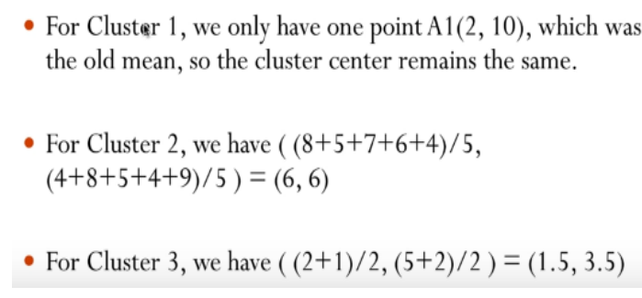
KMC
Step 4
Now calculate new centroids

Slide 20
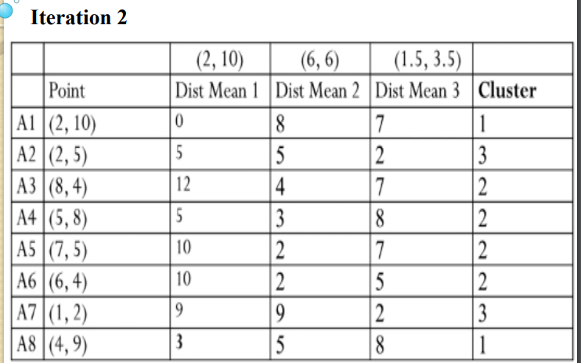
KMC
Now keep on repeating the steps 2 – 4.
Stop when you find that the clusters remain the same after two consecutive iterations.
Iteration 2

Slide 21
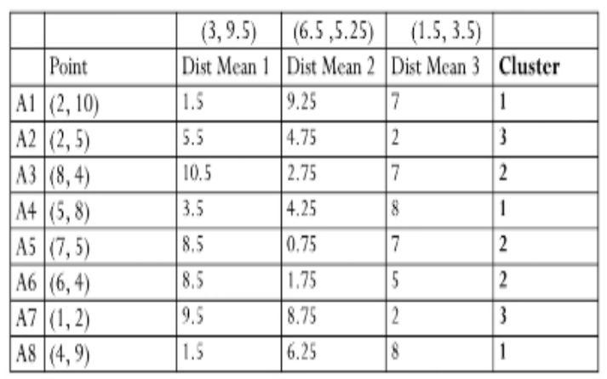
KMC
Now keep on repeating the steps 2 – 4.
Stop when you find that the clusters remain the same after two consecutive iterations.
Iteration 3
SHOULD WE STOP NOW?

Slide 22
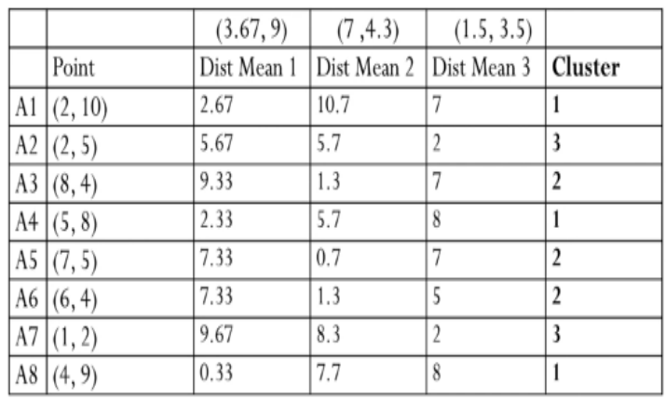
KMC
Now keep on repeating the steps 2 – 4.
Stop when you find that the clusters remain the same after two consecutive iterations.
Iteration 4
SHOULD WE STOP NOW?

Slide 23
KMC
Match the table with the diagram

Slide 24
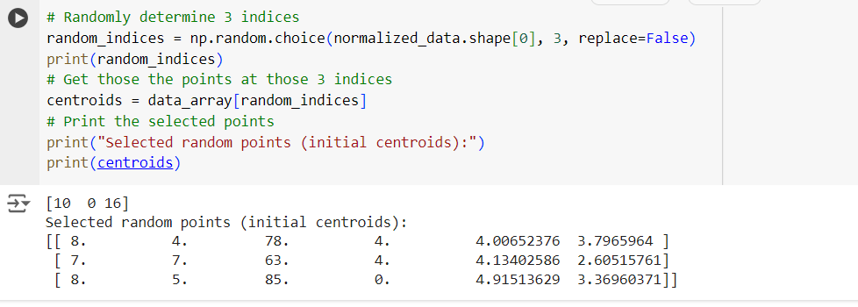
Now let’s get back to coding
Step 1 :
Select three points as centroids (k=3)
np.random.choice –
First parameter – we give it the number of data points
Second parameter – the number of random samples we want
Third Parameter – setting it false means that the same point will not be selected again

Slide 25
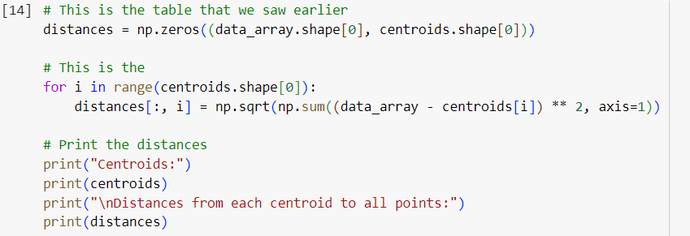
Now let’s get back to coding
Step 2 :
Now calculate the distance of all the points with these centroids
Take out your notebooks
Also write this code

Slide 26
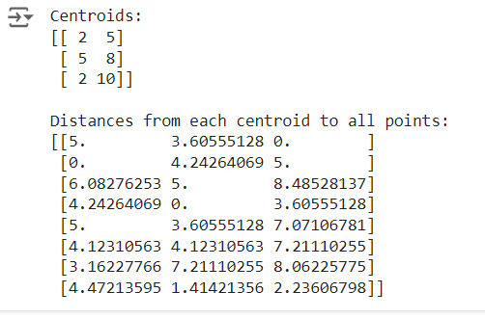
Now let’s get back to coding
Step 3 :
Now calculate the distance of all the points with these centroids
Take out your notebooks
Also write this code

Slide 27
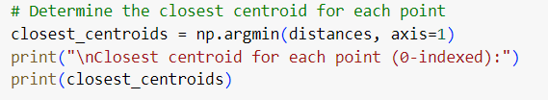
Now let’s get back to coding
Step 3 (continued) :
Now assign the data points to clusters
What does axis = 1 mean here (recall from previous classes)

Slide 28
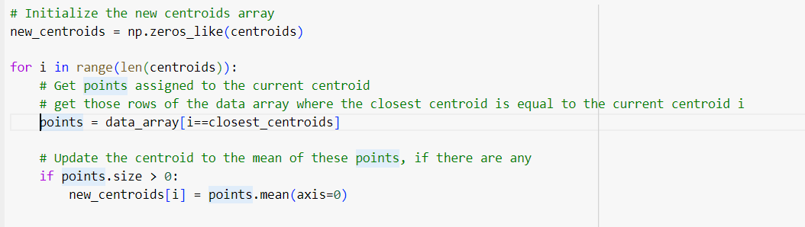
Now let’s get back to coding
Step 4 :
Now we are going to calculate new centroids
Take out your notebooks again!

Slide 29
Now let’s get back to coding
Step5
putting it all in a loop.
This is a part of your assignment -2.
You are going to execute the previous code in a loop
How can you determine the loop ending condition?
Hint: (you can compare two variables, what are those?)

Slide 30
Thank You

