Slide 1

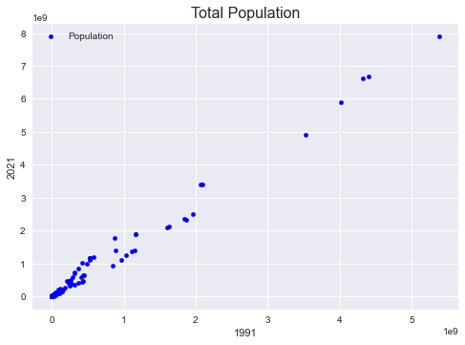
Subject: 7PAM2000 Applied Data Science 1
Assignment 3: Clustering and fitting
Name: Noman Amin
ID: 22017418
Introduction:
A Total Population and CO2 Emission data from the World Bank website was collected. Initially we showed the Scatter plot with Total Population Data.
Initial Population Data Plot:
Above scatter graph shows Total population of year 1991 and 2021.
Initial Population Data Plot:
Introduction:
A Total Population and CO2 Emission data from the World Bank website was collected. Initially we showed the Scatter plot with Total Population Data.

