Slide 1

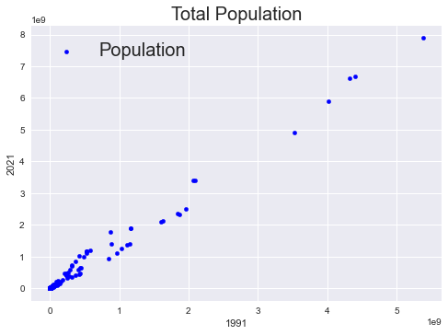
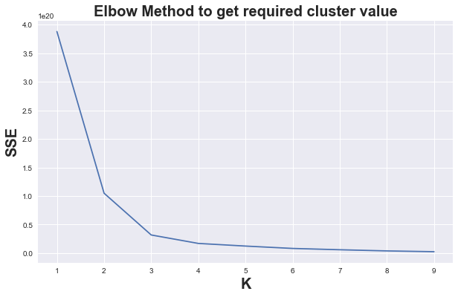
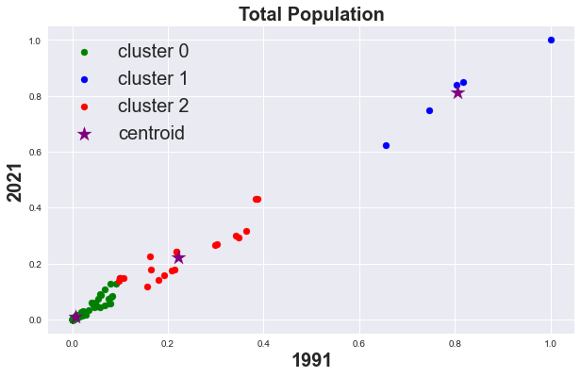
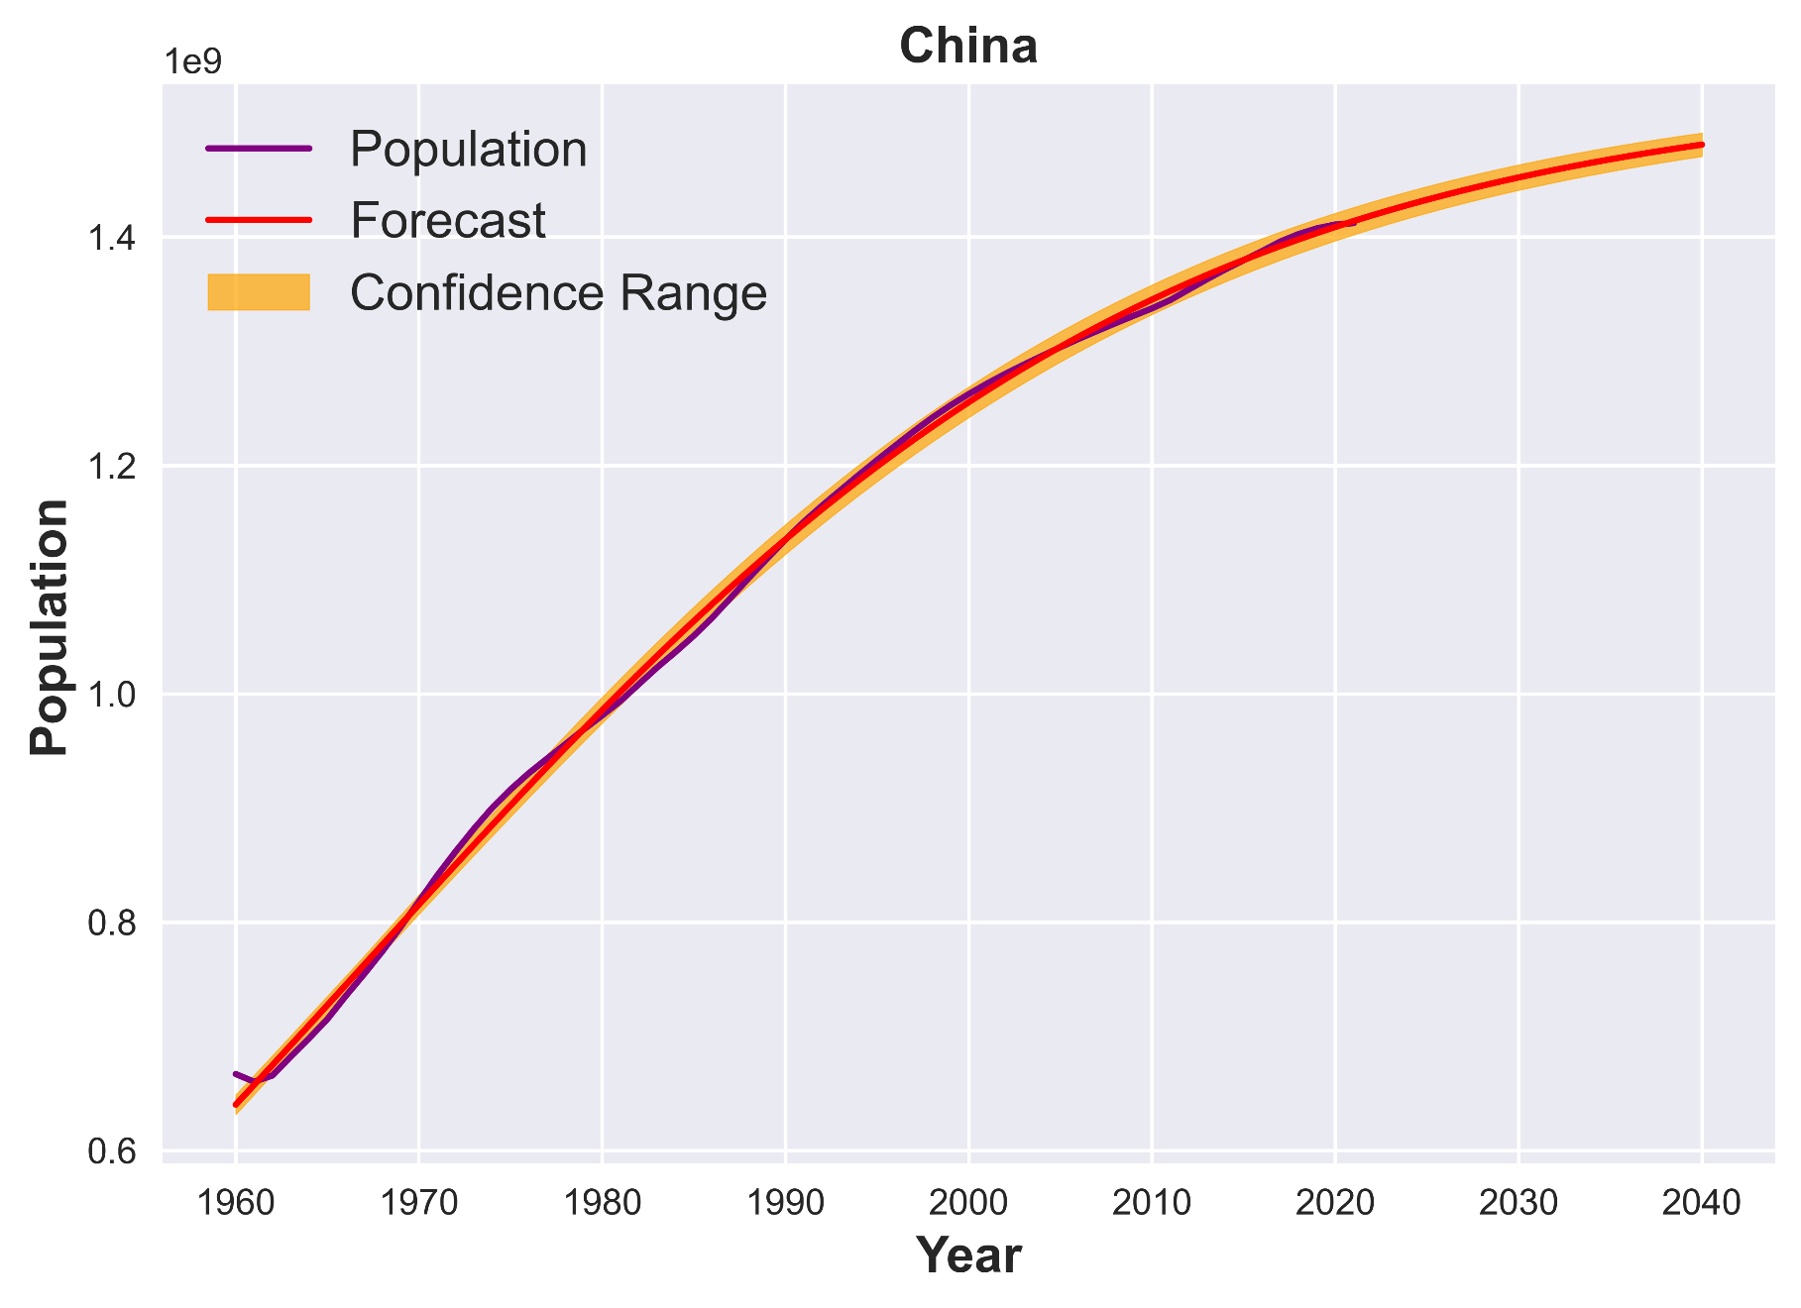
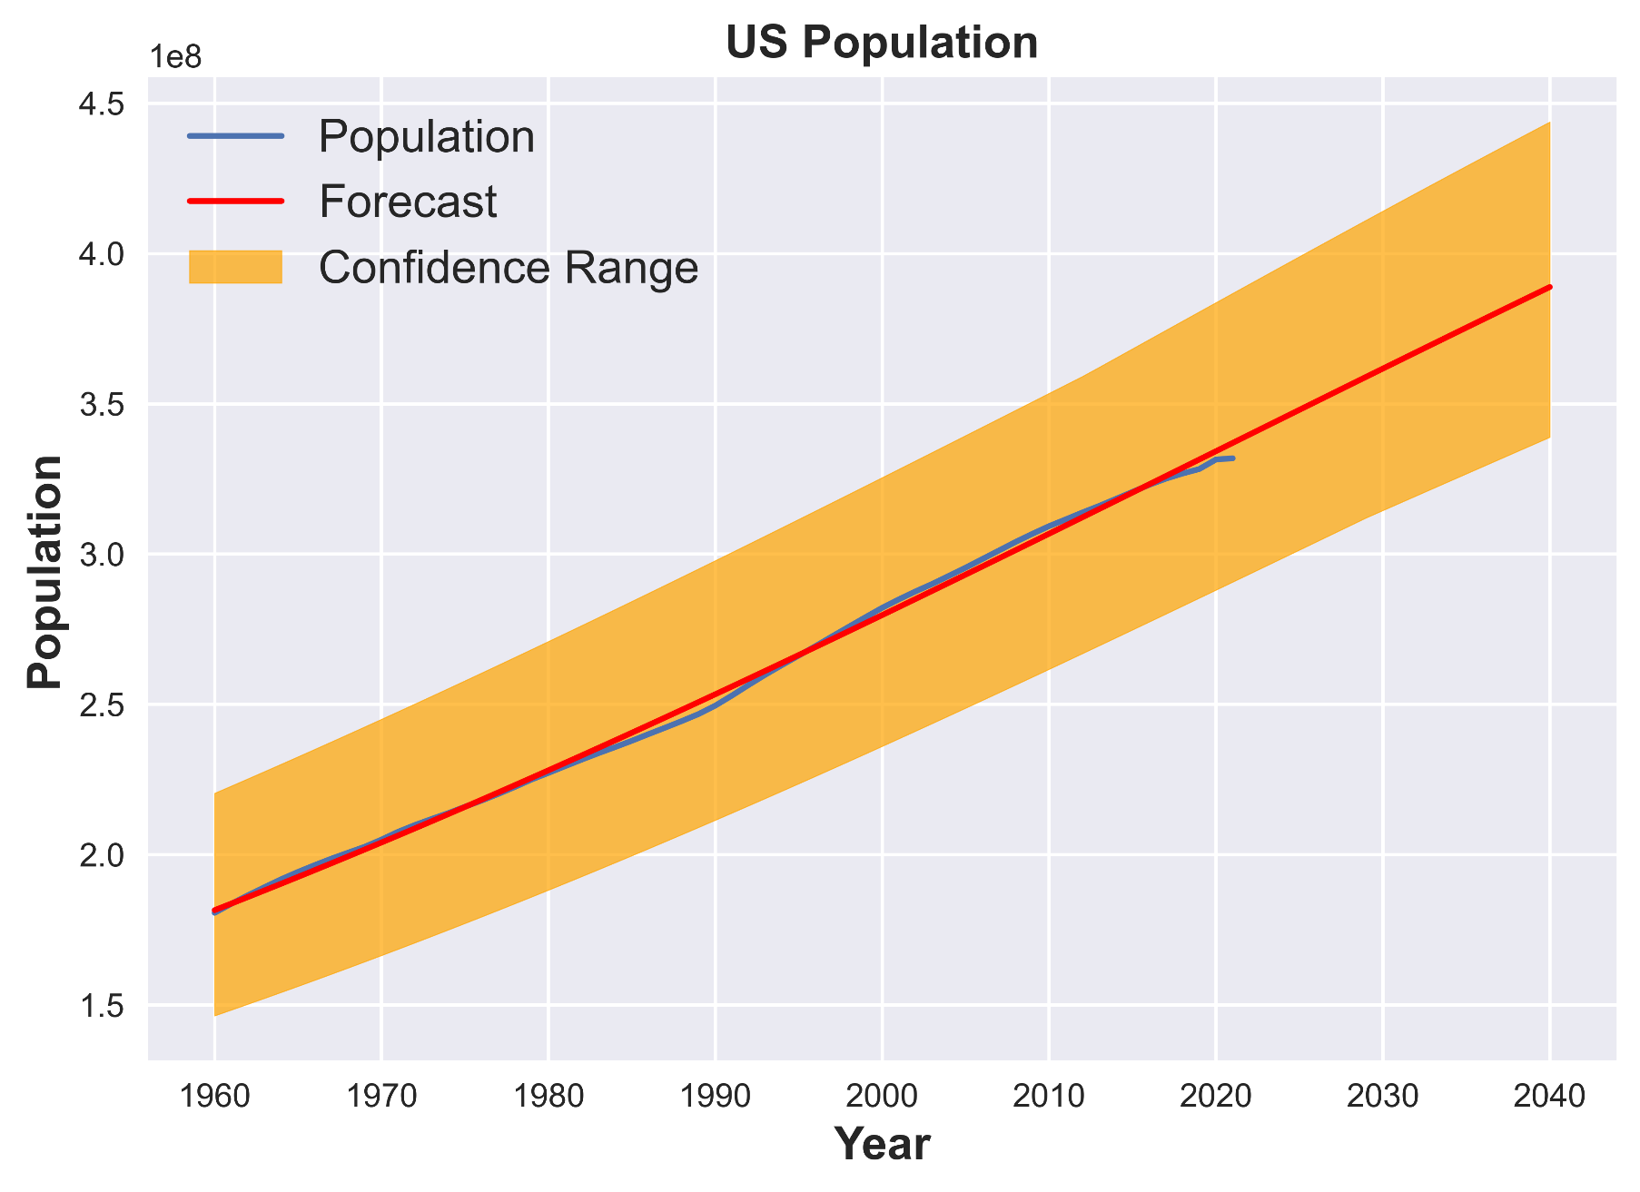
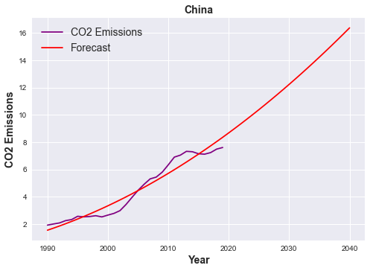
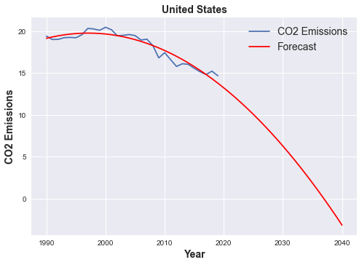
Subject: 7PAM2000 Applied Data Science 1
Assignment 3: Clustering and fitting
Name: Noman Amin
ID: 22017418
Introduction:
A Total Population and CO2 Emission data from the World Bank website was collected. In the first part we show the relation between two years of Population data and apply the cluster to make the three possible groups of data.
Initial Population Data Plot:
Above scatter graph shows the relation between Total population of year 1991 and year 2021.
Elbow Method Plot:
The elbow method plot give us a best number of cluster which is 3 according to the above plot.
Scatter Plot:
Three types of groups data shown in above plot blue, red, and green and also the star marker which is purple identify the center of all three clusters.
A Total Population of China and US shown between the years of 1960 to 2020 and future data for next 20 years. As per the China population which is purple color line is increasing rapidly but slow down from the last decade and as we see the red forecast line which shows us the expected population of China until 2040.
A Total Population and CO2 Emission data from the World Bank website was collected. Initially we showed the Scatter plot with Total Population Data. A Total Population and CO2 Emission data from the World Bank website was collected. Initially we showed the Scatter plot with Total Population Data.
A Total Population and CO2 Emission data from the World Bank website was collected. Initially we showed the Scatter plot with Total Population Data.

