Slide 1

Netflix Data Analysis Detecting High-Risk Shared Accounts: Rule-Based Insights from Netflix Data
Md Abdullah Al Noman Mridha
Data Science Project Seminar SoSe2025

Slide 2
TABLE OF CONTENTS
01
Dataset & Results
02
Engagement Trend & Critical Metrics
03
Data Driven Hypothesis
04
Risk Flagging Criteria & Enhanced Data Attribution
01
02
How the dataset has been through prepreration
Different Trends & Crital Metrics analysis
03
04
Combination of features & generation of hypothesis
Simple detection rules which netflix could use to assess account sharing risk.

Slide 3
Dataset Preparation
IP Behavior Segmentation & Risk Classification
Feature | Derived From | Purpose/use
IP_Mismatch | Login_1 vs. Login_2 | Provide information of shared account or not.
Subscription_Type | Subscription | 4=Add-Free, 3=Add-Supported
IP_Distance | Login_1 vs. Login_2 | Indicates how far logins occurred
Subnet_Check | Login_1 vs. Login_2 | Detects same vs. Different networks
Risk_Score | IP_Distance+Subnet | Quantifies behavior severity
Final_Flag | Risk_Score | Human-readable behavior pattern
Genre_Type | Last_Watched_Movies | Classifies user preferences

Slide 4
Dataset
Results
3905 anonymere Netflix accounts (Login, payment, last watch, location etc.)
Goal: Identify patterns of account sharing using IP Mismatch and behavioral signals.
IP Mismatch Found: 1505
Non-IP Mismatch: 2400
Top Subscription location: Indiana
Top IP Mismatch subscription location: Missouri
Total Female Subscriber: 1907
Total Male Subscriber: 1998
Top watched content: Transformer, SING, Interstellar, Terminator 2, Friends with kids, Avengers: Infinity war etc.
Gift card user: 684
High Risk accounts (Cross Country share): 1494
High Risk accounts (Different ISPs): 10
Different network using found: 1505
Tools Used
Excel (For creating features, Filtering and quick aggregation.
Tableau Public: For dashboards presentation

Slide 5
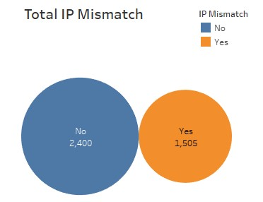
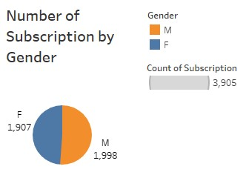
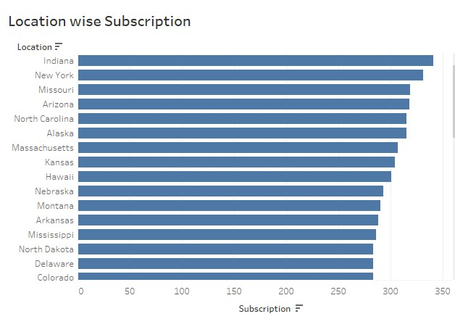
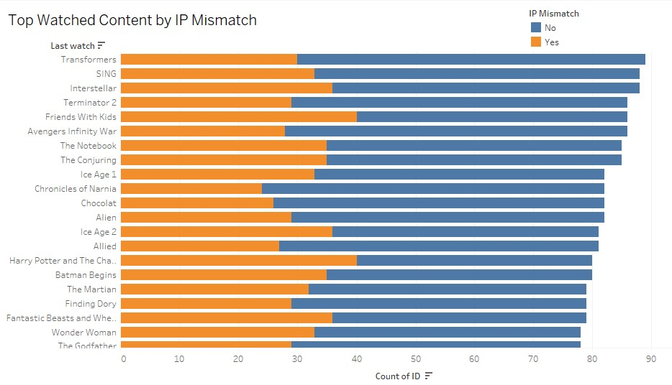
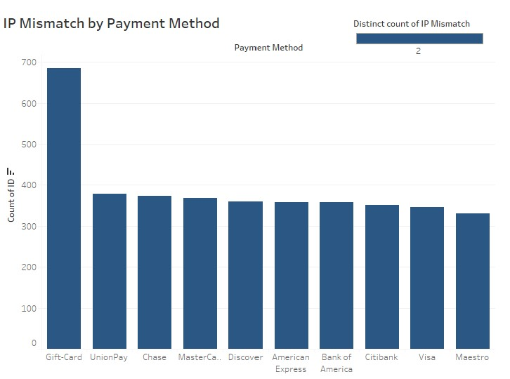
Engagement Trend & Critical Metrics

Slide 6
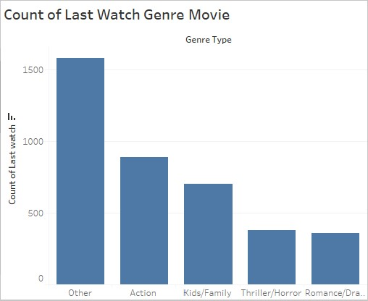
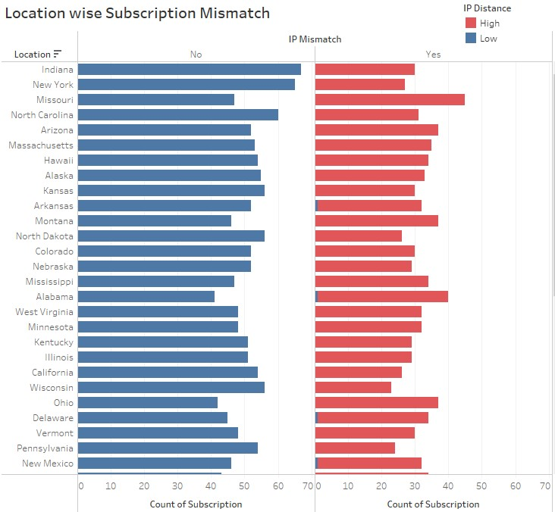
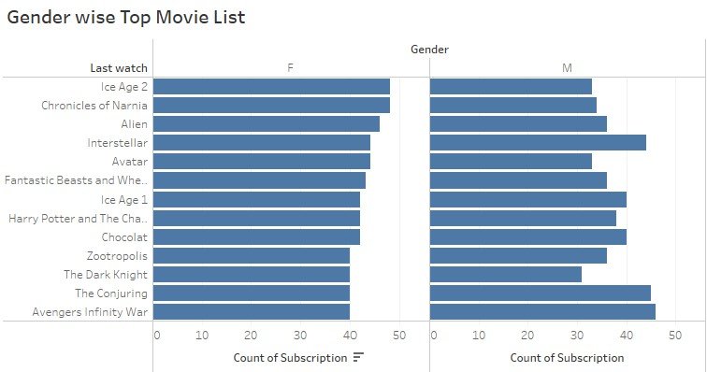
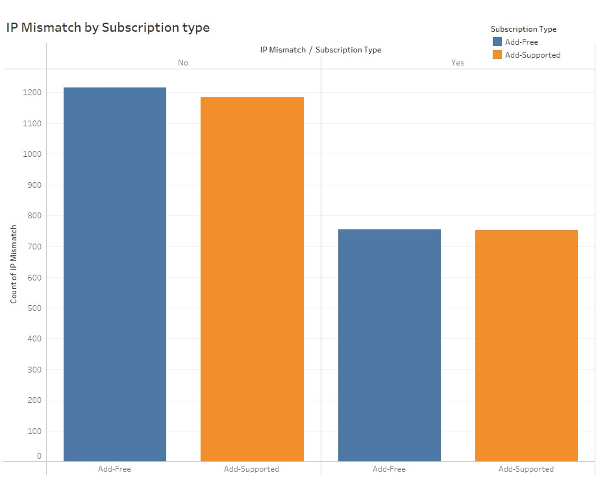
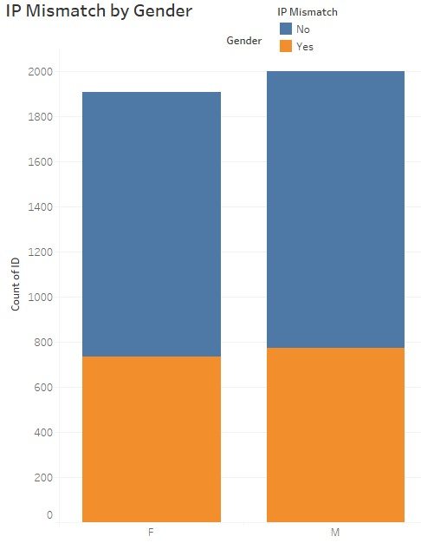
Engagement Trend & Critical Metrics

Slide 7
Engagement Trend & Critical Metrics Interpretation
1. Account Sharing & Suspicious Activity (IP Mismatches)
1,505 accounts (38.5%) have IP mismatches, suggesting potential account sharing or unauthorized access.
Ad-supported subscriptions show higher IP mismatch rates than ad-free plans, indicating that users on cheaper/free tiers are more likely to share accounts.
Top states with high mismatch rates:
Missouri, Alabama, and Alaska (data suggests regional hotspots for misuse).
Gender distribution:
Male (M) users (1,998 subscriptions) slightly outnumber Female (F) users (1,907), but both show IP mismatch risks.

Slide 8
Engagement Trend & Critical Metrics Interpretation
2. Content Preferences & Mismatch Correlation
Action/Sci-Fi movies (Interstellar, Terminator 2, The Dark Knight) are more common in mismatched accounts, possibly due to shared logins among fans.
Family/Kids films (Ice Age 2, Zootopia, Finding Dory) also appear frequently, suggesting parental account sharing.
Thriller/Horror (The Conjuring, The Notebook) and Classics (The Godfather) are also prevalent in mismatch data.
3. Geographic Trends in Subscription & Risk
Highest subscription volumes:
Indiana, New York, California, Illinois (expected due to population density).
High-risk mismatch states:
Alabama, Missouri, Alaska (smaller populations but disproportionately high mismatches).
Low-risk states:
Vermont, Delaware, North Dakota (minimal mismatches).

Slide 9
Critical Metrics Interpretation
4. Gender-Based Viewing Habits
Male-dominated watches:
The Dark Knight, Interstellar, Batman Begins.
Female-dominated watches:
The Notebook, Chocolat, Friends With Kids.
Neutral (both genders):
Harry Potter, Ice Age, Avengers Infinity War.
Key Takeaways
✅ 38.5% of accounts have IP mismatches → Ad-supported plans & Action/Family genres are biggest offender. ✅ Indiana, Missouri, Alabama, Alaska are high-risk states needing fraud monitoring. ✅ Male users slightly dominate subscriptions, but both genders share accounts for popular movies. ✅ Sci-Fi/Action & Family films are most shared → Consider targeted anti-sharing measures for these genres.

Slide 10
Hypotheses from Patterns
1. Subscription Type vs. IP Mismatch
Hypothesis: "Ad-supported accounts show fewer IP mismatches than Ad-free accounts, indicating less sharing among cost-sensitive users.“
2. Payment Method vs. IP Mismatch
Hypothesis: "Gift card users show more IP mismatches, possibly indicating more temporary or shared access than credit card users.“
3. Genre Preferences vs. IP Mismatch
Hypothesis: "Users who last watched family or children’s content show fewer IP mismatches than users who watched thrillers or trending content.“
4. Top States/Regions by IP Mismatch Rate
Hypothesis: "Certain states or cities show consistently higher IP mismatch rates, suggesting region-specific sharing behaviors.“
5. Gender-Based Differences
Hypothesis: "Male users show slightly higher IP mismatch activity compared to female users.“
6. Time of Last Login vs. IP Mismatch
Hypothesis: "Late-night logins (e.g., 11PM–3AM) are more likely to involve an IP mismatch, suggesting shared or unauthorized access.“
7. Device Type vs. IP Mismatch
Hypothesis: "IP mismatches are more common on smart TVs and tablets than on mobile or desktop devices.“
8. Credit Card Prefix vs. IP Mismatch
Hypothesis: "Certain credit card types (based on prefix or provider) correlate with higher mismatch rates, possibly due to shared family plans.“
9. Watch Time (Hours) vs. IP Mismatch
Hypothesis: "Heavy watchers (over 5 hours/day) are more likely to have IP mismatches, suggesting multiple users per account.“
10. Account Age vs. IP Mismatch
Hypothesis: "Older accounts show fewer IP mismatches than newly created ones, indicating trust and loyalty reduce sharing."

Slide 11
External Data for Enrichment
Income & Poverty rates by U.S State
High-mismatch states (AL, MO, AK) have lower median incomes → cost-driven sharing.
Broadband Internet Availability
Rural states (MT, AK) with poor broadband show more mismatches → limited household subscriptions.
Education Level by State
Target educational outreach in high-mismatch states to promote legitimate multi-user plans.
Household Size
Large households (UT, TX) correlate with family-genre mismatches (Ice Age, Zootopia).
Recommendation
Target ad-supported plans in low-income/high-mismatch states with stricter access controls.

Slide 12
Detection Rules & Interpretation
IP Address Mismatch
Payment + IP Mismatch
Geographic Hotspots
Content-based Flags
Concurrent Usage
Conditions
Conditions
Conditions
Conditions
Conditions
Logins from 2+ distinct states within 24h
IP Mismatch + Gift card used
IP Mismatch + High-risk State
IP Mismatch + Action/Sci-Fi Genre (e.g: Avengers)
3+ Devices streaming simultaneously
Risk Level: High
Risk Level: High
Risk Level: High
Risk Level: Medium
Risk Level: High
Likely shared across households
Untraceable Payment increases anonymity risk.
Regional sharing trends confirmed.
Popular titles often shared
Exceeds standard plan limits.

Slide 13
THANKS!
Home
About me
What I do
My experience
My work
Do you have any questions?

