Slide 1
AQIPredict
Lahore Air Quality Forecasting System
End-to-end ML pipeline · Hopsworks Feature Store · Streamlit Dashboard · GitHub Actions CI/CD
Python 3
Streamlit
Hopsworks
scikit-learn
Open-Meteo
GitHub Actions

Slide 2
Project Overview
Data Ingestion
ML Training
Open-Meteo Air Quality API provides current and hourly historical readings — PM2.5, PM10, gases, AQI — no API key required.
Seven regressors trained daily: Random Forest, Ridge, Gradient Boosting, Extra Trees, KNN, XGBoost and CatBoost. Best R² model auto-selected.
Feature Store
CI/CD
Hopsworks stores versioned feature groups with time-series pollution and calendar features for reproducible training.
GitHub Actions: hourly feature ingestion & daily retraining on ubuntu-latest / Python 3.12 with secret management.
Dashboard
Streamlit UI with 10 views — overview, 7-day forecasts, pollutant charts, health guidance, model stats, and more.
Lahore, Pakistan · 31.5204°N 74.3587°E · Coordinated via Open-Meteo & Hopsworks Cloud (eu-west)

Slide 3
System Architecture
Open-Meteo
Air Quality API
Feature
Pipeline
(hourly)
Hopsworks
Feature Store
Training
Pipeline
(daily)
Hopsworks
Model Registry
→
→
→
→
↓
Streamlit Dashboard
External services: Open-Meteo (free, no key) · Hopsworks Cloud eu-west · GitHub Actions for automation

Slide 4
Four-Stage Pipeline Flow
01
02
03
04
Backfill
Feature Pipeline
Training Pipeline
Streamlit App
→
→
→
backfill.py
365-day historical load (one-time)
feature_pipeline.py
Hourly via GitHub Actions
training_pipeline.py
Daily · trains 7 models
streamlit_app.py
10 pages · live & forecast
Pipeline lifecycle: Backfill → Feature ingestion (hourly) → Model training (daily) → Dashboard

Slide 5
Model Benchmark Results
Rank | Model | R² | RMSE | MAE
1 ★ | XGBRegressor | 0.938 | 12.00 | 8.54
2 | Extra Trees | 0.937 | 12.07 | 8.18
3 | Random Forest | 0.915 | 14.04 | 9.66
4 | CatBoost | 0.908 | 14.63 | 10.98
5 | Gradient Boosting | 0.849 | 12.27 | 9.72
6 | KNN | 0.700 | 26.41 | 19.84
7 | Ridge Regression | 0.682 | 26.49 | 20.00
Sample run · 2,184 records · 80/20 train/test split · Best model auto-saved to Hopsworks Model Registry

Slide 6
Streamlit Dashboard — 10 Pages
1. Overview
2. Hourly AQI
Live AQI hero, 3-day forecast, 7-model comparison, pollutants, 24h trend
Hourly averages and time-series visualization
3. Daily AQI
4. Forecast
Daily aggregates, monthly trends, category distribution pie
Full 7-day predicted AQI bar chart, day-by-day breakdown, confidence band
5. Charts
6. Pollutants
AQI by hour of day, day of week, 90-day rolling trend
PM2.5, PM10, O₃, NO₂, CO, SO₂ vs WHO limits
7. Heatmap
8. Model Stats
AQI intensity heatmap over time
All 7 models ranked by R²; best model highlighted with live metrics
9. Health Guide
10. Data History
AQI category health recommendations by range
Raw feature table and export-oriented view

Slide 7
US AQI Categories & Health Guidance
0 – 50
151 – 200
Good
Unhealthy
Air quality is satisfactory. No risk.
Everyone may begin to experience health effects.
51 – 100
201 – 300
Moderate
Very Unhealthy
Acceptable. Unusually sensitive people may be affected.
Health alert — everyone may experience serious effects.
101 – 150
301+
Unhealthy for
Sensitive Groups
Hazardous
Sensitive groups may experience effects. General public not likely affected.
Health emergency. Everyone is more likely to be affected.

Slide 8
Feature Group Schema & Training Inputs
Feature | Type | Description
timestamp / city | string | Primary key composite — e.g. Lahore
hour, day, month, day_of_week | int | Calendar / cyclical time features
pm2_5, pm10 | float | Particulate matter (µg/m³)
carbon_monoxide | float | CO concentration
nitrogen_dioxide | float | NO₂ concentration
ozone | float | O₃ concentration
sulphur_dioxide | float | SO₂ concentration
us_aqi | float | Target variable — US AQI index
aqi_change_rate | float | Hour-over-hour AQI delta (training feature)

Slide 9
CI/CD Workflows & Environment Configuration
Feature Pipeline
Train Pipeline
File: feature_pipeline.yml
File: train_pipeline.yml
Schedule: Every hour (0 * * * *)
Schedule: Daily at 06:00 UTC (0 6 * * *)
Script: feature_pipeline.py
Script: training_pipeline.py
Required GitHub Secrets
Secret | Required | Used by
HOPSWORKS_API_KEY | Yes | Both workflows
HOPSWORKS_PROJECT_NAME | Yes | Both workflows
FEATURE_GROUP_NAME | Yes | Both workflows
FEATURE_GROUP_VERSION | Yes | Both workflows

Slide 10
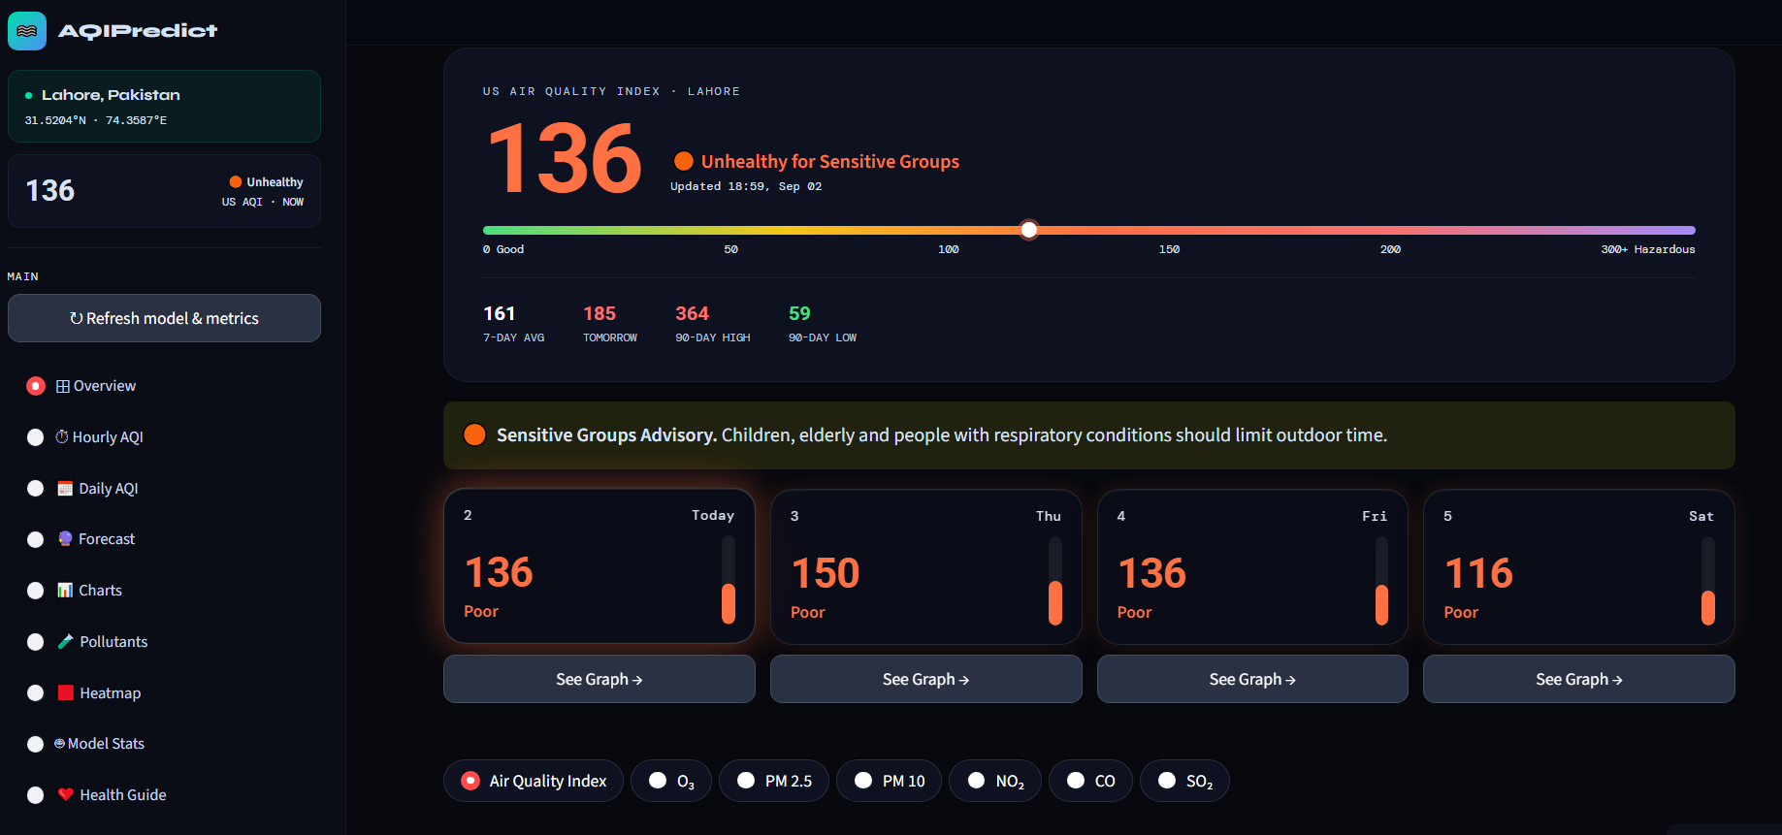
Screenshots

Slide 11
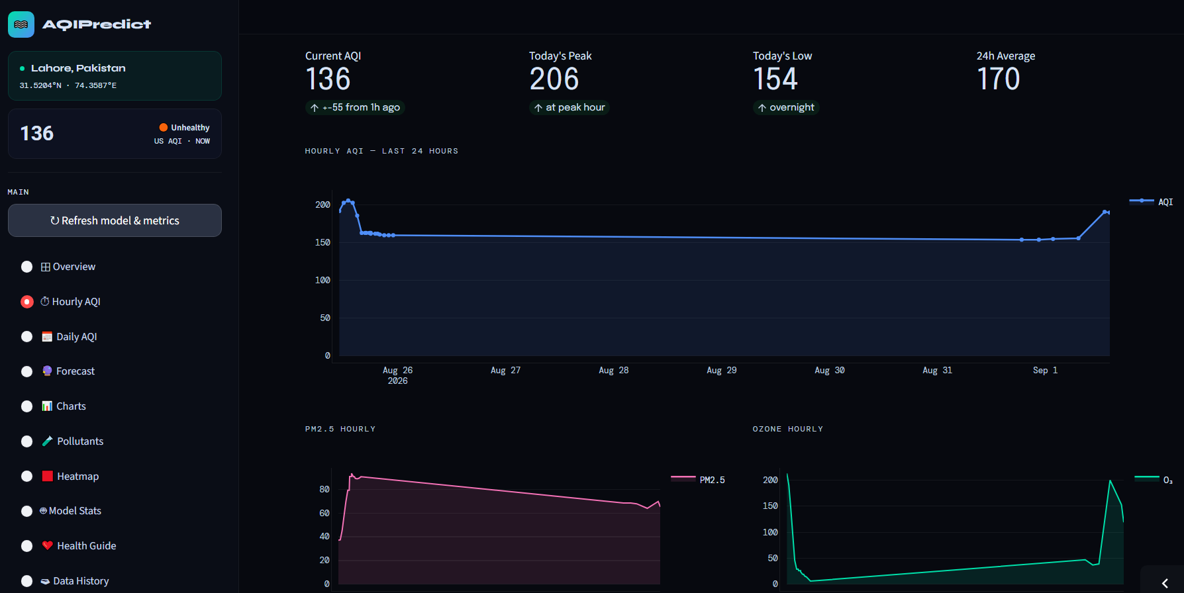

Slide 12
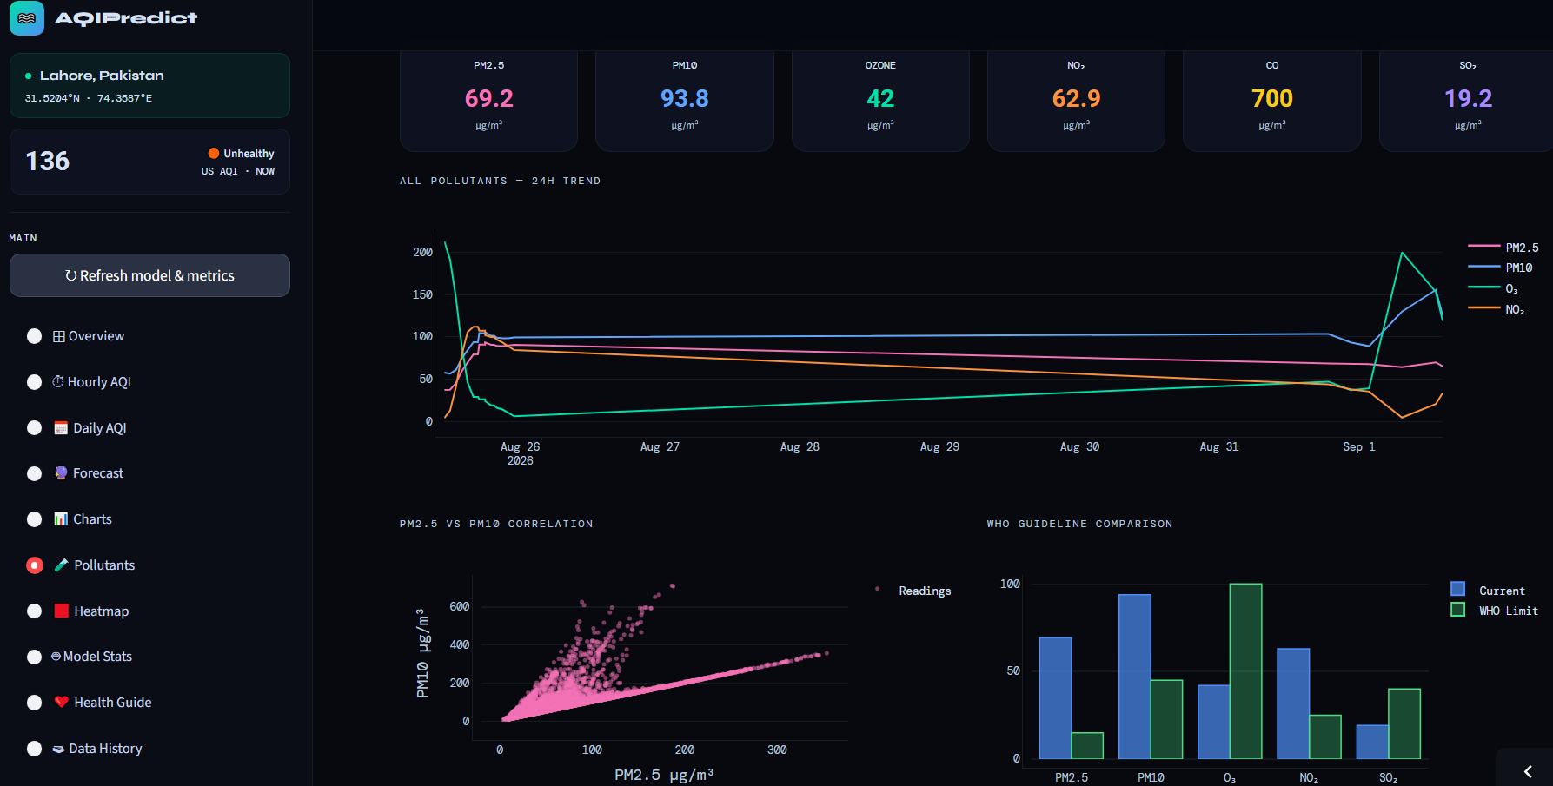

Slide 13
Thank You
AQI-Predictor · Lahore Air Quality Forecasting System
Data: Open-Meteo · Platform: Hopsworks · UI: Streamlit · CI/CD: GitHub Actions

