Slide 1
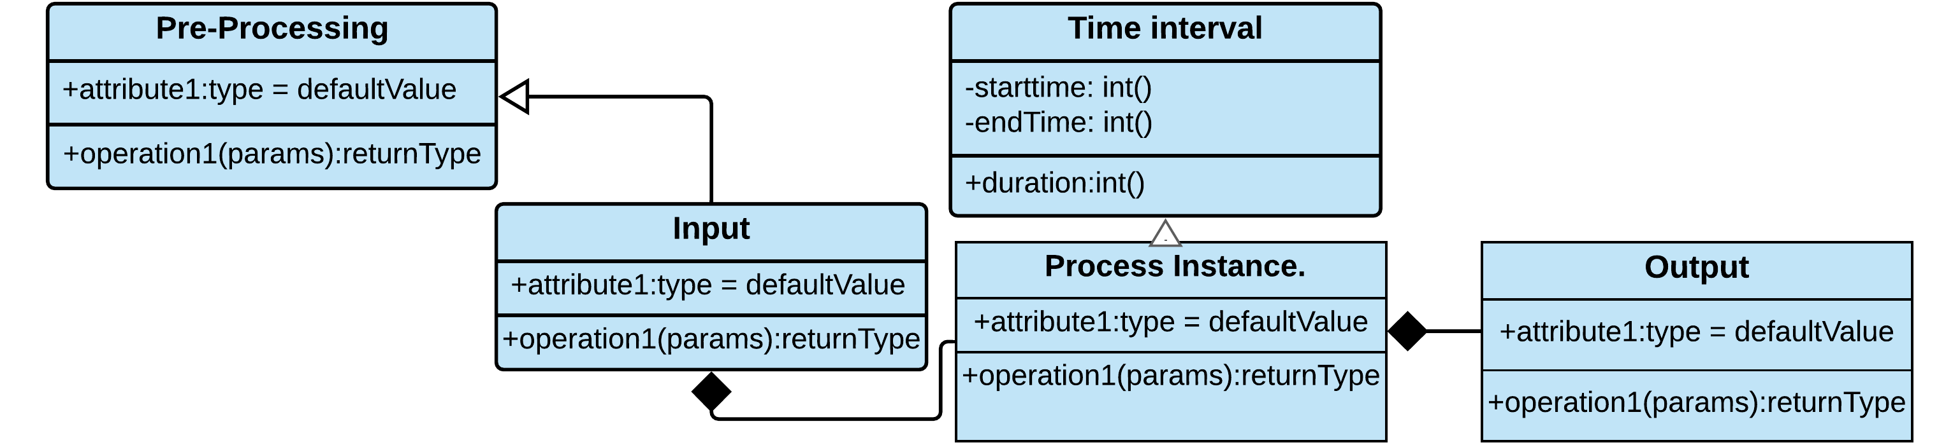
Ontologies for MUSICODE
Hafiz Noman
(13-05-2022)

Slide 2
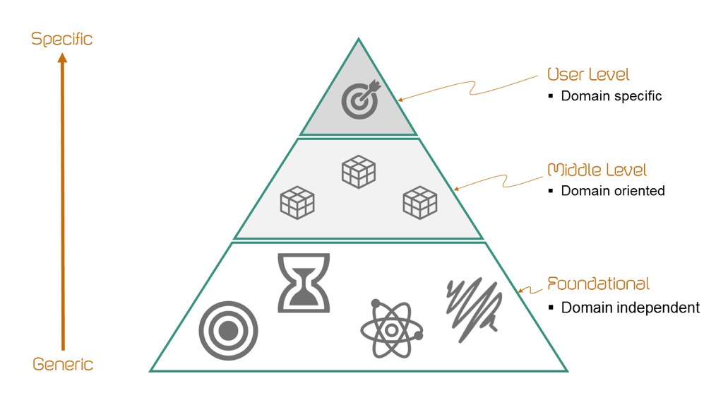
Introduction
Ontologies
An ontology is a formal description defining the organization of knowledge, intended as a set of concepts within a domain together with the relationships that hold between them. [1]
Modelling approaches
Top down
Domain independent
Bottom-up
Start with describing the most specific application
related to a domain
Middle-out
Model the most important classes/domain first
https://emmc.info/emmo-info/
https://tishchungoora.medium.com/ontology-mapping-infographic-621272b4d445

Slide 3
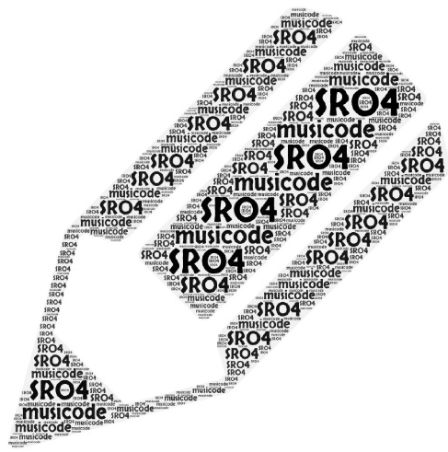
Simulation requirement ontology
SRO
An ontology for describing the generation & organization of
simulation process data within musicode project.
The SRO aims at reporting all the simulation activities, data generation (outputs), data items requirement (inputs) and organisation of simulation processes according to the length scale. i.e., micro, meso, and macro and the names of partners responsible for them.
SRO reuses some elements from the following ontologies
PROV-O
MDMC-NEP-top-level-ontology

Slide 4
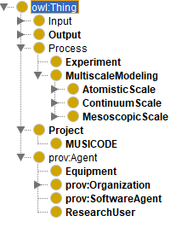
Important classes of SRO
The figure below shows the class hierarchy of the ontology
Input
The Input of any process without which a process cannot proceed
Process
Process, i.e., a physical entity with a temporal
evolution that 'has a meaning for the ontologist'
Output
Data items/output provides by a process after completion
Project
An enterprise (potentially individual/typically collaborative), planned to achieve a particular aim
Agent
An agent is something that bears some form of responsibility for an activity taking place, for the existence of an entity, or another agent's activity.

Slide 5
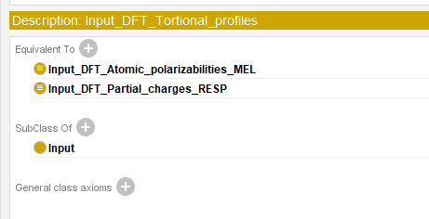
Concept of equivalent classes axiom
Equivalent classes
It states that two classes in an ontology are semantically equivalent to each other. This axiom allows one to use a class as a synonym for each other class without affecting the meaning of the ontology.
Following diagram displays an example of
equivalent clases in the ontology.
Input of DFT Tortional profiles is same as
of input of DFT atomic polarizabilities MEL
and DFT Partial charges RESP

Slide 6
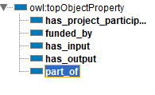
Object properties
The property that connects two classes/concepts.
Following are some of the most important object properties present in the Ontology
has_project_participant
Is used to connect a process with its respective partner
funded_by
Is used to connect project (musicode) with EU (funding body)
has_input
Connects input and a process class
has_output
Connects a process class with its outcome
Part_of
Is used to connect a process class with its project class

Slide 7

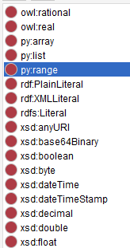
Data properties
Data propeties are used to connect individuals / instances of a class to a specific data type.
has_data_type

Slide 8
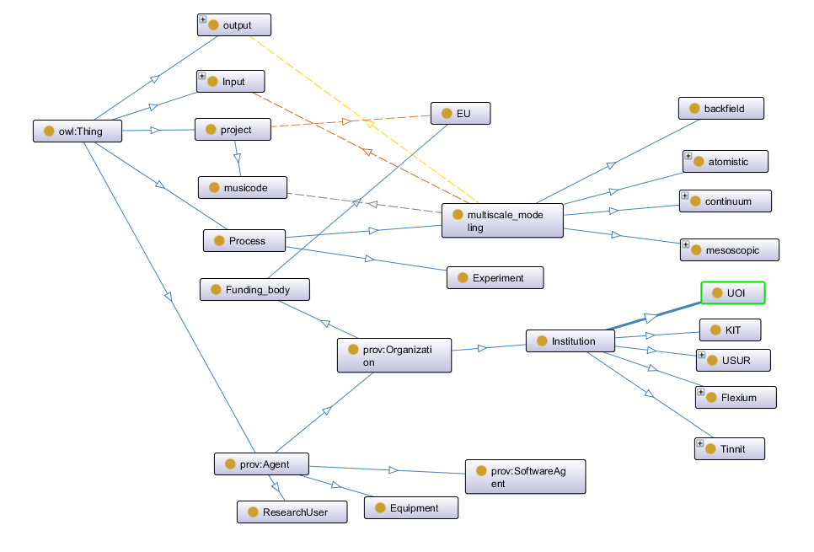
SRO (reduced view)
General overview

Slide 9
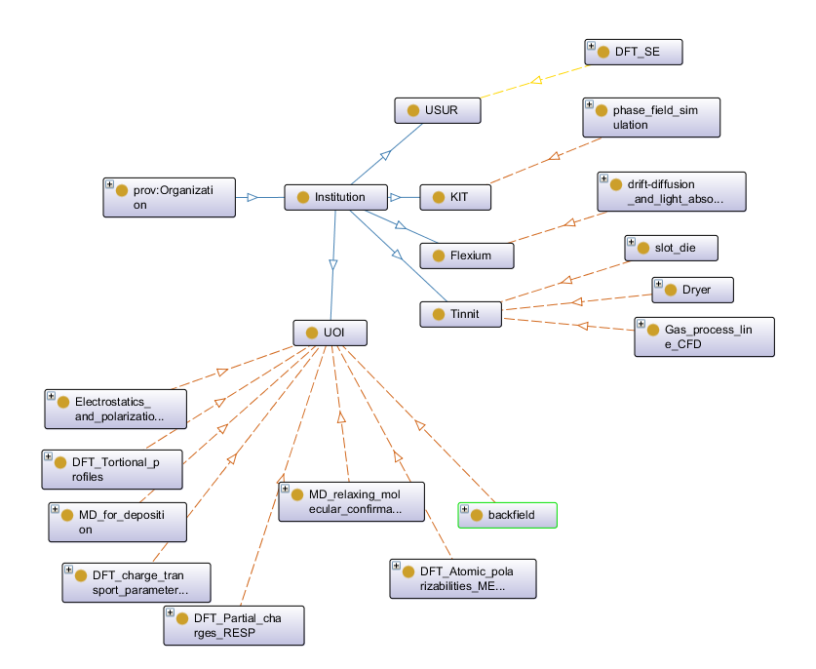
Participant view
Participant view

Slide 10
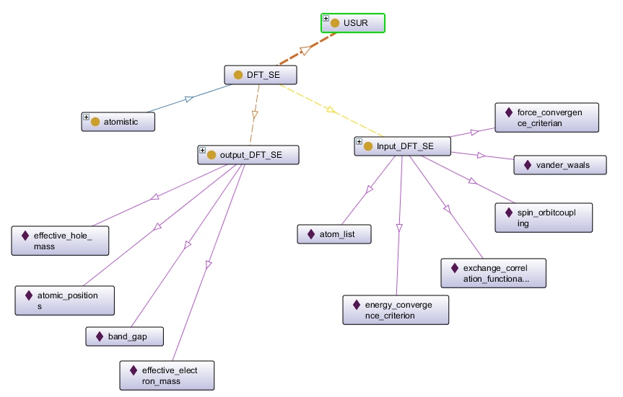
Atomistic process view
DFT for structural and electronic properties

Slide 11
Description of SR-UML Ontology
Simulation requirement Ontology (in UML)
Inputs are classified as „external“ and „from a partner“ and Outputs are classified as „for a partner “ or „for the database“.
Two types of links have been used extensively.
The simulation process that uses the outputs of another process (as input) is joined by the „uses“ link and red dashed line.
The output of a simulation process is shown by the „has“ link and green solid line.
The name of the process is written at the top of each block before the „@“ sign.
After the „@“ sign the name of the partner who is performing the simulation is mentioned.
The outputs that should be transferred to the other methods are mentioned in bold italic letters.
The outputs that should be saved in the database are mentioned in normal letters.

Slide 12
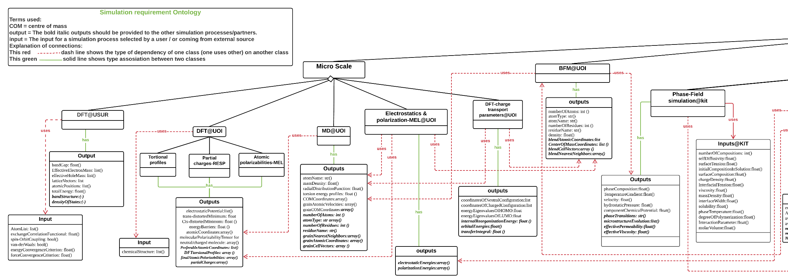
The simulation requirment Ontology (I)
.

Slide 13
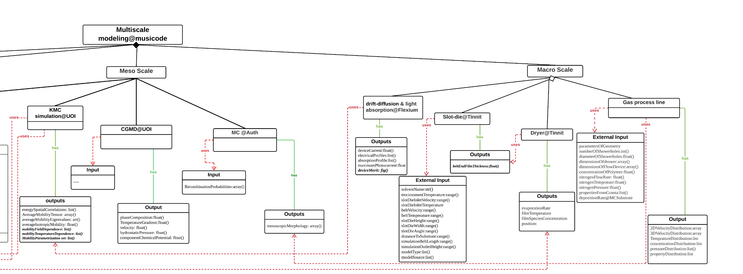
The simulation requirment Ontology (II)

Slide 14
The Ontology viewing link
https://lucid.app/lucidchart/da44b35f-2534-4717-a51f-499df8ff08a4/edit?invitationId=inv_110ea034-f1bb-4ce7-b7a9-28b55c7992f6
Click on the link
Set up a free account
View the Ontology
If someone wants to edit the Ontology, he/she can request for it.

Slide 15


Ontologies for MUSICODE
Presented by H.Noman (13-05-2022)

