Slide 1
RAICHU
remote access infrastructure for
controlled hardware units
Ben Tankersley
Thomas Tsang
Cmpe 195B – Final Project Presentation

Slide 2
The Inspiration
The internet is almost everywhere we go, whether it be via Smartphone, PC or other internet connected devices, we rarely find ourselves more than an arms length away from our next status update, bill payment or shoe purchase.
Many companies have realized this change in American culture and have capitalized by allowing internet users to control many things that were traditionally not possible over the web.

Slide 3
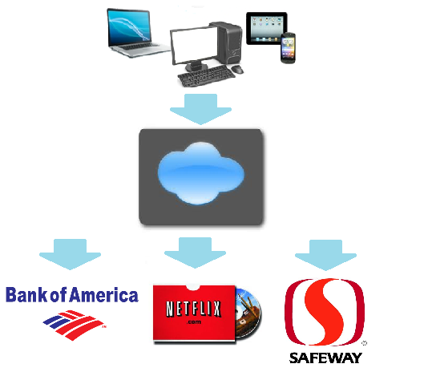
The Inspiration – cont.
It is now possible to pay bills, watch/rent movies, and even order your groceries.
RAICHU seeks to take this ever growing online community and extend its reaches to places that were also unreachable.

Slide 4
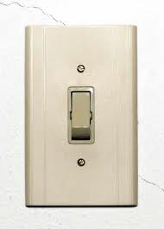
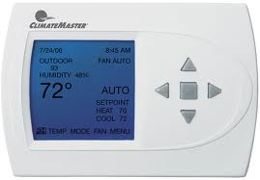
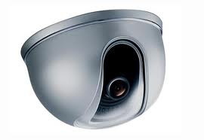
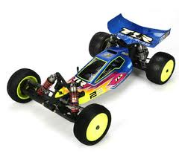
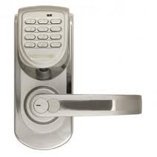
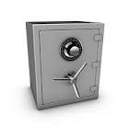
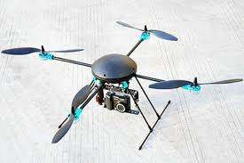
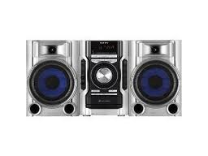
RAICHU DEVICES

Slide 5
THE IDEA
By implementing a small amount of code in a device, developers can enable their products to be controlled remotely with little set up and backend development.
The RAICHU API will allow developers to easily implement the cloud services to new projects as well inject the capabilities into existing source code.

Slide 6
The impact
With RAICHU enabled devices users will be able to access and control their devices from any where they can access the web.
Whether is a lock, light, safe, stereo, microwave or camera, Every device that needs to be controlled is right for RAICHU.
RAIHCU gives you the capability to control ‘em all.

