Slide 2

The Inspiration
The internet is almost everywhere we go, whether it be via smartphone, PC or other internet connected devices, we rarely find ourselves more than an arms length away from our next status update, bill payment or shoe purchase.
Many companies have realized this change in American culture and have capitalized by allowing internet users to control many things that were traditionally not possible over the web.

Slide 3
The Idea
RAICHU will be a system for to allow users to connect to, and control, their devices from anywhere in the world.
The RAICHU Mobile and Web Applications will facilitate control with a a fast, reliable and secure connection to the RAICHU Server and present the users with engaging UI.
The RAICHU API will allow developers to easily implement cloud services into new projects as well inject the capabilities into existing source code.

Slide 4
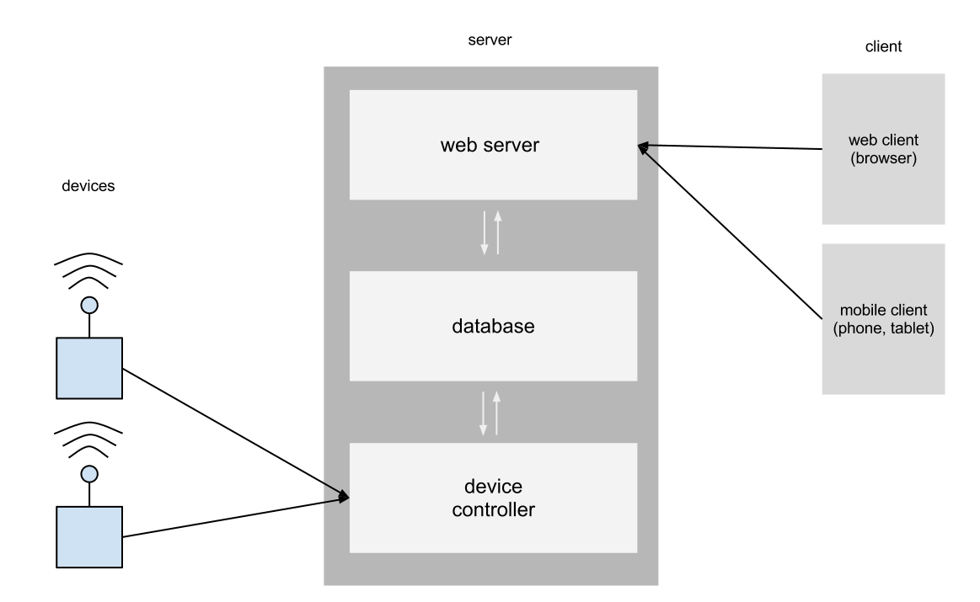
Server Architecture

Slide 5

The RAICHU API
A key aspect to RAICHU is a simple to use API that will allow for developers to integrate our system as either an initial building block in their code or inject into a living code source.
Function naming schemes and common API conventions make the API easy to navigate:
  Raichu_setDeviceName();
  Raichu_setDeviceCommands();
  Riachu_setStatusParameters();
  Riachu_getConnectedClient();
  Riachu_getServerStatus();
API documentation provides users with detailed information on RAICHU methods and variables.

Slide 6
Progress and Status
As of December 2012, the project is completed and in testing phase. The RAICHU system is beginning to shape its self and small unit testing shows good signs. Despite using the thread model, the system is handling stress from clients and devices well. We have deployed a server in the school network and requested for a certain of ports to be open through the firewall. We have successfully tested sending commands over the internet. We have selected an RC car, an MP3 player, and a power bank to use for our demonstration. The RC car demonstrates the processing of data in real time, the MP3 player demonstrates processing complex commands, while the power demonstrates the range of devices that the RAICHU system is capable of handling.

Slide 7
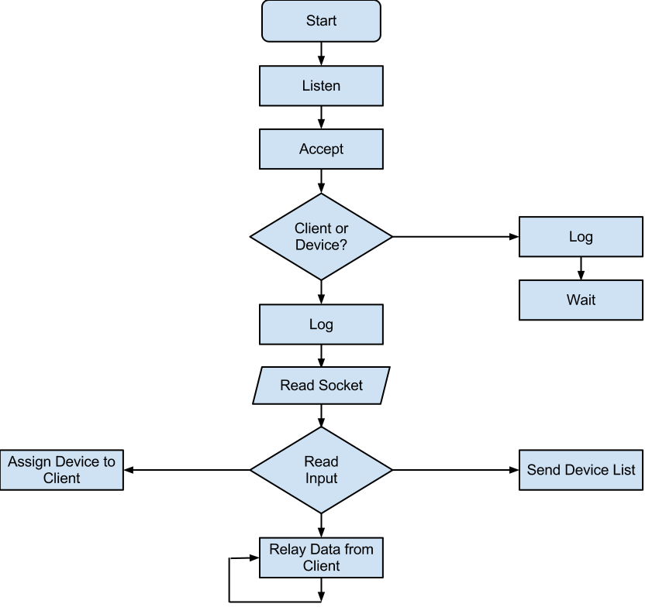
RAICHU Controller Flow Chart

Slide 8
Acknowledgments
Thank you to all listed below for your support and guidance
throughout the completion of this project.
Prof. Frank Lin, Ph.D.
Prof. Haluk Ozemek, Ph.D.
Prof. Keith Perry
Preet Kang
Deian Georgiev
Micheal J. Cox

