Slide 1
RAICHU
remote access infrastructure for
controlled hardware units
Ben Tankersley
Thomas Tsang
Cmpe 195B – Final Project Presentation

Slide 2
The Inspiration
The internet is almost everywhere we go, whether it be via Smartphone, PC or other internet connected devices, we rarely find ourselves more than an arms length away from our next status update, bill payment or shoe purchase.
Many companies have realized this change in American culture and have capitalized by allowing internet users to control many things that were traditionally not possible over the web.

Slide 3
THE IDEA
By implementing a small amount of code in a device, developers can enable their products to be controlled remotely with little set up and backend development.
The RAICHU API will allow developers to easily implement the cloud services to new projects as well inject the capabilities into existing source code.

Slide 4
The RAICHU API
A key aspect to RAICHU is a simple to use API that will allow for developers to integrate our system as either an initial building block in their code or inject into a living code source.
Function naming schemes and common API conventions make the API easy to navigate:
Raichu_setDeviceName();
Raichu_setDeviceCommands();
Riachu_setStatusParameters();
Riachu_getConnectedClient();
Riachu_getServerStatus();
API documentation provides users with detailed information on RAICHU methods and variables.

Slide 5
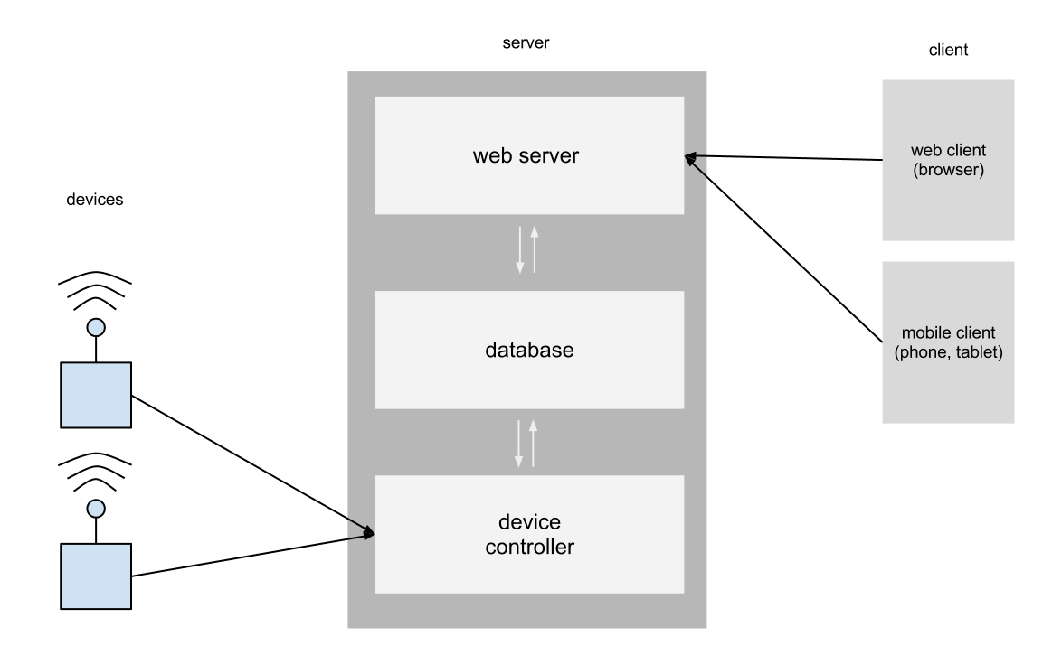
Server Architecture

Slide 6
Q&A

