Slide 1

RAICHU
Thomas Tsang and Ben Tankersley
Advisor: Frank Lin

Slide 2
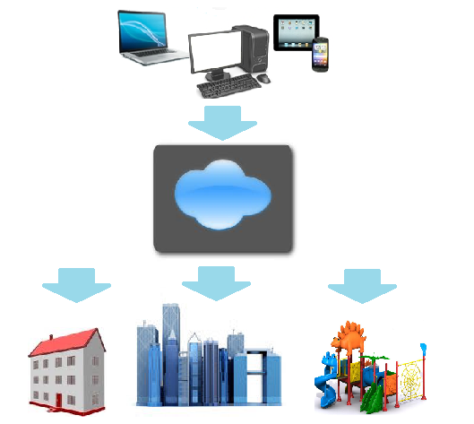
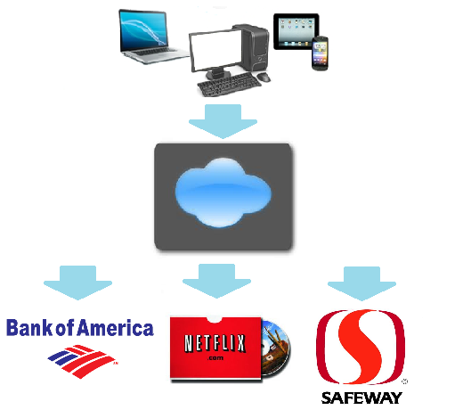
The problem…
The internet is almost everywhere we go, whether it be via Smartphone, PC or other internet connected devices, which enables users to check bank accounts, order dinner, rent a movie..etc.
Why not extend this connectivity more everyday items?

Slide 3
What is RAICHU?

Slide 4
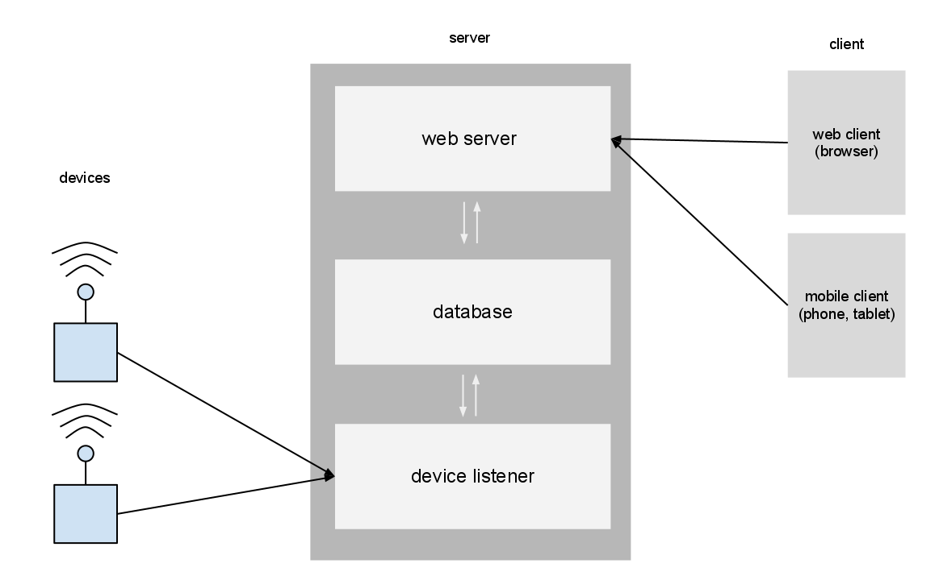
RAICHU system architecture

Slide 5
RAICHU Fundamentals
Each device will register with the RAICHU database and help RAICHU learn its specific commands.
RAICHU will then allow any user that has access to that device to take control of that device.
New RAICHU enabled devices will have near plug-N-play functionality

Slide 6
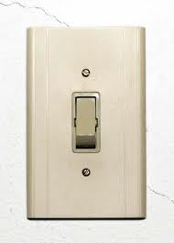
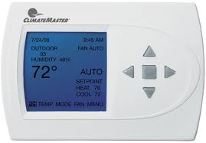
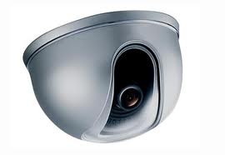
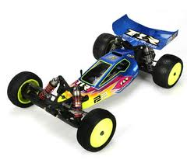
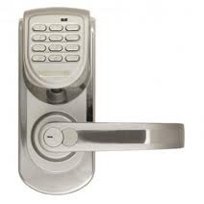

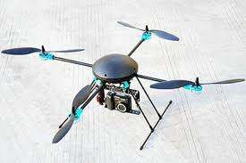
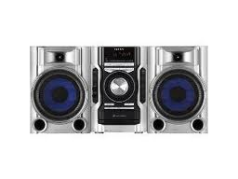
RAICHU Devices

Slide 7
Thank You
Questions?

