Slide 1
RAICHU
remote access infrastructure for
controlled hardware units
Ben Tankersley
Thomas Tsang
Cmpe 195B – Final Project Presentation

Slide 2
The Inspiration
The internet is almost everywhere we go, whether it be via Smartphone, PC or other internet connected devices, we rarely find ourselves more than an arms length away from our next status update, bill payment or shoe purchase.
Many companies have realized this change in American culture and have capitalized by allowing internet users to control many things that were traditionally not possible over the web.

Slide 3
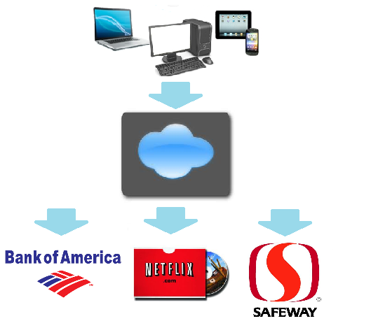
The Inspiration – cont.
It is now possible to pay bills, watch/rent movies, and even order your groceries.
RAICHU seeks to take this ever growing online community and extend its reaches to places that were also unreachable.

Slide 4
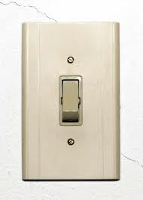
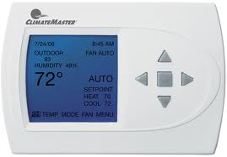
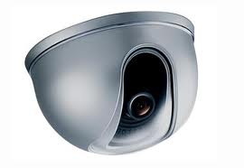
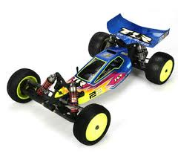
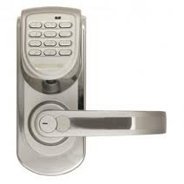

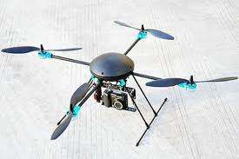
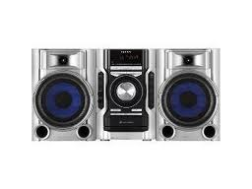
RAICHU DEVICES

Slide 5
THE IDEA
By implementing a small amount of code in a device, developers can enable their products to be controlled remotely with little set up and backend development.
The RAICHU API will allow developers to easily implement the cloud services to new projects as well inject the capabilities into existing source code.

Slide 6
The impact
With RAICHU enabled devices users will be able to access and control their devices from any where they can access the web.
Whether is a lock, light, safe, stereo, microwave or camera, Every device that needs to be controlled is right for RAICHU.
RAIHCU gives you the capability to control ‘em all.

Slide 7
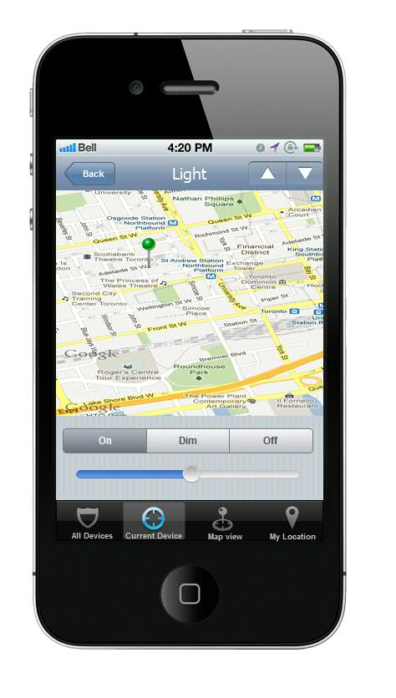
Mobile and web Applications
RAICHU incorporates both mobile and web applications to allow users to connect to their devices from virtually anywhere.
With dynamic controls and customized interaction per RAICHU enable device. The applications are simple to set up and easy to use.

Slide 8
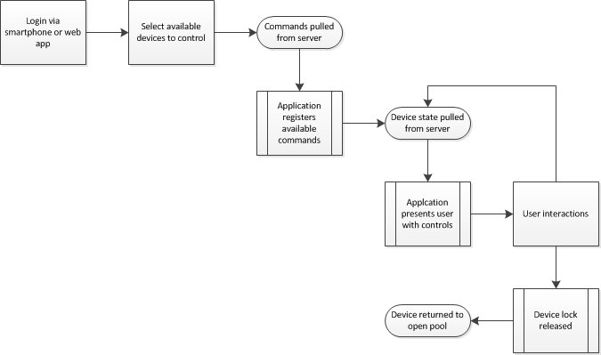

Client control flow
User interaction is fast and simple
Upon login, available devices are presented to the user.
Once device(s) are selected, available device controls and device state are relayed to client.
User interaction occurs
Upon user logout, devices are returned to ready-device pool.

Slide 9
Hardware Applications
To demo the RAICHU servers capabilities the team has come up with several hardware implementations that can show the diversity of the system.
RC car
Power bank
Mp3 player

Slide 10
Hardware Applications
Each device implementation utilizes a different set of commands and functionality.
The RC car allows users to drive(forward-back, left-right) while the device relays pertinent information back to the user such as GPS location, heading, speed, and if obstacles may obstruct path.
The power back allows the user to turn on and off two outlets independently that are located within the same wall socket and relays back the state of each switch.
The Mp3 player allows the user to play, pause, seek forward and back and relays the song title and duration of tracks, as well other tracks that can be selected.
Although each device represents a different aspect of everyday life, the RAICHU API allows developers to use the same code structure across a wide array of devices. To show RAICHU’s ability to be injected into an already viable and living code source, both the power bank and RC car were fitted with RAICHU functionality at the end of the development period. The power bank was designed from the beginning to target the RAICHU platform.

Slide 11
HARDWARE Requirements
Functional:
Hardware device should integrate into RAICHU system
Hardware should detect and acknowledge RAICHU server
Device malfunction should not effect server or client software/hardware
Hardware should be wifi-capable

Slide 12
Hardware Requirements
Non-functional:
Device hardware should be capable of interacting with servers and clients in near real time
Device hardware should have robust design that allows for long idle periods and fast wakeup times.

Slide 13
The RAICHU API
A key aspect to RAICHU is a simple to use API that will allow for developers to integrate our system as either an initial building block in their code or inject into a living code source.
Function naming schemes and common API conventions make the API easy to navigate:
Raichu_setDeviceName();
Raichu_setDeviceCommands();
Riachu_setStatusParameters();
Riachu_getConnectedClient();
Riachu_getServerStatus();
API documentation provides users with detailed information on RAICHU methods and variables.

Slide 14
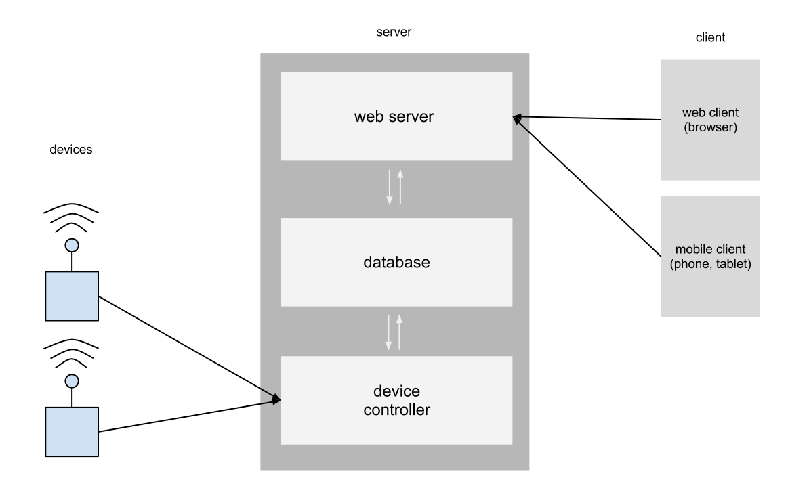
Server Architecture

Slide 15
Server Architecture
Custom server application to handle clients and devices
Apache HTTP web server to web clients
MySQL for database
Using InnoDB for database engine since it supports foreign keys, and we don’t need full text indexing

Slide 16
Server Architecture
Design:
Server application based off classical thread model
While it does not scale as well compared to asynchronous, it’s better suited to demonstrate a prototype
Design trade off:
Server was planned to utilize asynchronous framework to improve scalability and efficiency
However we decided the time and effort required to design, implement, and test the system would be beyond the demand of the project

Slide 17
Software Requirements
Functional:
Server should be robust and be resilient to failure
Server log messages should be clear on activity
Device crashes should not corrupt any part of server
Devices may only have one “owner” at any given instance
Clients can actively control only one device any given instance
Server must be secure against unwarranted input

Slide 18
Software Requirements
Non-functional:
Real-time devices require near real-time feedback
Devices should have minimal setup to boot up and connect to server
System should be responsive under any amount of stress
Server deployment should be straight forward

Slide 19
Server Implementation
When a client or device connects to the server, a new thread is spawn to handle and process any data sent
Once determined if it’s a client or device, the information is logged into a list, which is constantly updated locally and periodically updated on the database
Client asks the server to assign it a device, once assigned, the server will relay any data from the client to the device

Slide 20
Server Implementation
Server keeps a cached list of available devices and clients
Makes periodic database writes for web and mobile client access
Database writes can be expensive so only done periodically
Internal list needs to be updated in real time so devices aren’t mistakenly claimed

Slide 21
Server Issues
Expanding and extending the functionality of the API can be difficult, server can store what available commands exist for a certain device, but the user interface cannot dynamically translate commands into a practical layout

Slide 22
Team Dynamic
As a team of two it was rather hard to make a large divide in the work.
With two main aspects of this project, hardware that can demo and support RAICHU, as well as software running on the server, devices and control applications. We each took charge of one aspect.
Thomas ran software development while Ben was in charge of hardware.
It should also be noted that as a small team, no one area of this project was completed alone. It took careful planning and execution by all members to create a working system.

Slide 23
Individual responsibilities
Thomas
Server application
Web and database server
Control protocol
System architecture
Simulation tools
Ben
Device Design
API
Build System
Hardware requirements and implementation

Slide 24
Tools Used
Git
Sublime Text
Eclipse
Clang
Sequel Pro
Custom tool to simulate multiple devices and clients to connect to server

Slide 25
Future work
The RAICHU framework and API will be an ever evolving project that will work to best fit developers needs. One of the initial goals set fourth by the RAICHU team was to create a system in which developers would want to use and want to improve. At its current state, there are many shortcomings as well as many strengths. These can all be leveraged to help advance RAICHU and get it in more in more devices.
The RAICHU team encourages feedback, both positive and negative that can help make this architecture easier to use, more reliable, and more secure.

