Slide 1

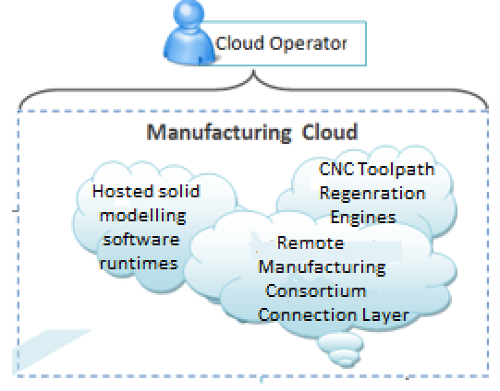
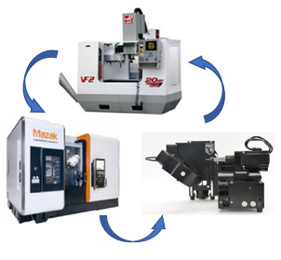

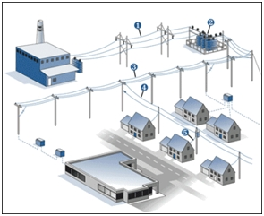
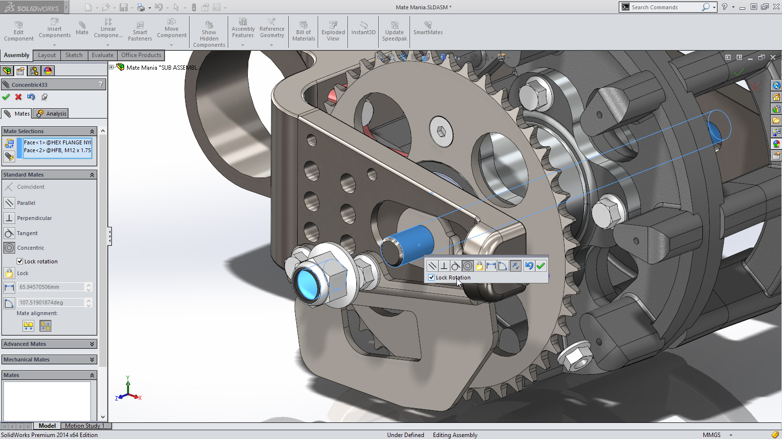
Physical Supply Chain Layer
1. Client interacts with digital twin of 3D model hosted on CMaaS CAD runtime via web browser.
2. CMaaS platform hosts CAD software runtime and toolpath regeneration engines.
3. Manufacturing consortium hosting manufacturing nodes capable of accepting G-code from CMaaS platform.
11. QC does quality check and makes RPC calls to blockchain to record QC event.
13. Distributor manages distribution of fabricated part to the client and makes RPC calls to blockchain to record such events.
Client Middleware
CMaaS Middleware
Manufacturing Middleware
4. Client and CMaaS middlewares exchange information to communicate parametric changes & toolpath regeneration commands to CAD runtime.
8. CMaaS platform regenerates toolpath and communicates with manufacturing consortium to delegate manufacturing task and transfer G-Code.
10. Part is transferred to Quality Control (QC).
12. Part is transferred to distributor and finally to client, generating events on the blockchain on every ownership change.
5. Client middleware makes RPC calls to smart contract on blockchain after satisfactory parametric change of model.
RPC calls sent to blockchain
Events on blockchain sent to subscribers
Blockchain Network Layer
6. Supply chain smart contract sends client instant quotation (RFQ replies).
7. On RFQ approval by client, make order is initiated and recorded as transaction on blockchain.
9. Part is manufactured, and part data modelled as ERC 721 non fungible token is registered on blockchain. Part meta data – raw material, volume etc. recorded as manufacturing transactions and tied to its distributed ledger.
14. Movement of part across the supply chain to QA and distributor is modelled as change of ownership of ERC721 token across blockchain. Client is able to access entire transaction history ensuring provenance.
15. Blockchain registers transactions from delivery and logistic events, manages payments, refunds & returns – all through automated logic on contracts.

Slide 2
CMaaS Middleware Architecture
Publisher/Subscriber (P/S) Layer
2. CAD runtime child thread hosting HTTP Web server.
Model parameter change request handler
1. CAD runtime main process thread.
CAD runtime UI event management
5. Main thread subscribes to events raised on the P/S layer and brings about required change in the CAD runtime via the API engine.
Model metadata and format conversion request handler
3. Client or other requests from cloud are received and responded to by HTTP server following RESTful
architecture.
Rendering and computational engine
CAD runtime API engine
4. Child thread publishes request events on the P/S layer.
Communication from cloud received from client/other middleware
Toolpath regeneration request handler
OS and background utility management
G-code generation request handler
I
II
III
IV
V

Slide 3
Client Middleware Architecture
CMaaS platform
Browser embedded blockchain wallet app
Parameter change request.
Geometry extraction request.
Toolpath regeneration request.
Model metadata.
Model geometry file.
Transaction signature permission request.
Private key and cryptocurrency access replies.
III
IV
V
CMaaS middleware interaction layer
WebGL runtime engine
Machine coordinate rendering engine
Blockchain identity and wallet management layer
Blockchain interface layer
I
II
Realtime manufacturing node toolpath coordinates.
RPC calls to smart contract functions.
Toolpath position and machine status query request.
Blockchain event generation.
RPC calls to smart contract functions.
Manufacturing middleware
Blockchain network layer

Slide 4
Manufacturing Middleware Architecture
CMaaS platform
CNC machine OS
G-code file load requests.
Low level device IO access requests.
Real time toolpath coordinates and machine status parameters.
I
II
III
CMaaS middleware interaction layer
Client middleware interaction layer
Machine firmware interaction layer
Concurrent thread hosting HTTP web server
Machine status and toolpath position query.
Machine status and toolpath position query replies.
Client front end

Slide 5
I
Smart Contract Inheritance structure for major stakeholders in CMaaS supply chain.
Base permission smart contract
Raw material sourcer smart contract
CNC machine owner smart contract
Quality controller smart contract
Distributor smart contract
Client/Consumer smart contract
II
Smart Contract Inheritance structure for assets in the CmaaS supply chain
ERC 721 Non fungible token smart contract
Asset Smart Contract
III
Core Supply chain smart contract method differentiations
Core Supply Chain Smart Contract
Collect raw material
Machine part from stock
Quality Control and Verification
Distribute and Ship
Final part
Customer Acceptance and approval

Slide 6
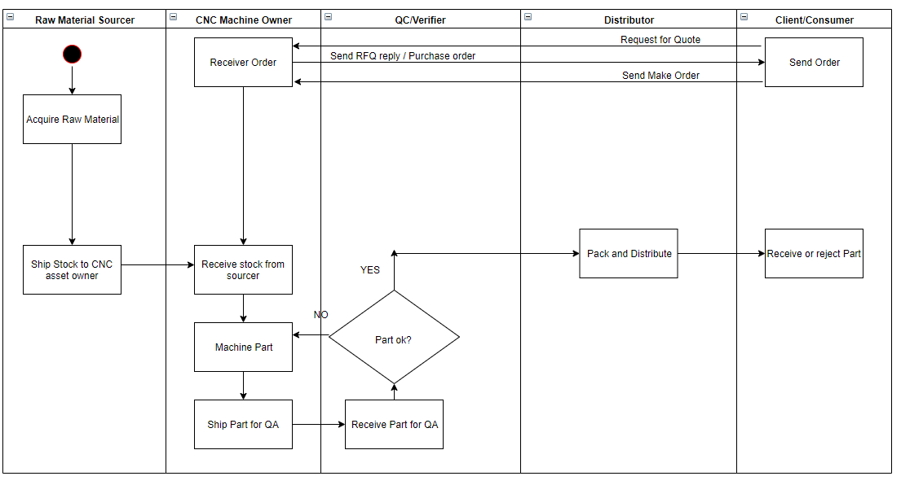

Slide 7
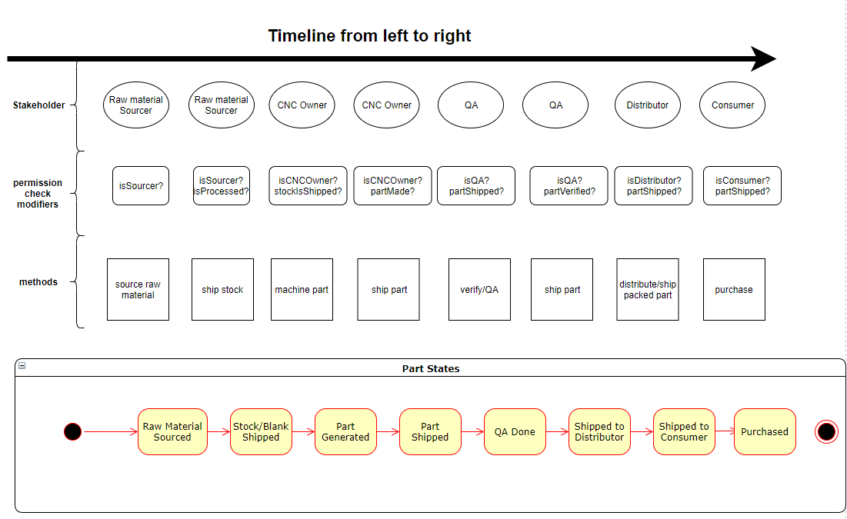

Slide 8


Stakeholders with their smart contracts on the Ethereum virtual environment
Inter-contract data exchange
Supply chain smart contracts invoking modifiers and doing permission checks via inter-contract data exchange

Slide 9
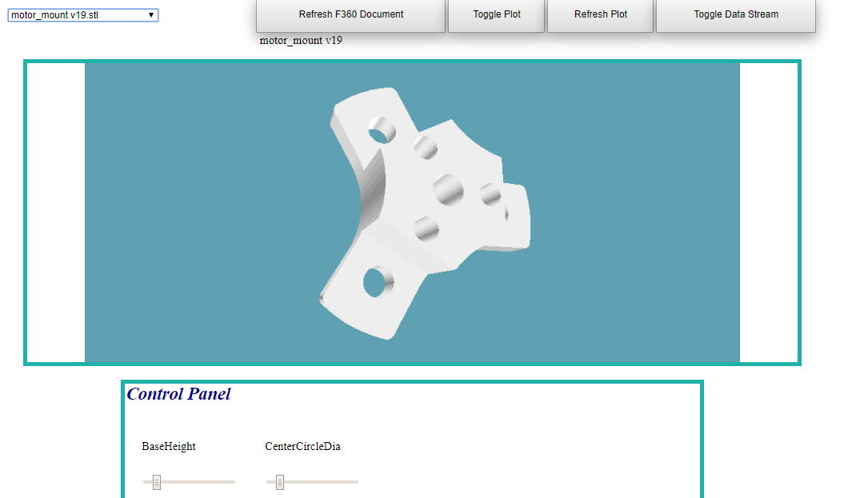
Model selection panel.
Manufacturing node communication control.
I
II
III
Model rendered output.
Digital twin of model housed in CMaaS platform
IV
Model parameter control panel.

Slide 10
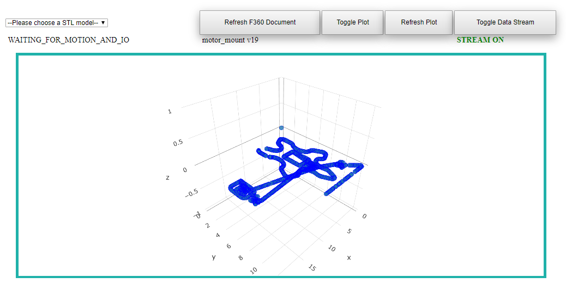
II
I
PocketNC machine status.
Data stream mode from manufacturing middleware.
III
Real time PocketNC toolpath tracing.

Slide 11
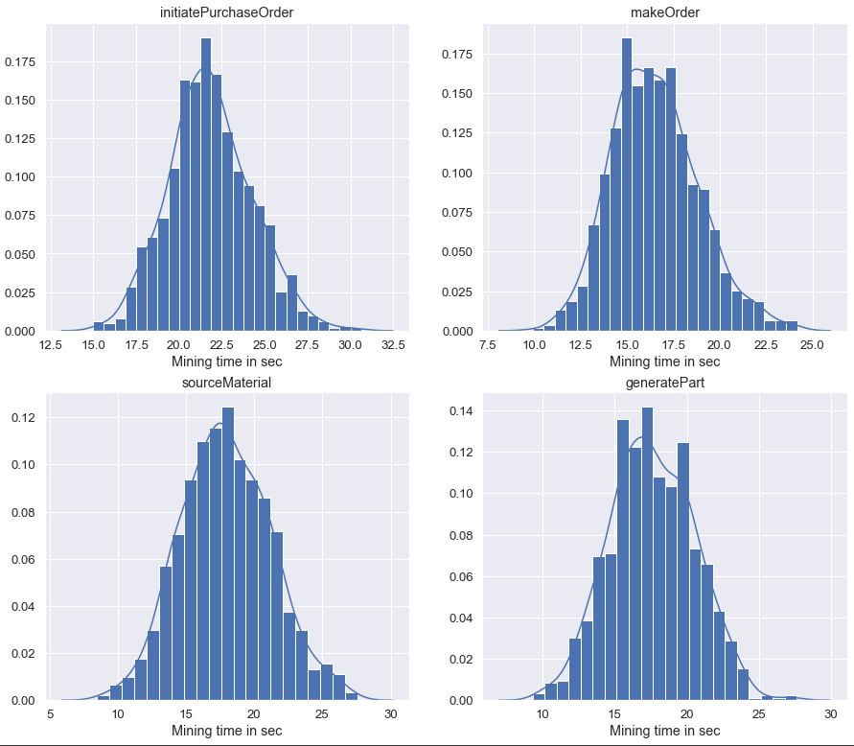
Rinkeby Network Time Distribution

Slide 12
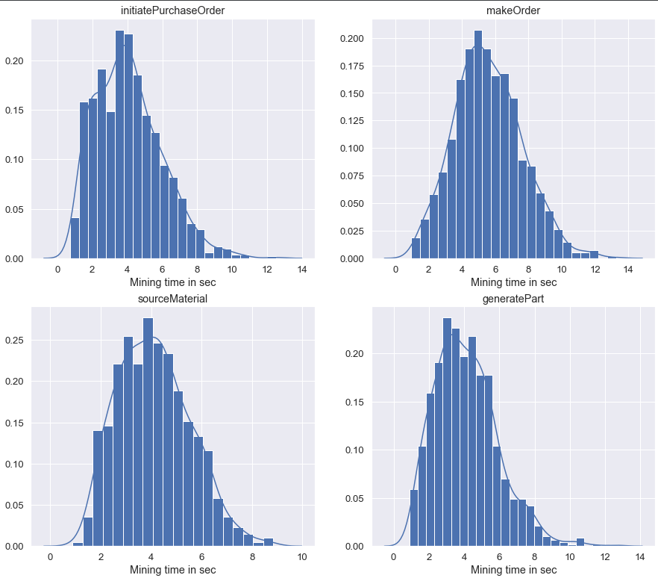
Kovan Network Time Distribution

Slide 13
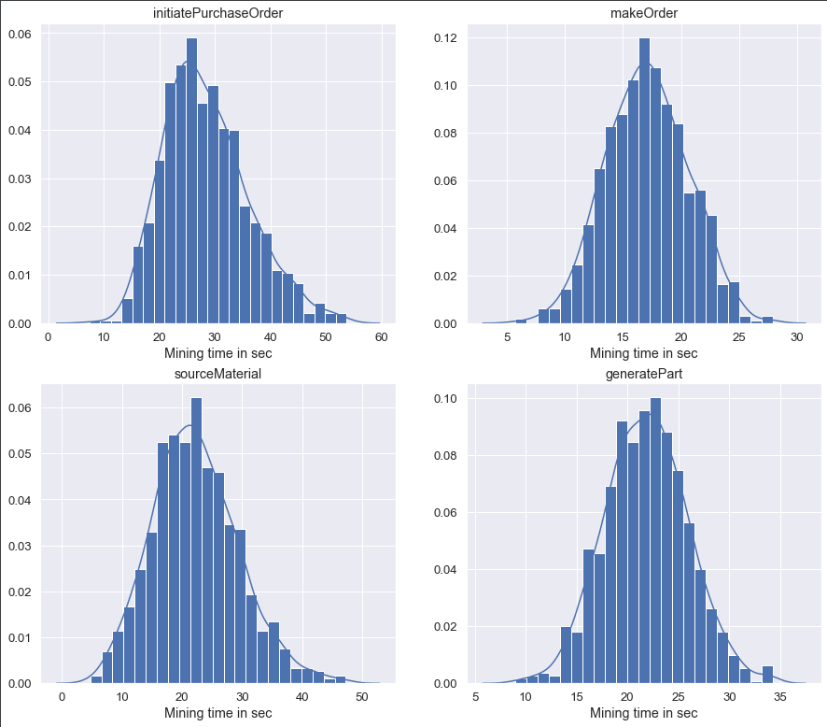
Ropsten Network Time Distribution

Slide 14
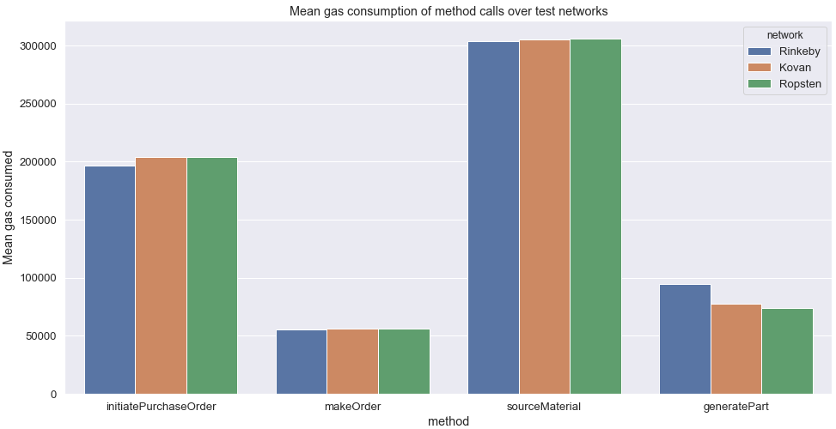

Slide 15
I
Core supply chain smart contract
START
II
Consumer/client contract
Initiate purchase order request
isConsumer?
Initiate Purchase Order ()
RFQ reply
Make-Order request
makeOrder()
Sourcer contract
III
IV
CNC owner contract
sourceMaterial()
Sourcing Request
Machine part
isSourcer?
isCNCOwner?
generatePart()
QC contract
V
VI
Distributor contract
verifyPart()
Quality Control
Distribute
isQC?
isDistributor?
Distribute()
Accept()

Slide 16
START
Initiate Purchase Order ()
Send ether equivalent to RFQ amount
makeOrder()
Ether stored in escrow against client address
Client satisfied ?
N
Refund
Y
Send escrow amount to CMaaS
END

Slide 17
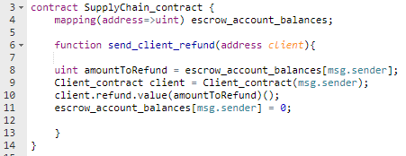
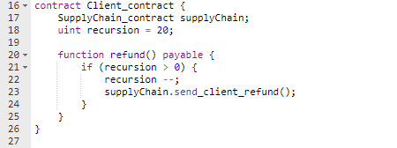
Supply chain contract snippet
Malicious Client smart contract snippet
Inter contract communication

Slide 18
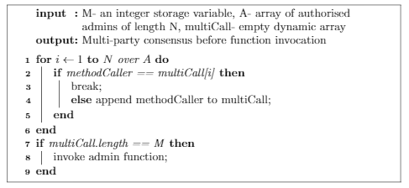

Slide 19
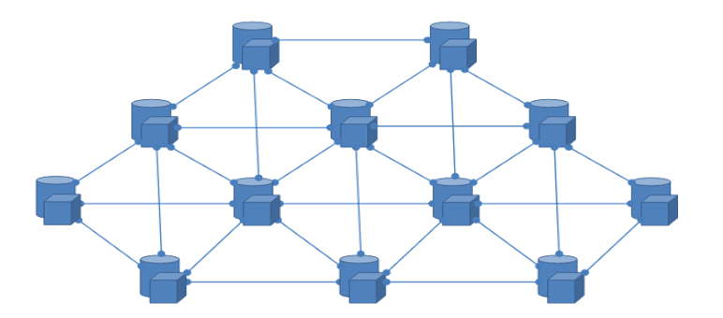

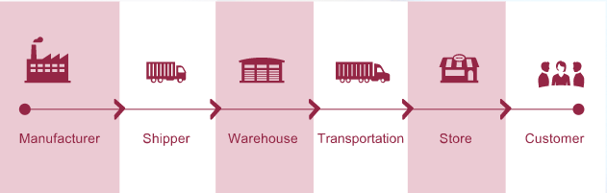
BigchainDB cluster
DB API calls to append new non-fungible asset data
Physical Supply Chain Layer
RPC calls for the management of payment (fungible assets)
Ethereum network

Slide 20
I
Text Embedding Vector
Training set of CAD images
Discriminator Network
Probability vector discriminating synthesized image from real CAD model image
Text Embedding Vector
Generator Network
Synthesized CAD model images
Latent Sample

Slide 21
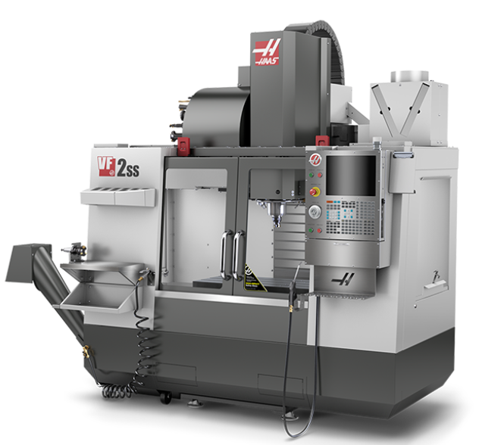
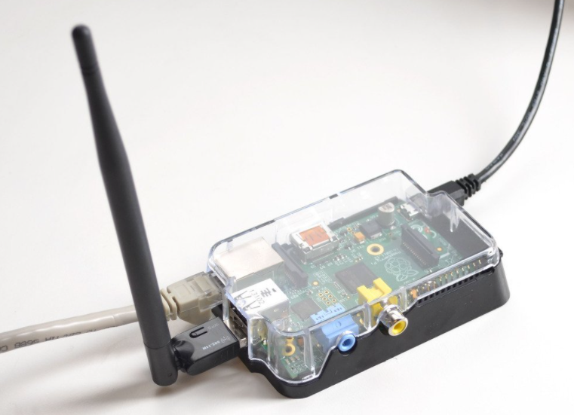
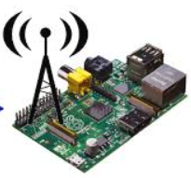
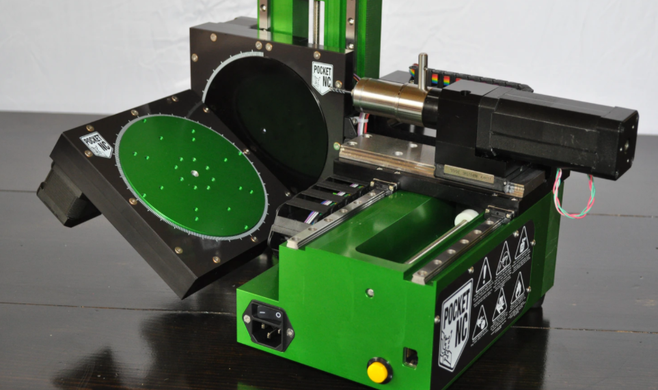

Haas VF2
Rpi Edge
RPC Calls
Rpi Edge
Blockchain Network
RPC Calls
Rpi Edge
Pocket NC

Slide 22
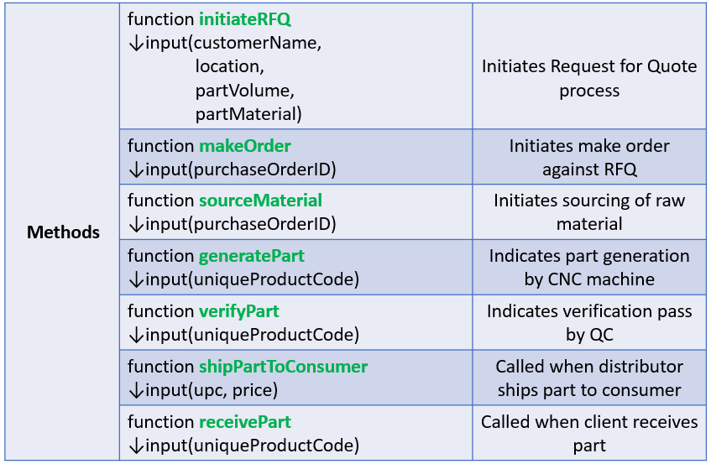
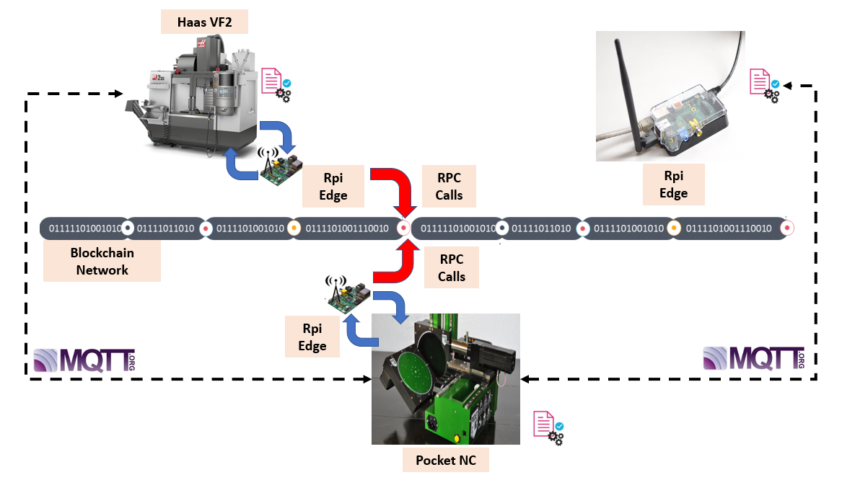
(a)
(b)

Slide 23
