Slide 1

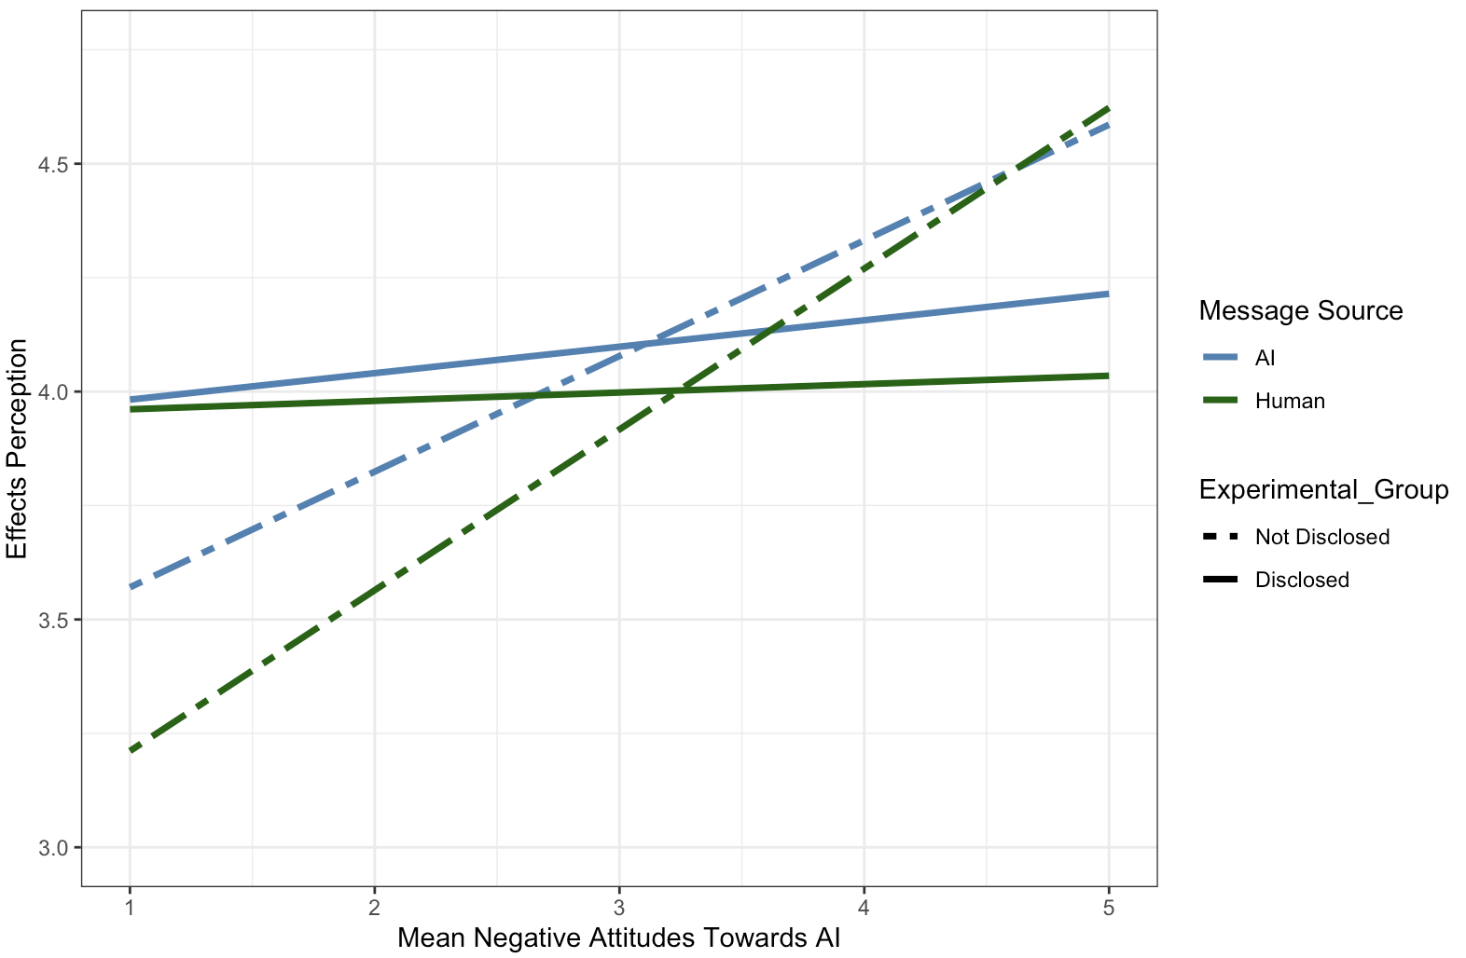

Source Disclosed
Source Not Disclosed
HUMAN: Sample Message Text
Sample Message Text
HUMAN- GENERATED
Not Negative towards AI
Negative towards AI
Not Negative towards AI
Negative towards AI
AI: Sample Message Text
Sample Message Text
AI- GENERATED
Not Negative towards AI
Negative towards AI
Not Negative towards AI
Negative towards AI
Notes:
As we can see from looking at figure X, a very salient difference refers to how the source disclosure manipulation interacted with the attitude-toward AI measure (this is the two-way interaction), with fairly flat slopes for the source disclosure condition (solid lines) and steeper slopes for the undisclosed source condition (dotted lines).
However, while this 2-way interaction is the most salient feature, there is actually a significant 3-way interaction between message source, source disclosure, and the attitude measure. When resolving this interaction by separately comparing how AI-attitudes affect AI-generated message evaluations in the undisclosed vs. disclosed condition, and then how AI attitudes relate to the evaluations of human-generated messages in the undisclosed vs. disclosed condition, we find the following pattern:

Slide 2
Better MSG
Sample Message Text
HUMAN- GENERATED
EP
HUMAN: Sample Message Text
Not Negative towards AI
Negative towards AI
Better MSG
Sample Message Text
AI- GENERATED
AI: Sample Message Text
EP
Not Negative towards AI
Negative towards AI
Notes:
As we can see from looking at figure X, a very salient difference refers to how the source disclosure manipulation interacted with the attitude-toward AI measure (this is the two-way interaction), with fairly flat slopes for the source disclosure condition (solid lines) and steeper slopes for the undisclosed source condition (dotted lines).
However, while this 2-way interaction is the most salient feature, there is actually a significant 3-way interaction between message source, source disclosure, and the attitude measure. When resolving this interaction by separately comparing how AI-attitudes affect AI-generated message evaluations in the undisclosed vs. disclosed condition, and then how AI attitudes relate to the evaluations of human-generated messages in the undisclosed vs. disclosed condition, we find the following pattern:

Slide 3
Source Disclosed
Source Not Disclosed
Sample Message Text
Sample Message Text
HUMAN- GENERATED
AI: Sample Message Text
AI- GENERATED
HUMAN: Sample Message Text
Not Negative towards AI
Negative towards AI
Not Negative towards AI
Negative towards AI
Notes:
As we can see from looking at figure X, a very salient difference refers to how the source disclosure manipulation interacted with the attitude-toward AI measure (this is the two-way interaction), with fairly flat slopes for the source disclosure condition (solid lines) and steeper slopes for the undisclosed source condition (dotted lines).
However, while this 2-way interaction is the most salient feature, there is actually a significant 3-way interaction between message source, source disclosure, and the attitude measure. When unpacking this interaction by separately comparing how AI-attitudes affect AI-generated (blue) va. Human-generated (green) message evaluations in the undisclosed (dashed lines) or the source disclosed condition (solid lines) , respectively, we find the following pattern:
When the message source was not disclosed, people with negative attitudes towards AI give higher ratings overall., but the

