Slide 1
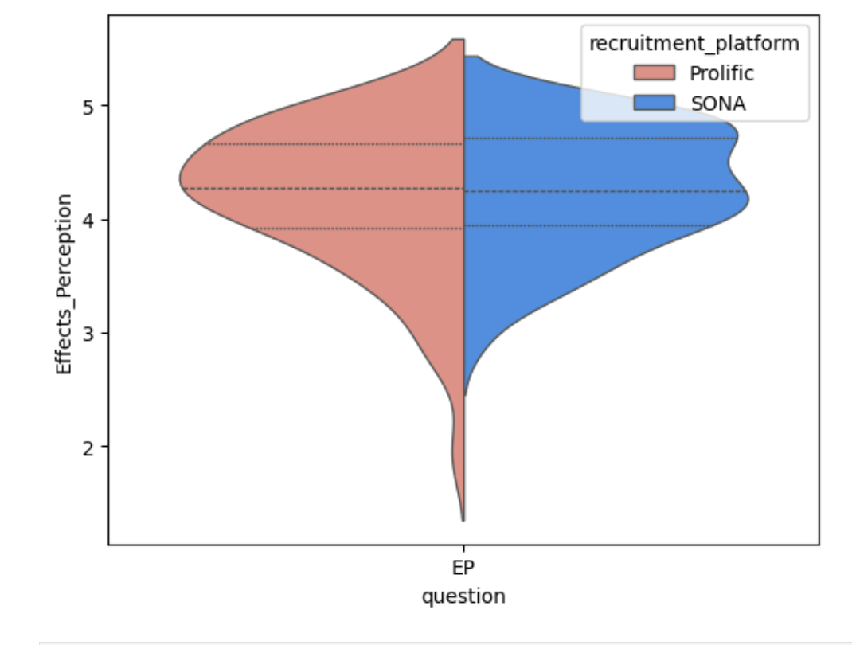
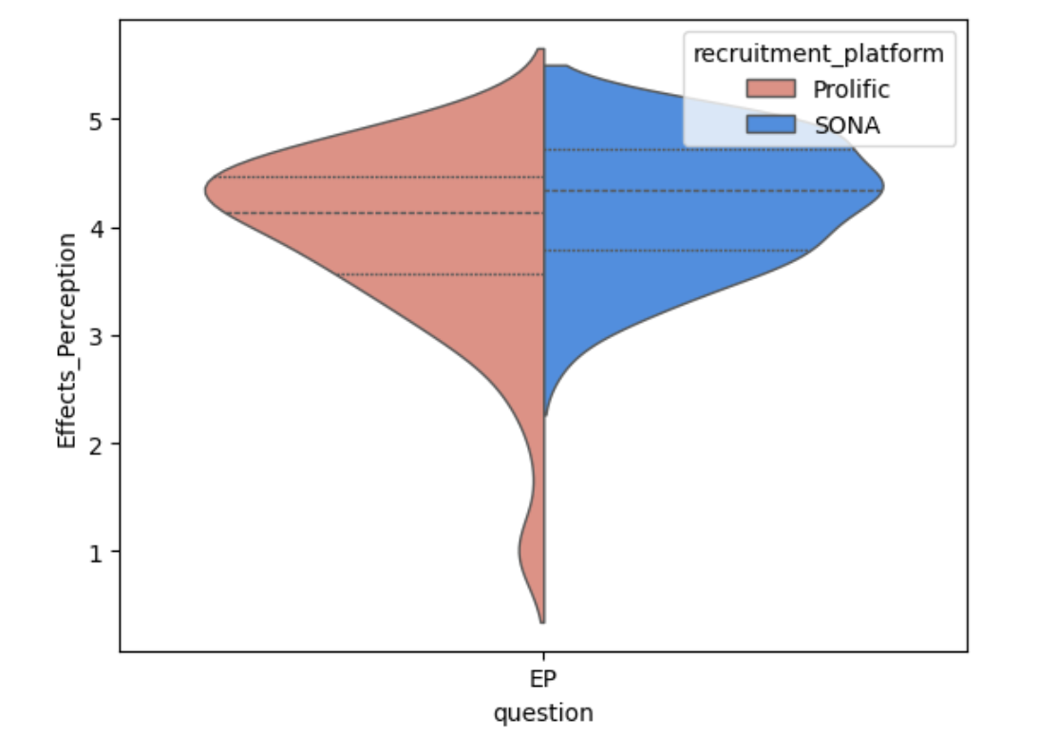
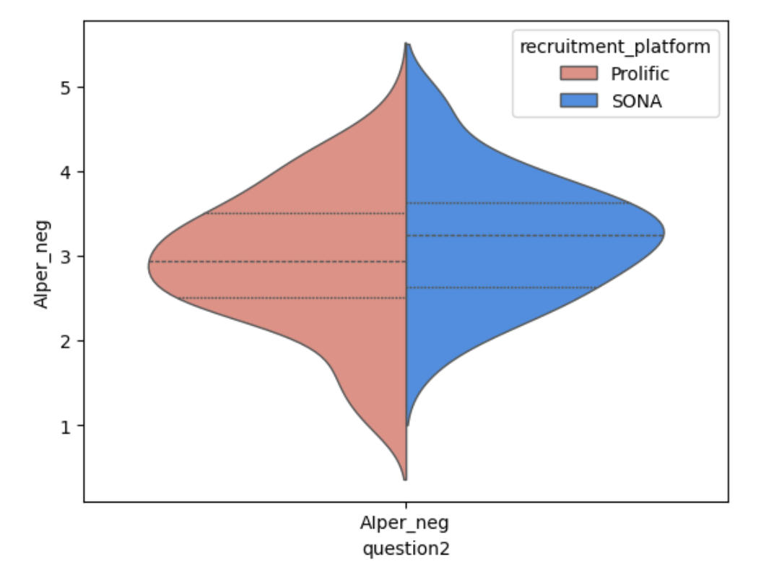
Study 1
Study 2
Effects Perceptions
Effects Perceptions
Negative Attitudes towards AI

