Slide 1
Computational modelling of decision making and action selection
Block Practical, Weeks 5-8, Michaelmas 2017
Drs. Laurence Hunt, Nils Kolling, Miriam Klein-Flugge, Jacquie Scholl

Slide 2
Plan for next 4 weeks
Today: setting up the task, collecting a dataset, building a learning model (Laurence Hunt) by Friday 24th Nov: collect three more datasets
Friday 17th Nov: further modelling, regression analysis (Nils Kolling)
Friday 24th Nov: data analysis, model fitting (Miriam Klein-Flugge)
Friday 1st Dec: statistics and write-up planning (Jacquie Scholl)

Slide 3
Why build a model?
What has modelling taught us about behaviour?
What has modelling taught us about the brain?
What practical uses might computational models of cognition have?

Slide 4
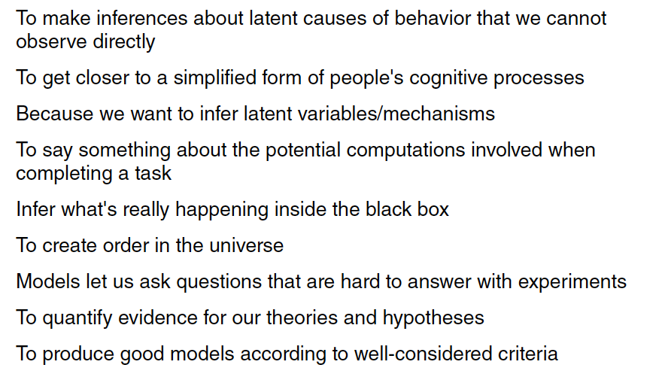
Why build a model?
Courtesy of Weiji Ma’s Lab, NYU

Slide 5
Why learn to code?
Building models often needs you to code them up.
How will it help you if you want to do research?
How will it help you if you want to pursue other careers?

Slide 6
What computational modelling often entails
Understand a bit of maths behind the model
(maths we’ll cover today is mostly easy maths (GCSE level/easier))
2. Understand what the parameters and variables
in the model mean
3. Fit the model to experimental data
4. Interpret the model parameters after it has been fit
5. Perform model comparison to ask how good your model is relative to others

Slide 7
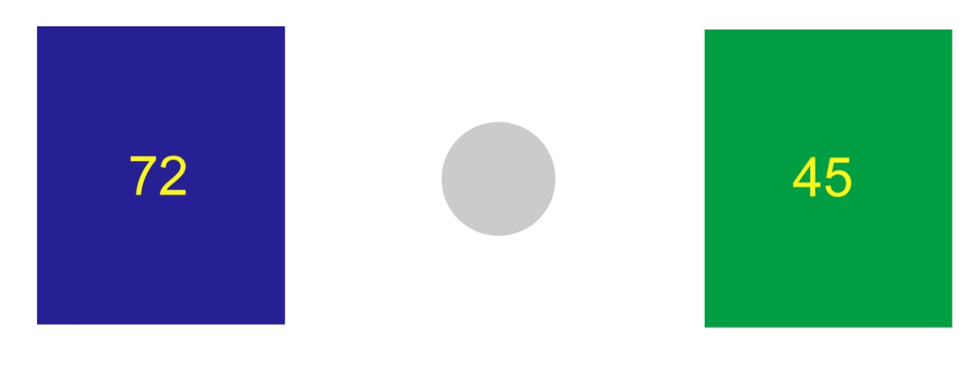
What we’re aiming to model.
Behrens et al., Nature Neuroscience, 2007
How do we learn across time which stimulus is more likely to be rewarded?
How do we decide between different options?
How might this be affected by our current level of stress?

Slide 8
Aims for today
Get to grips with MATLAB (30 mins)
Learn about the task you’ll be running in this block practical and Collect your first dataset on this task (on each other) (30 mins)
Build a simple reinforcement learning model of the task, and understand how varying parameters in the model affects its behaviour (~1.5 hours)

