Slide 1
Computational modelling of decision making and action selection
Block Practical, Weeks 5-8, Michaelmas 2017
Drs. Laurence Hunt, Nils Kolling, Miriam Klein-Flugge, Jacquie Scholl

Slide 2
Plan for the 4 weeks
Friday 10th Nov: setting up the task, collecting a dataset, building a learning model (Laurence Hunt)
Friday 17th Nov: further modelling, regression analysis (Nils Kolling)
TODAY: Friday 24th Nov: data analysis, model fitting & comparison (Miriam Klein-Flugge)
Friday 1st Dec: statistics and write-up planning (Jacquie Scholl)

Slide 3
Aims for today
Recap key hypotheses, RL, Softmax, Choice simulation
Initial inspection of the data (including choice accuracy, reaction times, win-stay/lose-stay and testing for ‘outlier participants’)
Model fitting using grid search and fminsearch
Model comparison using Akaike Information Criterion (AIC)

Slide 4
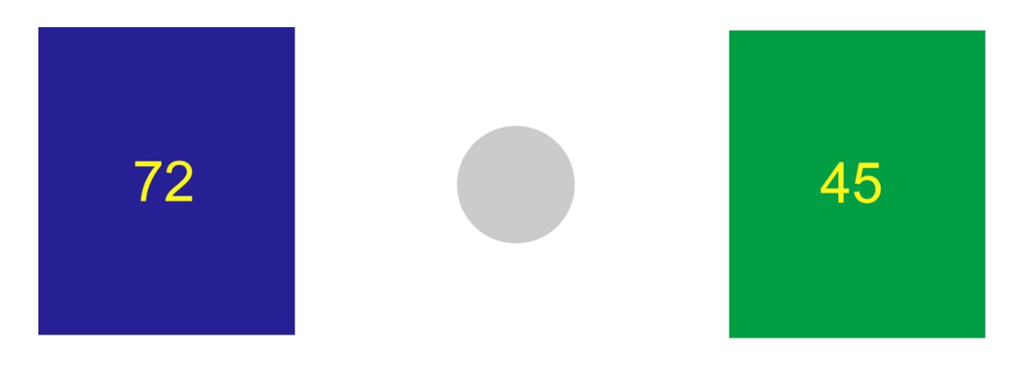
What are the critical manipulations in the task?
Behrens et al., Nature Neuroscience, 2007
What are our hypotheses?
Notes:
Stable vs volatile
Stress manipulation
Fill in with students on board…

Slide 5
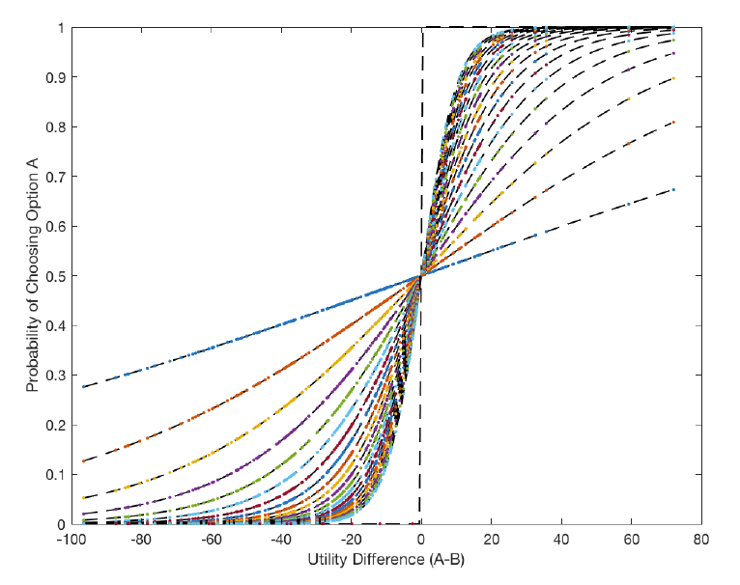
Overview
Data from ~80 participants
or
Simulated Data
Session 1
Reinforcement learner
Free param: 𝛼=learning rate
Prediction error 𝛿 : 𝛿_{t} = 𝑜_{t} − 𝑝_{t}
Probability 𝑝_{t+1} = 𝑝_{t} + 𝛼𝛿_{t}
𝑝Op2= 1-𝑝Op1
Session 2
Combining reward magnitude and probability
e.g. by multiplication
valueOp1 = 𝑝Op1*rewMagOp1
RL learner with two learning rates
𝛼_{S} 𝛼_{V}
Session 2
Feed ‘decision variable’ into softmax to generate probability of choosing Op1:
valueOp1-valueOp2
Free param: Temperature β
TODAY: To fit choices: vary 𝛼 and β to get ‘closest’ to real choice data
Sess 2: To simulate choices: use random numbers to set choice to 1/0 for each trial
Notes:
Talk about what values the different boxes produce. Talk about what values alpha and beta can take…
Say pipeline is the same even if you changed the model slightly
Simulating choices is running through this circle twice/fitting simulated choices again is running through the loop twice…

Slide 6
Why simulating can be useful
Two alphas One alpha
Check that you can recover parameters that you know are ‘true’ because you generated the choices from them.
This may not work if e.g. you have too few trials or if your choices are very noisy

Slide 7
Worksheet: Parts 3.0 and 3.1 (pages 1-4)

Slide 8
Inspecting data quality
What makes a ‘good’ subject, what makes a ‘bad’ subject? Try and express this in terms of the learning rate and softmax parameter…
Notes:
Stable phase: quite consistent in choices and thus slow learning rate (no change when one or two losses) but faster learning rate/adaptation in volatile (a few losses mean transitions have changed, so adapt)

Slide 9
How are we defining accurate trials?
Different ways to illustrate variance in accuracy across participants …
What do you expect for volatile versus stable?
Notes:
At the moment using ‘true underlying probability’; better would be to use subjective but not yet defined (later today)

Slide 10
Looking at RTs…
Do any participants strike you as unusual?

Slide 11
Who are the ‘outliers’ (if any)?
Depends on the criterion… What should we use?

Slide 12
Win-stay / Lose-stay

Slide 13
Next section: model fitting
Data from ~80 participants
or
Simulated Data
Session 1
Reinforcement learner
Free param: 𝛼=learning rate
Prediction error 𝛿 : 𝛿_{t} = 𝑜_{t} − 𝑝_{t}
Probability 𝑝_{t+1} = 𝑝_{t} + 𝛼𝛿_{t}
𝑝Op2= 1-𝑝Op1
Session 2
Combining reward magnitude and probability
e.g. by multiplication
valueOp1 = 𝑝Op1*rewMagOp1
RL learner with two learning rates
𝛼_{S} 𝛼_{V}
Session 2
Feed ‘decision variable’ into softmax to generate probability of choosing Op1:
valueOp1-valueOp2
Free param: Temperature β
TODAY: To fit choices: vary 𝛼 and β to get ‘closest’ to real choice data
Sess 2: To simulate choices: use random numbers to set choice to 1/0 for each trial

Slide 14
Function RLmodel.m
What are functions?
Only know the variables that you ‘pass on’ in brackets
For example, RLModel(alpha) would mean the function RLModel only knows the variable ‘alpha’
Everything that a function needs to know in order to complete its calculations needs to be passed on as function arguments in brackets
Functions can return values/variables, for example error=RLModel(alpha) will return an error variable which is computed within the function RLModel
What does RLmodel.m do?
No need to look at it today but important to understand its general purpose
For a given subject and two parameters alpha (learning rate) and beta (inverse temperature)
Calculate the subjective probabilities using the reinforcement learning algorithm covered in session 1
Convert these predictions into choice probabilities using the utility and softmax as covered in session 2
Calculate the error term, or in other words, how far the predicted choices are from the real choices
The error term is returned by the function. The smaller this error term, the better the fit.

Slide 15
What makes a good fit (intuitively)?
Notes:
Error between green (choice prob) and red (choice) is small…

Slide 16
Worksheet: Part 3.2 (pages 4-beginning of 8)

Slide 17
What makes a good fit (intuitively)?
Notes:
Error between green (choice prob) and red (choice) is small…

Slide 18
Negative log-likelihood
error = sum(log(probChoice))
To minimize error:
error = -1*sum(log(probChoice))
What trials are going to dominate the error term and why would this be good?
Notes:
Model fitting will cover grid search, then say that difficult to do with (a) too many params and inefficient etc; briefly explain gradient descent potentially and say Matlab has a way to look for min without having to measure every single point
This could probably be illustrate by showing a full grid and showing as an intuition that if you were to take the gradient at a point, it takes you down the slope to the minimum; but then there is the danger of being stuck in a local minimum

Slide 19
Grid search
One alpha Two alphas

Slide 20
Grid search for all subjects

Slide 21
Why not always use grid search?
Inefficient/spends too much time calculating the errors in parts of the ‘parameter space’ that are clearly not right/relevant
Becomes intractable with many parameters (i.e. if two parameters give 100 combinations, four parameters give 10,000 etc)
Matlab has a way to look for min without having to measure every single point (fminsearch)
Danger of being stuck in a local minimum (initialize from several points)

Slide 22
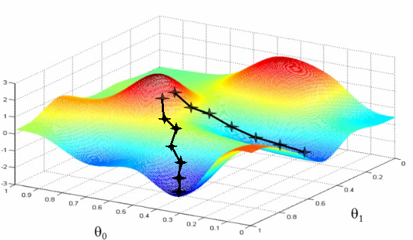
One possible trick: gradient descent
Negative log likelihood (badness of fit)
Parameter one (e.g. alpha)
Parameter two (e.g. inverse T)
Notes:
Gradient descent

Slide 23
Worksheet: Part 3.3 (page 8)

Slide 24
Fitted learning rates
Coarser conclusion from
grid search
No clear effect…
What about the order of blocks?
What about the stress manipulation?

Slide 25
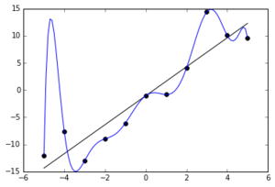
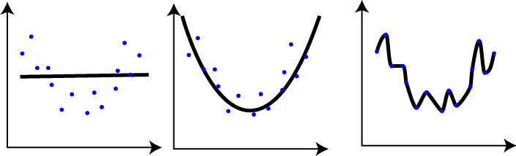
What is model comparison?
What happens when including more parameters in a model?
Is it fair to compare a model with more and a model with less parameters in terms of their errors?
Yes, as long as we ‘correct’ or account for the number of parameters

Slide 26
Akaike Information Criterion
AIC = -2*logLL + 2*numParam
The AIC is one way to correct for the number of parameters
It provides a trade-off between the goodness of fit (small error, large logLL) and the complexity of the model (many parameters, large numParam)
We can now fit two different models, compute their AIC, and the resulting values give us a way to compare which model is more likely to have generated the data
Small values are better than large values!
α₁
α
Softmax
Softmax
α₂
Notes:
Large logLL, small numP → very small (good fit with low complexity)
Large logLL, large numP → small (good fit but large complexity)
Small logLL, small numP → small (bad fit but small complexity)
Small logLL, large numP → large (bad fit despite large complexity)

Slide 27
Worksheet: Part 3.4 (pages 9-10)

Slide 28
AIC difference 2 versus 3-parameter model across participants
What do we conclude from today’s session?
Notes:
Crazy, those who had stable first, definitely better with 3 params (first and third quarter of people); those with volatile first (2nd 4th quarter), not so clear, slight pref for 2-param! Also STRESSED people with stable first, definitely 3 params!!!

Slide 29
That’s all for today! Thank you ☺

