Slide 1
Computational modelling block practical
Drs. Laurence Hunt, Miriam Klein-Flügge, Nils Kolling Jacquie Scholl

Slide 2
Plan for the 4 weeks
Session 1: setting up the task, collecting a dataset, building a learning model (Laurence Hunt)
Session 2: further modelling, regression analysis (Nils Kolling)
Session 3: Friday 24th Nov: data analysis, model fitting & comparison (Miriam Klein-Flugge)
Today: statistics and write-up planning (Jacquie Scholl)

Slide 3
Plan for today
Recap: Model fitting and model comparison
How to do statistical tests in Matlab
Within-subject t-tests to test for effects between blocks
Between-subject t-tests to test for effects of the group manipulation
Correlations between stress level and learning
Writing your report
If we have time: How to quantify evidence for the null hypothesis using JASP (And why Bayesian statistics are awesome)

Slide 4
Recap: Model fitting
Data from 64 participants
Reinforcement learner
Free parameters:
𝛼=learning rate (one or two)
β=inverse temperature
Fit the model to the data
= for each person find ‘their’ parameters
What does this mean?

Slide 5
Recap: Model fitting
Data from 64 participants
Reinforcement learner
Free parameters:
𝛼=learning rate (one or two)
β=inverse temperature
Fit the model to the data
= for each person find ‘their’ parameters
Best fitting parameters = parameters for which the predicted behaviour matches most closely the observed behaviour
How?

Slide 6
Recap: Model fitting
Data from 64 participants
Reinforcement learner
Free parameters:
𝛼=learning rate (one or two)
β=inverse temperature
Fit the model to the data
= for each person find ‘their’ parameters
Best fitting parameters = parameters for which the predicted behaviour matches most closely the observed behaviour
Fminsearch in Matlab

Slide 7
Negative log-likelihood
error for each trial = log(probChoice)
To minimize error:
error = -1*sum(log(probChoice))
Evaluate this error for either all possible parameter value combinations (grid search) or using a ‘trick’ that means you focus on evaluating ‘interesting’ combinations of parameters (=regions in parameter space)

Slide 8
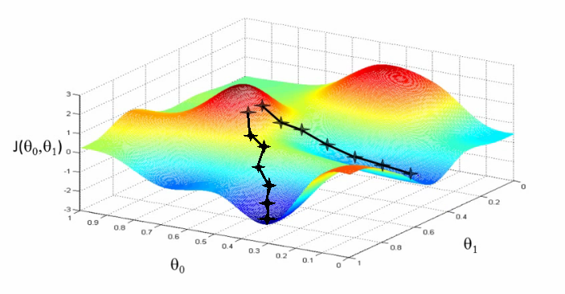
One possible trick: gradient descent
Negative log likelihood (badness of fit)
Parameter one (e.g. alpha)
Parameter two (e.g. inverse T)
Notes:
Gradient descent

Slide 9
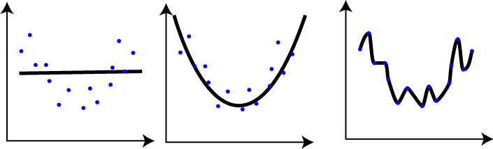
Model comparison
Which is the best model? (How do they differ)?
AIC: takes into account how well predicted and real data align and how many parameters the model uses.
Why do we need to compare models?

Slide 10
Statistical tests in Matlab - #1 T-tests
To test our two main hypotheses:
Is the learning rate higher in the volatile than in the stable condition?
Is this adaptation of the learning rate affected by the stress manipulation?

Slide 11
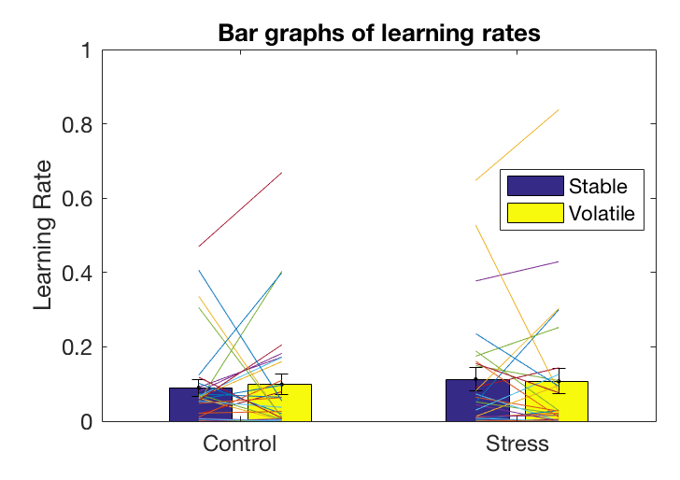
Statistical tests in Matlab - #1 T-tests
Step 1: Illustrate data in Matlab
What should you always do before running a statistical test?

Slide 12
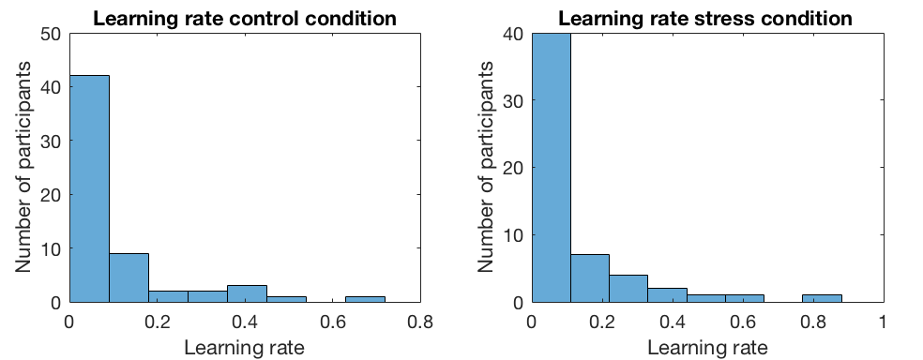
Statistical tests in Matlab - #1 T-tests
Step 2: Check the distribution of your data
Why do we check the distribution? And what do we do now?
Notes:
Other assumptions of t-test:
Continuous data
Independent observations
No significant outliers and normal distribution
For independent samples t-test: homogeneity of variances

Slide 13
Statistical tests in Matlab - #1 T-tests
Step 3: Run the appropriate statistical tests
Functions:
Ttest, ttest2, signrank

Slide 14
Statistical tests in Matlab - #1 T-tests
Step 4: Compute the effect size
Function: mes – extra toolbox that is included in the scripts folder for today
Q: Why should you compute the effect size? (Aren’t p-values enough?)

Slide 15
Statistical tests in Matlab - #1 T-tests
Go through the handout until page 6 (i.e. up to including A.4)

Slide 16
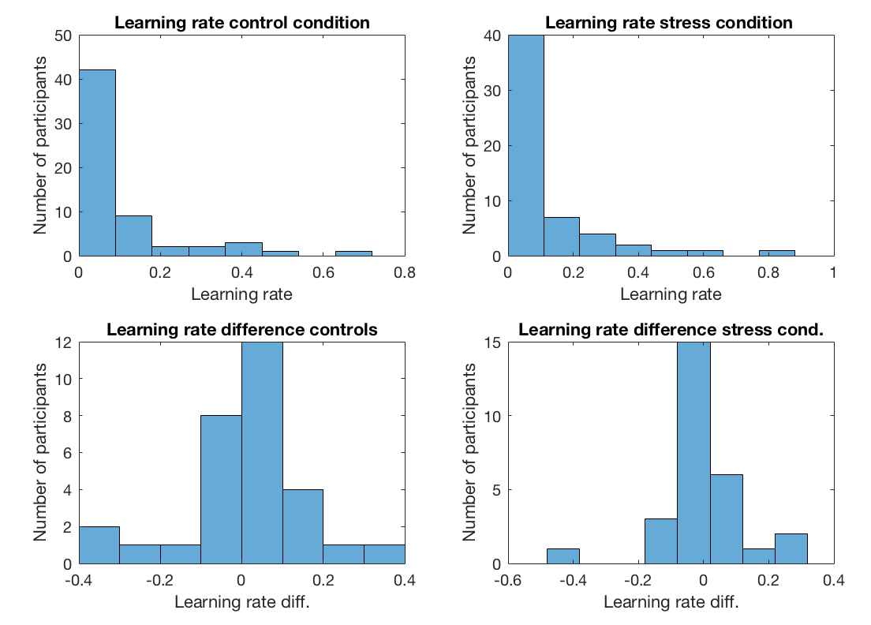
Did using a transformation of the learning rates help? What did you do then?
Is the same problem there for the difference in learning rates?

Slide 17
Statistical tests in Matlab – The stress manipulation
Reminder:
8 ratings of ‘how stressed do you feel?’
8 ratings of ‘how happy do you feel?’
Why did we ask participants to rate this?
Which measurement should we use?
Could there be a way to combine them?

Slide 18
Statistical tests in Matlab – The stress manipulation
In the handout, skip the optional section on using Bayesian statistics to quantify evidence for the null hypothesis.
Jump directly to section B) and complete the exercises until you get to section C). Here you will learn how to do between-subject t-tests in Matlab.

Slide 19
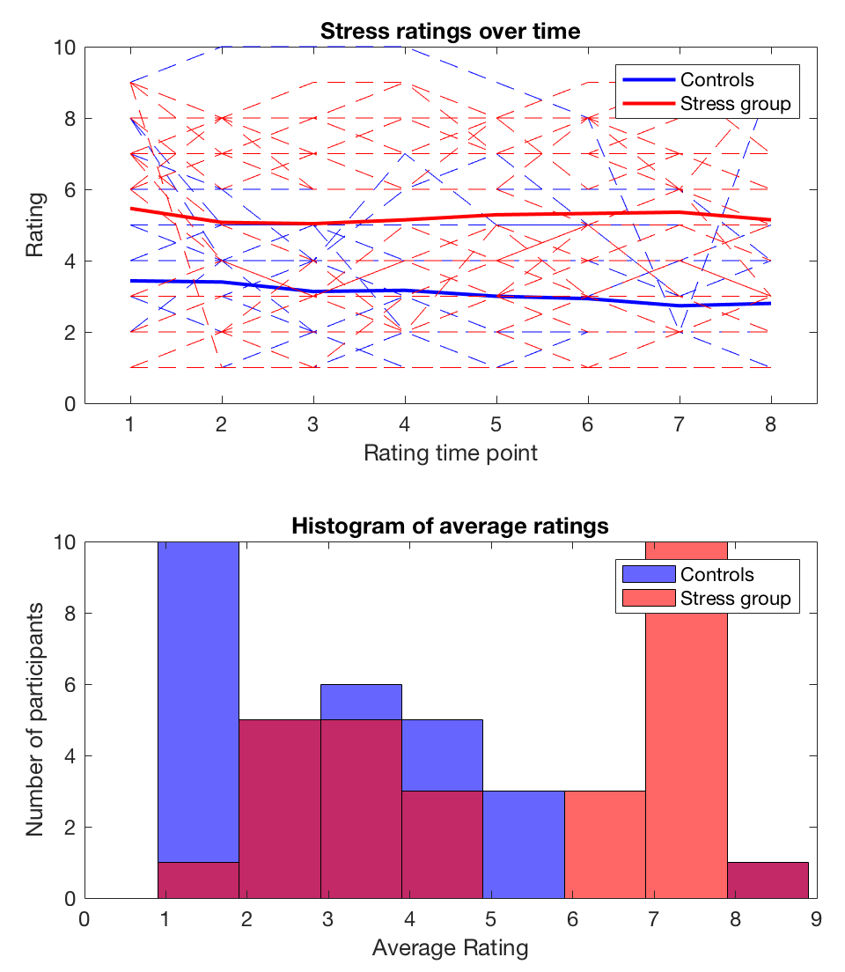

Slide 20
Statistical tests in Matlab – Correlations between reported stress and adaptation of learning rates
First: visualize data to check for:
Outliers
Shape of the relationship
Second: run appropriate parametric or non-parametric correlation
Third: check whether omitting the outlier affects the relationship

Slide 21
Statistical tests in Matlab – Correlations between reported stress and adaptation of learning rates
Handout: do the exercises in section C)

Slide 22
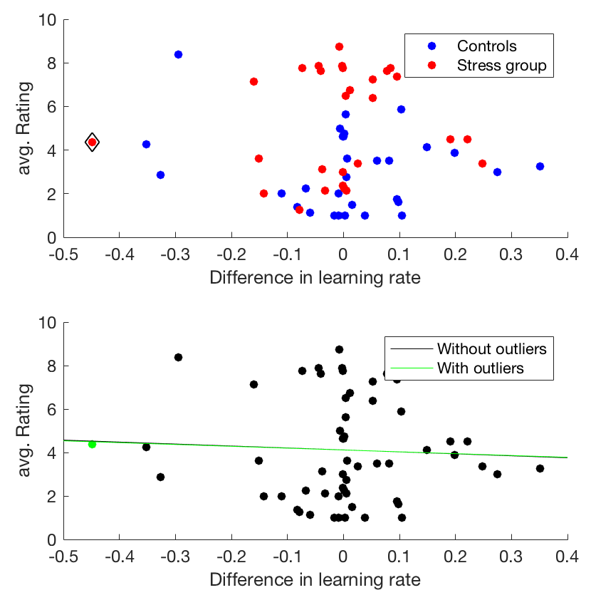
Statistical tests in Matlab – Correlations between reported stress and adaptation of learning rates
What do you note from the top graph?
Bottom graph: does omitting outliers change the correlation line?

Slide 23
Writing your report
Report format is a ‘mini-project’ for BPS accreditation
Focus: clearly explain what methods you used to test your hypotheses, why you chose these methods, how you made sure they were appropriate, what you find and what limitations there are
Turn to your neighbour and discuss:
What were the main experimental hypotheses?
Did we find evidence for them?
Did anything surprising happen?

Slide 24
Abstract
Very short (~120 words)
No more than two sentences summarising each section (hypothesis, methods, results, implications)

Slide 25
Introduction
Keep this very short (200-400 words)
Explain what each experimental question is
Why you have asked these experimental questions based on past literature
(See handout for literature recommendations)

Slide 26
Methods
This is a key section
Summaries the task design (you can copy this from session 2 and 3)
Do not just list what you did, but explain
Why the method (e.g. computational model) that you have chosen is appropriate
How exactly the model works
How you have validated the approach
How you have chose your statistical test and ensured that assumptions are met

Slide 27
Results
This should follow the same structure that you have introduced in the methods section
For each result, briefly recap what the aim of the analysis is.
You should be able to make most figures that you need using the script from today’s session. But don’t forget to add labels etc.
Report statistical tests including sample sizes. Optional: Bayesian statistics

Slide 28
Discussion
Start with a short summary of your findings
Were the results as expected (based on previous literature)?
Is there anything about either our data or about our analyses that could explain the differences? (i.e. what are the limitations of our study)
Future analyses: if you had had more time, what analyses would you have liked to do and why?

Slide 29
Feedback
https://oxfordxpsy.az1.qualtrics.com/jfe/form/SV_a05eVps542UI1y5

Slide 30

Bayesian Statistics with JASP
Many advantages of the Bayesian framework:
See Eric-Jan Wagenmakers (2007); or for an easy read: Regina Nuzzo (2014, ‘Scientific method: Statistical errors’)
Example: Which study provides more evidence against the null hypothesis?
p=0.05 with 20 participants
P=0.05 with 1000 participants

Slide 31
Bayesian Statistics with JASP
Main appeal for our data:
Bayesian statistics allow you to quantify how strong the evidence for the null hypothesis is
Bayes Factor: ‘How much more likely is my hypothesis to be true than the null hypothesis given my data’ (or vice versa to express evidence for the null hypothesis)
(vs p-value: ‘If the null hypothesis were true, I would only be x% likely to observe data at least as extreme as the data I have’). No way to quantify evidence for the null hypothesis

Slide 32
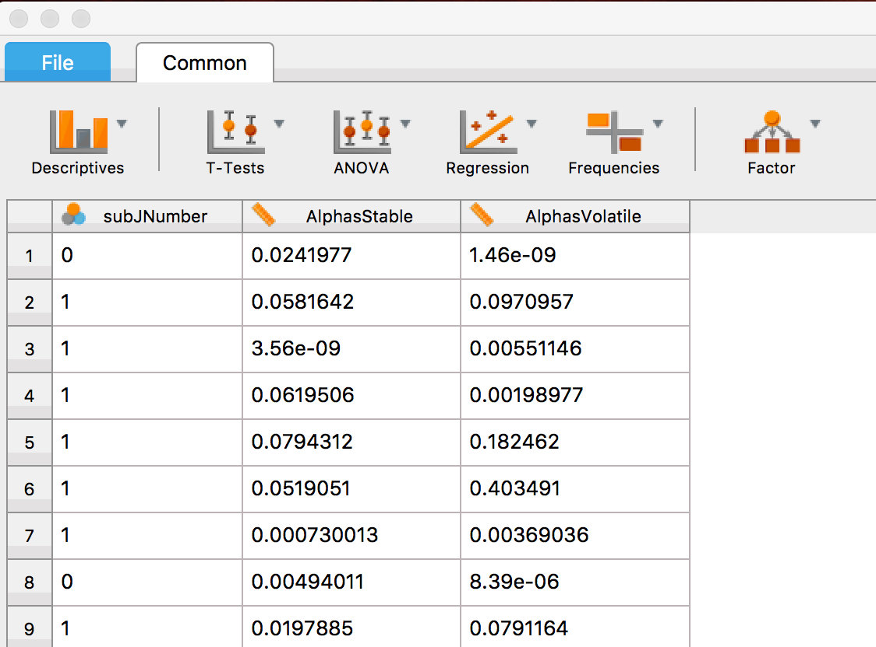

Slide 33
