Slide 1
AIR
WRITING
Transformer Neural Network on Sequential Pen Stroke Data | Deep Learning, Spring 2025
NOMITHA SUGAVASI
RAAGA PRAVIJA GADDAM
TYUSHA SARAWAGI
UNIVERSITY OF MARYLAND

Slide 2
Introduction
A real-time air-writing recognition system , trace a character with your fingertip, get an instant prediction.
Classifies 97 character classes (letters, digits, symbols) from raw (x, y) finger stroke coordinates.
Uses a Transformer neural network, it reats each coordinate point like a token in a sequence , like words in a sentence.
Runs end-to-end in ~50ms with a live webcam demo pipeline built using MediaPipe and OpenCV.
Three targeted improvements: confidence thresholding, LoRA writer adaptation, and trajectory forecasting.

Slide 3
Project Overview
Transformer classifier maps raw stroke sequences to character labels no image conversion, no temporal information lost.
Real-time webcam pipeline captures, smooths, and normalises finger strokes before feeding them to the model.
LoRA writer adaptation personalised the model to a new user using just 5 samples per class, training only 0.27% of parameters.
Confidence thresholding rejects uncertain predictions, raising usable accuracy from 71.7% to 81.4% at 76% coverage.

Slide 4
Problem Statement
Prior systems (Lin, UCSC; Baraiya et al.) convert strokes to images, permanently discarding the temporal drawing order.
Existing work handles only 10–36 classes ,no prior system covers the full 97-class vocabulary of letters, digits, and symbols
No prior air-writing system personalises to individual users, accuracy drops significantly for unseen writers.
LSTM-based systems process sequences step-by-step vanishing gradients cause failure on longer, more complex strokes.
Prior systems always output a prediction ,no mechanism exists to detect or reject ambiguous and uncertain gestures.

Slide 5
Proposed Solution
Our Approach
Why not CNN or LSTM?
Treat each (x, y) point as a token, projected into a 256-dim embedding space.
Prepend a BERT-style [CLS] token, its final state classifies the full stroke.
Self-attention: every stroke point attends to every other point simultaneously.
Three improvements extend the baseline beyond simple classification.
CNN
Needs a rendered image, converting a stroke to an image discards the temporal drawing order permanently.
LSTM
Processes points one-by-one, vanishing gradients degrade quality over longer stroke sequences.
Transformer
Sees the entire stroke at once. No length limit. Preserves full temporal structure via self-attention.

Slide 6
Tools and
Technologies Used
PyTorch - model implementation, training loop, and inference
MediaPipe Hand Landmarker - real-time fingertip coordinate extraction from webcam
OpenCV - webcam capture and live on-screen prediction display
scikit-learn - label encoding, stratified 70 / 15 / 15 data splitting, F1 scoring
Matplotlib / Seaborn - training curves and 97×97 confusion matrix visualisation
Google Colab T4 GPU - model training environment
UJI Pen Characters v2 (UCI ML Repository) - 11,640 samples · 97 classes · 60 writers · UNIPEN format

Slide 7
Architecture
1
INPUT
Variable-length (x, y) coordinate sequence · shape: (Batch, Time, 2)
2
EMBED
Linear projection → 256-dim space + learnable [CLS] token prepended to sequence
3
POSITION
Learnable positional encodings added to each token
4
ENCODE
6× Transformer encoder layers · 8 attention heads · ff_dim = 1,024 · dropout 0.15
5
CLASSIFY
[CLS] output → LayerNorm → Linear (256 → 97 classes) → predicted character
5,021,281 trainable parameters · AdamW · cosine annealing · 40 epochs · label smoothing 0.1 · gradient clipping 1.0

Slide 8

Live Demo

Slide 9
Novelty & Comparison
How our approach differs from conventional methods:
Approach | Input | Temporal Order | Long Sequences | Personalisation
CNN Classifier | Rendered image | Lost when rasterised | Fixed size only | No
LSTM on Coords | Raw (x, y) | Partial (fades over time) | Vanishing gradients | No
Our Transformer | Raw (x, y) | Fully preserved | No constraint | LoRA (+4.1pp)
Our key contributions:
Raw coordinate input - temporal drawing order is preserved exactly as drawn, unlike image-based methods that discard it.
LoRA writer adaptation - personalises accuracy per user with only 5 samples per class and 0.27% of parameters trained.

Slide 10
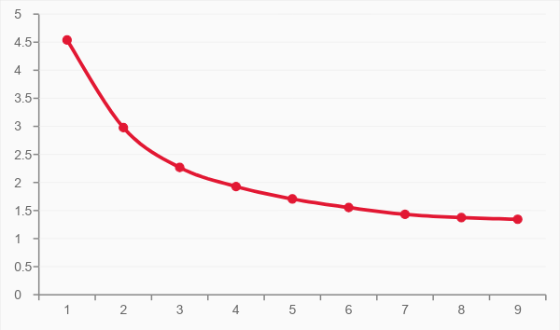
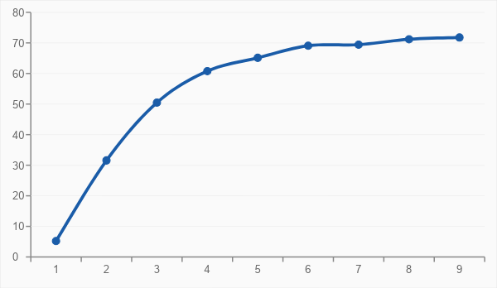
Evaluation
Google Colab T4 GPU · Stratified 70/15/15 split · Test set held out until final evaluation
Training Loss
Validation Accuracy (%)

Slide 11
Results
71.7%
95.4%
0.713
Top-1 Accuracy
Top-5 Accuracy
Macro F1 Score
Confidence Threshold Analysis
LoRA Writer Personalisation
Threshold | Accuracy | Coverage
τ = 0.10 | 71.8% | 100.0%
τ = 0.30 | 73.3% | 96.2%
τ = 0.50 | 81.4% | 76.2%
τ = 0.70 | 90.7% | 51.6%
τ = 0.90 | 97.8% | 28.4%
Metric | Result
Accuracy before LoRA | 71.9%
Accuracy after LoRA | 76.1%
Parameters trained | 13,700
Samples needed per class | 5 labelled samples
Forecasting val MSE | 0.054 after 20 epochs

Slide 12
Limitations
71.7% Top-1 accuracy is insufficient for accuracy-critical real-world deployment.
Trained on pen tablet data- a domain gap exists with actual free-air finger motion captured on webcam.
Only isolated character recognition - continuous or word-level input is not supported.
High visual similarity between character pairs (O/0, l/I/1) causes systematic misclassification.
Fingertip tracking degrades under poor lighting conditions or rapid hand movement.
LoRA personalisation requires at least 5 labelled samples per class from each user.

Slide 13
Future Scope
Collect and train on real free-air webcam data to close the pen tablet domain gap.
Extend from isolated characters to full word recognition using a language model decoder.
Automate LoRA adaptation, update writer-specific weights continuously during normal use.
Deploy on AR/VR devices as a natural, surface-free text input method.
Apply the same Transformer to full hand pose trajectories for sign language recognition.
Integrate depth cameras or IMU sensors for richer 3D motion signals beyond 2D projection.

Slide 14
Thank You.
UNIVERSITY OF MARYLAND · DEEP LEARNING · SPRING 2025

