Slide 1

Defect / E-Test Correlation Analysis System
POC Completion Report
'26.10.29
Notes:
Good afternoon. I am Byungju Jung from Miracom.
I will now present the completion report for the STATS ChipPAC Defect / E-Test Correlation Analysis System POC.

Slide 2
POC Overview
Key POC Functions and Results
Post-POC Operation Plan
Notes:
I will cover the POC overview, key POC functions and results, and the post-POC operation plan, in that order.

Slide 3
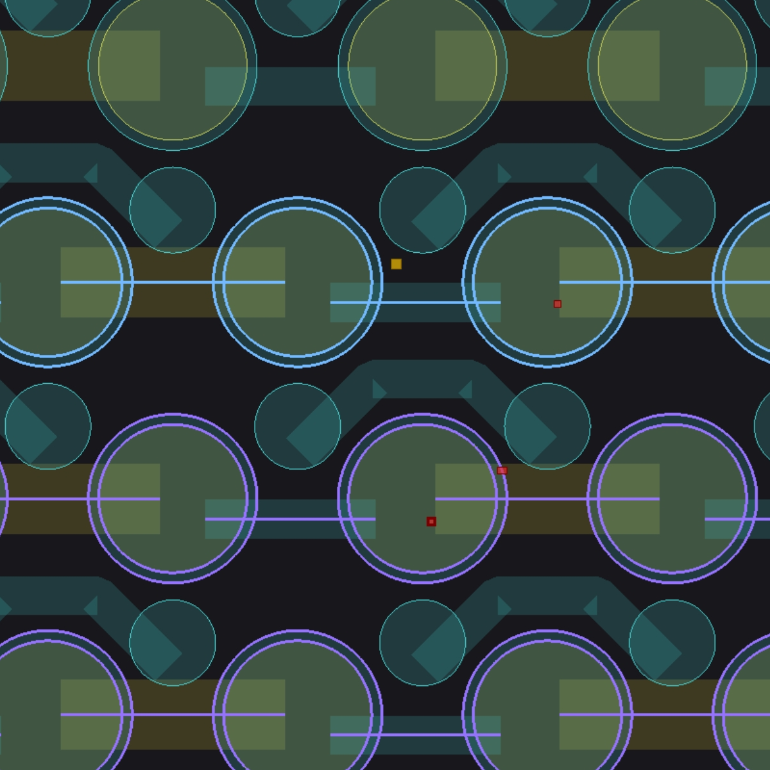
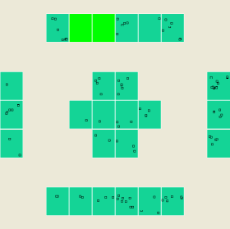
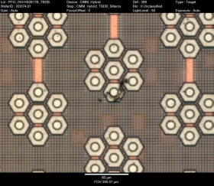
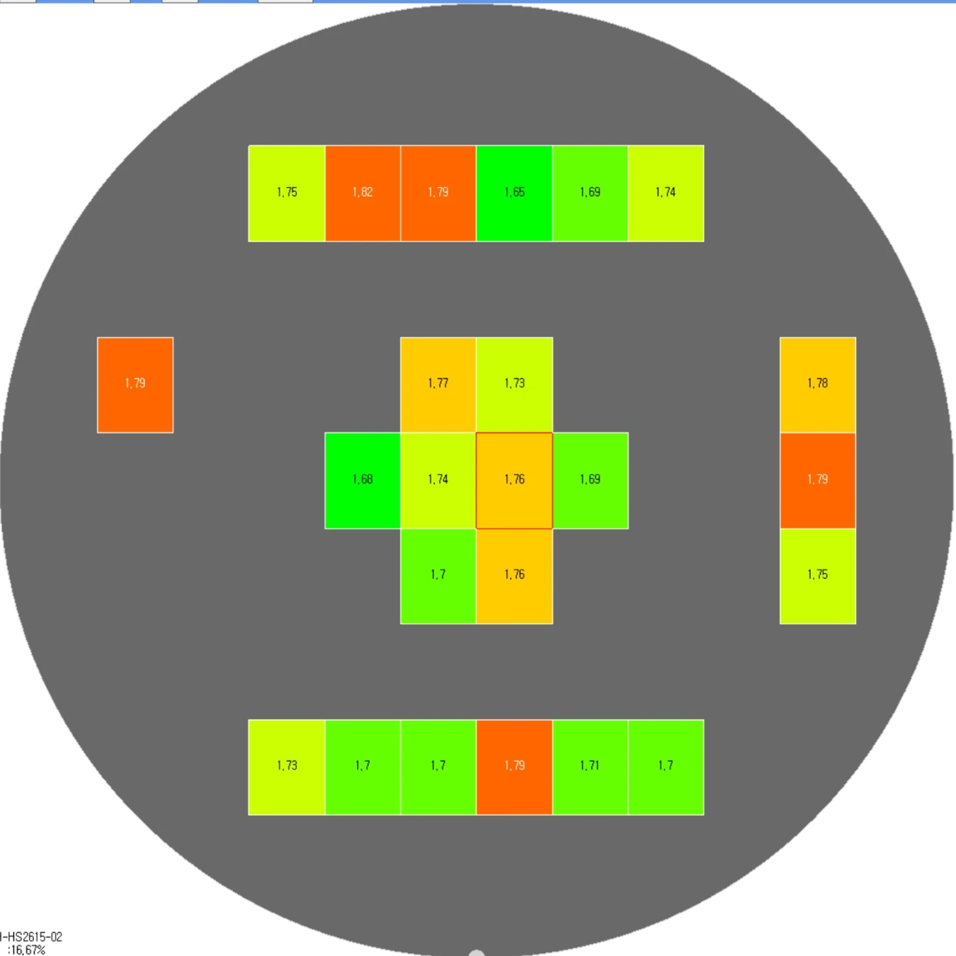
POC Background and Objectives
I. POC Overview
Correlating layout (GDS) <-> visual defects (KLARF) <-> electrical test (E-Test)
Packaging Process Flow
Correlation Analysis across Data
Package Process
GDS (wiring)
AOI Defect (KLARF map, images)
E-Test (values)
+
+
AOI Inspection
KLARF File
Defect coordinates, images
Electrical Test (TEST)
E-Test File
Measurements by chain
Overlay and compare the three data sets by die and chain
The system shows whether an electrical fail is caused by a visual defect
Current State
The three data sets are separate, so it is hard to quickly confirm whether an E-Test fail is caused by a visual defect
POC Objective
Link layout, visual defect and electrical test data on one screen to provide evidence for root-cause judgment
POC Scope
Period '26.10.01 ~ 10.30 / Target devices U9, U8 / Manual file upload / Correlation analysis of the three data sets
Notes:
This slide covers the POC background and objectives.
As shown on the left, AOI inspection and E-Test are performed after the packaging process.
The goal of this POC is for the system to provide evidence, based on the defect data from each step, of whether visual defects affect electrical fails.
As shown under Current State, the three data sets are separate today and engineers have to check them manually one by one, which is difficult. This POC links the data on one screen so the system provides the evidence for each defect.
This POC was carried out and verified on the U9 and U8 devices.

Slide 4
System Configuration and Scope of Work
I. POC Overview
All POC screens in the initial proposal have been delivered
Development reused existing YMS and DMS screens as much as possible
Area | Initially Proposed Functions | Delivered Screens | Type
Setup | Map Setup | Wafer Map Setup (based on KLARF file) | New + Existing
 | Bin Setup, Program Parameter Setup | Bin Define / E-Test Para Register, Para Setup | New + Existing
 | Defect Setup, Defect Type Setup | Defect Type Define | Existing
Correlation | GDS Data Registration, Chain Name / Data Setup | GDS Map Setup / GDS Map View, GDS Map View U8 | New
 | Defect / Test Correlation View | GDS-KLARF-ET Correlation / Die Detail Analysis | New
DMS | Defect Data Manual Input, Map / Image Gallery, Chart Analysis | KLARF File Upload / Map, Image Gallery, Chart Analysis | New + Existing
YMS | E-Test Data Manual Input | E-Test Result Upload, E-Test Limit Setup | New
 | 11 reports incl. Bin Map, Wafer Cumulative, Bin Stack, Yield, Test Map, Parameter Report | TEST Map View, Bin Map Gallery, Wafer Cum / Bin Report, Yield Report, Param Analysis, etc. | Existing
Miracom
SCK R&D Center
SCK IT Team
  PM, design, development, testing
  Handover, training, final report
  Requirements, sample data
  Result verification
  Server and DB
  System architecture support
Notes:
All 25 POC functions in our initial proposal have been implemented as screens.
Existing solution functions were used as they are, and new development focused on GDS, chains, correlation analysis and file upload.
Below is the division of roles. Miracom handled design, development, verification and handover.
The R&D Center provided requirements and sample data and verified the results, and the IT Team supported the server and DB.

Slide 5
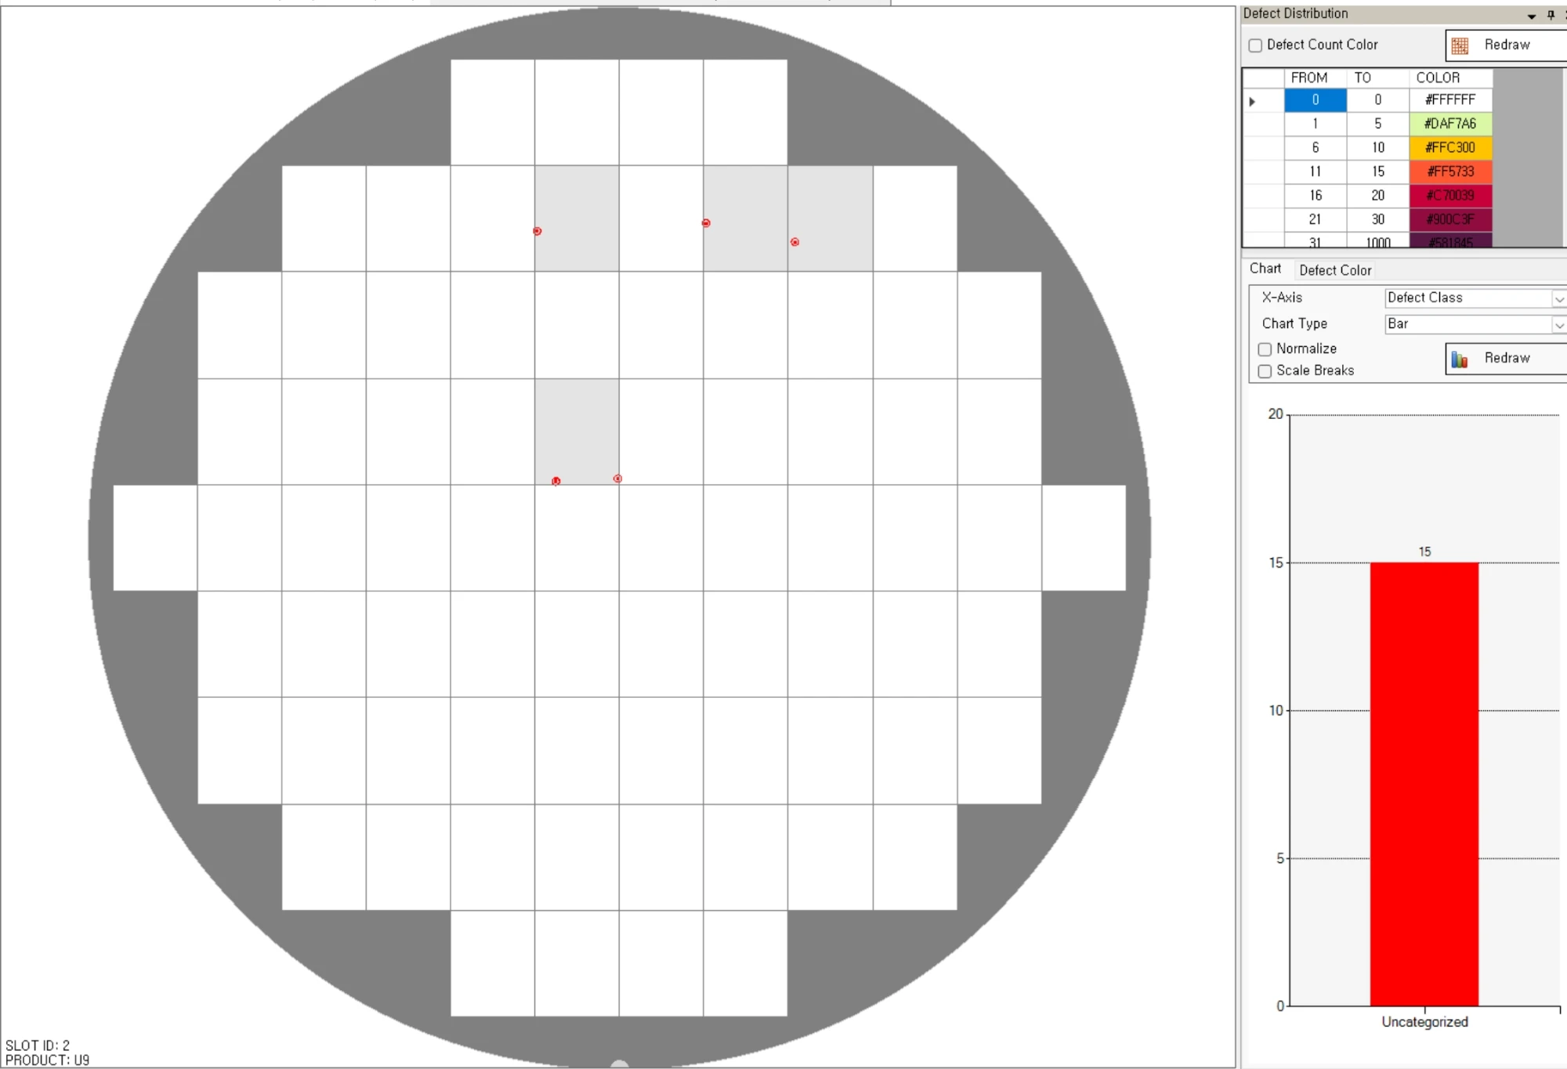
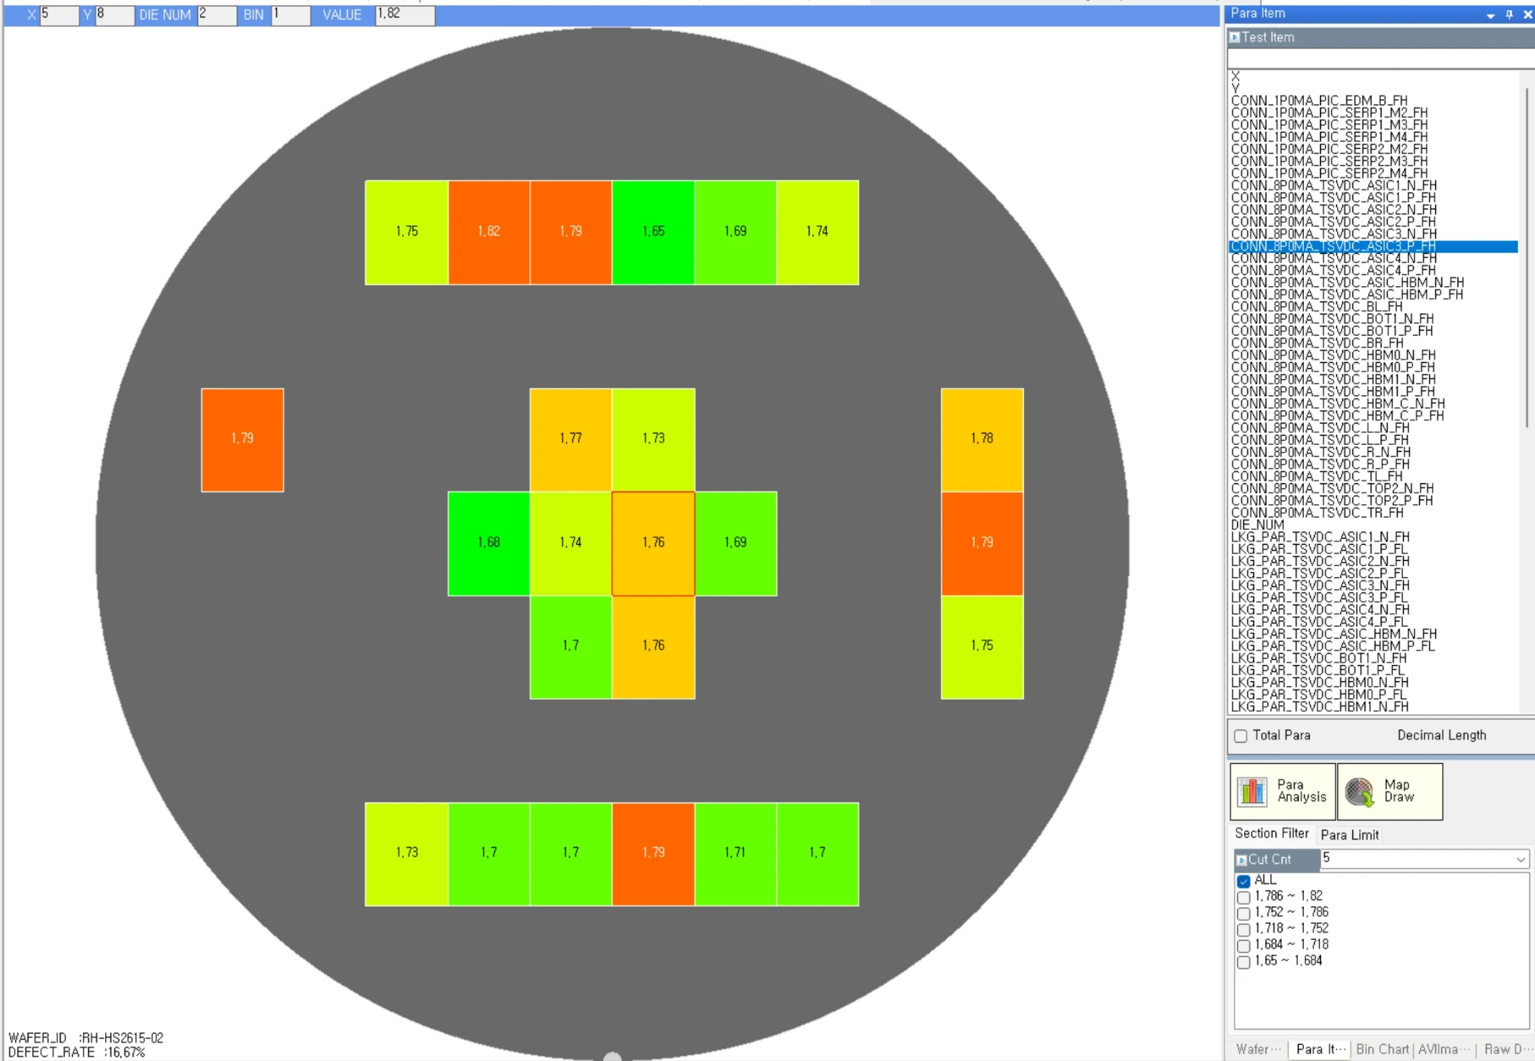
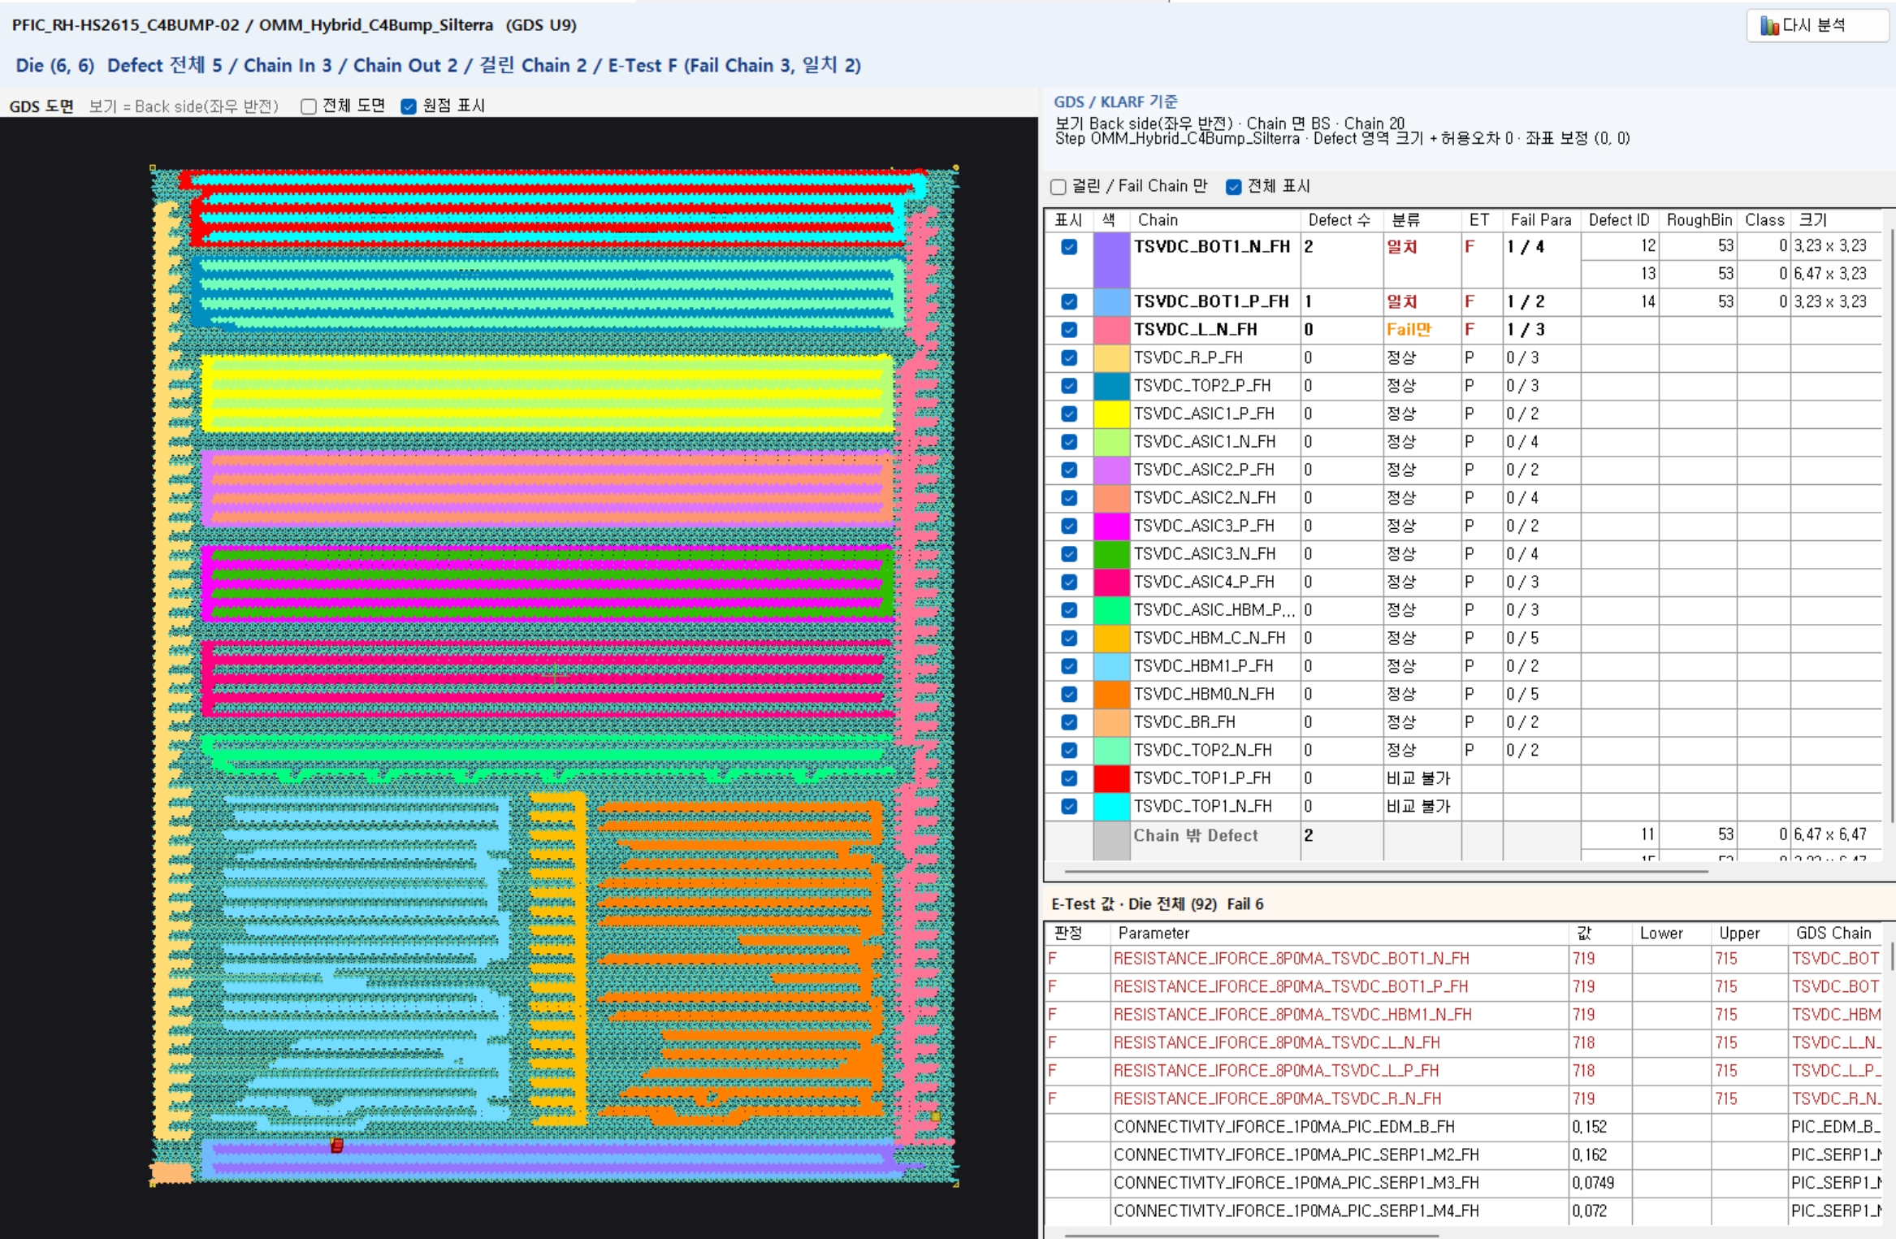
Key Functions - Miracom Solution + New Development
II. Key POC Functions and Results
Reused DMS and YMS functions; only GDS and Chain were newly developed
to link the three data sets in the POC
DMS
KLARF Defect Analysis
YMS
E-Test Measurement Analysis
POC New Development
GDS, Chain + Correlation Analysis
  E-Test measurements on wafer maps
  Maps by parameter, bin info, range filters
  Spec judgment and yield analysis screens
  Register GDS layouts, define chain areas
  Link DMS and YMS data to chains
  Defects on chains by die, image analysis
  View KLARF defect wafer maps
  Defect distribution by die, charts by class
  View defect images
Miracom Solution (existing functions)
New
Work Done
  Combined DMS (KLARF) and YMS (E-Test) data by GDS chain for Defect / E-Test correlation
  Reusing solution functions let new work focus on GDS, chain and correlation
Notes:
This POC was not built from scratch; it used Miracom's existing solutions.
On the left, DMS is the existing function for analyzing visual defect data, and in the middle, YMS analyzes electrical test data.
Only GDS and Chain on the right were newly developed to link the three data sets.

Slide 6
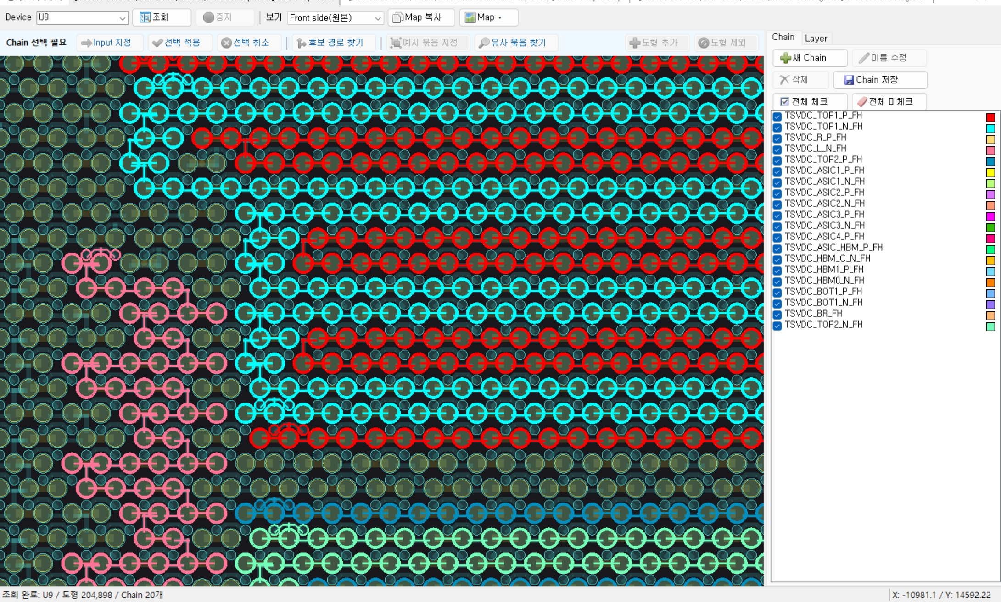
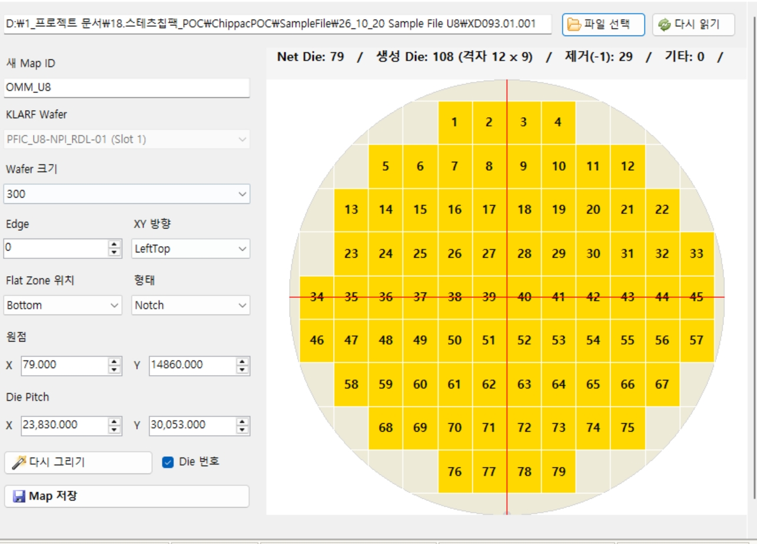
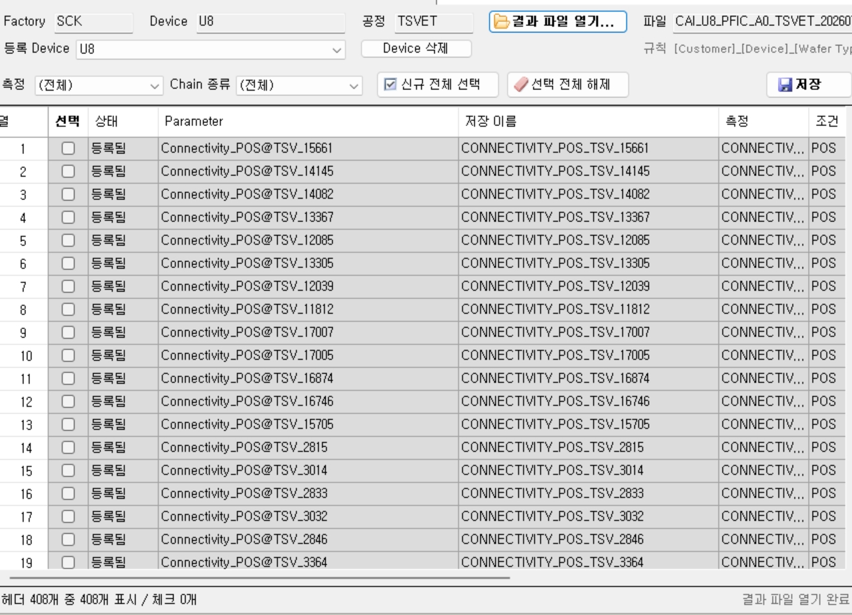
Key Functions - Auto Chain and File-based Setup
II. Key POC Functions and Results
GDS chains are auto-created from one start shape; wafer maps and parameters are registered from files for simple setup
Automatic GDS Chain Creation
File-based Wafer Map and Parameter Setup
GDS Map View: automatically created U9 chains, color-coded
Wafer Map Setup (KLARF file)
E-Test Para Register (result file)
  Select one input shape: connected wiring is traced into a chain (by actual overlap)
  Auto chain naming: label near the input matched to the E-Test chain name
  Auto coloring, bulk exclusion of similar groups to minimize manual editing
  Select a KLARF file: wafer map is created automatically (only check the origin)
  Open an E-Test result file: headers are split into measurement, condition and chain
  Select all new, then save to register parameters in bulk
Benefits
  New devices: setup with a file and a few clicks, registered directly by the R&D Center
  No manual entry of thousands of parameters and shapes: fewer errors, less time
Notes:
Next is ease of setup.
On the left, for GDS chains, you only pick one start shape; the system automatically traces the connected wiring to create the chain and names it from the nearby label.
For U9, 19 chains were registered this way.
On the right, wafer maps and E-Test parameters are registered directly from files. A wafer map is created from a KLARF file, and 2,755 E-Test result file headers were registered as parameters at once.
So when a new device comes in, the R&D Center can set up the master data directly.

Slide 7
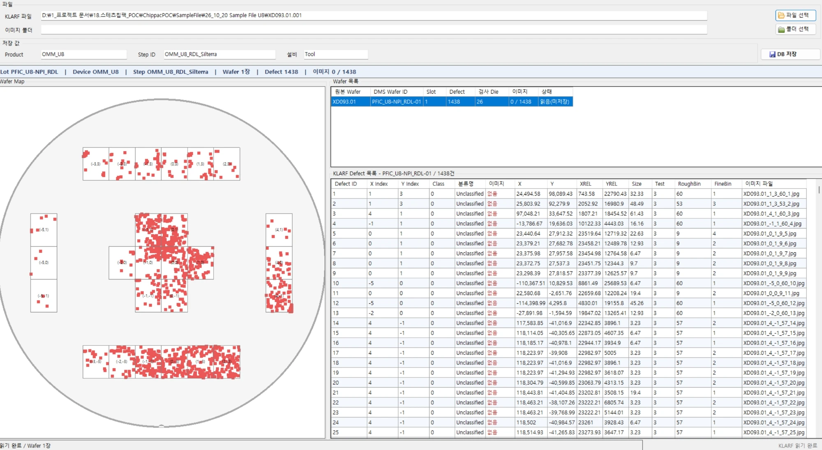
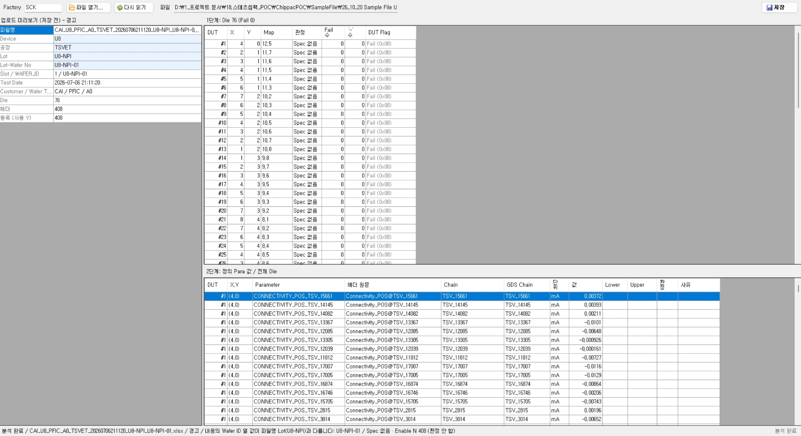
Key Functions - File-based Manual Upload
II. Key POC Functions and Results
Without MES or QMS integration, KLARF and E-Test files are uploaded manually, and master data and correlation mapping are created from the information inside the files
KLARF File Upload (DMS)
E-Test Result Upload (YMS)
  Select a KLARF file and defect image folder to save to DB
  Extract lot, device, step, wafer and defect info
  Map die index and XREL / YREL coordinates to wafer map and GDS positions
  Upload E-Test result files (xlsx) with preview before saving
  Extract device, process, lot, wafer and parameters
  Map parameter name -> GDS chain, die X / Y -> map position
Manual File Upload
Extract File Info
Create Master Data
(Device, Lot, Wafer)
Correlation Mapping
(Die XY, chain)
※ MES master data, QMS integration and automatic file collection are main project scope (the POC used only data inside the files)
Notes:
Data is not integrated with the MES or QMS used at ChipPAC; KLARF files and E-Test result files are uploaded directly.
Master data is created from the lot, wafer and device information in the files, and the data is linked by die coordinates and chain names.
Automatic collection and MES integration are in scope for the main project.

Slide 8
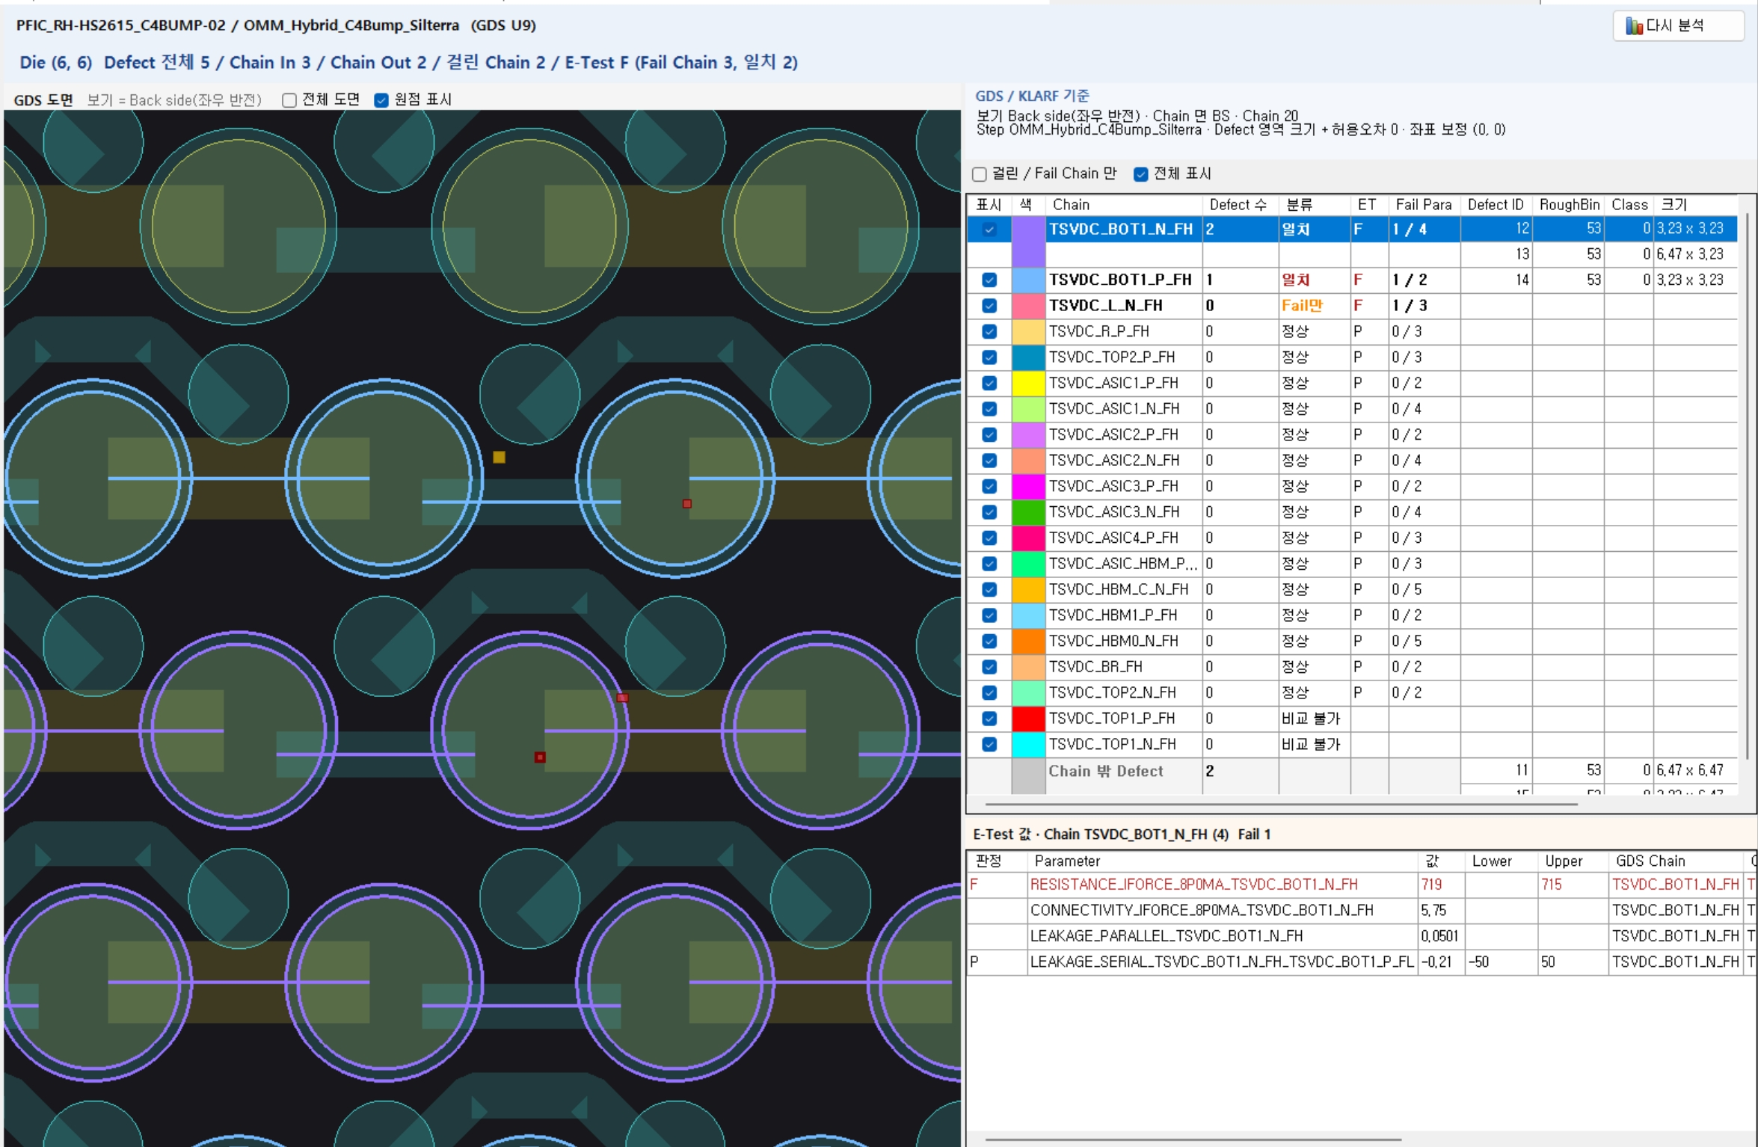
Key Functions - Die Detail Correlation Analysis
II. Key POC Functions and Results
GDS, KLARF and E-Test data overlaid on one map for location and E-Test correlation
Final POC analysis result screen
1
1
Die Analysis Summary
2
  Die defects in / out of chains
  Fail chains, correlation matches
3
2
GDS + KLARF Map
  KLARF defects on the GDS layout
  Defects on chains (Bump, RDL)
3
Location Analysis by Chain
  Defects in / out of chain areas
  With E-Test result and correlation
4
4
E-Test Correlation
  Parameter values, specs of chain
  Spec-out items flagged as evidence
Customer Requirements Addressed
  Location match: check on the layout whether a KLARF defect lies on a GDS chain
  Exact location: list of defect ID, coordinates and size by chain
  E-Test correlation: fail chains shown with overlapping defects (engineers judge)
Notes:
This is the final result screen of this POC.
Number 1 is a summary of the defects and fail chains of the selected die, and number 2 is a map that overlays visual defect positions on the layout.
In number 3, you check by chain whether each defect is inside or outside the wiring.
In number 4, you see the electrical test values and specs of that chain together.
The key point is that defect positions and electrical fails are compared on one screen to give engineers the evidence for their judgment.

Slide 9
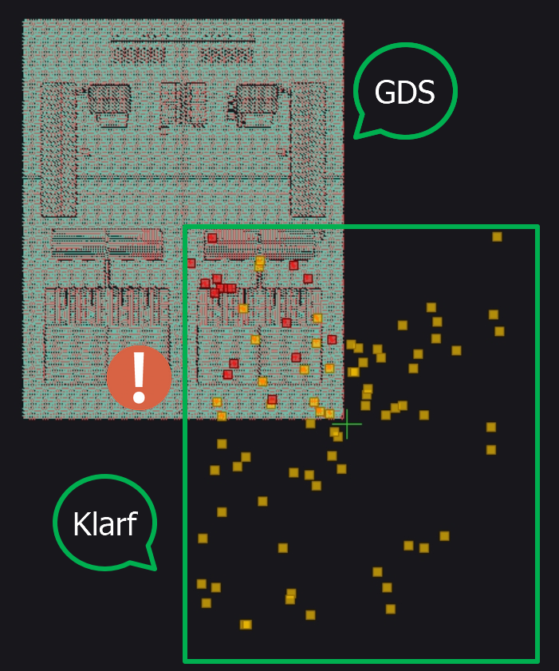
POC Results and Implications
II. Key POC Functions and Results
Layout-based defect correlation analysis was confirmed feasible; for real use, data standards such as wafer names and coordinate origins must be fixed first
Confirmed Feasibility
Remaining Issues
  Correlation analysis by linking layout, defect and electrical test data on one screen
  Chain creation rules improve ease of use
  GDS chains and E-Test chains linked by mapping naming rules
  Expandable to other products (devices)
  Fix data standards such as wafer names and coordinate origins (U8 and U9 use different origins)
  Define master data rules for result data (E-Test file, chain naming rule, wafer ID and lot ID inside KLARF files, etc.)
Functions for the Main Project
1
Auto Collection, MES Link
2
Defect Spec, Equip. Monitoring
3
BS / FS Master Data
4
New GDS Formats
Auto-collect KLARF / E-Test files and link MES master data (no manual upload), add STDF (E-Test)
Manage AOI defect and electrical fail specs; hold lot or equipment and auto-mail when exceeded
Manage back / front side master data by revision and operation
Extend auto chain creation rules to new GDS formats (U8, U9 done)
Notes:
In conclusion, we confirmed that layout-based defect correlation analysis is feasible.
The three data sets are linked on one screen, and because chains are created automatically and linked by naming rules, this can be extended to other devices.
Two issues remain. Data standards such as wafer names and coordinate origins, and the naming rules for files and chains, need to be fixed together with the R&D Center.
Below are the functions to pursue in the main project.
Automatic file collection and MES integration will remove manual upload, and managing defect specs will prevent quality incidents by holding equipment or sending mail when limits are exceeded.
We will also build BS / FS master data by revision and operation method, and extend automatic chain creation to new GDS formats.

Slide 10
Post-POC Operation Plan
III. Post-POC Operation Plan
After Miracom leaves the site, the R&D Center uses the POC system directly until '27.1.31
View only after '27.1.31
System Use
Operating Roles
Handover Materials
  POC license: data entry and edit until '27.1.31
  View-only after that (data is kept)
  Results inform the main project decision (about 3 months, as noted at kickoff)
  No device limit (5 at kickoff, later removed)
  R&D Center: upload, setup, analysis (key users)
  IT Team: check / restart 3 services (auto-start)
  IT Team: deploy new versions (after backup)
  Miracom: bug-fix updates, inquiries
  IT Maintenance Guide: servers, services, updates
  User Manual v1.0: screens, troubleshooting
Notes on Use
  New device: set GDS / wafer map before upload
  U8 and U9 origins differ; check per product
  Oracle timeout error
Next Schedule
10.26~10.28
Customer Verification
10.29
Final Report
End of Oct.
Site Exit
~'27.1.31
POC Use
'27.2~
Main Project Decision
Notes:
Even after Miracom leaves the site, the R&D Center can use the POC system directly until January 31 next year.
After that, the system is view-only, and registered data is kept.
For operation, the R&D Center handles upload and analysis, and the IT Team handles service management and updates.
If a problem occurs, Miracom will provide update files.
As handover materials, we provide the IT Maintenance Guide and the User Manual. For a new device, please set up the GDS map and wafer map first.
Please review the usage results to decide on expanding to the main project.

Slide 11
Notes:
This concludes the POC completion report. Thank you.
Please let me know if you have any questions.

