Slide 1
SCK E-Test POC
User Manual
2026.10

Slide 2
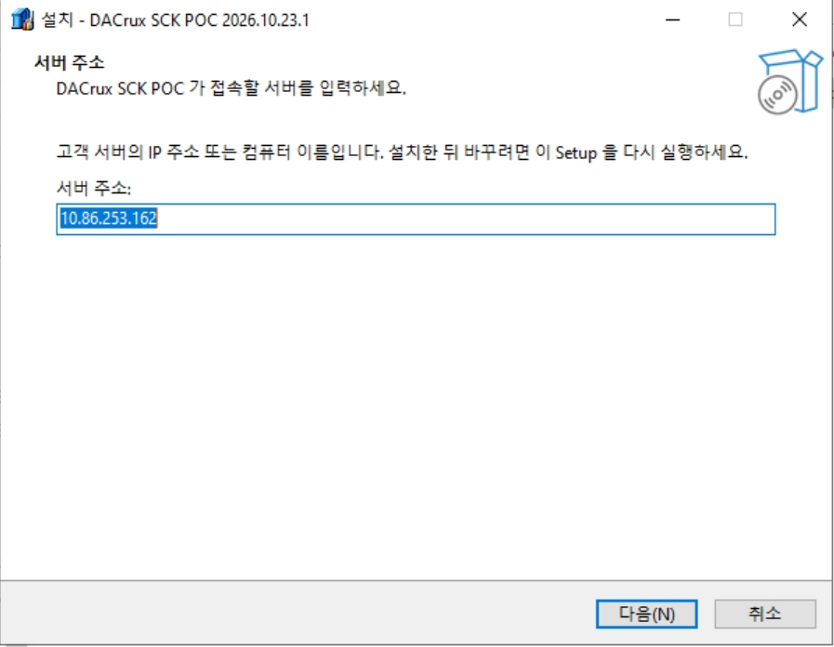
Installation Info
FTP Access
ftp://10.86.253.162/SetupFile/
POC / POC
Installation Server Address
10.86.253.162
Login Info
ADMIN / 1111

Slide 3
Screen Layout
Menu | Screen | Role
POC Setup | GDS Map Setup | Registers a GDS file in the DB as a device map
 | Wafer Map Setup | Creates and saves a round wafer map from a KLARF file
 | E-Test Para Register | Registers E-Test result file headers as parameters
 | E-Test Para Setup | Sets GDS chain, spec and use for registered parameters
 | E-Test Bin Setup | Sets E-Test bins
 | Defect Type Define | Sets defect classes
POC Data Upload | KLARF File Upload | Saves KLARF files and defect images to the DMS DB
 | E-Test Result Upload | Saves E-Test result files to the DB
POC View / Analysis | GDS Map View | Views GDS maps in the DB and sets and saves chains
 | Wafer Map View | Views saved wafer maps
 | E-Test Result View | Views saved E-Test result files
 | GDS-KLARF-ET Correlation | Analyzes the correlation between KLARF defects and GDS chain locations
DMS Analysis | Defect Map Viewer | Shows defect locations of the selected wafer on the wafer map
 | Chart Analysis | Charts defects of the selected wafer by criteria
 | Defect Map Gallery | Compares defect maps of several wafers on one screen
 | Defect Image Gallery | Shows defect images of the selected wafer by class
TEST Analysis | TEST Map View | Analyzes the bin map and value map of one wafer
 | Bin Map Gallery | Compares bin maps of several wafers in a grid
 | Test Map Gallery | Compares value maps of several wafers side by side
 | Wafer Cum Report | Shows bin locations of several wafers as a cumulative map
 | Wafer Bin Report | Charts bin composition and yield by wafer and lot
 | Yield Report | Charts yield trends by wafer, lot and day
 | Param Analysis | Shows item statistics and trends for one wafer

Slide 4
POC
DMS Analysis
TEST Analysis

Slide 5
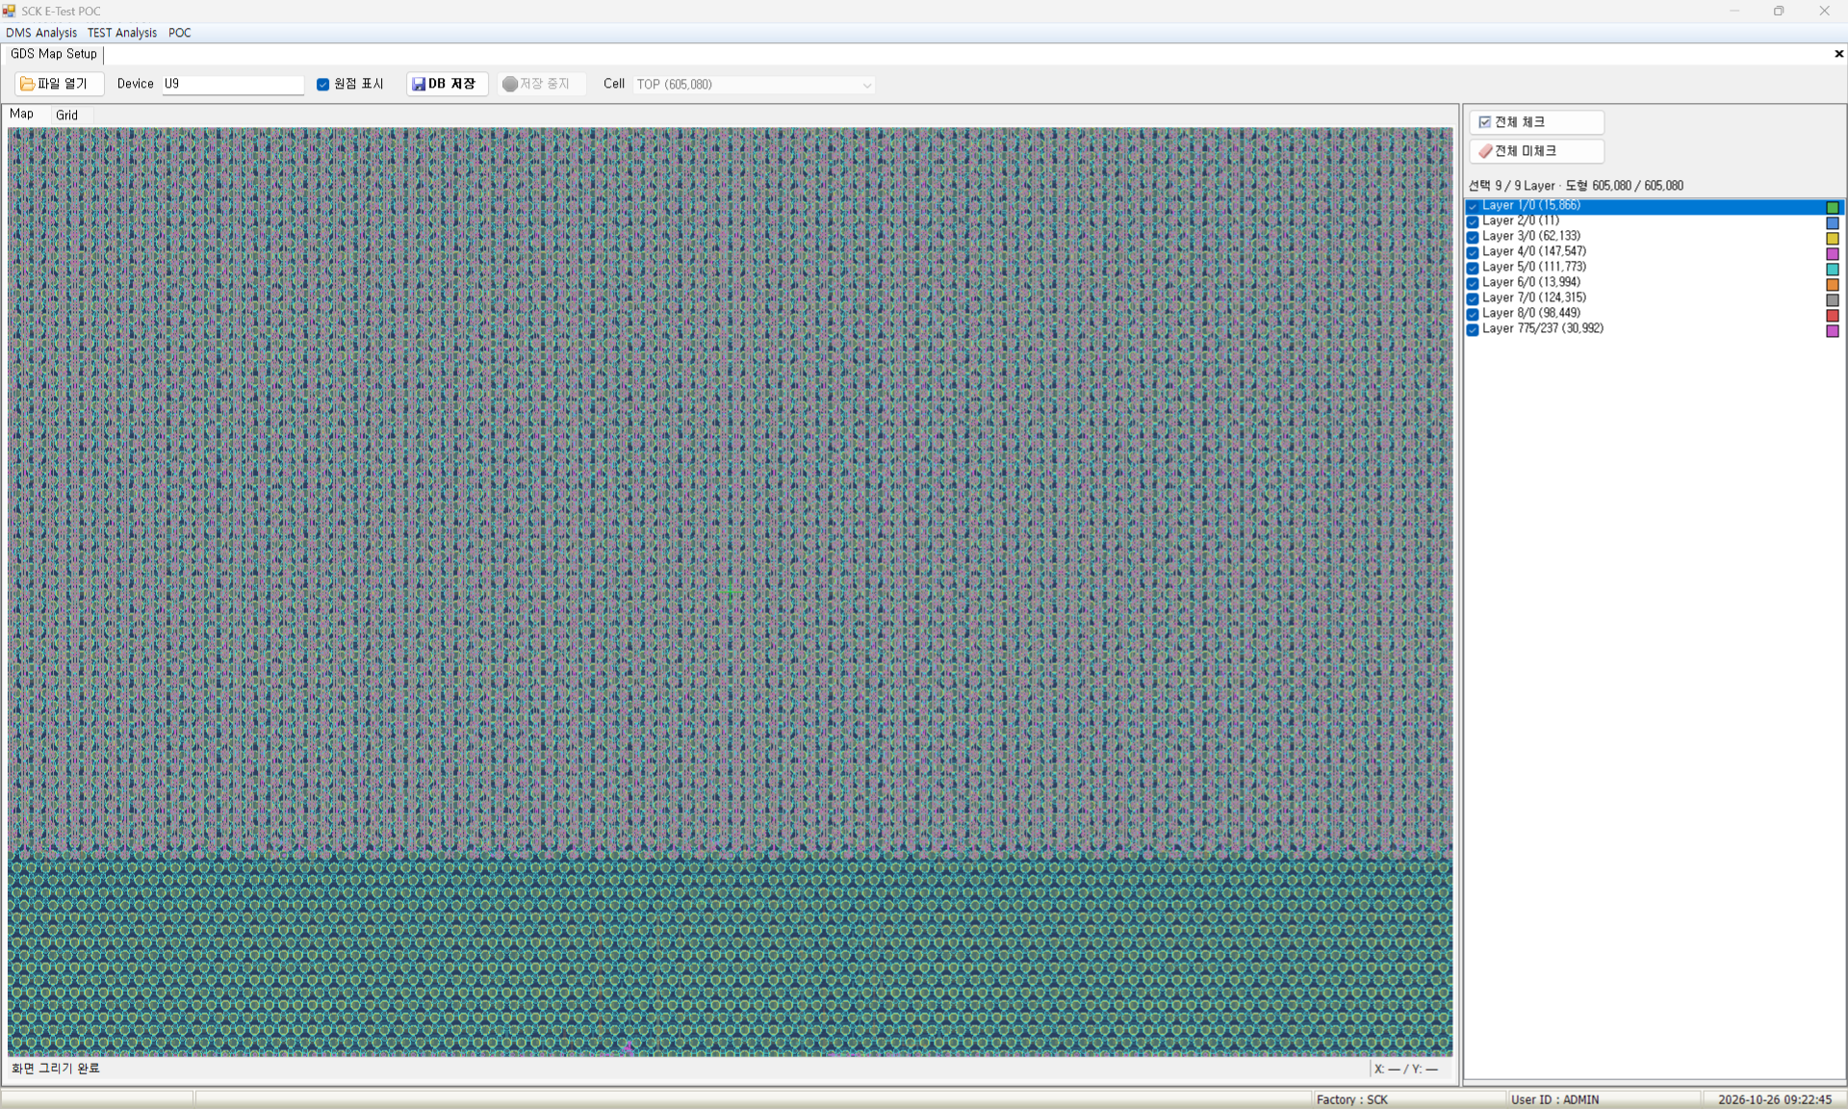
GDS Map Setup
- Role : Selects GDS file layers and registers them in the DB as a device map
Screen | Functions
 | Menu POC → Setup → GDS Map Setup View Shows the GDS layout in layer colors Mouse wheel zoom, drag to pan Shapes per layer, selected total Setup Saves only checked layers as a device map Limit Applied: no save, edit or delete after 2027-01-31 (menus disabled)
 | Items
 | Open File : select a GDS file to show the layout Device : device name to save the map under Save to DB : saves shapes of checked layers only Stop Saving : stops the save in progress Layer : only checked layers are shown and saved Show Origin : crosshair at the layout origin

Slide 6
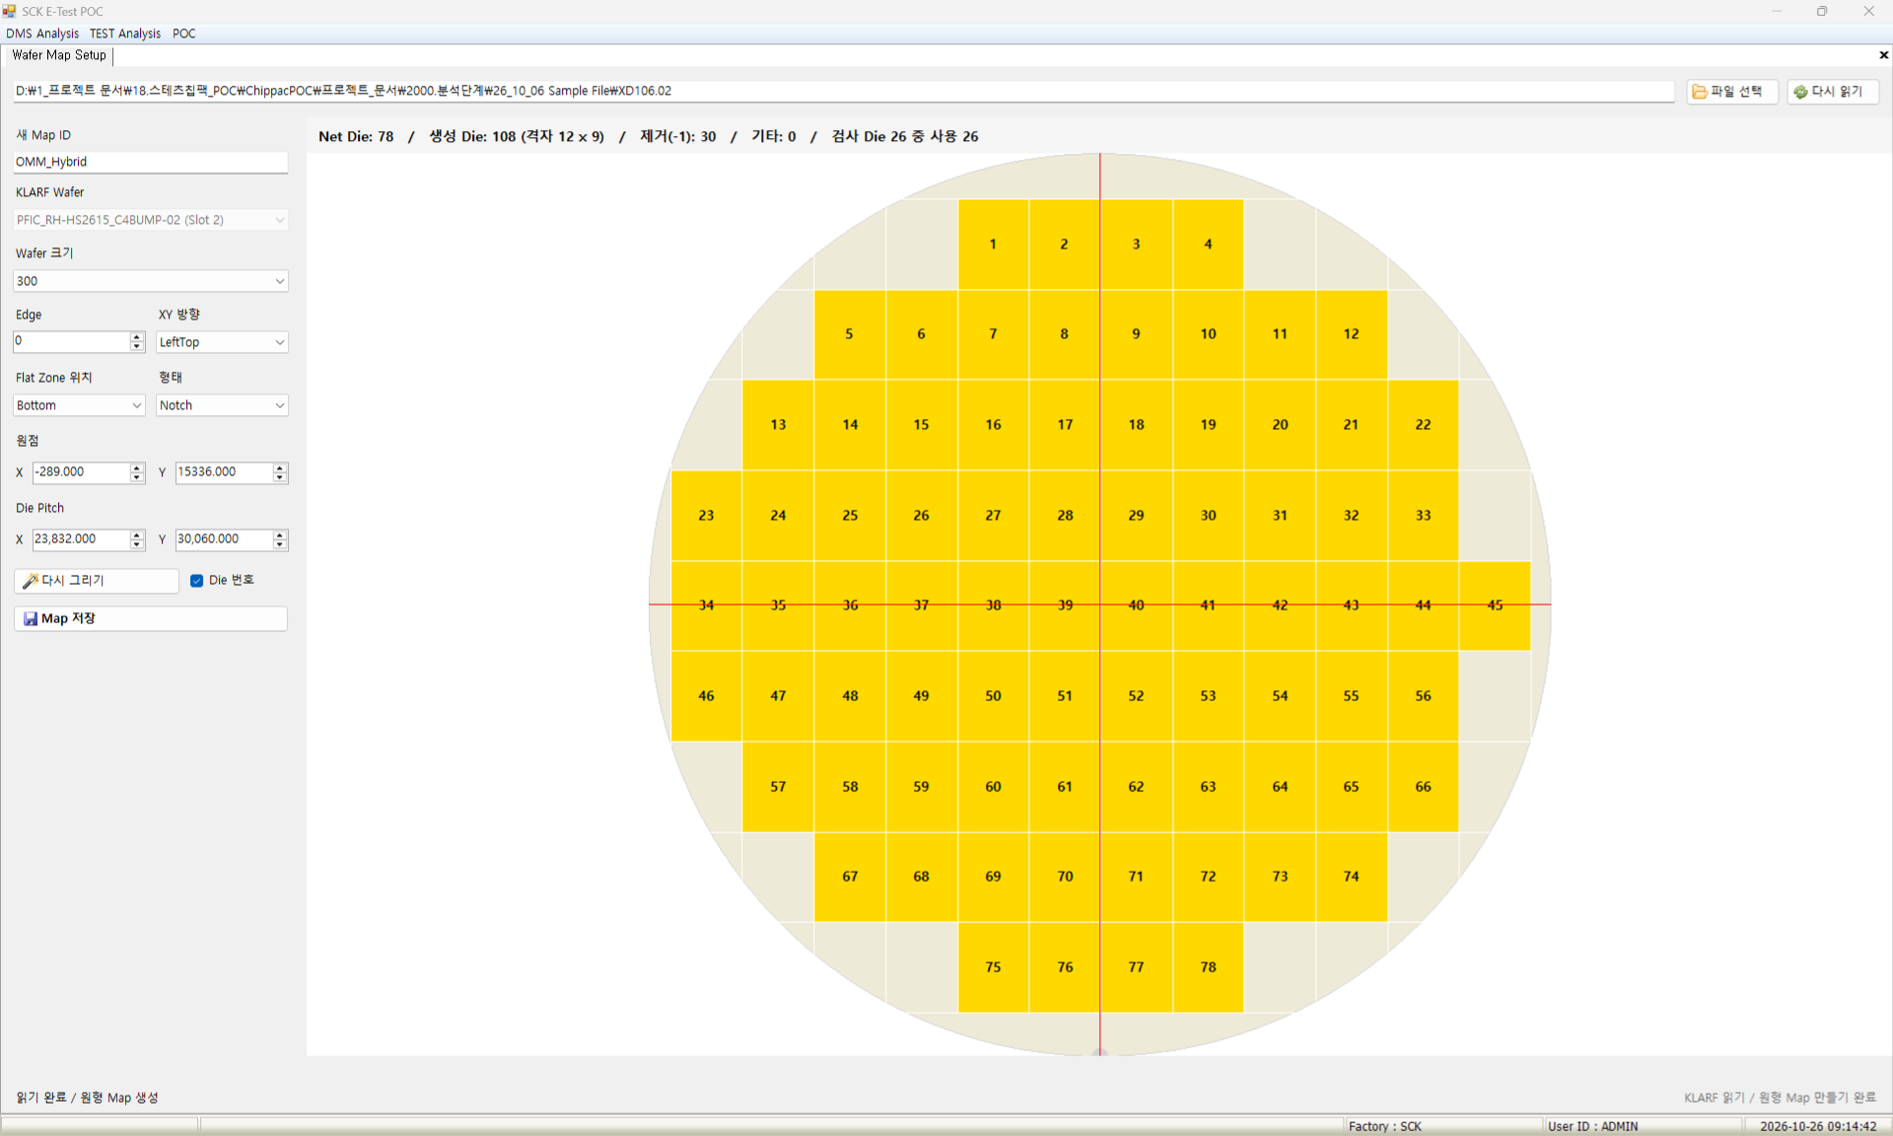
Wafer Map Setup
- Role : Creates and saves a round wafer map from a KLARF file
Screen | Functions
 | Menu POC → Setup → Wafer Map Setup View Preview of the round wafer map from KLARF Net, created and inspected die counts Die number and coordinates at the cursor Die numbers on the map Setup Wafer size, edge, XY direction Origin, die pitch, flat zone Saves as a new map ID; same ID is overwritten Limit Applied: no save, edit or delete after 2027-01-31 (menus disabled)
 | Items
 | Select File : select a KLARF file to create the map New Map ID : map ID to save as Edge : excluded width at the wafer edge (about 500) XY Direction : where die numbering starts Die Pitch : die spacing, default from KLARF Redraw : recreates the map with new settings Save Map : saves as the new map ID
1
2
3
4
5
6
7

Slide 7
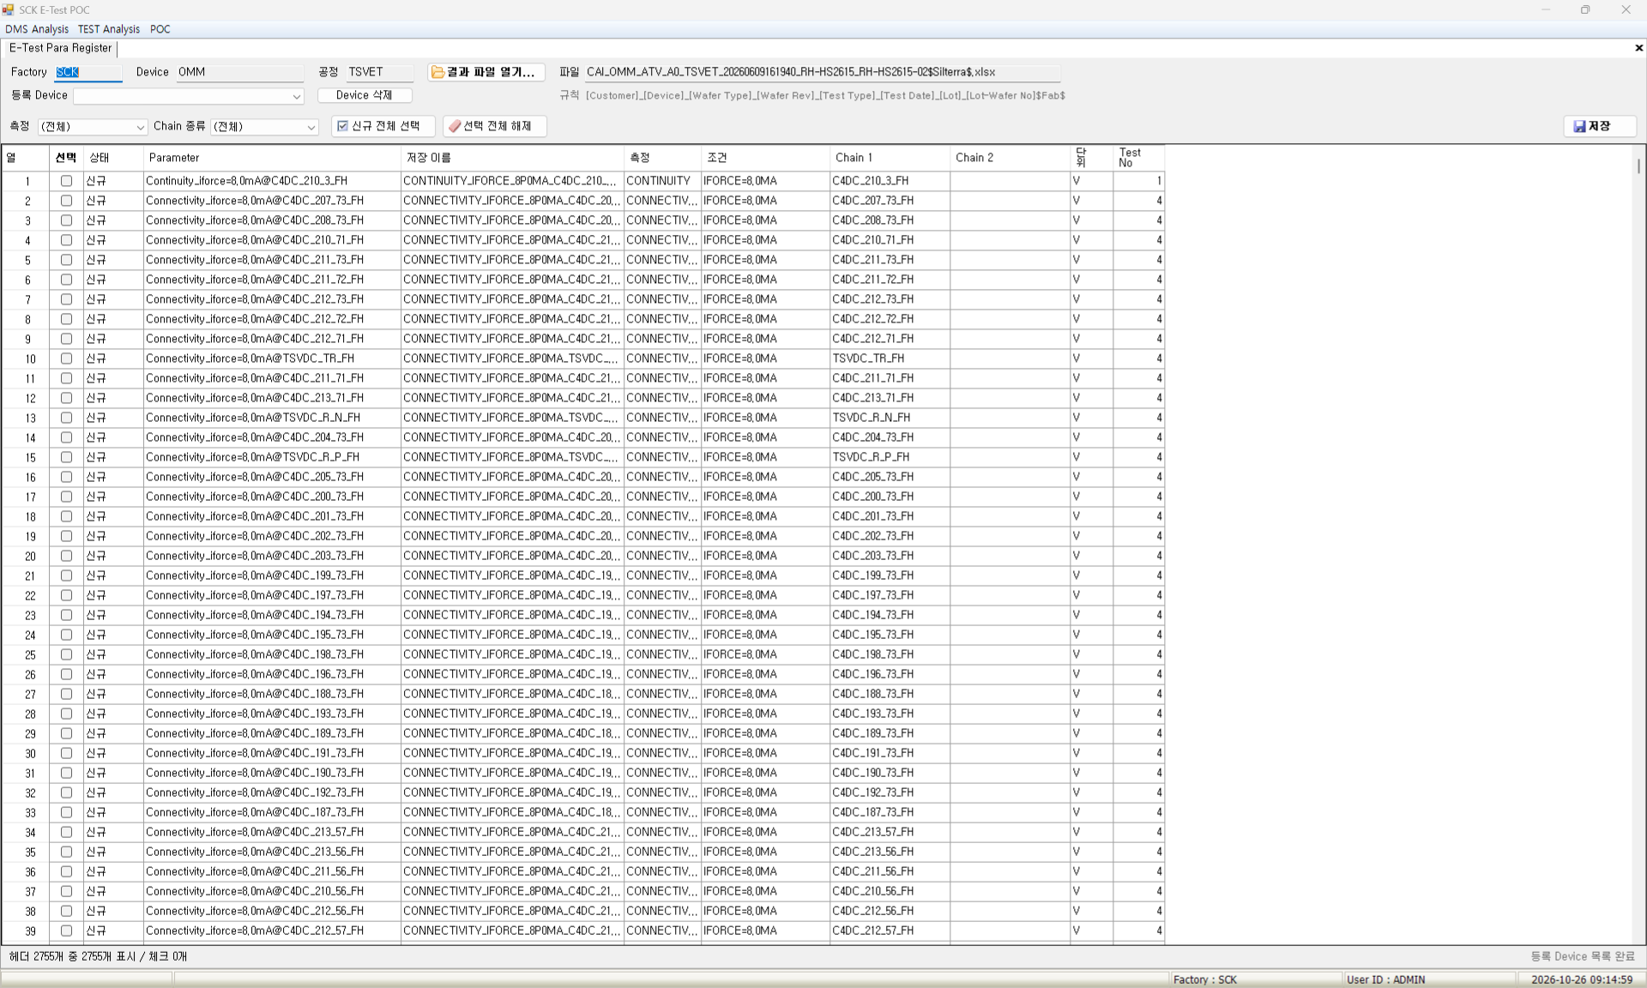
E-Test Para Register
- Role : Registers E-Test result file headers as parameters
Screen | Functions
 | Menu POC → Setup → E-Test Para Register View Status per header (new, registered, error) Measurement, condition, chain split from headers Device and process read from the file name Setup Registers checked new headers as parameters Deletes registrations and results per device Limit Applied: no save, edit or delete after 2027-01-31 (menus disabled)
 | Items
 | Open Result File : reads an E-Test result file and shows headers Rule : file name pattern Status : only new rows can be registered Save Name : parameter name saved in the DB Select All New : checks all new rows shown Registered Device : devices with parameters Delete Device : deletes registrations and results of the device
6
7
1
2
3
5
4

Slide 8
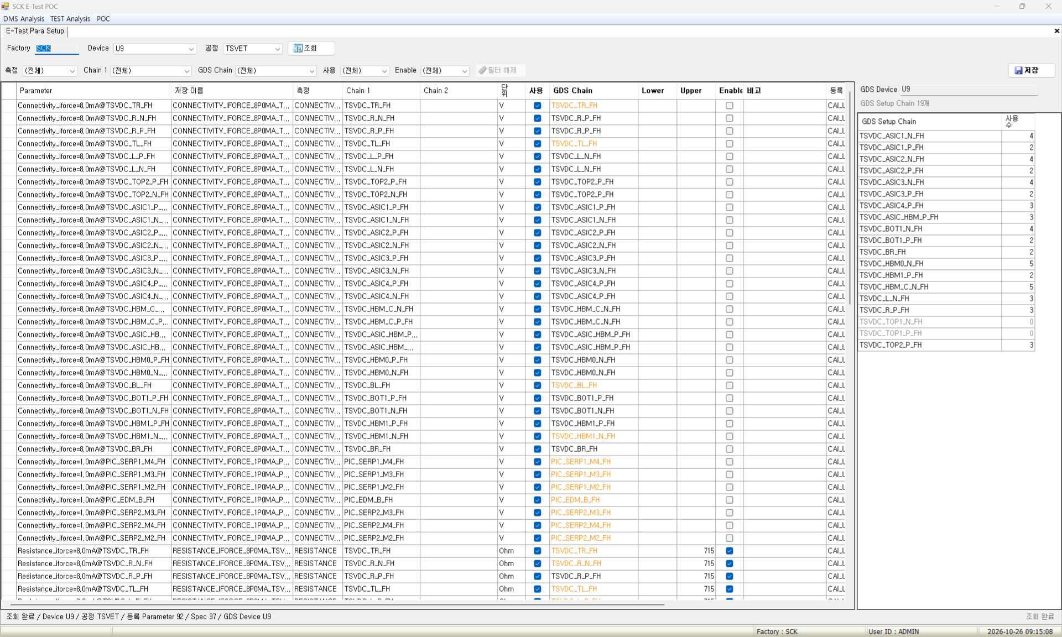
E-Test Para Setup
- Role : Sets GDS chain, spec and use for registered parameters
Screen | Functions
 | Menu POC → Setup → E-Test Para Setup View Registered parameters by device and process Filters for measurement, chain 1, use Setup chains of the GDS device with the same name Parameters in use per chain Setup Enter the GDS chain name per parameter Enter lower, upper and enable spec Edit use and remarks, then save Limit Applied: no save, edit or delete after 2027-01-31 (menus disabled)
 | Items
 | Measurement : filter by measurement item GDS Chain : GDS chain name linked to chain 1 Lower / Upper : spec lower and upper limits Enable : use spec judgment or not Use : save values on result upload or not GDS Setup Chain : double-click to copy the chain name Clear Filter : resets all filters
1
7
5
2
3
4
6

Slide 9
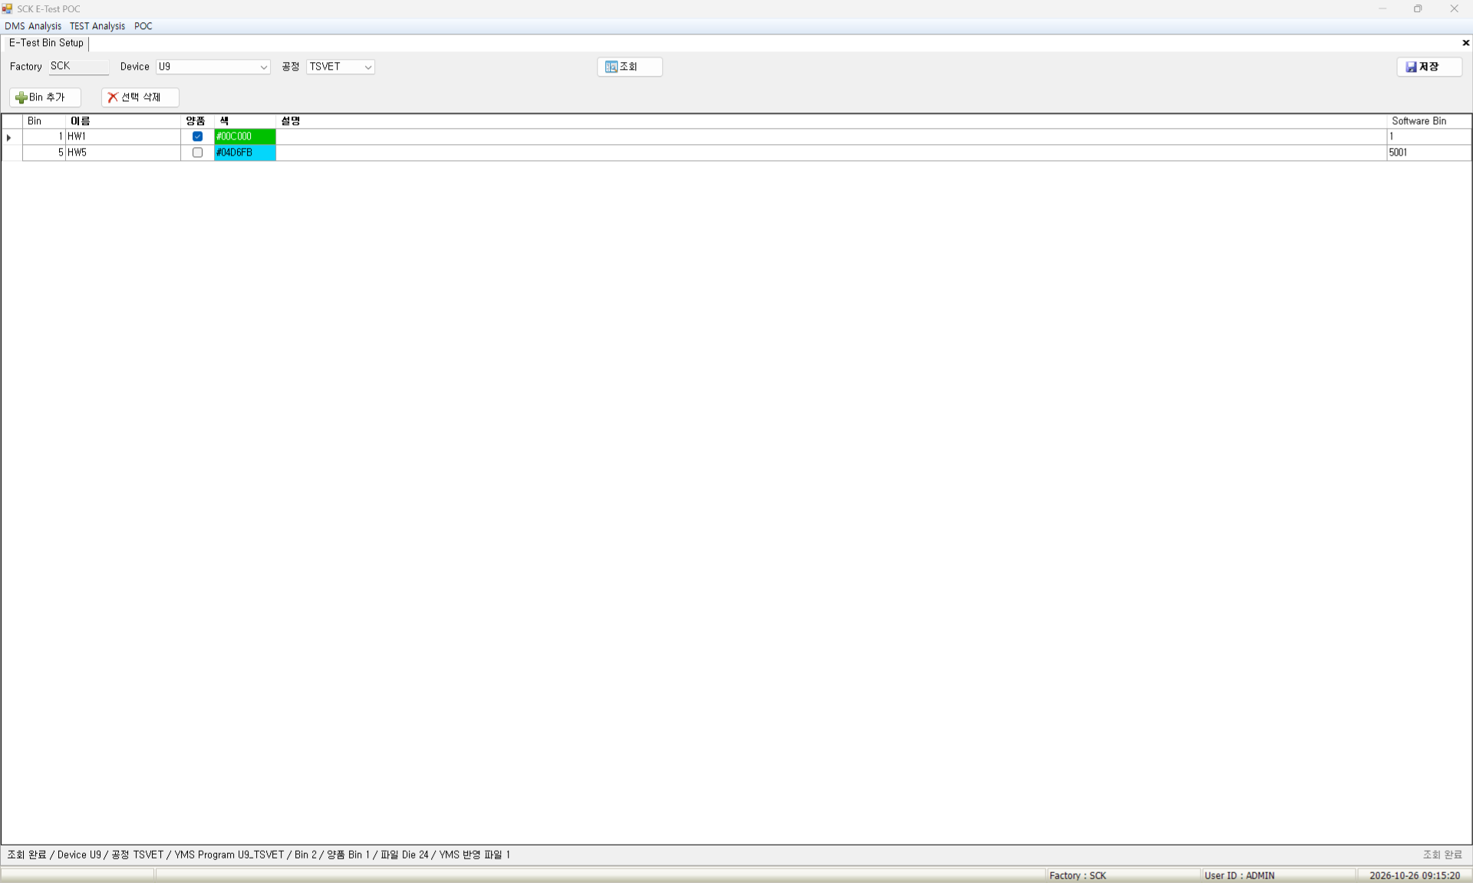
E-Test Bin Setup
- Role : Sets E-Test bin name, good flag, color and description
Screen | Functions
 | Menu POC → Setup → E-Test Bin Setup View Bins by device and process Software bin number per bin Display color per bin Good bin count, die count in file Setup Edit bin name, good flag, color, description Add, delete bins Limit Applied: no save, edit or delete after 2027-01-31 (menus disabled)
 | Items
 | Bin : hardware bin number Name : bin name Good : good bin for YMS yield Color : double-click to pick a color Software Bin : software bin number Add Bin : adds a new bin row Delete Selected : deletes the selected bin
6
7
1
2
3
4
5

Slide 10
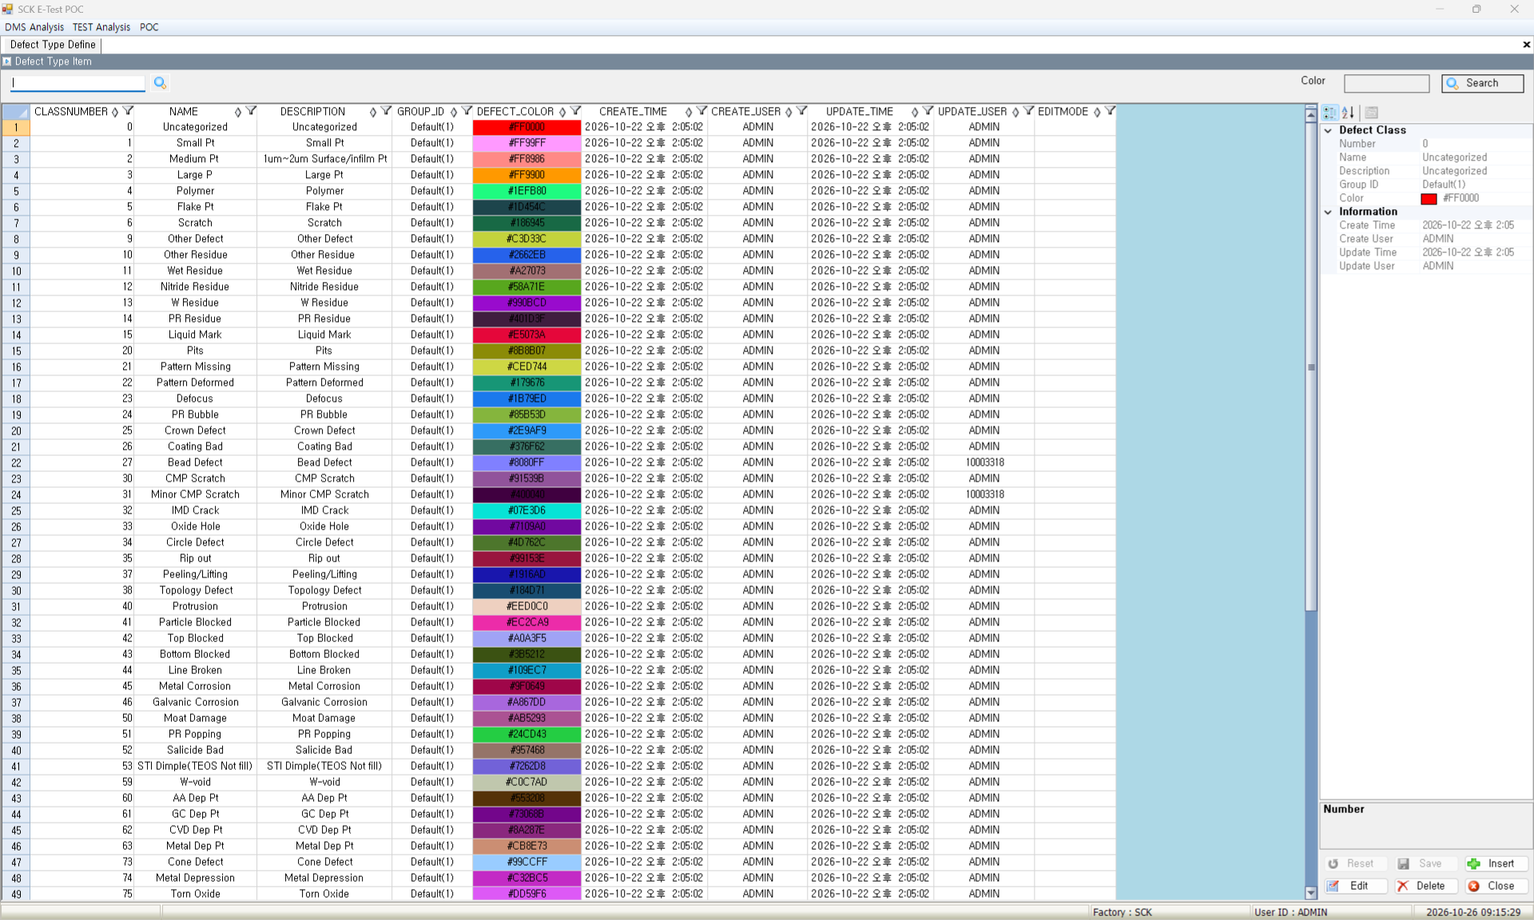
Defect Type Define
- Role : Registers name, group and color per defect class number
Screen | Functions
 | Menu POC → Setup → Defect Type Define View Name, description, group, color per class Created / updated user and time per class Setup Register a new class number, name, group, color Edit name, description, group ID, color Delete the selected class Limit Applied: no save, edit or delete after 2027-01-31 (menus disabled)
 | Items
 | Search : reloads the list CLASSNUMBER : class number (KLARF class value) Group ID : select a defect group Insert : enter a new class Edit : edit the selected class Save : saves inputs and edits Delete : deletes the selected class
2
1
3
5
6
4
7

Slide 11
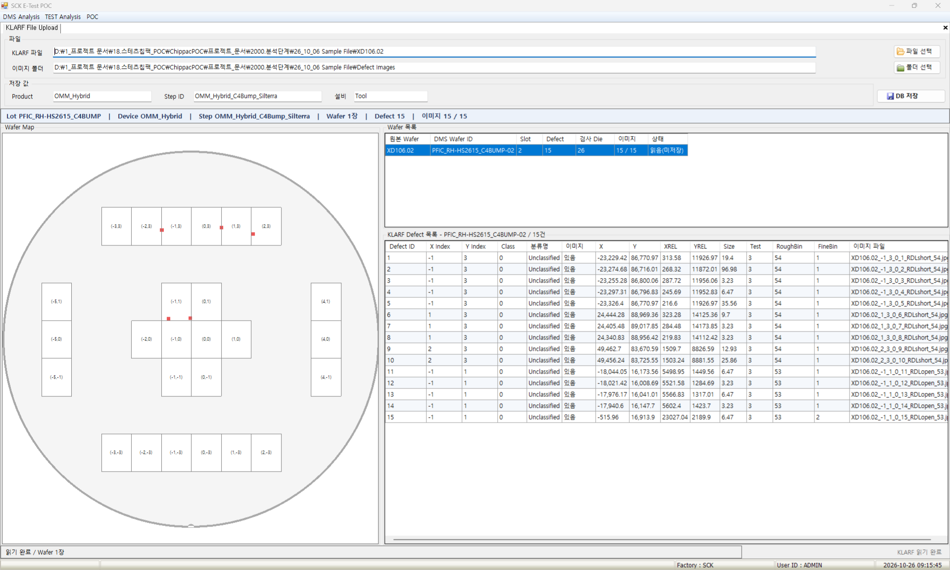
KLARF File Upload
- Role : Saves KLARF files and defect images to the DMS DB
Screen | Functions
 | Menu POC → Data Upload → KLARF File Upload View Summary of lot, device, step, defects Defects, inspected dies, images per wafer Map and defect list of the selected wafer Setup Saves KLARF defects and images to the DB Edit product, step ID, equipment to save Re-register or skip registered wafers Limit Applied: no save, edit or delete after 2027-01-31 (menus disabled)
 | Items
 | KLARF File : reads the file and previews it Image Folder : defect image folder Save Values : product, step ID, equipment Save to DB : saves defects and images Status : save result per wafer Class : KLARF class number, map color key Class Name : name of the class number
1
2
3
4
5
6
7

Slide 12
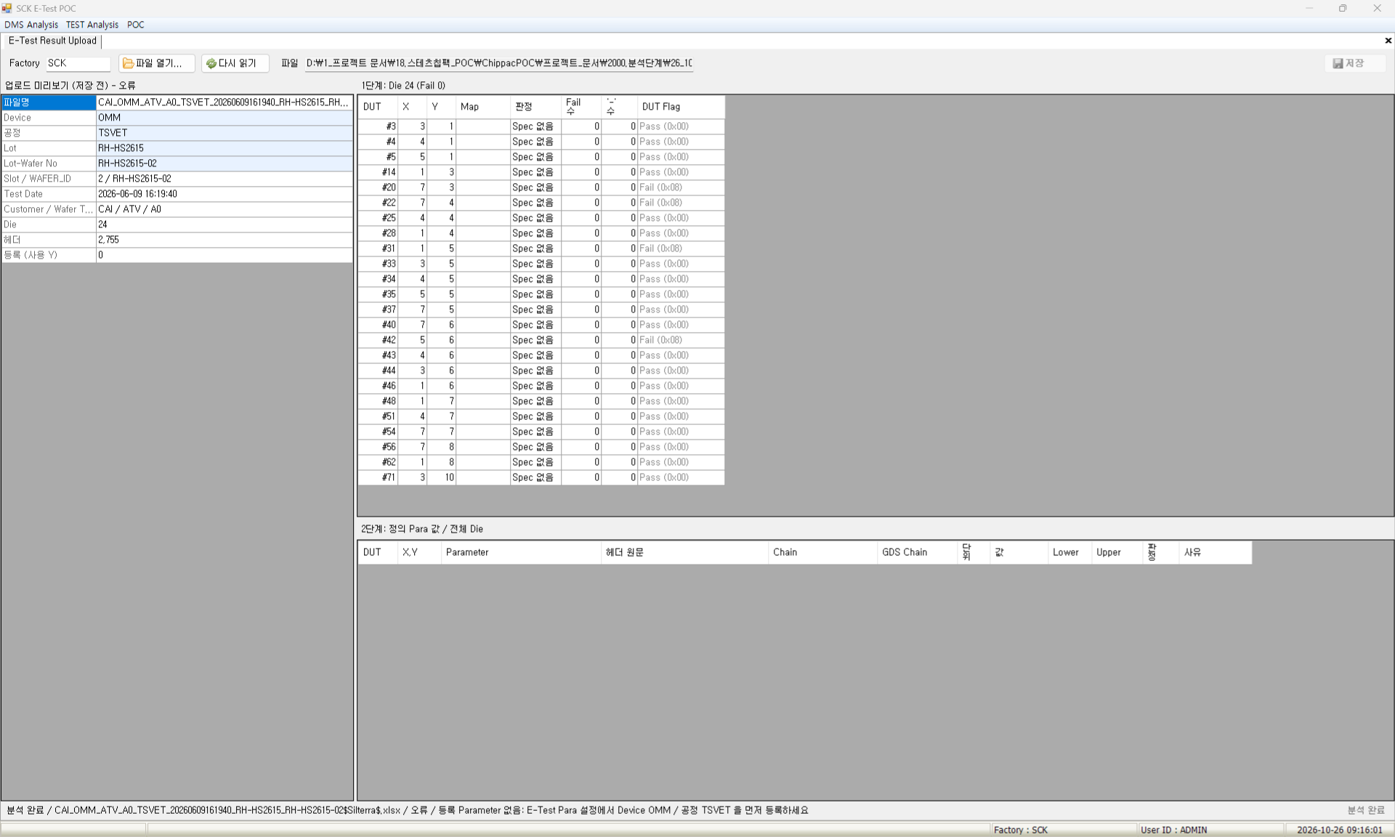
E-Test Result Upload
- Role : Analyzes one E-Test result file (xlsx) and saves it to the DB
Screen | Functions
 | Menu POC → Data Upload → E-Test Result Upload View Analysis status and reason Result, fail count, map coordinates per die Parameter values, spec, result of the selected die Setup Saves values of parameters in use only Edit device, process, lot in the info table Same wafer and process results are overwritten Limit Applied: no save, edit or delete after 2027-01-31 (menus disabled)
 | Items
 | Open File : reads and analyzes an E-Test result file Reload : re-analyzes after setting changes Upload Preview : file info, analysis status, double-click to edit Step 1: Die : result and fail count per die Step 2: Defined Para Values : values, spec, result of the die Map : die coordinates on the map Save : saves the analysis to the DB
3
1
2
4
7
6
5

Slide 13
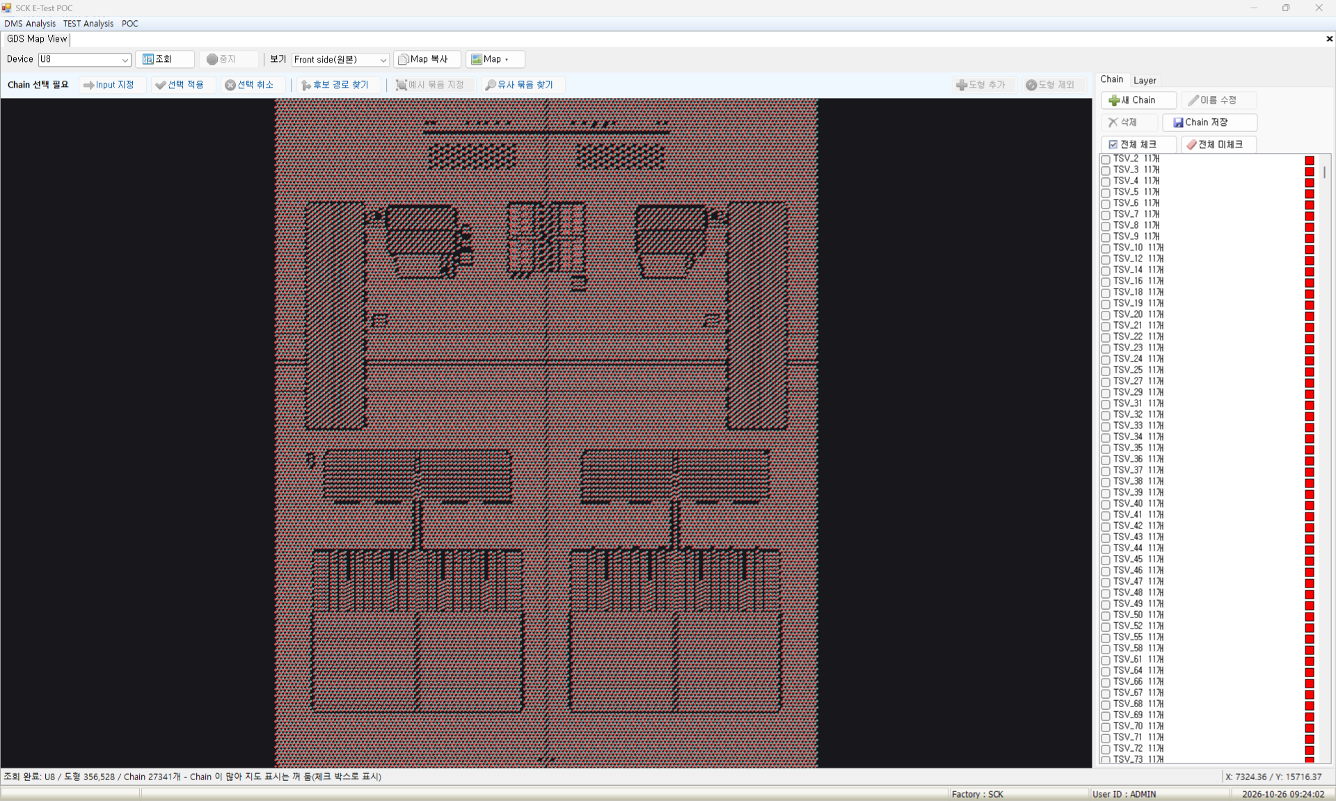
GDS Map View
- Role : Views GDS maps in the DB and sets and saves chains
Screen | Functions
 | Menu POC → View / Analysis → GDS Map View View Loads only checked layers from the DB to show Switches front / back side view Shows checked chains with colored outlines Map info per device Setup Create chain, set input, find path Add or exclude chain shapes Save chain, copy or delete map Limit Partly applied: no chain save, map copy or delete after 2027-01-31
 | Items
 | Device : select a device to view New Chain : creates a new chain Set Input : sets the chain start shape Find Path : traces shapes connected to the input Add Shape : click the map to add a shape Exclude Shape : click the map to exclude a shape Save Chain : saves chain changes to the DB
1
3
4
5
6
2
7

Slide 14
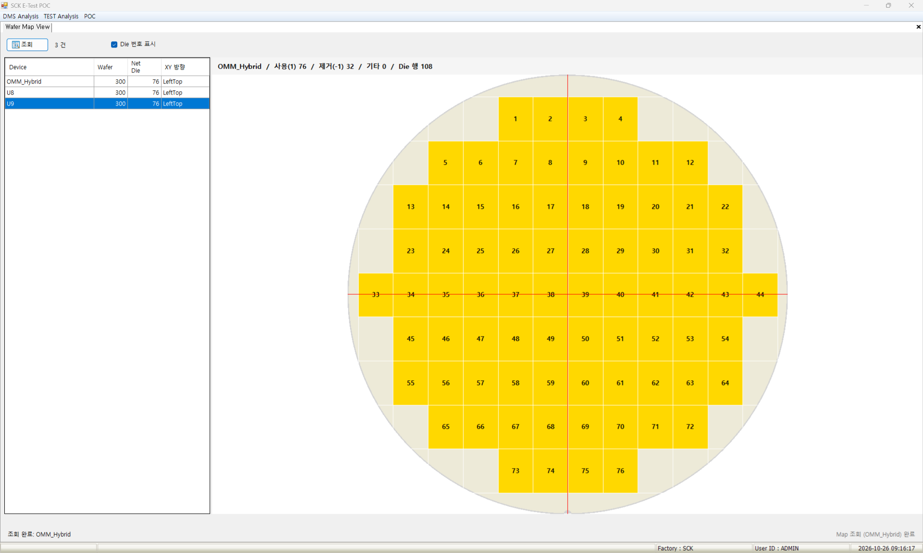
Wafer Map View
- Role : Views saved wafer map shapes and die counts
Screen | Functions
 | Menu POC → View / Analysis → Wafer Map View View Wafer, net die, XY direction in the map list Shape, used and removed dies of the map Die numbers by XY direction Limit Not applied (view screen)
 | Items
 | View : reloads the map list
1

Slide 15
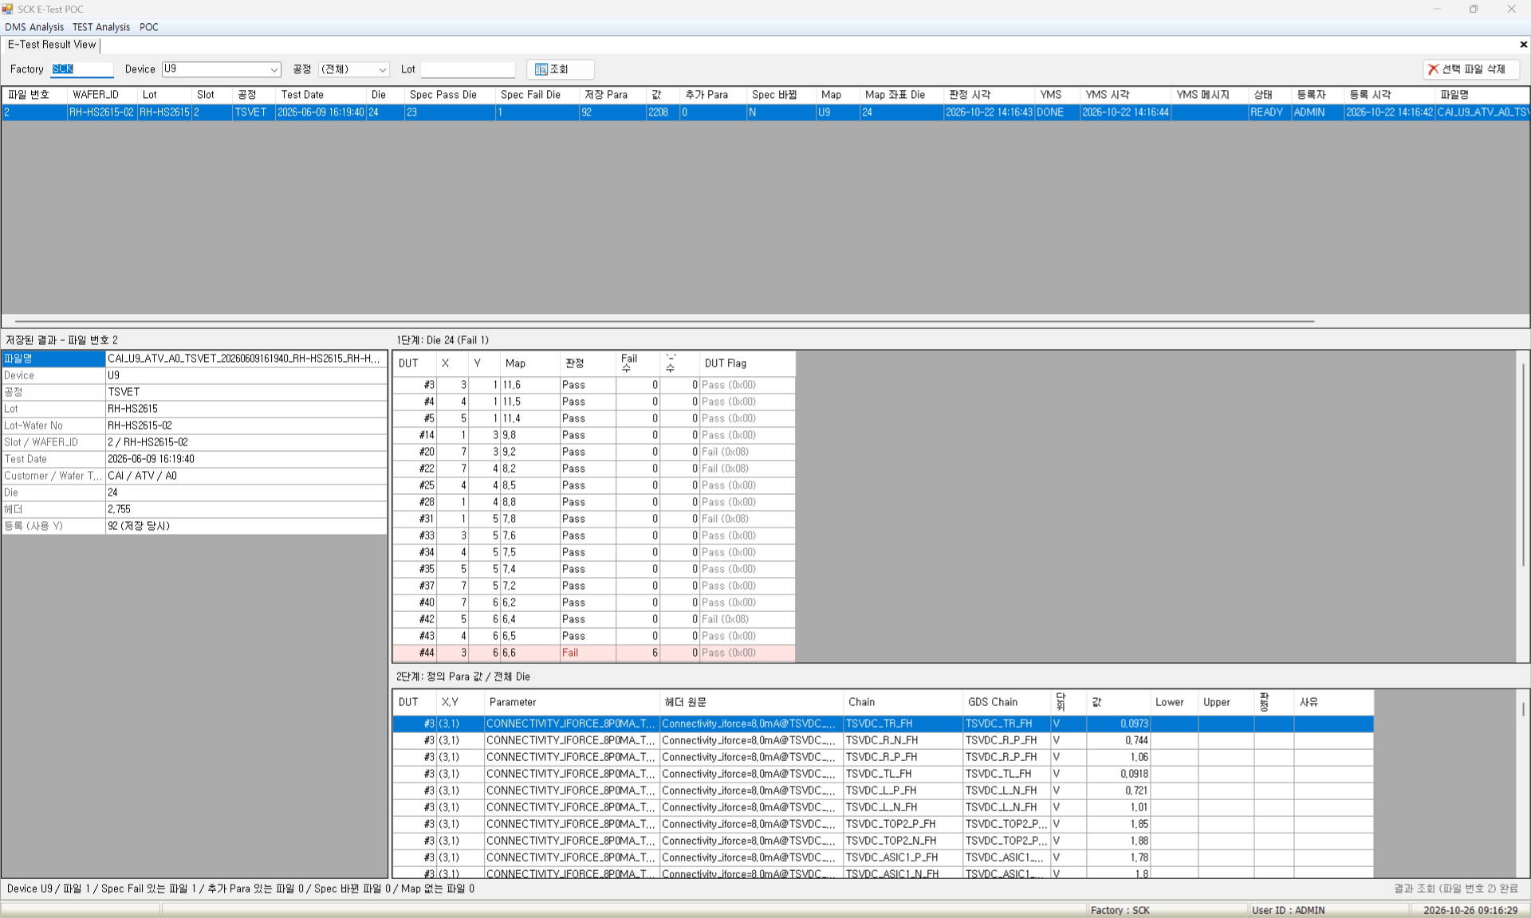
E-Test Result View
- Role : Views and deletes saved E-Test result files
Screen | Functions
 | Menu POC → View / Analysis → E-Test Result View View Saved files by device, process, lot Spec pass / fail dies per file Added parameters, spec changes, YMS status Die results and para values of the file Setup Delete the selected file Limit Not applied (file delete is not limited)
 | Items
 | Spec Fail Die : number of spec fail dies Added Para : parameters added after saving Spec Changed : spec changed after judgment Map : map used for coordinates YMS : YMS update status Lower / Upper : spec lower and upper limits Delete File : deletes the file, dies and values
1
2
3
4
5
7
6

Slide 16
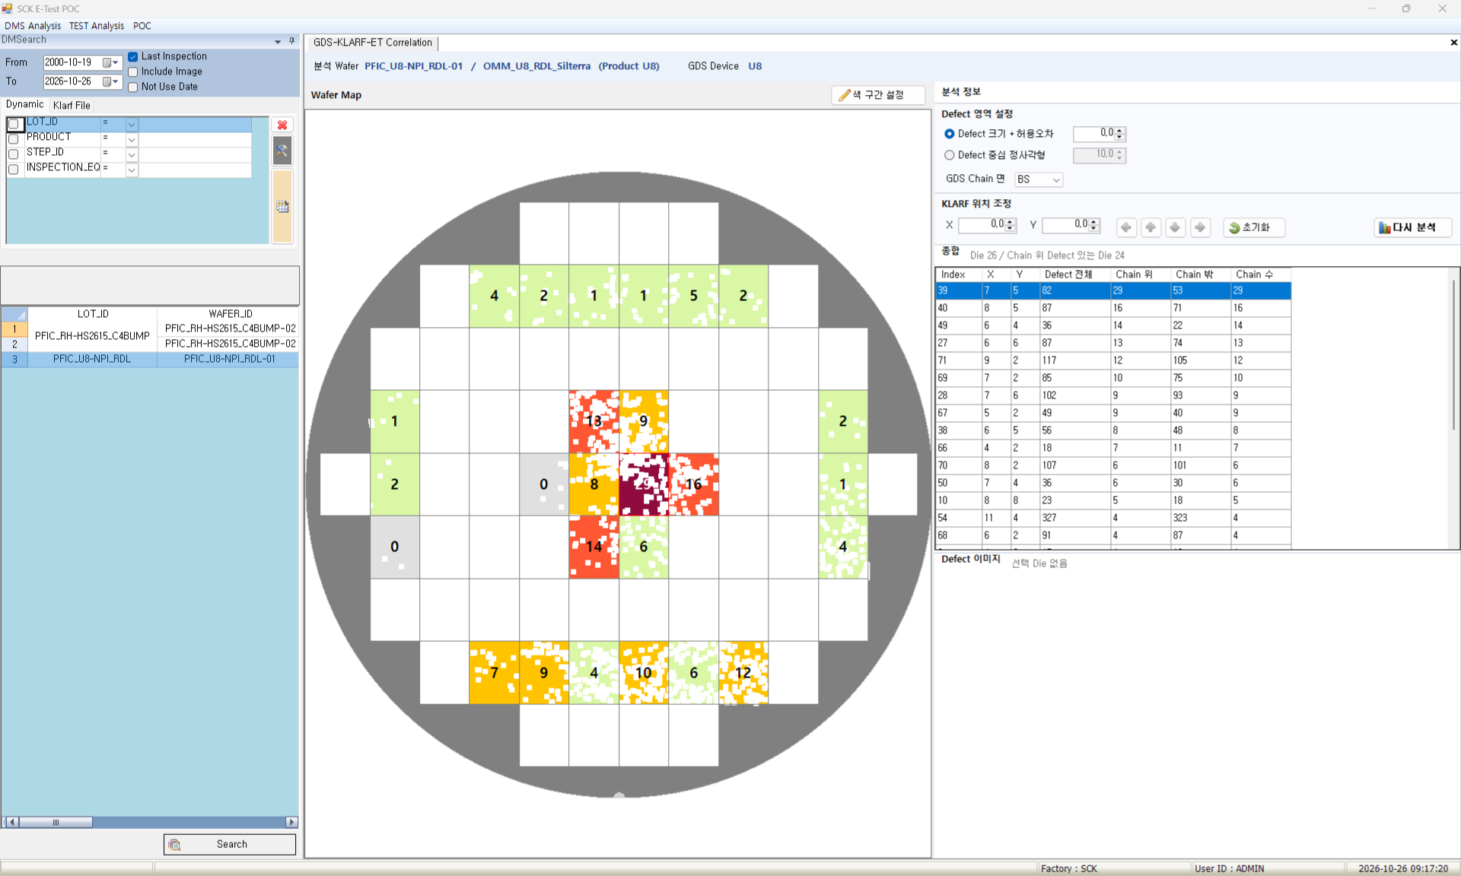
GDS-KLARF-ET Correlation
- Role : Analyzes the correlation between KLARF defects and GDS chain locations
Screen | Functions
 | Menu POC → View / Analysis → GDS-KLARF-ET Correlation View Defects on chains per die Defects on / off chains per die Defect images of the selected die Die X, Y, index at the cursor Setup Defect area method, tolerance GDS chain side, KLARF offset Map color ranges, display basis Limit Not applied (view screen)
 | Items
 | Color Range : sets map color ranges and basis Defect Size + Tolerance : judges by size plus tolerance Defect Center Square : judges by a square at the center GDS Chain Side : select chain side (FS, BS) KLARF Offset : adjusts KLARF X, Y Re-analyze : re-analyzes with new settings Summary : defects on / off chains per die
1
2
3
4
5
6
7

Slide 17
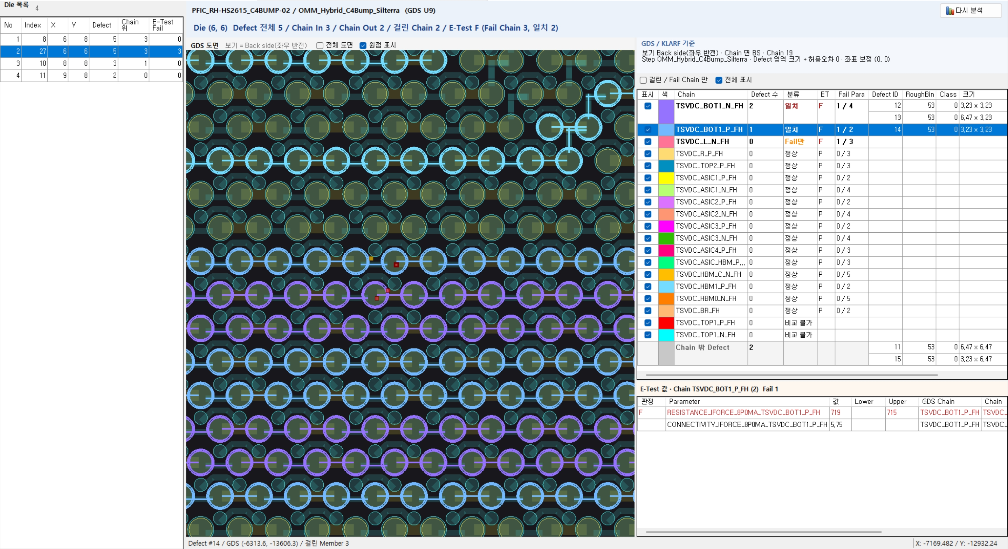
GDS-KLARF-ET Correlation Detail (Die Detail Analysis)
- Role : Checks chains, defect locations and E-Test values on the GDS layout of the die
Screen | Functions
 | Menu POC → View / Analysis → GDS-KLARF-ET Correlation → double-click a die View Defects and defects on chains per die Defects hit per chain, defects off chains E-Test values of the chain (wafers with E-Test) Setup Layout display range, origin Select chains to show on the layout Limit Not applied (view screen)
 | Items
 | Die List : switches detail to the selected die Re-analyze : re-analyzes with main screen settings Full Layout : shows all layers, not only chains Show Origin : shows the layout origin Hit / Fail Chains Only : chains with defects or E-Test fails Show All : turns all chains on or off Show : show each chain or not
1
2
3
4
5
6
7

Slide 18
POC
DMS Analysis
TEST Analysis

Slide 19
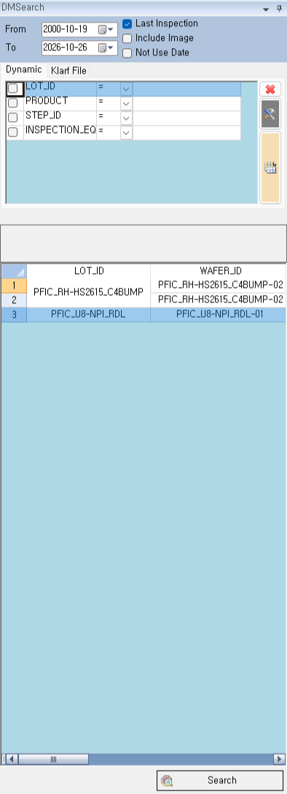
DMSearch (left wafer search panel)
- Role : Finds matching wafer inspections and sends them to the analysis screen
Screen | Functions
 | Menu Shown on the left in DMS Analysis and Correlation View Wafer inspections matching period and conditions Defects and images per inspection Tree grouped by condition items Setup Search by lot / wafer without a period Limit Not applied (view screen)
 | Items
 | From / To : inspection period Last Inspection : last inspection only Not Use Date : search by lot / wafer without a period Dynamic : enter conditions per item Search Icon : lists matching inspections Search : sends selected wafers to analysis
1
2
3
4
5
6

Slide 20
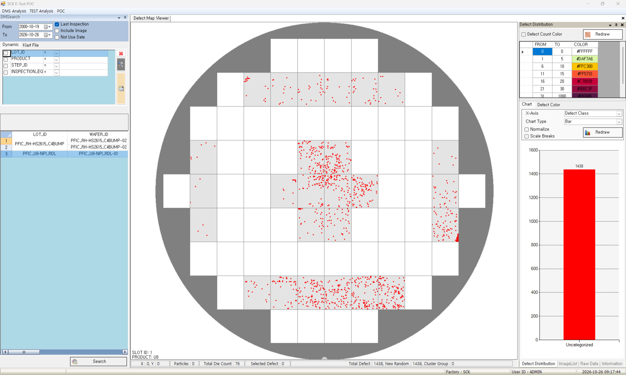
Defect Map Viewer
- Role : Shows defect locations of the selected wafer on the wafer map
Screen | Functions
 | Menu DMS Analysis → Defect Map Viewer View Defect locations on the map, colors by class Defect distribution chart by class and size Image, die, class, size of the defect Map info, selected defect details Setup Defect count color ranges Colors by class (Defect Color tab) Limit Not applied (view screen)
 | Items
 | Defect Select : drag to select defects X-Axis : chart category Chart : click a bar to show those defects Defect Count Color : colors by defects per die ImageList : defect image, double-click to zoom Raw Data : defect ID, coordinates, size Information : map and defect info
4
3
2
5
6
7

Slide 21
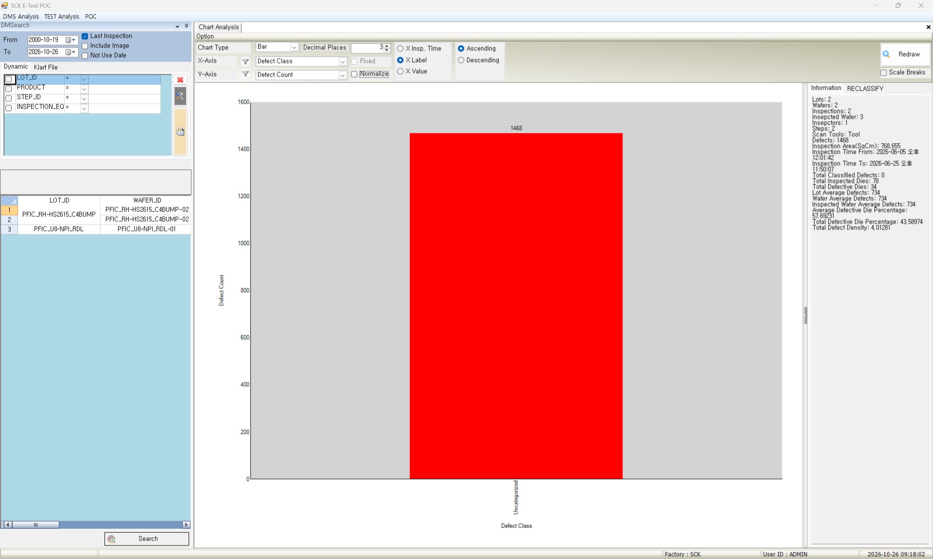
Chart Analysis
- Role : Charts defects of the selected wafer by criteria
Screen | Functions
 | Menu DMS Analysis → Chart Analysis View Charts by step, wafer, class, etc. Defect count, density, bad dies and ratio Limit Not applied (view screen)
 | Items
 | Chart Type : bar or line X-Axis : chart category Y-Axis : value (defect count, etc.) Filter Icon : size range, defect type Normalize : shows as ratio X Label / X Insp. Time / X Value : X-axis sort Redraw : redraws with new options
1
6
7
2
4
3
5

Slide 22
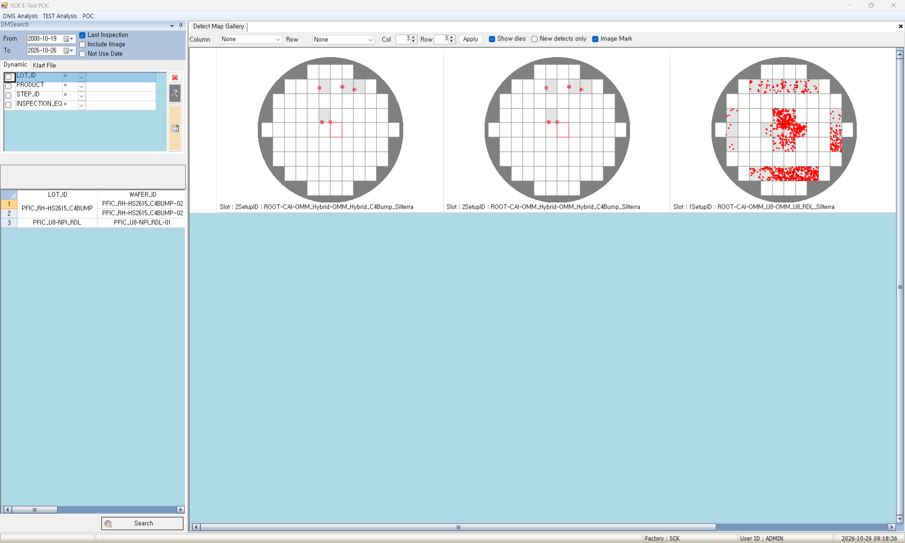
Defect Map Gallery
- Role : Compares defect maps of several wafers on one screen
Screen | Functions
 | Menu DMS Analysis → Defect Map Gallery View Defect maps per inspection side by side Grid by lot, step, class Lot, wafer info per map Setup Maps per row and column Die grid, image marks Grouping (column, row) Limit Not applied (view screen)
 | Items
 | Column : horizontal grouping Row : vertical grouping Col / Row : maps per row and column Apply : applies the counts Show dies : shows the die grid New defects only : new defects only Image Mark : marks defects with images
1
2
4
3
5
6
7

Slide 23
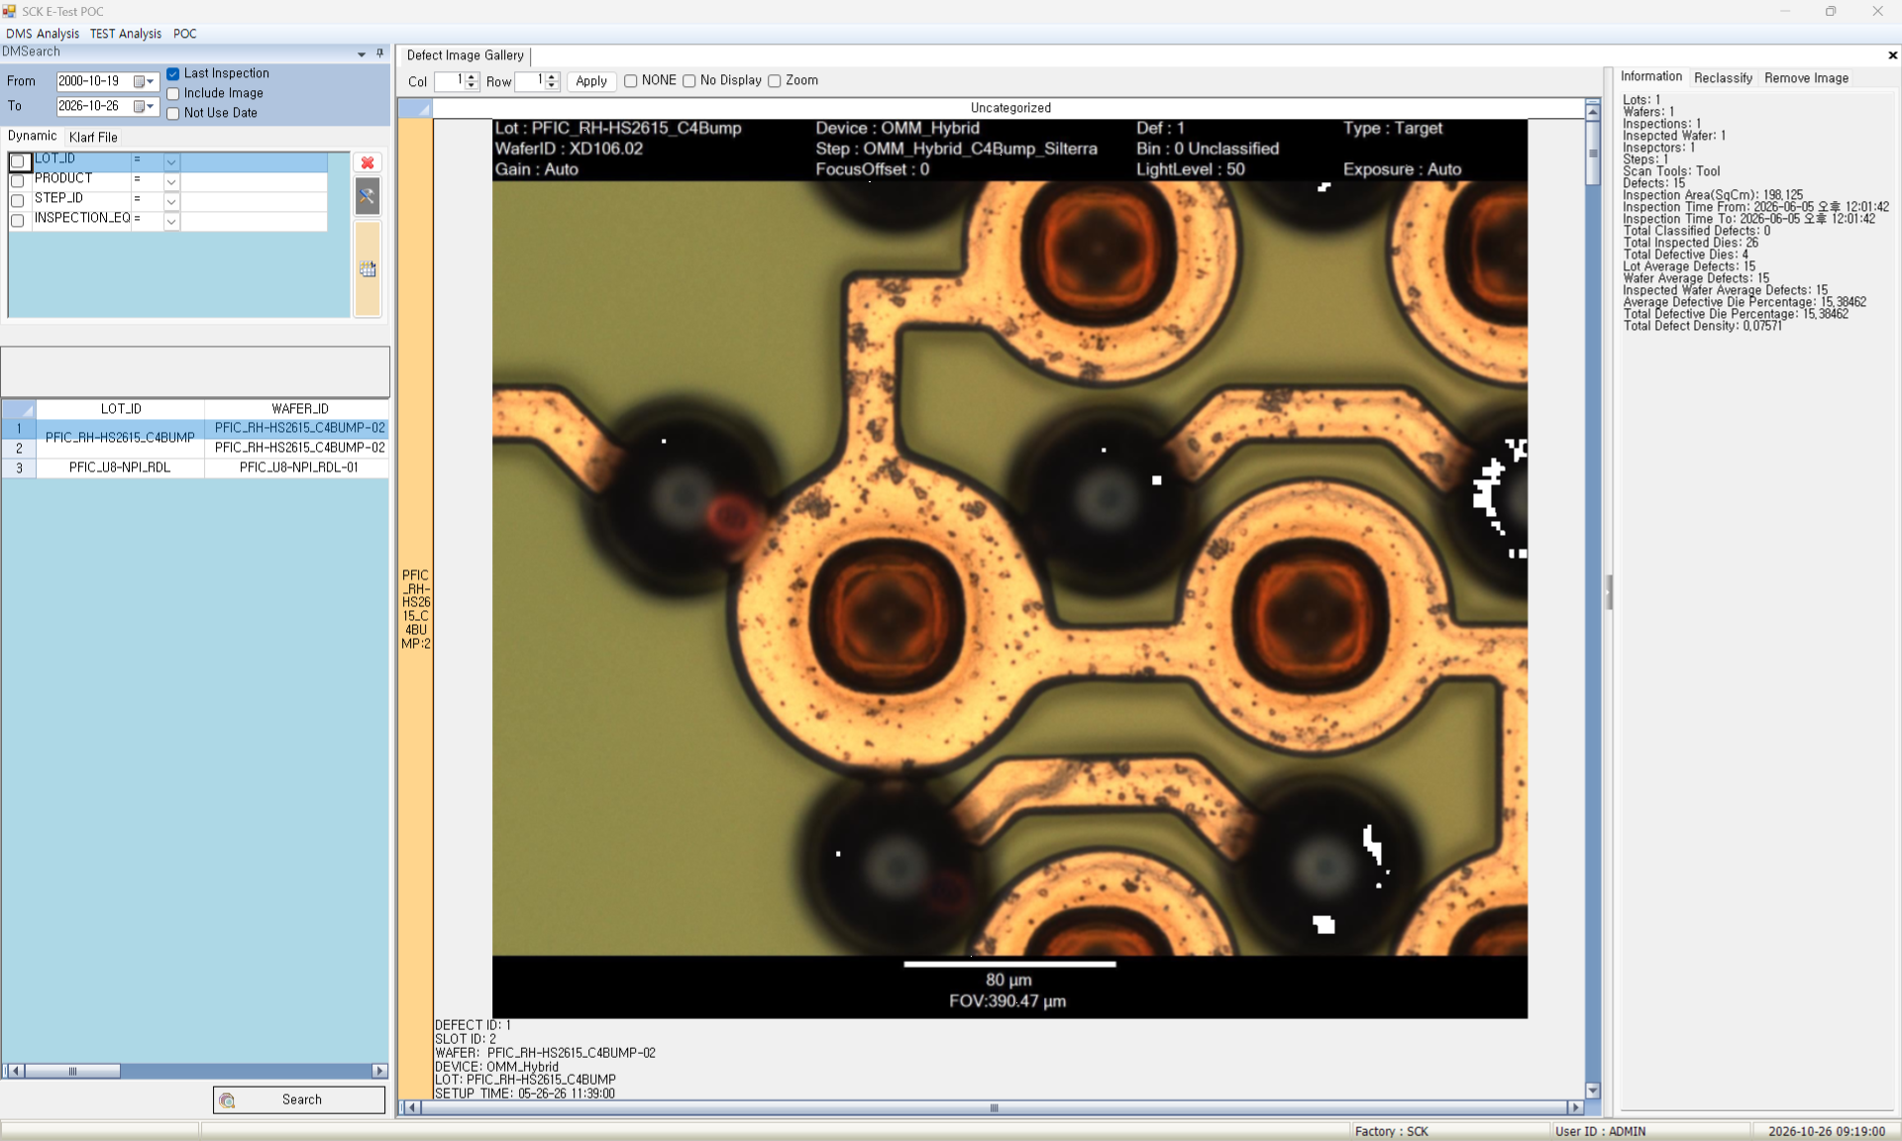
Defect Image Gallery
- Role : Shows defect images of the selected wafer by class
Screen | Functions
 | Menu DMS Analysis → Defect Image Gallery View Image thumbnails by defect class Images compared by wafer Double-click to enlarge Setup Images per row and column List without class grouping Limit Not applied (view screen)
 | Items
 | Col / Row : images per row and column Apply : applies the counts NONE : no class grouping No Display : hides info under thumbnails Zoom : opens a zoom window Information : defect info of the image Remove Image : deletes the selected image
1
2
3
4
5
6
7

Slide 24
POC
DMS Analysis
TEST Analysis

Slide 25
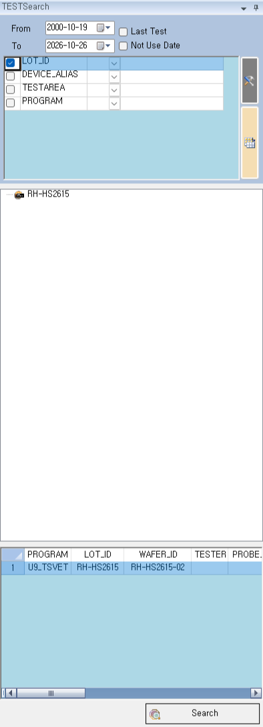
TESTSearch (left TEST search panel)
- Role : Finds matching TEST wafers and sends them to the analysis screen
Screen | Functions
 | Menu Shown on the left in TEST Analysis View Wafers matching period and conditions Yield, tested dies, test time per wafer Tree by lot / product for checked items Setup Add, delete, reorder condition items Restores last conditions and period Limit Not applied (view screen)
 | Items
 | From / To : test period Last Test : latest result for retested wafers Not Use Date : search by lot / wafer without a period Condition Table : enter conditions (comma, *) Settings Icon (tool) : sets condition items Search Icon (table) : lists matching tests Search : sends selected wafers to analysis
1
2
4
3
5
6
7

Slide 26
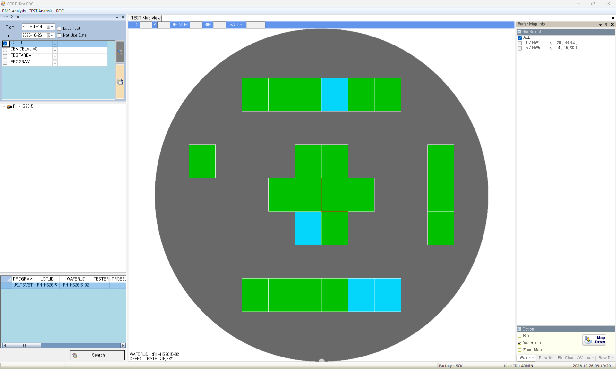
TEST Map View
- Role : Analyzes the bin map and value map of one wafer
Screen | Functions
 | Menu TEST Analysis → TEST Map View View Bin-colored wafer map, count and ratio per bin Count chart per bin Color map by value range Values per die (raw data) Limit Not applied (view screen)
 | Items
 | Bin Select : bins to show Map Draw (Option) : redraws with selected bins Bin / Wafer Info / Zone Map : bin no., wafer info, zones Test Item List : color map of the selected item Section Filter : number and choice of ranges Para Limit : select the spec Para Analysis : distribution chart of the item
1
3
2
4

Slide 27
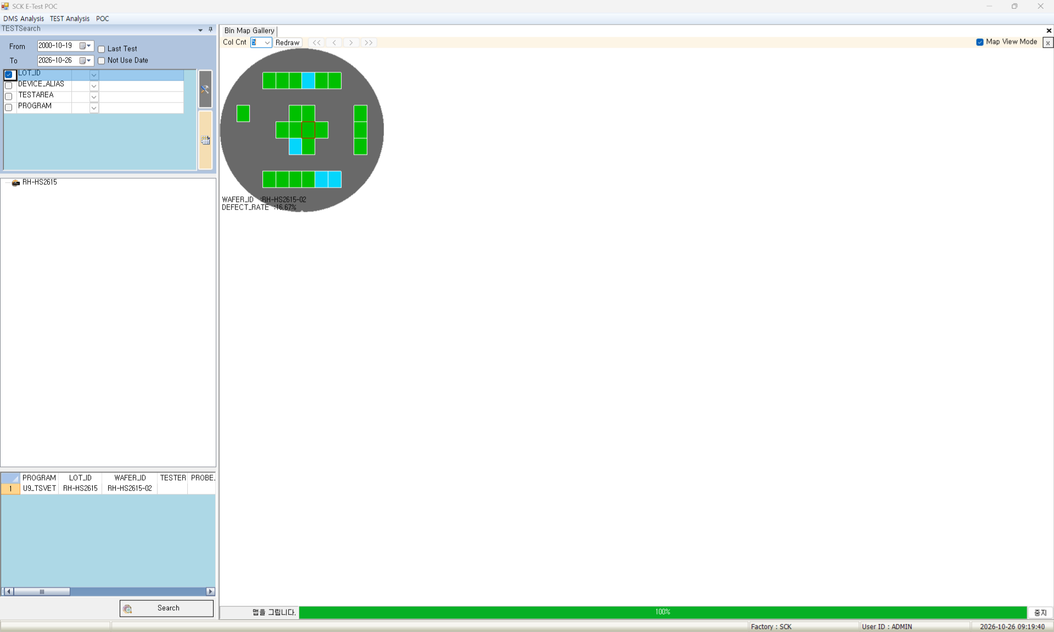
Bin Map Gallery
- Role : Compares bin maps of several wafers in a grid
Screen | Functions
 | Menu TEST Analysis → Bin Map Gallery View Bin-colored maps per wafer on one screen Product, program, yield, tester per map Enlarge one map Limit Not applied (view screen)
 | Items
 | Col Cnt : maps per row Redraw : rearranges the maps Map View Mode : double-click opens map analysis << < > >> : moves the enlarged view Stop : stops map creation Map Click : select maps (Ctrl, Shift for multiple)
1
2
4
3
5

Slide 28
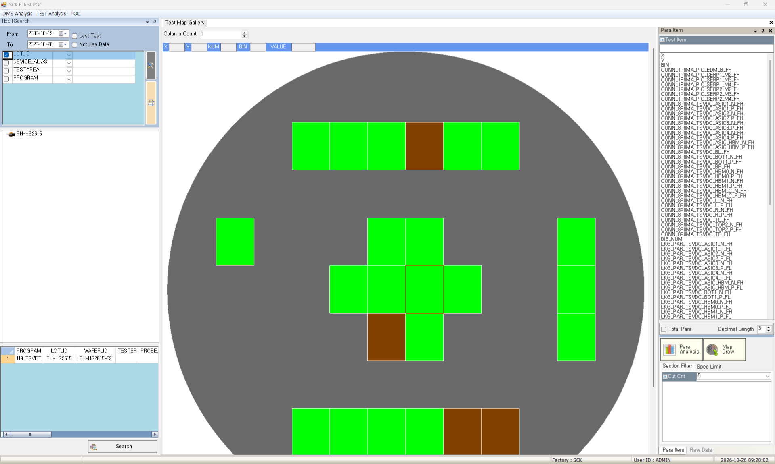
Test Map Gallery
- Role : Compares value maps of several wafers side by side
Screen | Functions
 | Menu TEST Analysis → Test Map Gallery View Compare value maps of one item Pass / fail map by spec lines Values per die of the item Limit Not applied (view screen)
 | Items
 | Column Count : maps per row Filter Box : filter by item name Total Para : shows all items Decimal Length : decimal places Map Draw : redraws with the item Section Filter : number and choice of ranges Spec Limit : select the spec
1
2
3
5
4
6
7

Slide 29
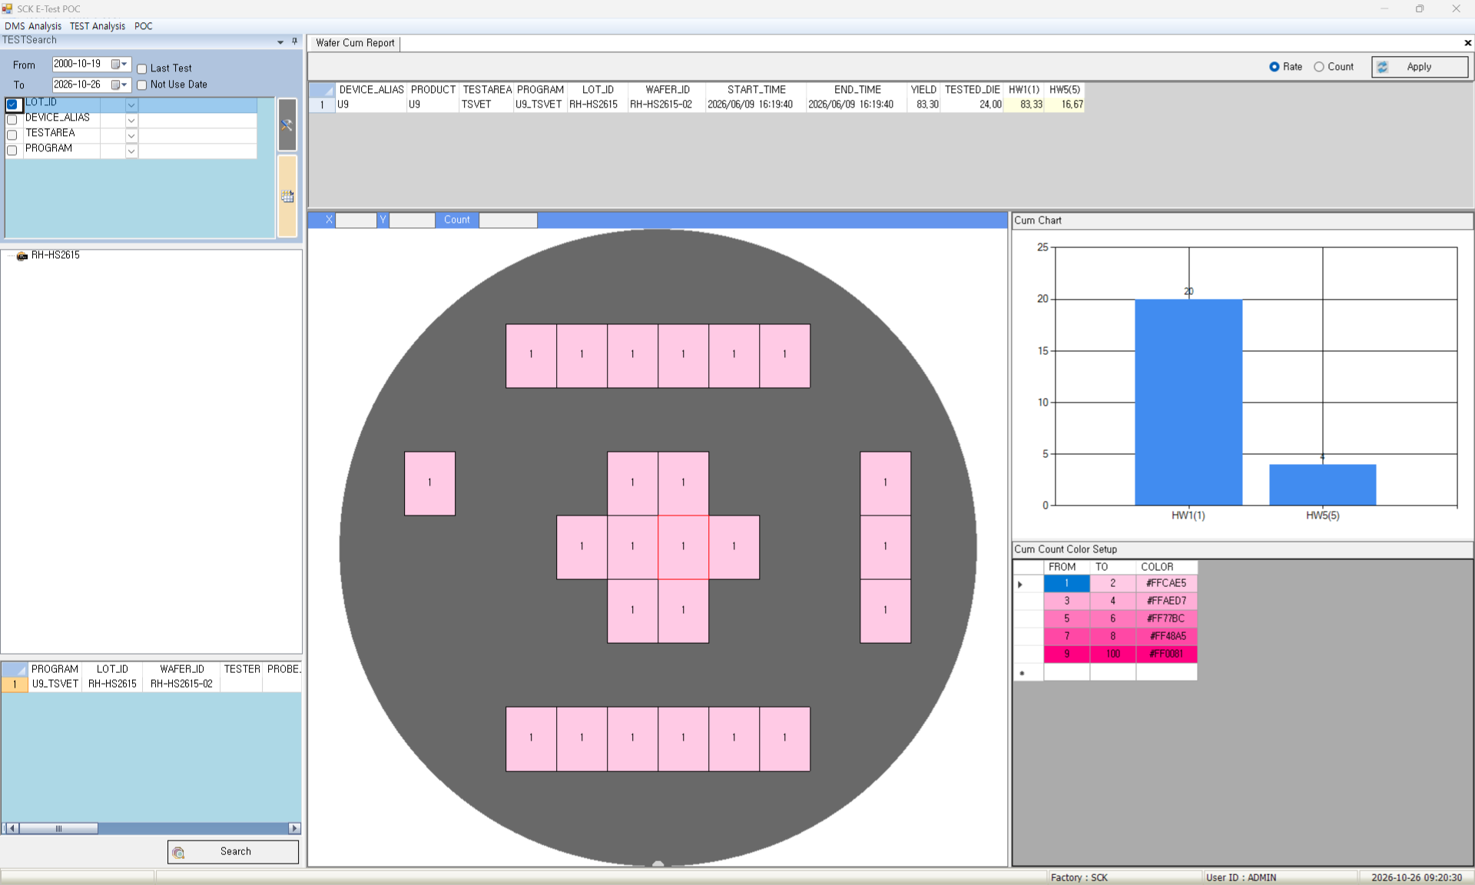
Wafer Cum Report
- Role : Shows bin locations of several wafers as a cumulative map
Screen | Functions
 | Menu TEST Analysis → Wafer Cum Report View Bin count and ratio per wafer Cumulative map of selected bins Bar chart of dies per selected bin Setup Colors by cumulative count Toggle table ratio / count Limit Not applied (view screen)
 | Items
 | Rate / Count : ratio or count Bin Column (yellow) : bins to accumulate Apply : cumulative map of wafers and bins X / Y / Count : die coordinates, count Cum Chart : dies per selected bin Cum Count Color Setup : colors by count
2
1
3
4
5
6

Slide 30
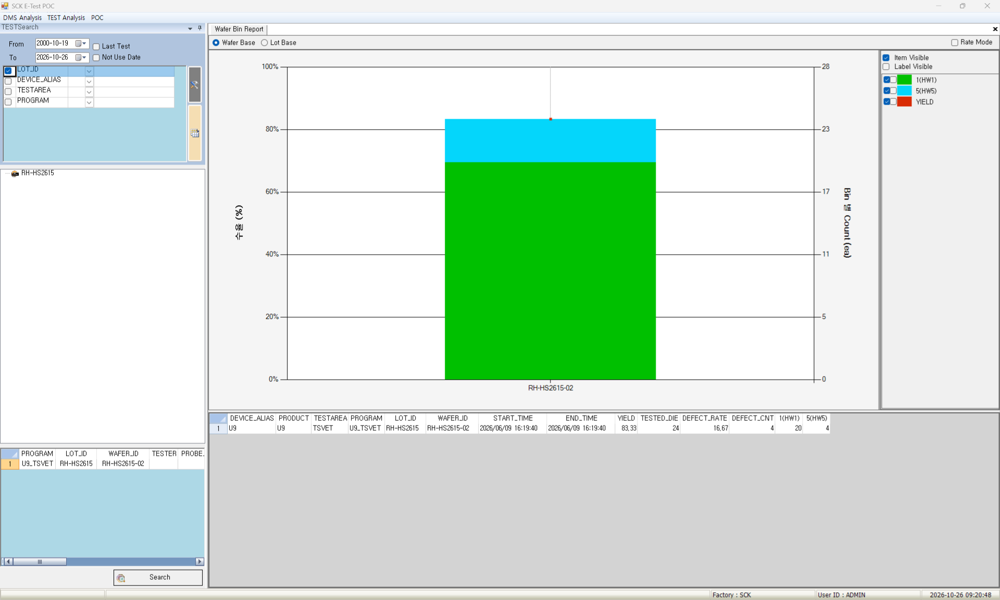
Wafer Bin Report
- Role : Charts bin composition and yield by wafer and lot
Screen | Functions
 | Menu TEST Analysis → Wafer Bin Report View Stacked bin bars and yield line per wafer Totals compared by lot Count, ratio, fail rate per bin Setup Chart Y-axis max, min, interval Show bins and value labels Limit Not applied (view screen)
 | Items
 | Wafer Base / Lot Base : per wafer or lot Rate Mode : bins as ratios Item Visible (legend) : bins to show Label Visible (legend) : values on bars Size Reset (right-click) : resets zoom Chart Config (right-click) : Y-axis range
1
3
2
4

Slide 31
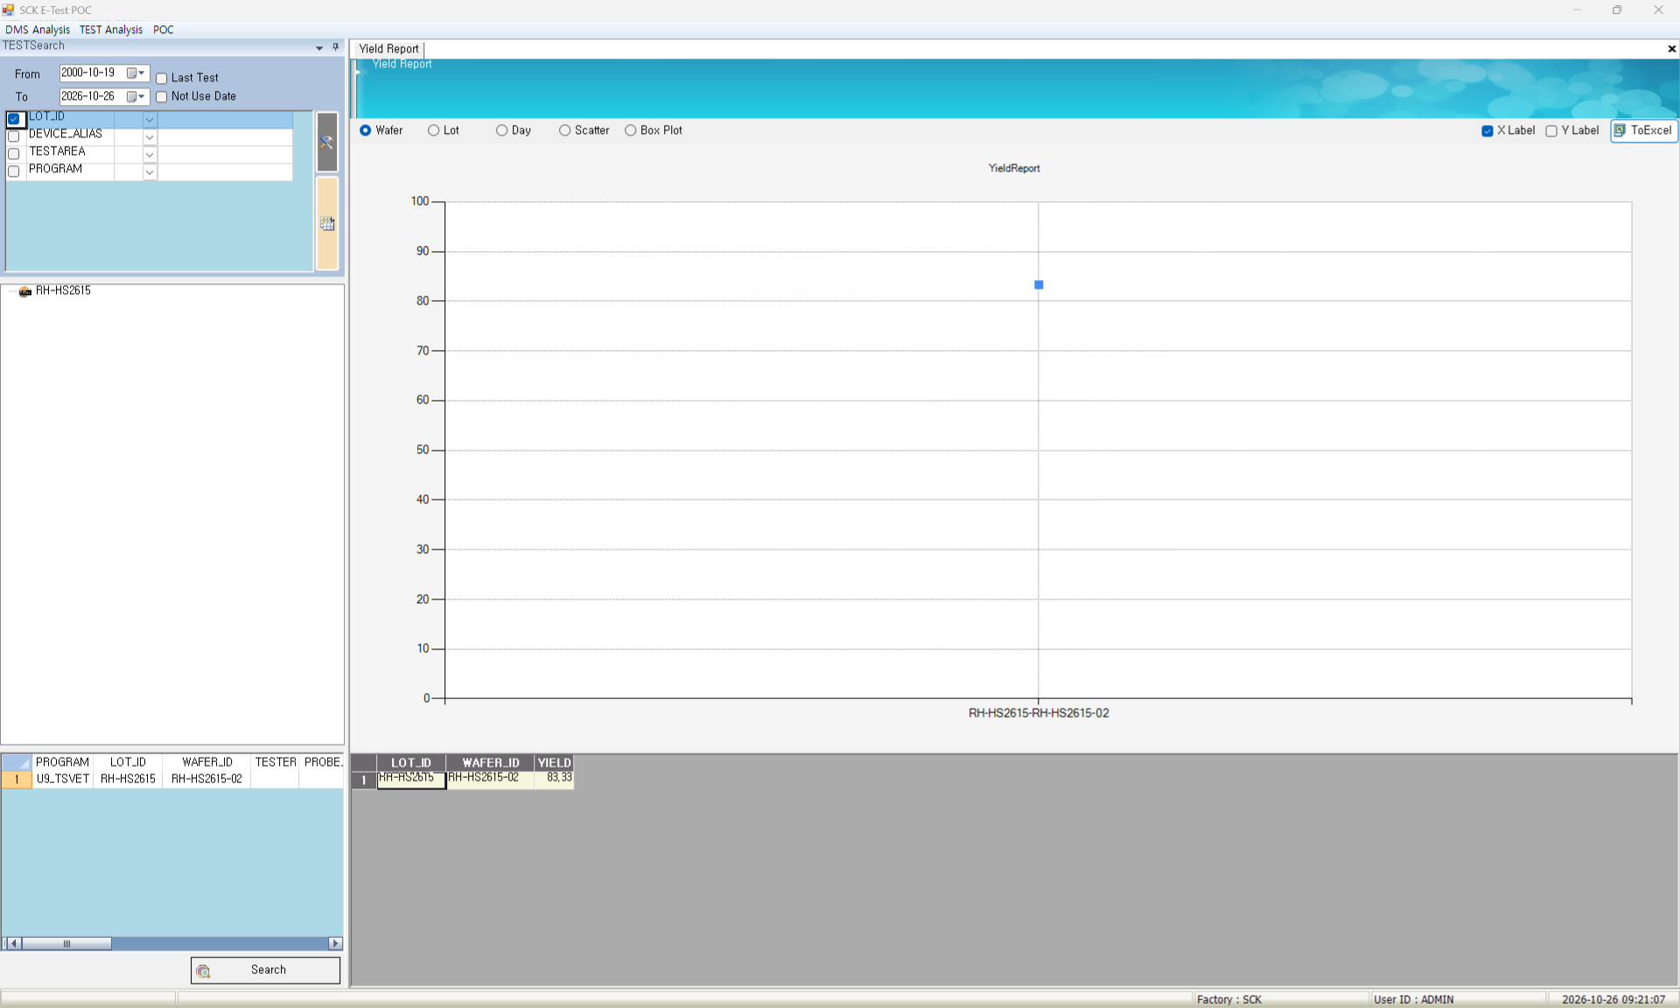
Yield Report
- Role : Charts yield trends by wafer, lot and day
Screen | Functions
 | Menu TEST Analysis → Yield Report View Yield line chart per wafer Average yield trend by lot and day Wafer yield distribution per lot Setup X-axis labels, point values Limit Not applied (view screen)
 | Items
 | Wafer : yield per wafer Lot : average yield per lot Day : average yield per day Scatter : wafer yield per lot Box Plot : yield box plot per lot X Label / Y Label : axis labels, point values ToExcel : saves table and chart to Excel
1
2
3
4
5
6
7

Slide 32
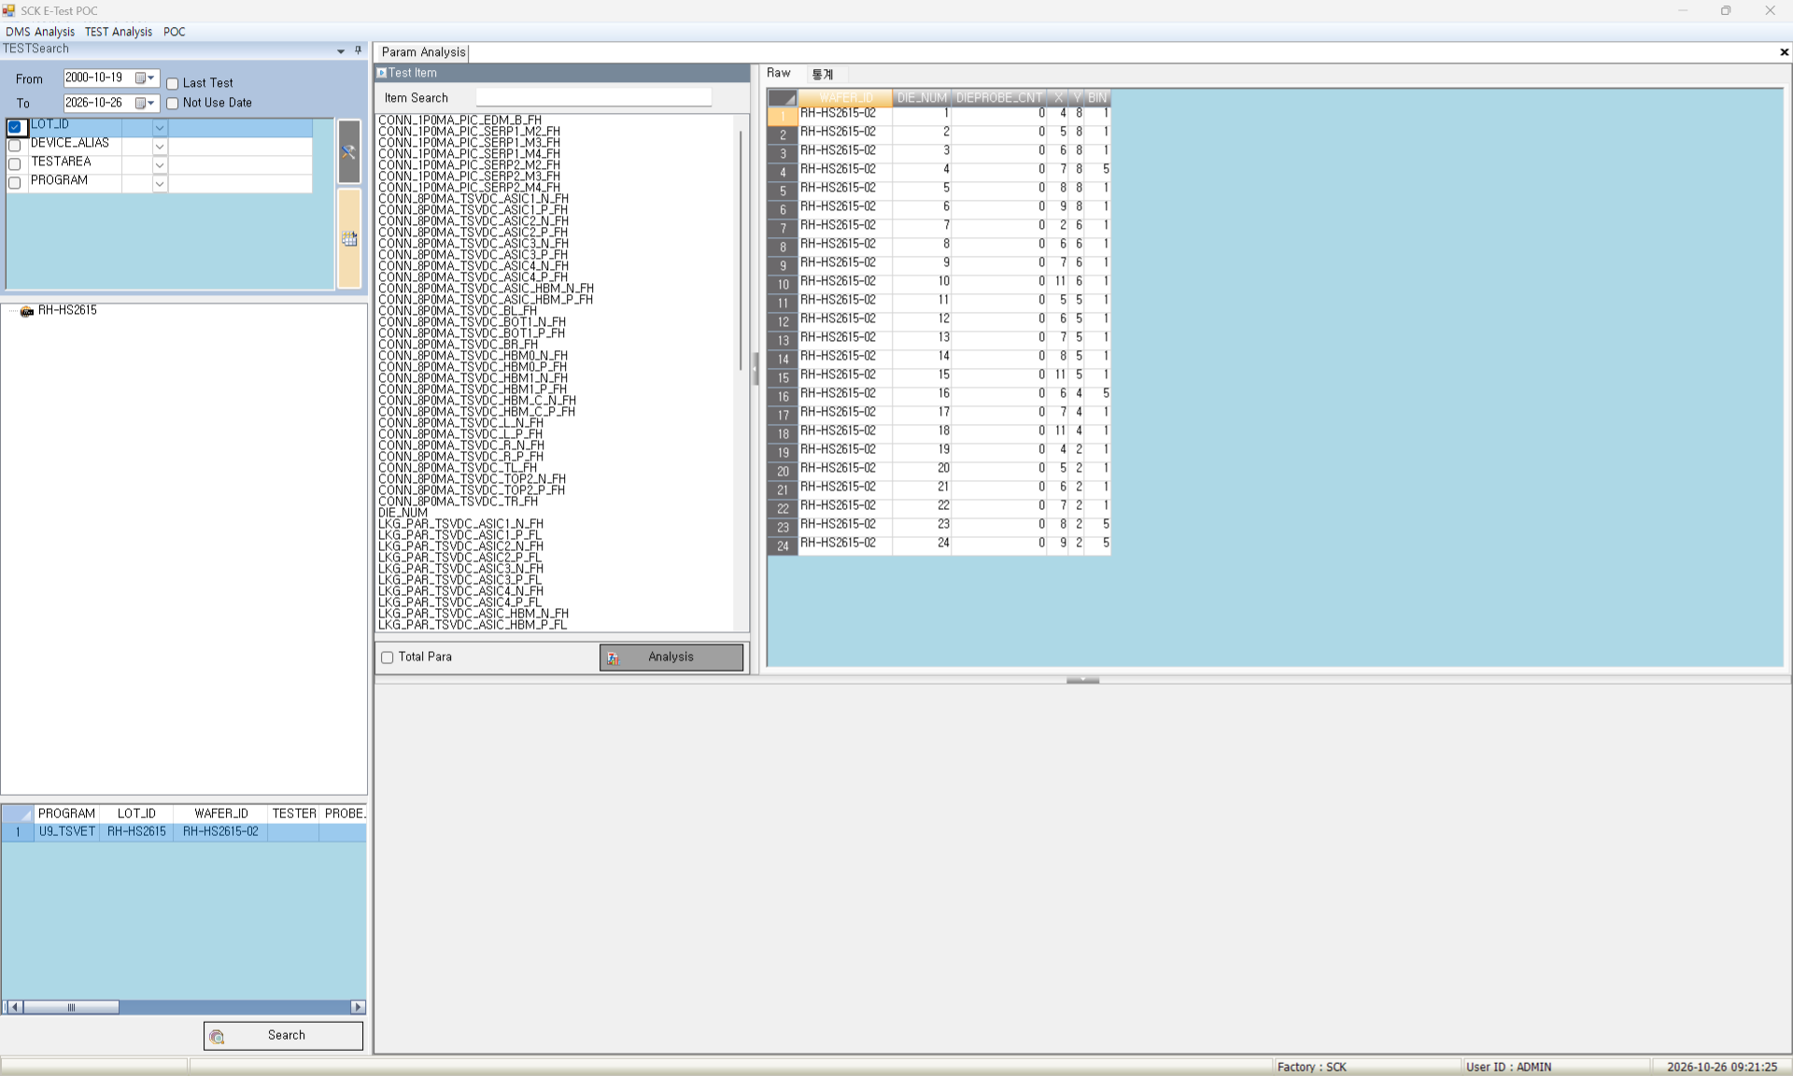
Param Analysis
- Role : Shows item statistics and trends for one wafer
Screen | Functions
 | Menu TEST Analysis → Param Analysis View Values per die (raw) Min, max, mean, std. dev. per item Setup Trend, sigma and spec lines Chart Y-axis max, min Limit Not applied (view screen)
 | Items
 | Item Search : filter by item name Total Para : shows all items Analysis : table and chart of the items Raw / Statistics : values per die, stats per item
1
4
2
3

Slide 33
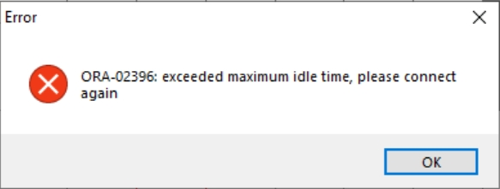
Troubleshooting
Oracle Connection Lost
Symptom : DB error on search or save after the program sits idle
Cause : the DB idle time limit closes unused connections
Action : restart the program or search again a few times
Shared Folder File Freeze
Symptom : the screen freezes when a GDS, KLARF or E-Test file is opened directly from a shared (network) folder
Action : copy the file to a local PC folder and open it from there
GDS Needs a Graphics Card
Symptom : on a PC without a graphics card, the GDS layout is not shown or a screen error occurs
Cause : the GDS layout is drawn by the graphics card
Screens : GDS Map Setup, GDS Map View, GDS-KLARF-ET Correlation Detail
Action : use a PC with a graphics card and driver (integrated graphics OK). Remote desktop, VDI or virtual PCs may not work

Slide 34

Copyright ⓒ2026 Miracom Inc. Co., Ltd. All rights reserved

