Slide 1


Planning day hikes using open data
Zsolt Sz Sztupak Raven 15/11/2025
Notes:
Hi, my name is Zsolt, and one of my hobbies are answering weird mapping related questions on social media

Slide 2

the irrelevant question I would try to find the answer to if I had an infinite amount of unnecessary time
where is the place in Hungary that is the farthest away from a Kossuth street?
Notes:
For example if someone asks me where is the place in Hungary that is the farthest away from a Kossuth street

Slide 3
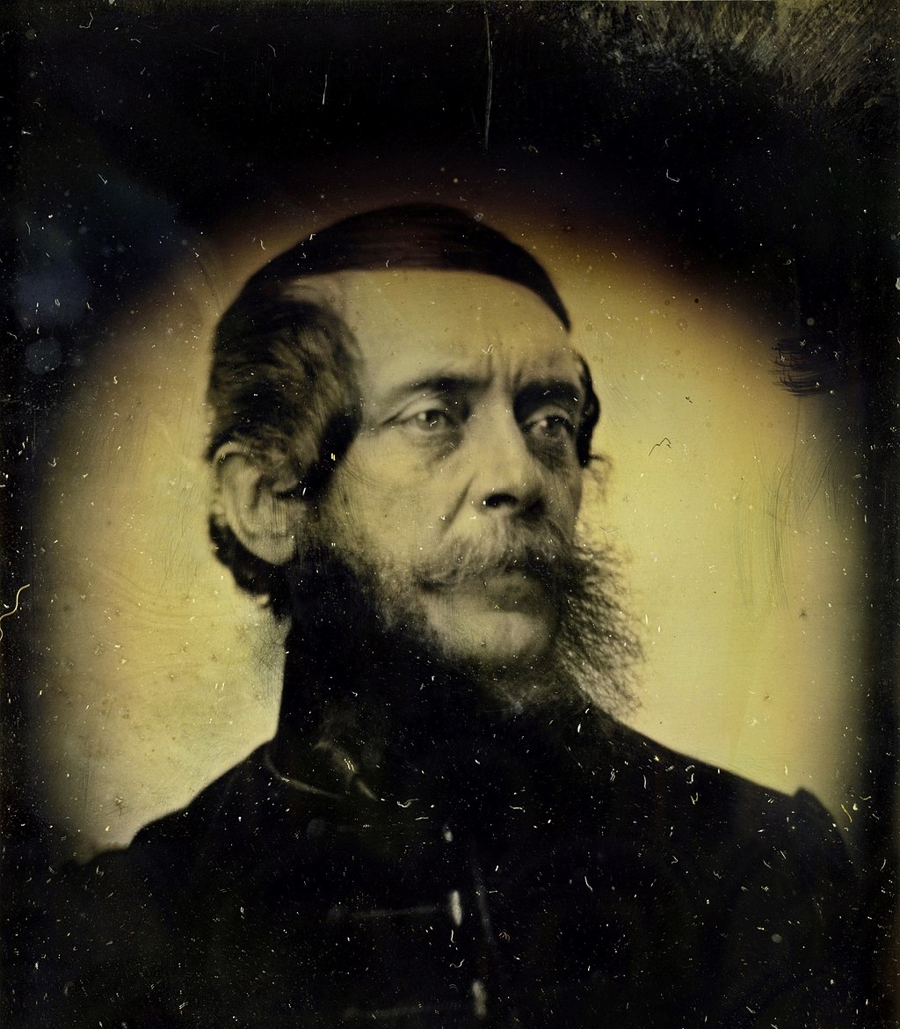
Context time!
Lajos Kossuth
Lived 1802–1894
Hungarian statesman
“Father of Hungarian Democracy”
Almost all towns and villages will have a “Kossuth street”
It is more likely to have than a “High Street” (Fő út)
Notes:
Lajos Kossuth was a famous Hungarian statesman, and in Hungary it is much more likely to have a “Kossuth street” in a village than a street called “High Street”

Slide 4
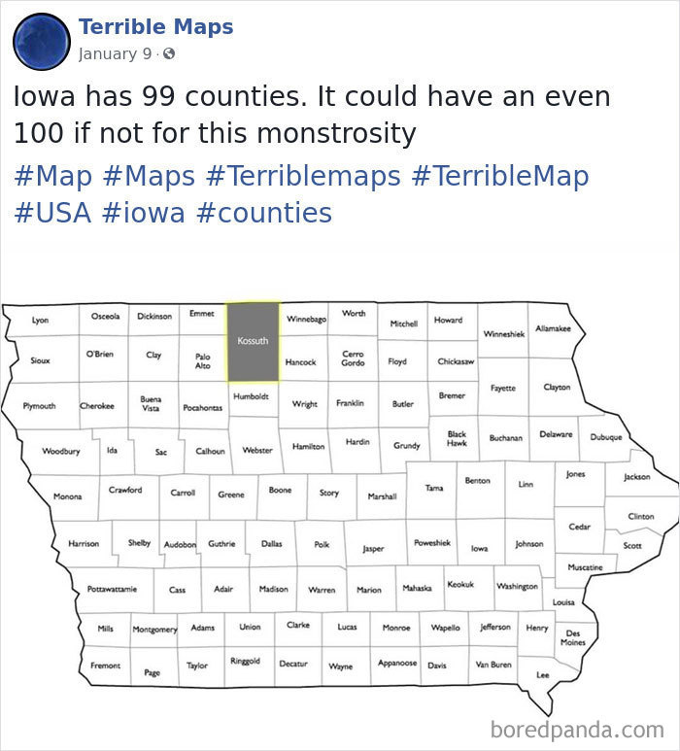
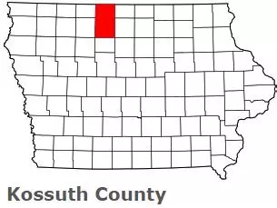
Notes:
For mapping geeks, he is also the namesake of the one Iowan county in the US that takes up two squares

Slide 5
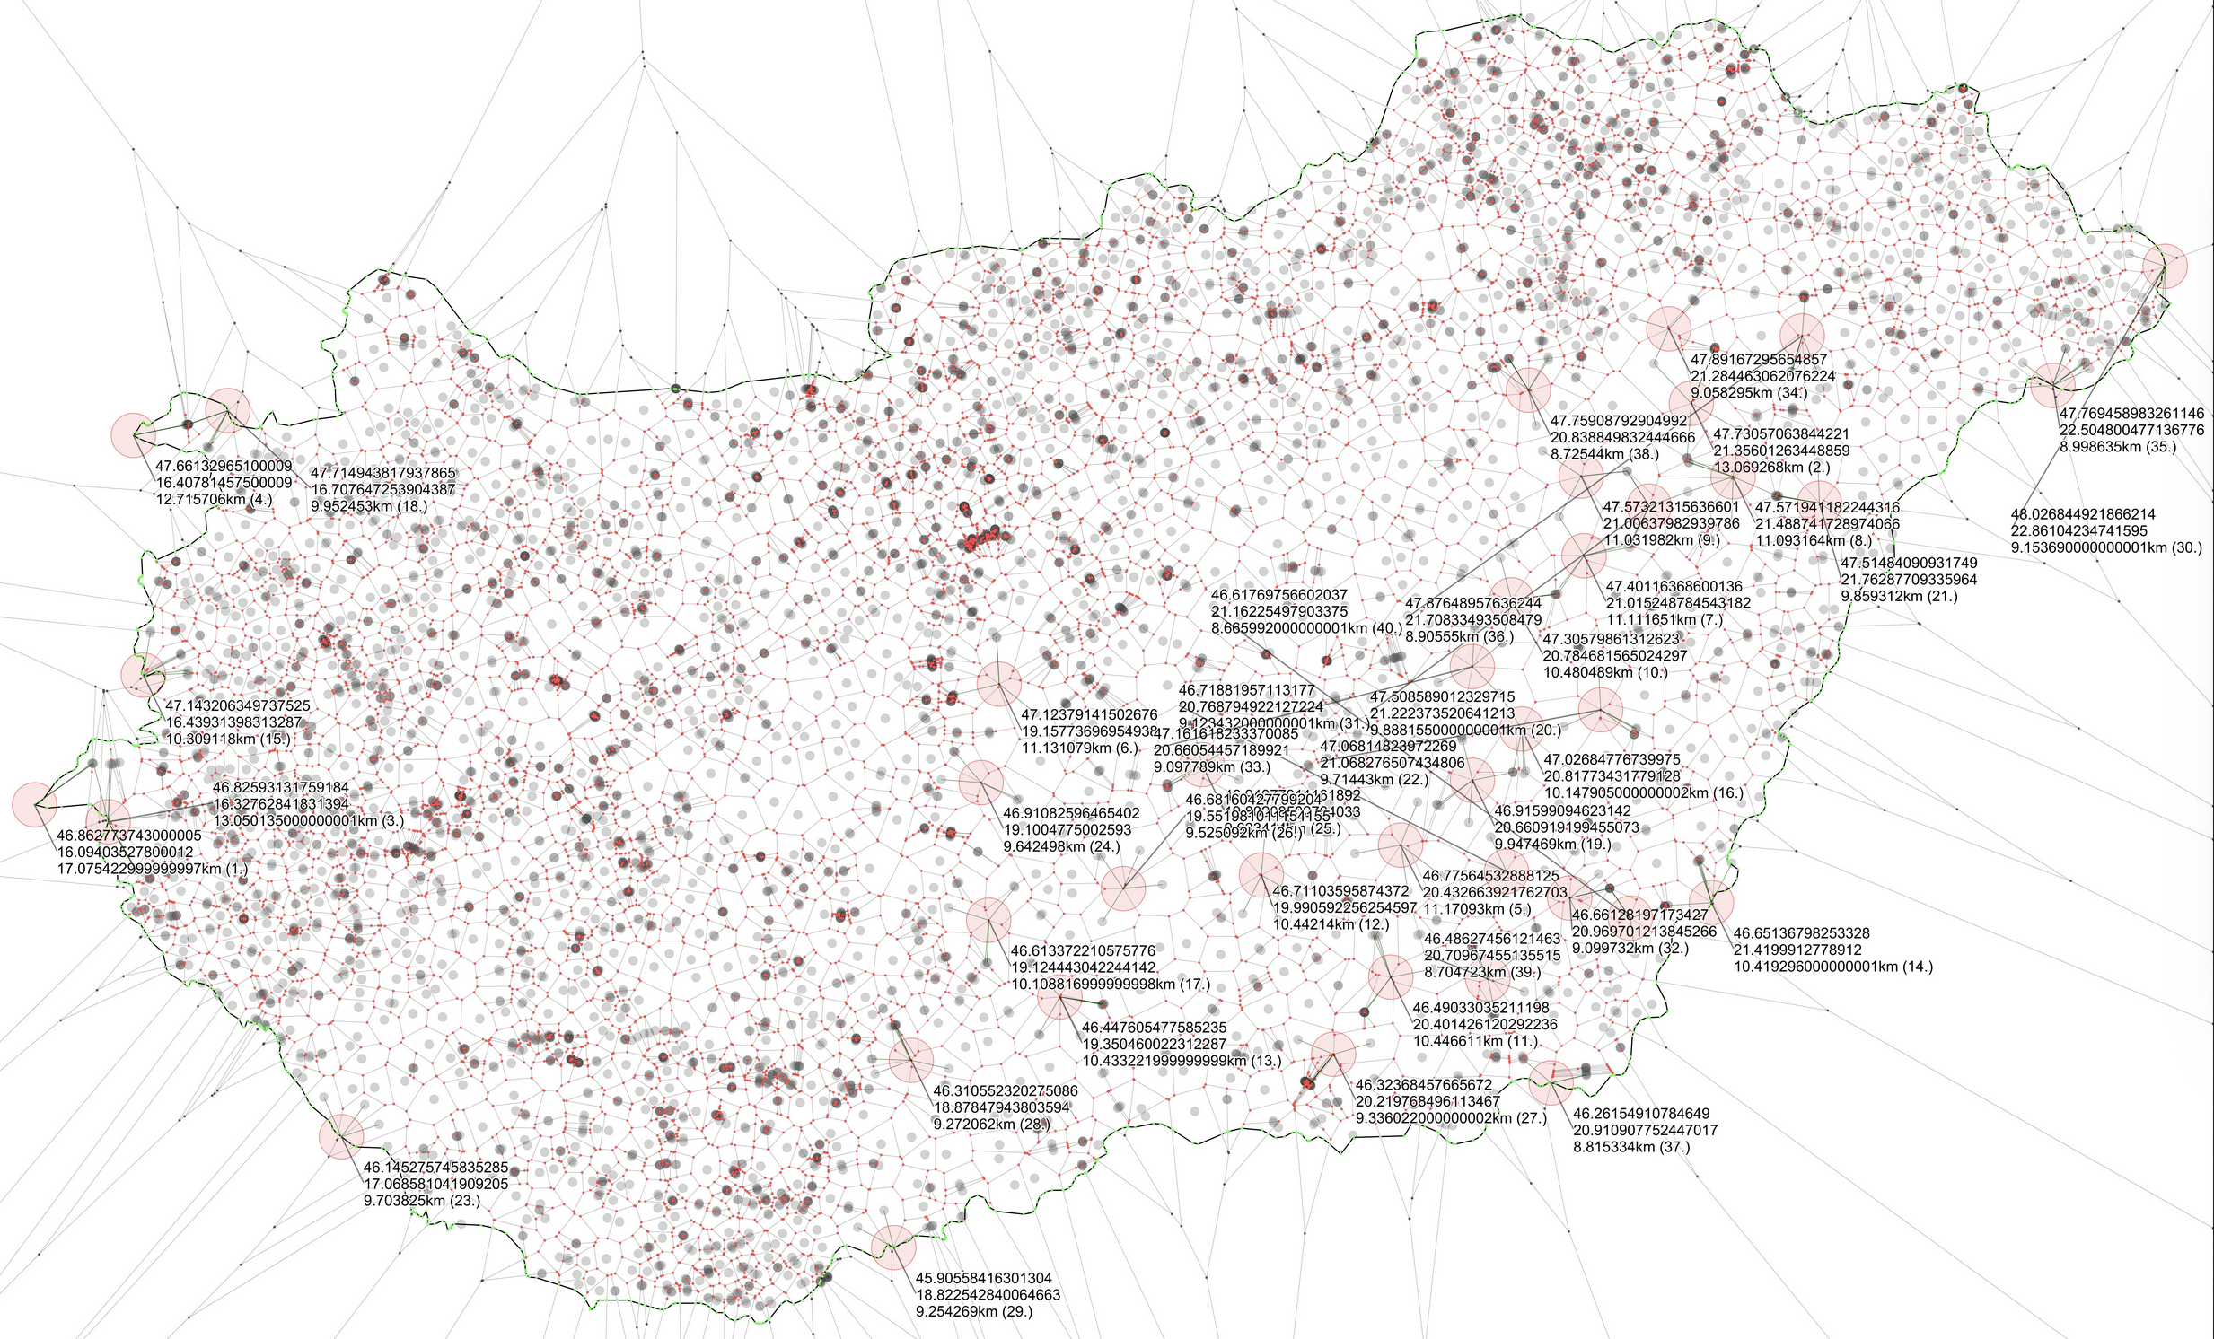
the irrelevant question I would try to find the answer to if I had an infinite amount of unnecessary time
where is the place in Hungary that is the farthest away from a Kossuth street?
Notes:
So back to the original question, it’s right there, in the corner. It’s 17 km away of the nearest Kossuth Street

Slide 6

Does anyone have any ideas for a section of the National Blue Trail that is between 15-20 km long and can be accessed by
leaving the car at point A
taking public transport to point B
and walking back to point A to the car
Notes:
So this was fun, but other times the questions look actually more useful, like the one here

Slide 7
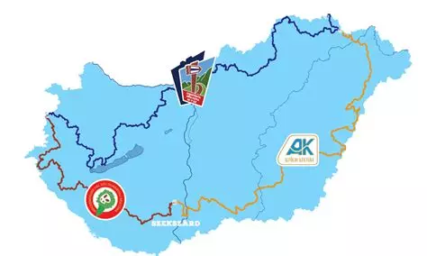
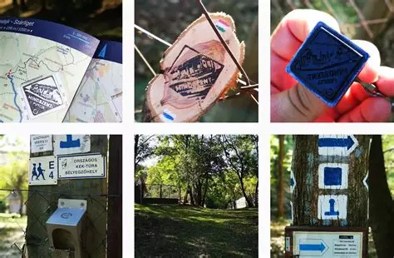
Context time!
National Blue Trail
First long-distance walking route in Europe first way-marked in 1938
Initially 910 km, but later extended to all around Hungary to 2595 km
It’s name comes from the blue marks along the trail showing the way
Official rules one how to complete the full trail with 304 stamps you need to collect in the official guidebooks along the route
There is no time limit and you can complete the whole route in small sections
Notes:
Again Context Time! The national blue trail is first way marked long-distance walking route in Europe, that is now around 2595km long with an official guidebook and certificate you can obtain when completing it. However there is no time limit and you can complete the route in small sections if you’d like

Slide 8
What do we need?
Data
The official route, including the list of sections
Publicly available from the National Blue Trail Website https://www.kektura.hu
Public transport data
OpenStreetMap
GTFS data (General Transit Feed Specification)
Long-distance buses (Volánbusz)
Budapest (BKK)
Trains (MÁV)
Walking routes between bus stops and the trail itself
OpenStreetMap
Notes:
So what data would we need? Obviously the official route, available from the official website, public transport data - OSM is unfortunately lacking here, but GTFS data is available for most of Hungary though, except for trains where the government keeps this data from the public, and finally the walking routes between bus stops and the trail, where we can actually use OpenStreetMap data

Slide 9
What do we need?
Tools
QGis
Manual editing of the input data
Postgres, with PostGIS and pg_routing
Bulk route calculations
OpenTripPlanner
Local system to obtain public transport connections in bulk
Notes:
Tool wise, we use QGis for some manual editing, Postgres’s PostGIS and pg_routing to quickly calculate routes in bulk, and OpenTripPlanner to have the GTFS data accessible through a local API

Slide 10
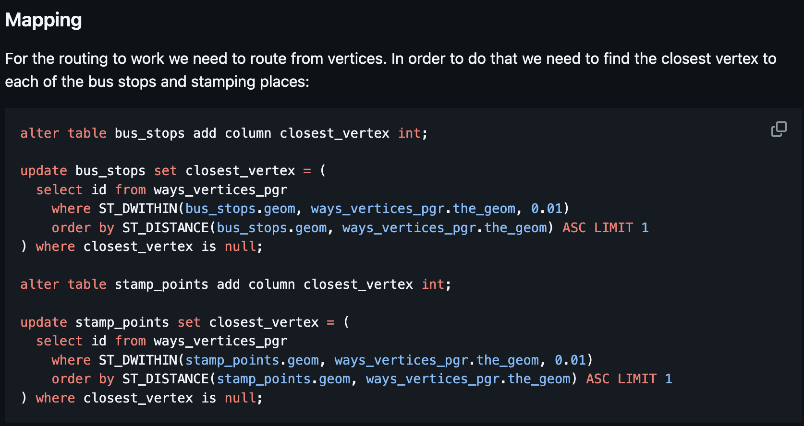
How to do this?
Full details on the project website: https://github.com/sztupy/kekkor-kereso
Notes:
Full details are on the project website with some nice code if you’re keen on this

Slide 11
How to do this?
Full details on the project website: https://github.com/sztupy/kekkor-kereso
First is lots of manual and semi-manual cleanup of the data
Mostly making sure the three sources of data align properly
National Blue Trail
OpenStreetMap
Public transport data from GTFS
Notes:
Crust is that there is lots and lots of manual and semi-manual cleanup of the data, mainly to align the three different sources so they behave well with each other

Slide 12
How to do this?
Full details on the project website: https://github.com/sztupy/kekkor-kereso
Next is running a custom script that would go through each viable section(s) of the trail
And first find the nearest bus stops
Use OSM data to calculate the walking route between the section’s end points and the bus stops
And then using OpenTripPlanner to calculate if there’s a viable bus route between the two bus stops
This is done in bulk, the whole calculation took around 10 hours to finish
Notes:
Once the data behaves it is time to actually calculate the possible routes. This is done by going through each pair of viable sections on the trail, and using OSM data (with pg_routing) to calculate the walking routes, then OpenTripPlanner to calculate the public transport data. This is done in bulk

Slide 13
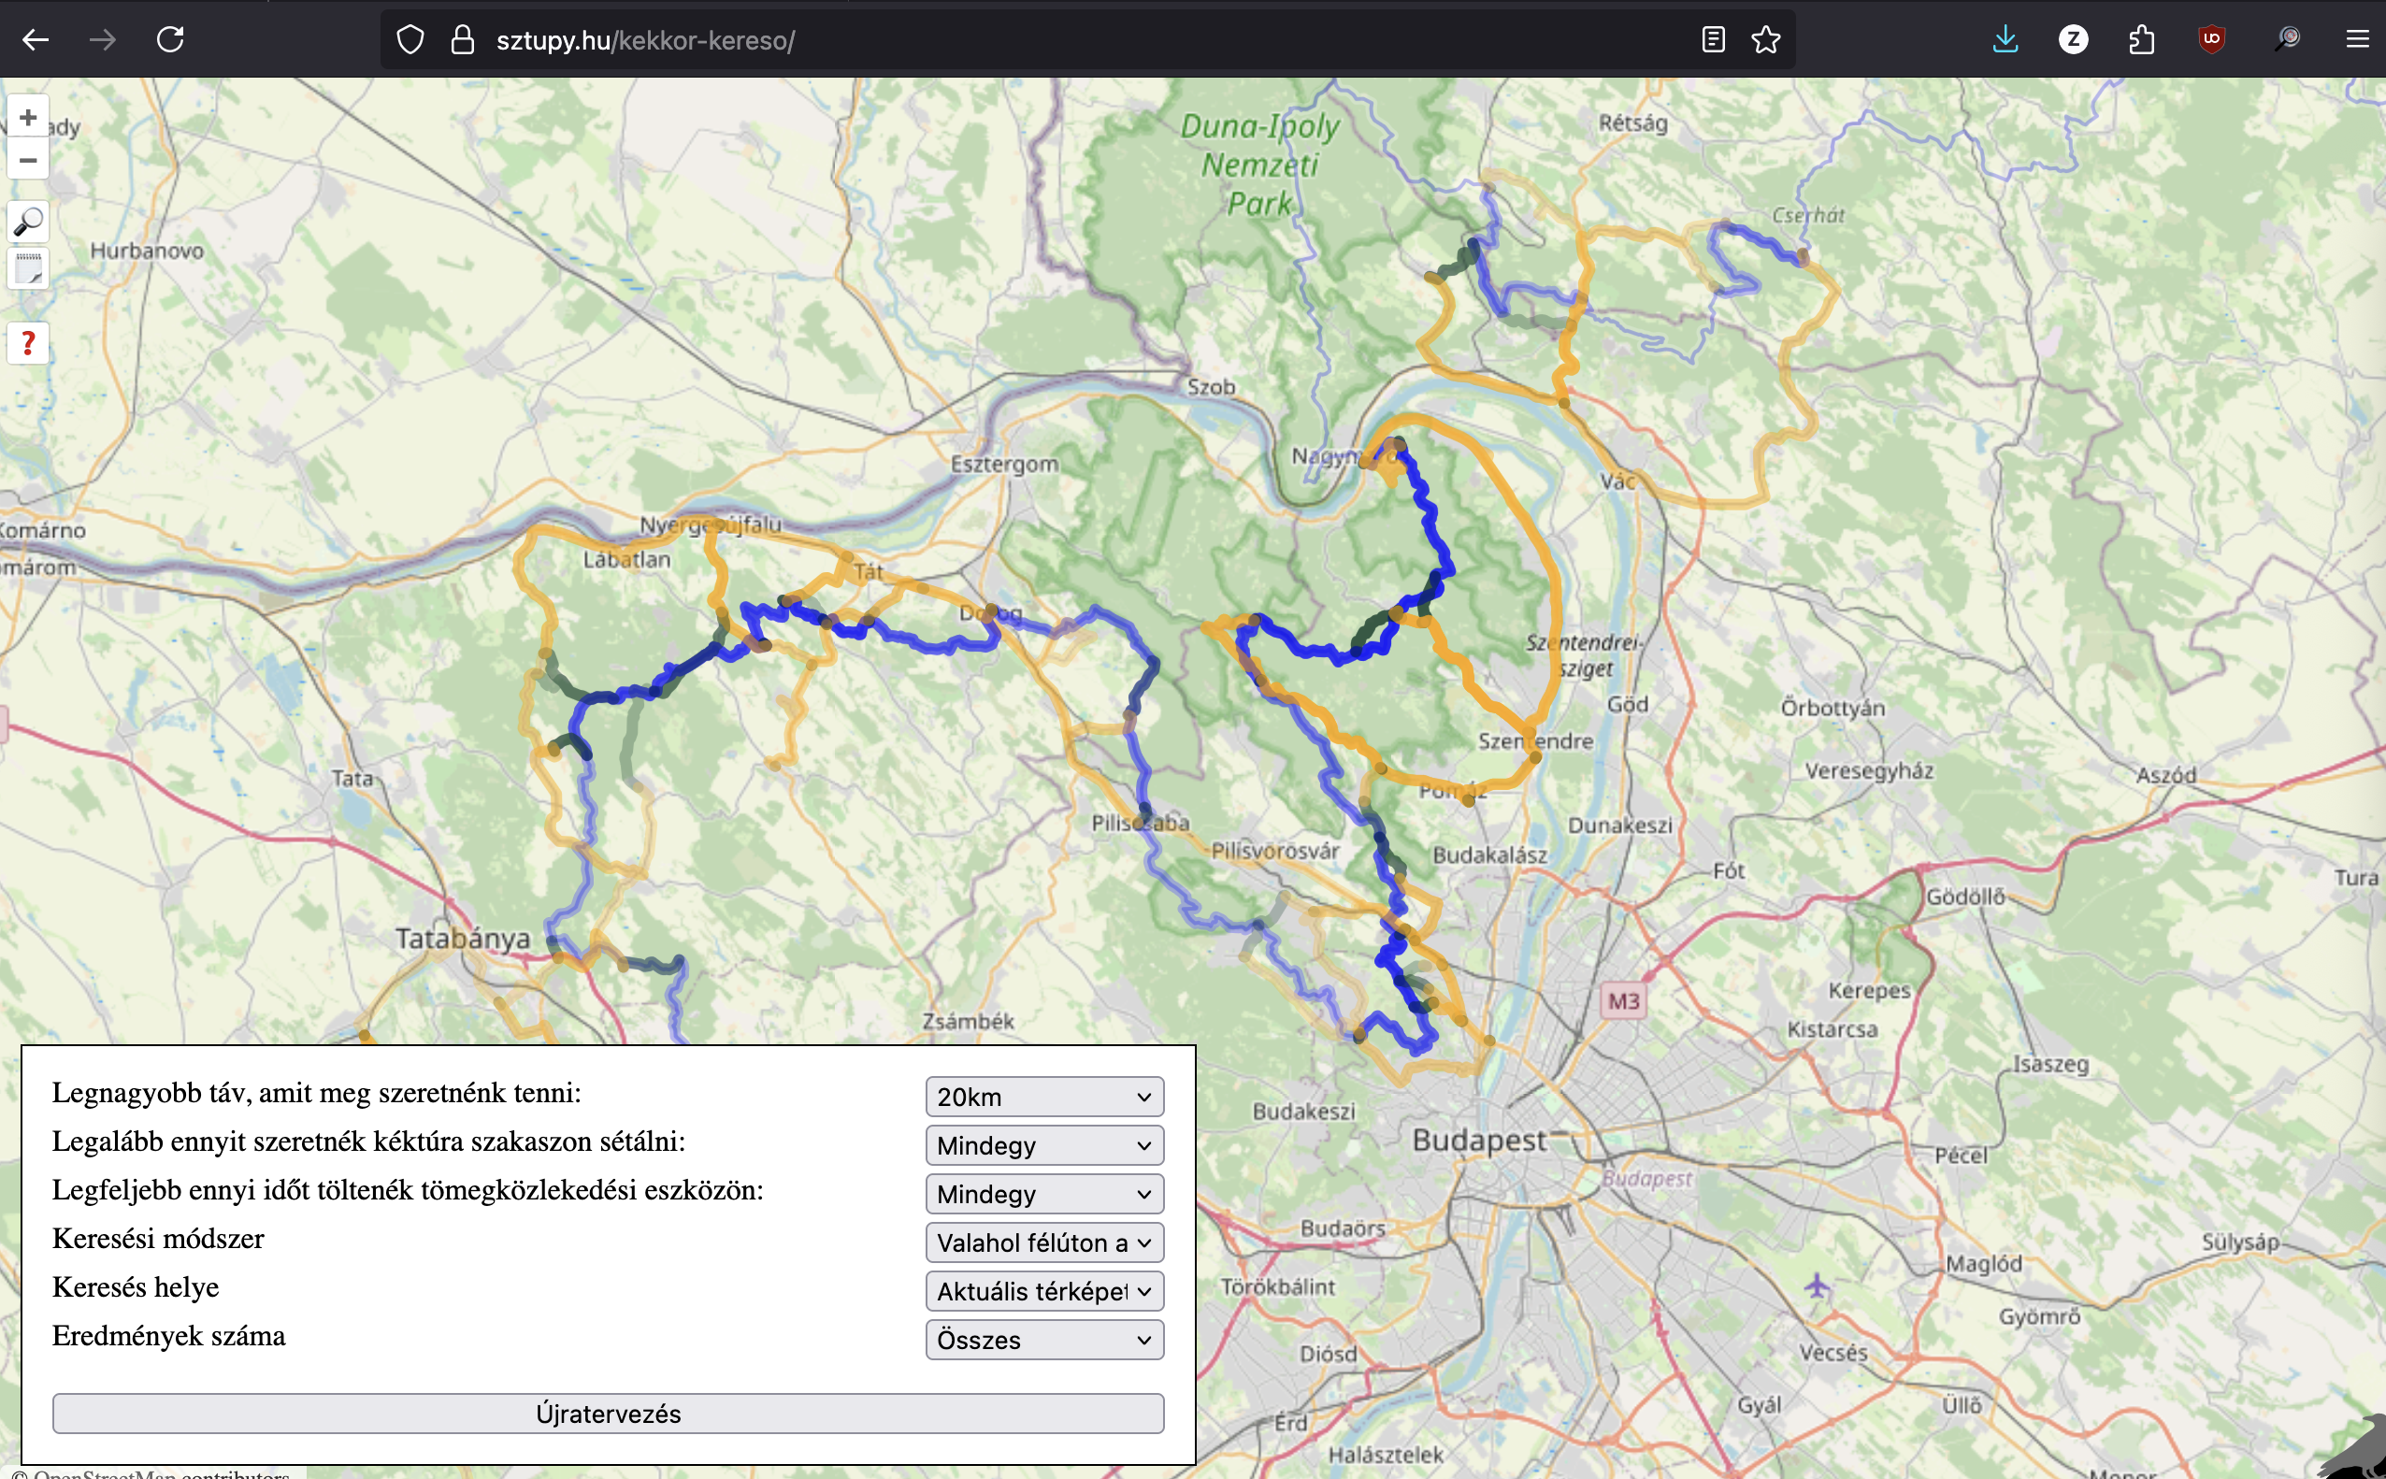
How to do this?
Full details on the project website: https://github.com/sztupy/kekkor-kereso
Presentation. We need to have a nice website to show the results, and allow people to play around with the data
https://sztupy.hu/kekkor-kereso/
Hungarian-only right now
Notes:
And finally presentation. We need to have a nice website to show the results. You can find this on the website, unfortunately it’s in Hungarian only so you’ll likely need to use Google Translate

Slide 14
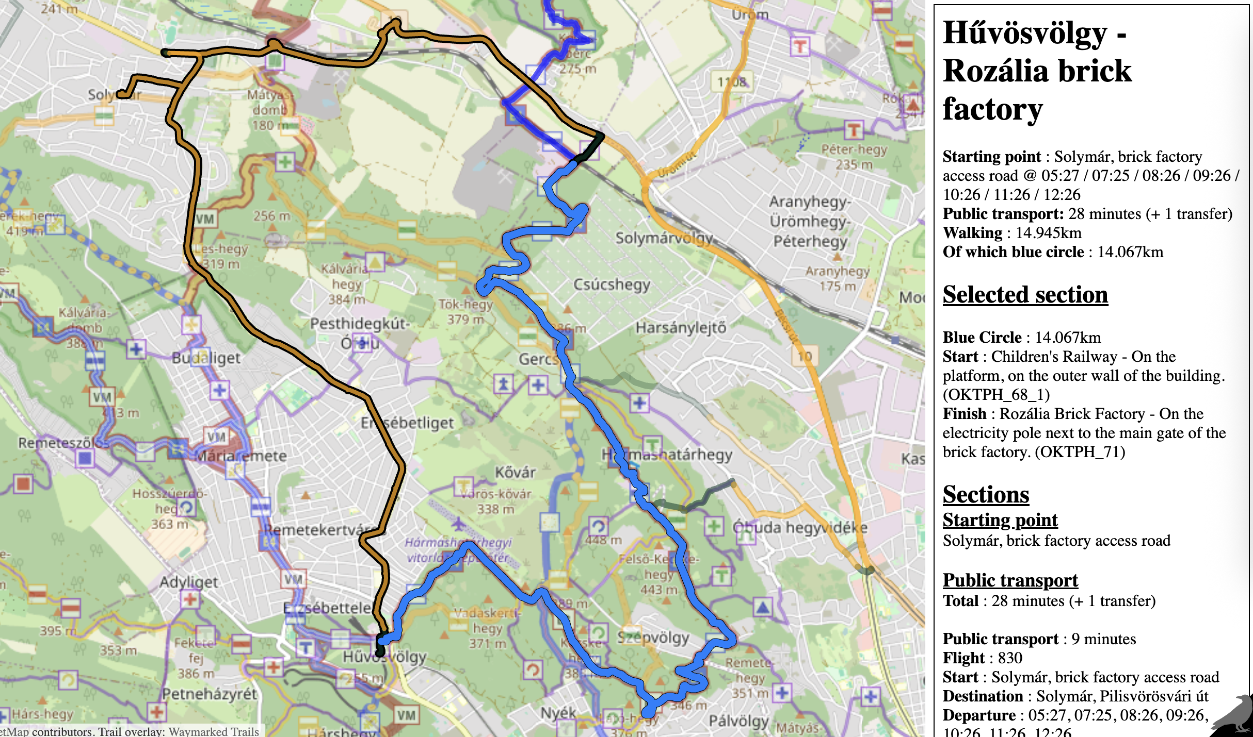
Example
Notes:
Here’s an example of what the tool gives out, if you want to have a nice stroll next time you’re in Budapest.You have to stop your car at the Solymár Brick Factory, take a 28 minute public transport to Hűvösvölgy (marked in orange), then walk 14 km along the blue trail (blue obviously), and finally arriving back to your car

Slide 15
Future?
Really want to do something similar to Scotland
However
No good free database of walking routes
WalkHighlands is the biggest source, but their licensing is opaque
They’re quite unfriendly towards people using their data
No good database for public transport
Bus Open Data Service is only available for England
While a lot of Scottish bus operators are nevertheless included, especially more local/rural ones are missing
Notes:
I really want to do something similar for Scotland, but there’s neither a good and free database of walking routes, nor a good database for public transport publicly available.

Slide 16
Thanks!
Source code and description (English): https://github.com/sztupy/kekkor-kereso/
Project Website (Hungarian): https://sztupy.hu/kekkor-kereso/
Contacts
My other projects: https://sztupy.hu/projects
Fediverse / Mastodon: @sztupy@social.sztupy.hu
Bluesky: @sztupy.bsky.sztupy.hu
Tumblr: https://tumblr.sztupy.hu/
Notes:
Thanks for listening, you can find the project details as above if you’re interested

Slide 17
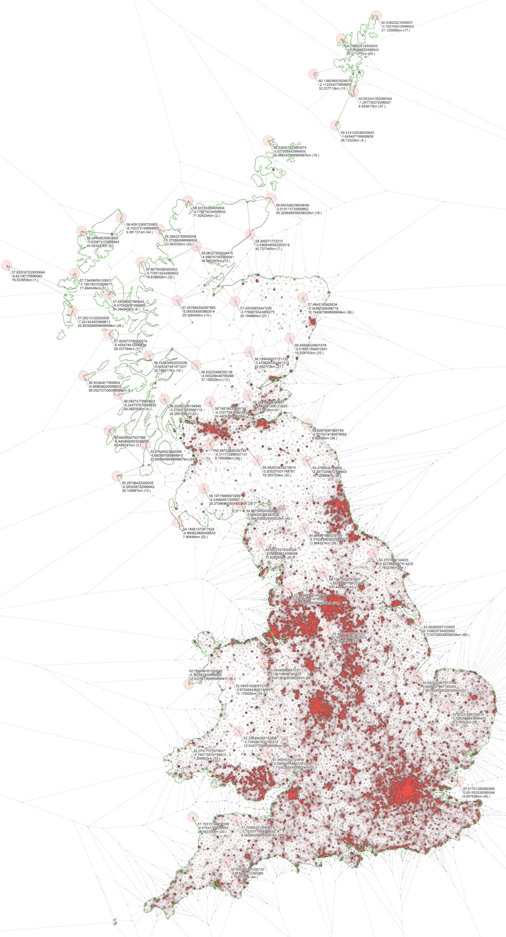
Thanks!
Source code and description (English): https://github.com/sztupy/kekkor-kereso/
Project Website (Hungarian): https://sztupy.hu/kekkor-kereso/
Contacts
My other projects: https://sztupy.hu/projects
Fediverse / Mastodon: @sztupy@social.sztupy.hu
Bluesky: @sztupy.bsky.sztupy.hu
Tumblr: https://tumblr.sztupy.hu/
The place in Britain furthest away from the closest pub
Notes:
And if you got mesmerised by the idea of finding points furthest away from something the place in Britain furthest away from the closest pub is in Sutherland, North of Scotland

