Slide 1
Using OSMF vector tiles
We have vector tiles, what now?
Notes:
Paul Norman and here to tell you all about the OSMF’s new vector tiles
Been working for OSMF as part-time contractor as well as being member of OWG. I’ve been around OSM since 2010

Slide 2
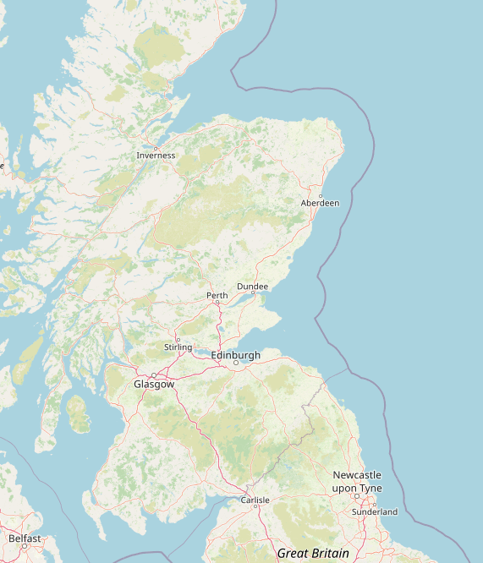
Standard tile layer
Using OpenStreetMap Carto for a style since 2013
Composed of 256px PNGs
Updated every minute with the latest data
Notes:
Start with the raster layer. Everyone has seen it, it’s the default on osm.org

Slide 3
Issues with the Standard tile layer
Data can’t be overlaid on top intelligently
New features like dark mode, retina tiles, fractional zooms, and rotation don’t work
Self-hosting heavier loads is difficult for others
Ignoring the usage policy causes undue load
Parts of the software stack are complicated with no developers
Notes:
The standard layer has a few issues. Some common to all vector tiles
Data can’t be overlaid on top very well. This is mainly an issue for sites other than osm.org
Dark mode, retina tiles, fractional zooms, and rotation don’t work with our raster tiles. If you’re one of the many mobile users the map will always seem a bit blurry
If someone wants to migrate to self-hosting, there’s not a great path. It can be daunting to set up and put into operation
The architecture makes it so people ignoring the usage policy cause undue load.
Parts of the software stack are complicated with no developers. If it were one or the other we could manage, but both is a problem

Slide 4
Vector tiles!
Not raster images
Does not include styling information
Allows more rendering flexibility
Contents of tiles are defined by a schema
  The OSMF is using Shortbread
Notes:
What’s the solution to some of these problems? Vector tiles
Vector tiles are fundamentally different from raster
They’re not images, they’re filled with points, lines, and areas. This is turned to an image client-side
More rendering flexibility which allows retina tiles, dark mode, etc. All the things from before that I said our raster tiles can’t do
What goes into the tiles is defined by a schema. We’re using shortbread. There’s a shortbread steering committee meeting this weekend

Slide 5
Using the tiles
Usage policy: https://operations.osmfoundation.org/policies/vector/
Key URLs
https://vector.openstreetmap.org/shortbread_v1/tilejson.json
https://vector.openstreetmap.org/shortbread_v1/{z}/{x}/{y}.mvt
Notes:
How do you get and use these tiles? See our usage policy.
You will need to give your software one of two URLs in the tiles

Slide 6
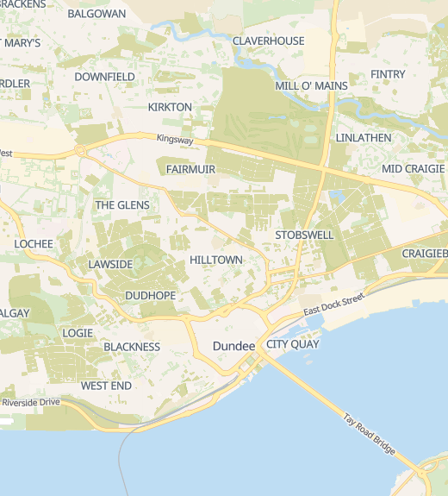
Using the tiles with MapLibre
You need a style that works with Shortbread tiles
https://switch2osm.org/using-tiles/getting-started-with-maplibre
VersaTiles Colorful is a good starting point
Notes:
If you want to use the tiles, you’re probably going to use maplibre
To use maplibre you need a style written for shortbread tiles. Switch2osm uses versatiles colorful, so I’m going to use that as an example. You can see full details at switch2osm.org
This will get you a map that looks like the right. Rather than just repeat instructions you can find online, I’m going to show how you can use the tiles in ways you couldn’t use the raster tiles

Slide 7
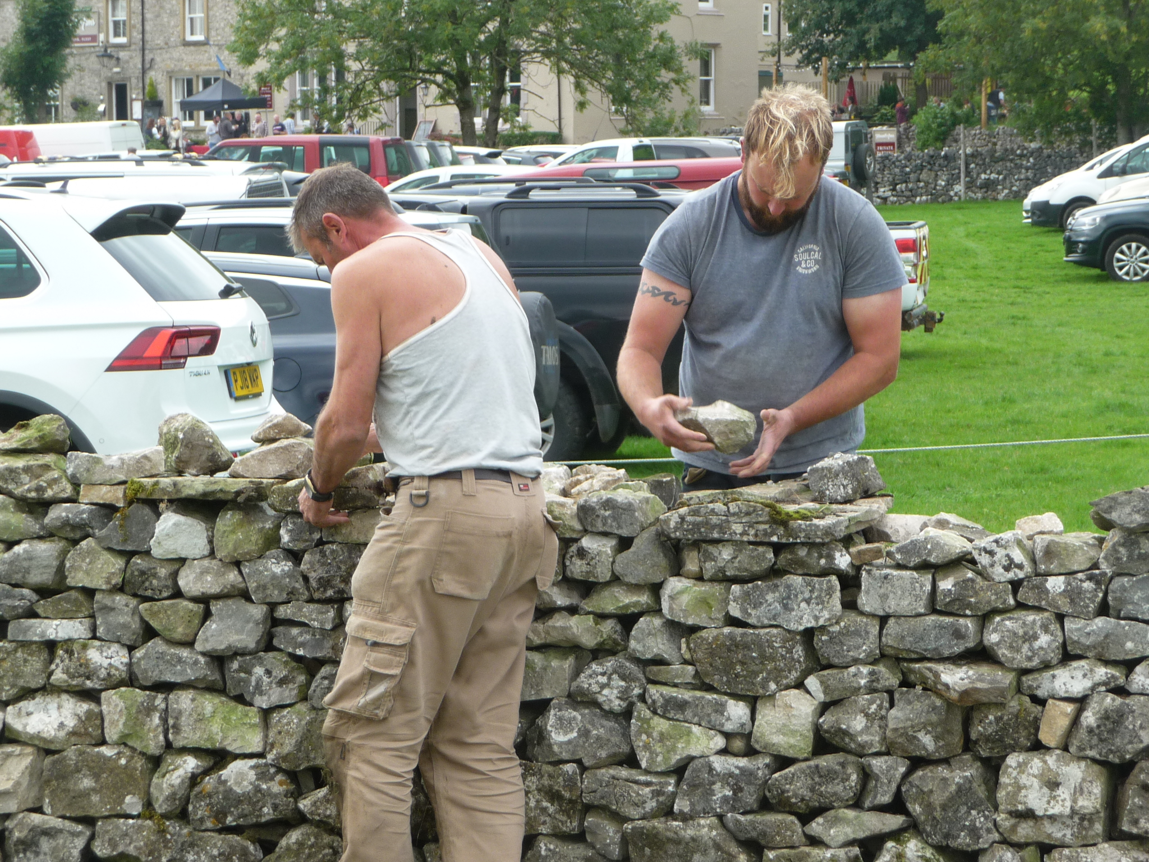
Get more from your map
Most maps exist to show you data and tell a story
Let’s add some data
Using walls as an example
Tiles with detailed wall data are needed
Notes:
Normally with a map you want to highlight some data. I’m going to use the example of walls. Now, the vector tiles don’t contain detailed information on walls. We need to bring our own vector tiles.
But, we only need walls in our tiles. We can use the OSMF vector tiles for everything else

Slide 8
Making tiles with tilemaker
https://github.com/systemed/tilemaker is software to generate tiles from OSM data
You can generate your own shortbread tiles with this
We’re going to generate tiles with wall data
Notes:
We’re going to use software called tilemaker to make the tiles. You can use it to generate your own shortbread tiles, but we’re just doing wall data.
I’m going to go through the next slides quickly. The tilemaker config isn’t complicated but you can read it online later.

Slide 9
Config files
{
"layers": {
"walls": { "minzoom": 10, "maxzoom": 14 }
},
"settings": {
"minzoom": 10,
"maxzoom": 14,
"basezoom": 14,
"include_ids": false,
"compress": "gzip",
"name": "Walls example",
"version": "0.1",
"description": "Sample fector tiles"
}
}
Notes:
We tell tilemaker that there’s one layer in the tiles that are being made

Slide 10
Config files
elseif wall == "stone" or material == "stone" then
kind = "stone"
elseif wall == "concrete" or material == "concrete" then
kind = "concrete"
elseif material == "wood" then
kind = "wood"
end
if kind ~= nil then
-- The lower side of a retaining wall is on the right, so that's the side we see the wall from
if barrier == "retaining_wall" then
Attribute("right", kind)
else
Attribute("right", kind)
Attribute("left", kind)
end
end
end
end
Notes:
It writes out attributes based on the materials

Slide 11
Config files
way_keys = {"barrier=retaining_wall", "barrier=wall"}
function way_function()
local barrier = Find("barrier")
-- Roads
if barrier == "wall" or barrier == "retaining_wall" then
local wall = Find("wall")
local material = Find("material")
local height = Find("height")
Layer("walls", false)
local kind
if wall == "dry_stone" then
kind = "dry_stone"
elseif wall == "brick" or material == "brick" or material == "masonry" then
kind = "brick"
Notes:
We then write a config. It looks at barrier=wall or retaining_wall
It gets a few tags and then…

Slide 12
Generate some pmtiles!
It takes 2 minutes to generate walls.pmtiles for the planet
Serve the style, associated files, and pmtiles at http://127.0.0.1:8000/
Use Maputnik, a visual style editor and load the style
Notes:
We’re going to save the tiles in a collection in the pmtiles format. This is a format that is easier to deal with than millions of small files. We can then use Maputnik, a visual style editor to add walls to the style

Slide 13
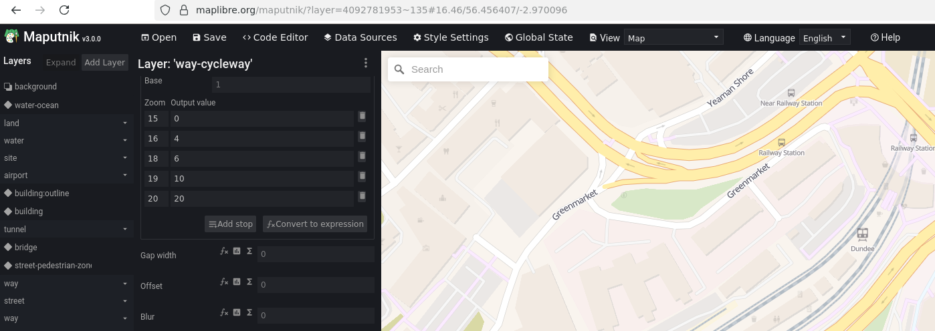
Maputnik
Notes:
We’ll open up maputnik and load the versatiles colorful style we made based on the switch2osm instructions

Slide 14
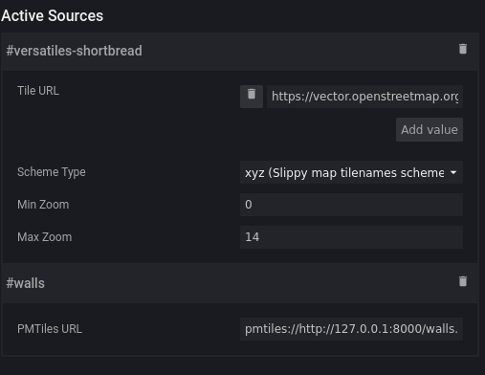
Add a PMTiles source
PMTiles requires a plugin which Maputnik already has
Add layers using the new source
Notes:
We then add another source. The first source is the OSMF vector tiles. The second is wall data.

Slide 15
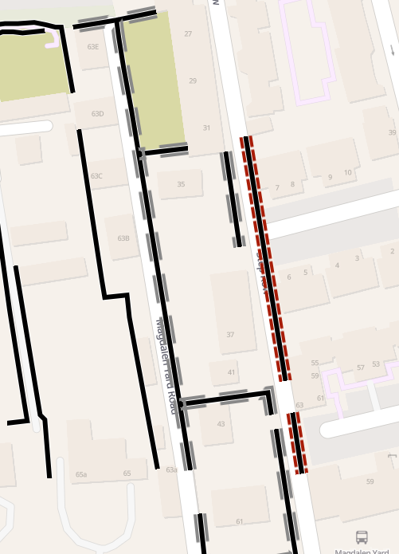
Some simple styling
Colored sides indicate the material on that side
See published files for details
Possible with raster tiles with a transparent overlay
Notes:
We’ll add some simple styling based on the material of the walls
So far we haven’t done anything that’s impossible for raster tiles. It would be more difficult, but it can be done.

Slide 16
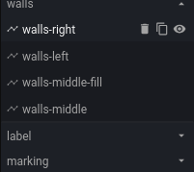
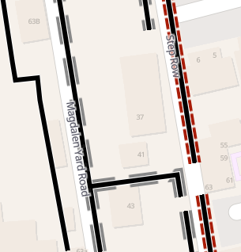
Making it better
Labels should be drawn on top of walls
Drag the layers to the right place and export the style
Notes:
Normally you want labels to be drawn on top of lines and other areas. This is easy with vector tiles. You just move the layers around.

Slide 17
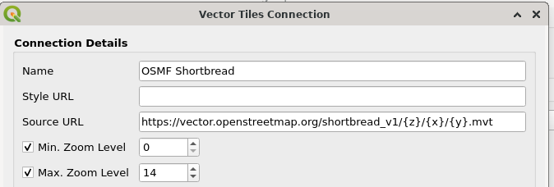
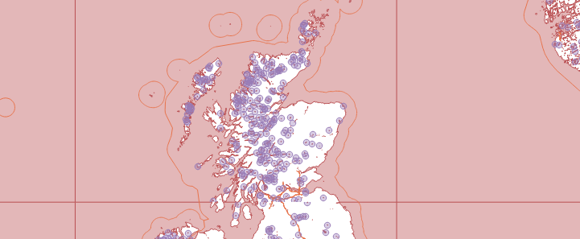
Using them in QGIS
QGIS can natively read vector tiles
You can style in QGIS or import a
Notes:
Vector tiles aren’t restricted to maplibre. You can use them in qgis too. Either the tiles by themselves, or qgis can read some maplibre styles.

Slide 18
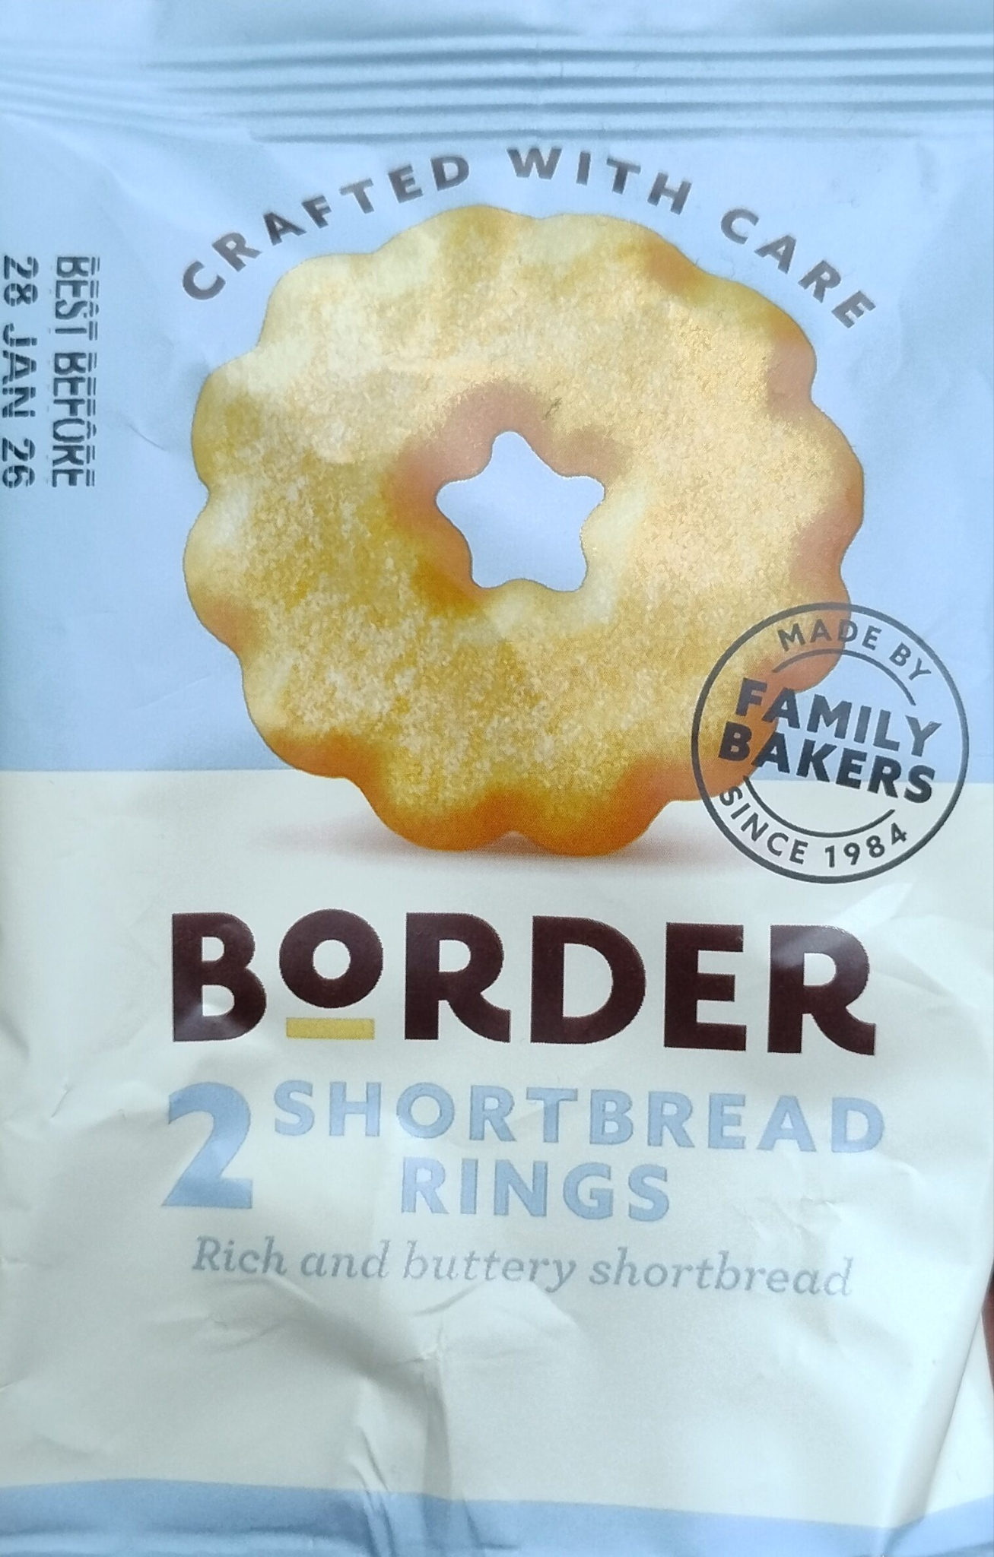
What can I do next?
Make your own Shortbread tiles with tilemaker
Download pre-made tiles from Geofabrik
CC BY-SA factfinds@openfoodfacts

Slide 19
What’s next for OSMF vector tiles?
Shortbread 1.1
  Better multilingual support
  Missing POIs added
  Route relations?
  Access restrictions?
More styles

Slide 20
Get involved!
Write and publish styles using Shortbread
Get involved at shortbread-tiles.org
Help with the implementation at https://github.com/pnorman/spirit
Help with the serving at https://github.com/pnorman/tilekiln

