Slide 1


State of the Map Europe 2025
Complementing OSM Cycling Data through Official Datasets
Christos Konstantinou
European Cyclists’ Federation

Slide 2
General Structure
Extraction of cycling infrastructure data in a standardized format
From OSM
From official datasets (Extensive research of official national, regional and local cycling infrastructure datasets in EU Member States)
Developing a methodology for comparing datasets
Results of dataset analysis and comparison
Use case: EuroVelo
Next steps
Notes:
This is the general structure of the presentation

Slide 3
Extraction of cycling infrastructure in standardized format - OSM
Extraction of cycling infrastructure types
Cycle tracks
Cycle and pedestrian tracks
Cycle lanes
Bus and cycle lanes
Cycle street
30 km/h roads
Specific service roads
Contraflow cycling

Slide 4
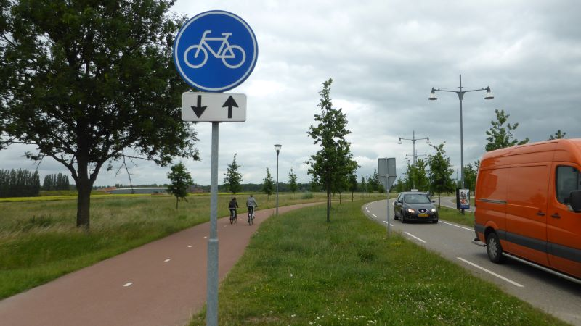
Extraction of cycling infrastructure in standardized format - OSM
Cycle track
A cycle track is an independent road or part of a road designated for cycles, signposted as such. A cycle track is separated from other roads or other parts of the same road by structural means.

Slide 5
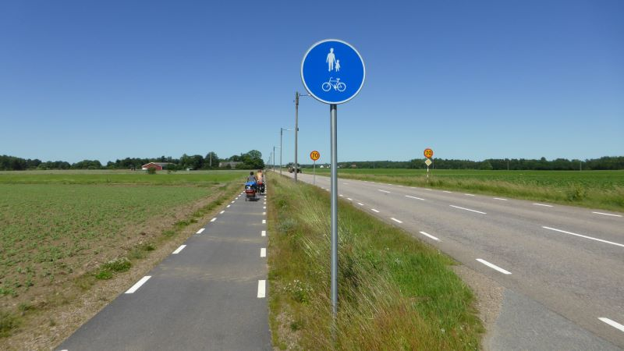
Extraction of cycling infrastructure in standardized format - OSM
Cycle and pedestrian track
A cycle and pedestrian track is an independent road or part of a road designated for cycles and pedestrians sharing the same surface, signposted as such. A cycle and pedestrian track is separated from other roads or other parts of the same road by structural means.

Slide 6
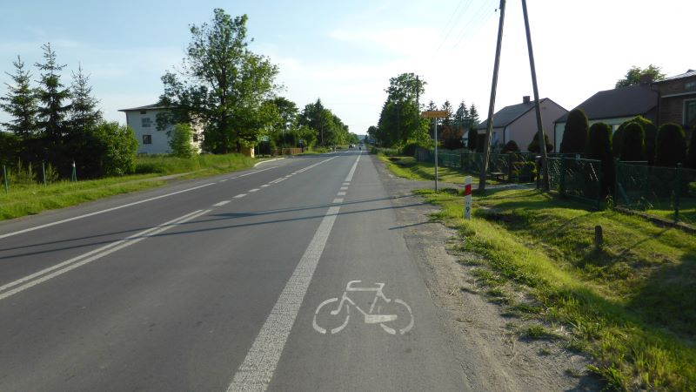
Extraction of cycling infrastructure in standardized format - OSM
Cycle lane
A cycle lane is a part of a carriageway designated for cycles. A cycle lane is distinguished from the rest of the carriageway by longitudinal road markings.

Slide 7
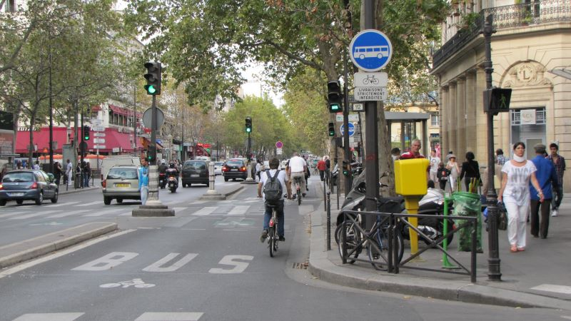
Extraction of cycling infrastructure in standardized format - OSM
Bus and cycle lane
A bus-and-cycle lane is a lane reserved for (public transport) buses and cycles.

Slide 8
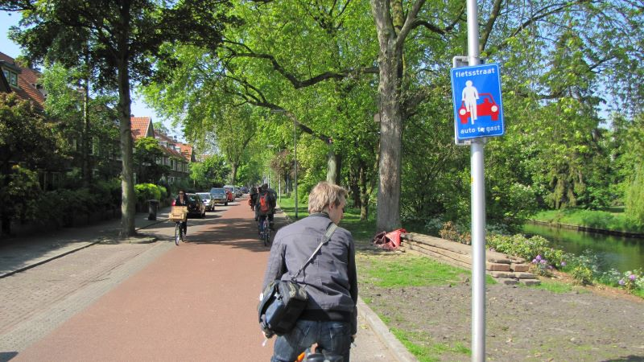
Extraction of cycling infrastructure in standardized format - OSM
Cycle street
A cycle street is a specially designed section of road or an area where special traffic rules apply, and It is signposted as such at its entries and exits.

Slide 9
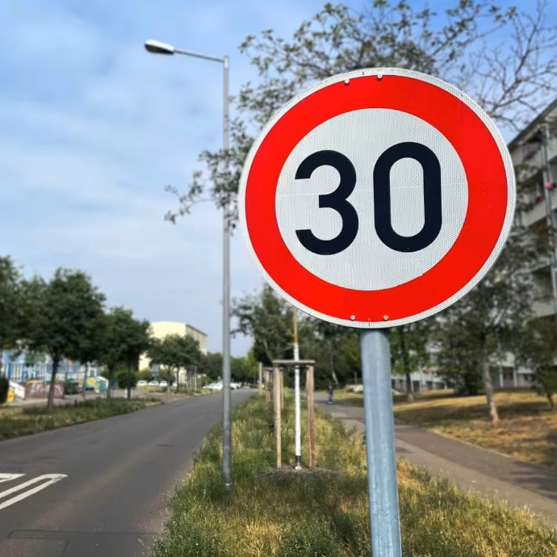
Extraction of cycling infrastructure in standardized format - OSM
30 km/h roads
Designated urban roads with a maximum speed limit of 30 km/h; only main and local road network segments considered. Only public and main roads taken into account in the analysis

Slide 10
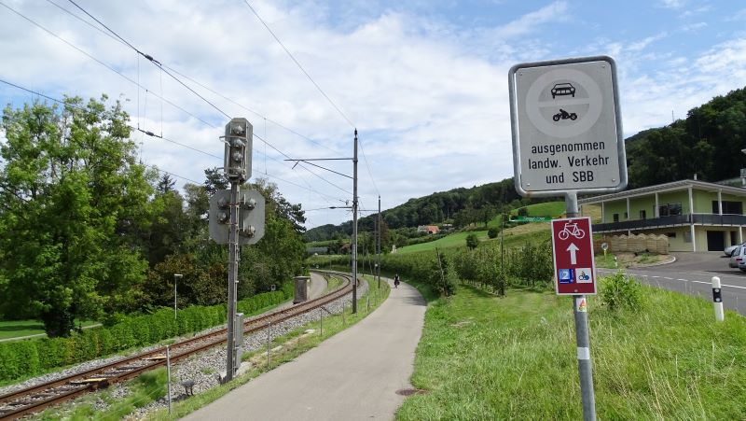
Extraction of cycling infrastructure in standardized format - OSM
Specific service roads
A specific service road is a non-public road closed to general traffic, but open to cycles and selected motor vehicles, for example agricultural, forestry, industry and/or water management vehicles.

Slide 11
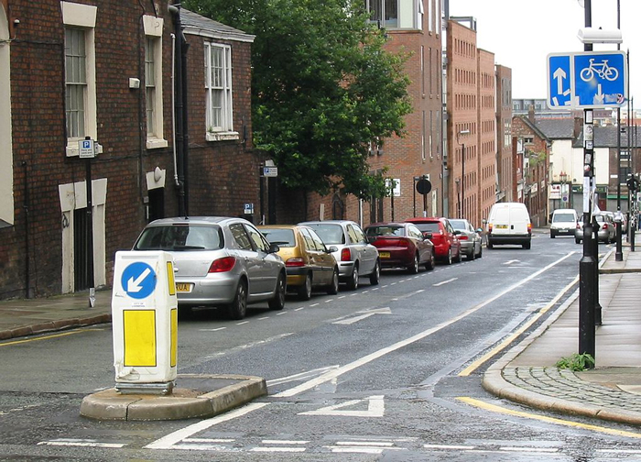
Extraction of cycling infrastructure in standardized format - OSM
Contraflow cycling
Street is unidirectional for cars and bidirectional for bicycles.

Slide 12
Infrastructure type | OSM tags
Cycle track | 1. (highway = cycleway) & ((foot != designated) & (segregated != yes)) 2. (highway = footway | path | pedestrian | corridor) & (bicycle = yes | designated) & (segregated = yes) 3. cycleway* = track | opposite_track
Cycle and pedestrian track | 1. (highway = footway | path | pedestrian | corridor) & (bicycle = designated) & (segregated != yes) 2. (highway = cycleway) & (foot = designated) & (segregated != yes)
Cycle lane | cycleway* = lane | opposite_lane
Bus and cycle lane | 1. cycleway* = share_busway | opposite_share_busway 2. highway = busway & (bicycle = yes | designated)
Cycle street | 1. cycle_street = yes 2. bicycle_road = yes

Slide 13
Infrastructure type | OSM tags
Specific service road | 1. (highway = unclassified | tertiary | service | residential) & (access = no | agricultural | forestry | destination) & (bicycle = yes | designated) 2. highway = track & ((tracktype = grade1 | grade2) | (surface = asphalt_concrete | blocks_slabs_cobbles_sel | stabilised_gravel)) 3. classified as cycle track, cycle and pedestrian track or pedestrian track with cycling allowed in first approach & (access | motorcar | motor_vehicle | agricultural | vehicle) = (yes | designated | agricultural | forestry | destination | delivery | permissive | private)
30 km/h roads | (highway = (main_road_types, local_road_types)) & (maxspeed <= 30)
Contraflow cycling | (oneway = yes) & ((oneway:bicycle = no) | (cycleway = opposite_lane | opposite_track))
Main roads | highway = motorway | trunk | primary | secondary | tertiary | motorway_link | trunk_link | primary_link | secondary_link | tertiary_link
Local roads | highway = living_street | residential | unclassified
Explanation of symbols | | = or; & = and, = equals, != = does not equal, * = cycleway* includes cycleway, cycleway:left, cycleway:right, cycleway:both

Slide 14
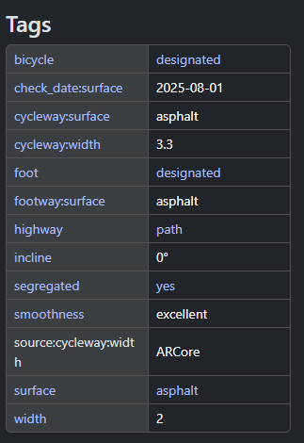
Example of cycling infrastructure extraction from OSM
Infrastructure type | OSM tags
Cycle track | 1. (highway = cycleway) & ((foot != designated) & (segregated != yes)) 2. (highway = footway | path | pedestrian | corridor) & (bicycle = yes | designated) & (segregated = yes) 3. cycleway* = track | opposite_track
Notes:
Lets see an example on how we extract cycle tracks. So the result is that for every specified area we we input, we automatically extract the corresponding cycling infrastructure

Slide 15

Extraction of cycling infrastructure in standardized format OSM
OSM Tags used for the extraction of standardized cycling infrastructure data are an updated version of ECF’s Cycling Infrastructure Tracker tool. CIT tool quantifies the different types of cycling infrastructure across European countries and regions. It also provides percentages of data availability for quality parameters.
Notes:
Currently we have the previous version available but in the next months we will publish all

Slide 16
Extensive research of official cycling infrastructure datasets in EU Member States (national, regional, local)
116 official datasets identified
48 official datasets selected for further analysis (infrastructure type and quality parameters included)
Notes:
Lets go on the official part of extraction. The first step was to identify all the available datasets across EU Member States. We decided to further analyze 48 of them as they included infra type and a good amount of different quality parameters

Slide 17
Official Dataset analysis
Review of documentation
Desk research
Consultation with dataset responsible stakeholders
Country | Area of dataset
Austria | National
Belgium | Brussels, Mons
Bulgaria | National
Cyprus | National
Czechia | National, Prague
Germany | Baden-Wurttemberg, Berlin, Brandenburg, Hamburg, Sachsen
Denmark | National, Copenhagen
Estonia | National, Tallinn, Tartu
Spain | Bizkaia, Madrid
Finland | National, Helsinki
France | National, Nantes, Toulouse, Lyon
Croatia | Zagreb
Ireland | Dublin, Cork, Waterford, Limerick, Galway
Italy | Bologna, Emilia-Romagna, Milano
Lithuania | Vilnius
Latvia | National, Jurmala, Marupe, Riga
Malta | National
Netherlands | National
Poland | Warsaw, West Pomerania, Wielkopolski Voivodship, Wroclaw
Portugal | Lisbon
Sweden | National
Slovenia | National
Accurate mapping of cycling infrastructure
Cycle tracks
Cycle and pedestrian tracks
Cycle lanes
Bus and cycle lanes
Cycle streets
30 km/h roads
Specific service roads
Contraflow cycling
Notes:
Keep in mind that sometimes in the official dataset cycle tracks and cycle and pedestrian track may be in the same tag from official – so we have to combine them also from the osm side. Also the

Slide 18
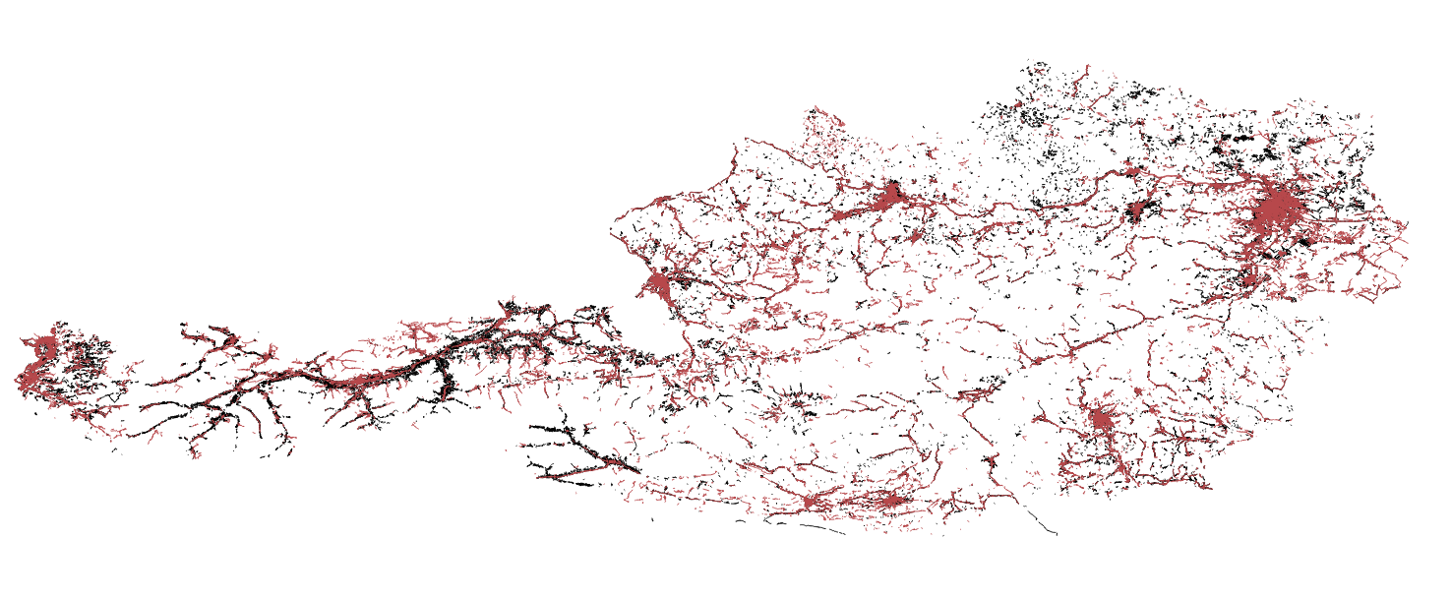
Austria OSM network
Cycle tracks
Cycle and pedestrian tracks
Cycle lanes
Bus and Cycle lanes
Cycle street
30 km/h roads
Specific service roads
Contraflow cycling
Austria Official network
Notes:
Austria is a good example but there are also instances from other datasets where the matching is very low.

Slide 19
Comparison methodology
Projection of both networks in coordinate system of the area of analysis
1
Creation of a 10m buffer zone around OSM network and Official network
2
Spatial overlays between networks
3
Correction of the previous networks by checking the angle of intersection
5
Automated creation of OSM network not in official, Official network not in OSM
4
URL link addition of Google Street view per segment
6
Notes:
mention that we used Google for some quick and dirty checks, but you should mention that you're aware that this approach cannot be replicated in improving OSM.
OSM buffer -> Official not in osm, official in osm
Official buffer -> Osm not in official
Angle correction: filter out segments that have an intersection angle more than 40 degrees from the official in osm and pass them to official not in osm. And the corresponding.

Slide 20
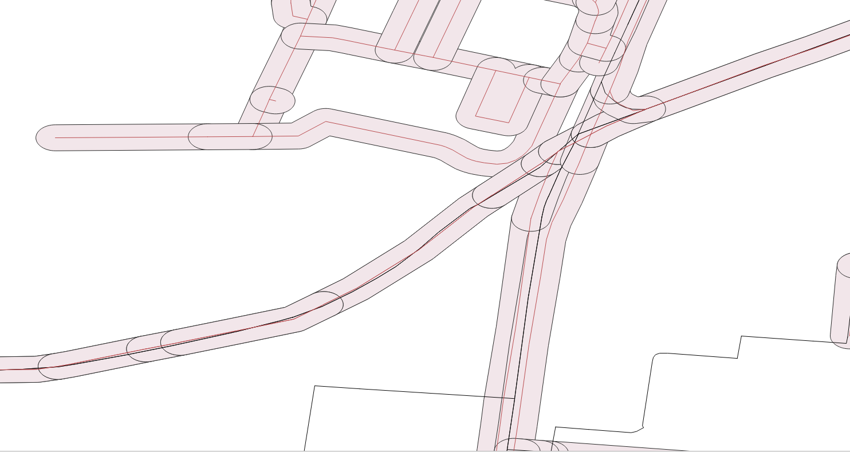
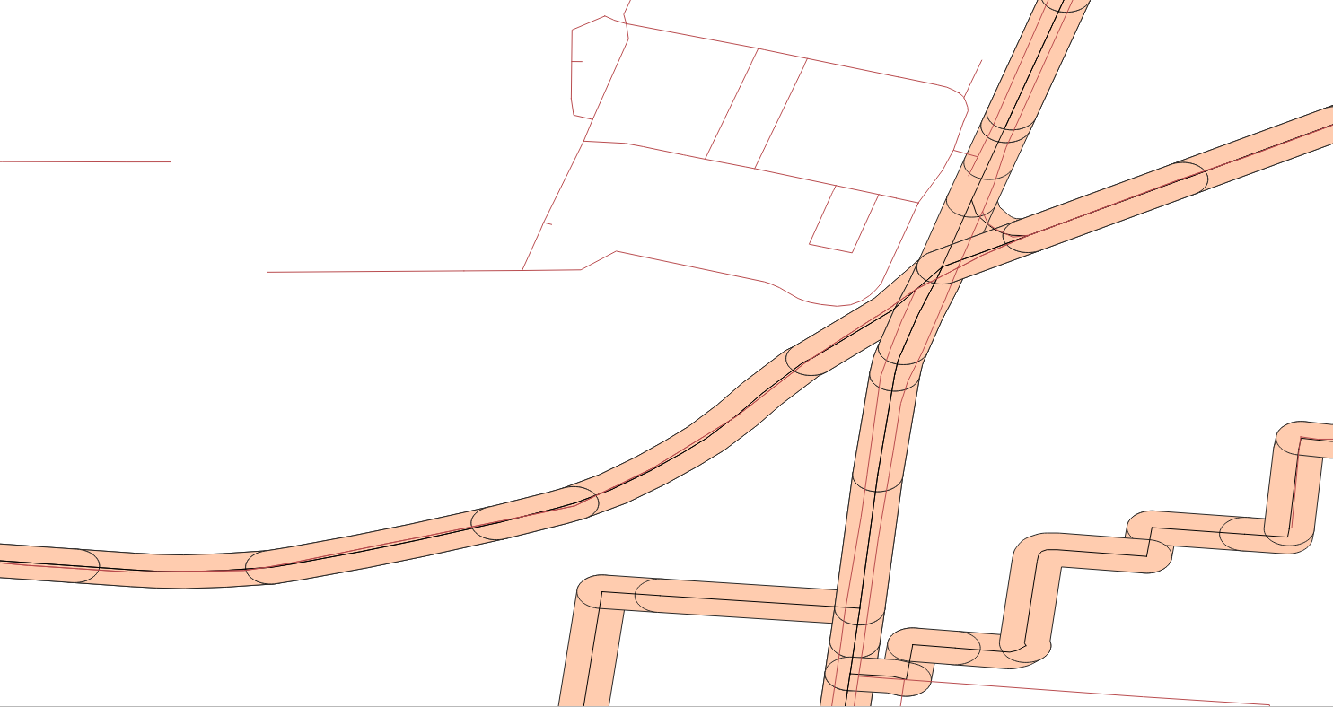
Austria OSM buffer zone
10m buffer zones
Austria Official buffer zone
Notes:
OSM buffer -> Official not in osm, official in osm
Official buffer -> Osm not in official

Slide 21

Austria OSM network
Angle check
Austria Official network
Austria Official buffer zone
If the angle of intersection is more than 40 degrees, it is considered as not inside the official network
Notes:
Angle correction: filter out segments that have an intersection angle more than 40 degrees from the official in osm and pass them to official not in osm. And the corresponding.

Slide 22
Country | Area of dataset
Austria | National
Belgium | Brussels, Mons
Bulgaria | National
Cyprus | National
Czechia | National, Prague
Germany | Baden-Wurttemberg, Berlin, Brandenburg, Hamburg, Sachsen
Denmark | National, Copenhagen
Estonia | National, Tallinn, Tartu
Spain | Bizkaia, Madrid
Finland | National, Helsinki
France | National, Nantes, Toulouse, Lyon
Croatia | Zagreb
Ireland | Dublin, Cork, Waterford, Limerick, Galway
Italy | Bologna, Emilia-Romagna, Milano
Lithuania | Vilnius
Latvia | National, Jurmala, Marupe, Riga
Malta | National
Netherlands | National
Poland | Warsaw, West Pomerania, Wielkopolski Voivodship, Wroclaw
Portugal | Lisbon
Sweden | National
Slovenia | National
(1) Official not in OSM GPKG files
(2) OSM not in official GPKG files
Infrastructure type
Surface type
Surface quality
Lighting information
Width
Directionality
Standardized format
Complement OSM database through (1)
Find incorrect information through (2)
Notes:
So for all these different datasets we analyzed we have produced these 2 gpkg files that we plan to share with the OSM community.
Every GPKG has these info and infra type in standardized format and can be used to either complement or find incorrect information

Slide 23
Preliminary results of the analysis
​ | Cities ​ | Towns and suburbs ​ | Rural areas ​ | Outside LAU ​ | Unknown ​ | Total ​
Cycle tracks ​ | 60,729 km ​ | 105,880 km ​ | 70,493 km ​ | 189 km ​ | 66,056 km ​ | 303,346 km ​
Cycle lanes ​ | 6,311km ​ | 8,300 km ​ | 4,481 km ​ | 3 km ​ | 10,986 km ​ | 30,080 km ​
Cycle-friendly mixed traffic ​ | 121,758 km ​ | 197,823 km ​ | 128,054 km ​ | 64 km ​ | 133,322 km ​ | 581,021 km ​
Total network ​ | 188,798 km ​ | 312,002 km ​ | 203,028 km ​ | 256 km ​ | 210,364 km ​ | 914,447 km ​
Contraflow cycling ​ | 8,067km ​ | 4,700 km ​ | 854 km ​ | 1 km ​ | 5,954 km ​ | 19,576 km ​
Notes:
Through all this analysis we were able to combine the official and osm datasets by identifying the most complete infra type from every source. Results from June – CC project funded from European Commission published the results.
Refer to the combinations
official_only_length Length (in km) of official features that are not within the OSM buffer (represents official-only segments).
common_osm_ratio Share of OSM network that overlaps with the official network, expressed as a percentage. Computed as common_length / (common_length + osm_only_length). common_official_ratio Share of official network that overlaps with the OSM network, expressed as a percentage. Computed as common_length / (common_length + official_only_length).

Slide 24
Preliminary results of the analysis
Strong fragmentation of cycling infrastructure data at national, regional and local level
Great variation among the identified national, regional and local datasets regarding the infrastructure’s geographical coverage and quality parameters
Need for standardized data practices to facilitate data integration, harmonization and, ultimately, dataset usability across the EU ➔ OSM can play a significant role

Slide 25
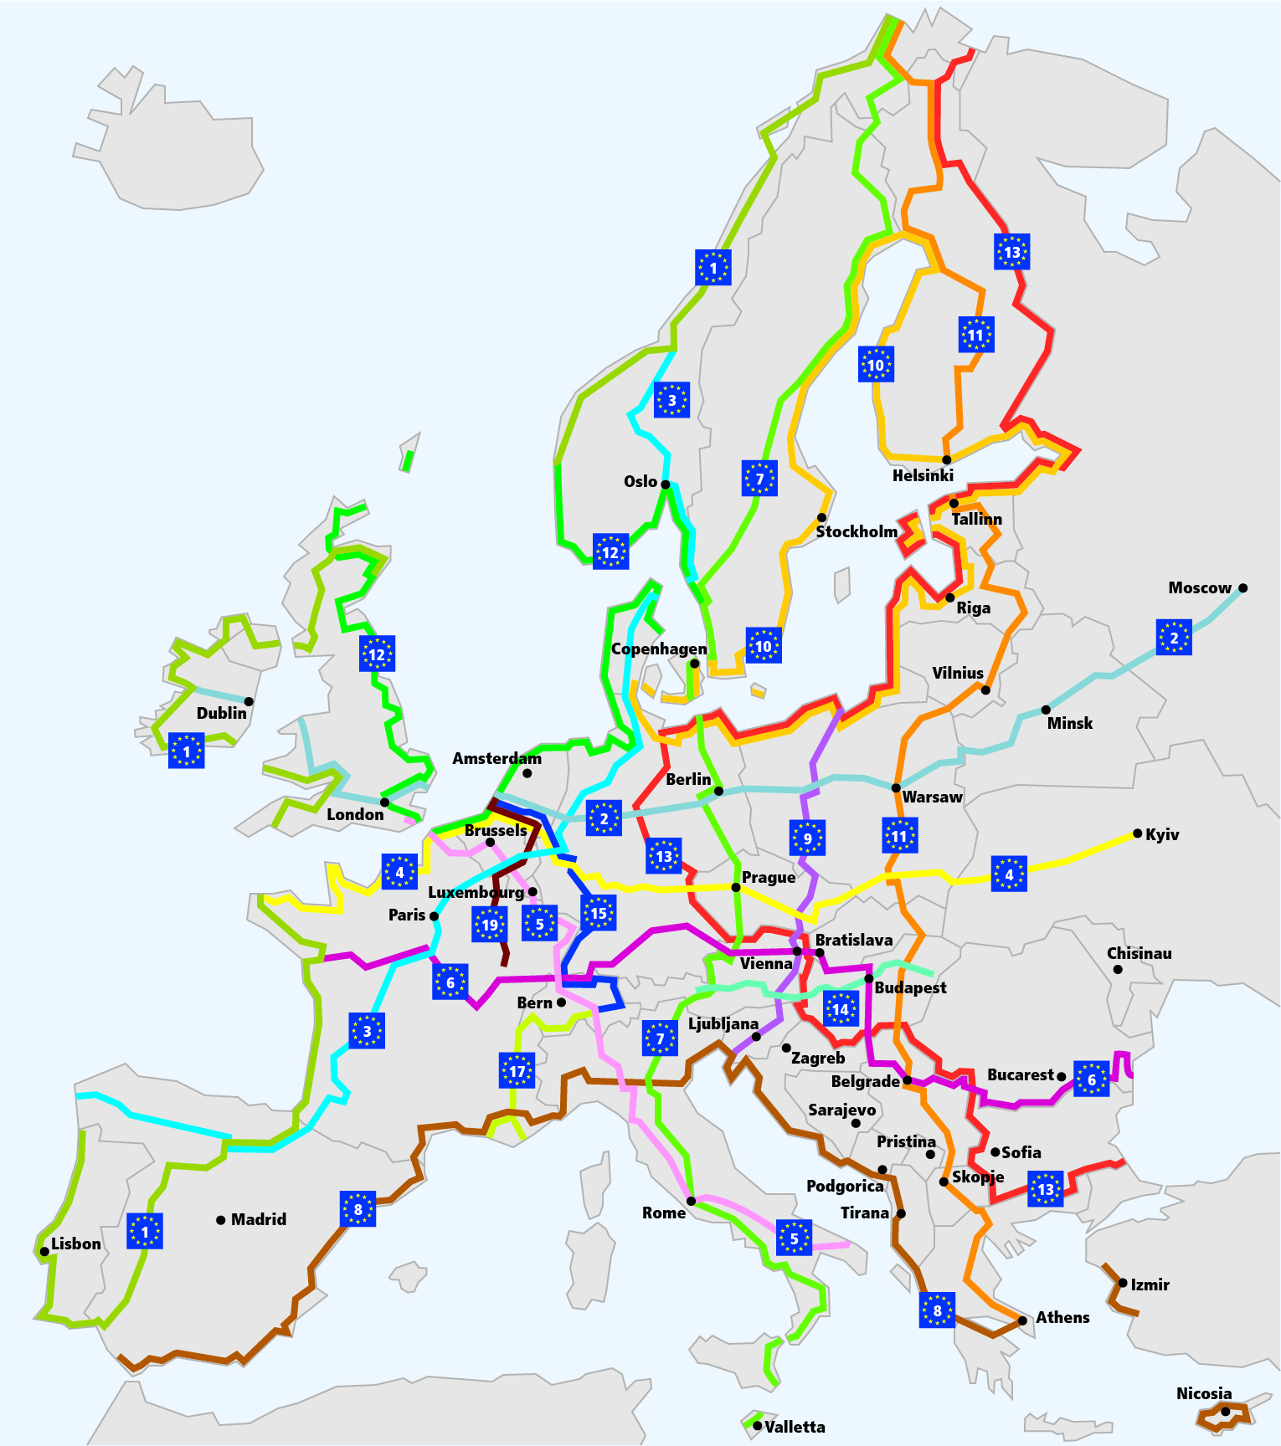
EuroVelo use case
EuroVelo Network: European Cycle Route network

Slide 26
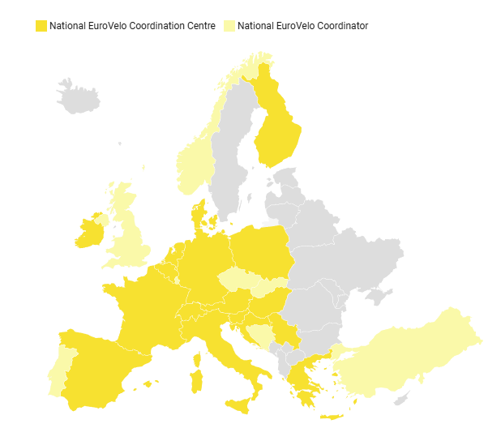
Organisation of EuroVelo NECCs network
EuroVelo use case
26 National EuroVelo Coordination Centres
Responsible for the implementation, coordination, quality assurance and communication of EuroVelo nationally
Subsidiarity principle
Notes:
Here is the respective official datasets from NECCs. Some are very active some , so we did the same analysis.

Slide 27
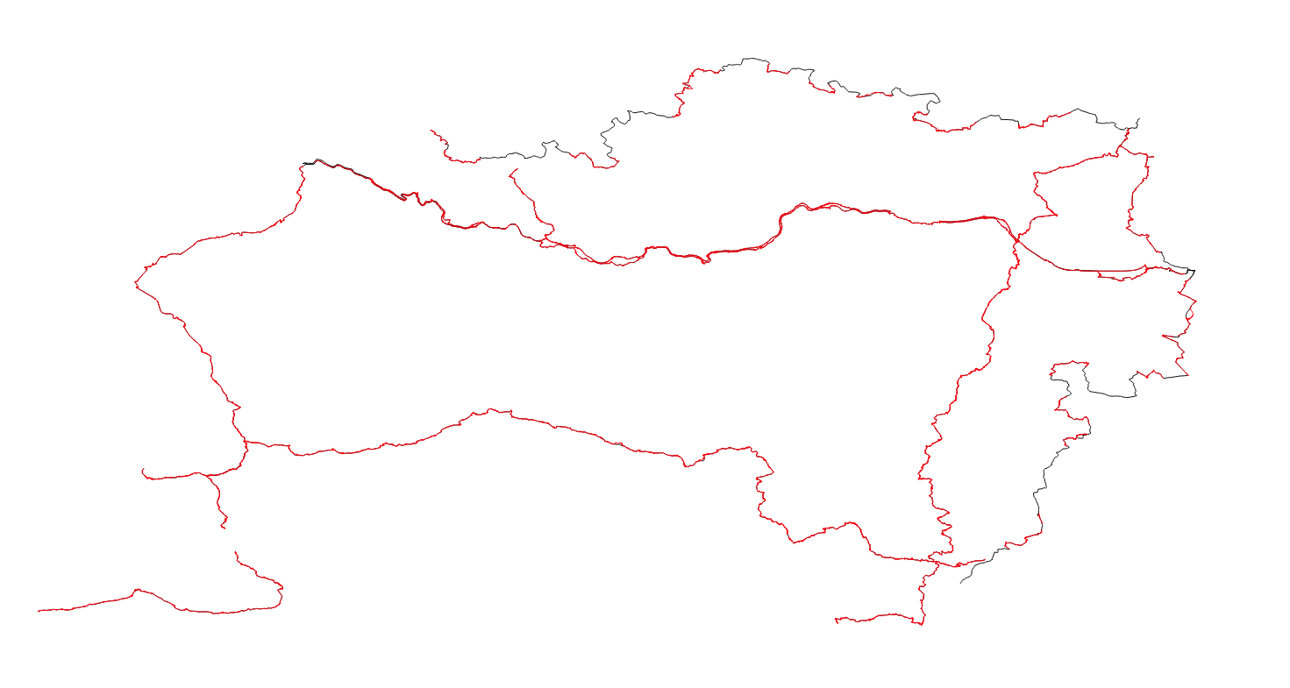
Austria OSM network
Austria Official network
EuroVelo use case
Notes:
Austria is one of the best but again we can see missing parts from OSM.

Slide 28
EuroVelo use case
(1) Official not in OSM GPKG files
(2) OSM not in official GPKG files
Comparison between NECCs data and OSM
Infrastructure type
Complement OSM database through (1)
Find incorrect information through (2)

Slide 29
Next steps
Identify more official datasets
Extend the comparison analysis to quality parameters
Expand the analysis to other types of cycling infrastructure and networks
Notes:
What is the proper way to share the results?
Can you think of any other network that can apply similar methodology?

Slide 30
State of the Map Europe 2025
Complementing OSM Cycling Data through Official Datasets
Christos Konstantinou
European Cyclists’ Federation

