Slide 1


State of the Map Europe 2025
Mapping Waste the Open Way
Building OpenWasteMap
Jack Gilmore
Open Data Scotland

Slide 2
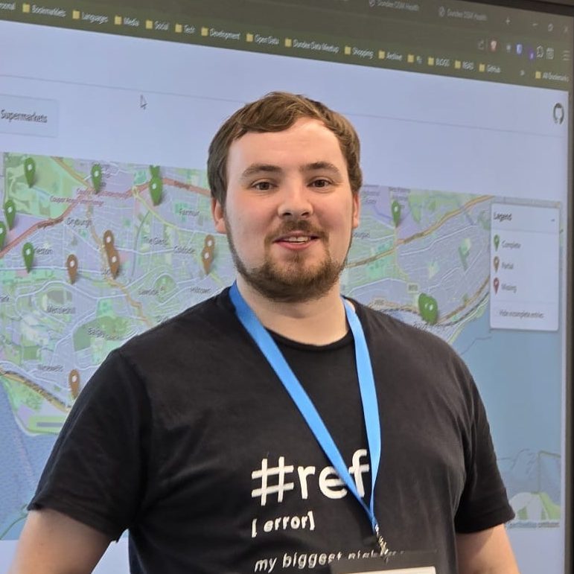
About Me
Based in Arbroath, originally from Aberdeen
Senior Platform Engineer at NHS
Co-founder of Open Data Scotland
Co-founder of Dundee Data Meetup
OpenUK 2025 Open Data Leader honouree
Coffee and LEGO lover (94 sets and counting)
Mapper since June 2020
Notes:
Based in Arbroath, originally from Aberdeen
Senior Platform Engineer at NHS
Co-founder of Open Data Scotland
Co-founder of Dundee Data Meetup
OpenUK 2025 Open Data Leader honouree
Coffee and LEGO lover (94 sets and counting)
Mapper since June 2020

Slide 3
Terminologies/jargon/info
HWRC = Household Waste Recycling Centre
Council = Local authority / municipal administration
Wikidata = Structured open knowledge base linked to Wikipedia and OSM
Notes:
HWRC = Household Waste Recycling Centre
Council = Local authority / municipal administration
Wikidata = Structured open knowledge base linked to Wikipedia and OSM

Slide 4
Disclaimer
This was my first ever OpenStreetMap project
A lot has changed since 2020!
Notes:
I probably got a lot wrong

Slide 5


The Problem
I have X and I live at Y postcode
Where do I dispose of my waste?
Illustration by Boxicons on Unsplash
Notes:
No single, consistent source for UK waste and HWRC data
Each local authority publishes information differently, pretty much all static info on their websites
Incomplete or outdated information on council websites
Difficult for the public to find accurate, location-based disposal info
Poor machine-readability limits reuse in apps, maps, and research
No shared data model or open standard for waste infrastructure

Slide 6
How can we fix this?
Enter OpenStreetMap and Wikidata…
Notes:
Data should answer that question clearly, wherever you live
Councils already publish this information, but in inconsistent formats
We can use open data and open mapping to unify it
OpenStreetMap offers a shared, community-maintained base
Civic tech can make it usable for everyone, not just data experts

Slide 7
The approach
Time to get building!
Notes:
Started at a Code the City hack weekend in Aberdeen
Goal: map HWRCs across the UK
Build something open, reusable, and public-facing
Use OpenStreetMap and Wikidata as the foundation
Combine civic tech methods with community mapping principles

Slide 8
The approach
Register of Waste Carriers, Brokers and Dealers datasets
Populated Wikidata using QuickStatements
Target estimation of ~1,000 public/municipal HWRCs
Established/adopted a tagging convention
Notes:
Register of Waste Carriers, Brokers and Dealers datasets
Split across 3 authorities/datasets; one for England, one for Wales and one for Scotland
Target estimation of ~1,000 public/municipal HWRCs
Population of Wikidata using QuickStatements
Created a base layer of data that we could then marry up with OSM entries
Established/adopted a tagging convention
Did our research and made sure to adopt existing tags rather than unnecessarily creating new ones

Slide 9
Building the Map
Frontend: built with Leaflet.js for lightweight, interactive maps
Backend: powered by .NET for data handling and API endpoints
Data source: OpenStreetMap via Overpass API
Database: “cached” in SQL Server
Geocoding: postcodes.io for local authority
Wikidata: linked HWRC entries for richer context
Goal: fast, usable map anyone can explore. No login, no barriers
Notes:
Frontend; leaflet; had used many times before in previous projects, most recently when I worked for Falkirk Council
Backend; .NET; my programming language de jour; lots of people refer to as “MS Java” but since .NET core it’s an open language
Queried overpass to get the data
Database: primitive cache, mainly added so we’re not abusing Overpass
Geocoding using postcodes.io to match you to a local authority
Linked into other data sources like wikidata where attached to an OSM feature
End goal of a fast, usable map that anyone can explore

Slide 10
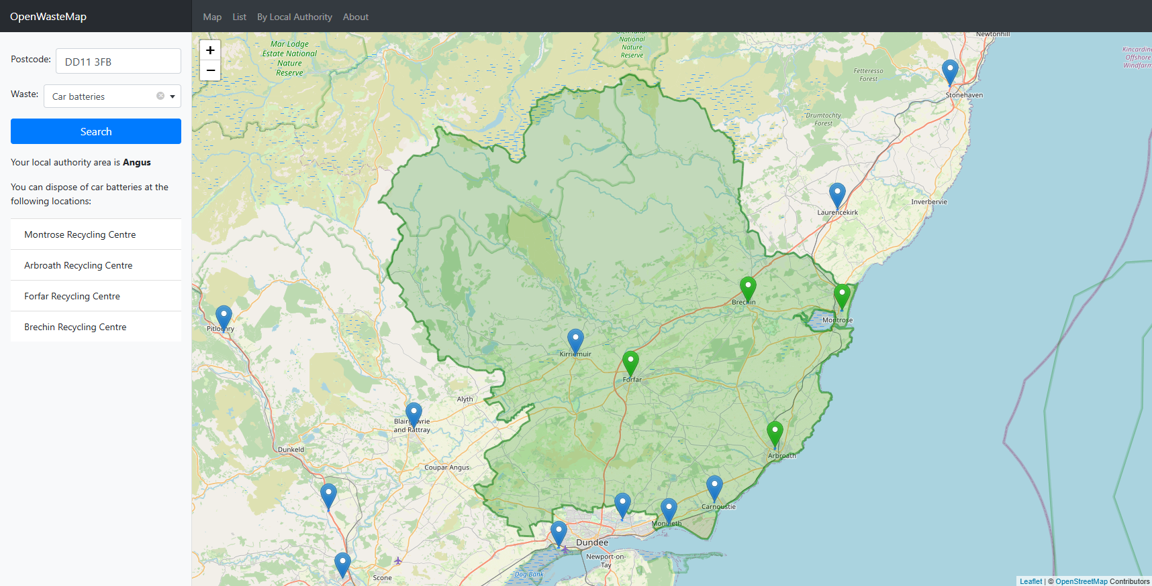
https://openwastemap.uk
The result

Slide 11
https://openwastemap.uk
The result

Slide 12
https://openwastemap.uk
The result

Slide 13
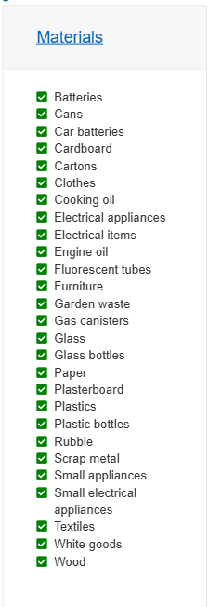
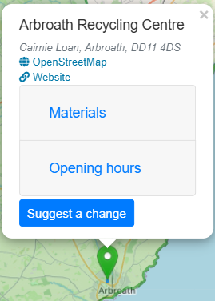
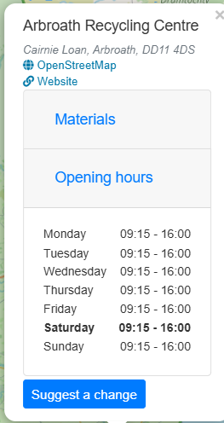
https://openwastemap.uk
The result

Slide 14
Impact and Insights
Mapped coverage: HWRCs added or improved across the UK
Improved consistency in tagging and naming of waste sites
Revealed data gaps: councils missing key info like accepted materials or opening hours
Notes:
People saw where their HWRCs were missing or not tagged correctly and added them
By adding them we improved consistency in the tagging and naming of waste sites
We were able to examine existing sites and identify gaps in the data
Sparked collaboration between mappers, civic tech groups, and councils
Demonstrated reuse of OSM and Wikidata for public benefit

Slide 15
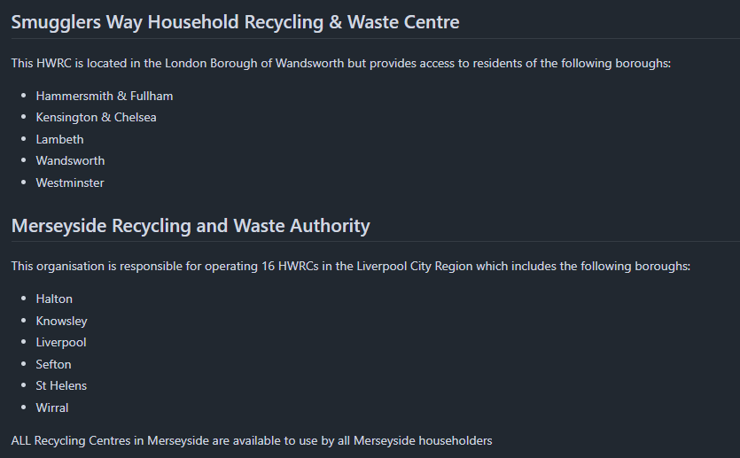
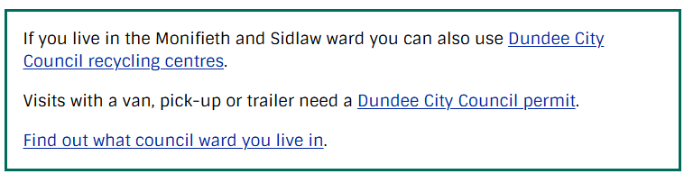
Challenges
Issue #18 on JackGilmore/OpenWasteMap
Local authority residency ≠
Right of access
From angus.gov.uk:
Notes:
Built on a big assumption that local authority residency means right of access
Different rules for commercial access
Ownership ambiguity
Matching residency to where the recycling centre is uses an exact keyword match

Slide 16
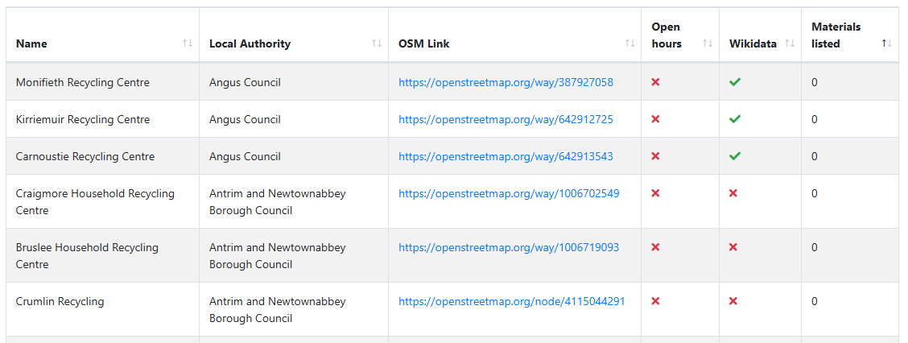
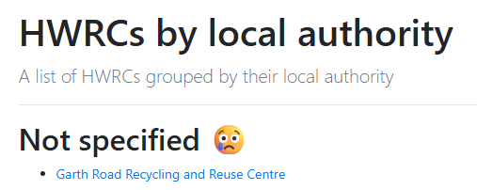
Challenges
Notes:
Gaps in the data
Incomplete coverage: not every HWRC is mapped or fully tagged on OSM
Tagging complexity: differing opinions on how to represent facilities. Waste types
Sustainability: maintaining and updating the dataset over time
Engagement: encouraging ongoing mapper and council participation

Slide 17
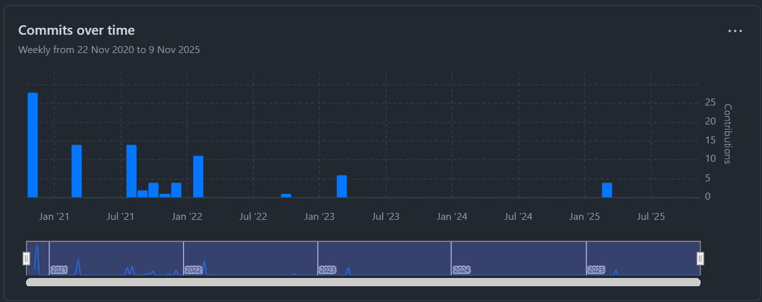
Challenges

Slide 18

Next Steps

Slide 19
Next Steps
Expand to include bring sites, reuse centres, and reverse vending machines
Align with Open3R for structured recycling data
Improve data validation and visualisation tools
Strengthen links with local and national government
Explore better feedback loops
Notes:
Expand to include other venues for disposing of waste and recyclable materials.
Not just HWRCs and they’re not accessible to non-car users
Align/publish datasets under the Open3R standard
Validate against those existing datasets, improve that frontend to make it more performant
Work with government to see if we can get them to adopt a standard to publish this data
Links in with exploring better feedback loops, if we improve the publishing of this data, could it reduce flytipping?

Slide 20


Wrap Up
Try it yourself!
Big thanks to
for sponsoring 6 years of domain registration and web hosting
https://openwastemap.uk

Slide 21
State of the Map Europe 2025
Mapping Waste the Open Way
Building OpenWasteMap
Jack Gilmore
Open Data Scotland
https://2025.stateofthemap.eu
Mastodon: en.osm.town/sotmeu Instagram: openstreetmapuk

