Slide 1



State of the Map Europe 2025
Transparency and Trust in Collaborative Mapping
Concerns and Dilemmas in AI-assisted Road Integration within OpenStreetMap
Francis Andorful
GIScience Research Group, Heidelberg University

Slide 2
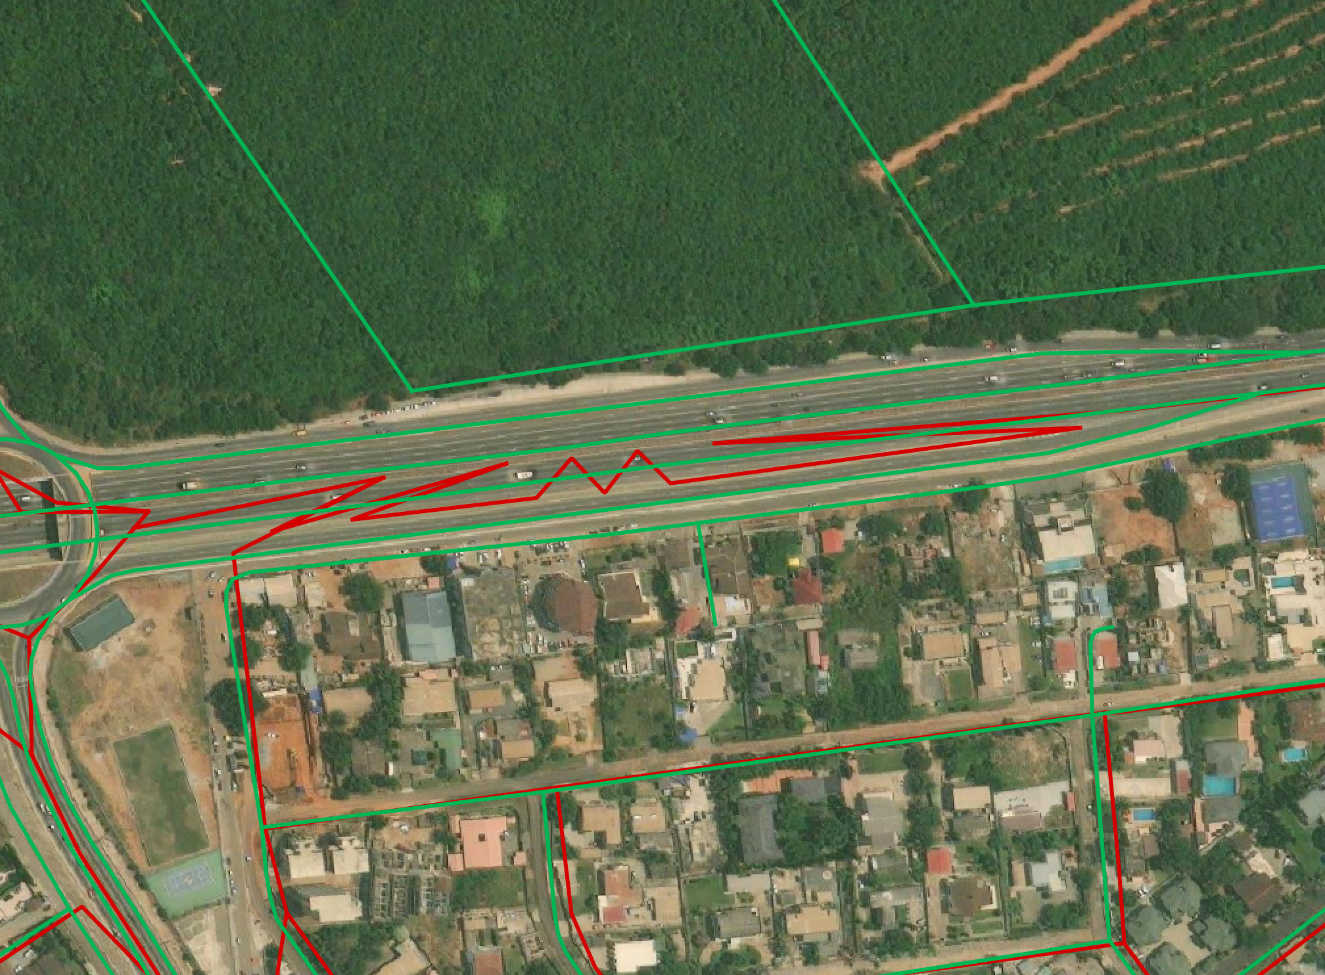
Take a Wild Guess?
Which of this dataset was created by AI?
© OpenStreetMap contributors, “Shortbread” style

Slide 3
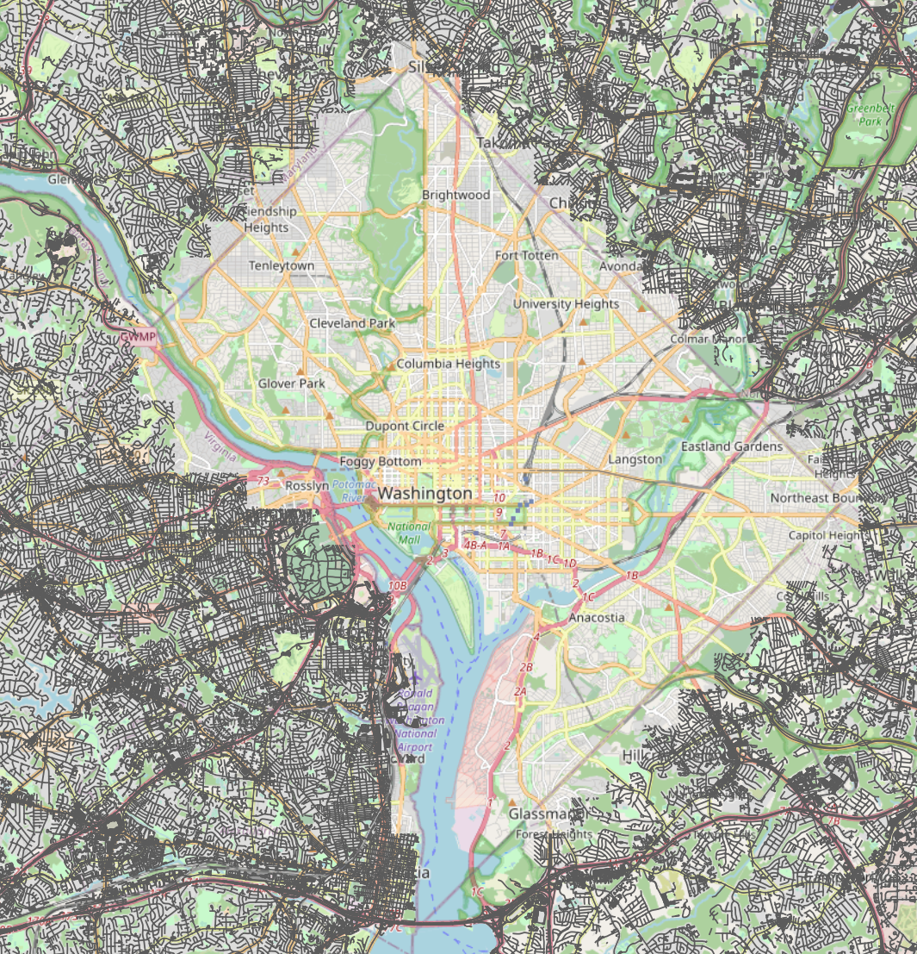

What do you think?
What percentage of this data is likely to be of AI origin?
AI Origin: 20%
© OpenStreetMap contributors || The PyCoach

Slide 4
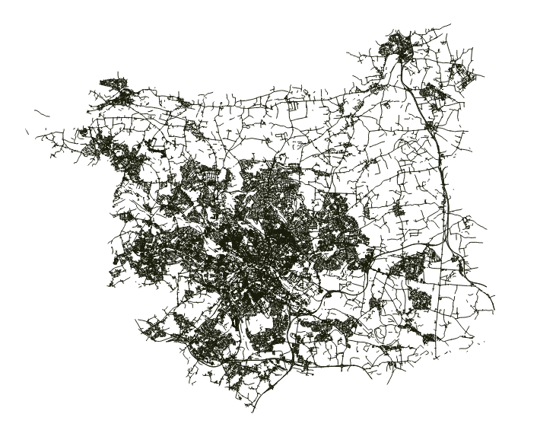
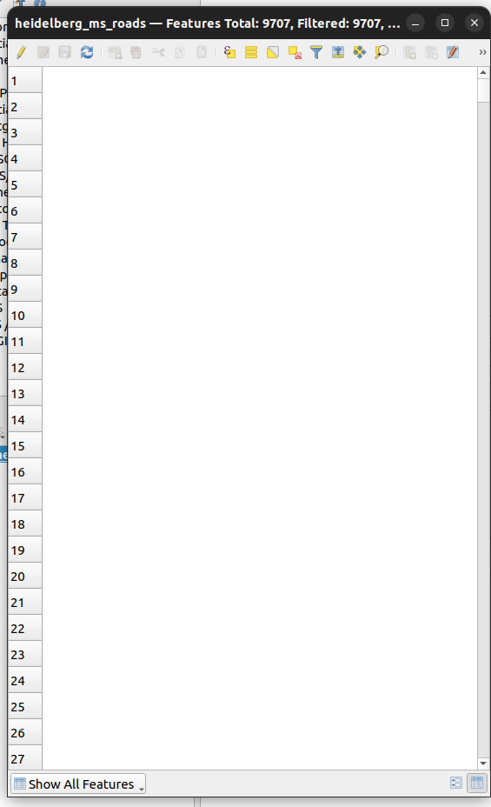
Baseline: What Does AI Gives?
City of Leeds
© Ms RoadDetections

Slide 5
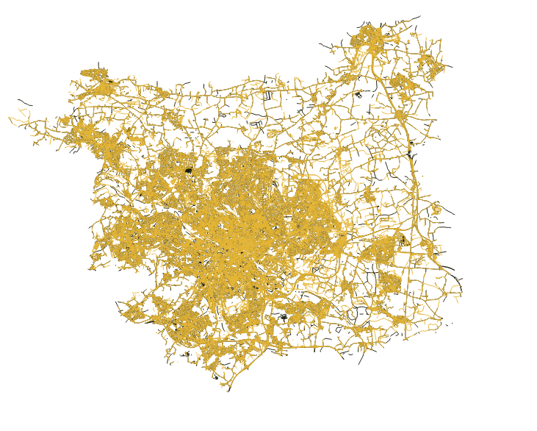
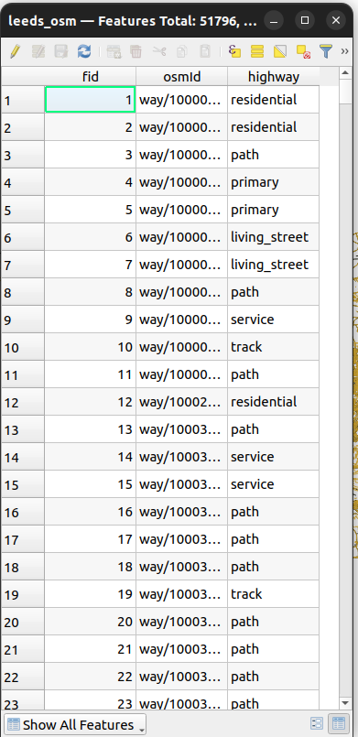

Baseline: What Does AI Gives?
City of Leeds
City of Leeds
Difference = Human judgement
© Ms RoadDetections

Slide 6
Baseline: What Does AI Gives?
City of Leeds
City of Leeds
Recreate
Delete nodes
Split
Extend
Mearge
etc
© Ms RoadDetections

Slide 7


The Challenge
Generally:
JOSM
#mapwithai #country
RapidID
“#nsroadimport #thailand”
“#nsroadimport #indonesia”
source: facebook wiki
© OpenStreetMap contributors, “Shortbread” style

Slide 8
Research Question
Can Machine Generated Roads (MGR) data be reliably detected based on its geometric characteristics alone offering a potential workaround in the absence of explicit metadata.

Slide 9
Research
Study 1:
OSM Community Reactions to AI Contributions
Study 2:
How Reliably can we Detect AI-aR from OSM Database?

Slide 10



Data Source
Thread Topic | Post Analyzed
Tagging Thread | 42
Editors AI-Content | 58
Computer Vision | 37

Slide 11
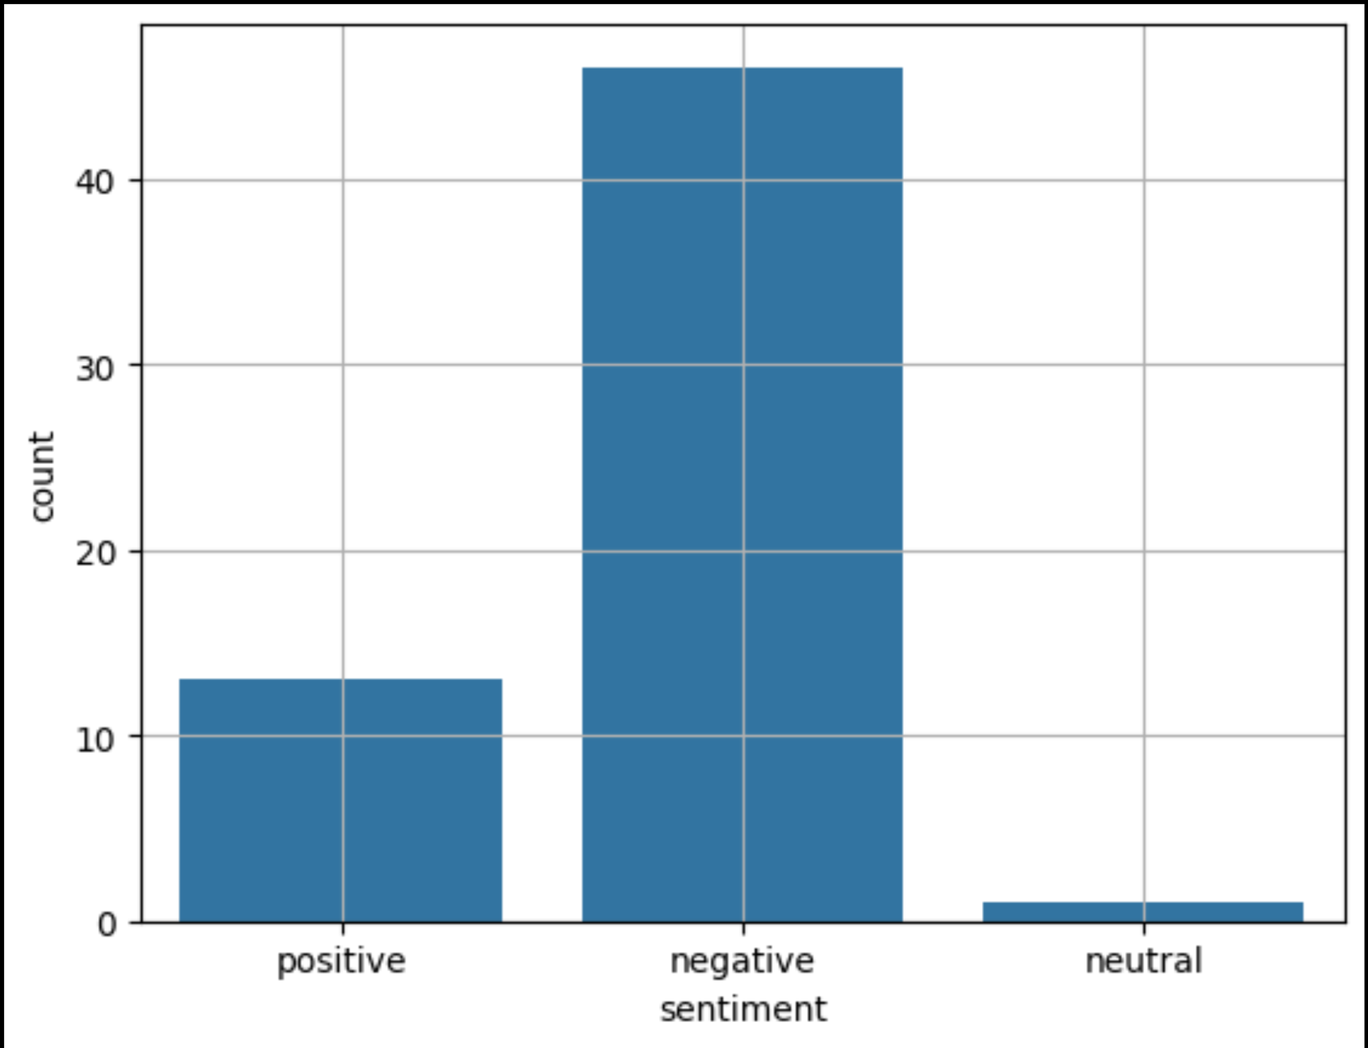
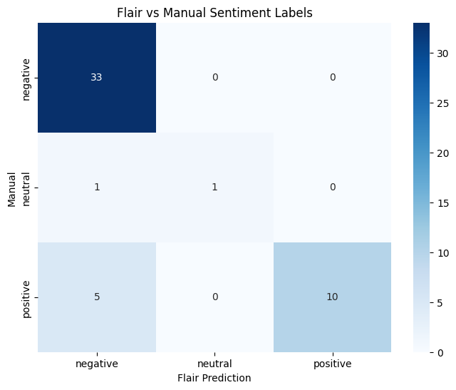
Study 1
© OpenStreetMap contributors, “Shortbread” style

Slide 12
Hypothesis & Testing
T-Test
Whether the mean node spacing differs between the two groups under the null hypothesis.
H₀:
Equal means, assuming equal variances
Kolmogorov Smirnov (KS)
Does the underlying distributions differ?
H₀: F(x) = G(x) for all x,
where
F(x) = Pure AI Data
G(x) = Pure HGR
Algorithmic roads follow deterministic rules, likely producing roads with uniform node spacing and regular structural patterns.
Node Density
Std node distance
© OpenStreetMap contributors, “Shortbread” style

Slide 13

Results: Hypothesis Testing
t-test |  | Kolmogorov–Smirnov (KS) test
Variable | Score | Variable | Score
Statistics | -968.18 | Statistics | 0.9887
P-value | < 0.0001 | P-Value | < 0.0001
© BBC News

Slide 14
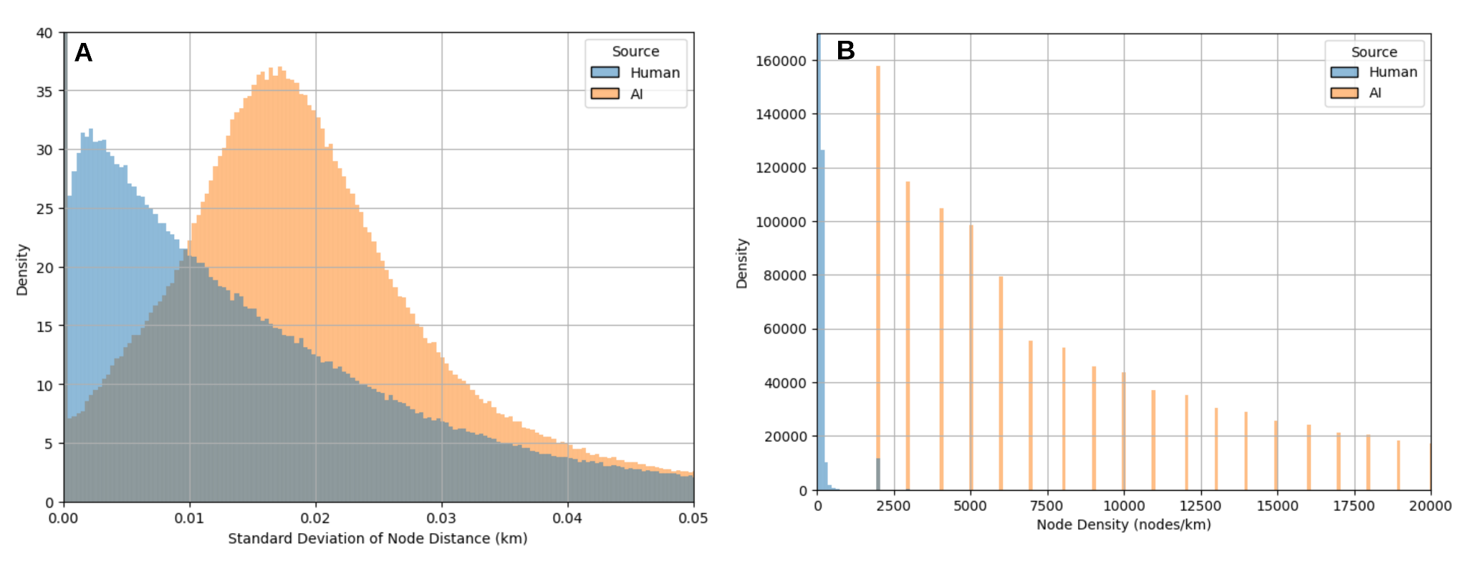
Results: Hypothesis Testing
© OpenStreetMap contributors, “Shortbread” style

Slide 15

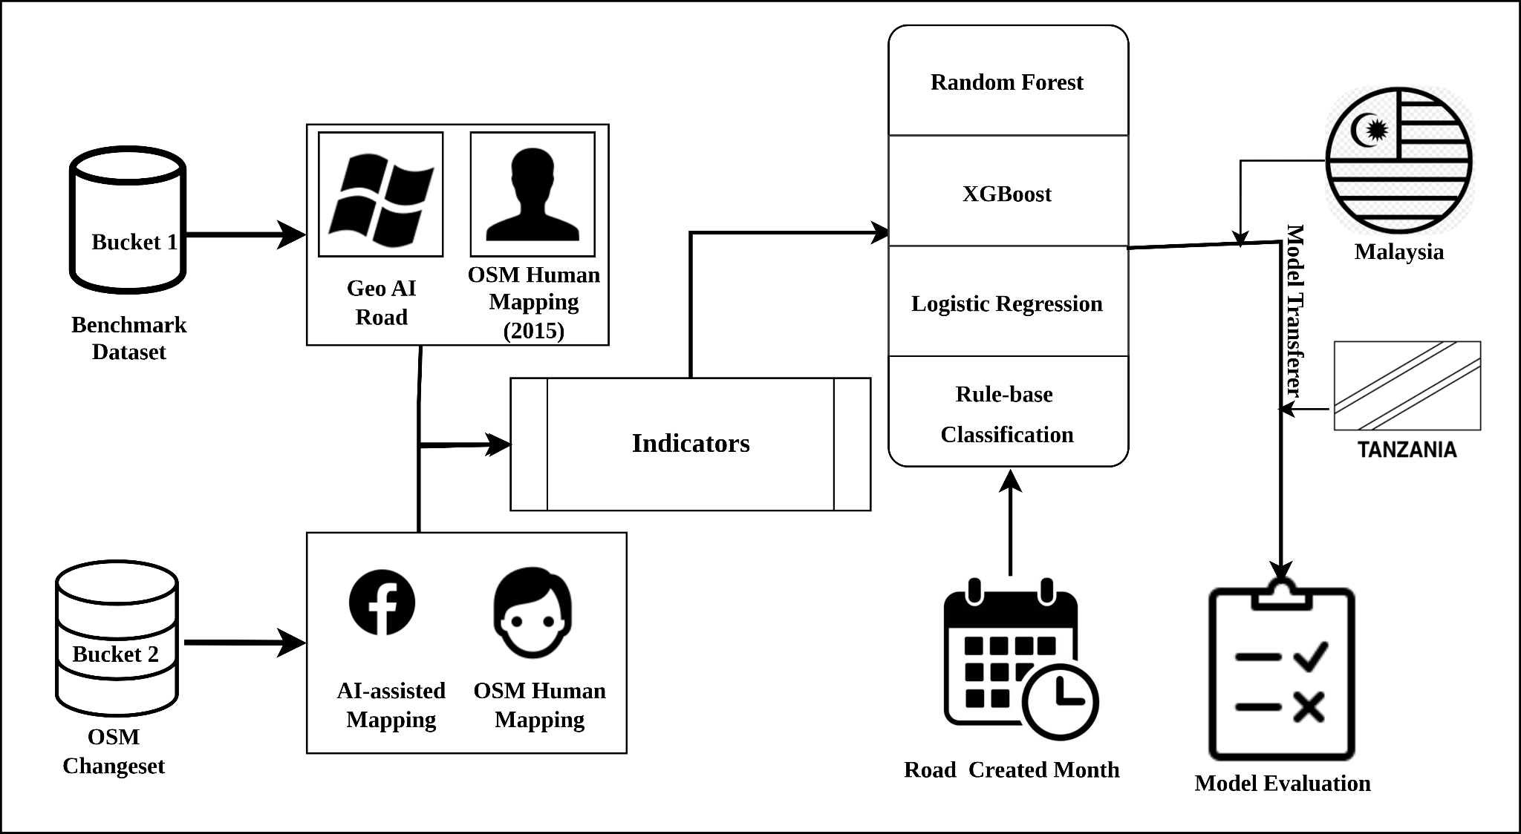

Methodology of Study 2
Hashtags: #MapWithAI
Editor : Rapid editor
Imports: Import Catalogue

Slide 16
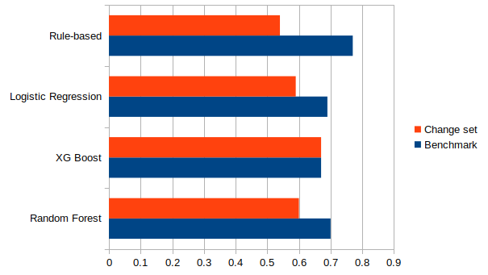
Model Results
Rule base perform better than all.
General performance in the benchmark.

Slide 17
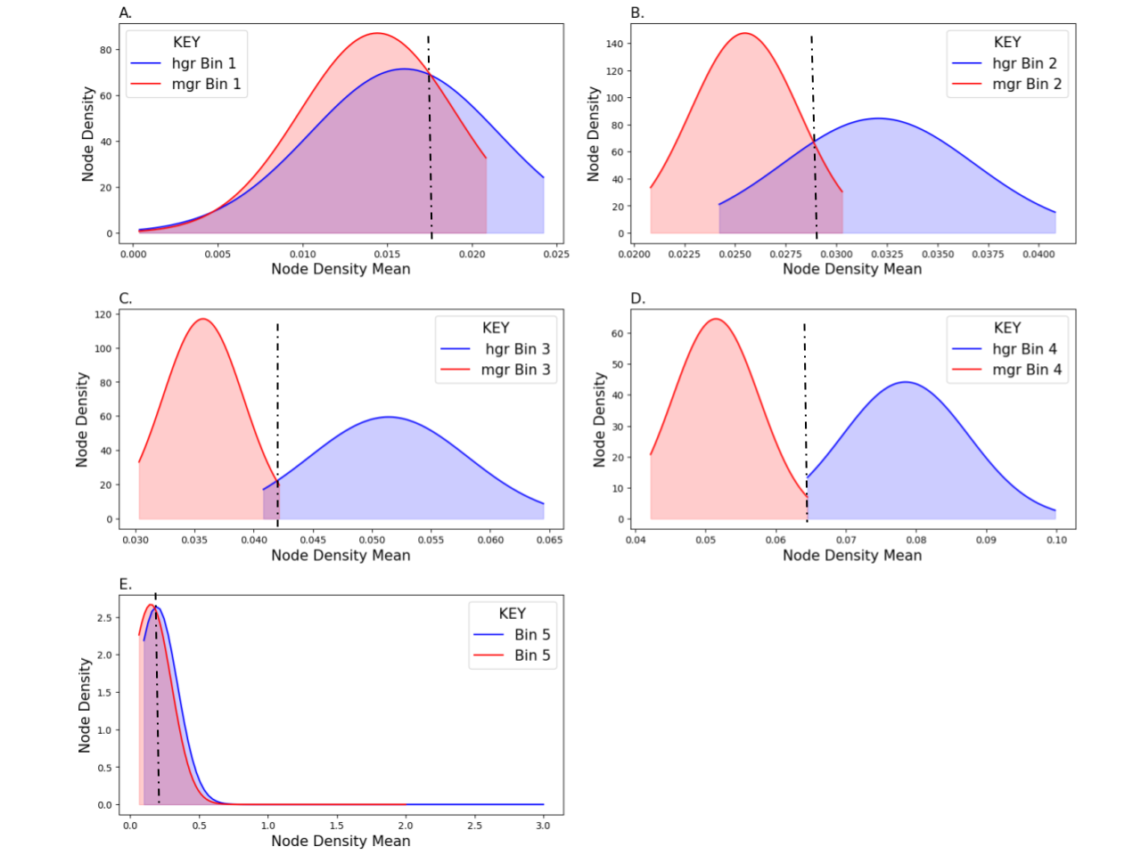
Why rule base perform better?
Why the overlap?
Original data touch?
natural /chance
Why the clear seperation?
Original data untouch?

Slide 18
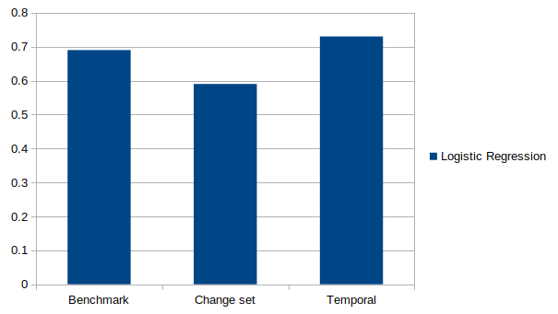
The Magic Judge
When month of the year is added, model outperform even benchmark

Slide 19
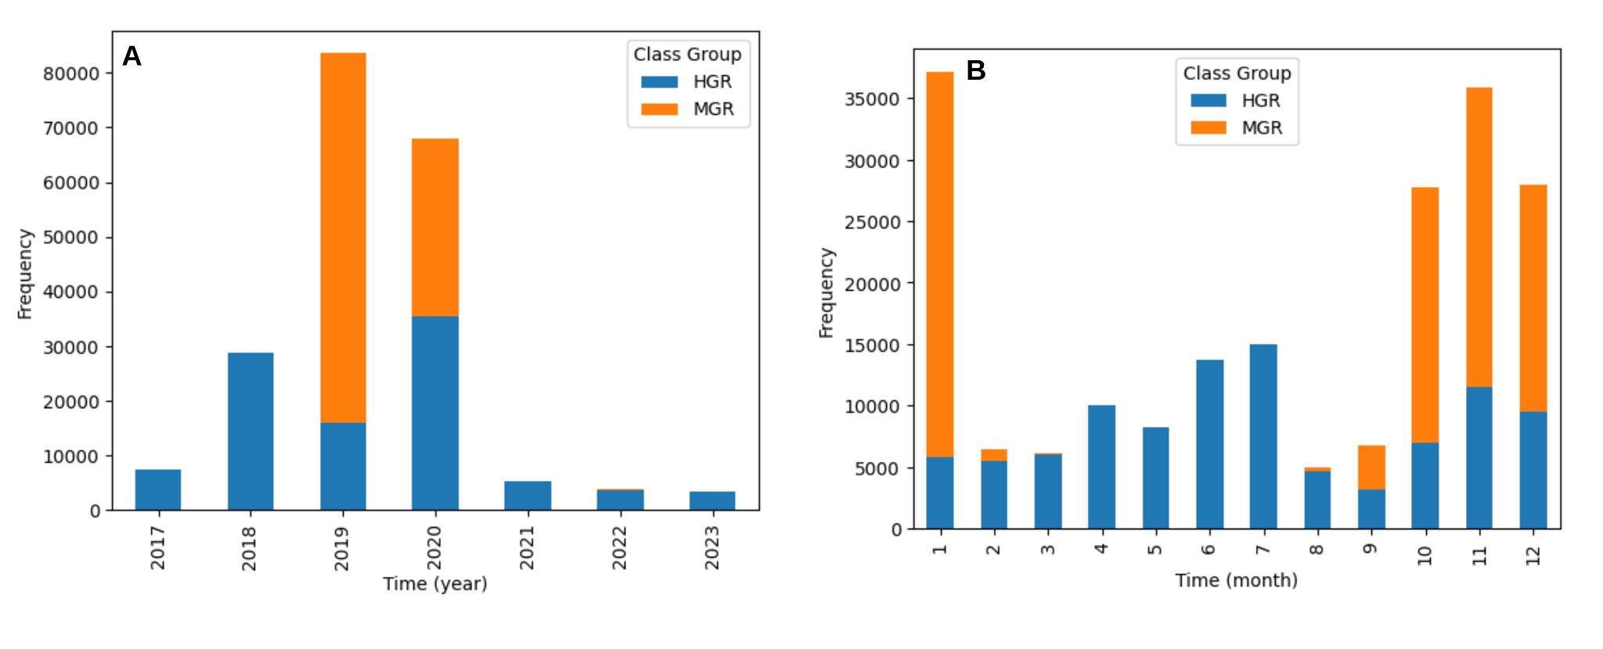
Month a Proxy, not an Intrinsic Property

Slide 20
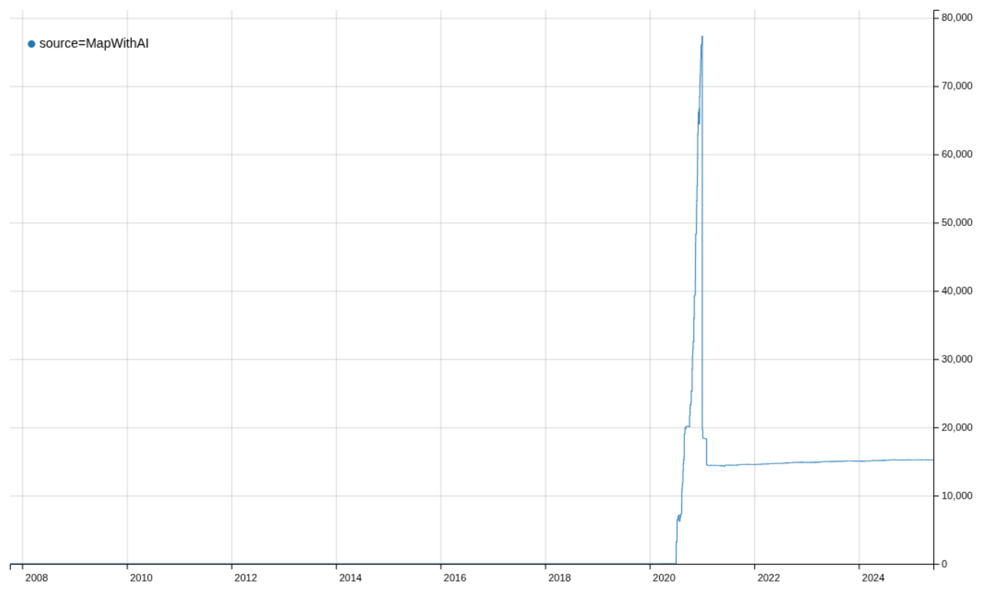
Maybe it’s too early
AI-assisted Mapping tools have not been fully adopted yet.
© OSM TagInfo, Accessed on August 2025

Slide 21

Black Box?
Recreate
Delete nodes
Merge
Split
Extend
What role does the human play in the loop?
Cant afford = Data Poverty

Slide 22
Future Risks
Data validation Loop bias
Leading to complacency
Accountability Sink
Who is responsible for the error we may see?
Where do we put the necessary effort to improve quality?
e.g. HOT's experience during the Syria-Turkey earthquake response in 2023.

Slide 23
Take Home Lessons
The model performed better on the benchmark scenario than changeset.
limitations of our metrics may also play a role in model performance.
Temporal metadata acts as a proxy for the rollout of AI assistance tools, not as an intrinsic property of the geometry
Such models may perform best on fresh AI contributions with minimal human modification.
Distinction between AI-aR and HGR will continue to blur as integration deepens.
The absence of robust tagging frameworks for AI-assisted mapping compounds this challenge.

Slide 24
Conclusion
Prioritize AI-assisted Mapping tagging standardization.
May not fully resolve the data quality challenges we have identified.
Provide a critical foundation for conducting quality analytics
Developing appropriate metrics.
Make available the original AI-data the volunteers are suppose to modify?

Slide 25






Meet the Team
Dr. Benjamin Herfort GIScience/ HeiGIT
Prof. Alexander Zipf GIScience/ HeiGIT
Francis Andorful PhD Student, GIScience
Prof. Silvana P. Camboim Federal University of Paraná
Prof. Edson A. Melanda Federal University of São Carlos
São Carlos
Nathan D. Anthonio Federal University of Paraná

Slide 26
References
Facebook. 2019. “Mapping-At-Facebook.” GitHub. July 2019. https://github.com/facebookmicrosites/Open-Mapping-At-Facebook/wiki/Available-Countries.
HOT. 2023. “HOT’s Approach to OSM Data Validation for Earthquake Response Mapping.” Humanitarian OpenStreetMap Team. March 17, 2023. https://www.hotosm.org/updates/hot-approach-to-osm-data-validation-to-eq-mapping-projects/.
OSM TagInfo, accessed, August 2025. taginfo.com
OSM Community forum, https://community.openstreetmap.org/t/ai-assisted-tagging-in-openstreetmap-a-case-for-responsible-innovation-and-copyright-compliance/119461
OSM Community forum, https://community.openstreetmap.org/t/editors-adding-buildings-through-ai-tools/127720
OSM Community forum, https://community.openstreetmap.org/t/about-mapping-features-with-computer-vision/127790

