Slide 1



Quality of OSM data created by humanitarian mappers
State of the Map Europe 2025
Patrik Brigant
Missing Maps GIS Officer
Médecins Sans Frontières
15 November 2025
Notes:
MSF medical humanitarian organization, MM Team, Community Eng & Comms Coordinator

Slide 2
Who are you?
What was the first feedback that you received about your mapping? How did it made you feel?

Slide 3

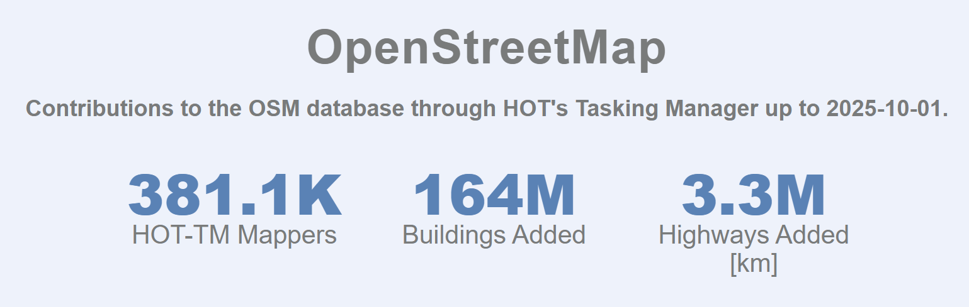
OpenStreetMap
Contributions to the OSM database through HOT's Tasking Manager 11/2012 - 10/2025
Humstats.heigit.org
Notes:
Since November 2012

Slide 4
Structure
Quality assurance using HOT Tasking Manager
Overview of what we have been doing for validation
DISCUSSION:
What can we do better?
How to facilitate completing priority tasks?
Bonus: trend

Slide 5
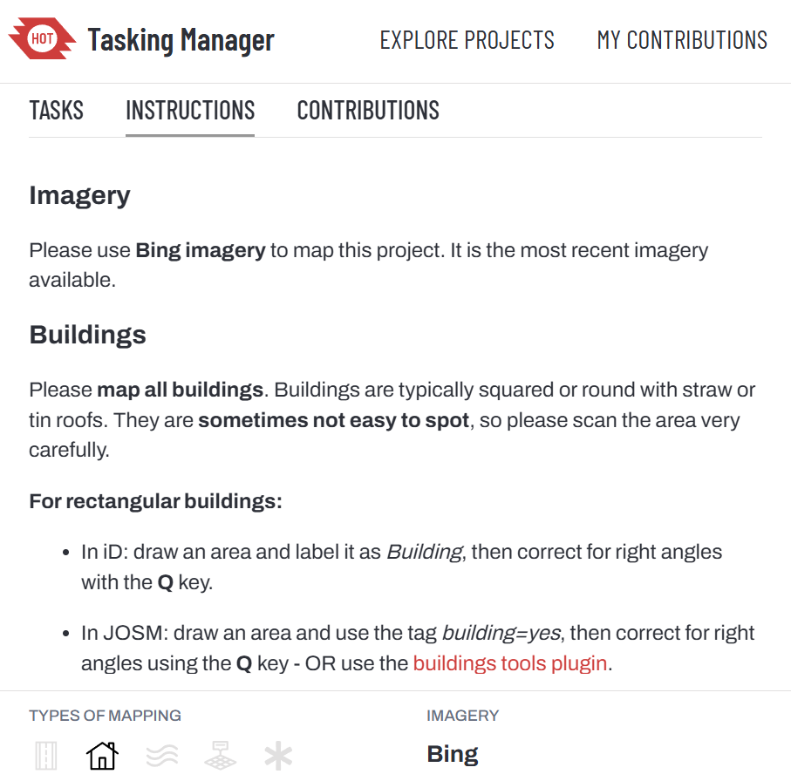
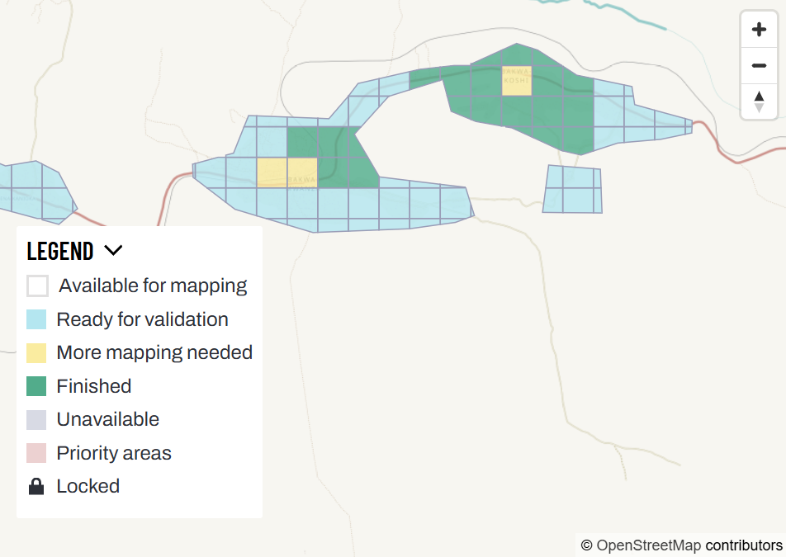
HOT Tasking Manager
Notes:
Checking other mappers’ mapping in OpenStreetMap on the HOT Tasking Manager, giving them feedback, correcting and completing (or invalidating for further mapping) it in order to ensure data quality

Slide 6
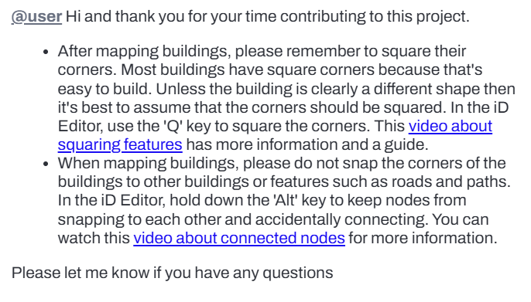
How OSM data validation over HOT TM works
What is HOT TM validation?
Result of validation
Who is doing validation?

Slide 7
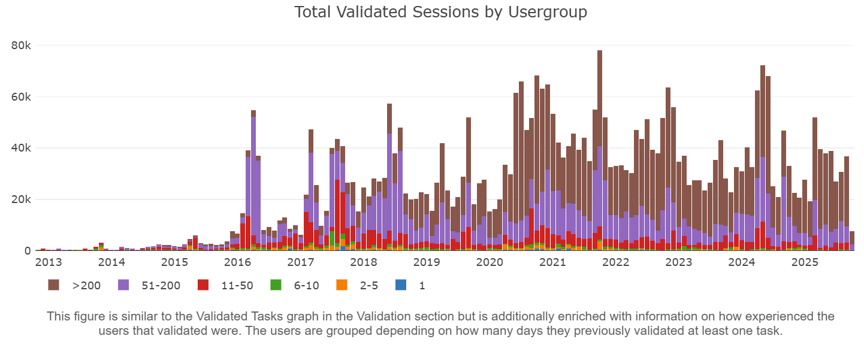

Slide 8
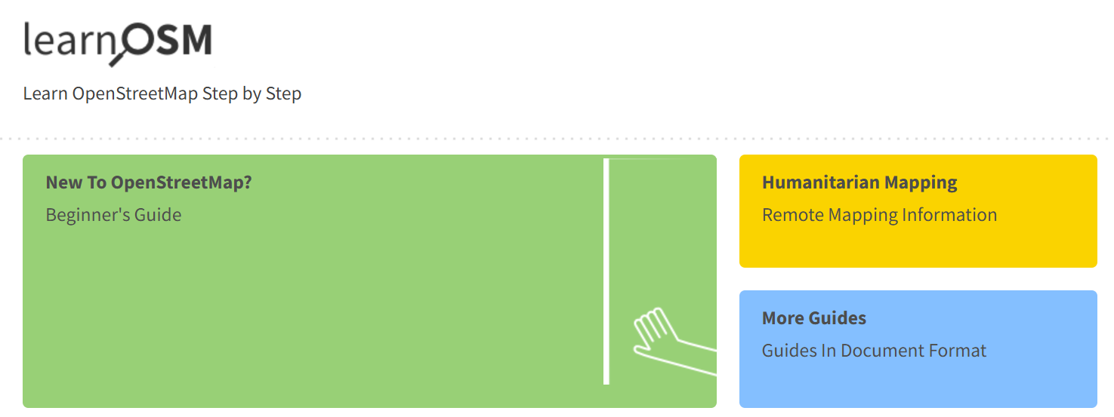
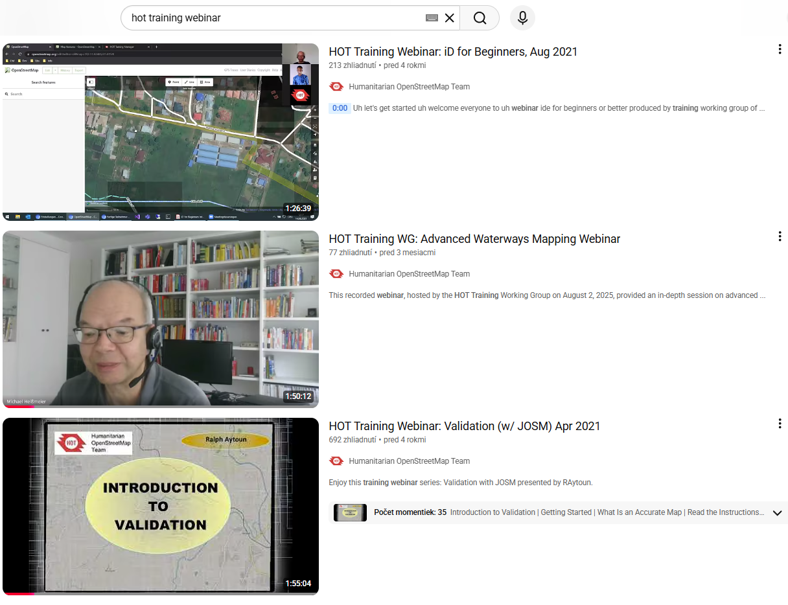
Learning materials

Slide 9
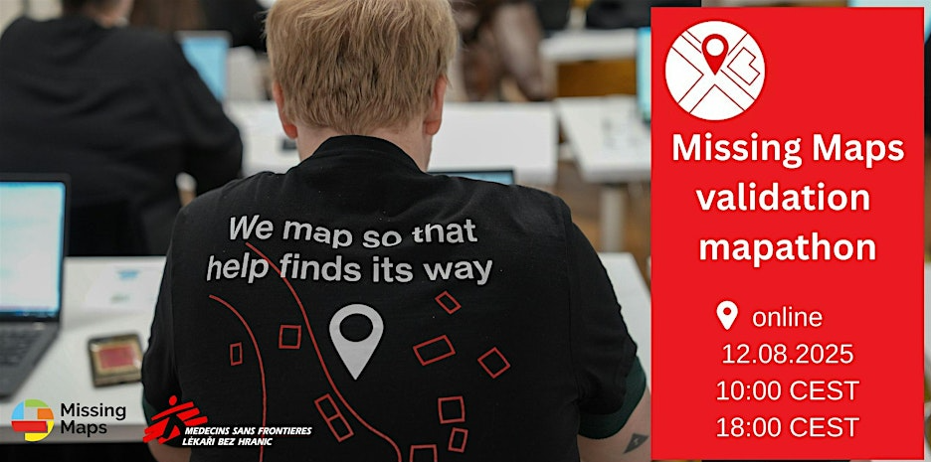
Validation training/group at MM London, Missing Maps CZ SK mapathons and validation mapathons
What we do to get more validators

Slide 10
What we do for validation for MSF projects
MSF Validators Team
Sending messages to announce upcoming MSF mapathons
Messages for urgent projects

Slide 11
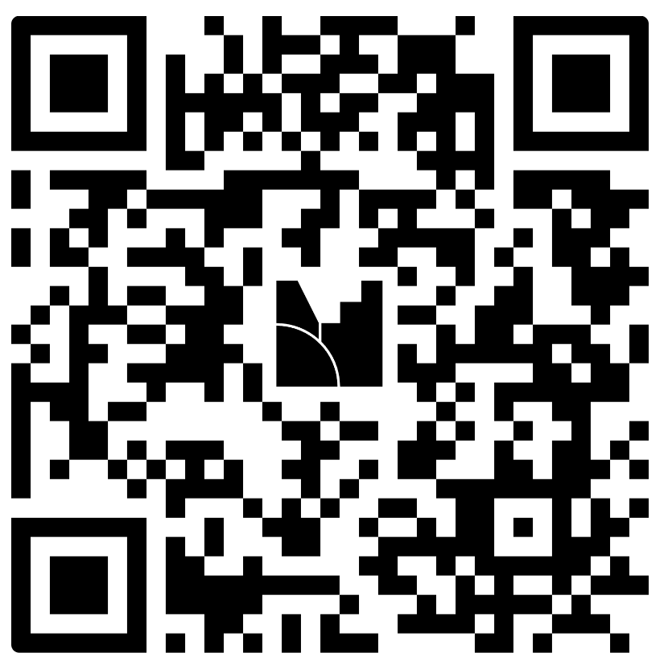
Discussion
Is this working?
Are these steps effective?
What frustrate you as a validator?
What would you like to see more of?
Notes:
HOT TM Data Quality working group - https://www.mentimeter.com/app/presentation/al5772cmkjjye7pafivr6gxz12aozrzw/edit?question=ywhc6ncaf2f2

Slide 12
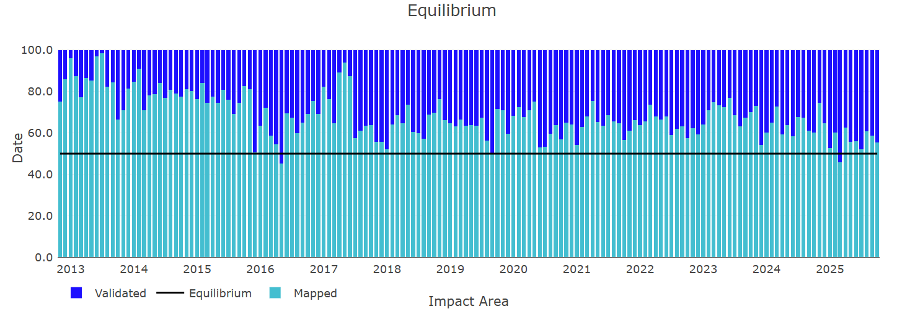

Slide 13
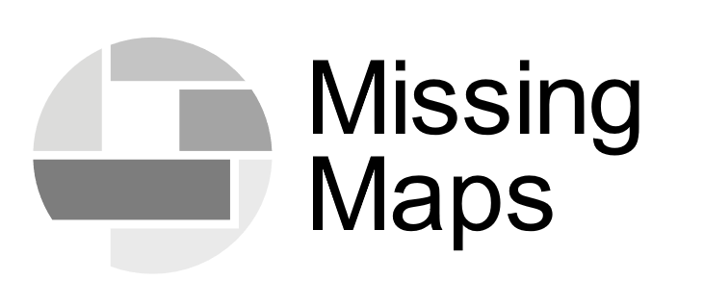



Thank you!
Join us mapping so that help can find its way.
patrik.brigant@prague.msf.org
OSM: Patrik_B
OSM/HOTOSM Slack: Patrik_B
TheMissingMaps
TheMissingMaps
TheMissingMaps

