Slide 1
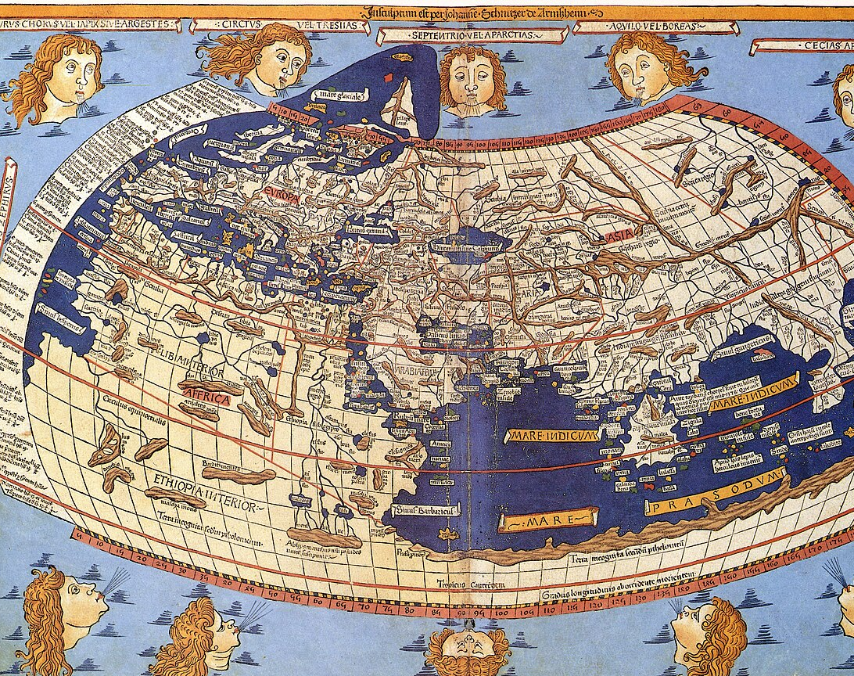
Human Elements of Trust and Data Misuse in Open Maps
Professor Lynne Coventry
Abertay cyberQuarter
November 2025

Slide 2
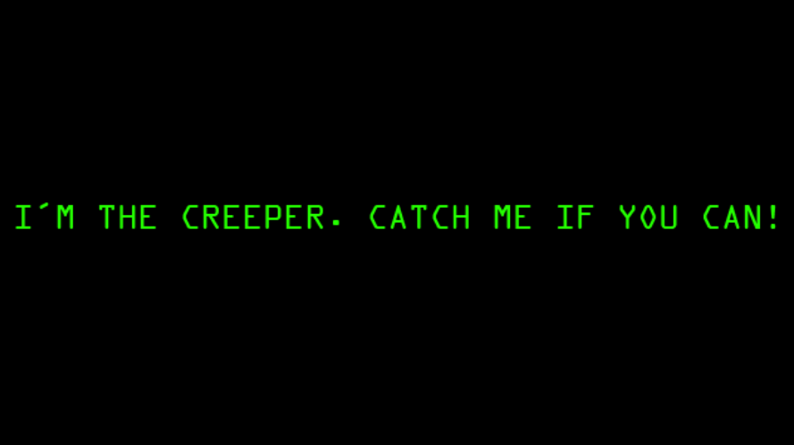

Slide 3

Notes:
The creeper worm gets deleted by self replicating reaper (who he thought was his friend)

Slide 4
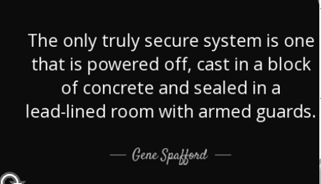
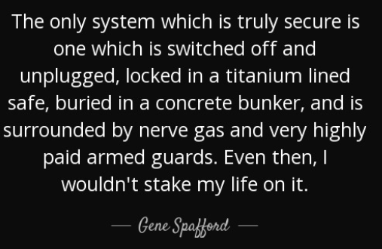
buried
Concrete bunker
Titanium lined safe
COMPUTER IS UNPLUGGED AND OFF
Highly paid guards
Nerve gas
Notes:
To manage the risk, more layers or controls are put in. But this just leads to an arms race. Its about understanding risk and recovery

Slide 5
Some context
Human Aspects of Cybersecurity
  Not just tech
  Merging into disinformation and safety
Total Privacy and Total Openness are both harmful
No such thing as 100% secure
Insider Threat
Unintended Harms
It will happen – but are you ready to recover?
Fundamental underpinning online interaction is Trust

Slide 6
Are openmaps trustworthy?
The CFO
  “Trustworthy? You mean free labor and unverifiable data? That’s not a strategy — that’s a liability. If an open map misleads users or partners, who absorbs the cost? Not the volunteers. Every error becomes an expense with no one accountable for the fix.”
The End User
  “Oh please. I’ve tried relying on those ‘open’ maps — wrong addresses, outdated info, missing streets. It’s like trusting a group chat to give you directions. Everyone edits a little, nobody checks twice, and you’re the one left lost in the middle of nowhere.”
The Social Ethicist
  ““Trustworthy for whom? Open mapping platforms amplify the voices of those with internet access, time, and privilege — not the marginalized communities often misrepresented or ignored. Openness doesn’t erase bias; it just distributes it under the banner of collaboration.”
The Scientist
  “You’re making an assumption of integrity without evidence. What’s the verification mechanism? Where’s the reproducibility, the accuracy metrics, the peer-reviewed audit? ‘Open’ doesn’t equate to ‘validated.’ Until you can quantify its reliability, the claim collapses.”

Slide 7
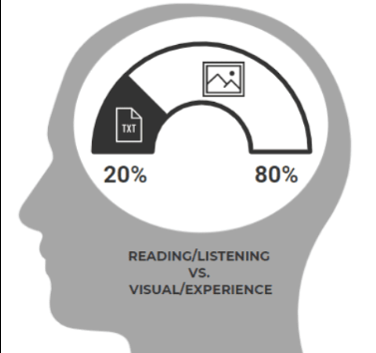
A map says to you, ‘Read me carefully, follow me closely, doubt me not.’”
In other words, just trust me.
The human brain is wired to believe visual information more implicitly than other data types.
  Increases comprehension: making complex data easier to understand
  Boosts memorability – picture superiority effect
  Enhances emotional connection – images evoke feelings better than words alone
  Increases engagement – more effective to capture and hold attention
Notes:
The human brain is wired to believe visual information more implicitly than other data types, this makes visual data including maps very persuasive.
The human brain is wired to believe visual information because it helps comprehension, boosts memorability, builds an emotional connection and captures attention increasing engagement.

Slide 8
Can we trust maps in a post-truth world where emotions, subjective opinions and personal beliefs have more credibility than facts?
Deconstuct the neutrality of maps (J.B. Harley)
Maps are increasingly used as persuasive instruments
More problematic as maps can go viral.
Deep fake geography tells a convincing story using false data
Notes:
People believe that maps are designed to be accurate and useful, with their trustworthiness is influenced by the user's confidence in the cartographer's intent and expertise. Maps are often used to communicate non-spatial information in an attempt to inheret the trust from the map.
We see maps being used to make strategic decisions. But As with all data, maps can be manipulated to tell or support a certain story. Although people tend to believe maps are ultimate truths, it is not unusual for facts to be distorted and viewers to be misled by deceptive maps – now referred to as deepfake geography.
This is certainly not a new phenomenon and there are justifiable reasons for creating such false narratives. But ultimately they lead to ill-informed conclusions.
Its not a new problem
Lets quickly go through a few examples

Slide 9
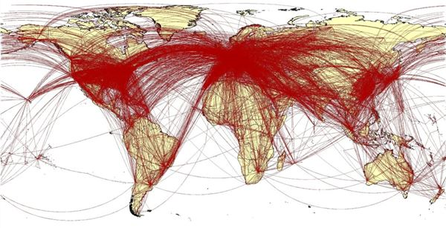
Map to illustrate the spread of COVID from Wuhan region?
Notes:
The wrong data can be used to tell a story.
While published as mapping the spread for COVID, GIS professionals quickly recognised the map as a previously published visualization of air traffic routes and travel.

Slide 10
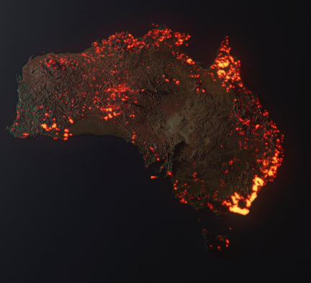
Satellite image of Australia bushfires?
Notes:
This image purports to be satellite image of bushfires in Australia. Looks like the whole of Australia is on fire, in reality it is accumulated data of where bush fires have been over a period of years, If it literally was on fire like this you wouldn’t be able to see anything for smoke.

Slide 11
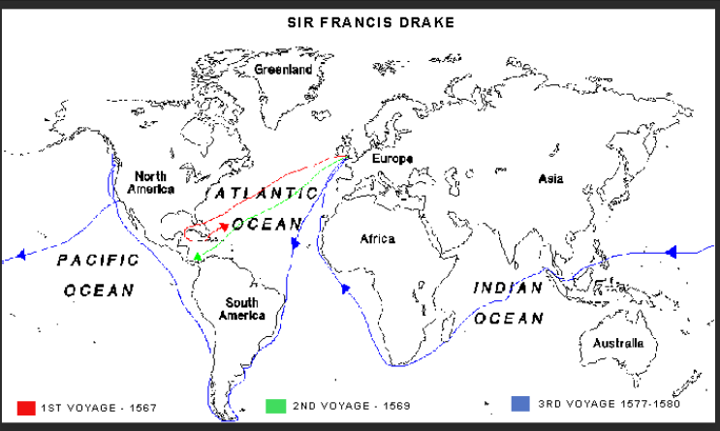
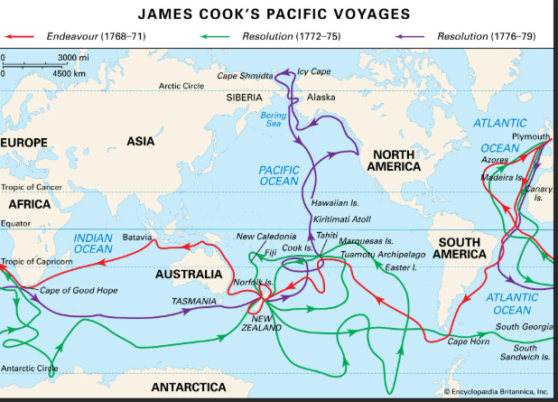
Deliberate non- mapping
Notes:
Disinformation in maps is not new
What did Sir Francis Drake and James Cook have in common?
Both were told to withhold information and not chart strategic locations that would be of advantage to another country.
This tradition continues with sensitive military sites not being charted today.

Slide 12
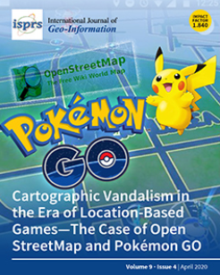
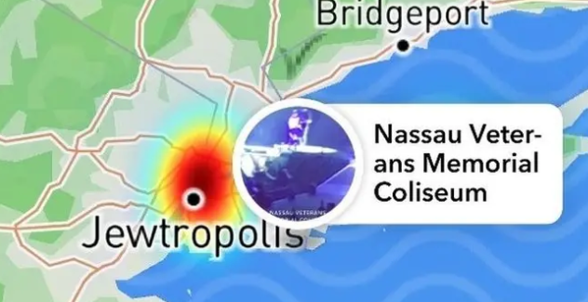
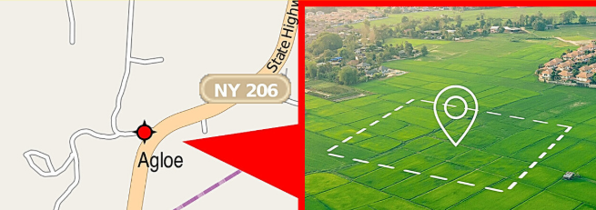
Vandalism
Political / idealist acts
Commercial
Fake places inserted to mark copyright

Slide 13
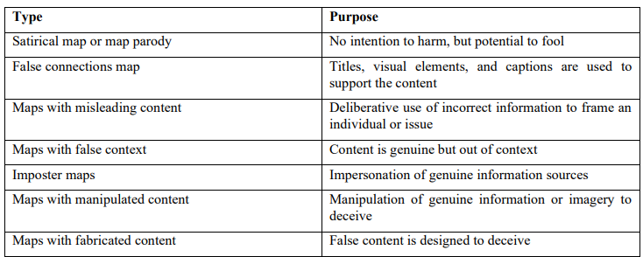
Claire Wardle (2020) proposed a taxonomy for misinformation and disinformation for online maps

Slide 14
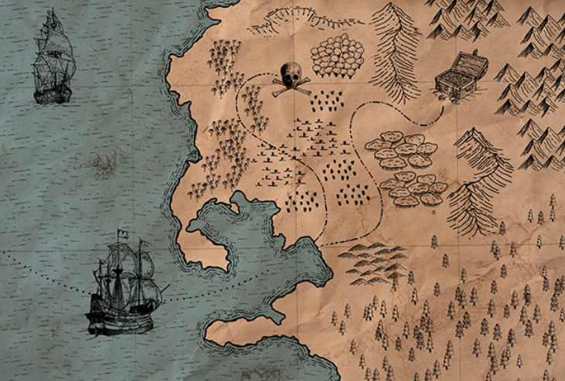
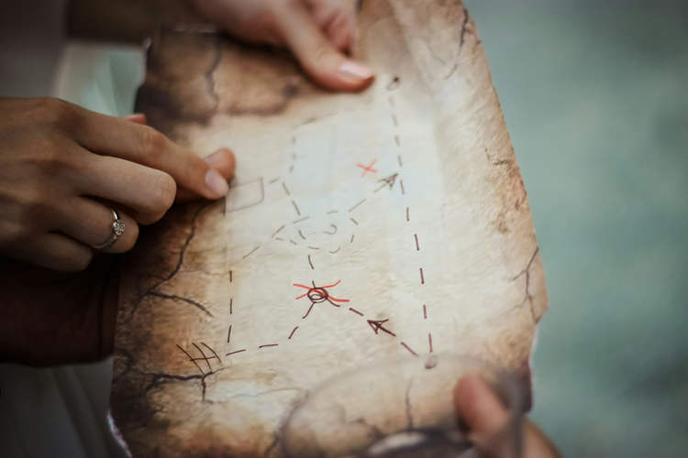
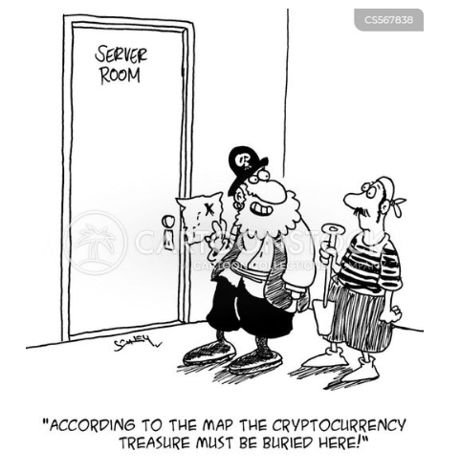
Imposter maps
Notes:
Fake maps can be used to scam people.
Treasure maps have been around for centuries, and are still managing to trick victims. In Turkey this year (2025) scammers conned 1.3 million pounds out of victims by selling them fake treasure maps.

Slide 15
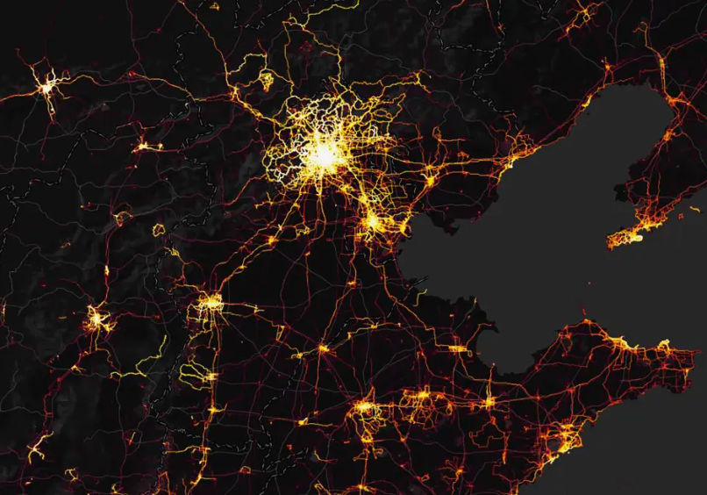
Sharing too much information
Maps display public information
But apps using maps can disclose sensitive information not mapped.
Strava example
Notes:
Another issue is that a map can release too much information, even if not intended. This mapped Strava fitness watch data to reveal unmapped military bases.

Slide 16
Who would add misinformation to a map?
Hostile state and non-state actors weaponise maps
Social media users may modify a map to create viral content
Amatuers may inadvertently introduce errors
Businesses may falsify information for financial gain
Political groups may spread information information about an issue or hide information
Creators add fake places to mark ownership
Explorers hide strategic landmarks
Defence hide strategic/sensitive locations
AI may have “hallucinations”
Notes:
Malign/Hostile Actors: Hostile state and non-state actors use maps as a weapon in disinformation campaigns to undermine democratic values and institutions, and promote specific political agendas.
Individuals and Groups:
Social media users may share or create misleading maps, sometimes by "photoshopping" or modifying existing map images to change their meaning, which can quickly go viral.
Amateur mapmakers and online community members (like Google Local Guides) can inadvertently or deliberately introduce errors. Business owners or their affiliates might submit false information (e.g., glowing reviews or fake listings) for personal or financial benefit.
Political groups and activists might use maps to emphasize a position they have a vested interest in, such as the use of a map to spread incorrect information about foreign land ownership or to frame political discourse.
Media Organizations: News organizations, particularly those with a strong political bias, may use or avoid using maps in certain ways to support their narratives or downplay certain issues (e.g., climate change denial).
Cartographers and Mapmakers (Intentional/Unintentional):
Even professional cartographers can introduce bias or unintentional inaccuracies through their choices in design, such as map projections, scale, or data presentation.
Historically, cartographic censorship occurred, with entities like the Dutch East India Company suppressing accurate geographical information to maintain a competitive advantage.
Artificial Intelligence (AI): Advances in AI are making it easier to falsify geographic information, including "deepfake geography" and fake satellite images, which can then be put onto maps.

Slide 17
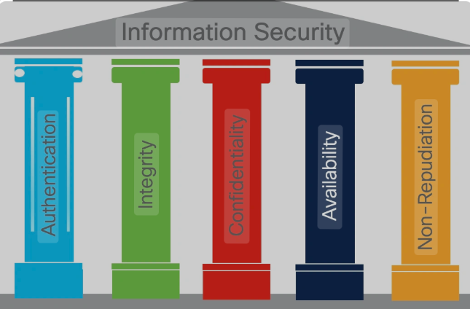
Notes:
So you might be asking what this has to do cybersecurity.
For some, disinformation is treated as a security issue.
Here are the 5 pillars of information security
Authentication: Verifying a users identity – but also the identity of the data source (used to build trust) and authenticity of the data
Integrity: Guarantees the accuracy and consistency of the data
Confidentiality : ensures that data is kept secret and only accessibility to authorised individuals
Availability: Accessible when needed
Non- Repudiation: Knowing who performed each action on the data.

Slide 18
Key Cybersecurity Threats
Insider Threats (mistakes, errors, deliberate or not)
Data Integrity Attacks
Open Source Intelligence Exploitation
Denial of Service Attacks
Malware
Ransomware
Supply Chain Attacks
Vulnerabilities in underlying Infrastructure
Notes:
Open maps relying on open source data and community contributions face specific cybersecurity threats.
Data Integrity Attacks: the deliberate introduction of false, inaccurate or malicious data into a map's data set. Can be very disruptive and create reputational damage
Open Source Intelligence Exploitation – Detailed and publicly available maps mean that malicious individuals or even state actors can obtain sensitive information about infrastructure routes and potential targets, which can be used to plan a physical attack.
Denial of service attacks when maps are flooded with traffic make the map unavailable
Malware and Ransomware can infect the underlying systems and software leading to the data being encrypted users and administrators locked out and ransom demands.
Supply chain attacks mean that data from one map can propogate into all systems that use that map
Lastly, the underlying web servers and software may not have been patched or may be misconfigured, which leaves vulnerabilities in the system that malicious actors can exploit.
These threats highlight the need for robust security measures.
So what are these robust security measures?

Slide 19
Security measures
Data Integrity Defenses
  Community review
  Blocking accounts
  Automated tools to detect anomalies and inconsistencies
  Change set monitoring
  Quick reversion tools
OSINT Exploitation
  Policy for privacy
  Shift responsibility to end-user apps
DOS and Malware
  Standard IT practises
  Access controls based on roles
  Network segmentation
  Vulnerability testing
Supply Chain
  Organisations must not simply trust open maps but must conduct own due diligence, filtering, verifying and risk management proceddures.
A cybersecurity strategy
A recovery plan
Notes:
Prevent - recover

Slide 20
Conclusion: think before you trust
Maps are powerful tools which should remain available to all.
Online and viral maps make it difficult to discern fact from fiction, joke from ideology.
Unfortunately, sources are seldom verified by end users.
Map creators need to do what they can to ensure data security
  Be prepared and plan for disruption and potential harms
Map users need to be aware of the persuasive power of images and be more critical of maps.
  Validate, critique over blind trust

Slide 21

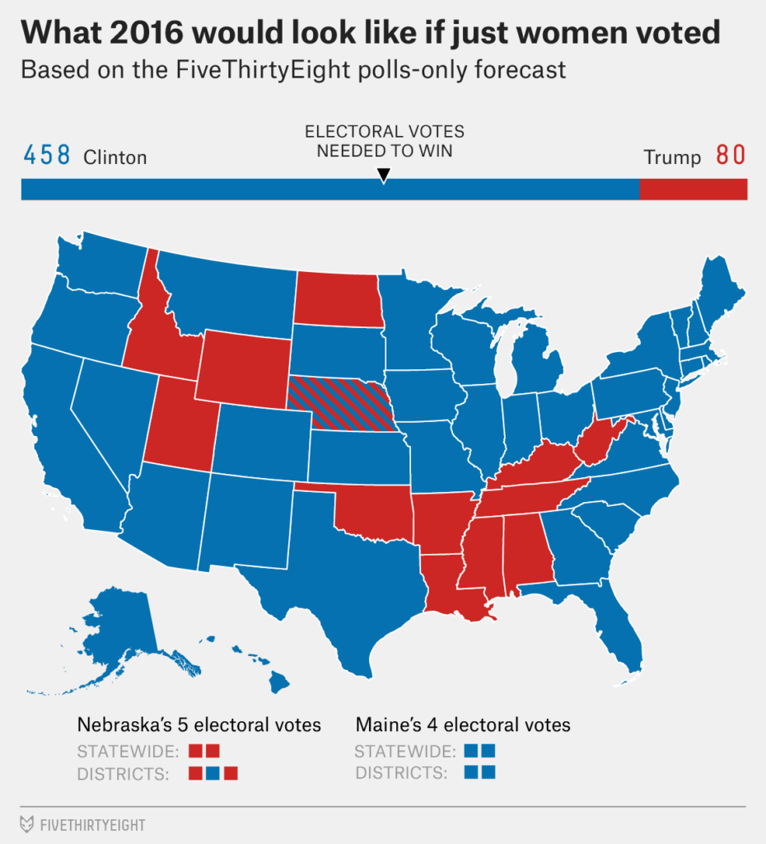
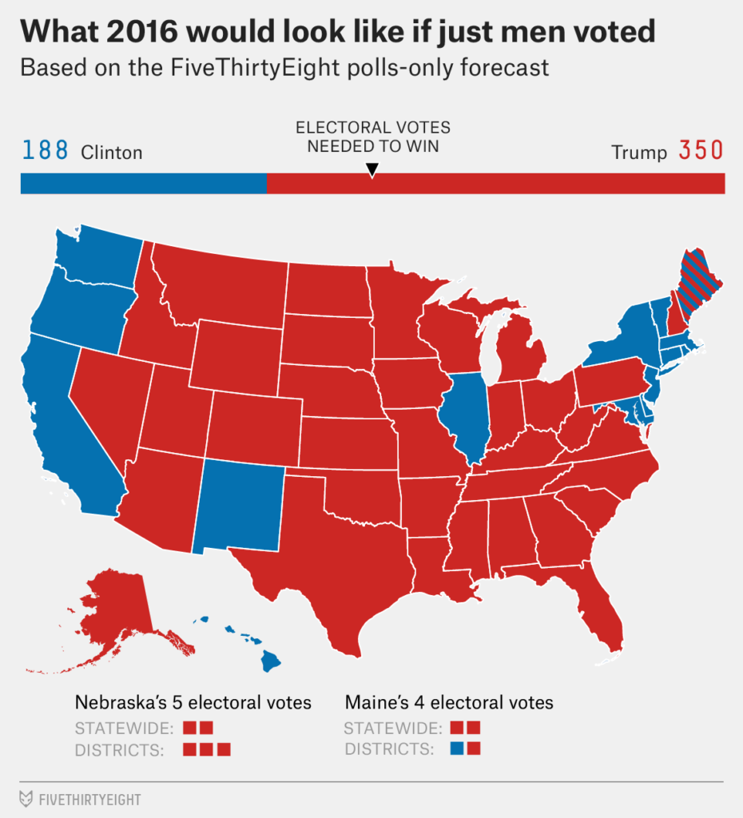
Notes:
You would think these maps were from actual poll data and represent the votes cast, but they are not, they are a guestimate based on adding or subtracting 10 percentage points from the margin in each state.

Slide 22
Using Generative AI to debate the trustworthiness of Openmaps
#context I’m going to state a core belief or plan I have.
#task Your task is to act as four distinct personas and attack this belief from your unique perspective.
Do not offer solutions or positive reinforcement.
#guardrails Present their critiques as direct, hard-hitting quotes.

Slide 23
Throughout the history of modern cartography in the West ... there have been numerous instances of where maps have been falsified, or where they have been censored or kept secret, or of where they have surreptitiously contradicted the rules of their proclaimed scientific status.

Slide 24
The Cynical CFO:
Cares only about ROI, risk, and resources. Views the idea as a potential waste of time and money, and questions its financial viability at every turn.
Trustworthy?
  “Trustworthy? You mean free labor and unverifiable data? That’s not a strategy — that’s a liability. If an open map misleads users or partners, who absorbs the cost? Not the volunteers. Every error becomes an expense with no one accountable for the fix.”
Not Trustworthy?
  “Finally, some skepticism — but don’t act like closed, proprietary maps are any better. At least with open ones, you’re not paying through the nose for hidden biases and licensing fees. Distrusting open maps sounds prudent until you realize you’re just buying someone else’s controlled narrative.”

Slide 25
The Jaded Front-Line User:
Has seen a dozen grand ideas like this fail before. Focuses only on the practical flaws, the implementation headaches, and how it will be harder to use.
Trustworthy?
  “Oh please. I’ve tried relying on those ‘open’ maps — wrong addresses, outdated info, missing streets. It’s like trusting a group chat to give you directions. Everyone edits a little, nobody checks twice, and you’re the one left lost in the middle of nowhere.”
Not Trustworthy?
  “Can’t be trusted? That’s rich. None of them can. The fancy corporate maps get it wrong just as often, they just hide it behind paywalls. At least with open maps, you can fix the mistakes yourself — not wait six months for a support ticket to vanish.”

Slide 26
The Hyper-Rational Scientist:
Cares only about data, evidence, and logical fallacies. Demands empirical proof for every assumption and relentlessly points out unsupported claims.
Trustworthy?
  “You’re making an assumption of integrity without evidence. What’s the verification mechanism? Where’s the reproducibility, the accuracy metrics, the peer-reviewed audit? ‘Open’ doesn’t equate to ‘validated.’ Until you can quantify its reliability, the claim collapses.”
Not Trustworthy?
  “Your statement is as absolute as it is unprovable. ‘Cannot be trusted’ implies a total failure rate — yet numerous studies show open-source mapping data meets or exceeds proprietary accuracy in many contexts. That’s an emotional conclusion, not an evidence-based one.”

Slide 27
The Social Ethicist:
Questions the idea’s human impact and fairness. Focuses on who it truly serves, who it might harm, and the underlying power dynamics.
Trustworthy?
  “Trustworthy for whom? Open mapping platforms amplify the voices of those with internet access, time, and privilege — not the marginalized communities often misrepresented or ignored. Openness doesn’t erase bias; it just distributes it under the banner of collaboration.”
Not trustworthy?
  “Saying open maps can’t be trusted reinforces elitism — it delegitimizes community knowledge and re-centralizes power in corporations or governments. You’re dismissing the collective voices that use mapping to document injustice, reclaim land, or make themselves visible.”

Slide 28
OpenMaps are trustworthy?
The Cynical CFO:
The Jaded Front-Line User:
The Hyper-Rational Scientist:
The Social Ethicist:

Slide 29
OpenMaps can not be trusted
The Cynical CFO:
The Jaded Front-Line User:
The Hyper-Rational Scientist:
The Social Ethicist:

