Slide 1
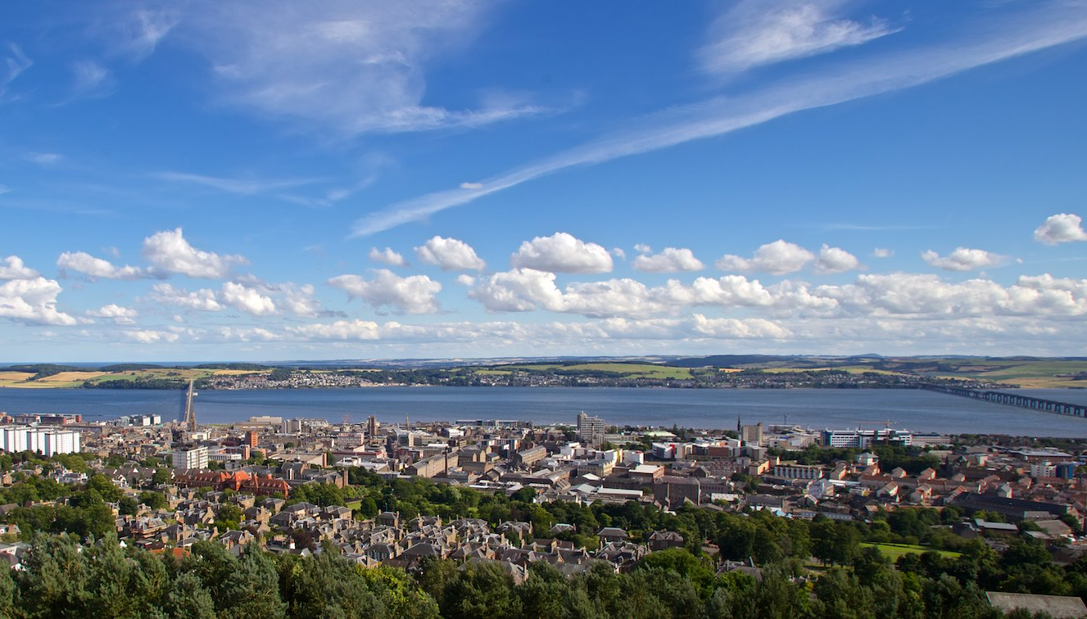


State of the Map Europe 2025
State of the Map Europe 2025
Welcome
Welcome to
Dundee
Gregory Marler
Conference Lead

Slide 2
State of the Map Europe 2025
Welcome
Gregory Marler
Conference Lead

Slide 3


Need some help?
Ask our volunteer team.
Go to the Info Desk.
See the website.
Make friends...
State of
the Map
Europe 2025
Example Name
example
TEAM
TEAM

Slide 4
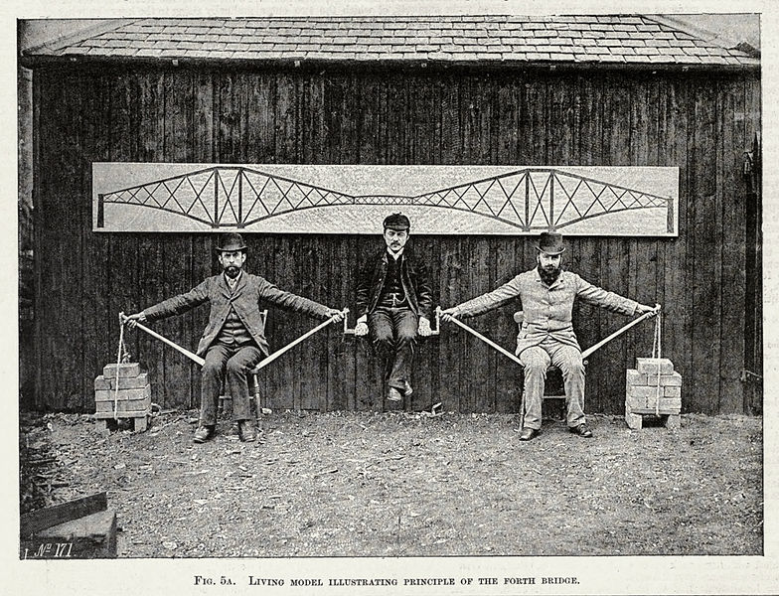
Make friends, and support each other
Inclusion & Safety Team: Gregory, Jo, and Gala

Slide 5
Stay Connected
Join the Wifi: Abertay Guest
Requires an e-mail address (or LinkedIn)
Sends you a pin to enter in
Post on social media with #sotmeu25

Slide 6
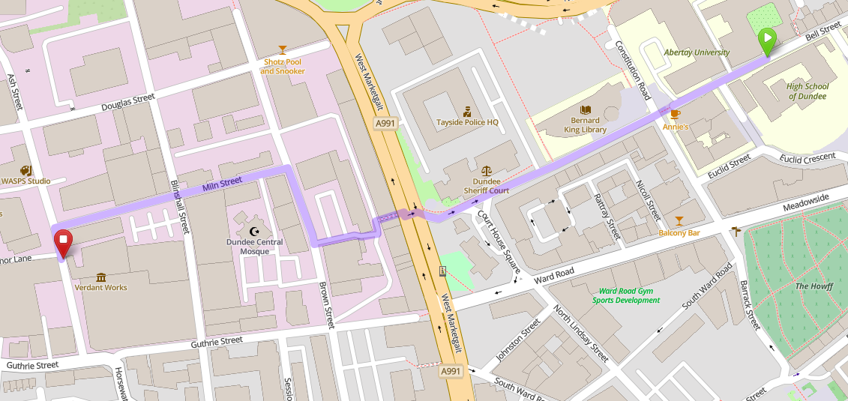
State of the Map Europe 2025
Saturday evening social
at Verdant Works
6pm Doors open 6:30pm Food
7pm prize giving 9pm closes

Slide 7
Many sessions
Get involved, and ask questions
Switch between rooms
Lightning Talks: sign-up at Lunch Time

Slide 8
Reminder for speakers
At the start of the break before your session, please meet the session-host at the front of the room.
Provide your talk on a USB-stick, or use the provided one to copy it across.
Filenames with your talk title will make organisation easier for us.
12 – 1pm | Lunch
1pm | Talk C | Speakers for these talks should go to the room at 12pm with their slides, and to meet the session host.
1:30pm | Talk D
2pm | Talk E
2:30 - 3pm | Tea & Coffee
3pm | Talk F | Speakers for these talks should go to the room at 2:30pm
3:30pm | Talk G
Actual schedule timings are on the website

Slide 9
State of the Map Europe 2025
Visit the Info Desk
Take part in:
Badge-making
Collaborative posters
Sticker-swap

Slide 10





Thank you
To everyone here
To the team
To our sponsors
TomTom Infrageomatics Verso

Slide 11
Need some help?
Ask our volunteer team.
Go to the Info Desk.
See the website.
Make friends...
State of
the Map
Europe 2025
Example Name
example
TEAM
TEAM

Slide 13
State of the Map Europe 2025
Human elements of
trust and data misuse
in open maps
Professor Lynne Coventry
Director of the CyberQuarter Abertay University

Slide 15
State of the Map Europe 2025
News from Europe
Gregory Marler
Jochen Topf, OSM Germany
Lorenzo Stucchi, OSM Italy
Robert Whittaker, OSM UK

