Slide 1

Disaster data: OSM POI data with stable IDs for emergency planning
14/11/2025
how the NCCN uses OSM & authentic sources in Paragon

Slide 2
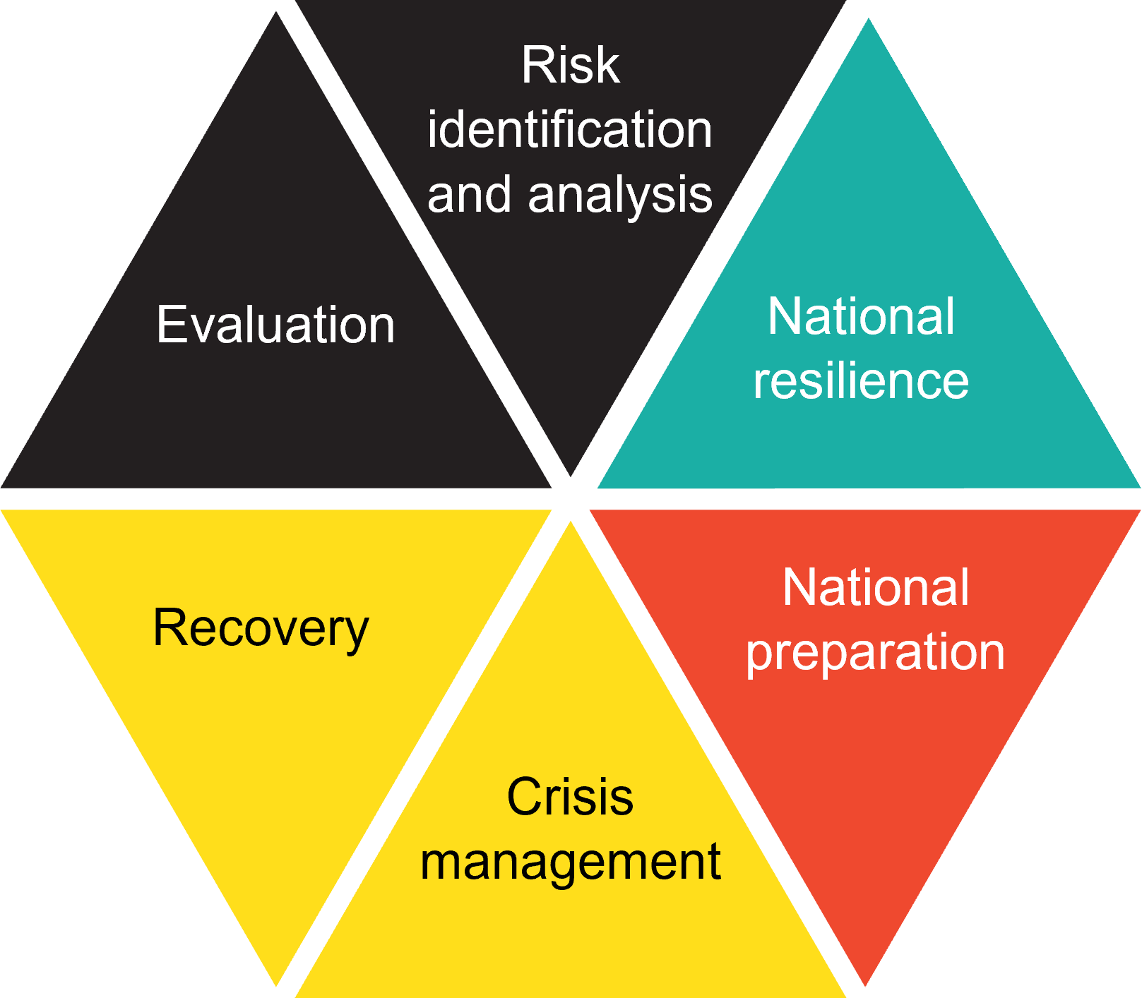
What is Paragon?
National security platform
What is a security platform?
Cooperation between police, fire fighters, medical staff, logistics and communication
Crisis/national preparation + Crisis management
+ Database of emergency plans
Tackle a crisis as soon as possible!
Notes:
Map based interface
Activate during specific crisis to keep track of situation on the ground and communicate core information

Slide 3
DATA FOR Paragon
Map-centric interface
Multiple basemaps (default OSM tiles)
Overlays with Anchors (POIs) which can be interacted with & can be linked
Emergency Plans containing locations & contacts that might become relevant
Cases get ad hoc Anchors or re-use existing ones
Notes:
Map centered tool - getting a common operational picture
OSM as a basemap is kind of obvious for us here, but less obvious in the federal government environment

Slide 4
External POI data in paragon
Using the data our own users generate?
Using official data?
Or using publicly crowdsourced data?
Notes:
The precursor application only used data provided by the users
Big problems with regional differences in quality, lack of maintenance and standardization
Official data to the rescue?
Or do public crowdsourcing?

Slide 5
WHICH SOURCES TO USE?
Why use official data?
Strength
Complete*
Standardized (within the region)
Standardized update cycle
Weakness
Administrative reality
Different between regions
Slow update cycle
Geocoded address
Notes:
*: for what is in the administrative scope
“this case is not in the data because it doesn’t fit our world view” (e.g. temporary school, school is not subsidized)
Logic based on administrative processes; e.g. a school is not a site

Slide 6
WHICH SOURCES TO USE?
Why use OpenStreetMap data?
Strength
Detailed polygons
As you see it in reality
Continuous updates
Precise geometry
Global data model (with local “dialects”)
Weakness
Limited on attributes (e.g. contact details)
Unstructured maintenance process
Completeness and detail very variable between places
Notes:
Need to go cross-border with our application
Note: not just OSM, also Wikidata to some degree

Slide 7
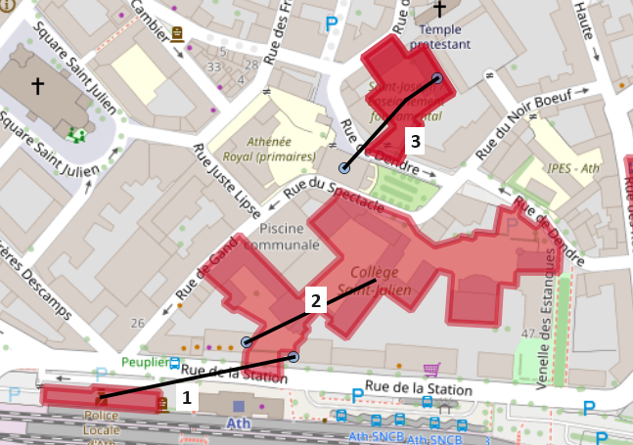
WHICH SOURCES TO USE?
Por que no los dos?
Notes:
Summarize the official data
Link to OSM data if available
Based on location, name, address, some attributes
Combine to build something better than the parts

Slide 8
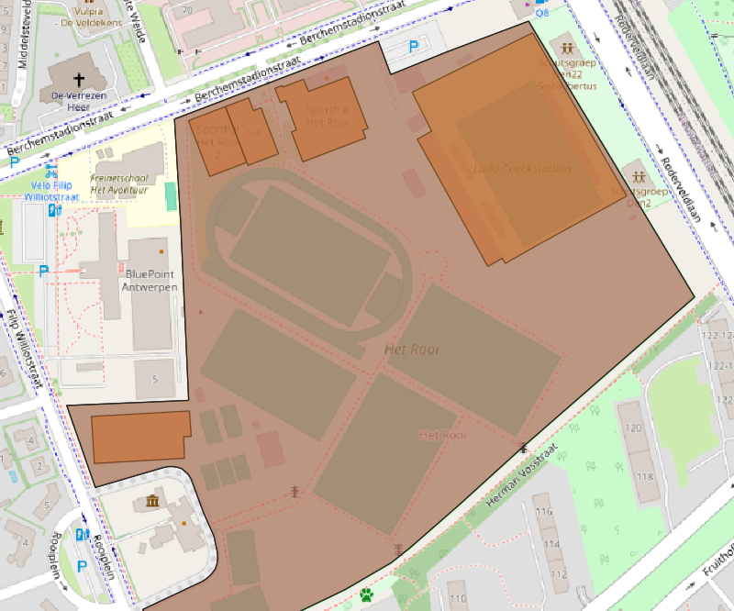
Filtering: sports example
Start with all sports related facilities (N: 240.047)
Remove private pools (N: 202.324)
Remove tracks & pitches without a name (N: 63.488)
Remove amenities used in other processes (N: 63.354)
Merge all overlapping features’ info on outer polygon (N: 56.295)
Remove if still no name (N: 34.225)

Slide 9
Anchor source types
OSM ONLY
Hospitals*
Firestations*
Airports*
Prisons*
Cultural centres*
Sports
Religious buildings
Train stations
Metro stations
Wind turbines*
Asylum detention*
Locks & dams
Civil protection
Shopping malls
Power stations
High voltage lines
OFFICIAL DATA ONLY
Seveso sites
Pipelines
Nuclear installations
Seaports
Bus & tram stops
Town halls
Nurseries
Asylum reception
Water sensors
Nuclear radiation sensors
Rivers
Summer camps
High voltage pylons
MIXED DATA
Schools
Police stations
Care for the disabled
Nursing homes
Notes:
So in the end, a lot of data comes either from official data sources (italic is public data)
many layers are pure OSM data
Relatively few mixed data, because of added complexity – but with new modular approach it became easier
Hospitals: will be merged in the future
*: OSM data validated with official sources

Slide 10
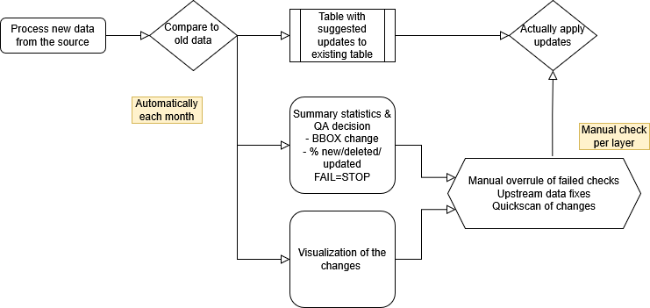
The data management problem
Notes:
How to handle 35 different ingestion processes with monthly updates & high QA necessity & lots of user feedback?
Simple common resulting data structure for all the datasets
Processes that try to re-use techniques and preferably code blocks
Modular processes, e.g. generic compare dataset process, generic “merge official point to OSM polygon” module
Run processes automatically using Airflow
Bulk analyze results & monthly release cycle of all the sources at once

Slide 11
External POI data in paragon
Anchors are for linking
Add location to your Cases & Emergency Plans
Need for stable IDs!
Notes:
Unique IDs are not a uniquely OSM problem
The same ID in the source does not always mean we would like to consider it the same object. E.g. a police station that moved may no longer be relevant for an emergency plan for a specific zone

Slide 12
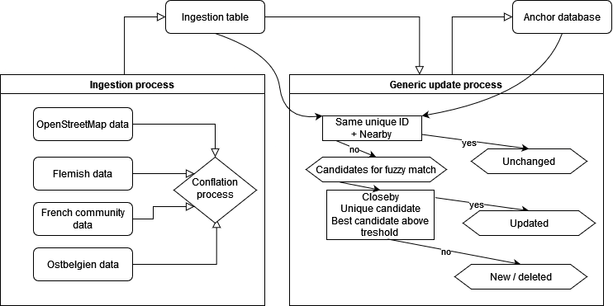
The UNIQUE ID problem
Notes:
Start by processing new data. Maybe just filtering, simplification & restructuring. Maybe includes conflating different sources
At the end we have an “ingestion table” where everything has a new UUID
If the layer is now, we copy straight to the Anchor database
For updating, we use a generic process:
Check if the same original ID still represents the same object > lightens computing load
The rest become candidates for fuzzy match. Found a single good candidate? > updated
No candidate? New/deleted objects

Slide 13
THE DATA QUALITY PROBLEM
Working on better data
With official sources
With the OSM community
Notes:
For official sources… well it’s hard
Some minor success
Often not even a reply to an email
For OSM data: appears a lot easier. But unique challenges too

Slide 14
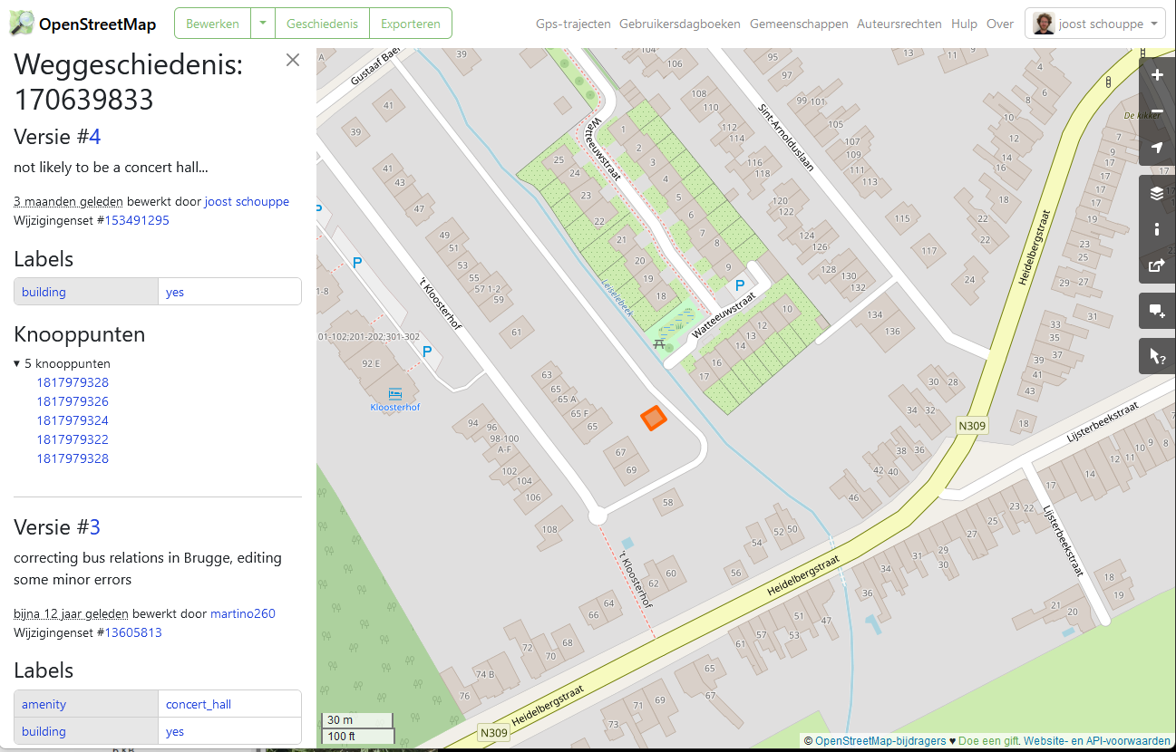
Notes:
Some manual reviewing of OSM data
Adding extra tags to clarify things, like
- type of fire station
- international airport vs any old airstrip
- hospital heliports

Slide 15
OSM projects
Review all firestations
Check police stations not in official data
Cultural center fixup
Hospitals
Check completeness & add official IDs
Standardize heliports
Add emergency ward entrances
Schools: sites without a name, add missing schools
Places of worship: filtering out the small stuff
Notes:
* Includes minor data model extensions

Slide 16
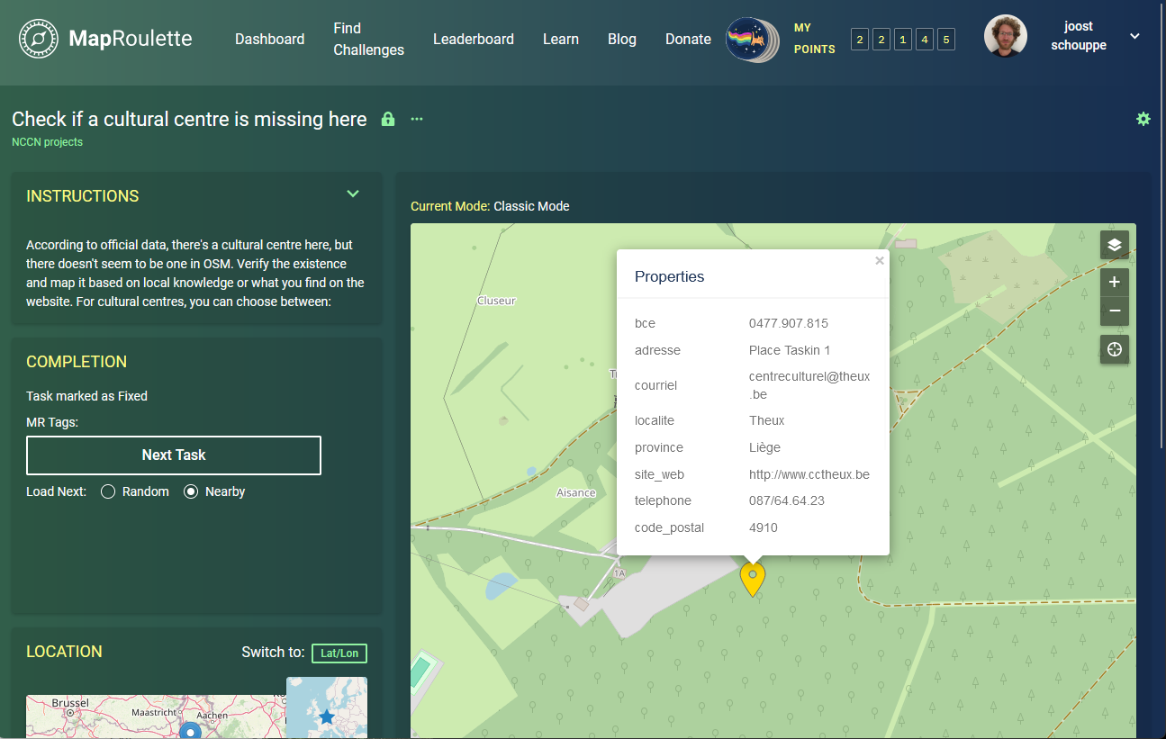
MapRoulette
Turn all issues into microtasks
With management dashboard
6 big challenge, over 1500 tasks finished = 254 hours of work = two months FTE

Slide 17
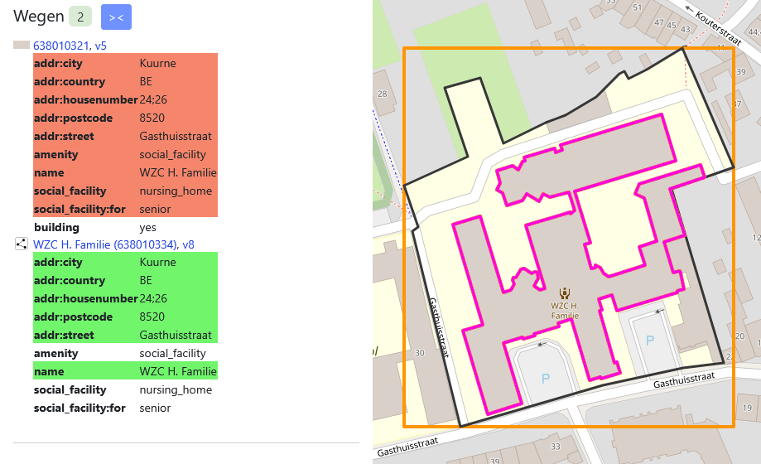
Common mistakes – mapping for the render
Notes:
Tags “for rendering” on the outline, but then also some or all tags on the building
Amenity only needed once!

Slide 18
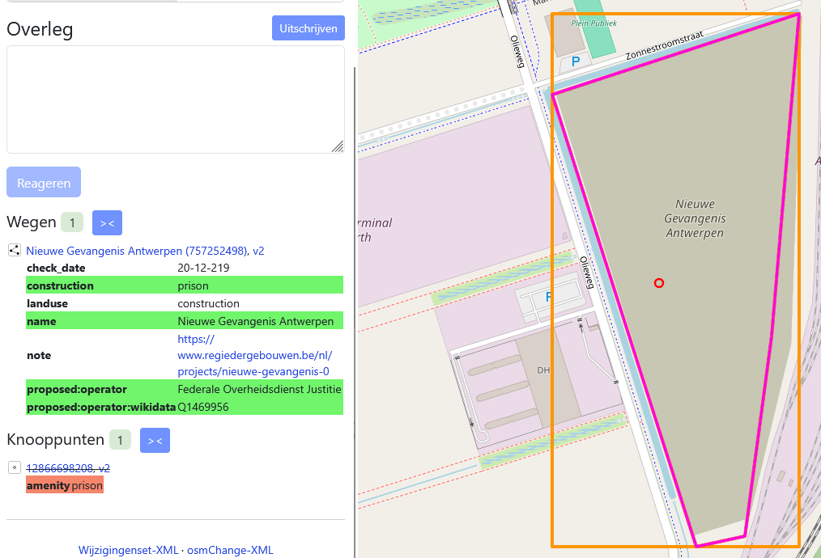
Common mistakes - overenthousiasm
Notes:
Overly enthusiastic mapping: adding things as what they will be, not as what they are

Slide 19
Common annoyances – everything is a (unqualified) thing
Notes:
Everything is a place of worship
It’s hard to identify which are big
14% we have no idea
Another 13% we can only make an educated guess

Slide 20

Wanna help?
https://maproulette.org/browse/projects/54664
Supports OpenStreetMap Belgium as a Corporate Member

Slide 21





Paragon data team: paragon-data@nccn.fgov.be Help us improve OSM https://maproulette.org/browse/projects/54664 Use our code https://github.com/joostschouppe/NCCN-anchor-processing https://en.osm.town/@joost_schouppe
https://crisiscentrum.be @CrisiscenterBE
Notes:
Help us improve OSM for national crisis management

