Slide 1
OpENING A BAR IN AMSTERDAM
IBM DATA SCIENCES CAPSTONE PROJECT

Slide 2
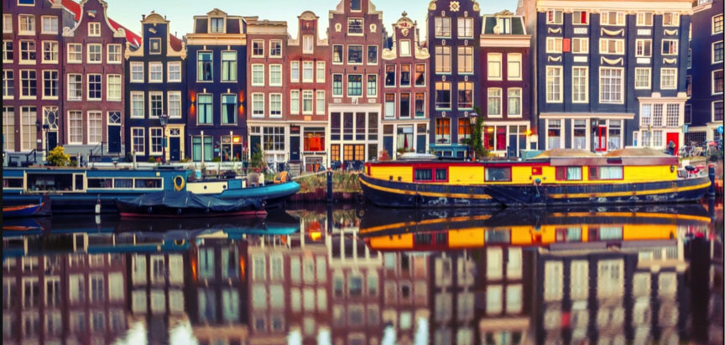
Introduction

Slide 3
Introduction & BUSINESS PROBLEM
Amsterdam is one of the most popular European cities for travellers. According to the prediction of Netherlands Board of Tourism and Conventions, 24 millions of people has visited Amsterdam in 2017, and this number will reach 31 millions in 2030.
A wealthy retired banker is looking for a good location in Amsterdam to open up a bar, and hope that the revenue generated by this business can support his retirement life in a Greek island

Slide 4
Data Collection
Amsterdam Neighborhoods’ Namehttps://en.wikipedia.org/wiki/Category:Neighbourhoods_of_Amsterdam
Geographic coordinates from Geocoder
https://geocoder.readthedocs.io/index.html
Request Foursquare data of all the venues in Amsterdam via Foursquare developer API

Slide 5
Methodology
Import python libraries that are needed for performing analysis
- BeautifulSoup, pandas and numpy, etc.
Fetch and Consolidate data from different data sources
Explore data
Conduct K-mean clustering
- Simple and popular machine learning algo
Inspect the results and draw conclusion

Slide 6
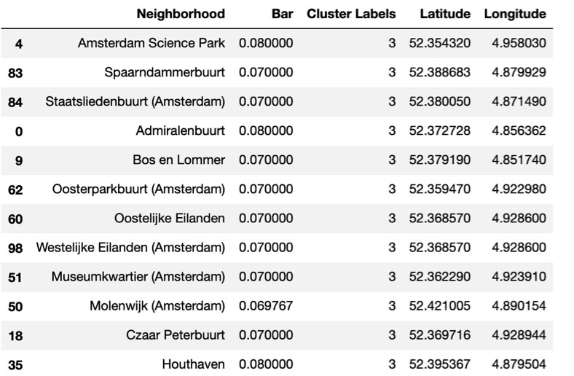
DON’T open a bar in those area! Why?

Slide 7
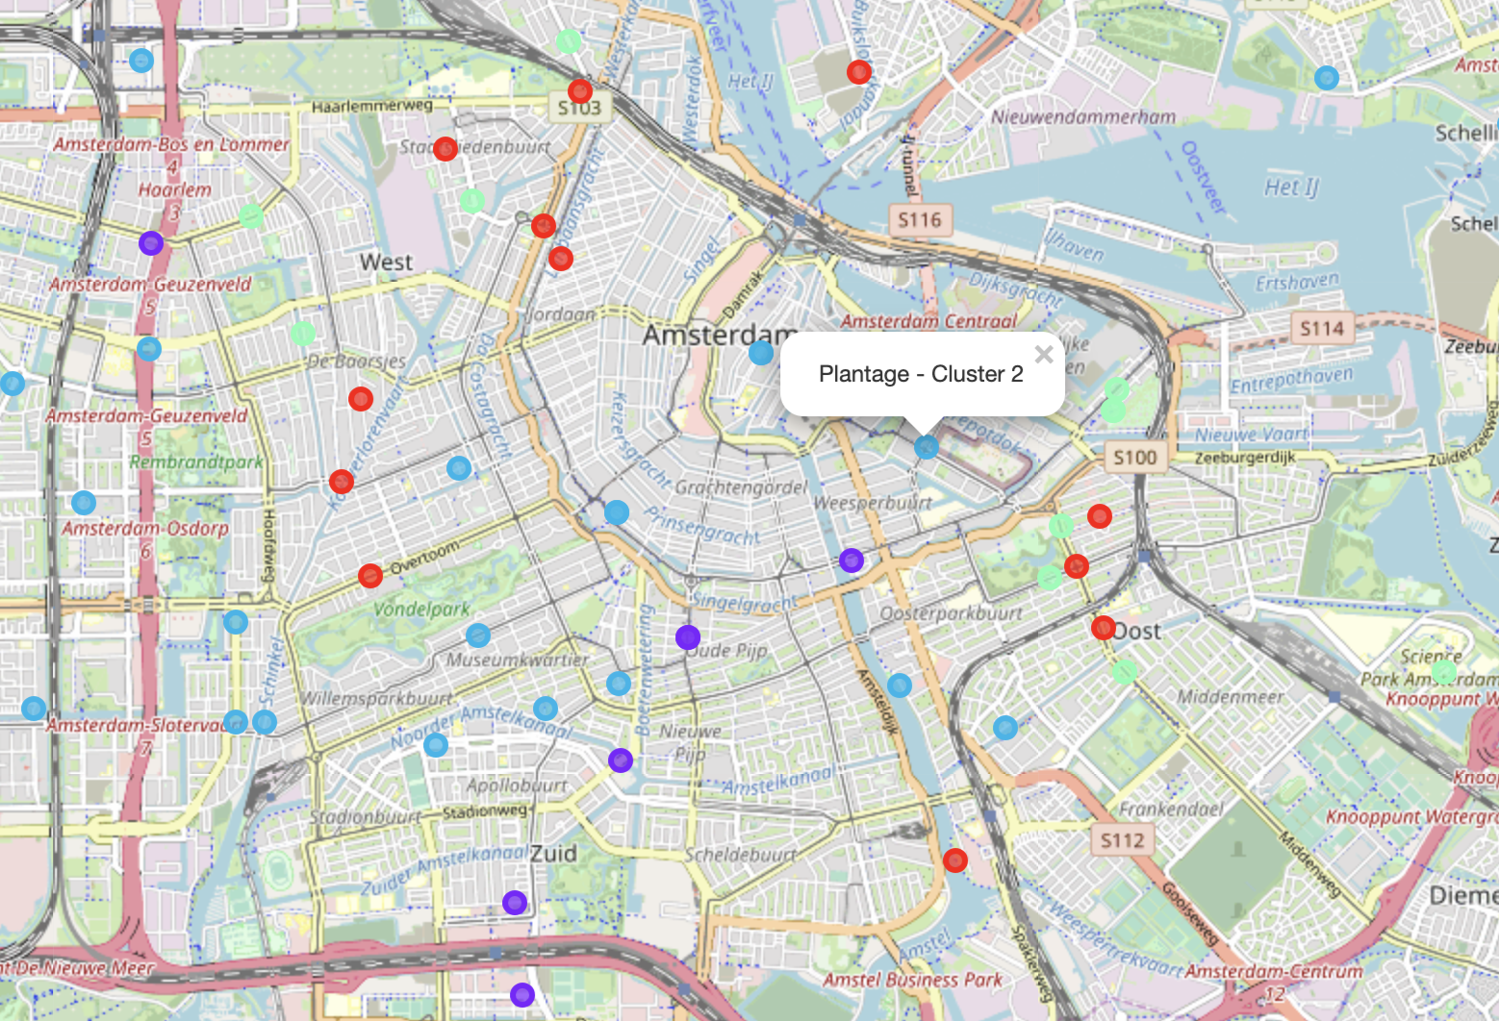
open a bar in those area! Why?
Cluster 1 & 2

Slide 8
Conclusion
Recommended Neighborhoods for opening a small bar:
Cluster 1
Cluster 2
The best location for opening a small bar is in cluster 1 and 2, they are the purpledots and blue dots on map respectively. As we can see from the map, they are located close to Amsterdam city centre and close to tourist attractions. Neighbourhood such as Uilenburg and Plantage are nice areas that are in the center of city, but are not too competitive.

Slide 9
Any questions?

