Slide 1
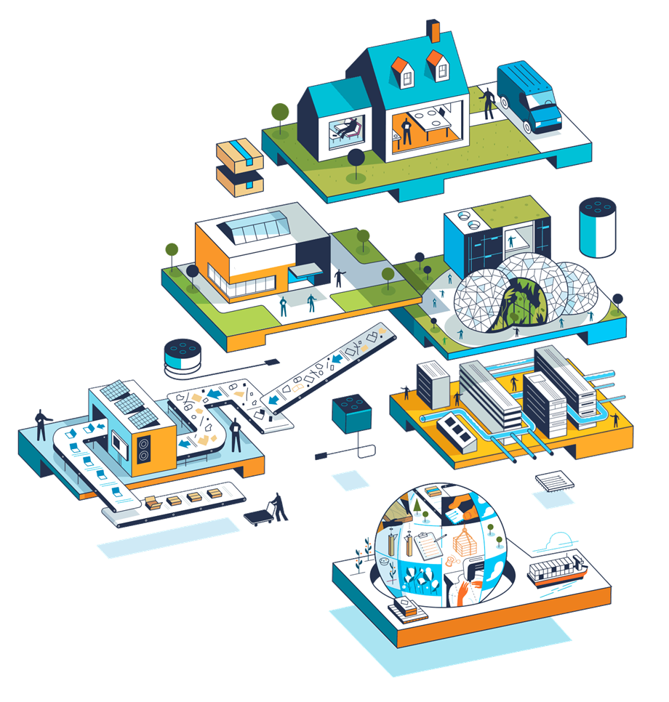

How can organizations become more resilient to disruptive dynamics and stresses?
Insights from:
Ethical Systems Design
Return on Sustainability Investment
NOMUKA LUEHR

Slide 2


How Ethical Design Systems Promote Resilience
Many nations have faced slow growth & rising income inequality since the 2008 financial crisis
Ethical design systems can help nations and organizations combat disruptive forces through:
Increasing growth:
Brand reputation is valuable
Illegal and unethical conduct can be catastrophic
Research shows ethical governance is financially rewarding
Reducing inequality & populist discontent:
Traditional focus on shareholder returns encourages low wages & disruptive rebellions
Ethical systems design focus on long term sustainability encourages value maximization for all stake holders
$
Ethical
Designs
$
Economic Growth
Economic Growth
$
Economic Growth
Have you ever paid more or avoided a product based on the company’s brand reputation?

Slide 3





Building an Ethical Design System
Ethical design systems lens considers the following three levels of analysis
Levels of Ethical Design Analysis
Organizational
Regulatory/
Government
Personal
Personal
How to encourage ethical employee conduct?
Ethical failure at any level can be catastrophic
Organizational
How to establish and maintain a culture of ethical business decisions?
Achieving good ethics at all levels yields enormous benefits
Regulatory/Government
How to get regulatory agents to reward ethical actions at an organizational level?
What are some organizational actions for which the government currently rewards?

Slide 4
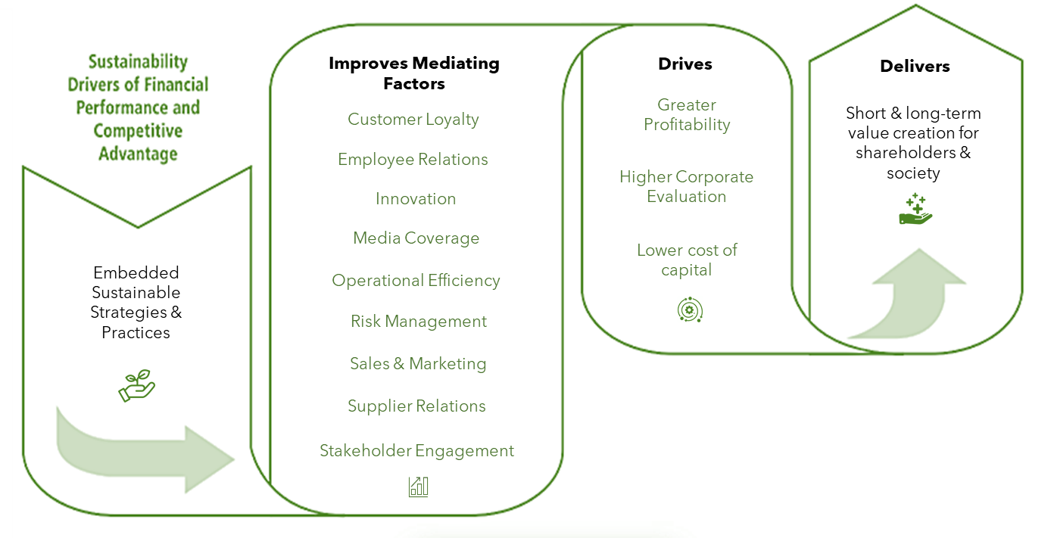
Potential Benefits of an Ethical Design Systems
Research finds strong correlation between sustainability & corporate financial performance
Sustainable business practices:
At a minimum do not harm people or the planet
At best create value by improving drivers of financial performance
These drivers fall into 9 key categories of mediating factors

Slide 5





Measuring & Monetizing Returns on Sustainability
Corporations struggle to evaluate the financial return of sustainable actions
Proposed Solution Process: Five steps to monetize sustainability actions
1
2
3
4
5
Monetize & Calculate Net Value
Identify Material Sustainable Actions
List Potential
Benefits
Quantitative Cost/Benefit Analysis
Refine & Iterate
Create comprehensive list of potential actions, benefits & metrics using company data or other sources like sustainability reports
Identify potential impacts on mediating factors
Gather data, inputs, and assumptions for each benefit
Net Benefit considers cost as well as benefits
Build scenarios of possible actions
Improve & document assumptions
Perform sensitivity analysis
Find optimal methods of measuring value of benefits (Ex: NPV)
Weight uncertain factors with probability of occurrence

Slide 6

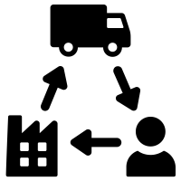
Applied Examples: Two Cases
Financial benefits of sustainable practices in business
Financial Benefits
Can charge full prices
Greater employee attraction & retention
More Innovation
Lower reputational risk & fine avoidance
Improved upstream & downstream relations
Product Differentiation
Sustainable Actions
Cattle intensification
Pasture rotation
Management of water sources
Conserve biodiversity & forestlands
Reduced use of agrichemicals
Sustainable Actions
Materials efficiency and recycling product safety
Labor relations
Fuel economy and use-phase emissions
Materials sourcing
Financial Benefits
Reduced operational cost from energy saving and recycling
Lower treatment costs
Gained revenue from selling recycled materials
Avoided cost of recalls
Reduced dependency on certain materials
Both industries yielded a positive NPV for their sustainability actions
Beef Supply Chain
Automotive Industry
+

Slide 7
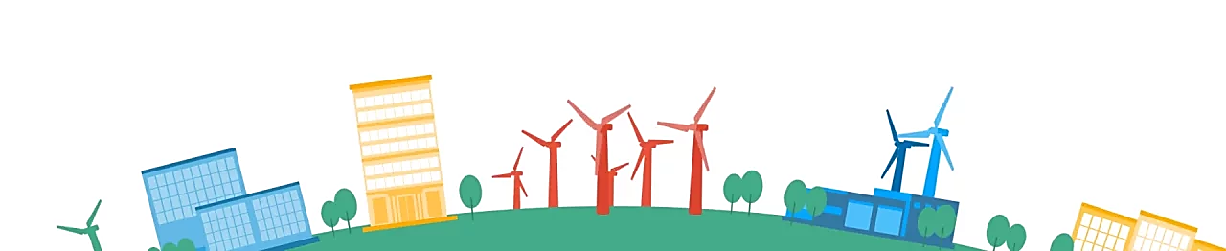

Breakout Room Exercise
Sustainability made Nike more resilient
Discuss with your group about Nike’s sustainability efforts as outlined in the report below. Namely, everyone please find one interesting initiative and think about how it could be monetized. Be ready to share in 5 minutes with the class.
Nike Sustainability Report, FY20: Link Here

Slide 8
Discussion Question
Evaluating practicality
Sustainability is desirable on a firm level, but not always achievable.
Come up with an example of how a company face a dilemma between sustainability and returning gains to shareholders.
?

Slide 9
Thank You

Slide 10
Appendix

Slide 11
Breakout Room Exercise 2
Apple Return on Sustainability Exercise
You are the CEO of Apple. A chief sustainability officer proposes removing all chargers & earpods from the latest iPhone launch to reduce e-waste.
How can we use the previous five steps to monetize this sustainability action?
What are the potential costs and benefits
Based on your analysis, do you think Apple should remove chargers and earpods?

