Slide 1
Federated Multi-Agent Reinforcement Learning for Privacy-Preserving Distributed Wireless Resource Management
B.Tech Project | Final Review | Python-based simulation study
A.Y.: 2026-27
by
K. Harshit Roll no: 2520040035
N. Karthik Ram Prasad Roll NO: 2520040046
M. Tirumala Teja Roll No:2520049126
Under the Esteemed guidance of
Dr. Vinnakota Venu Balaji assistant Professor,
Department of ECE
]
FedAvg aggregation server
(model updates, not raw data)
Agent 1
Agent 2
Agent 3
Agent 4
Agent 5
5 wireless devices | 3 channel choices | privacy-aware learning

Slide 2
Problem Statement and Motivation
Devices compete for limited channels: poor allocation causes interference, collisions, latency and low throughput
Centralized learning needs device data gathered at one point
Independent agents learn alone and gain nothing from peers
Federated learning aggregates local model updates (FedAvg)
Differential privacy can add protection, usually with a performance cost
Problem statement
How can distributed wireless agents learn good channel-allocation policies while limiting raw-data sharing, and what does this cost in wireless performance?
Research gap
The joint trade-off between wireless metrics, communication overhead and privacy is rarely compared across centralized, independent, federated and DP-federated learning.
Python simulation study | 2 / 10
Notes:
Explain that wireless devices share limited spectrum, so poor allocation causes collisions, latency and wasted throughput. Centralized learning needs data collected in one place; independent agents cannot learn from each other. Federated learning shares model updates instead; differential privacy adds a further mechanism but can cost performance. Finish with the problem statement and gap.

Slide 3
Objectives and Proposed Contributions
Build a Python-based wireless resource-management simulation
Model five agents and three channel choices (to be confirmed against code)
1
2
Compare centralized DQN, independent MARL, federated MARL and DP-federated MARL
Evaluate with wireless metrics: throughput, goodput, spectral efficiency, latency, BER/PER/PDR, collisions, fairness
3
4
Study privacy and communication overhead alongside network performance
Identify limitations and directions for improvement
5
6
Python simulation study | 3 / 10
Notes:
Walk through the six objectives. Be honest: objectives are addressed within a simulation; privacy and overhead analysis depend on what the implementation actually records, and limitations are part of the outcome.

Slide 4
Dataset, System Model and Feature Engineering
Dataset
data/augmented_dataset_ready.csv
Preprocessing and feature processing
Wireless simulation state
Agent observations (5 agents)
Reported dataset size: 15,760 records (to be verified)
Feature categories: timestamp, user/device ID, application type, signal strength, latency, required bandwidth, allocated bandwidth, resource allocation
System concept: 5 agents, 3 channel choices, a simulation abstraction (not a real-router experiment)
RL environment supplies states, actions, transitions and rewards per the implementation
Recorded dataset features differ from calculated metrics: throughput, goodput, BER and PER are computed, not CSV columns (unless confirmed).
Preprocessing steps, train/test split, seed and leakage prevention: not verified, project code not supplied.
Python simulation study | 4 / 10
Notes:
Describe the dataset file and its feature categories. Stress that dataset columns are recorded inputs, while throughput, goodput, BER, PER and others are computed by the evaluation code. Record count (15,760) and preprocessing details come from your project summary and must be confirmed in the code before presenting. State the actual train/test split and seed from your code.

Slide 5
Proposed System Block Diagram
Dataset (CSV)
Preprocessing and feature preparation
Wireless simulation environment: 5 agents, 3 channels; returns state, reward, feedback
Agent 1
Agent 2
Agent 3
Agent 4
Agent 5
Optional DP step: clip + noise on updates (DP-FedMARL only, if implemented)
FedAvg aggregation server
Local DQN training on local observations and rewards (data stays local)
Global model redistributed to agents
Separate baseline paths: Centralized DQN (joint decisions) | Independent MARL (no aggregation)
Wireless metrics evaluation and comparison (all four approaches)
Blue arrows: data/feedback flow Cyan: model updates to server Dashed grey: global model back Amber: privacy step on updates
Python simulation study | 5 / 10
Notes:
Trace the flow: dataset to preprocessing to the simulated environment; each of the five agents observes local state and picks a channel; the reward and wireless feedback train local DQNs; updates go to the FedAvg server, optionally clipped and noised in the DP-FedMARL branch; the global model returns to agents. Centralized and independent baselines are separate paths into the same evaluation. Local data staying local is the design intent, to be confirmed against the code; no privacy guarantee is claimed.

Slide 6
Learning Models and Methodology
A. Centralized DQN
B. Independent MARL
C. Federated MARL
D. DP-FedMARL
Single learner over joint decisions; centralized baseline
Separate DQN agents, no model aggregation
Local training; FedAvg builds a global model
Federated training plus clipping/noise (if confirmed in code)
centralized_dqn.pt
independent_marl_agents.pt
federated_marl_global.pt
dp_federated_marl_global.pt
Cycle: observe state, choose channel (action), receive reward, update local DQN policy, send update, aggregate (FedAvg) over rounds, redistribute global model.
DQN = reinforcement-learning algorithm | MARL = multi-agent setup | FedAvg = aggregation algorithm | Differential privacy = privacy mechanism (guarantee not claimed without a verified accountant)
Refs: Mnih et al., Nature 2015 (DQN); McMahan et al., AISTATS 2017 (FedAvg); Dwork & Roth, 2014 (DP). Checkpoint names are as reported; no fifth model is claimed.
Python simulation study | 6 / 10
Notes:
Four approaches: centralized DQN as a baseline; independent MARL with separate DQN agents; federated MARL where local DQNs are averaged by FedAvg; and DP-FedMARL which adds clipping and noise to updates if the code does so. Clarify that DQN is the RL algorithm, MARL the multi-agent setup, FedAvg the aggregation rule and differential privacy a privacy mechanism, so they are not four unrelated algorithms. Cycle: observe state, choose channel, get reward, update local policy, send update, aggregate, redistribute. Refs: Mnih et al. 2015 (DQN); McMahan et al. 2017 (FedAvg); Dwork and Roth 2014 (DP).

Slide 7
Wireless Metrics and Evaluation Setup
Metric | Nature (confirm in code)
Throughput, demand-satisfied throughput (kbps) | Simulated, Shannon-based from SINR
Instantaneous / decoupled goodput (kbps) | Derived; decoupled is an approximation
Spectral efficiency (bits/s/Hz) | Derived from rate and bandwidth
Latency (ms), SINR (dB) | Simulated / dataset-informed
BER (QPSK), PER, PDR | Model-derived estimates, not measured
Collision rate, resource utilization | Simulated from channel choices
Jain's fairness index | Derived (Jain et al., 1984)
Ergodic capacity | Same Shannon basis as throughput: not independent
Not evaluated: EVM, because raw I/Q measurements are unavailable. Accuracy, F1 and R² are not used as performance measures.
Episodes, seeds, held-out split, training settings, privacy accounting (epsilon, delta), communication overhead: not verified, project files not supplied. Fill from experiment_configuration.csv and privacy_accounting.csv.
Python simulation study | 7 / 10
Notes:
Explain that evaluation uses wireless metrics rather than generic ML scores. For each metric, say whether it is simulated or derived. The nature column is the expected definition and must be checked against wireless_metrics.py. Theoretical BER is a model estimate, not a measured bit-error rate. EVM is not evaluated because raw I/Q data are unavailable. Episodes, seeds and the split must be filled in from your code. Jain, Chiu and Hawe 1984 defines the fairness index.

Slide 8
Results: Wireless Performance Comparison (reported, not independently verified)
Model | Fairness (Jain) | Utilization % | BER (QPSK)
Central DQN | 0.366 | 52.0 | 0.284
Indep. MARL | 0.374 | 56.8 | 0.266
FedMARL | 0.371 | 53.8 | 0.277
DP-FedMARL | 0.363 | 55.6 | 0.278
BER is a theoretical model estimate. Reported values; source CSV/code not supplied, so NOT independently verified.
Python simulation study | 8 / 10
Notes:
These numbers come from an earlier project summary; wireless_model_comparison.csv was not available, so they are labelled unverified. Replace with CSV values before presenting. Point out trade-offs: independent MARL has the highest Shannon throughput and spectral efficiency, federated MARL has the highest demand-satisfied throughput, DP-FedMARL gives up some demand-satisfied throughput and PDR relative to FedAvg, and collision rate stays near 80 percent for all except the centralized baseline at 98.6 percent. Fairness is about 0.37 for all, so low.

Slide 9
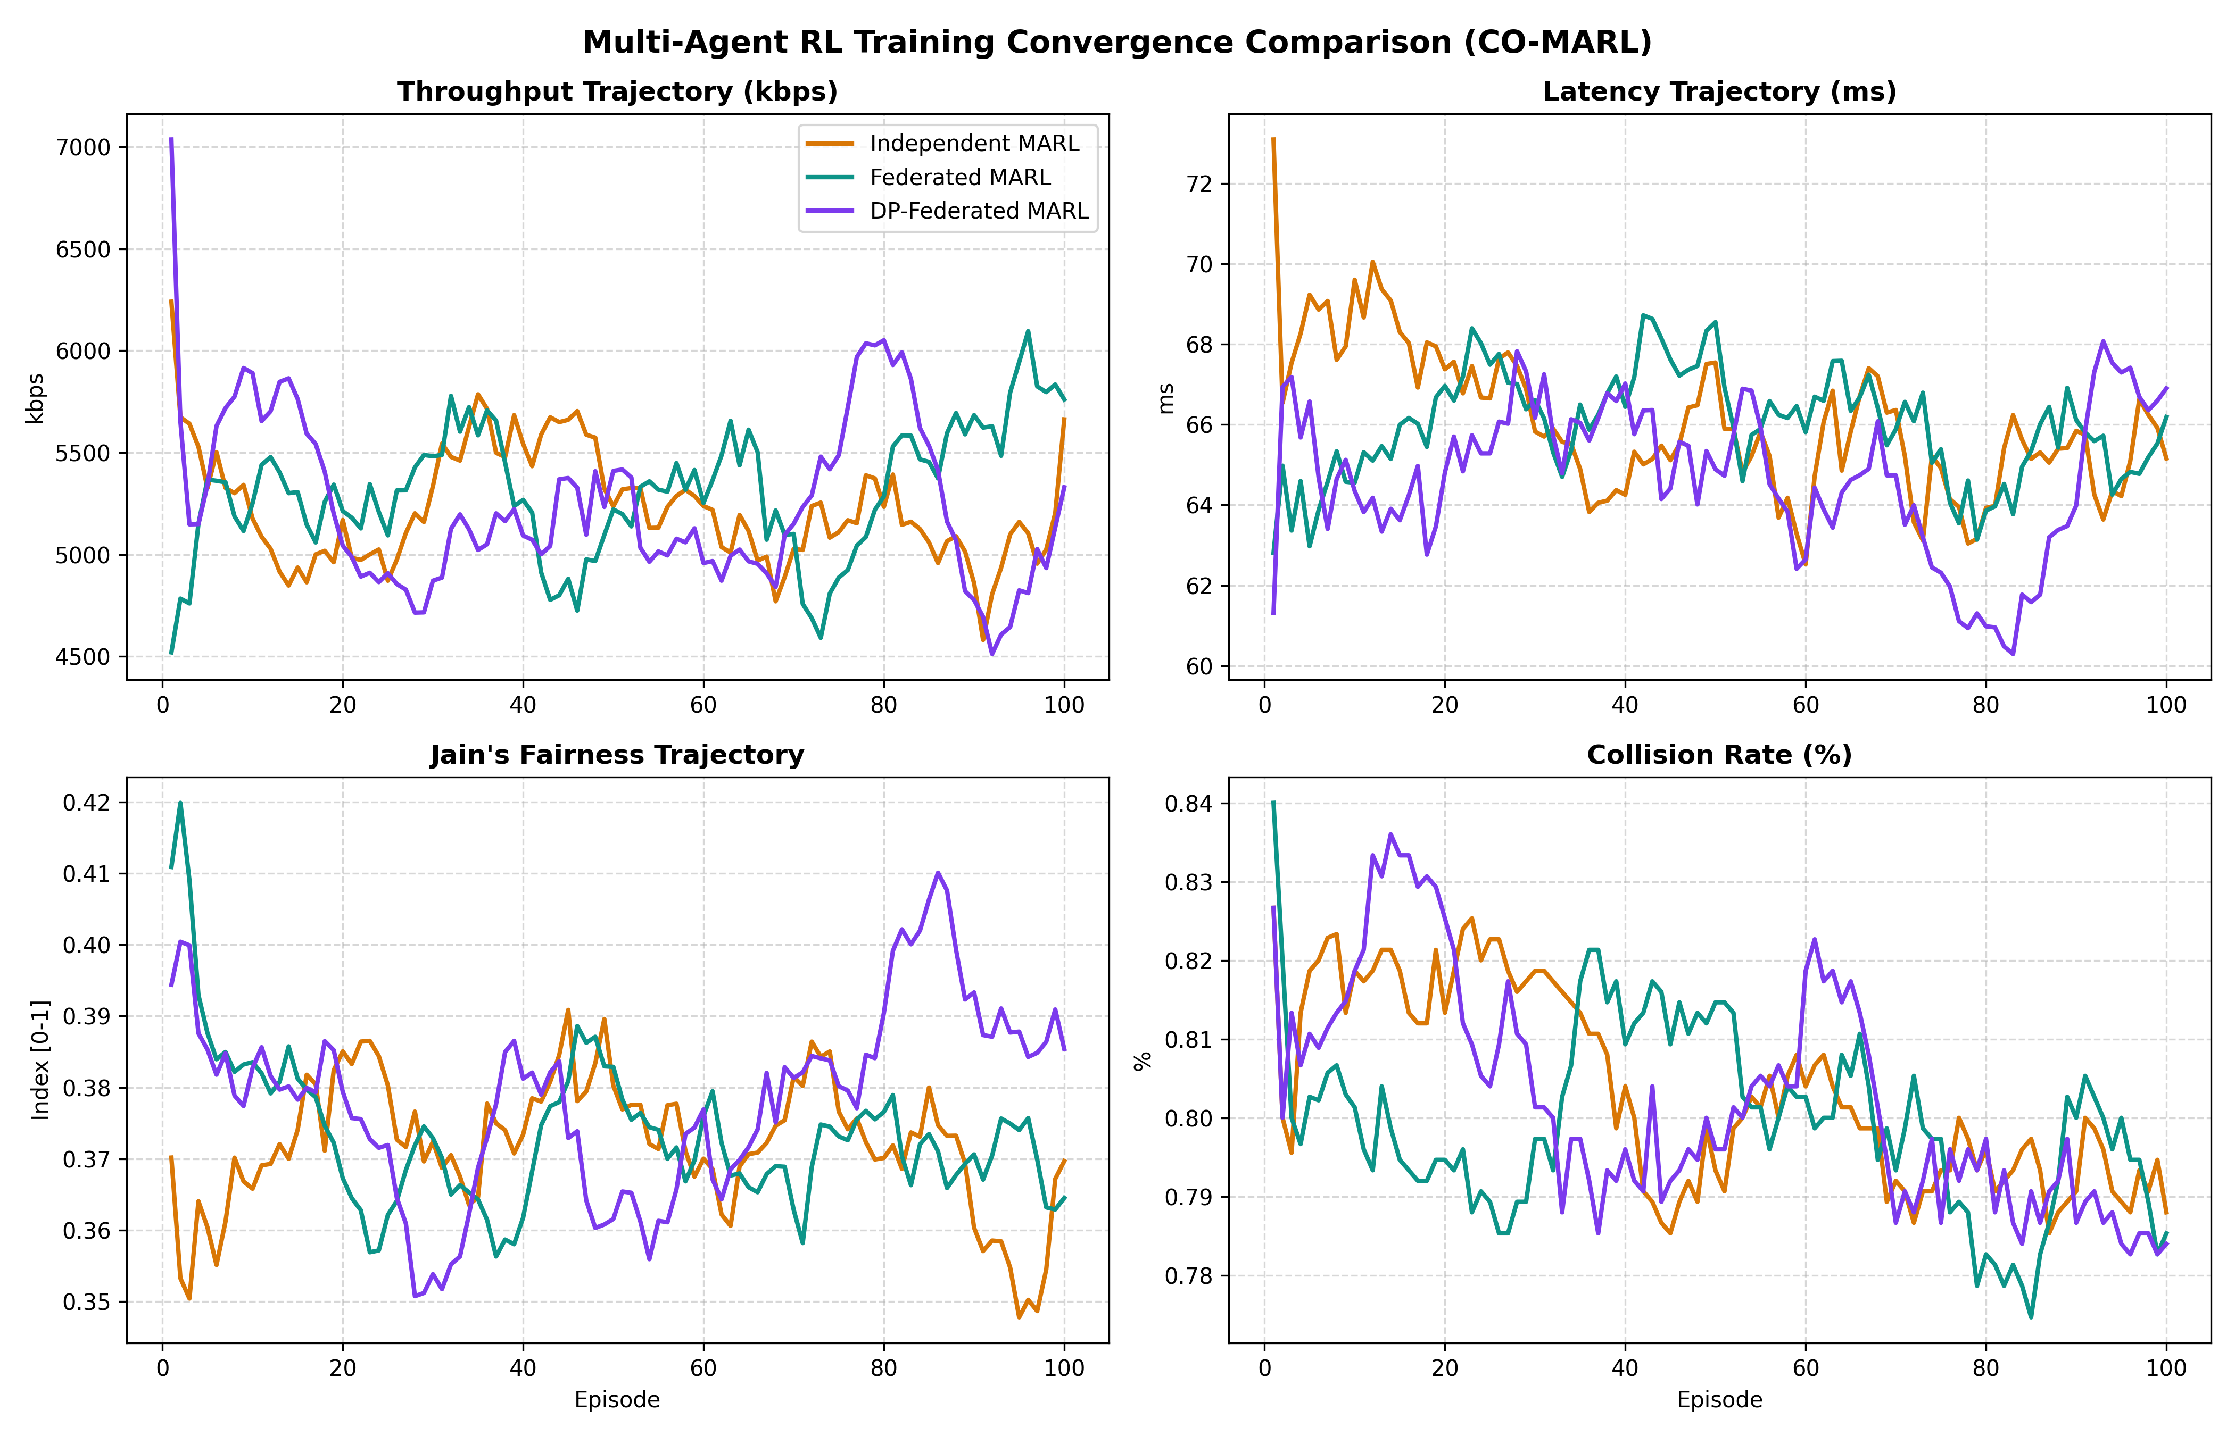

Slide 10
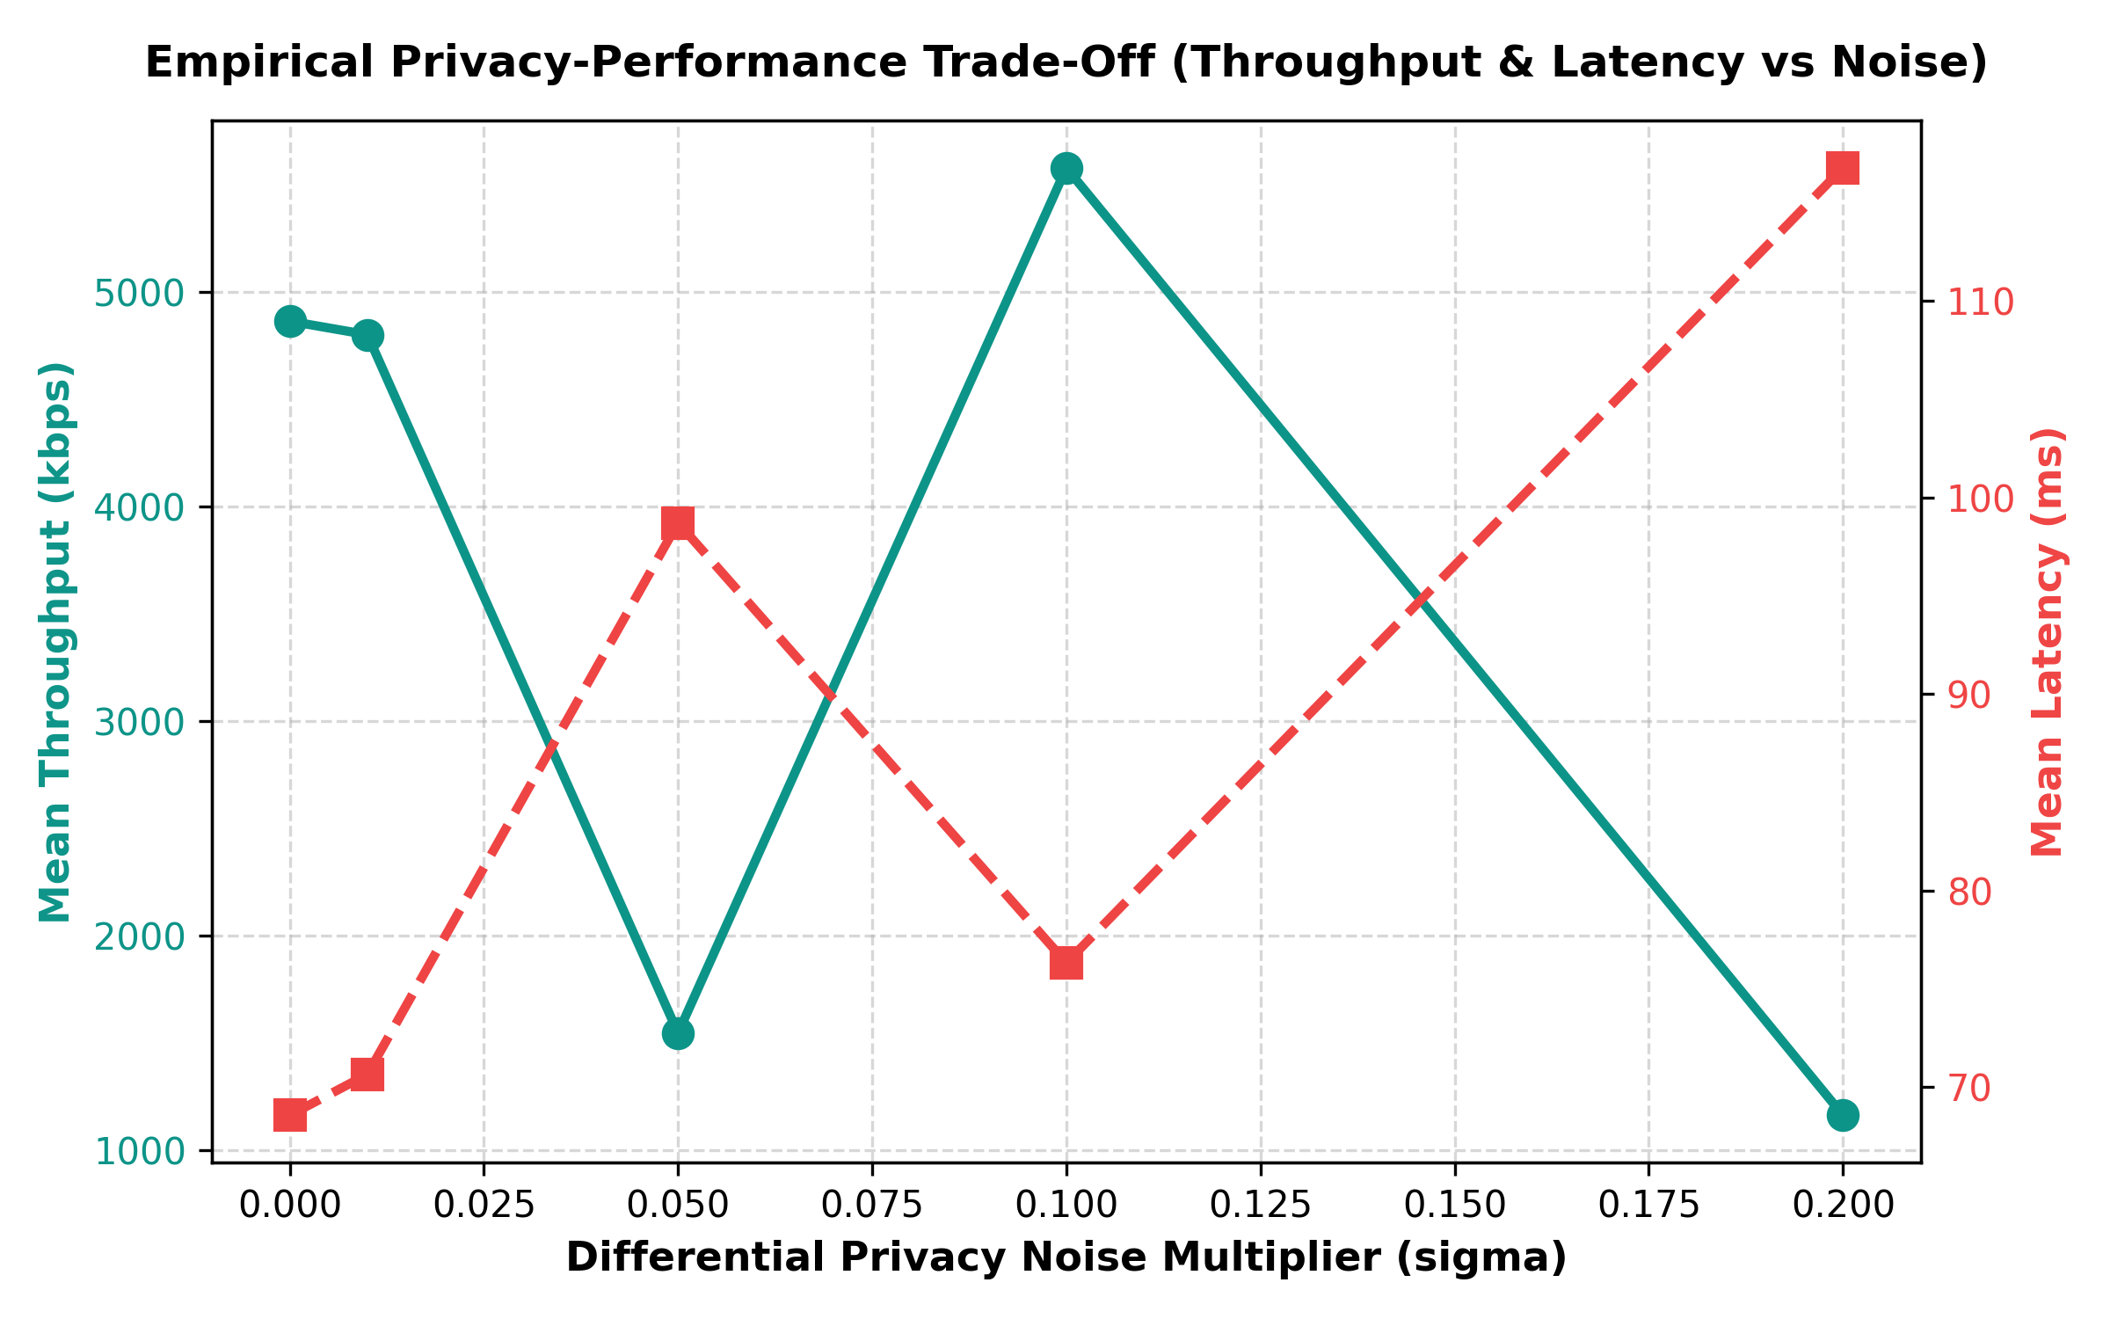

Slide 11
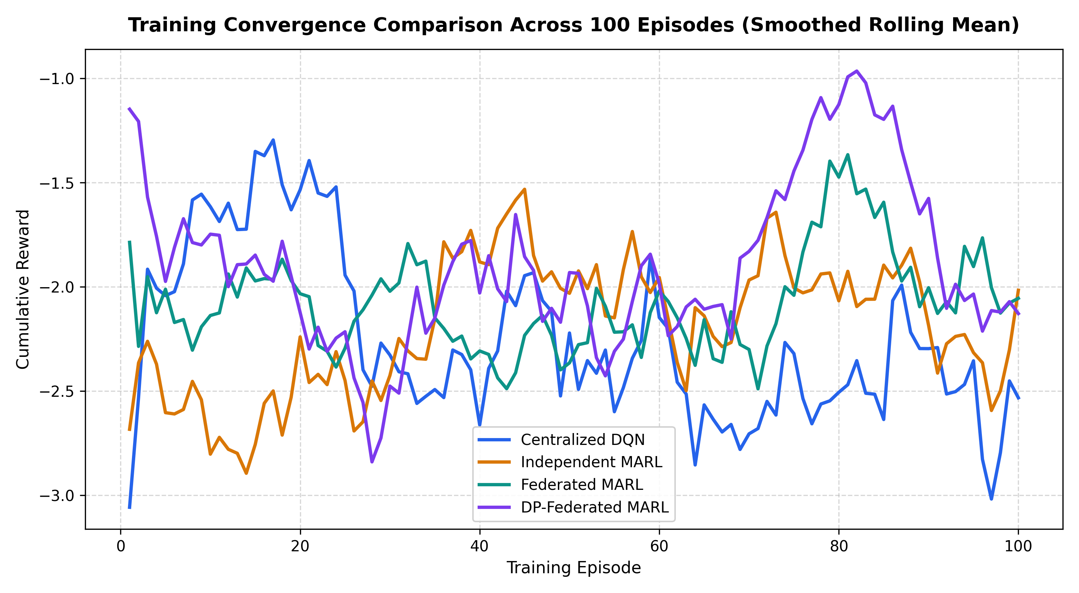

Slide 12
Discussion, Privacy, Limitations and Applications
Observations (reported values)
Limitations
Independent MARL: highest throughput and spectral efficiency, lowest latency
FedMARL: highest demand-satisfied throughput (1525 kbps)
DP-FedMARL vs FedMARL: lower demand-satisfied throughput, SE and PDR; slightly higher Shannon throughput
Federated communication overhead: not measured here (unverified)
Collision rates near 80% (98.6% centralized) and PDR near 30% need improvement
Fairness about 0.37 is low
Simulation only; no hardware; EVM not evaluated (no raw I/Q)
No formal DP guarantee claimed without verified accounting
Possible applications (not demonstrated): Wi-Fi resource management, private IoT networks, smart factories, distributed wireless systems. No approach is claimed universally superior.
Python simulation study | 9 / 10
Notes:
Discuss trade-offs using the reported figures, noting they are unverified. No approach wins everywhere. Be candid that collision rates of about 80 percent and PDR near 30 percent are weak and need improvement. Simulation results do not equal real deployment. Applications are possibilities, not demonstrated deployments. Do not claim formal privacy guarantees.

Slide 13
Conclusion and Future Work
Addressed: privacy-aware distributed wireless resource management
Implemented: Centralized DQN, Independent MARL, FedMARL (FedAvg), DP-FedMARL, evaluated with wireless metrics in Python simulation
Reported results show trade-offs, not one winner: independent MARL leads throughput; FedMARL leads demand-satisfied throughput; DP costs some performance
Not shown: real-hardware performance or formal privacy guarantees
Future work
Reduce collisions
Test more network conditions
Strengthen privacy accounting
Validate on a real wireless testbed
Evaluate EVM if raw I/Q becomes available
Thank You | Questions?
Notes:
Summarize: problem, four implemented approaches, the key reported results (to be verified), what they show (trade-offs in a simulation) and what they do not show (real-world performance, formal privacy). Close with future work, then invite questions.

