Slide 1



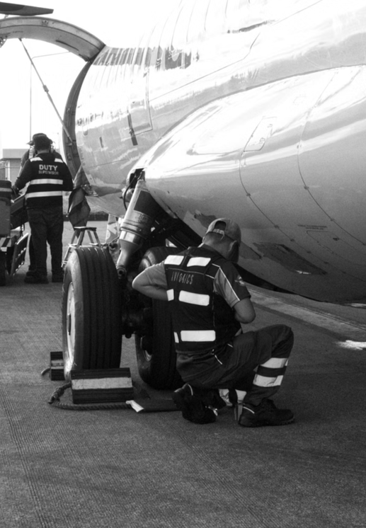

AIRCRAFT MAINTENANCE TRACKER
HOME ABOUT PROJECT CONTACT
Aircraft Maintenance
Tracker
A centralized system for tracking aircraft health, scheduled maintenance, defects, and spare-parts inventory.
N. Sainath Reddy
Roll No: 2520090115
N. Sainath Reddy | Roll No: 2520090115
01 / 15

Slide 2






AIRCRAFT MAINTENANCE TRACKER
HOME ABOUT PROJECT CONTACT
INTRODUCTION
Why Aircraft Maintenance Matters
What Is Aircraft Maintenance?
Scheduled inspection, servicing, and repair that keeps every aircraft system airworthy.
Safety & Inspection Comes First
Rigorous checks protect passengers, crew, and aircraft integrity on every flight.
Safety. Reliability.
Compliance.
Why a Management System?
Digital tracking replaces paper logs to prevent missed checks and lost defect history.
Every inspection record, defect, and component matters to keep aircraft flight-ready.
N. Sainath Reddy | Roll No: 2520090115
02 / 15

Slide 3





AIRCRAFT MAINTENANCE TRACKER
HOME ABOUT PROJECT CONTACT
PROBLEM STATEMENT
Current Challenges in Maintenance Tracking
Manual Maintenance
Records
Delayed
Inspections
Poor Defect
Tracking
Inventory Management
Difficulties
Lack of Centralized
Monitoring
Without a unified platform, maintenance teams lose visibility — risking safety, compliance, and turnaround time.
N. Sainath Reddy | Roll No: 2520090115
03 / 15

Slide 4




AIRCRAFT MAINTENANCE TRACKER
HOME ABOUT PROJECT CONTACT
OBJECTIVES
What This System Sets Out To Do
Track Aircraft Information
Centralized profile for every aircraft in the fleet.
Record & Manage Defects
Track Spare Parts Inventory
Log, assign, and resolve issues with a clear history.
Real-time stock levels for critical components.
Improve Maintenance Efficiency
Faster decisions through organized, accessible data.
N. Sainath Reddy | Roll No: 2520090115
04 / 15

Slide 5





AIRCRAFT MAINTENANCE TRACKER
HOME ABOUT PROJECT CONTACT
SYSTEM ARCHITECTURE
How the Modules Connect
User
Dashboard
Aircraft
Module
Maintenance
Module
Defect Mgmt.
Module
Inventory Mgmt.
Module
A single dashboard orchestrates four focused modules — each owning one part of the maintenance lifecycle.
N. Sainath Reddy | Roll No: 2520090115
05 / 15

Slide 6





AIRCRAFT MAINTENANCE TRACKER
HOME ABOUT PROJECT CONTACT
TECHNOLOGIES USED
Built With a Modern Front-End Stack
React.js
JavaScript
CSS3
VS Code
GitHub
Component UI
ES6 Logic
Styling
Development
Version Control
A lightweight, component-driven stack chosen for fast iteration and a responsive user experience.
N. Sainath Reddy | Roll No: 2520090115
06 / 15

Slide 7




AIRCRAFT MAINTENANCE TRACKER
HOME ABOUT PROJECT CONTACT
REACT WORKFLOW
From User Action to Updated UI
User
Action
useState
Hook
State
Update
Component
Re-render
Updated
UI
A predictable one-directional cycle keeps the dashboard fast, consistent, and easy to debug.
N. Sainath Reddy | Roll No: 2520090115
08 / 15

Slide 8
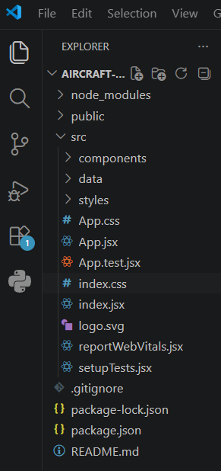
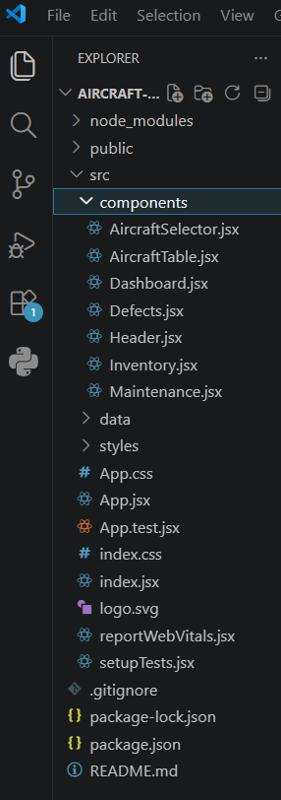
AIRCRAFT MAINTENANCE TRACKER
HOME ABOUT PROJECT CONTACT
Project folder structure
N. Sainath Reddy | Roll No: 2520090115
10 / 15

Slide 9
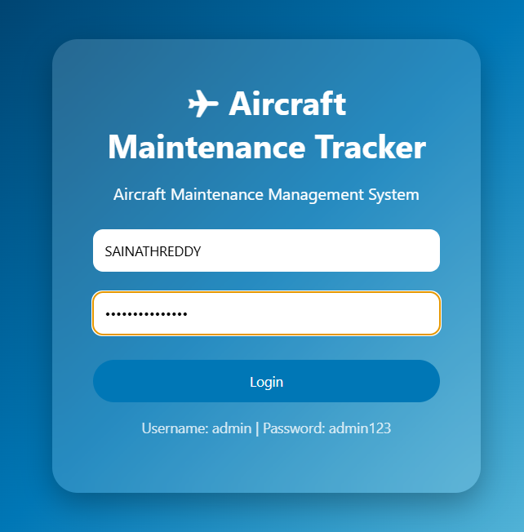
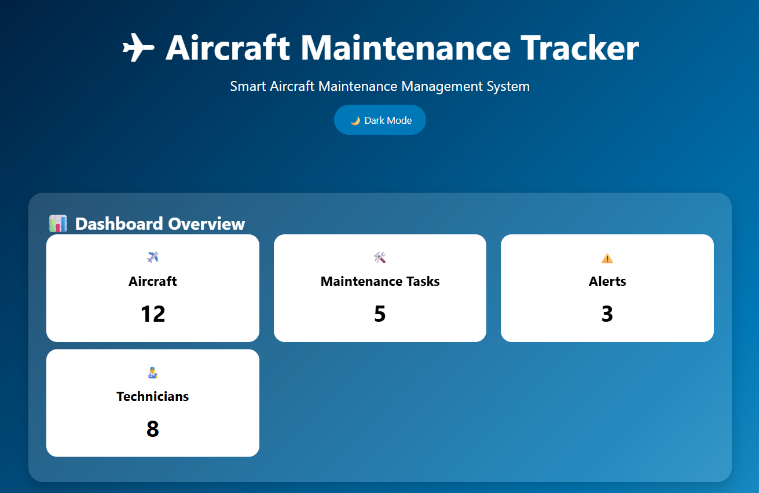
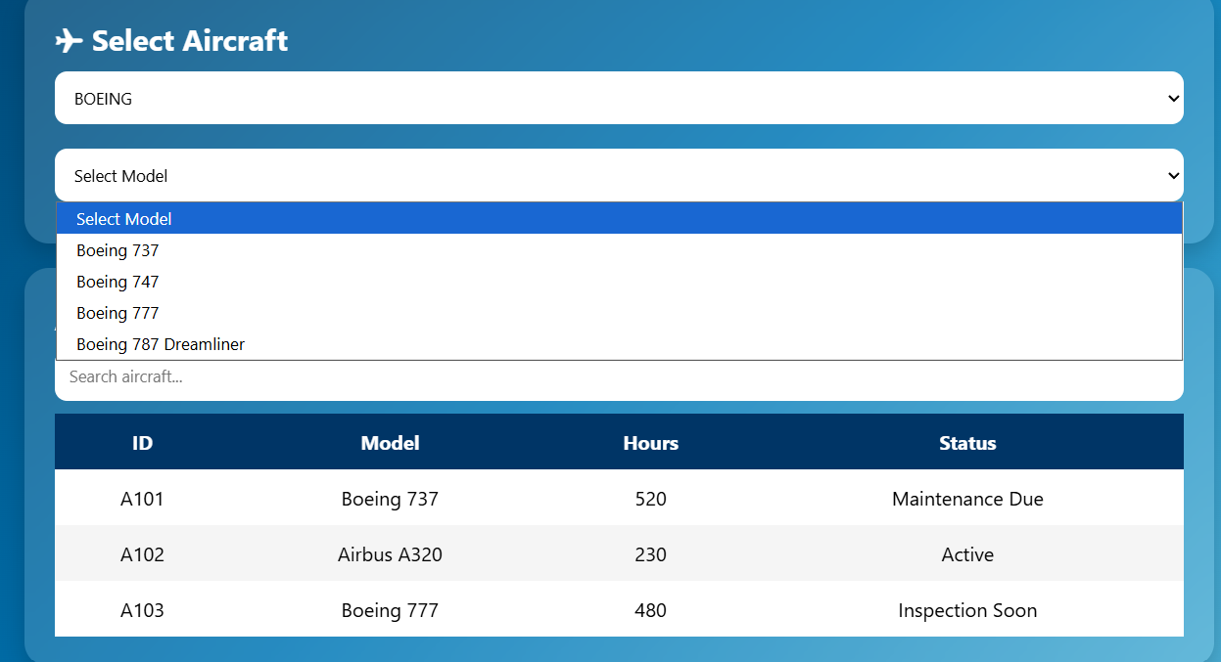


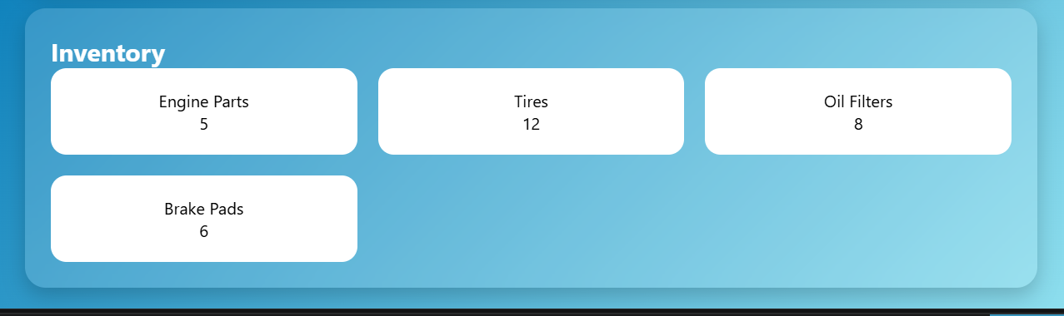

AIRCRAFT MAINTENANCE TRACKER
HOME ABOUT PROJECT CONTACT
WEBSITE
Database Integration
AI-Based Prediction
Real-Time Alerts
Forecast component failures before they happen.
Instant notifications for critical maintenance events.
Technician Assignment
.
Route defects to the right specialist automatically.
N. Sainath Reddy | Roll No: 2520090115
13 / 15

Slide 10
AIRCRAFT MAINTENANCE TRACKER
HOME ABOUT PROJECT CONTACT
CO-WISE IMPLEMENTATION
Course Outcomes Mapped to the Project
CO1
CO2
CO3
Designed application structure and user interface.
Implemented JavaScript logic and event handling.
Used React state management and forms.
CO4
CO5
CO6
Managed component communication and data flow.
Created responsive and user-friendly design.
Developed and maintained project using GitHub and VS Code.
N. Sainath Reddy | Roll No: 2520090115
11 / 15

Slide 11
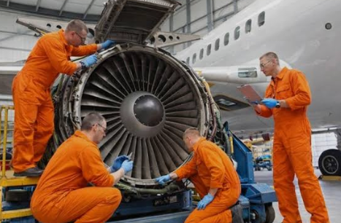



AIRCRAFT MAINTENANCE TRACKER
HOME ABOUT PROJECT CONTACT
1
ADVANTAGES
2
Why This System Adds Value
Improved Aircraft
Safety
Faster Maintenance
Tracking
3
4
Efficient Spare
Parts Monitoring
Better Defect
Management
N. Sainath Reddy | Roll No: 2520090115
12 / 15

Slide 12


AIRCRAFT MAINTENANCE TRACKER
HOME ABOUT PROJECT CONTACT
CONCLUSION
Bringing It All Together
Aircraft Maintenance Tracker turns scattered paper logs into one organized, visual workflow — giving teams a faster, clearer way to manage aircraft health, defects, and inventory.
Solid Foundation
Ready to Scale
Built for Safety
A working React front end covering the full maintenance lifecycle.
Modular structure makes future features straightforward to add.
Centralized tracking supports timely, well-documented inspections.
N. Sainath Reddy | Roll No: 2520090115
14 / 15

Slide 13
AIRCRAFT MAINTENANCE TRACKER
HOME ABOUT PROJECT CONTACT
THANK YOU
N. Sainath Reddy
Roll No: 2520090115 • Aircraft Maintenance Tracker
N. Sainath Reddy | Roll No: 2520090115
15 / 15

