Slide 1
Module 10: Basic Router Configuration
Instructor Materials
Introduction to Networks v7.0 (ITN)

Slide 2
Instructor Materials – Module 10 Planning Guide
This PowerPoint deck is divided in two parts:
Instructor Planning Guide
Information to help you become familiar with the module
Teaching aids
Instructor Class Presentation
Optional slides that you can use in the classroom
Begins on slide #10
Note: Remove the Planning Guide from this presentation before sharing with anyone.
For additional help and resources go to the Instructor Home Page and Course Resources for this course. You also can visit the professional development site on netacad.com, the official Cisco Networking Academy Facebook page, or Instructor Only FB group.
Notes:
2

Slide 3
What to Expect in this Module
To facilitate learning, the following features within the GUI may be included in this module:
Feature | Description
Animations | Expose learners to new skills and concepts.
Videos | Expose learners to new skills and concepts.
Check Your Understanding(CYU) | Per topic online quiz to help learners gauge content understanding.
Interactive Activities | A variety of formats to help learners gauge content understanding.
Syntax Checker | Small simulations that expose learners to Cisco command line to practice configuration skills.
PT Activity | Simulation and modeling activities designed to explore, acquire, reinforce, and expand skills.

Slide 4
What to Expect in this Module (Cont.)
To facilitate learning, the following features may be included in this module:
Feature | Description
Packet Tracer Physical Mode Activity | These activities are completed using Packet Tracer in Physical Mode.
Hands-On Labs | Labs designed for working with physical equipment.
Class Activities | These are found on the Instructor Resources page. Class Activities are designed to facilitate learning, class discussion, and collaboration.
Module Quizzes | Self-assessments that integrate concepts and skills learned throughout the series of topics presented in the module.
Module Summary | Briefly recaps module content.

Slide 5
Check Your Understanding
Check Your Understanding activities are designed to let students quickly determine if they understand the content and can proceed, or if they need to review.
Check Your Understanding activities do not affect student grades.
There are no separate slides for these activities in the PPT. They are listed in the notes area of the slide that appears before these activities.
Notes:
5

Slide 6
Packet Tracer Physical Mode Activities
These activities are completed using Packet Tracer in Physical Mode.
They are designed to emulate the corresponding Labs.
They can be used instead of the lab when access to physical equipment is not possible.
These activities often do not have the level of scaffolding that is present in PT activities that immediately precede these activities.
Notes:
6

Slide 7
Module 10: Activities
What activities are associated with this module?
Page # | Activity Type | Activity Name | Optional?
10.1.3 | Syntax Checker | Configure Initial Router Settings | Recommended
10.1.4 | Packet Tracer | Configure Initial Router Settings | Recommended
10.2.5 | Syntax Checker | Configure Interfaces | Recommended
10.3.3 | Syntax Checker | Configure the Default Gateway | Recommended
10.3.4 | Packet Tracer | Connect a Router to a LAN | Recommended
10.3.5 | Packet Tracer | Troubleshoot Default Gateway Issues | Recommended
10.4.1 | Video | Network Device Differences: Part 1 | Recommended
10.4.1 | Video | Network Device Differences: Part 2 | Recommended
10.4.3 | Packet Tracer | Basic Device Configuration | Recommended
10.4.4 | Packet Tracer Physical Mode | Packet Tracer - Build a Switch and Router Network - Physical Mode | Recommended
10.4.4 | Lab | Build a Switch and Router Network | Recommended
Notes:
7

Slide 8
Module 10: Best Practices
Prior to teaching Module 10, the instructor should:
Review the activities and assessments for this module.
Try to include as many questions as possible to keep students engaged during classroom presentation..
Topic 10.1
Ask the students or have a class discussion
What tasks should be completed when initially configuring a router?
What is the purpose of configuring a banner message on a router?
Topic 10.2
Ask the students or have a class discussion
What is the benefit of configuring a description on a router interface?
What are some popular show commands used to verify router interface configuration?
Notes:
8

Slide 9
Module 10: Best Practices (Cont.)
Topic 10.3
Ask the students or have a class discussion
What information does an end device need to have to communicate with remote networks?
Why would a switch need to be configured with a default gateway?
Notes:
9

Slide 10
Module 10: Basic Router Configuration
Introduction to Networks v7.0 (ITN)
Notes:
Cisco Networking Academy Program
Introduction to Networks v7.0 (ITN)
Module 10: Basic Router Configuration

Slide 11
Module Objectives
Module Title: Basic Router Configuration
Module Objective: Implement initial settings on a router and end devices.
Topic Title | Topic Objective
Configure Initial Router Settings | Configure initial settings on an IOS Cisco router.
Configure Interfaces | Configure two active interfaces on a Cisco IOS router.
Configure the Default Gateway | Configure devices to use the default gateway.
Notes:
11
10 – Basic Router Configuration
10.0.2- What will I learn in this module?

Slide 12
10.1 Configure Initial Router Settings
Notes:
10 – Basic Router Configuration
10.1 Configure Initial Router Settings

Slide 13
Configure Initial Router Settings Basic Router Configuration Steps
Configure the device name.
Secure privileged EXEC mode.
Secure user EXEC mode.
Secure remote Telnet / SSH access.
Encrypt all plaintext passwords.
Provide legal notification and save the configuration.
Router(config)# hostname hostname
Router(config)# enable secret password
Router(config)# line console 0
Router(config-line)# password password
Router(config-line)# login
Router(config)# line vty 0 4
Router(config-line)# password password
Router(config-line)# login
Router(config-line)# transport input {ssh | telnet}
Router(config)# service password encryption
Router(config)# banner motd # message #
Router(config)# end
Router# copy running-config startup-config
Notes:
10 – Basic Router Configuration
10.1 – Configure Initial Router Settings
10.1.1 – Basic Routing Configuration Steps

Slide 14
Configure Initial Router Settings Basic Router Configuration Example
Commands for basic router configuration on R1.
Configuration is saved to NVRAM.
R1(config)# hostname R1
R1(config)# enable secret class
R1(config)# line console 0
R1(config-line)# password cisco
R1(config-line)# login
R1(config-line)# line vty 0 4
R1(config-line)# password cisco
R1(config-line)# login
R1(config-line)# transport input ssh telnet
R1(config-line)# exit
R1(config)# service password encryption
R1(config)# banner motd #
Enter TEXT message. End with a new line and the #
***********************************************
WARNING: Unauthorized access is prohibited!
**********************************************
R1(config)# exit
R1# copy running-config startup-config
Notes:
10 – Basic Router Configuration
10.1 – Configure Initial Router Settings
10.1.2 – Basic Routing Configuration Example
10.1.3 - Syntax Checker – Configure Initial Router Settings

Slide 15
Configure Initial Router Settings Packet Tracer – Configure Initial Router Settings
In this Packet Tracer, you will do the following:
Verify the default router configuration.
Configure and verify the initial router configuration.
Save the running configuration file.
Notes:
10 – Basic Router Configuration
10.1 – Configure Initial Router Settings
10.1.4 – Packet Tracer – Configure Initial Router Settings

Slide 16
10.2 Configure Interfaces
Notes:
10 – Basic Router Configuration
10.2 Configure Interfaces

Slide 17
Configure Interfaces Configure Router Interfaces
Configuring a router interface includes issuing the following commands:
Router(config)# interface type-and-number Router(config-if)# description description-text Router(config-if)# ip address ipv4-address subnet-mask Router(config-if)# ipv6 address ipv6-address/prefix-length Router(config-if)# no shutdown
It is a good practice to use the description command to add information about the network connected to the interface.
The no shutdown command activates the interface.
Notes:
10 – Basic Router Configuration
10.2 – Configure Interfaces
10.2.1 – Configure Router Interfaces

Slide 18
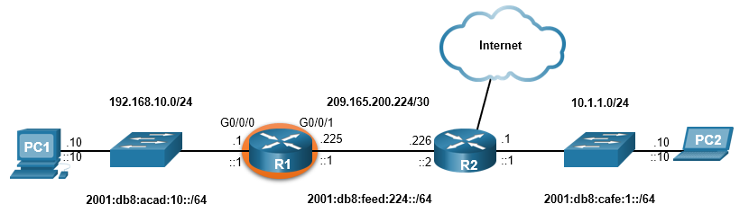
Configure Interfaces Configure Router Interfaces Example
The commands to configure interface G0/0/0 on R1 are shown here:
R1(config)# interface gigabitEthernet 0/0/0
R1(config-if)# description Link to LAN
R1(config-if)# ip address 192.168.10.1 255.255.255.0
R1(config-if)# ipv6 address 2001:db8:acad:10::1/64
R1(config-if)# no shutdown
R1(config-if)# exit
R1(config)#
*Aug 1 01:43:53.435: %LINK-3-UPDOWN: Interface GigabitEthernet0/0/0, changed state to down
*Aug 1 01:43:56.447: %LINK-3-UPDOWN: Interface GigabitEthernet0/0/0, changed state to up
*Aug 1 01:43:57.447: %LINEPROTO-5-UPDOWN: Line protocol on Interface GigabitEthernet0/0/0, changed state to up
Notes:
10 – Basic Router Configuration
10.2 – Configure Interfaces
10.2.2 – Configure Router Interfaces Example

Slide 19
Configure Interfaces Configure Router Interfaces Example (Cont.)
The commands to configure interface G0/0/1 on R1 are shown here:
R1(config)# interface gigabitEthernet 0/0/1
R1(config-if)# description Link to R2
R1(config-if)# ip address 209.165.200.225 255.255.255.252
R1(config-if)# ipv6 address 2001:db8:feed:224::1/64
R1(config-if)# no shutdown
R1(config-if)# exit
R1(config)#
*Aug 1 01:46:29.170: %LINK-3-UPDOWN: Interface GigabitEthernet0/0/1, changed state to down
*Aug 1 01:46:32.171: %LINK-3-UPDOWN: Interface GigabitEthernet0/0/1, changed state to up
*Aug 1 01:46:33.171: %LINEPROTO-5-UPDOWN: Line protocol on Interface GigabitEthernet0/0/1, changed state to up
Notes:
10 – Basic Router Configuration
10.2 – Configure Interfaces
10.2.2 – Configure Router Interfaces Example (Cont.)

Slide 20
Configure Interfaces Verify Interface Configuration
To verify interface configuration use the show ip interface brief and show ipv6 interface brief commands shown here:
R1# show ip interface brief
Interface IP-Address OK? Method Status Protocol
GigabitEthernet0/0/0 192.168.10.1 YES manual up up
GigabitEthernet0/0/1 209.165.200.225 YES manual up up
Vlan1 unassigned YES unset administratively down down
R1# show ipv6 interface brief
GigabitEthernet0/0/0 [up/up]
FE80::201:C9FF:FE89:4501
2001:DB8:ACAD:10::1
GigabitEthernet0/0/1 [up/up]
FE80::201:C9FF:FE89:4502
2001:DB8:FEED:224::1
Vlan1 [administratively down/down]
unassigned
R1#
Notes:
10 – Basic Router Configuration
10.2 – Configure Interfaces
10.2.3 – Verify Interface Configuration

Slide 21
Configure Interfaces Configure Verification Commands
The table summarizes show commands used to verify interface configuration.
Commands | Description
show ip interface brief show ipv6 interface brief | Displays all interfaces, their IP addresses, and their current status.
show ip route show ipv6 route | Displays the contents of the IP routing tables stored in RAM.
show interfaces | Displays statistics for all interfaces on the device. Only displays the IPv4 addressing information.
show ip interfaces | Displays the IPv4 statistics for all interfaces on a router.
show ipv6 interfaces | Displays the IPv6 statistics for all interfaces on a router.
Notes:
10 – Basic Router Configuration
10.2 – Configure Interfaces
10.2.4 – Configuration Verification Commands

Slide 22
Configure Interfaces Configure Verification Commands (Cont.)
View status of all interfaces with the show ip interface brief and show ipv6 interface brief commands, shown here:
R1# show ip interface brief
Interface IP-Address OK? Method Status Protocol
GigabitEthernet0/0/0 192.168.10.1 YES manual up up
GigabitEthernet0/0/1 209.165.200.225 YES manual up up
Vlan1 unassigned YES unset administratively down down
R1#
R1# show ipv6 interface brief
GigabitEthernet0/0/0 [up/up]
FE80::201:C9FF:FE89:4501
2001:DB8:ACAD:10::1
GigabitEthernet0/0/1 [up/up]
FE80::201:C9FF:FE89:4502
2001:DB8:FEED:224::1
Vlan1 [administratively down/down]
unassigned
R1#
Notes:
10 – Basic Router Configuration
10.2 – Configure Interfaces
10.2.4 – Configuration Verification Commands (Cont.)

Slide 23
Configure Interfaces Configure Verification Commands (Cont.)
Display the contents of the IP routing tables with the show ip route and show ipv6 route commands as shown here:
R1# show ip route
< output omitted>
Gateway of last resort is not set
192.168.10.0/24 is variably subnetted, 2 subnets, 2 masks
C 192.168.10.0/24 is directly connected, GigabitEthernet0/0/0
L 192.168.10.1/32 is directly connected, GigabitEthernet0/0/0
209.165.200.0/24 is variably subnetted, 2 subnets, 2 masks
C 209.165.200.224/30 is directly connected, GigabitEthernet0/0/1
L 209.165.200.225/32 is directly connected, GigabitEthernet0/0/1
R1#
R1# show ipv6 route
<output omitted>
C 2001:DB8:ACAD:10::/64 [0/0]
via GigabitEthernet0/0/0, directly connected
L 2001:DB8:ACAD:10::1/128 [0/0]
via GigabitEthernet0/0/0, receive
C 2001:DB8:FEED:224::/64 [0/0]
via GigabitEthernet0/0/1, directly connected
L 2001:DB8:FEED:224::1/128 [0/0]
via GigabitEthernet0/0/1, receive
L FF00::/8 [0/0]
via Null0, receive
R1#
Notes:
10 – Basic Router Configuration
10.2 – Configure Interfaces
10.2.4 – Configuration Verification Commands (Cont.)

Slide 24
Configure Interfaces Configure Verification Commands (Cont.)
Display statistics for all interfaces with the show interfaces command, as shown here:
R1# show interfaces gig0/0/0
GigabitEthernet0/0/0 is up, line protocol is up
Hardware is ISR4321-2x1GE, address is a0e0.af0d.e140 (bia a0e0.af0d.e140)
Description: Link to LAN
Internet address is 192.168.10.1/24
MTU 1500 bytes, BW 100000 Kbit/sec, DLY 100 usec,
reliability 255/255, txload 1/255, rxload 1/255
Encapsulation ARPA, loopback not set
Keepalive not supported
Full Duplex, 100Mbps, link type is auto, media type is RJ45
output flow-control is off, input flow-control is off
ARP type: ARPA, ARP Timeout 04:00:00
Last input 00:00:01, output 00:00:35, output hang never
Last clearing of "show interface" counters never
Input queue: 0/375/0/0 (size/max/drops/flushes); Total output drops: 0
Queueing strategy: fifo
Output queue: 0/40 (size/max)
5 minute input rate 0 bits/sec, 0 packets/sec
5 minute output rate 0 bits/sec, 0 packets/sec
1180 packets input, 109486 bytes, 0 no buffer
Received 84 broadcasts (0 IP multicasts)
0 runts, 0 giants, 0 throttles
<output omitted>
R1#
Notes:
10 – Basic Router Configuration
10.2 – Configure Interfaces
10.2.4 – Configuration Verification Commands (Cont.)

Slide 25
Configure Interfaces Configure Verification Commands (Cont.)
Display IPv4 statistics for router interfaces with the show ip interface command, as shown here:
R1# show ip interface g0/0/0
GigabitEthernet0/0/0 is up, line protocol is up
Internet address is 192.168.10.1/24
Broadcast address is 255.255.255.255
Address determined by setup command
MTU is 1500 bytes
Helper address is not set
Directed broadcast forwarding is disabled
Outgoing Common access list is not set
Outgoing access list is not set
Inbound Common access list is not set
Inbound access list is not set
Proxy ARP is enabled
Local Proxy ARP is disabled
Security level is default
Split horizon is enabled
ICMP redirects are always sent
ICMP unreachables are always sent
ICMP mask replies are never sent
IP fast switching is enabled
IP Flow switching is disabled
<output omitted>
R1#
Notes:
10 – Basic Router Configuration
10.2 – Configure Interfaces
10.2.4 – Configuration Verification Commands (Cont.)

Slide 26
Configure Interfaces Configure Verification Commands (Cont.)
Display IPv6 statistics for router interfaces with the show ipv6 interface command shown here:
R1# show ipv6 interface g0/0/0
GigabitEthernet0/0/0 is up, line protocol is up
IPv6 is enabled, link-local address is FE80::868A:8DFF:FE44:49B0
No Virtual link-local address(es):
Description: Link to LAN
Global unicast address(es):
2001:DB8:ACAD:10::1, subnet is 2001:DB8:ACAD:10::/64
Joined group address(es):
FF02::1
FF02::1:FF00:1
FF02::1:FF44:49B0
MTU is 1500 bytes
ICMP error messages limited to one every 100 milliseconds
ICMP redirects are enabled
ICMP unreachables are sent
ND DAD is enabled, number of DAD attempts: 1
ND reachable time is 30000 milliseconds (using 30000)
ND NS retransmit interval is 1000 milliseconds
R1#
Notes:
10 – Basic Router Configuration
10.2 – Configure Interfaces
10.2.4 – Configuration Verification Commands (Cont.)
10.2.5 Syntax Checker – Configure Interfaces

Slide 27
10.3 Configure the Default Gateway
Notes:
10 – Basic Router Configuration
10.3 Configure the Default Gateway

Slide 28
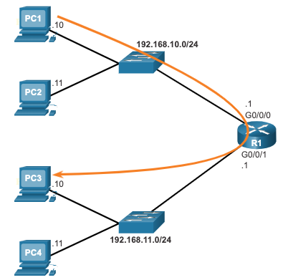
Configure the Default Gateway Default Gateway on a Host
The default gateway is used when a host sends a packet to a device on another network.
The default gateway address is generally the router interface address attached to the local network of the host.
To reach PC3, PC1 addresses a packet with the IPv4 address of PC3, but forwards the packet to its default gateway, the G0/0/0 interface of R1.
Note: The IP address of the host and the router interface must be in the same network.
Notes:
10 – Basic Router Configuration
10.3 – Configure the Default Gateway
10.3.1 – Default Gateway on a Host

Slide 29
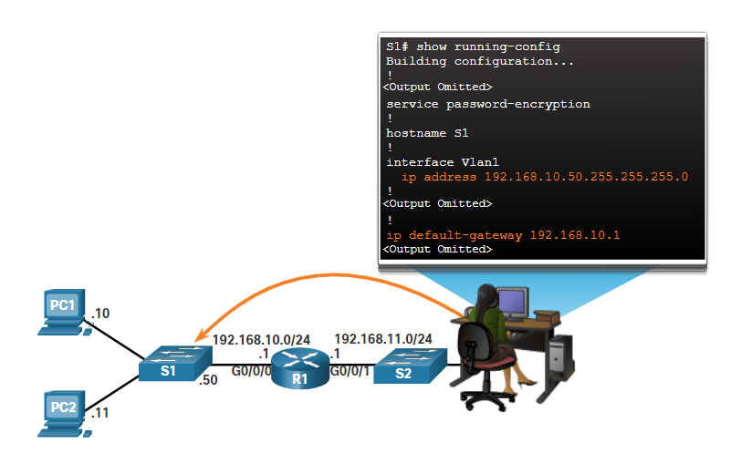
Configure the Default Gateway Default Gateway on a Switch
A switch must have a default gateway address configured to remotely manage the switch from another network.
To configure an IPv4 default gateway on a switch, use the ip default-gateway ip-address global configuration command.
Notes:
10 – Basic Router Configuration
10.3 – Configure the Default Gateway
10.3.2 – Default Gateway on a Switch
10.3.3 – Syntax Checker – Configure the Default Gateway

Slide 30
Configure Initial Router Settings Packet Tracer – Connect a Router to a LAN
In this Packet Tracer, you will do the following:
Display the router information.
Configure router interfaces.
Verify the configuration.
Notes:
10 – Basic Router Configuration
10.3– Configure the Default Gateway
10.3.4 – Packet Tracer – Connect a Router to a LAN

Slide 31
Configure Initial Router Settings Packet Tracer – Troubleshoot Default Gateway Issues
In this Packet Tracer, you will do the following:
Verify the network documentation and use tests to isolate problems.
Determine an appropriate solution for a given problem.
Implement the solution.
Test to verify the problem is resolved.
Document the solution.
Notes:
10 – Basic Router Configuration
10.3– Configure the Default Gateway
10.3.5 – Packet Tracer – Troubleshoot Default Gateway Issues

Slide 32
10.4 Module Practice and Quiz
Notes:
10 – Basic Router Configuration
10.4 Module Practice and Quiz

Slide 33
Module Practice and Quiz Video – Network Device Differences: Part 1
This video will cover the different physical characteristics of the following:
Cisco 4000 Series Router.
Cisco 2900 Series Router.
Cisco 1900 Series Router.
Notes:
10 – Basic Router Configuration
10.4 – Module Practice and Quiz
10.4.1 – Video – Network Device Differences: Part 1

Slide 34
Module Practice and Quiz Video – Network Device Differences: Part 2
This video will cover the different configurations of the following:
Cisco 4000 Series Router.
Cisco 2900 Series Router.
Cisco 1900 Series Router.
Notes:
10 – Basic Router Configuration
10.4 – Module Practice and Quiz
10.4.2 – Video – Network Device Differences: Part 2

Slide 35
Configure Initial Router Settings Packet Tracer – Basic Device Configuration
In this Packet Tracer, you will do the following:
Complete the network documentation.
Perform basic device configurations on a router and a switch.
Verify connectivity and troubleshoot any issues.
Notes:
10 – Basic Router Configuration
10.4– Configure the Default Gateway
10.4.3 – Packet Tracer – Basic Device Configuration

Slide 36
Configure Initial Router Settings Packet Tracer – Build a Switch and Router Network – Physical Mode Lab – Build a Switch and Router Network
In both the Packet Tracer Physical Mode activity and in the Lab, you will complete the following objectives:
Set up the topology and initialize devices.
Configure devices and verify connectivity.
Display device information.
Notes:
10 – Basic Router Configuration
10.4– Configure the Default Gateway
10.4.4 – PTPM and Lab – Build a Switch and Router Network

Slide 37
Module Practice and Quiz What did I learn in this module?
The tasks that should be completed when configuring initial settings on a router.
Configure the device name.
Secure privileged EXEC mode.
Secure user EXEC mode.
Secure remote Telnet / SSH access.
Secure all passwords in the config file.
Provide legal notification.
Save the configuration.
For routers to be reachable, the router interfaces must be configured.
Using the no shutdown command activates the interface. The interface must also be connected to another device, such as a switch or a router, for the physical layer to be active. There are several commands that can be used to verify interface configuration including the show ip interface brief and show ipv6 interface brief, the show ip route and show ipv6 route, as well as show interfaces, show ip interface and show ipv6 interface.
Notes:
10 – Basic Router Configuration
10.4 – Module Practice and Quiz
10.4.5 – What did I learn in this module?

Slide 38
Module Practice and Quiz What did I learn in this module (Cont.)?
For an end device to reach other networks, a default gateway must be configured.
The IP address of the host device and the router interface address must be in the same network.
A switch must have a default gateway address configured to remotely manage the switch from another network.
To configure an IPv4 default gateway on a switch, use the ip default-gateway ip-address global configuration command.
Notes:
10 – Basic Router Configuration
10.4 – Module Practice and Quiz
10.4.5 – What did I learn in this module (Cont.)?

Slide 39
Module 10: Basic Router Configuration New Terms and Commands
show ip interface brief show ipv6 interface brief show ip route show ipv6 route show interfaces show ip interface show ipv6 interface ip default-gateway

