Slide 1
Module 11: IPv4 Addressing
Instructor Materials
Introduction to Networks v7.0 (ITN)
Notes:
Cisco Networking Academy Program
Introduction to Networks v7.0 (ITN)
Module 11: IPv4 Addressing

Slide 2
Instructor Materials – Module 11 Planning Guide
This PowerPoint deck is divided in two parts:
Instructor Planning Guide
Information to help you become familiar with the module
Teaching aids
Instructor Class Presentation
Optional slides that you can use in the classroom
Begins on slide # 15
Note: Remove the Planning Guide from this presentation before sharing with anyone.
For additional help and resources go to the Instructor Home Page and Course Resources for this course. You also can visit the professional development site on netacad.com, the official Cisco Networking Academy Facebook page, or Instructor Only FB group.
Notes:
2

Slide 3
What to Expect in this Module
To facilitate learning, the following features within the GUI may be included in this module:
Feature | Description
Animations | Expose learners to new skills and concepts.
Videos | Expose learners to new skills and concepts.
Check Your Understanding(CYU) | Per topic online quiz to help learners gauge content understanding.
Interactive Activities | A variety of formats to help learners gauge content understanding.
Syntax Checker | Small simulations that expose learners to Cisco command line to practice configuration skills.
PT Activity | Simulation and modeling activities designed to explore, acquire, reinforce, and expand skills.

Slide 4
What to Expect in this Module (Cont.)
To facilitate learning, the following features may be included in this module:
Feature | Description
Packet Tracer Physical Mode Activity | These activities are completed using Packet Tracer in Physical Mode.
Hands-On Labs | Labs designed for working with physical equipment.
Class Activities | These are found on the Instructor Resources page. Class Activities are designed to facilitate learning, class discussion, and collaboration.
Module Quizzes | Self-assessments that integrate concepts and skills learned throughout the series of topics presented in the module.
Module Summary | Briefly recaps module content.

Slide 5
Check Your Understanding
Check Your Understanding activities are designed to let students quickly determine if they understand the content and can proceed, or if they need to review.
Check Your Understanding activities do not affect student grades.
There are no separate slides for these activities in the PPT. They are listed in the notes area of the slide that appears before these activities.
Notes:
5

Slide 6
Packet Tracer Physical Mode Activities
These activities are completed using Packet Tracer in Physical Mode.
They are designed to emulate the corresponding Labs.
They can be used instead of the lab when access to physical equipment is not possible.
These activities often do not have the level of scaffolding that is present in PT activities that immediately precede these activities.
Notes:
6

Slide 7
Module 11: Activities
What activities are associated with this module?
Page # | Activity Type | Activity Name | Optional?
11.1.5 | Video | Network, Host and Broadcast Addresses | Recommended
11.1.7 | Activity | ANDing to Determine the Network Address | Recommended
11.1.8 | Check Your Understanding | IPv4 Address Structure | Recommended
11.2.4 | Activity | Unicast, Broadcast, or Multicast | Recommended
11.3.3 | Activity | Pass or Block IPv4 Addresses | Recommended
11.3.7 | Activity | Public or Private IPv4 Address | Recommended
11.3.8 | Check Your Understanding | Types of IPv4 Addresses | Recommended
11.4.4 | Check Your Understanding | Network Segmentation | Recommended
11.5.3 | Video | The Subnet Mask | Recommended
Notes:
7

Slide 8
Module 11: Activities (Cont.)
What activities are associated with this module?
Page # | Activity Type | Activity Name | Optional?
11.5.4 | Video | Subnet with the Magic Number | Recommended
11.5.5 | Packet Tracer | Subnet an IPv4 Network | Recommended
11.6.4 | Video | Subnet Across Multiple Octets | Recommended
11.6.5 | Activity | Calculate the Subnet Mask | Recommended
11.6.6 | Lab | Calculate IPv4 Subnets | Recommended
11.7.4 | Activity | Determine the Number of Bits to Borrow | Recommended
11.7.5 | Packet Tracer | Subnetting Scenario | Recommended
11.8.1 | Video | VLSM Basics | Recommended
11.8.2 | Video | VLSM Example | Recommended
Notes:
8

Slide 9
Module 11: Activities (Cont.)
What activities are associated with this module?
Page # | Activity Type | Activity Name | Optional?
11.8.6 | Activity | VLSM Practice | Recommended
11.9.3 | Packet Tracer | VLSM Design and Implementation Practice | Recommended
11.10.1 | Packet Tracer | Design and Implement a VLSM Addressing Scheme | Recommended
11.10.2 | Packet Tracer Physical Mode | Packet Tracer - Design and Implement a VLSM Addressing Scheme - Physical Mode | Recommended
11.10.2 | Lab | Design and Implement a VLSM Addressing Scheme | Recommended
11.10.4 | Module Quiz | IPv4 Addressing | Recommended
Notes:
9

Slide 10
Module 11: Best Practices
Prior to teaching Module 11, the instructor should:
Review the activities and assessments for this module.
Try to include as many questions as possible to keep students engaged during classroom presentation.
Topic 11.1
Ask the students or have a class discussion
How does a router identify the network and host portions of an IP address?
Can you explain how the IPv4 subnet mask and the IPv6 prefix length are used to identify the network and host portions using the ANDing process.
Topic 11.2
Ask the students or have a class discussion
Can you provide an example of unicast, broadcast, and multicast communication?
Notes:
10

Slide 11
Module 11: Best Practices (Cont.)
Topic 11.3
Ask the students or have a class discussion
What kind of address are they using when they are accessing the internet?
Why is it that the subnet mask field automatically populates itself with a 255.0.0.0, 255.255.0.0, or 255.255.255.0 subnet mask when you manually assign a Windows host an IP address?
Topic 11.4
Ask the students or have a class discussion
Can you provide and example of a broadcast domain using people and rooms?
Can you provide examples of how we can group devices and services into subnets?
Notes:
11

Slide 12
Module 11: Best Practices (Cont.)
Topic 11.5
Ask the students or have a class discussion
Can you provide an example of subnetting using a pizza? Subnet (i.e., divide) it into appropriate sized slices.
Can you explain how to subnet a /24 network address?
Topic 11.6
Ask the students or have a class discussion
What kind of address are they using when they are accessing the internet?
Why is it that the subnet mask field automatically populates itself with a 255.0.0.0, 255.255.0.0, or 255.255.255.0 subnet mask when you manually assign a Windows host an IP address?
Notes:
12

Slide 13
Module 11: Best Practices (Cont.)
Topic 11.7
Ask the students or have a class discussion
Can you explain why subnetting can waste host IP addresses? Using the pizza analogy, highlight how not everyone has the same hunger. Maybe one person wants two or three slices while another wans half a slice.
Ask how this problem could be solved.
Ask how you this could be applied to subnetting.
Topic 11.8
Ask the students or have a class discussion
Can you provide an example of VLSM using slices of pizza? Appropriate sized slices are cut based on need.
Can you explain how VLSM could be applied to subnetting?
Notes:
13

Slide 14
Module 11: Best Practices (Cont.)
Topic 11.9
Ask the students or have a class discussion
Given a multi-site topology, can you design a scalable addressing scheme?
Can you create a logical topology diagram and identify a scalable addressing scheme?
Notes:
14

Slide 15
Module 11: IPv4 Addressing
Introduction to Networks v7.0 (ITN)
Notes:
Cisco Networking Academy Program
Introduction to Networks v7.0 (ITN)
Module 11: IPv4 Addressing

Slide 16
Module Objectives
Module Title: IPv4 Addressing
Module Objective: Calculate an IPv4 subnetting scheme to efficiently segment your network.
Topic Title | Topic Objective
IPv4 Address Structure | Describe the structure of an IPv4 address including the network portion, the host portion, and the subnet mask.
IPv4 Unicast, Broadcast, and Multicast | Compare the characteristics and uses of the unicast, broadcast and multicast IPv4 addresses.
Types of IPv4 Addresses | Explain public, private, and reserved IPv4 addresses.
Network Segmentation | Explain how subnetting segments a network to enable better communication.
Subnet an IPv4 Network | Calculate IPv4 subnets for a /24 prefix.
Notes:
16

Slide 17
Module Objectives (Cont.)
Module Title: IPv4 Addressing
Module Objective: Calculate an IPv4 subnetting scheme to efficiently segment your network.
Topic Title | Topic Objective
Subnetting a /16 and a /8 Prefix | Calculate IPv4 subnets for a /16 and a /8 prefix.
Subnetting to Meet Requirements | Given a set of requirements for subnetting, implement an IPv4 addressing scheme.
Variable Length Subnet Masking (VLSM) | Explain how to create a flexible addressing scheme using variable length subnet masking (VLSM).
Structured Design | Implement a VLSM addressing scheme.
Notes:
17

Slide 18
11.1 IPv4 Address Structure
Notes:
11 – IPv4 Addressing
11.1 – IPv4 Address Structure

Slide 19
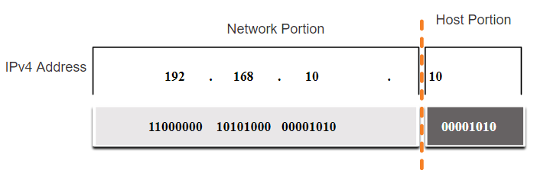
IPv4 Address Structure Network and Host Portions
An IPv4 address is a 32-bit hierarchical address that is made up of a network portion and a host portion.
When determining the network portion versus the host portion, you must look at the 32-bit stream.
A subnet mask is used to determine the network and host portions.
Notes:
11 – IPv4 Addressing
11.1 – IPv4 Address Structure
11.1.1 – Network and Host Portions

Slide 20
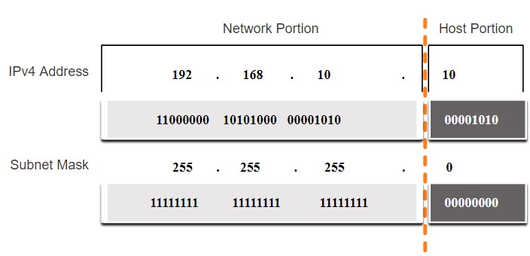
IPv4 Address Structure The Subnet Mask
To identify the network and host portions of an IPv4 address, the subnet mask is compared to the IPv4 address bit for bit, from left to right.
The actual process used to identify the network and host portions is called ANDing.
Notes:
11 – IPv4 Addressing
11.1 – IPv4 Address Structure
11.1.2 – The Subnet Mask

Slide 21
IPv4 Address Structure The Prefix Length
A prefix length is a less cumbersome method used to identify a subnet mask address.
The prefix length is the number of bits set to 1 in the subnet mask.
It is written in “slash notation” therefore, count the number of bits in the subnet mask and prepend it with a slash.
Subnet Mask | 32-bit Address | Prefix Length
255.0.0.0 | 11111111.00000000.00000000.00000000 | /8
255.255.0.0 | 11111111.11111111.00000000.00000000 | /16
255.255.255.0 | 11111111.11111111.11111111.00000000 | /24
255.255.255.128 | 11111111.11111111.11111111.10000000 | /25
255.255.255.192 | 11111111.11111111.11111111.11000000 | /26
255.255.255.224 | 11111111.11111111.11111111.11100000 | /27
255.255.255.240 | 11111111.11111111.11111111.11110000 | /28
255.255.255.248 | 11111111.11111111.11111111.11111000 | /29
255.255.255.252 | 11111111.11111111.11111111.11111100 | /30
Notes:
11 – IPv4 Addressing
11.1 – IPv4 Address Structure
11.1.3 – The Prefix Length

Slide 22
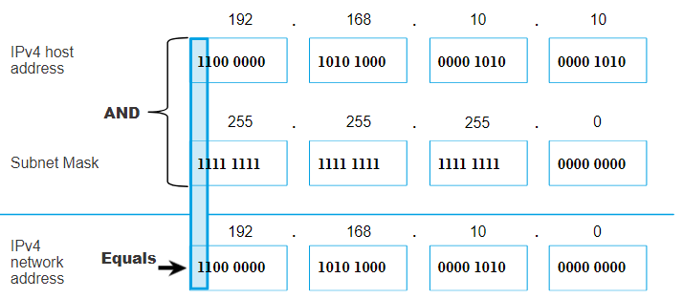
IPv4 Address Structure Determining the Network: Logical AND
A logical AND Boolean operation is used in determining the network address.
Logical AND is the comparison of two bits where only a 1 AND 1 produces a 1 and any other combination results in a 0.
1 AND 1 = 1, 0 AND 1 = 0, 1 AND 0 = 0, 0 AND 0 = 0
1 = True and 0 = False
To identify the network address, the host IPv4 address is logically ANDed, bit by bit, with the subnet mask to identify the network address.
Notes:
11 – IPv4 Addressing
11.1 – IPv4 Address Structure
11.1.4 – Determining the Network: Logical AND

Slide 23
IPv4 Address Structure Video – Network, Host and Broadcast Addresses
This video will cover the following:
Network address
Broadcast Address
First usable host
Last usable host
Notes:
11 – IPv4 Addressing
11.1 – IPv4 Address Structure
11.1.5 – Video – Network, Host and Broadcast Addresses

Slide 24
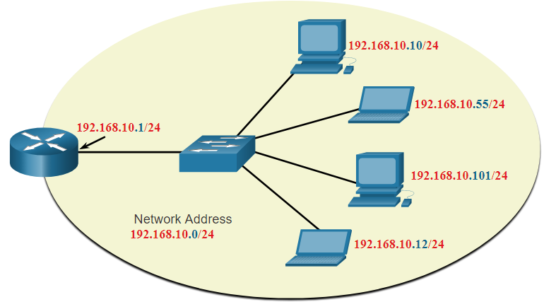
IPv4 Address Structure Network, Host, and Broadcast Addresses
Within each network are three types of IP addresses:
Network address
Host addresses
Broadcast address
 | Network Portion | Host Portion | Host Bits
Subnet mask 255.255.255.0 or /24 | 255 255 255 11111111 11111111 11111111 | 0 00000000
Network address 192.168.10.0 or /24 | 192 168 10 11000000 10100000 00001010 | 0 00000000 | All 0s
First address 192.168.10.1 or /24 | 192 168 10 11000000 10100000 00001010 | 1 00000001 | All 0s and a 1
Last address 192.168.10.254 or /24 | 192 168 10 11000000 10100000 00001010 | 254 11111110 | All 1s and a 0
Broadcast address 192.168.10.255 or /24 | 192 168 10 11000000 10100000 00001010 | 255 11111111 | All 1s
Notes:
11 – IPv4 Addressing
11.1 – IPv4 Address Structure
11.1.6 – Network, Host, and Broadcast Addresses
11.1.7 – Activity – ANDing to Determine the Network Address
11.1.8 – Check Your Understanding - IPv4 Address Structure

Slide 25
11.2 IPv4 Unicast, Broadcast, and Multicast
Notes:
11 – IPv4 Addressing
11.2 – IPv4 Unicast, Broadcast, and Multicast

Slide 26
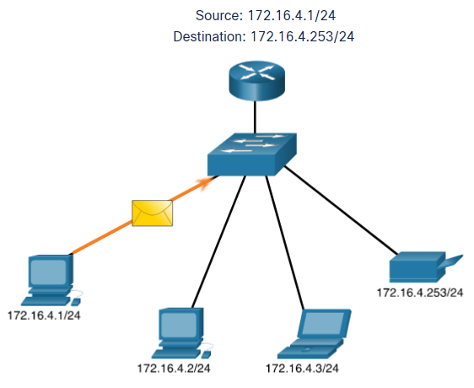
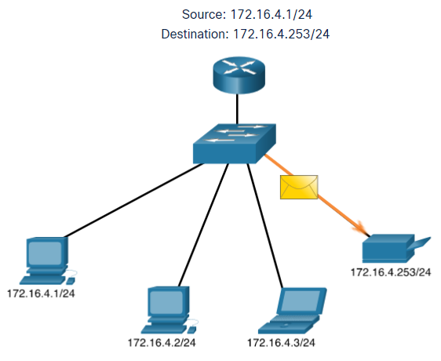
IPv4 Unicast, Broadcast, and Multicast Unicast
Unicast transmission is sending a packet to one destination IP address.
For example, the PC at 172.16.4.1 sends a unicast packet to the printer at 172.16.4.253.
Notes:
11 – IPv4 Addressing
11.2 – IPv4 Unicast, Broadcast, and Multicast
11.2.1 – Unicast

Slide 27
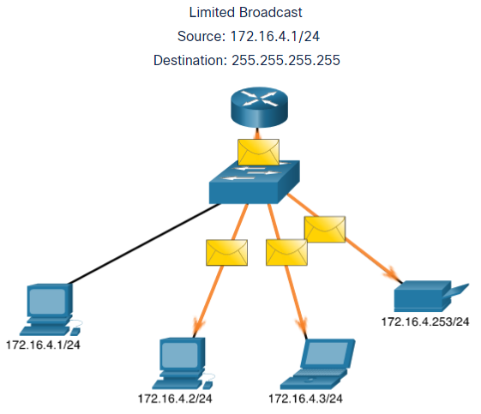
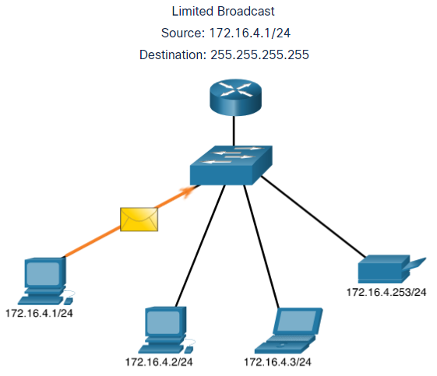
IPv4 Unicast, Broadcast, and Multicast Broadcast
Broadcast transmission is sending a packet to all other destination IP addresses.
For example, the PC at 172.16.4.1 sends a broadcast packet to all IPv4 hosts.
Notes:
11 – IPv4 Addressing
11.2 – IPv4 Unicast, Broadcast, and Multicast
11.2.2 – Broadcast

Slide 28
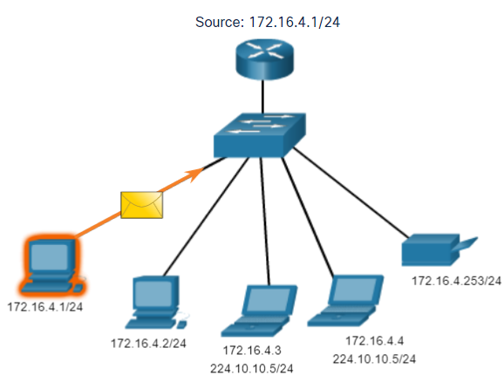
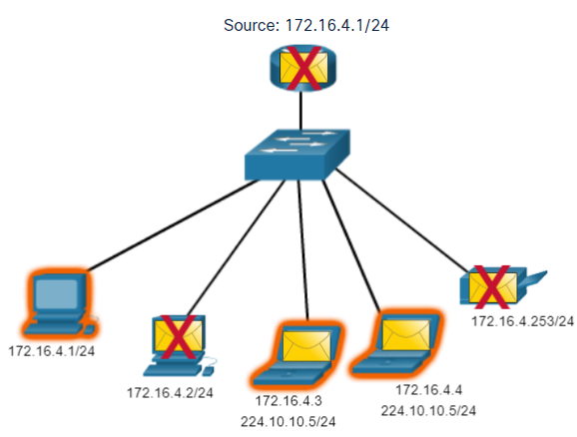
IPv4 Unicast, Broadcast, and Multicast Multicast
Multicast transmission is sending a packet to a multicast address group.
For example, the PC at 172.16.4.1 sends a multicast packet to the multicast group address 224.10.10.5.
Notes:
11 – IPv4 Addressing
11.2 – IPv4 Unicast, Broadcast, and Multicast
11.2.3 – Multicast
11.2.4 – Activity - Unicast, Broadcast, or Multicast

Slide 29
11.3 Types of IPv4 Addresses
Notes:
11 – IPv4 Addressing
11.3 – Types of IPv4 Addresses

Slide 30
Types of IPv4 Addresses Public and Private IPv4 Addresses
As defined in in RFC 1918, public IPv4 addresses are globally routed between internet service provider (ISP) routers.
However, private addresses are not globally routable.
Private addresses are common blocks of addresses used by most organizations to assign IPv4 addresses to internal hosts.
Private IPv4 addresses are not unique and can be used internally within any network.
Network Address and Prefix | RFC 1918 Private Address Range
10.0.0.0/8 | 10.0.0.0 - 10.255.255.255
172.16.0.0/12 | 172.16.0.0 - 172.31.255.255
192.168.0.0/16 | 192.168.0.0 - 192.168.255.255
Notes:
11 – IPv4 Addressing
11.3 – Types of IPv4 Addresses
11.3.1 – Public and Private IPv4 Addresses

Slide 31
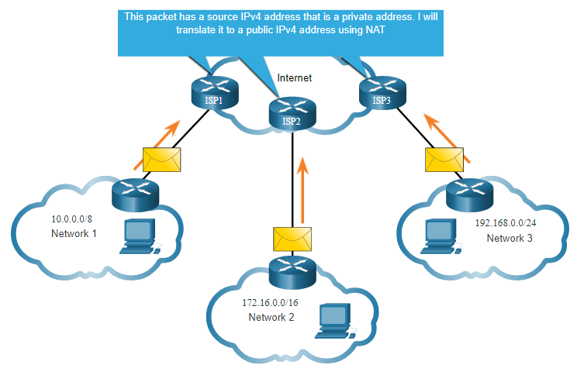
Types of IPv4 Addresses Routing to the Internet
Network Address Translation (NAT) translates private IPv4 addresses to public IPv4 addresses.
NAT is typically enabled on the edge router connecting to the internet.
It translates the internal private address to a public global IP address.
Notes:
11 – IPv4 Addressing
11.3 – Types of IPv4 Addresses
11.3.2 – Routing to the Internet
11.3.3 – Activity - Pass or Block IPv4 Addresses

Slide 32

Types of IPv4 Addresses Special Use IPv4 Addresses
Loopback addresses
127.0.0.0 /8 (127.0.0.1 to 127.255.255.254)
Commonly identified as only 127.0.0.1
Used on a host to test if TCP/IP is operational.
Link-Local addresses
169.254.0.0 /16 (169.254.0.1 to 169.254.255.254)
Commonly known as the Automatic Private IP Addressing (APIPA) addresses or self-assigned addresses.
Used by Windows DHCP clients to self-configure when no DHCP servers are available.
Notes:
11 – IPv4 Addressing
11.3 – Types of IPv4 Addresses
11.3.4 – Special Use IPv4 Addresses

Slide 33
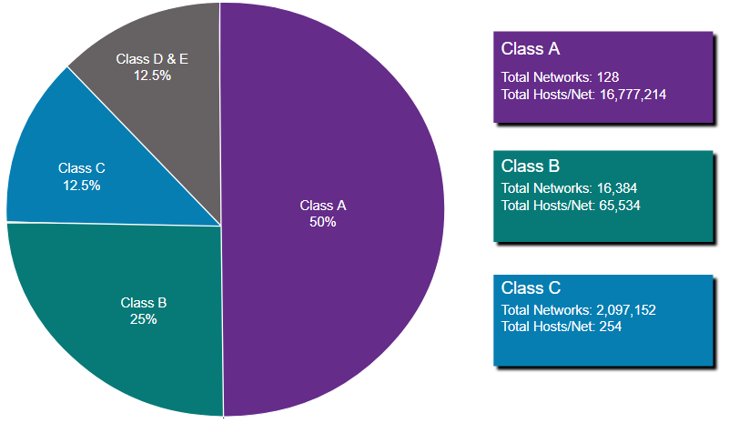
Types of IPv4 Addresses Legacy Classful Addressing
RFC 790 (1981) allocated IPv4 addresses in classes
Class A (0.0.0.0/8 to 127.0.0.0/8)
Class B (128.0.0.0 /16 – 191.255.0.0 /16)
Class C (192.0.0.0 /24 – 223.255.255.0 /24)
Class D (224.0.0.0 to 239.0.0.0)
Class E (240.0.0.0 – 255.0.0.0)
Classful addressing wasted many IPv4 addresses.
Classful address allocation was replaced with classless addressing which ignores the rules of classes (A, B, C).
Notes:
11 – IPv4 Addressing
11.3 – Types of IPv4 Addresses
11.3.5 – Legacy Classful Addressing

Slide 34
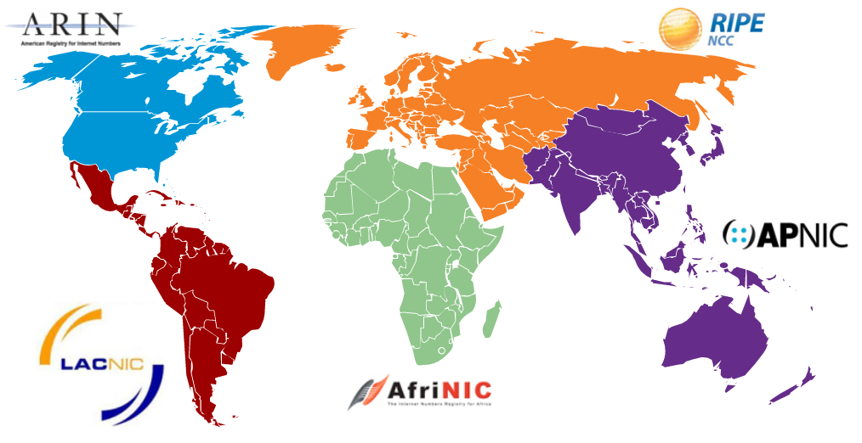
Types of IPv4 Addresses Assignment of IP Addresses
The Internet Assigned Numbers Authority (IANA) manages and allocates blocks of IPv4 and IPv6 addresses to five Regional Internet Registries (RIRs).
RIRs are responsible for allocating IP addresses to ISPs who provide IPv4 address blocks to smaller ISPs and organizations.
Notes:
11 – IPv4 Addressing
11.3 – Types of IPv4 Addresses
11.3.6 – Assignment of IP Addresses
11.3.7 – Activity - Public or Private IPv4 Address
11.3.8 – Check Your Understanding - Types of IPv4 Addresses

Slide 35
11.4 Network Segmentation
Notes:
11 – IPv4 Addressing
11.4 – Network Segmentation

Slide 36
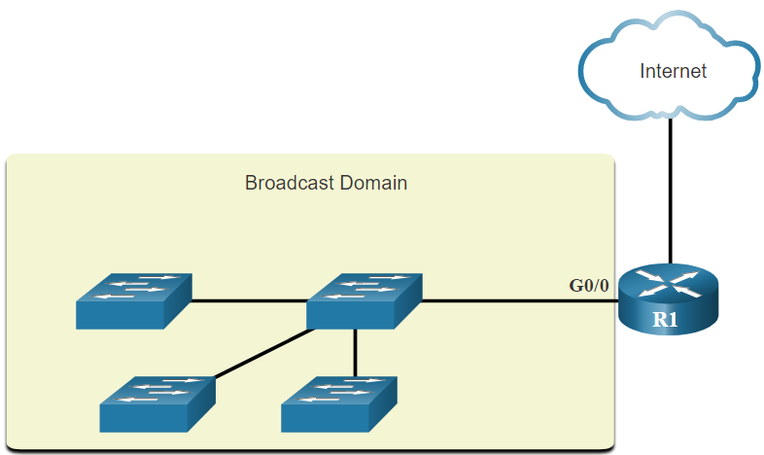
Network Segmentation Broadcast Domains and Segmentation
Many protocols use broadcasts or multicasts (e.g., ARP use broadcasts to locate other devices, hosts send DHCP discover broadcasts to locate a DHCP server.)
Switches propagate broadcasts out all interfaces except the interface on which it was received.
The only device that stops broadcasts is a router.
Routers do not propagate broadcasts.
Each router interface connects to a broadcast domain and broadcasts are only propagated within that specific broadcast domain.
Notes:
11 – IPv4 Addressing
11.4 – Network Segmentation
11.4.1 – Broadcast Domains and Segmentation

Slide 37
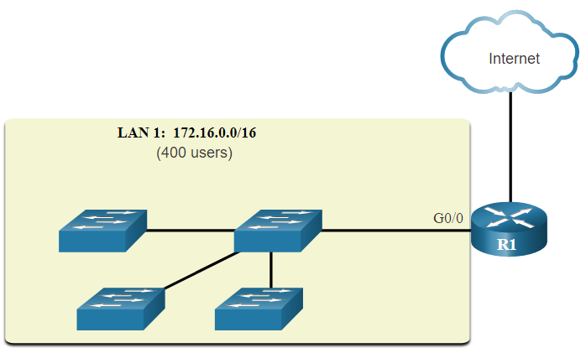
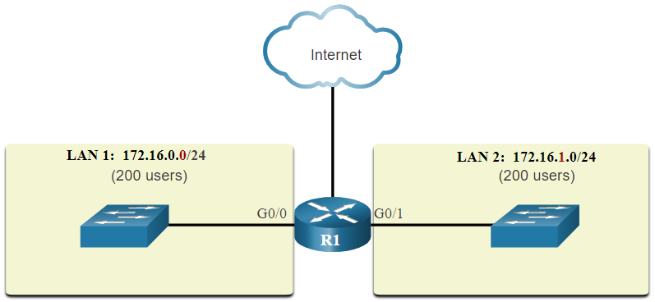
Network Segmentation Problems with Large Broadcast Domains
A problem with a large broadcast domain is that these hosts can generate excessive broadcasts and negatively affect the network.
The solution is to reduce the size of the network to create smaller broadcast domains in a process called subnetting.
Dividing the network address 172.16.0.0 /16 into two subnets of 200 users each: 172.16.0.0 /24 and 172.16.1.0 /24.
Broadcasts are only propagated within the smaller broadcast domains.
Notes:
11 – IPv4 Addressing
11.4 – Network Segmentation
11.4.2 – Problems with Large Broadcast Domains

Slide 38
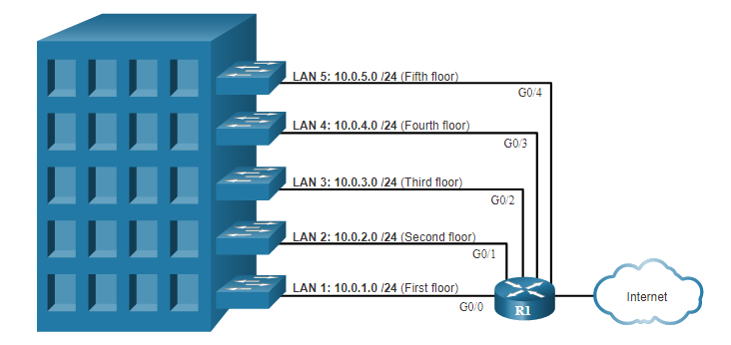
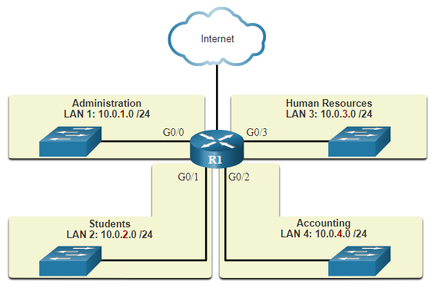
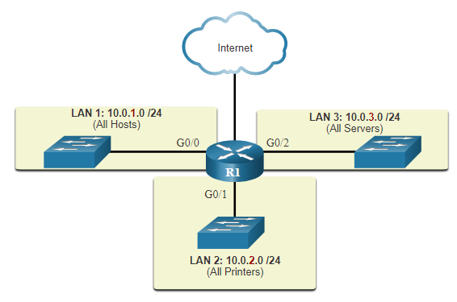
Network Segmentation Reasons for Segmenting Networks
Subnetting reduces overall network traffic and improves network performance.
It can be used to implement security policies between subnets.
Subnetting reduces the number of devices affected by abnormal broadcast traffic.
Subnets are used for a variety of reasons including by:
Location
Group or Function
Device Type
Notes:
11 – IPv4 Addressing
11.4 – Network Segmentation
11.4.3 – Reasons for Segmenting Networks
11.4.4 – Check Your Understanding - Network Segmentation

Slide 39
11.5 Subnet an IPv4 Network
Notes:
11 – IPv4 Addressing
11.5 – Subnet an IPv4 Network

Slide 40
Subnet an IPv4 Network Subnet on an Octet Boundary
Networks are most easily subnetted at the octet boundary of /8, /16, and /24.
Notice that using longer prefix lengths decreases the number of hosts per subnet.
Prefix Length | Subnet Mask | Subnet Mask in Binary (n = network, h = host) | # of hosts
/8 | 255.0.0.0 | nnnnnnnn.hhhhhhhh.hhhhhhhh.hhhhhhhh 11111111.00000000.00000000.00000000 | 16,777,214
/16 | 255.255.0.0 | nnnnnnnn.nnnnnnnn.hhhhhhhh.hhhhhhhh 11111111.11111111.00000000.00000000 | 65,534
/24 | 255.255.255.0 | nnnnnnnn.nnnnnnnn.nnnnnnnn.hhhhhhhh 11111111.11111111.11111111.00000000 | 254
Notes:
11 – IPv4 Addressing
11.5 – Subnet an IPv4 Network
11.5.1 – Subnet on an Octet Boundary

Slide 41
Subnet an IPv4 Network Subnet on an Octet Boundary (Cont.)
In the first table 10.0.0.0/8 is subnetted using /16 and in the second table, a /24 mask.
Subnet Address (256 Possible Subnets) | Host Range (65,534 possible hosts per subnet) | Broadcast
10.0.0.0/16 | 10.0.0.1 - 10.0.255.254 | 10.0.255.255
10.1.0.0/16 | 10.1.0.1 - 10.1.255.254 | 10.1.255.255
10.2.0.0/16 | 10.2.0.1 - 10.2.255.254 | 10.2.255.255
10.3.0.0/16 | 10.3.0.1 - 10.3.255.254 | 10.3.255.255
10.4.0.0/16 | 10.4.0.1 - 10.4.255.254 | 10.4.255.255
10.5.0.0/16 | 10.5.0.1 - 10.5.255.254 | 10.5.255.255
10.6.0.0/16 | 10.6.0.1 - 10.6.255.254 | 10.6.255.255
10.7.0.0/16 | 10.7.0.1 - 10.7.255.254 | 10.7.255.255
... | ... | ...
10.255.0.0/16 | 10.255.0.1 - 10.255.255.254 | 10.255.255.255
Subnet Address (65,536 Possible Subnets) | Host Range (254 possible hosts per subnet) | Broadcast
10.0.0.0/24 | 10.0.0.1 - 10.0.0.254 | 10.0.0.255
10.0.1.0/24 | 10.0.1.1 - 10.0.1.254 | 10.0.1.255
10.0.2.0/24 | 10.0.2.1 - 10.0.2.254 | 10.0.2.255
… | … | …
10.0.255.0/24 | 10.0.255.1 - 10.0.255.254 | 10.0.255.255
10.1.0.0/24 | 10.1.0.1 - 10.1.0.254 | 10.1.0.255
10.1.1.0/24 | 10.1.1.1 - 10.1.1.254 | 10.1.1.255
10.1.2.0/24 | 10.1.2.1 - 10.1.2.254 | 10.1.2.255
… | … | …
10.100.0.0/24 | 10.100.0.1 - 10.100.0.254 | 10.100.0.255
... | ... | ...
10.255.255.0/24 | 10.255.255.1 - 10.2255.255.254 | 10.255.255.255
Notes:
11 – IPv4 Addressing
11.5 – Subnet an IPv4 Network
11.5.1 – Subnet on an Octet Boundary (Cont.)

Slide 42
Subnet an IPv4 Network Subnet within an Octet Boundary
Refer to the table to see six ways to subnet a /24 network.
Prefix Length | Subnet Mask | Subnet Mask in Binary (n = network, h = host) | # of subnets | # of hosts
/25 | 255.255.255.128 | nnnnnnnn.nnnnnnnn.nnnnnnnn.nhhhhhhh 11111111.11111111.11111111.10000000 | 2 | 126
/26 | 255.255.255.192 | nnnnnnnn.nnnnnnnn.nnnnnnnn.nnhhhhhh 11111111.11111111.11111111.11000000 | 4 | 62
/27 | 255.255.255.224 | nnnnnnnn.nnnnnnnn.nnnnnnnn.nnnhhhhh 11111111.11111111.11111111.11100000 | 8 | 30
/28 | 255.255.255.240 | nnnnnnnn.nnnnnnnn.nnnnnnnn.nnnnhhhh 11111111.11111111.11111111.11110000 | 16 | 14
/29 | 255.255.255.248 | nnnnnnnn.nnnnnnnn.nnnnnnnn.nnnnnhhh 11111111.11111111.11111111.11111000 | 32 | 6
/30 | 255.255.255.252 | nnnnnnnn.nnnnnnnn.nnnnnnnn.nnnnnnhh 11111111.11111111.11111111.11111100 | 64 | 2
Notes:
11 – IPv4 Addressing
11.5 – Subnet an IPv4 Network
11.5.2 – Subnet within an Octet Boundary

Slide 43
Subnet an IPv4 Network Video – The Subnet Mask
This video will demonstrate the process of subnetting.
Notes:
11 – IPv4 Addressing
11.5 – Subnet an IPv4 Network
11.5.3 – Video – The Subnet Mask

Slide 44
Subnet an IPv4 Network Video – Subnet with the Magic Number
This video will demonstrate subnetting with the magic number.
Notes:
11 – IPv4 Addressing
11.5 – Subnet an IPv4 Network
11.5.4 – Video – Subnet with the Magic Number

Slide 45
Subnet an IPv4 Network Packet Tracer – Subnet an IPv4 Network
In this Packet Tracer, you will do the following:
Design an IPv4 Network Subnetting Scheme
Configure the Devices
Test and Troubleshoot the Network
Notes:
11 – IPv4 Addressing
11.5 – Subnet an IPv4 Network
11.5.5 – Packet Tracer – Subnet an IPv4 Network

Slide 46
11.6 Subnet a Slash 16 and a Slash 8 Prefix
Notes:
11 – IPv4 Addressing
11.6 – Subnet a Slash 16 and a Slash 8 Prefix

Slide 47
Subnet a Slash 16 and a Slash 8 Prefix Create Subnets with a Slash 16 prefix
Prefix Length | Subnet Mask | Network Address (n = network, h = host) | # of subnets | # of hosts
/17 | 255.255.128.0 | nnnnnnnn.nnnnnnnn.nhhhhhhh.hhhhhhhh 11111111.11111111.10000000.00000000 | 2 | 32766
/18 | 255.255.192.0 | nnnnnnnn.nnnnnnnn.nnhhhhhh.hhhhhhhh 11111111.11111111.11000000.00000000 | 4 | 16382
/19 | 255.255.224.0 | nnnnnnnn.nnnnnnnn.nnnhhhhh.hhhhhhhh 11111111.11111111.11100000.00000000 | 8 | 8190
/20 | 255.255.240.0 | nnnnnnnn.nnnnnnnn.nnnnhhhh.hhhhhhhh 11111111.11111111.11110000.00000000 | 16 | 4094
/21 | 255.255.248.0 | nnnnnnnn.nnnnnnnn.nnnnnhhh.hhhhhhhh 11111111.11111111.11111000.00000000 | 32 | 2046
/22 | 255.255.252.0 | nnnnnnnn.nnnnnnnn.nnnnnnhh.hhhhhhhh 11111111.11111111.11111100.00000000 | 64 | 1022
/23 | 255.255.254.0 | nnnnnnnn.nnnnnnnn.nnnnnnnh.hhhhhhhh 11111111.11111111.11111110.00000000 | 128 | 510
/24 | 255.255.255.0 | nnnnnnnn.nnnnnnnn.nnnnnnnn.hhhhhhhh 11111111.11111111.11111111.00000000 | 256 | 254
/25 | 255.255.255.128 | nnnnnnnn.nnnnnnnn.nnnnnnnn.nhhhhhhh 11111111.11111111.11111111.10000000 | 512 | 126
/26 | 255.255.255.192 | nnnnnnnn.nnnnnnnn.nnnnnnnn.nnhhhhhh 11111111.11111111.11111111.11000000 | 1024 | 62
/27 | 255.255.255.224 | nnnnnnnn.nnnnnnnn.nnnnnnnn.nnnhhhhh 11111111.11111111.11111111.11100000 | 2048 | 30
/28 | 255.255.255.240 | nnnnnnnn.nnnnnnnn.nnnnnnnn.nnnnhhhh 11111111.11111111.11111111.11110000 | 4096 | 14
/29 | 255.255.255.248 | nnnnnnnn.nnnnnnnn.nnnnnnnn.nnnnnhhh 11111111.11111111.11111111.11111000 | 8192 | 6
/30 | 255.255.255.252 | nnnnnnnn.nnnnnnnn.nnnnnnnn.nnnnnnhh 11111111.11111111.11111111.11111100 | 16384 | 2
The table highlights all the possible scenarios for subnetting a /16 prefix.
Notes:
11 – IPv4 Addressing
11.6 – Subnet a Slash 16 and a Slash 8 Prefix
11.6.1 – Create Subnets with a Slash 16 prefix

Slide 48
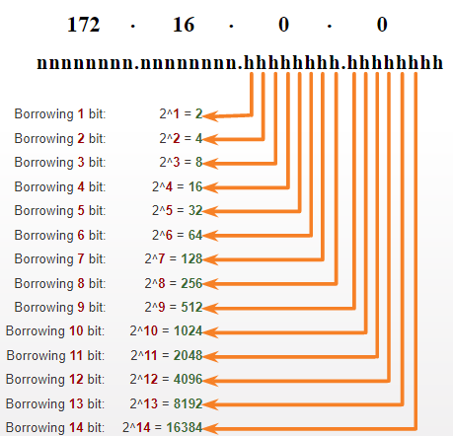
Subnet a Slash 16 and a Slash 8 Prefix Create 100 Subnets with a Slash 16 prefix
Consider a large enterprise that requires at least 100 subnets and has chosen the private address 172.16.0.0/16 as its internal network address.
The figure displays the number of subnets that can be created when borrowing bits from the third octet and the fourth octet.
Notice there are now up to 14 host bits that can be borrowed (i.e., last two bits cannot be borrowed).
To satisfy the requirement of 100 subnets for the enterprise, 7 bits (i.e., 2⁷ = 128 subnets) would need to be borrowed (for a total of 128 subnets).
Notes:
11 – IPv4 Addressing
11.6 – Subnet a Slash 16 and a Slash 8 Prefix
11.6.2 – Create 100 Subnets with a Slash 16 prefix

Slide 49
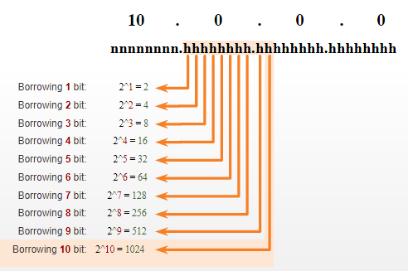
Subnet a Slash 16 and a Slash 8 Prefix Create 1000 Subnets with a Slash 8 prefix
Consider a small ISP that requires 1000 subnets for its clients using network address 10.0.0.0/8 which means there are 8 bits in the network portion and 24 host bits available to borrow toward subnetting.
The figure displays the number of subnets that can be created when borrowing bits from the second and third.
Notice there are now up to 22 host bits that can be borrowed (i.e., last two bits cannot be borrowed).
To satisfy the requirement of 1000 subnets for the enterprise, 10 bits (i.e., 2¹⁰=1024 subnets) would need to be borrowed (for a total of 128 subnets)
Notes:
11 – IPv4 Addressing
11.6 – Subnet a Slash 16 and a Slash 8 Prefix
11.6.3 – Create 1000 Subnets with a Slash 8 prefix

Slide 50
Subnet a Slash 16 and a Slash 8 Prefix Video – Subnet Across Multiple Octets
This video will demonstrate creating subnets across multiple octets.
Notes:
11 – IPv4 Addressing
11.6 – Subnet a Slash 16 and a Slash 8 Prefix
11.6.4 – Video – Subnet Across Multiple Octets
11.6.5 – Activity - Calculate the Subnet Mask

Slide 51
Subnet a Slash 16 and a Slash 8 Prefix Lab – Calculate IPv4 Subnets
In this lab, you will complete the following objectives:
Part 1: Determine IPv4 Address Subnetting
Part 2: Calculate IPv4 Address Subnetting
Notes:
11 – IPv4 Addressing
11.6 – Subnet a Slash 16 and a Slash 8 Prefix
11.6.6 – Lab – Calculate IPv4 Subnets

Slide 52
11.7 Subnet to Meet Requirements
Notes:
11 – IPv4 Addressing
11.7 – Subnet to Meet Requirements

Slide 53
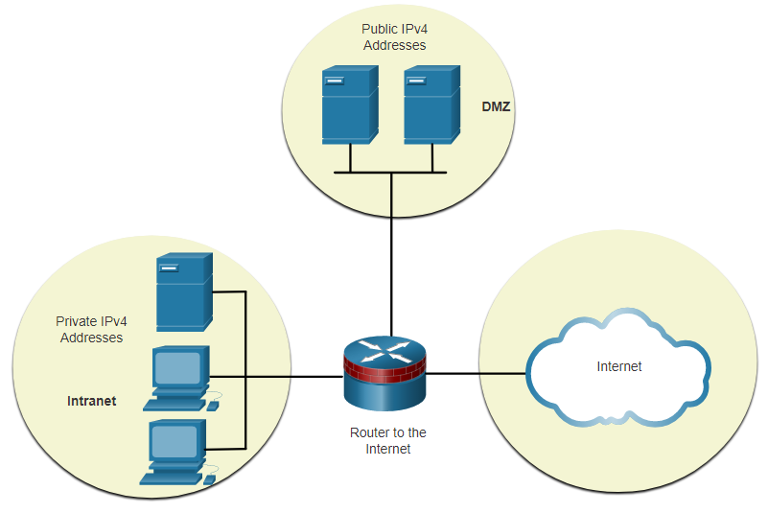
Subnet to Meet Requirements Subnet Private versus Public IPv4 Address Space
Enterprise networks will have an:
Intranet - A company’s internal network typically using private IPv4 addresses.
DMZ – A companies internet facing servers. Devices in the DMZ use public IPv4 addresses.
A company could use the 10.0.0.0/8 and subnet on the /16 or /24 network boundary.
The DMZ devices would have to be configured with public IP addresses.
Notes:
11 – IPv4 Addressing
11.7 – Subnet to Meet Requirements
11.7.1 – Subnet Private versus Public IPv4 Address Space

Slide 54
Subnet to Meet Requirements Minimize Unused Host IPv4 Addresses and Maximize Subnets
There are two considerations when planning subnets:
The number of host addresses required for each network
The number of individual subnets needed
Prefix Length | Subnet Mask | Subnet Mask in Binary (n = network, h = host) | # of subnets | # of hosts
/25 | 255.255.255.128 | nnnnnnnn.nnnnnnnn.nnnnnnnn.nhhhhhhh 11111111.11111111.11111111.10000000 | 2 | 126
/26 | 255.255.255.192 | nnnnnnnn.nnnnnnnn.nnnnnnnn.nnhhhhhh 11111111.11111111.11111111.11000000 | 4 | 62
/27 | 255.255.255.224 | nnnnnnnn.nnnnnnnn.nnnnnnnn.nnnhhhhh 11111111.11111111.11111111.11100000 | 8 | 30
/28 | 255.255.255.240 | nnnnnnnn.nnnnnnnn.nnnnnnnn.nnnnhhhh 11111111.11111111.11111111.11110000 | 16 | 14
/29 | 255.255.255.248 | nnnnnnnn.nnnnnnnn.nnnnnnnn.nnnnnhhh 11111111.11111111.11111111.11111000 | 32 | 6
/30 | 255.255.255.252 | nnnnnnnn.nnnnnnnn.nnnnnnnn.nnnnnnhh 11111111.11111111.11111111.11111100 | 64 | 2
Notes:
11 – IPv4 Addressing
11.7 – Subnet to Meet Requirements
11.7.2 – Minimize Unused Host IPv4 Addresses and Maximize Subnets

Slide 55
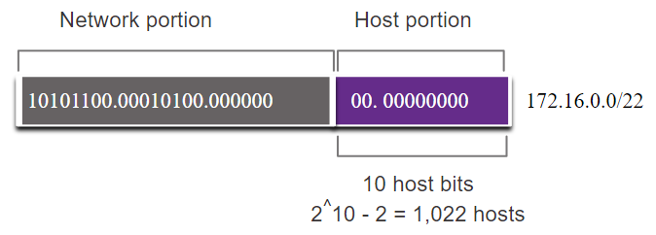
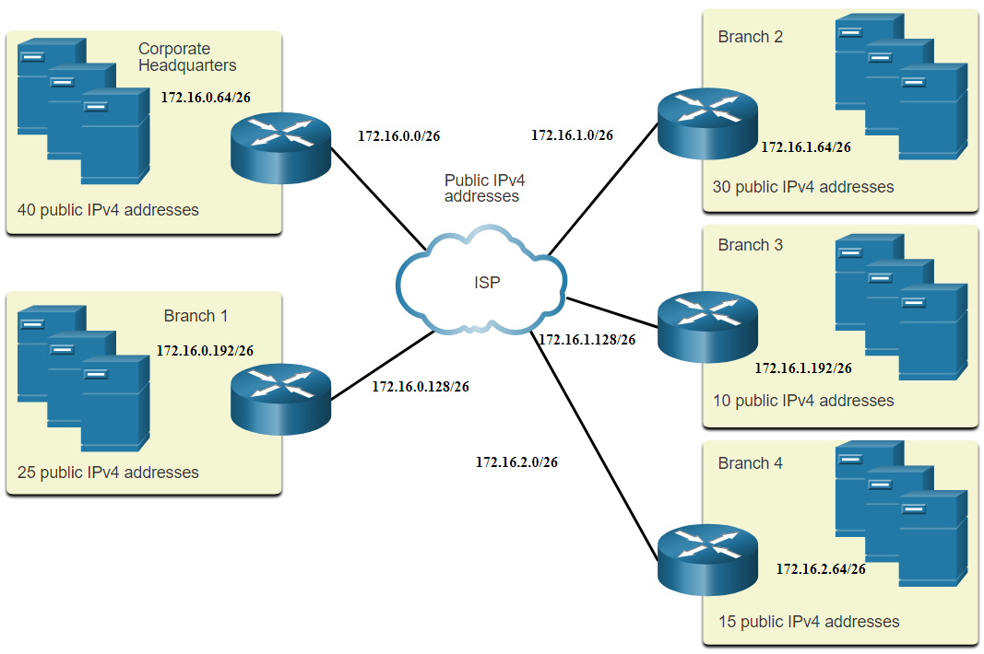
Subnet to Meet Requirements Example: Efficient IPv4 Subnetting
In this example, corporate headquarters has been allocated a public network address of 172.16.0.0/22 (10 host bits) by its ISP providing 1,022 host addresses.
There are five sites and therefore five internet connections which means the organization requires 10 subnets with the largest subnet requires 40 addresses.
It allocated 10 subnets with a /26 (i.e., 255.255.255.192) subnet mask.
Notes:
11 – IPv4 Addressing
11.7 – Subnet to Meet Requirements
11.7.3 – Example: Efficient IPv4 Subnetting
11.7.4 – Activity - Determine the Number of Bits to Borrow

Slide 56
Subnet to Meet Requirements Packet Tracer – Subnetting Scenario
In this Packet Tracer, you will do the following:
Design an IP Addressing Scheme
Assign IP Addresses to Network Devices and Verify Connectivity
Notes:
11 – IPv4 Addressing
11.7 – Subnet to Meet Requirements
11.7.5 – Packet Tracer – Subnetting Scenario

Slide 57
11.8 VLSM
Notes:
11 – IPv4 Addressing
11.8 – VLSM

Slide 58
VLSM Video – VLSM Basics
This video will explain VLSM basics.
Notes:
11 – IPv4 Addressing
11.8 – VLSM
11.8.1 – Video – VLSM Basics

Slide 59
VLSM Video – VLSM Example
This video will demonstrate creating subnets specific to the needs of the network.
Notes:
11 – IPv4 Addressing
11.8 – VLSM
11.8.2 – Video – VLSM Example

Slide 60
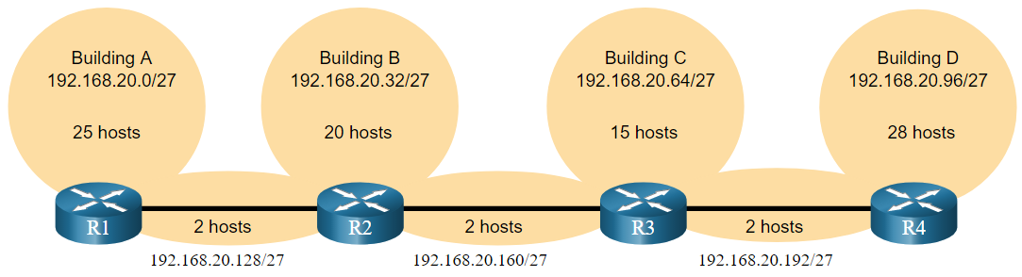
VLSM IPv4 Address Conservation
Given the topology, 7 subnets are required (i.e, four LANs and three WAN links) and the largest number of host is in Building D with 28 hosts.
A /27 mask would provide 8 subnets of 30 host IP addresses and therefore support this topology.
Notes:
11 – IPv4 Addressing
11.8 – VLSM
11.8.3 – IPv4 Address Conservation

Slide 61
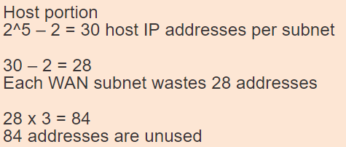
VLSM IPv4 Address Conservation (Cont.)
However, the point-to-point WAN links only require two addresses and therefore waste 28 addresses each for a total of 84 unused addresses.
Applying a traditional subnetting scheme to this scenario is not very efficient and is wasteful.
VLSM was developed to avoid wasting addresses by enabling us to subnet a subnet.
Notes:
11 – IPv4 Addressing
11.8 – VLSM
11.8.3 – IPv4 Address Conservation

Slide 62
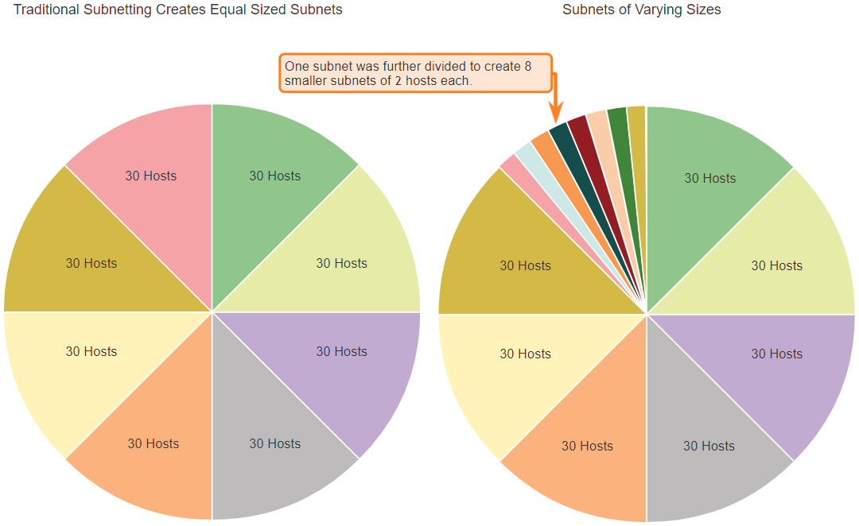
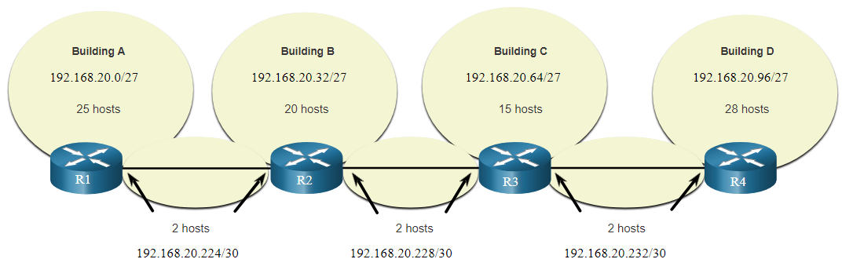
VLSM VLSM
The left side displays the traditional subnetting scheme (i.e., the same subnet mask) while the right side illustrates how VLSM can be used to subnet a subnet and divided the last subnet into eight /30 subnets.
When using VLSM, always begin by satisfying the host requirements of the largest subnet and continue subnetting until the host requirements of the smallest subnet are satisfied.
The resulting topology with VLSM applied.
Notes:
11 – IPv4 Addressing
11.8 – VLSM
11.8.4 – VLSM

Slide 63
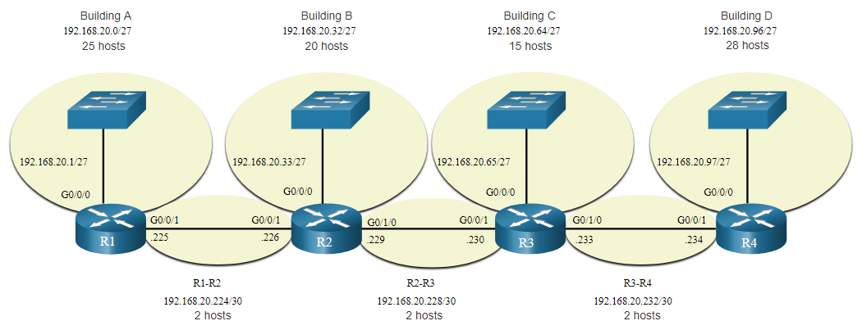
VLSM VLSM Topology Address Assignment
Using VLSM subnets, the LAN and inter-router networks can be addressed without unnecessary waste as shown in the logical topology diagram.
Notes:
11 – IPv4 Addressing
11.8 – VLSM
11.8.5 – VLSM Topology Address Assignment
11.8.6 – Activity - VLSM Practice

Slide 64
11.9 Structured Design
Notes:
11 – IPv4 Addressing
11.9 – Structured Design

Slide 65
Structured Design IPv4 Network Address Planning
IP network planning is crucial to develop a scalable solution to an enterprise network.
To develop an IPv4 network wide addressing scheme, you need to know how many subnets are needed, how many hosts a particular subnet requires, what devices are part of the subnet, which parts of your network use private addresses, and which use public, and many other determining factors.
Examine the needs of an organization’s network usage and how the subnets will be structured.
Perform a network requirement study by looking at the entire network to determining how each area will be segmented.
Determine how many subnets are needed and how many hosts per subnet.
Determine DHCP address pools and Layer 2 VLAN pools.
Notes:
11 – IPv4 Addressing
11.9 – Structured Design
11.9.1 – IPv4 Network Address Planning

Slide 66
Structured Design Device Address Assignment
Within a network, there are different types of devices that require addresses:
End user clients – Most use DHCP to reduce errors and burden on network support staff. IPv6 clients can obtain address information using DHCPv6 or SLAAC.
Servers and peripherals – These should have a predictable static IP address.
Servers that are accessible from the internet – Servers must have a public IPv4 address, most often accessed using NAT.
Intermediary devices – Devices are assigned addresses for network management, monitoring, and security.
Gateway – Routers and firewall devices are gateway for the hosts in that network.
When developing an IP addressing scheme, it is generally recommended that you have a set pattern of how addresses are allocated to each type of device.
Notes:
11 – IPv4 Addressing
11.9 – Structured Design
11.9.2 – Device Address Assignment

Slide 67
Structured Design Packet Tracer – VLSM Design and Implementation Practice
In this Packet Tracer, you will do the following:
Examine the Network Requirements
Design the VLSM Addressing Scheme
Assign IP Addresses to Devices and Verify Connectivity
Notes:
11 – IPv4 Addressing
11.9 – Structured Design
11.9.3 – Packet Tracer – VLSM Design and Implementation Practice

Slide 68
11.10 Module Practice and Quiz
Notes:
11 – IPv4 Addressing
11.10 Module Practice and Quiz

Slide 69
Structured Design Packet Tracer – Design and Implement a VLSM Addressing Scheme
In this Packet Tracer, you will do the following:
Design a VLSM IP addressing scheme given requirements
Configure addressing on network devices and hosts
Verify IP connectivity
Troubleshoot connectivity issues as required.
Notes:
11 – IPv4 Addressing
11.10 – Structured Design
11.10.1 – Packet Tracer – Design and Implement a VLSM Addressing Scheme

Slide 70
Structured Design Packet Tracer – Design and Implement a VLSM Addressing Scheme - Physical Mode Lab – Design and Implement a VLSM Addressing Scheme
In both the Packet Tracer Physical Mode activity and in the Lab, you will complete the following objectives:
Examine Network Requirements
Design the VLSM Address Scheme
Cable and Configure the IPv4 Network
Notes:
11 – IPv4 Addressing
11.10 – Structured Design
11.10.2 – Packet Tracer and Lab– Design and Implement a VLSM Addressing Scheme

Slide 71
Module Practice and Quiz What did I learn in this module?
The IP addressing structure consists of a 32-bit hierarchical network address that identifies a network and a host portion. Network devices use a process called ANDing using the IP address and associated subnet mask to identify the network and host portions.
Destination IPv4 packets can be unicast, broadcast, and multicast.
There are globally routable IP addresses as assigned by the IANA and there are three ranges of private IP network addresses that cannot be routed globally but can be used on all internal private networks.
Reduce large broadcast domains using subnets to create smaller broadcast domains, reduce overall network traffic, and improve network performance.
Create IPv4 subnets using one or more of the host bits as network bits. However, networks are most easily subnetted at the octet boundary of /8, /16, and /24.
Larger networks can be subnetted at the /8 or /16 boundaries.
Use VLSM to reduce the number of unused host addresses per subnet.
Notes:
11 – IPv4 Addressing
11.10 – Structured Design
11.10.3 – What did I learn in this module?

Slide 72
Module Practice and Quiz What did I learn in this module? (Cont.)
VLSM allows a network space to be divided into unequal parts. Always begin by satisfying the host requirements of the largest subnet. Continue subnetting until the host requirements of the smallest subnet are satisfied.
When designing a network addressing scheme, consider internal, DMZ, and external requirements. Use a consistent internal IP addressing scheme with a set pattern of how addresses are allocated to each type of device.
Notes:
11 – IPv4 Addressing
11.10 – Structured Design
11.10.3 – What did I learn in this module? (Cont.)
11.10.4 – Module Quiz – IPv4 Addressing

Slide 73
Module 11: IPv4 Addressing New Terms and Commands
prefix length logical AND network address broadcast address first usable address last usable address unicast, broadcast, and multicast transmissions private addresses public addresses Network Address Translation (NAT) loopback addresses Automatic Private IP Addressing (APIPA) addresses classful addressing (Class A, B, C, D, and E) | Internet Assigned Numbers Authority (IANA) Regional Internet Registries (RIRs) AfriNIC, APNIC, ARIN, LACNIC, and RIPE NCC broadcast domains subnets octet boundary variable-length subnet mask (VLSM)

