Slide 1
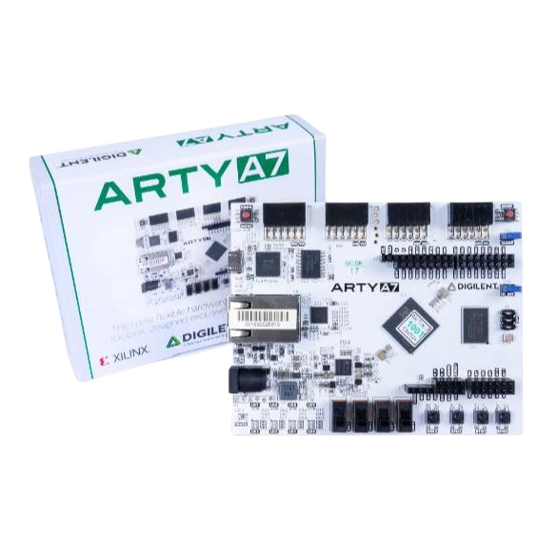
LOW POWER SOC DESIGN FINAL PRESENTATION
授課老師: 阮聖彰
組員: 賴晉頡 賴敬予

Slide 2

Outline
  Model Training
  Stage1 Detection & Stage2 Recognition
  Single Core & Dual-core SoC
  Hardware Accelerator
  Synthesis Report
  RTL sim & Pre sim
  Result Summary
  Conclusion
YOUR_DATA

Slide 3
System
Dataset
& Augmentation
Model Training
Transfer Learning
Quantization
Export Quantized Model
Software System

Slide 4
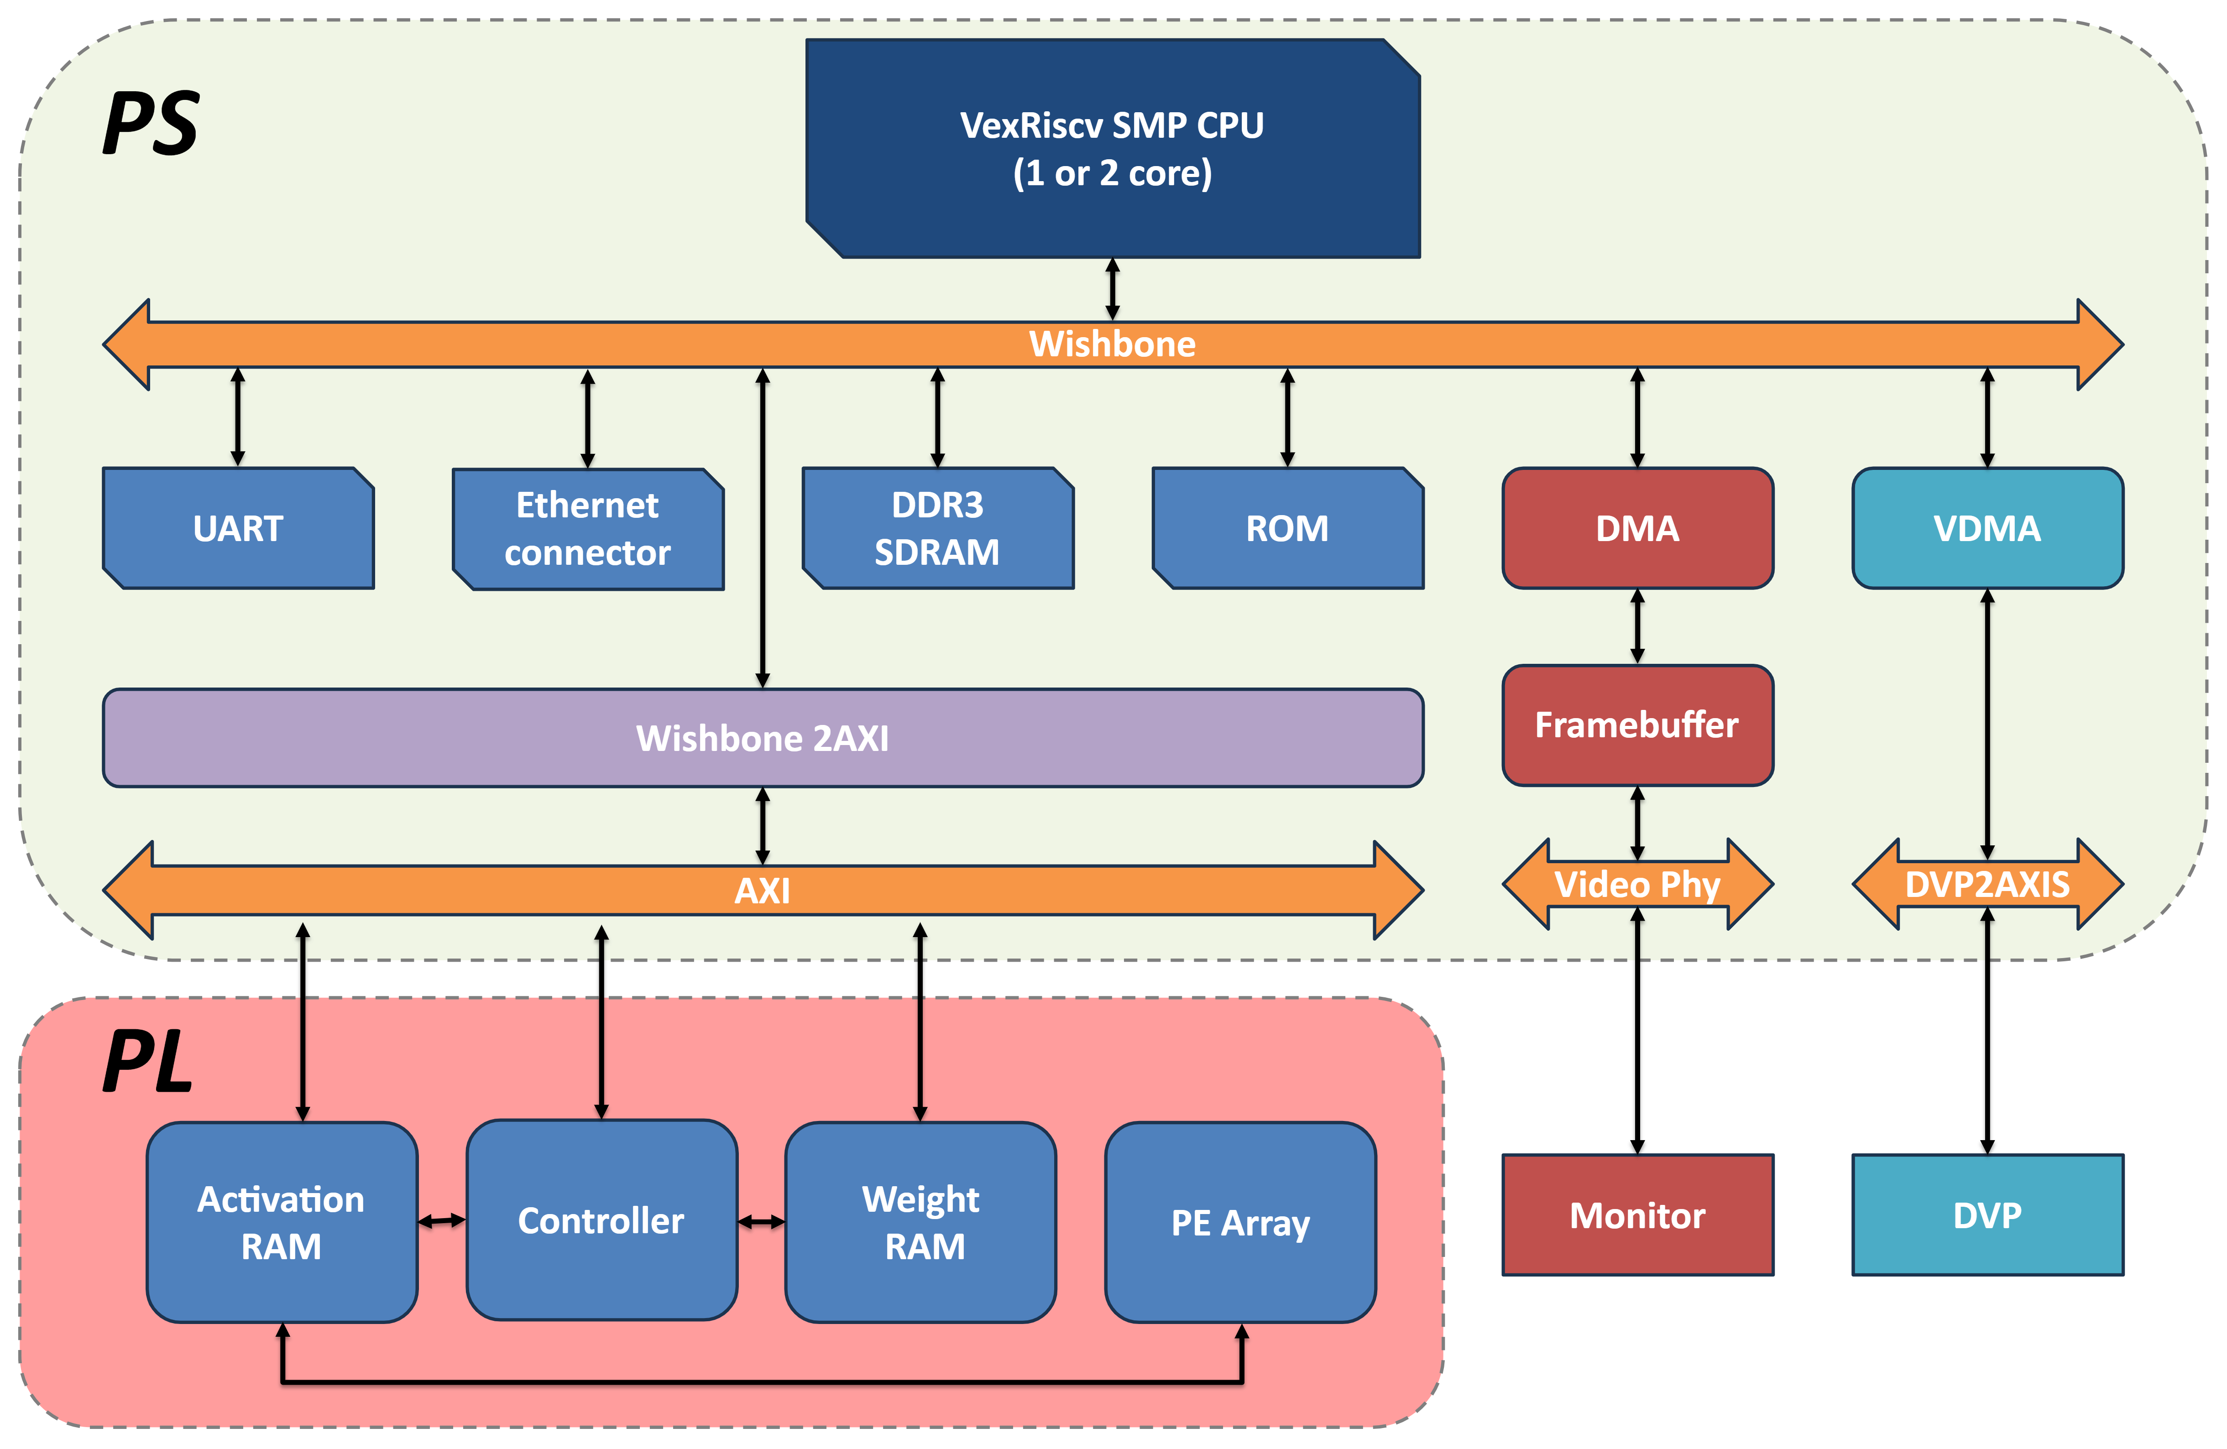

Arty A7 System
DMA get the classification result and store into the frame buffer and display on the monitor
Stage 1 Face Detection &
Stage 2 Face Classifiaction
Video
out
in
/
PS control peripheral & SOC
Transfer exe, bitstream through Ethernet Connector、UART
PL control the Hardware Accelerator
Hardware Accelerator accelerate the CONV, FC, POOLING
VDMA get the DVP input image store into the DMA
Design Advantage:
Low Power: 1.5980 mW
Low area: 490206.250511 total cell
High Accurancy: 100% YOUR_DATA
YOUR DATA
Hardware System

Slide 5
System
Partition | Task | Description
SW | Dataset & Augmentation | Collect and augment dataset (e.g., random crop, flip, color jitter)
SW | Model Training | Train the model from scratch or fine-tune a pre-trained model
SW | Transfer Learning | Adapt a pre-trained model to the target face datase
SW | Quantization | Convert FP32 weights to INT8 for efficient inference
SW | Export Quantized Model | Export the quantized model for FPGA
HW | Stage 1: Face Detection | Detect faces and generate ROIs (Regions of Interest) for the next stage
HW | Stage 2: Face Classification | Classify each ROI (e.g., identity, expression, gender, age)

Slide 6
Model Training
  Dataset / Training：
    Input image size：3 x 50 x 50
    Total Class:11 classes
    (YOUR_DATA, p1 ~ p9, unknown)
    Train: 880
    Valid: 110
    Test: 110
    Model variant: balanced
    Training parameters: 16,946
  Model Architecture：
    Layer Operation
    Conv1_1 Conv2d 3→8, K=5, P=1
    Conv1_2 Conv2d 8→12, K=5, P=1
    Pool1 MaxPool 2×2
    Conv2_1 Conv2d 12→12, K=3, P=1
    Conv2_2 Conv2d 12→24, K=3, P=1
    Pool2 MaxPool 2×2
    Conv3 Conv2d 24→8, K=1
    FC Linear 968→10

Slide 7
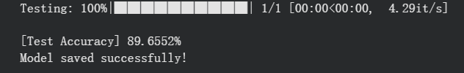
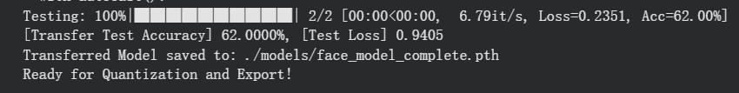
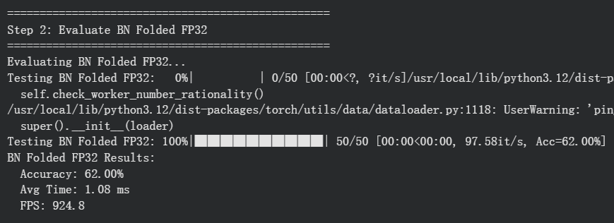
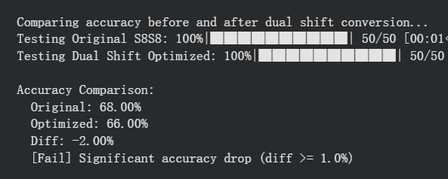
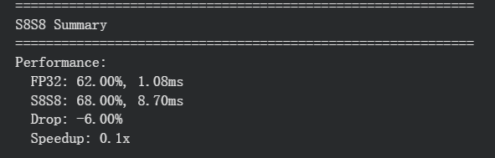
Model Training
  Webface Training Accuracy：89.6552%
  Transfer Learning Test accuracy：62.00%
  Quantization Accuracy
    FP32 BN-folded: 62.00%
    S8S8 quantized: 68.00%
    Dual-shift optimized: 66.00%

Slide 8
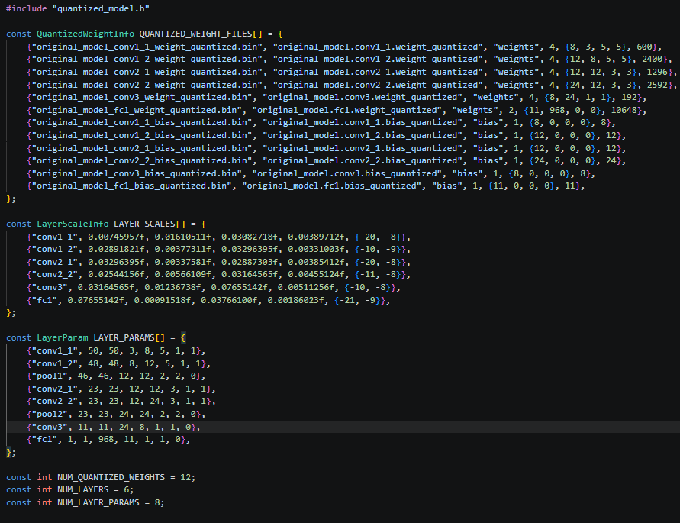
Model Training
Conv1={50, 50, 3, 8, 5, 1, 1}
Conv2={48, 48, 8, 12, 5, 1, 1}
Pool1={46, 46, 12, 12, 2, 2, 0}
Conv3={23, 23, 12, 12, 3, 1, 1}
Conv4={23, 23, 12, 24, 3, 1, 1}
Pool2={23, 23, 24, 24, 2, 2, 0}
Conv5={11, 11, 24, 8, 1, 1, 0}
FC1={1, 1, 968, 11, 1, 1, 0}

Slide 9
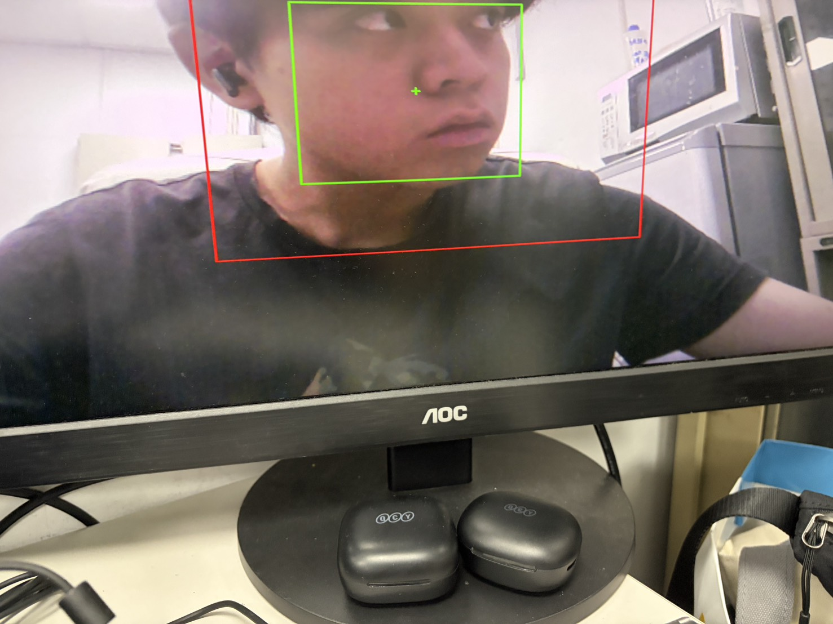
Stage1 Detection & Stage2 Recognition
Utilizing the Video In & Out model, the monitor displays the detection Region of Interest (ROI) in green. This setup precisely identifies the face's location within the designated boundary (red square), which is pre-defined in the common.h configuration file

Slide 10
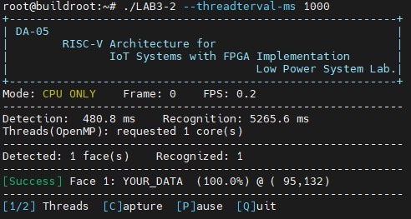
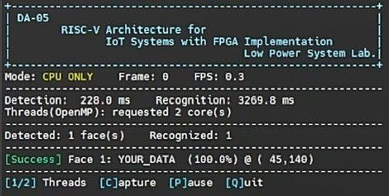
Single Core & Dual Core
single-core
After inferencing the single-core and dual-core results, we achieved 100% accuracy for both of them. The total inference time is 5746.4 ms for single-core, and 3497.8 ms for dual-core.
Recognition time improves from 5265.6 ms to 3269.8 ms, about 1.61 x speedup.
dual-core

Slide 11
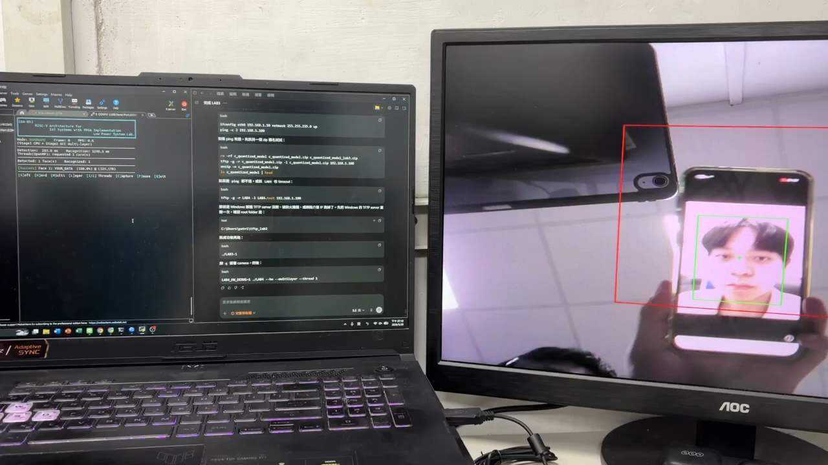
Demo

Slide 12
Hardware Accelerator
Block | Purpose | Implementation / Modification
PE | Executes the core INT8 Multiply-Accumulate (MAC) operations | PE.v implements signed INT8 multiplication and accumulation, serving as the fundamental arithmetic unit for Convolution and Fully-Connected (FC) layers.
Datapath | Provides parallel computing capabilities to accelerate MAC workloads. | Accelerator_datapath.v cascades 8 PEs in parallel, enabling simultaneous processing of eight INT8 data.
Controller FSM | Manages the execution flow and scheduling across different network layers. | Accelerator_controller.v switches its Finite State Machine (FSM) based on operational modes (CONV, POOL, FC). It coordinates BRAM read operations, computation pipelines, result packing, and memory writebacks.
FC Writeback Fix | Resolves timing and synchronization issues during the final output stage of the Fully-Connected layer. | Introduces and modifies the ST_FC_WRITE_HOLD state to guarantee that the FC results are securely committed to BRAM0.
BRAM0 / BRAM1 | store feature map、output、weight/bias | BRAM0 is dedicated to storing input, intermediate, and output feature maps, while BRAM1 stores weights and biases. The accelerator core streams data from these memories and writes back the computed results.
BRAM Access Mux | Prevents resource contention between the AXI-Stream interface and the accelerator core. | Accelerator.v utilizes multiplexers (Muxes) to dynamically arbitrate BRAM access between the AXIS Writer, Reader interfaces and the accelerator core.
Single-port SRAM Mapping | Adapts the design for ASIC synthesis compliance and fulfills standard SRAM macro deployment constraints. | dual_port_bram.v replaces the behavioral BRAM models with TSMC 16nm single-port SRAM macros.
SRAM Banking | Pools multiple single-port SRAM macros together to construct a larger aggregated memory space. | Each dual_port_bram wrapper instantiates 64 SRAM banks. Across both BRAM instances, a total of 128 SRAM macros are utilized.

Slide 13
Hardware Accelerator
Performance gain
  8‑way parallel 8‑bit MACs up to 8× throughput, data reuse can be easily in the PE array.
Area & power cost
  Area dominated by 8 multipliers, accumulators. Power mainly from BRAM accesses and PE switching. Dynamic power is reduced by clock‑gating‑like controls (bram_ce, dp_input_valid only when needed).
Trade‑off
  modest area trade inference speedup ideal for resource‑constrained edge devices and meanwhile lower the power .

Slide 14
Hardware Accelerator
Layer | Operation | Total MACs | Runtime | HW/SW
Conv1 | Conv2d(3, 8, K=5, padding=1), out 48x48 | 1,382,400 | 5,721,111 cycles / 81.730 ms | HW
relu1 | ReLU | 0 | included in Conv1 | HW fused
Conv2 | Conv2d(8, 12, K=5, padding=1), out 46x46 | 5,078,400 | 20,408,451 cycles / 291.549 ms | HW
relu2 | ReLU | 0 | included in Conv2 | HW fused
Pooling | MaxPool1, out 23x23x12 | 0 | 83,319 cycles / 1.190 ms | HW
Conv3 | Conv2d(12, 12, K=3, padding=1), out 23x23 | 685,584 | 2,714,499 cycles / 38.779 ms | HW
relu3 | ReLU | 0 | included in Conv3 | HW fused
Conv4 | Conv2d(12, 24, K=3, padding=1), out 23x23 | 1,371,168 | 5,429,007 cycles / 77.557 ms | HW
relu4 | ReLU | 0 | included in Conv4 | HW fused
Pooling | MaxPool2, out 11x11x24 | 0 | 38,127 cycles / 0.545 ms | HW
Conv5 | Conv2d(24, 8, K=1, padding=0), out 11x11 | 23,232 | 106,592 cycles / 1.523 ms | HW
relu5 | ReLU | 0 | included in Conv5 | HW fused
FC | Linear(968, 11) | 10,648 | 7,764 cycles / 0.111 ms | HW

Slide 15
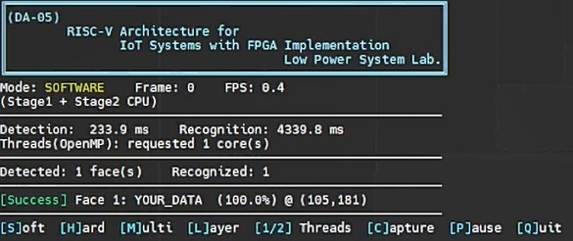
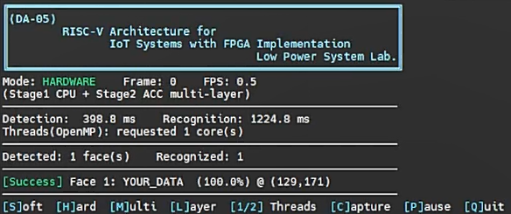
Hardware Accelerator
software
After inferencing the software and hardware results, we achieved 100% accuracy for both software and hardware. The total inference time is 4573.7 ms for software, and 1623.6 ms for hardware.
Recognition time improves from 4339.8 ms to 1224.8 ms, about 3.54x speedup.
hardware

Slide 16
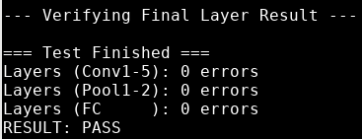
Synthesis Report
golden pattern 比對結果

Slide 17
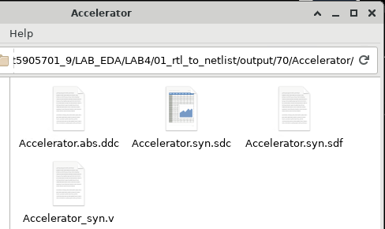
Synthesis Report
Synthesis file

Slide 18

Synthesis Report
Timing report(slack > 0)

Slide 19
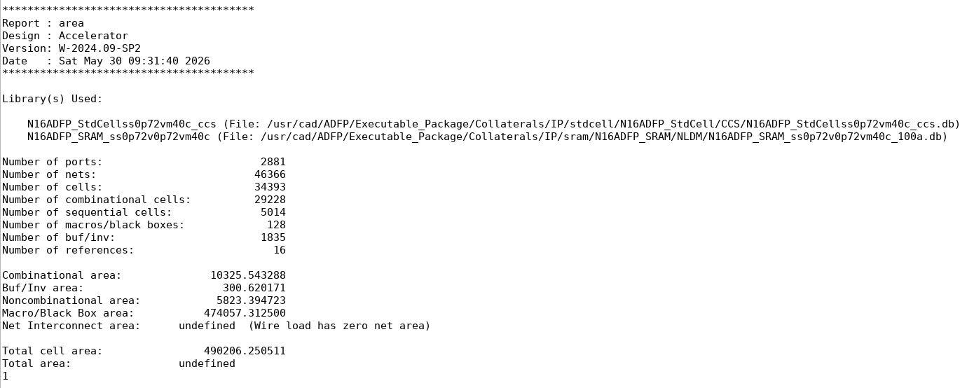
Synthesis Report
Area report

Slide 20
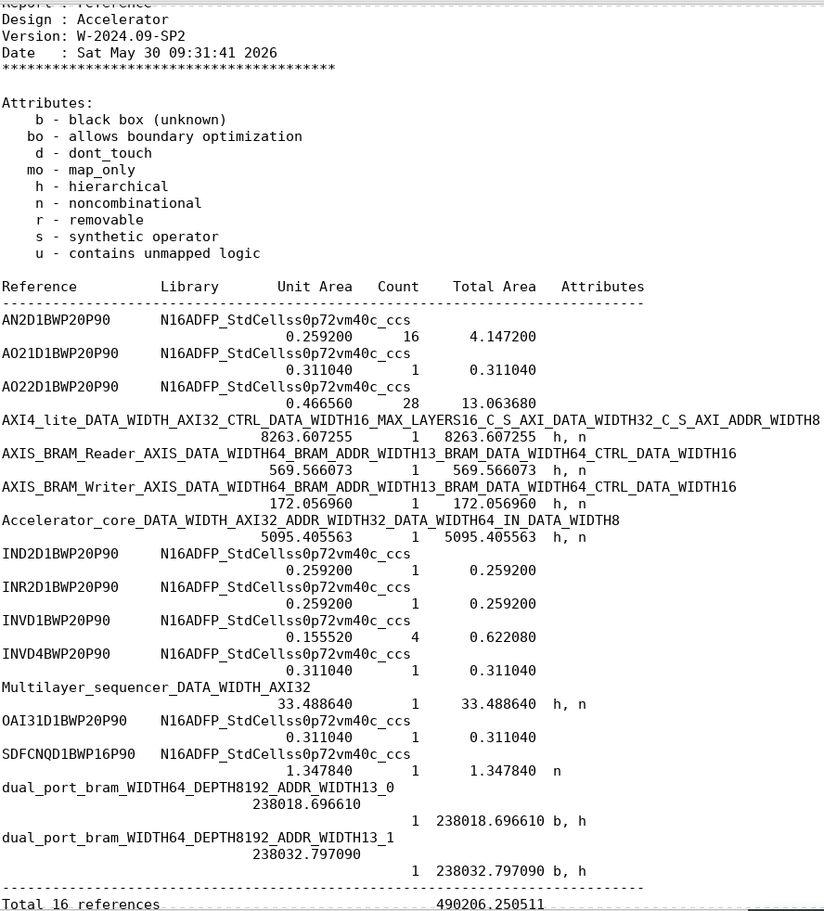
Synthesis Report
Area report

Slide 21
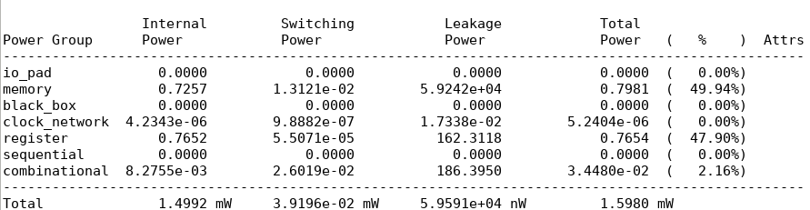
Synthesis Report
Power report

Slide 22
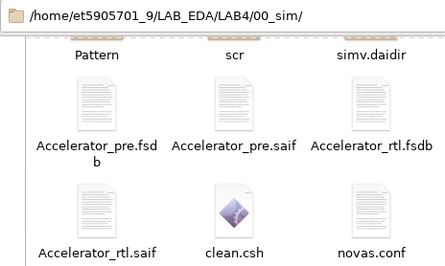
RTL sim & Pre sim
RTL sim & Pre sim file

Slide 23
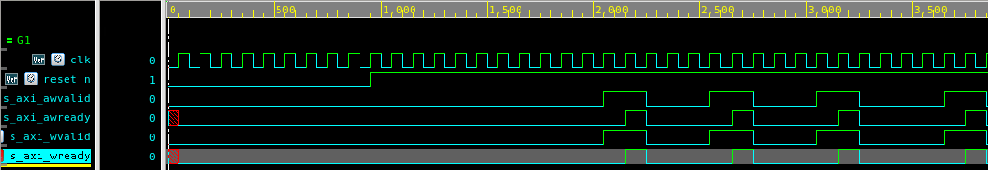
RTL sim & Pre sim
RTL sim
Pre sim

Slide 24
Result Summary
Metrics | Hardware Accelerator
Clock Speed | 70 MHz
Total cell area | 490206.250511
SRAM macros | 128
Total power | 1.5980 mW
Simulation | PASS
Metrics | Single core | Dual core | Software | Hardware
Accuracy | 100 % | 100% | 100 % | 100%
Inference time (ms) | 5746.4 | 3497.8 | 4573.7 | 1623.6 (x2.817)
Inference result compare
Synthesis result

Slide 25

Conclusion
Through this project, we successfully explored the comprehensive flow of SoC and ASIC design. Although there is still room for performance optimization, we gained invaluable insights into CNN acceleration techniques, including model quantization, multi-core scalability, and custom accelerator architecture. Notably, our design achieved outstanding efficiency in maintaining low power consumption, providing us with a solid foundation for tackling complex hardware designs in the future.

Slide 26
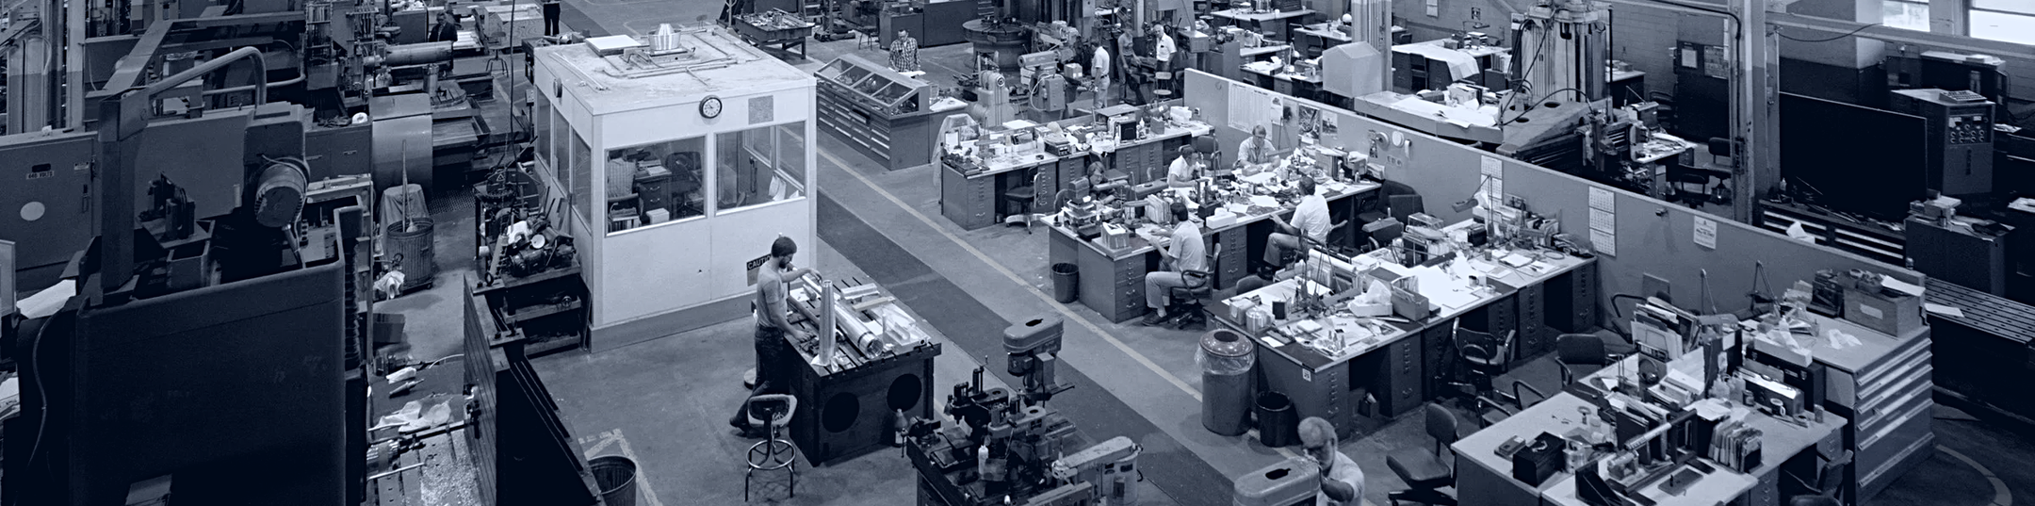
THANKS FOR YOUR ATTENTION
15

