Slide 1
SQL-Based Analysis for Finance, Customers, Markets & Product Insights
SQL Project

Slide 2
About the Company
AtliQ Hardware operates globally as a premium manufacturer of high-performance computer parts and accessories
Their market presence spans across APAC, EU, NA, and LATAM, delivering a wide range of products—from CPUs and motherboards to SSDs, RAM, and peripherals like keyboards and monitors
With a strong focus on quality and innovation, AtliQ serves both individual and business clients with robust computing solutions

Slide 3
Challenges & Goals
Increasing inefficiencies due to bloated Excel files
New junior analysts being hired to scale data capabilities
Migrating to MySQL for better data management and analysis
Aiming to optimize business decisions, streamline processes, and boost overall performance

Slide 4
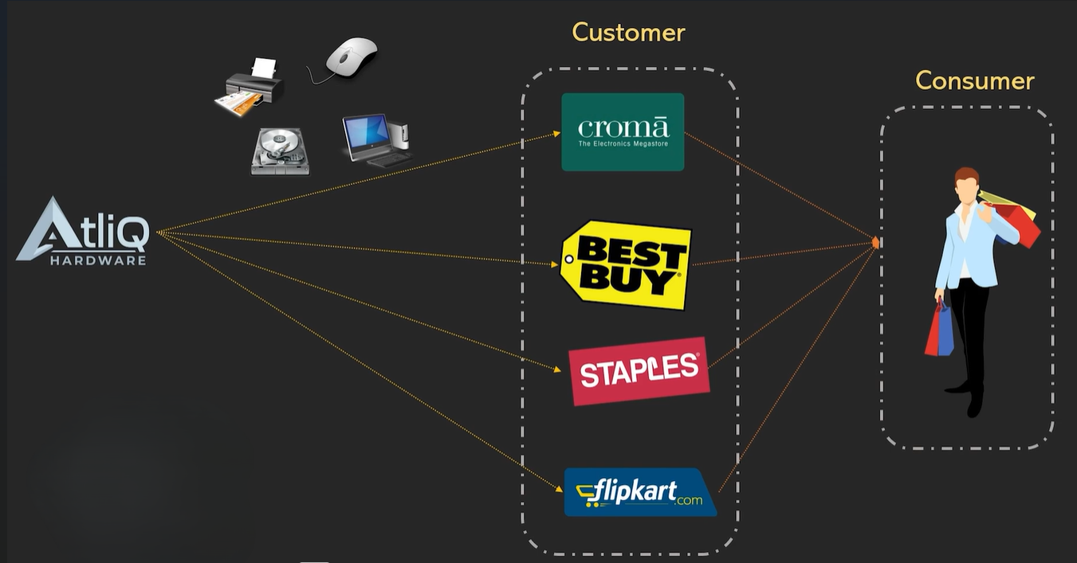

AtliQ Business Structure

Slide 5
Assignment: 1
In order to track individual product sales and perform additional product analytics on it using Excel, I, as the product owner, would like to create a report of Croma India customers' sales of individual products (aggregated monthly at the product code level) for FY-2021. The following fields should be included in the report:
1. Month
2. Product Name
3. Variant
4. Sold Quantity
5. Gross Price Per Item
6. Gross Price Tota1

Slide 6
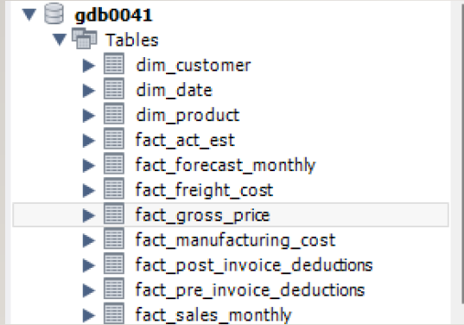
Database
Imported one million rows of data into a MySQL database(gdb0041) and performed various SQL queries.
Examined multiple tables to extract and demonstrate key SQL concepts.

Slide 7
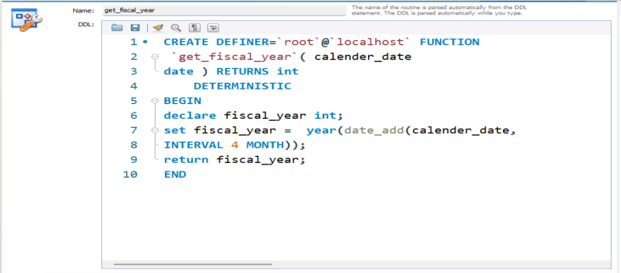
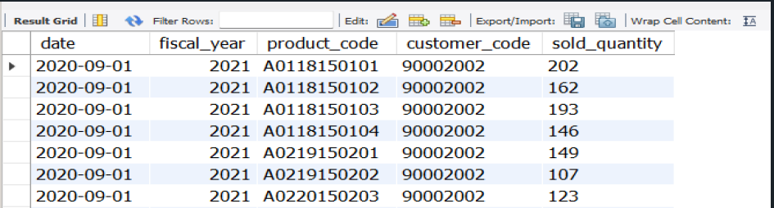
FINANCE ANALYSIS
Define a function called get_fiscal_year that returns the fiscal year for a given date.
Query: SELECT * FROM fact_sales_monthly WHERE customer_code=90002002 AND get_fiscal_year(date)=2021 ORDER BY date ascLIMIT 100000;

Slide 8
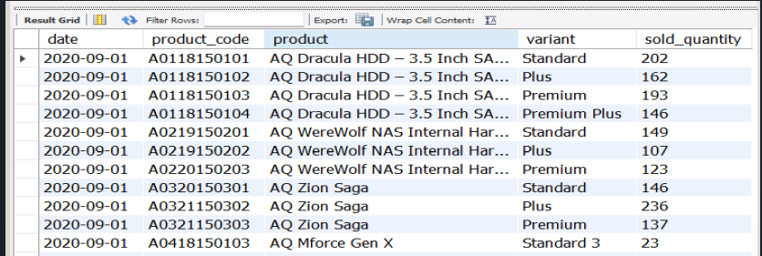
Gross Sales Report: Monthly Product Transactions
1. Perform joins to pull product information
SELECT
s.date, s.product_code, p.product, p.variant, s.sold_quantity
FROM fact_sales_monthlys JOIN dim_productp
ON s.product_code = p.product_code
WHERE customer_code= 90002002 AND get_fiscal_year(date)=2021 LIMIT 1000000;

Slide 9
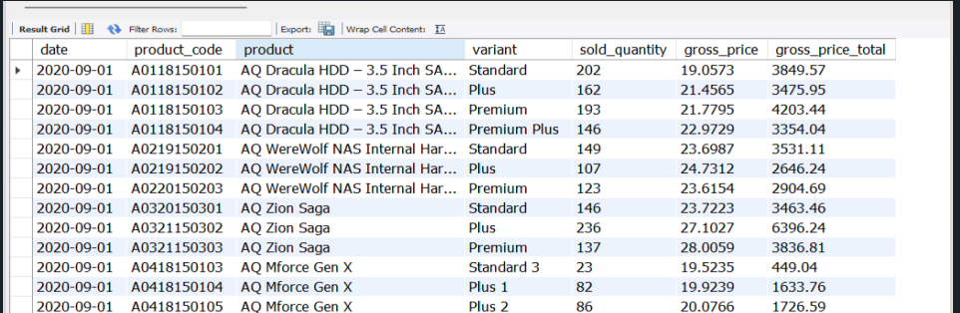
2. Performing join with 'fact_gross_price' table with the above query and generating required fields
SELECT
s.date, s.product_code, p.product, p.variant, s.sold_quantity, g.gross_price, ROUND(s.sold_quantity*g.gross_price,2) as gross_price_total
FROM fact_sales_monthlys
JOIN dim_productp ON s.product_code=p.product_code
JOIN fact_gross_priceg ON g.fiscal_year=get_fiscal_year(s.date) AND g.product_code=s.product_code
WHERE customer_code=90002002 AND get_fiscal_year(s.date)=2021
LIMIT 1000000;

Slide 10
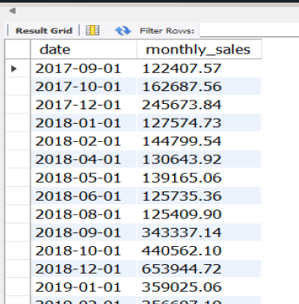
Generate monthly gross sales report for Croma India for all the years
SELECT s.date, SUM(ROUND(s.sold_quantity*g.gross_price,2)) as monthly_sales
FROM fact_sales_monthlys
JOIN fact_gross_priceg ON g.fiscal_year=get_fiscal_year(s.date) AND g.product_code=s.product_code
WHERE customer_code=90002002 GROUP BY date;

Slide 11
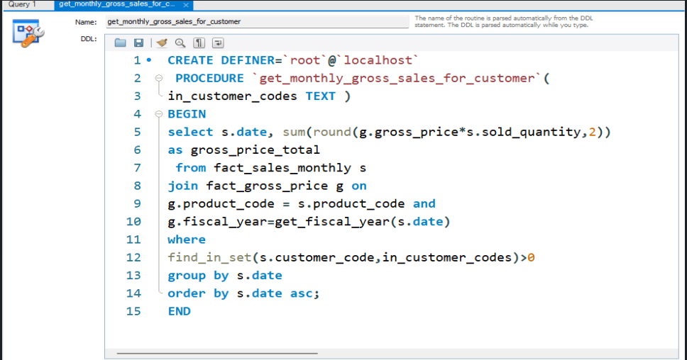
Stored Procedures: Monthly Gross Sales Report Generate monthly
Gross sales report for any customer using stored procedure

Slide 12
Assaignment : 2
1.Report For Top market
2. Report for Top products
3. Report for Top customers

Slide 13
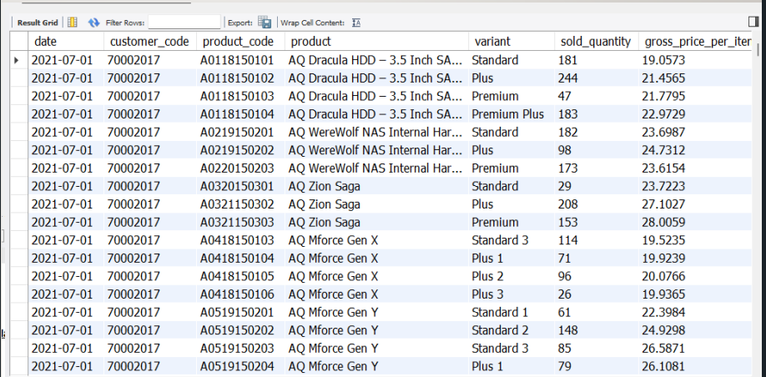
Problem Statement and Pre-Invoice Discount Report
Include pre-invoice deductions in Croma detailed report
SELECT s.date, s.product_code, p.product, p.variant, s.sold_quantity, g.gross_priceas gross_price_per_item, ROUND(s.sold_quantity*g.gross_price,2) as gross_price_total, pre.pre_invoice_discount_pct
FROM fact_sales_monthlys JOIN dim_productp
ON s.product_code=p.product_codeJOIN fact_gross_priceg
ON g.fiscal_year=get_fiscal_year(s.date)
AND g.product_code=s.product_code
JOIN fact_pre_invoice_deductions as pre ON pre.customer_code= s.customer_code AND pre.fiscal_year=get_fiscal_year(s.date) WHERE s.customer_code=90002002 AND get_fiscal_year(s.date)=2021 LIMIT 1000000;

Slide 14
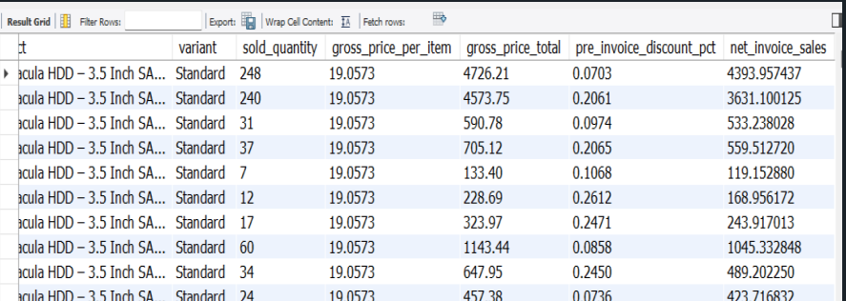
Database Views
Get the net_invoice_salesamount using the CTE’s
WITH cte1 AS (
SELECT
s.date, s.customer_code, s.product_code, p.product, p.variant, s.sold_quantity,
g.gross_price as gross_price_per_item,
ROUND(s.sold_quantity*g.gross_price,2) as gross_price_total, pre.pre_invoice_discount_pct
FROM fact_sales_monthlys
JOIN dim_product ON s.product_code=p.product_code
JOIN fact_gross_priceg ON g.fiscal_year=s.fiscal_year AND g.product_code=s.product_code
JOIN fact_pre_invoice_deductionsas pre ON pre.customer_code= s.customer_code
AND pre.fiscal_year=s.fiscal_yearWHERE s.fiscal_year=2021)
SELECT *, (pre_invoice_discount_pct*gross_price_total) as net_invoice_sales FROM cte1

Slide 15
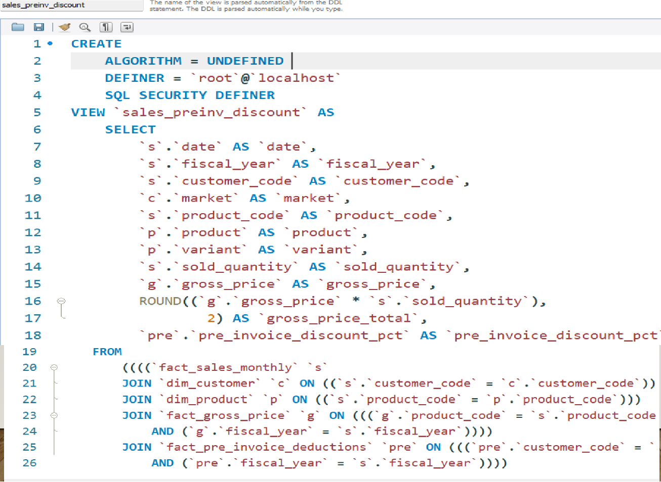
Creating the view `sales_preinv_discount` and store all the data in like a virtual table

Slide 16
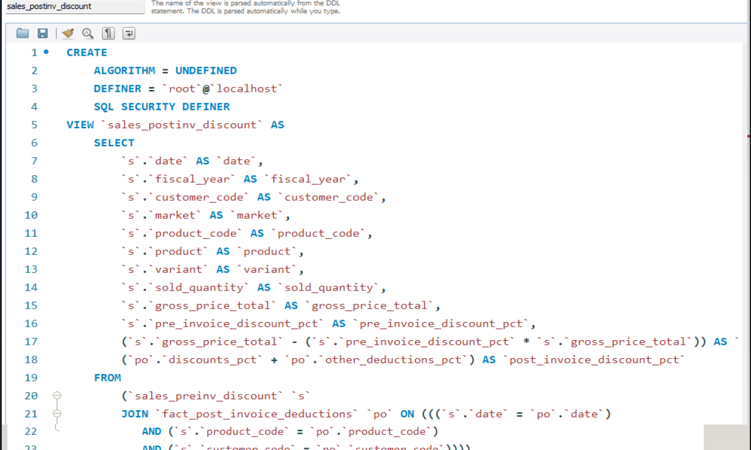
Database Views: Post Invoice Discount, Net Sales

Slide 17
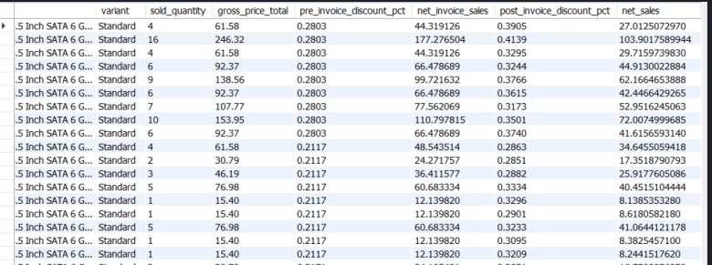
Create a report for net sales
SELECT *,net_invoice_sales*(1-post_invoice_discount_pct) as net_sales
FROM gdb0041.sales_postinv_discount;
--Finally creating the view `net_sales` which inbuiltly use/include all the previous created view and gives the final result
CREATE VIEW `net_sales` AS
SELECT *, net_invoice_sales*(1-post_invoice_discount_pct)
as net_sales FROM gdb0041.sales_postinv_discount;

Slide 18
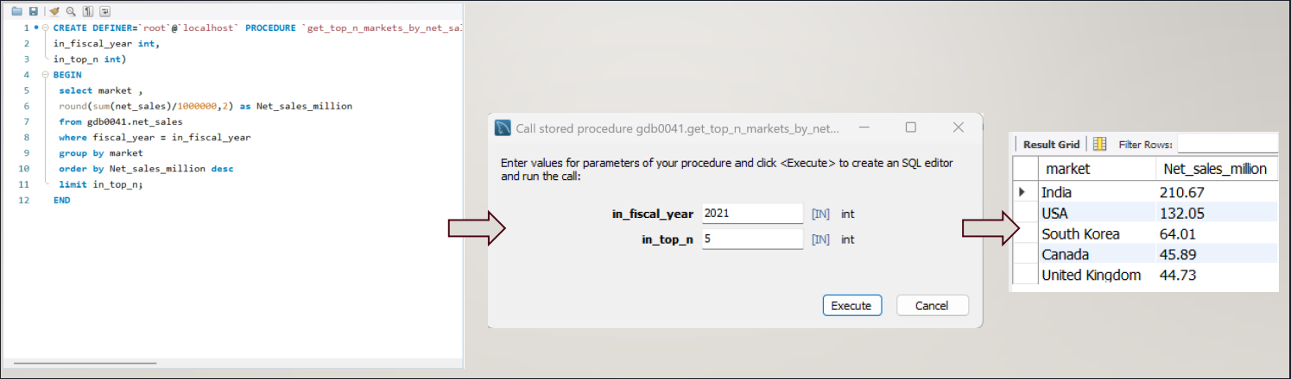
Stored proc to get top n markets by net sales for a given year

Slide 19
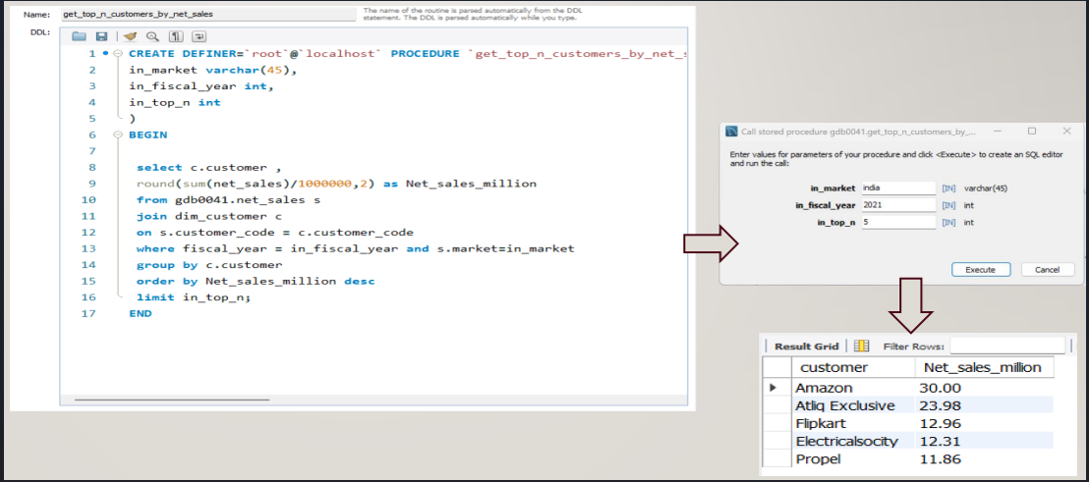
Stored procedure that takes market, fiscal_year and top n as an input and returns Top n customers by net

Slide 20
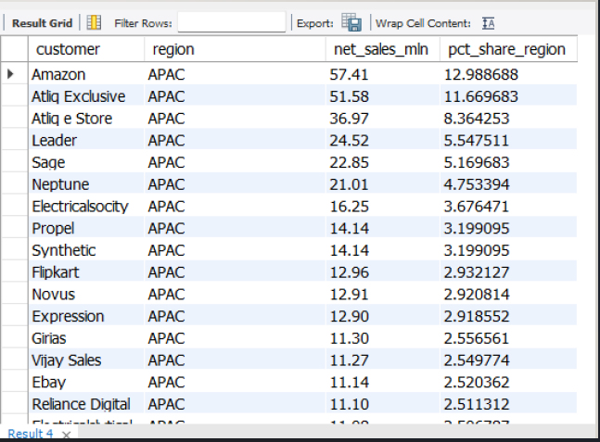
Window Functions: OVER Clause
Find customer wise net sales distribution per region for FY 2021.
with cte1 as (
select
c.customer,
c.region,
round(sum(net_sales)/1000000,2) as net_sales_mln
from gdb0041.net_sales n
join dim_customer c
on n.customer_code=c.customer_code
where fiscal_year=2021
group by c.customer, c.region)
select *, net_sales_mln*100/sum(net_sales_mln) over (partition by region)
as pct_share_region from cte1 order by region, pct_share_region desc

Slide 21
WINDOW FUNCTIONS: ROW_NUMBER, RANK, DENSE_RANK
FIND OUT TOP 3 PRODUCTS FROM EACH DIVISION BY TOTAL QUANTITY SOLD IN A GIVEN YEAR
with cte1 as
(select
p.division,
p.product,
sum(sold_quantity) as total_qty
from fact_sales_monthly s
join dim_product p
on p.product_code=s.product_code
where fiscal_year=2021
group by p.product),
cte2 as
(select
*,
dense_rank() over (partition by division order by total_qty desc) as drnk
from cte1)
select * from cte2 where drnk<=3

Slide 22
CREATING STORED PROCEDURE FOR THE ABOVE QUERY
CREATE PROCEDURE `get_top_n_products_per_division_by_qty_sold`(
in_fiscal_year INT,
in_top_n INT
)
BEGIN
with cte1 as (
select
p.division,
p.product,
sum(sold_quantity) as total_qty
from fact_sales_monthly s
join dim_product p
on p.product_code=s.product_code
where fiscal_year=in_fiscal_year
group by p.product),
cte2 as (
select *,
dense_rank() over (partition by division order by total_qty desc) as drnk
from cte1)
select * from cte2 where drnk <= in_top_n;
END

