Slide 1

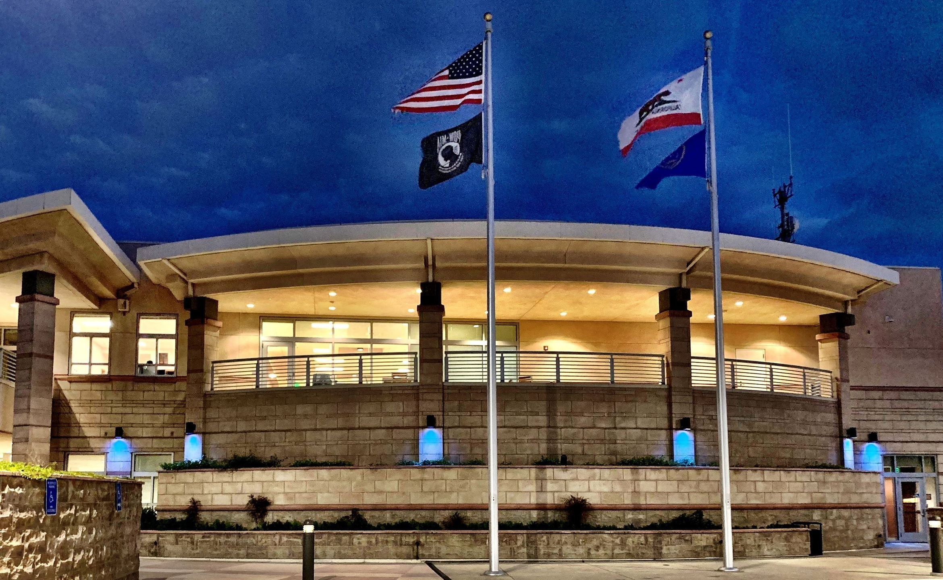


REAL TIME
INFORMATION CENTER
STUDY SESSION OCTOBER 2026
San Mateo Police Department

Slide 2
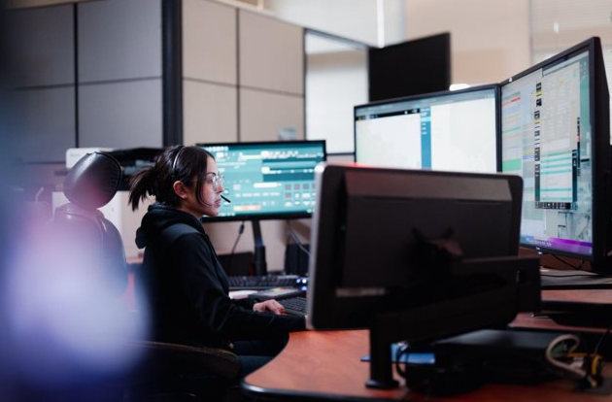
AGENDA
I. Introduction
Chief Ed Barberini
II. RTIC Overview
Police Technical Services Administrator Kelly O’Keefe
III. ALPR Technology
Lieutenant Stephan Casazza
IV. Drone as a First Responder
Lieutenant Anthony Riccardi
V. Closing Remarks
Chief Ed Barberini

Slide 3
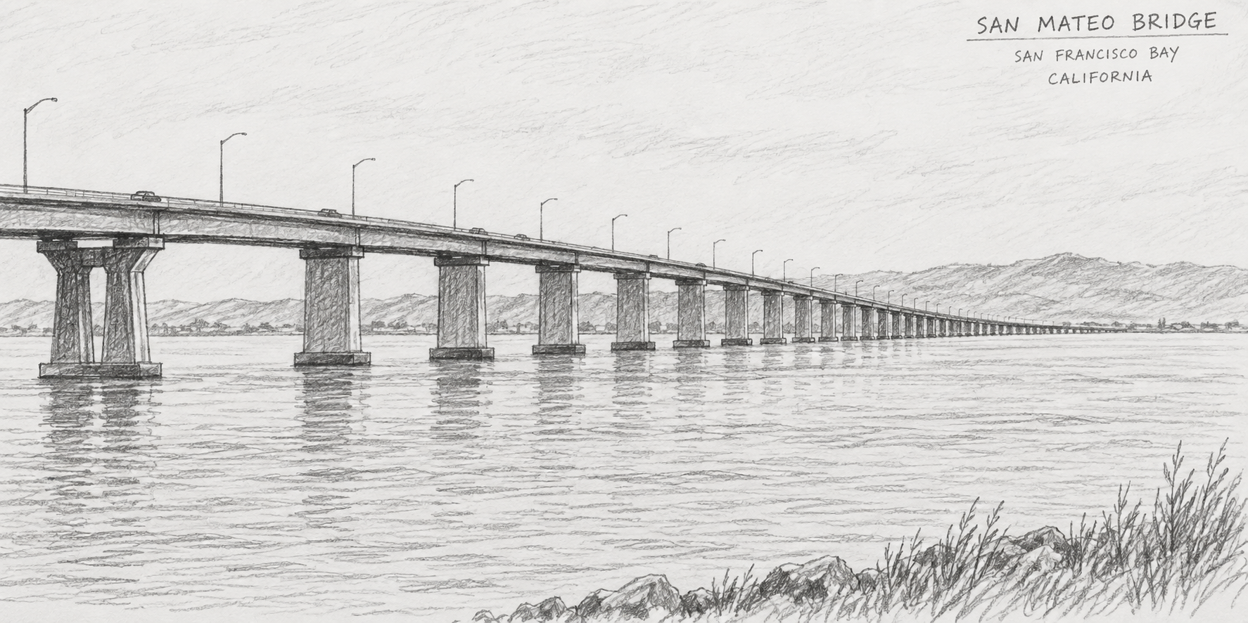
Who are we?
Think of it as a high-tech command center that bridges the gap between data and frontline action — turning raw information into something officers can use right now to stay safe and be more effective.

Slide 4

ELEMENTS OF AN RTIC
ALPR
INTELLIGENCE
Property crime is one of the most prevalent issues impacting communities within the bay area. Stolen vehicles often go hand in hand with package theft, retail theft, and robberies.
The real time operators are well versed in various intelligence databases and tactics. Timely intelligence allows for officers to identify safety risks and respond more prepared.
FUSUS
Integrating Department drones and public cameras allows the real time information center to get eyes on an active scene within seconds of the call for service - preserving resources and preparing officers for unfolding incidents.

Slide 5
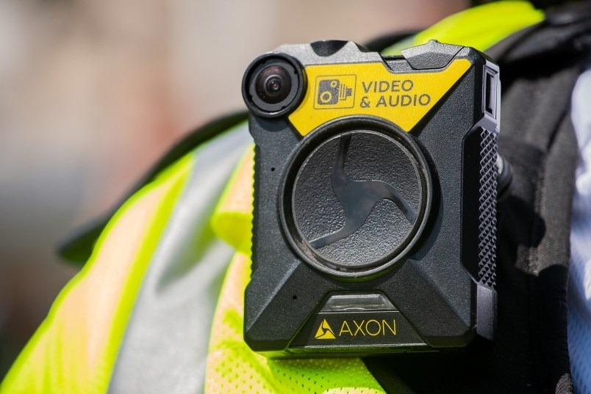
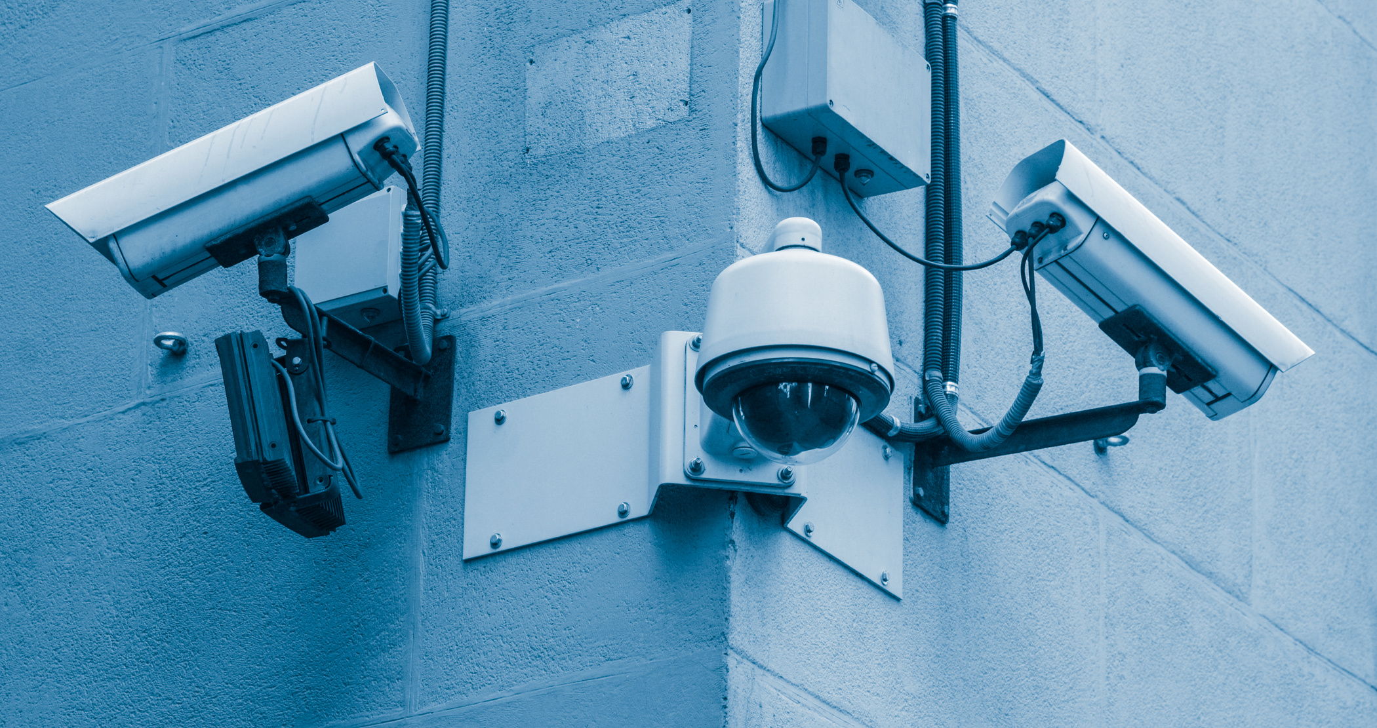
Video Technology in Fusus
Body Worn Cameras
Operators can monitor officer’s body worn cameras in real time. When an officer responds to an incident and is thrust into an active situation, the operator can monitor their cameras until their cover responds. This enables a level of officer safety when situations quickly turn in the field.
City Cameras
RTIC operators utilize city-owned cameras to live stream calls for service and special events. The cameras were strategically placed to bring problem areas into view; helping reduce vandalism and other crimes occurring on City-owned property.

Slide 6



Intelligence
Work directly with the reporting parties to get cell phone videos and pictures.
Utilize police databases to retrieve intel within moments of receiving the call- even before an officer arrives on scene.
Work with field personnel to strategize best use for the operators during preplanned events.
COMMUNICATION
RESEARCH
STRATEGY

Slide 7
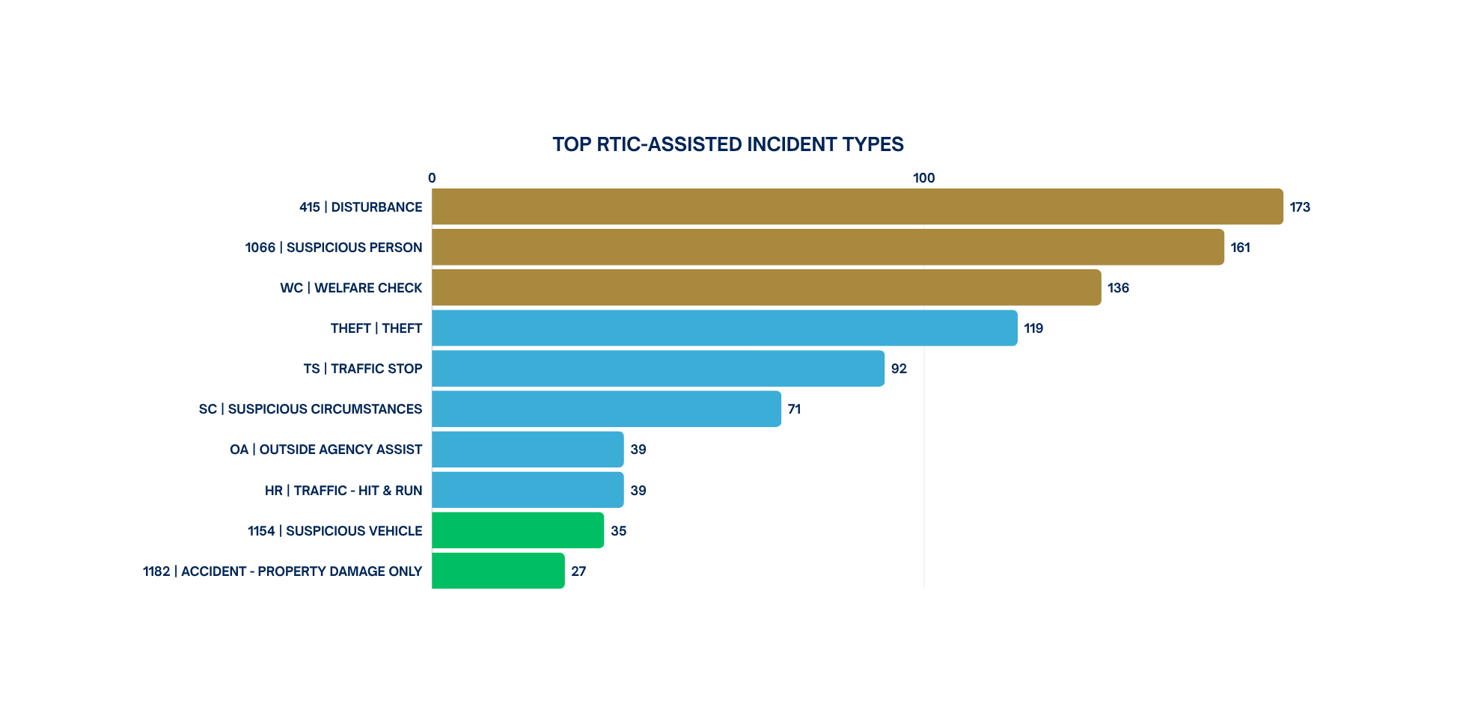
RTIC-Assisted Incidents
Data from 10/24 to 08/26

Slide 8
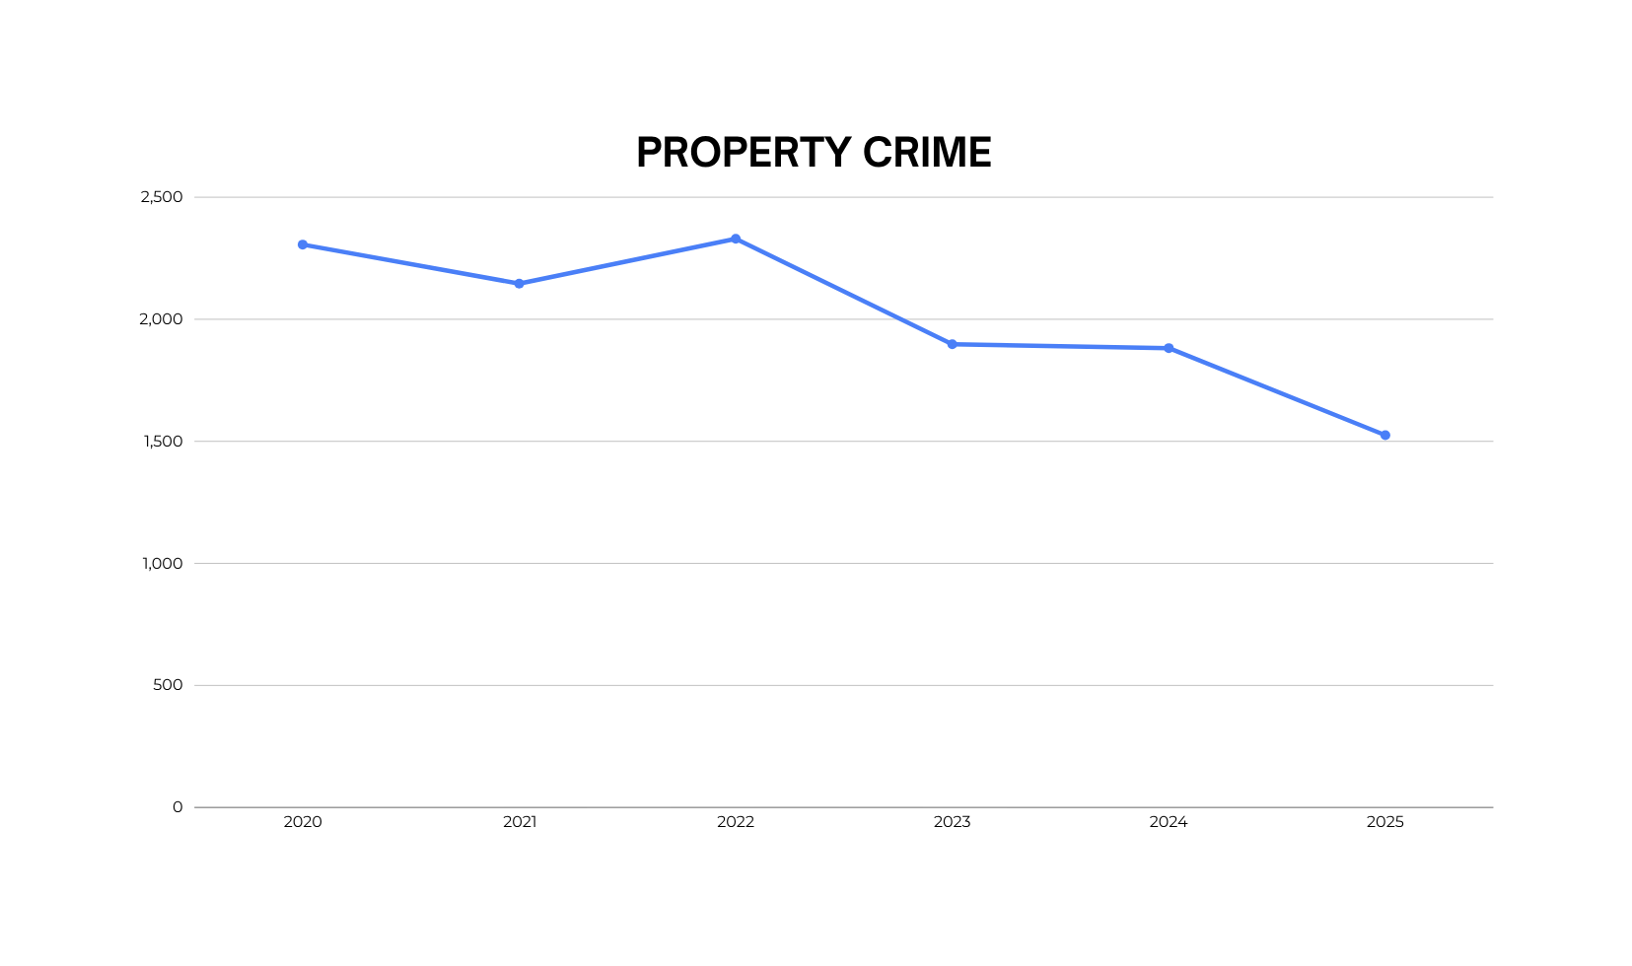
SMPD Five Year Crime Trends
Flock Introduced — End of 2020
RTIC/DFR Launch — 2024
STATE OF CALIFORNIA DEPARTMENT OF JUSTICE - OPENJUSTICE

Slide 9
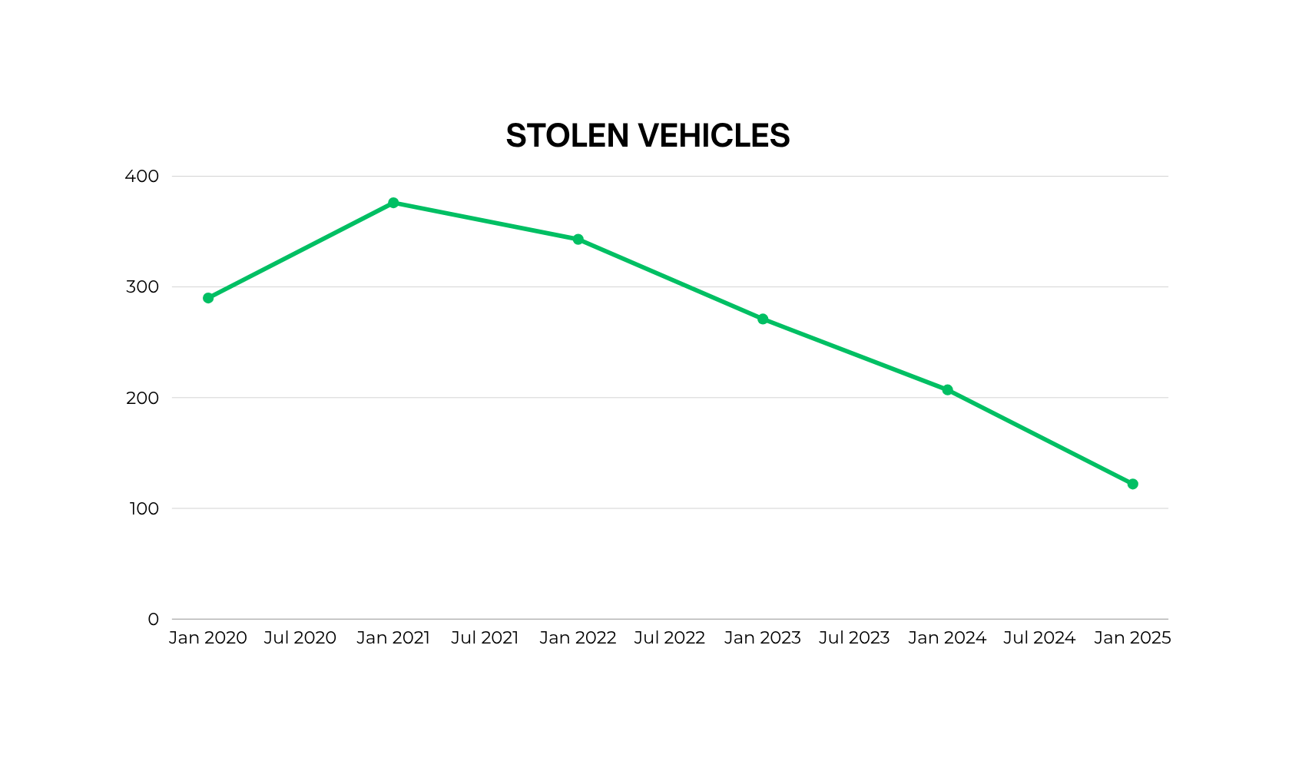
SMPD Five Year Crime Trends
Flock Introduced — 2020
RTIC/DFR Launch — 2024
2020
2021
2022
2023
2024
2025
STATE OF CALIFORNIA DEPARTMENT OF JUSTICE - OPENJUSTICE

Slide 10
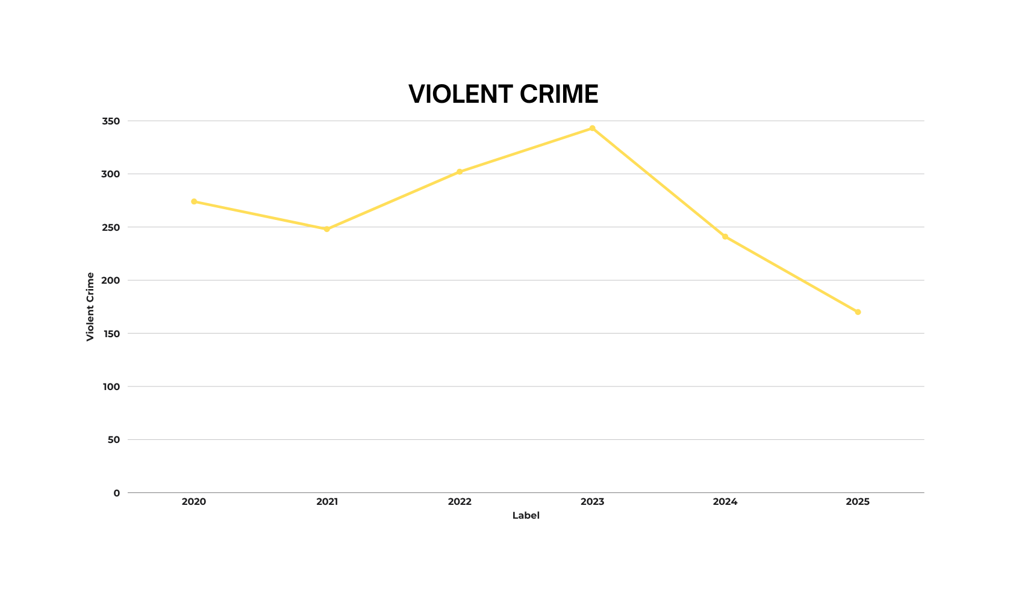
SMPD Five Year Crime Trends
Flock Introduced — 2021
RTIC/DFR Launch — 2024
2020
2021
2022
2023
2024
2025
STATE OF CALIFORNIA DEPARTMENT OF JUSTICE - OPENJUSTICE

Slide 11
RTIC Activity Since October 2024
1,500+
418
339
79%
Incidents Assisted
Cases Generated
Cases with a Criminal Component
Cases with a Suspect Identified
Data from 10/24 to 08/26

Slide 12







Arrest Rates
RTIC-ASSISTED CRIMINAL CASES
DEPARTMENT OVERALL
57%
48%
339 cases with a criminal component
All Department cases during the same period
The two case populations may differ in case type, seriousness, available evidence, or other factors. The rates are shown for descriptive context only; no causal relationship is implied.

Slide 13
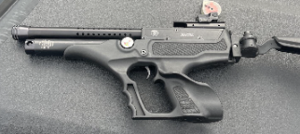
CASE STUDY
01
02
03
04
05
06
Initial Report
Limited Details
RTIC Intervention
Case
Link
Confirmation
Technology
Utilized
Male in a white Jeep driving erratically and pointing a gun at pedestrians.
Officers had minimal information—only a vehicle description.
Operator recognized the suspect’s M.O. from a similar incident the previous month.
Retrieved prior case file, identified license plate, and contacted original reporting party.
Reporting party verified the vehicle through unique identifiers.
Operator used ALPR to locate the vehicle near the scene.
Outcome
Officers located and arrested the suspect; the weapon was a replica firearm.

Slide 14

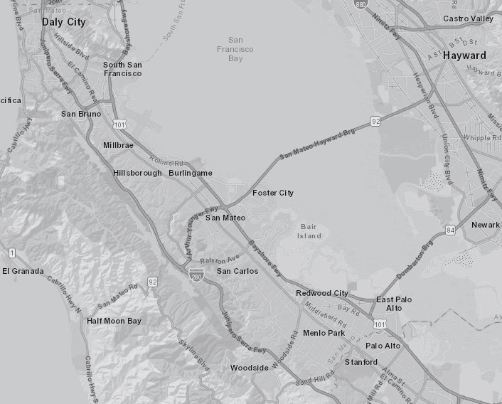
THE FUTURE OF RTIC
Collaboration & Partnerships
Support multi-agency responses and collaborate with other City Departments including Public Works, Community Development, and San Mateo Consolidated Fire.
Data-Driven Strategy
Use trends and incident data to guide patrol deployments and city resource allocation.
Vision Forward
Serve multiple jurisdictions and operate as a regional hub for surrounding agencies
Promote community involvement in the project and continue to establish best practices.

Slide 15
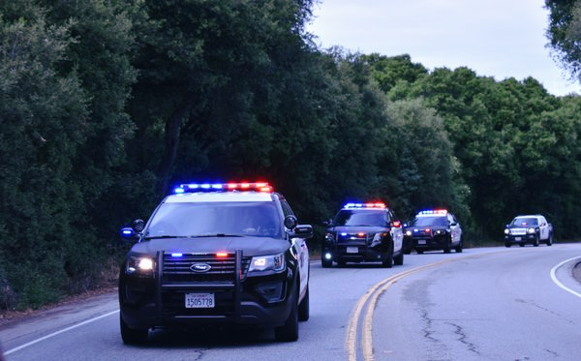
AUTOMATED LICENSE PLATE READER (ALPR) TECHNOLOGY

Slide 16
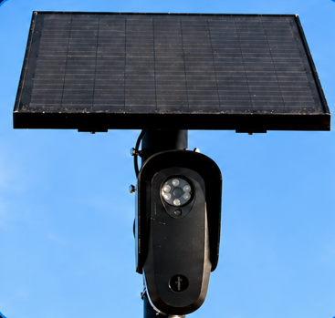
What is an Automated License Plate Reader?
A camera that captures license plates and vehicle characteristics-such as make, color, and body type-along with the date, time, and location of the observation.
HOW THE INFORMATION IS USED
Authorized personnel can search the information to help identify vehicles, generate investigative leads, and enhance public safety.

Slide 17






ALPR Systems Used by San Mateo Police Department
San Mateo Police Department uses both mobile and fixed ALPR technology.
MOBILE
FIXED
MOBILE
AXON FLEET
FLOCK SAFETY
flock safety
AXON
MOBILE ALPR
FIXED ALPR
Installed on equipped patrol vehicles and used while officers are in the field.
Uses stationary cameras strategically placed throughout the community.
KEY FEATURES
KEY FEATURES
  ALPR – Automatically reads license plates encountered by the patrol vehicle and can provide alerts or investigative information.
  Forward-Facing/Dash Camera - Records activity in front of the patrol vehicle, including traffic stops, pursuits, and other incidents.
  In-Car Camera – Captures activity inside the patrol vehicle, including the rear-seat area used for prisoner transport.
  Integrated with Body-Worn Cameras – Fleet and Axon body-worn cameras can operate as part of the same evidence ecosystem, helping coordinate recording and organize associated video evidence.
  Data Sharing - We are not sharing our Axon ALPR data with other agencies.
  ALPR – Captures plates, including partial and temporary plates, along with vehicle information.
  Real-Time Hotlist Alerts – Checks detections against configured/NCIC hotlists and sends alerts when a potential match occurs.
  Vehicle Signature Technology – Searches by make, color, body type, racks, wheels, tool boxes, and other distinguishing features, including cases where a readable plate isn’t available.
  Investigative Search – Searches historical vehicle detections using full/part plate and vehicle characteristics to develop leads.

Slide 18
Flock Safety
66
Total cameras
54
ALPR cameras
12
VMS cameras
(video only)
Stationary cameras provide fixed-location vehicle observations that support real-time alerts and retrospective investigative searches.

Slide 19
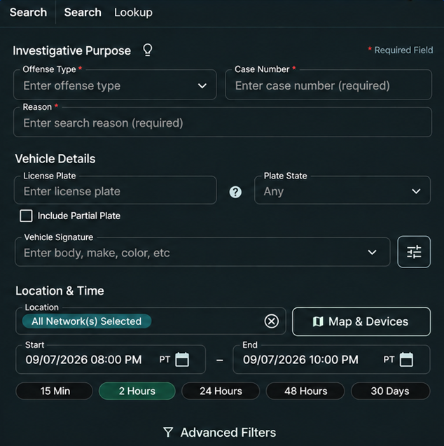
How Does a Flock Search Work?
1. Offense Type
Select the offense type that best matches the investigation.
2. Case Number
Enter the case number to connect the search to the related investigation.
3. Reason for Search
Briefly explain the legitimate law enforcement purpose for accessing ALPR data.
Why do these fields matter?
  Required fields create a clear, reviewable audit trail.
  The audit trail records who conducted the search, what was searched, and the documented purpose.
  This supports accountability, transparency, and compliance with department policy.

Slide 20
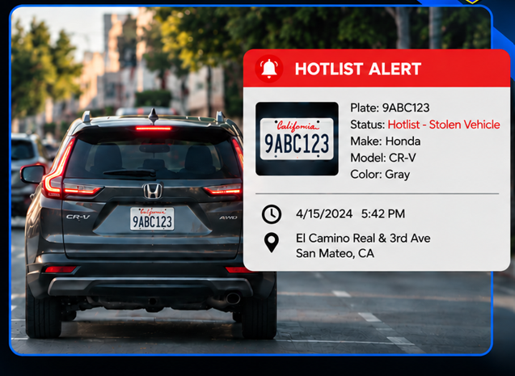
How Do Hotlist Alerts Work?
  Flock cameras automatically compare detected license plates against Hotlist records.
  Hotlists identify vehicles of interest, such as:
    Stolen vehicles
    Wanted vehicles
    Vehicles associated with specific law-enforcement investigations
    Missing/endangered person(s)
  Flock can receive Hotlist information originating from the National Crime Information Center (NCIC).

Slide 21


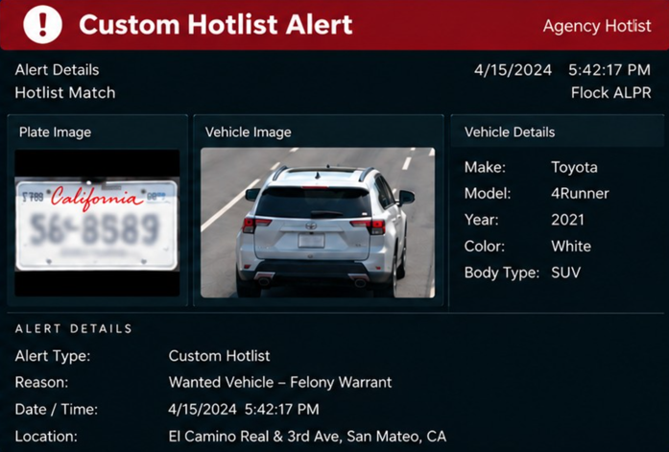



Custom Hotlist Alerts
Agency-created list of vehicles or plates tied to a legitimate law-enforcement purpose.
Entries are manually added by authorized personnel.
May include BOLOs, wanted vehicles, investigative leads, and missing/endangered persons.
Flock cameras automatically check plates and send real-time alerts on matches.

Slide 22
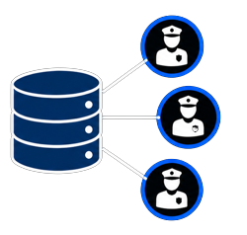
Data Sharing
Local Control
San Mateo PD sets data sharing settings and policies. Nothing is shared unless we choose to share it.
Authorization Required
Any sharing of ALPR data must be specifically authorized by San Mateo PD through a data sharing agreement.
Consistent with Policy and Law
All data sharing agreements must be consistent with San Mateo PD policies and applicable law.
Purpose-Driven
We only share data when it supports legitimate law-enforcement purposes and enhances public safety.

Slide 23
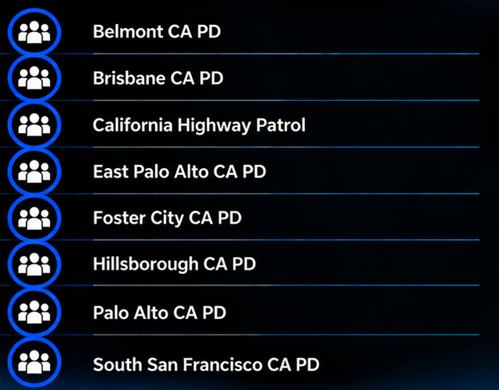
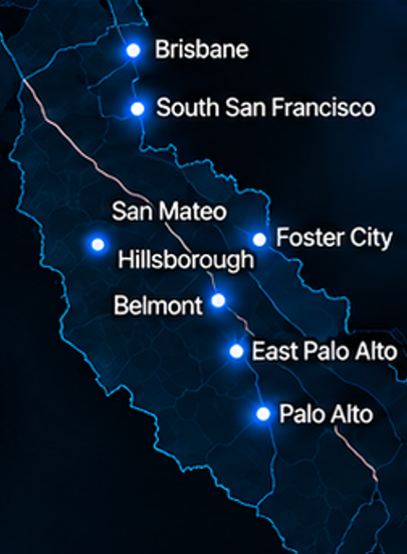
Network Data Sharing
The organizations below have been granted access to San Mateo PD data:

Slide 24
What Flock LPRs Do and Don’t Do
Federal Sharing
Safeguards
No Data
Resale
Breach & Security Risk
Built in
Transparency
Flock uses CJIS-aligned controls (including encryption at rest and in transit) and our cloud has never been compromised.
Flock does not contract with ICE.
Flock does not sell or share LPR data and is not a data broker.
Flock offers permanent audit trails, automatic data deletion, and transparency portals.
What Flock LPRs Collect (and What We Don’t)
COLLECTED
NOT COLLECTED
License Plate Text, Date/Time, Camera Location, and Basic Vehicle Attributes (Make/Model/Color) - All Observable From Public Roadways.
Names, Addresses, Phone Numbers, Driver Identity, Biometric Identifiers, or Other Confidential Personal Information.
Bottom line: Flock’s LPR is not connected to DMV records and does not build a database of people, only vehicle attributes already visible in public.

Slide 25
California Specific Guardrails
SB 34
ALPR Privacy & Data Sharing
SB 54
Immigration Enforcement
  Requires safeguards for ALPR data.
  Requires a public ALPR use and privacy policy.
  Limits ALPR data sharing to California public agencies.
  Limits local resources used for immigration enforcement.
  We do not share ALPR data for immigration-enforcement purposes.
  Restricts ALPR access and sharing consistent with state and federal law.
Key Distinctions: SB 34 governs ALPR privacy and sharing; SB 54 limits use for immigration enforcement.

Slide 26





AUTHORIZED ACCESS
Every search is tied to an authorized user.
REQUIRED PURPOSE
Users document the offense type, reason for the search, and case number.
Flock Accountability & Transparency
AUDIT TRAIL
All searches are recorded and reviewable.
CLEAR VISIBILITY
Audits show who searched, what was searched, and why.
ONGOING REVIEW
Regular audits support policy compliance and help identify potential misuse.

Slide 27


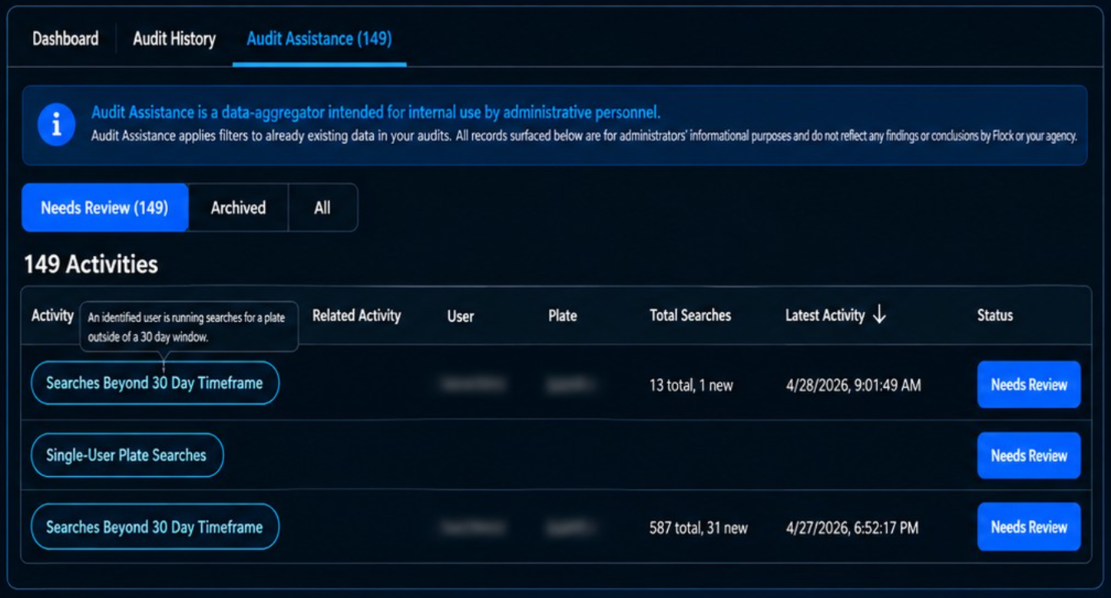
Audit Assistance
Surfaces atypical search patterns and flags them for admin review, making it easier to have oversight on how the system is used.
Flock recommends best auditing practices for customers, encouraging a reliable rhythm of oversight.

Slide 28
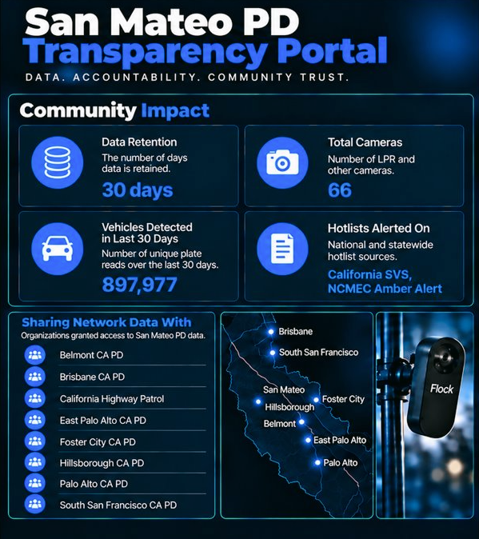
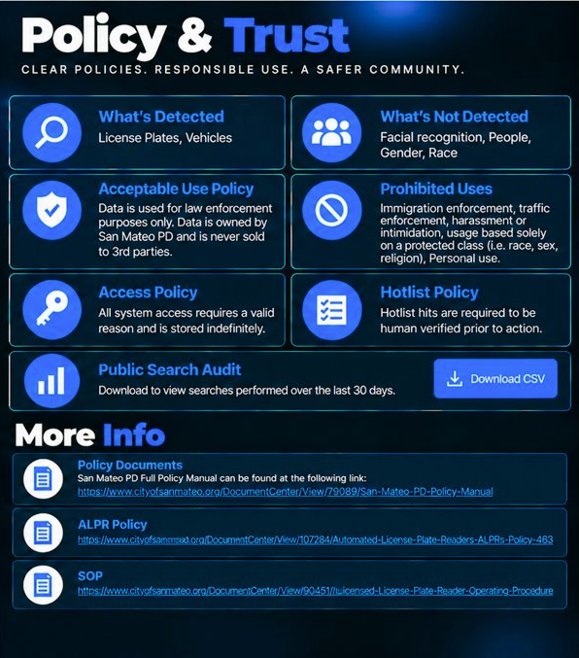


Slide 29
Updated the public portal with the Public Audit, ALPR Policy, SOP, and verified camera count. | Restricted Admin access to Lt. Pak, Lt. Casazza, and Sgt. Trujillo. | Removed sharing with all university police departments. | Moved network and organizational audits from quarterly to monthly.
Reviewed and cleaned up the ALPR Policy and SOP. | Reviewed all user roles and assigned personnel to the correct permissions. | Limited approved sharing permissions to Search and Alerts only. | Strengthened oversight of system access, sharing, search documentation, and user permissions.
Added another case # or CAD # to the search platform and removed “Other” as a search reason. | Limited Custom Hotlist creation to RTIC, Supervisors, Bureau, or CRU. | Centralized Sharing Request approvals through Lt. Casazza.
Accountability & Transparency
Policy & Public Transparency
Access & User Controls
Sharing
Controls
Auditing & Oversight

Slide 30
Training & Ongoing Compliance
Standardizing training, documentation, and continuing education.
TRAINING DOCUMENTATION
FLOCK COMMITTEE DEVELOPMENT
PATROL SERGEANT TRAINING
Entered Employee Flock training records into METR, including the date of training. Retrained department users so everyone has current knowledge of the Flock System.
Flock Committee members engage in ongoing Flock Academy training and professional development. Continuing education keeps committee members current on system capabilities and safeguards.
Provided training on system use, Flock Academy, Audit Assistance features, Hotlists, Public Audit, and Sharing Requests. Reinforced expectations for accountability, proper system use, and supervisory oversight.
Result: Stronger governance, tighter access, controlled sharing, more frequent auditing, and better trained users.

Slide 31

Success Story
A REAL IMPACT ON PUBLIC SAFETY
01
02
03
04
The Crime
Flock Lead
Investigation
Arrest
12/19/2020
A suspect, who was lying in wait, approached the victim as he approached his car. The suspect shot the victim several times, killing him, and then fled the scene.
Through further investigation and with the assistance of a newly placed Flock camera, the suspect’s vehicle was identified.
A lengthy investigation led to two suspects who lived in Southern California.
The two suspects were eventually located and arrested.
Without the Flock camera, we would not have had a lead on the suspect vehicle.

Slide 32

Success Story
A REAL IMPACT ON PUBLIC SAFETY
01
02
03
04
The Crime
Flock Lead
Investigation
Arrest
8/04/2024
The suspect (victim’s boyfriend) killed his girlfriend, who was 9 months pregnant. After killing her, the suspect stole the victim’s car and fled the scene.
Through further investigation and by utilizing Flock, it was learned that the suspect had fled to Southern California.
In coordination with Southern California law enforcement agencies, the suspect was tracked down in the victim’s car.
After a standoff with the suspect, he was taken into custody.
05
Justice
The suspect was convicted of murder (x2) and is currently serving his sentence in prison.
Had it not been for Flock, this could have caused a delay in tracking this suspect down.

Slide 33




Our Commitment to Our Community
ALPR is one tool that helps our officers protect this community, but how we use that tool matters.
Our commitment is to use it with purpose, with appropriate safeguards, and with meaningful oversight.
We will continue to evaluate our practices, protect privacy, and remain transparent and accountable to the community we serve.
Public safety and public trust
must always go hand in hand.

Slide 34
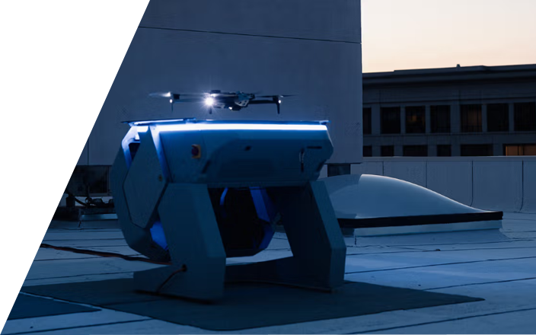
DRONE AS A FIRST
RESPONDER (DFR)

Slide 35
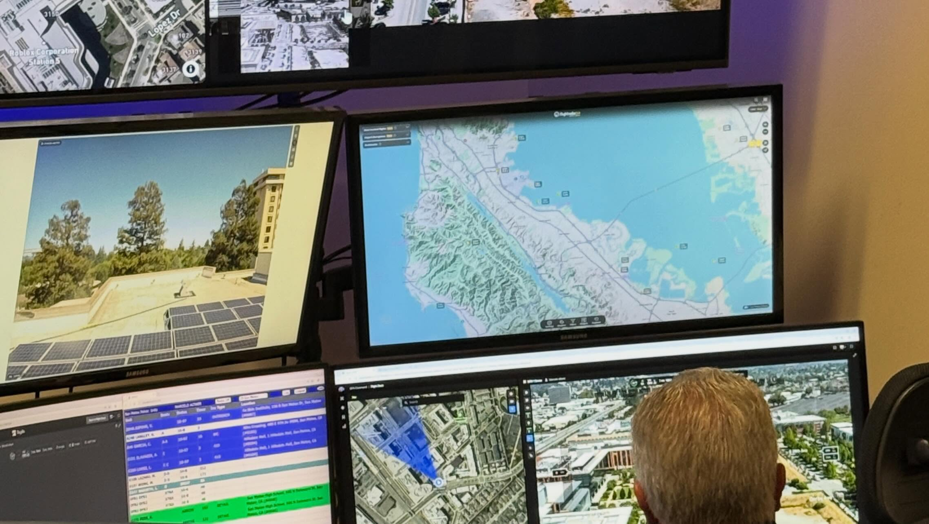
Drone as a First Responder
A public safety tool that responds to a call for service ahead of the officers, providing aerial intelligence to the units on the ground. This allows us to assess the situation instantly, send the appropriate resources, and in many cases, cancel the dispatch entirely so police officers don't have to enter a neighborhood unnecessarily.​

Slide 36
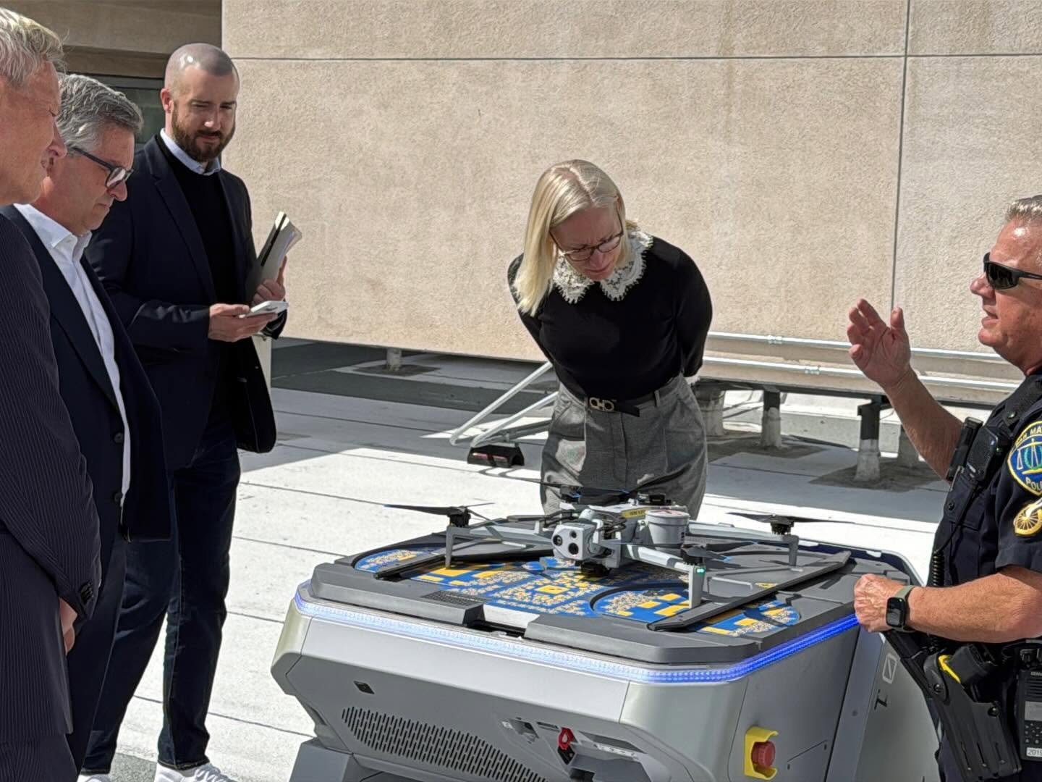
Drone as a First Responder
  X10 Docks – 3​
    Docks are stationary and flown remotely from the RTIC.
​
  X10 Field Deployed – 3​
    Field deployed drones are deployed from our patrol vehicles.​
  R10 Interior – 5​
    R10 drones are deployed inside structures ahead of officers keeping them out of harm’s way.
SMPD has partnered with Skydio for DFR​.

Slide 37
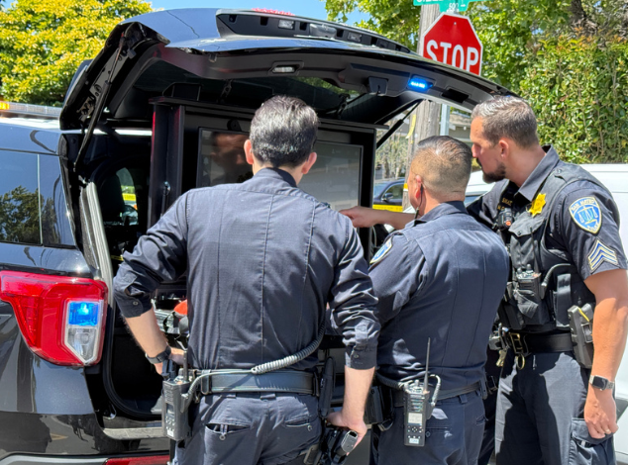
Why do we have a DFR Program?
  Rapid Situational Awareness​
  Search and Rescue​
  Fire Watch and Firefighting​
  Critical Operations Support​
  Increased Officer Safety​
  Reduced Use of Force​
  Delivery of Life-Saving Payloads​
  De-escalation of situations ​
  HAZMAT incidents​
Notes:
Example of our response to a swatting call with DFR

Slide 38
DFR Workflow
1
2
3
4
5
Begins with a documented public safety purpose.
Addresses an identified concern within a defined area.
Limits observation to the purpose of the assignment.
Does not permit random patrol flights or general surveillance.
Has a defined end point.
Notes:
DFR response flights are mission-based, not random-based. They begin with a documented public-safety purpose, normally a CAD call for service, and observation is limited to that purpose.
Separate training, emergency-management, fire-support and other authorized UAS activities are governed by Department policy but are not random DFR patrol

Slide 39
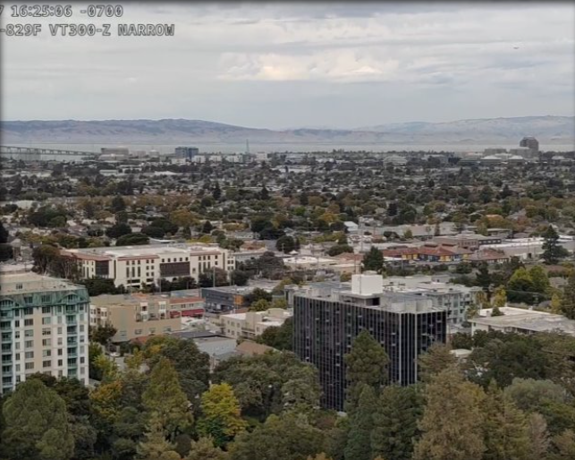
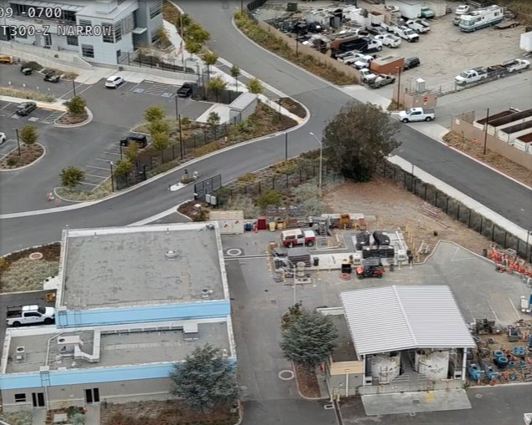
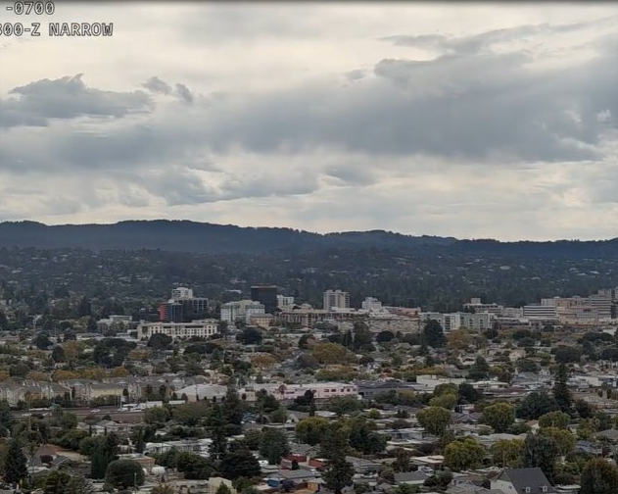
Protecting Privacy
  Protecting community privacy is part of how we operate the DFR program.​
  During a flight, our pilots keep the camera pointed toward the horizon to reduce incidental recording of people and private property along the flight path. Upon arrival, the camera focuses on the incident and the information needed to assist first responders. ​The process is repeated for return flights.
  We record every DFR flight from start to finish. That recording preserves a record of the operation that can be reviewed to evaluate how the drone and camera were used.​
  The data is automatically uploaded to our CJIS compliant evidence software​.
  These safeguards reduce unnecessary observation and help protect community privacy.​
Notes:
Autonomous flight
Pilots are not staring at the screen
Compiling intel for officers on the ground

Slide 40

DFR Accountability: From Launch to Landing
1
2
3
4
Authorized purpose
Flight recorded
Camera use documented
Role-based access
8
7
6
5
Supervisor/Program
Review
Retention/
deletion
Access audit trail
Secured CJIS Compliant Cloud

Slide 41


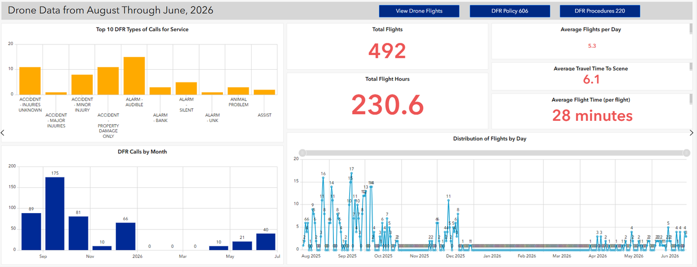



Transparency
SMPD has a DFR program transparency page available to the public
Flight logs and live flights are monitored weekly by the program manager
DFR Policy is published online

Slide 42
What We Do
AUTHORIZED USES PER OUR POLICY
Only authorized operators who have completed the required training shall be permitted to operate the sUAS for the following purposes:
  Respond to calls for service
  Assist with the apprehension of criminal offenders
  To protect life, limb, and property
  Search and rescue / Disaster response
  Crime scene reconstruction / Mapping
  Individuals in physical or mental distress
  For infrastructure inspections emergency management and disaster response, or surveying and mapping.
  UAS program readiness activities including, but not limited to, training, certification, evaluation, and maintenance.
  Acts of terrorism / Mass casualty incidents

Slide 43
What We Don’t Do
UNAUTHORIZED USES PER OUR POLICY
  To conduct random surveillance activities.
​
  To target a person based solely on actual or perceived characteristics, such as race, ethnicity, national origin, religion, sex, sexual orientation, gender identity or expression, economic status, age, cultural group, or disability.
​
  To harass, intimidate, or discriminate against any individual or group.
​
  To conduct any business other than official Department business.​
  The UAS shall not be weaponized

Slide 44

Data Security
1
Network security
There is no sharing network.
2
Authorized Users
Only authorized viewers can see the drone video.
3
Secure link access:
Flight video is shared via a secure link to authorized viewers.
4
Program manager notifications:
All drone flights are sent via notification to the program manager.
5
Vendor access
SMPD controls all access to its DFR data.
6
Data ownership
We own all drone data.
7
Evidence storage
All drone video is automatically uploaded to our secure CJIS compliant software.
Notes:
SMPD controls access to its DFR data. Vendor platforms provide the technical infrastructure used to operate and store the system, and access is governed by contractual, technical and role-based security controls.
Vendors are not authorized to independently use SMPD footage for unrelated purposes
Minimum retention is 2 years for recorded media
This was updated from the previous policy 9/28

Slide 45
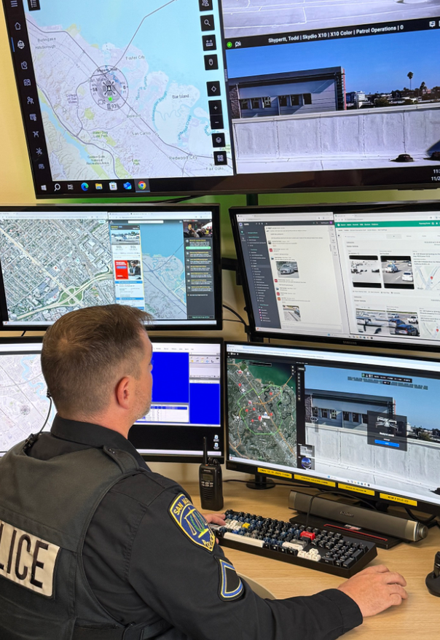
RTIC Integration
The RTIC helps first responders understand what is happening at an incident. DFR provides a live aerial view that RTIC personnel can use to relay relevant information to officers and other emergency responders.
This can help responders locate someone who needs assistance, recognize hazards, and choose a safer approach before arriving, improving officer safety.
Using drone video within the RTIC does not expand the authorized purpose of the flight. The same mission limits, privacy protections, and restrictions on access and use continue to apply.
Notes:
BE BRIEF

Slide 46
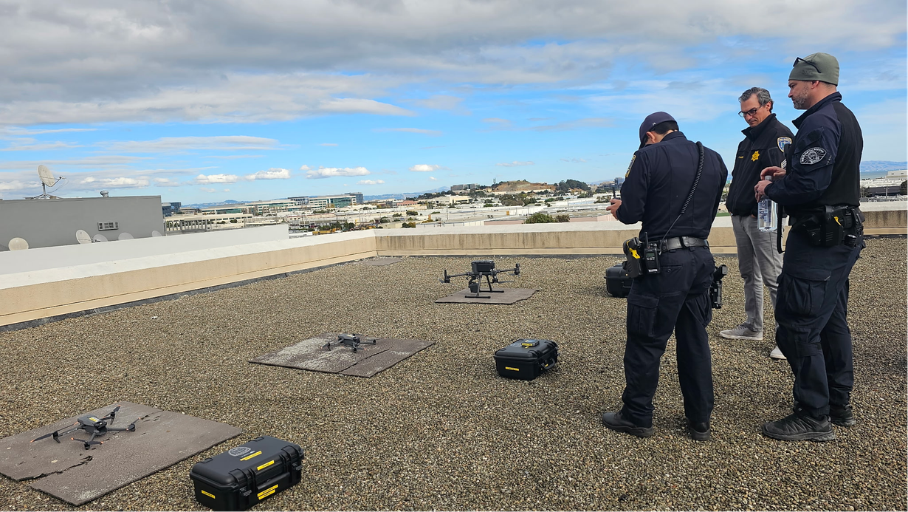
DFR Impact: 2024 to Present
3,348
694
Total Flights
People of Interest Located
414
116
Vehicles of Interest Located
Arrests Assisted
9
6
Search and Rescue
Scene Reconstructions

Slide 47
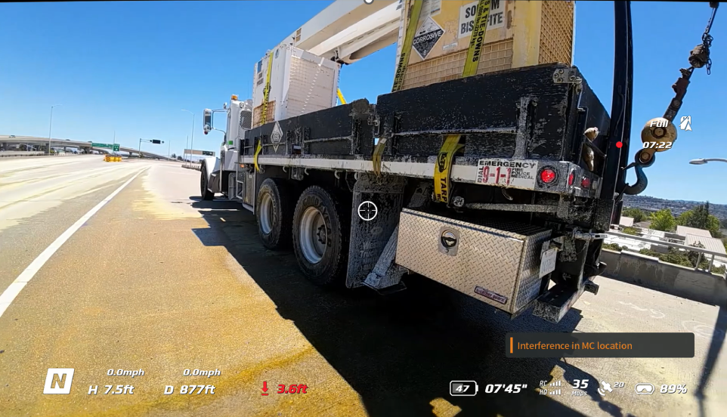
Not Just a Crime Fighter
Notes:
Hazmat call on Hwy 92
Shut down traffic in both directions and all traffic under 92 including a nearby school
We were quickly able to identify the substance using the drone and consult with County Hazmat team

Slide 48
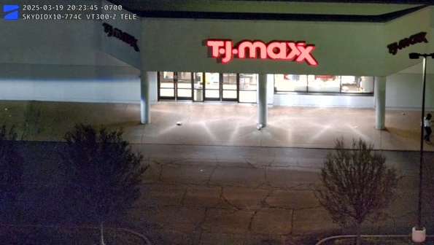
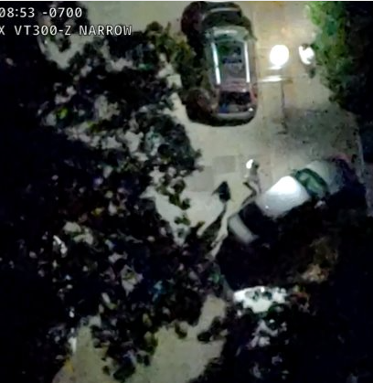
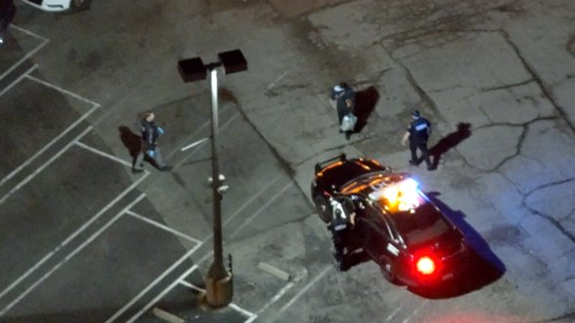
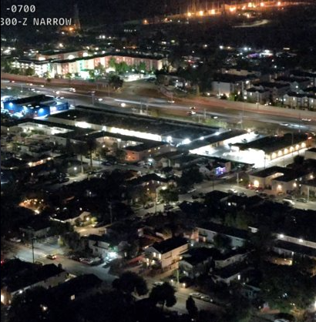
4th of July Vehicle Pursuit​
Organized Retail Theft​
Notes:
ORT case with multiple suspects exiting the store. Drone provided location to the responding officers
4th of July pursuit - drone was responding to a fireworks call and captured a pursuit - pursuing officers backed off and the drone tracked the suspect to an apartment complex - officers responded and arrested a violent wanted subject and seized a firearm

Slide 49
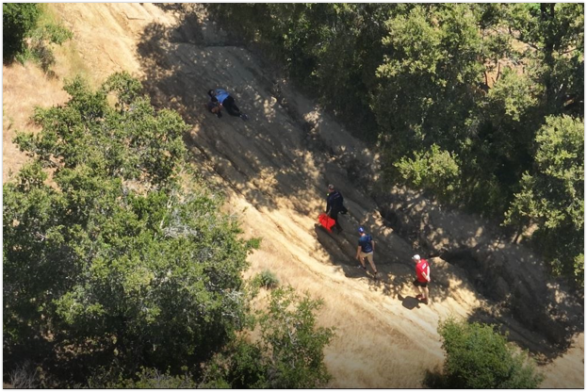
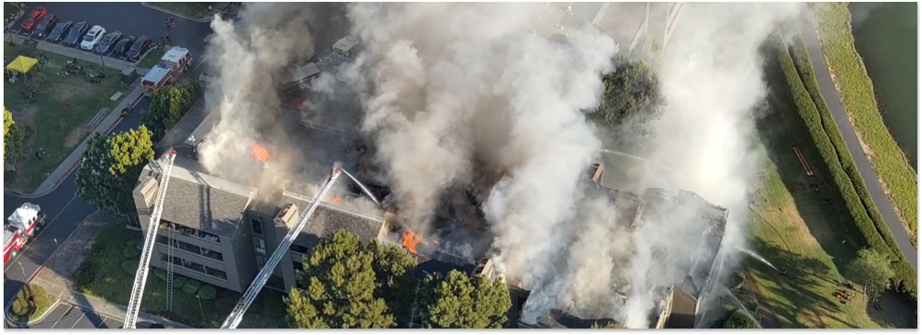
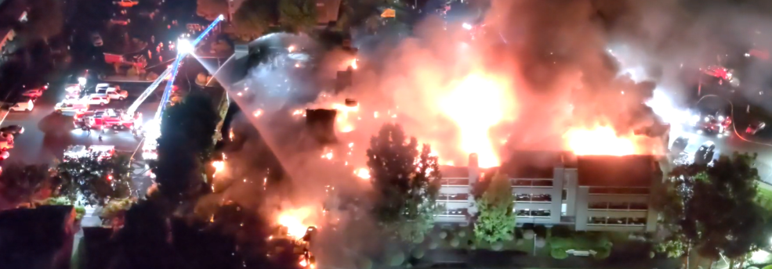
Foster City Fire
Injured Hiker at Laurelwood Park
Notes:
Injured hiker in Laurelwood Park did not know where she was - Drone located her in minutes and guided medical assistance to her
Foster City Fire - drone provided critical intel regarding trapped residents and hot spots on the roof

Slide 50

THANK YOU
STUDY SESSION OCTOBER 2026

