Slide 1
CurveScope
Launch configuration evidence
for Meteora builders
Crypto World’s Fair · Meteora DBC developer tooling
Notes:
A working offline prototype created September 30, 2026 with AI coding assistance. No mainnet deployment, customers or revenue are claimed. Listing: https://superteam.fun/earn/listing/meteora-dbc

Slide 2
The launch parameter review gap
Curve settings affect the first buyer.
A launch team needs to see how order size, fee timing and the graduation boundary change execution.
CurveScope makes those choices inspectable before a pool exists, without funding a wallet or writing a custom simulation script.
CurveScope / 2
Notes:
Product hypothesis, not validated market research. Meteora DBC configurable primitives: https://docs.meteora.ag/developer-guides/dbc. The SDK already provides math helpers; CurveScope contributes a review workflow and reproducible reports around them.

Slide 3
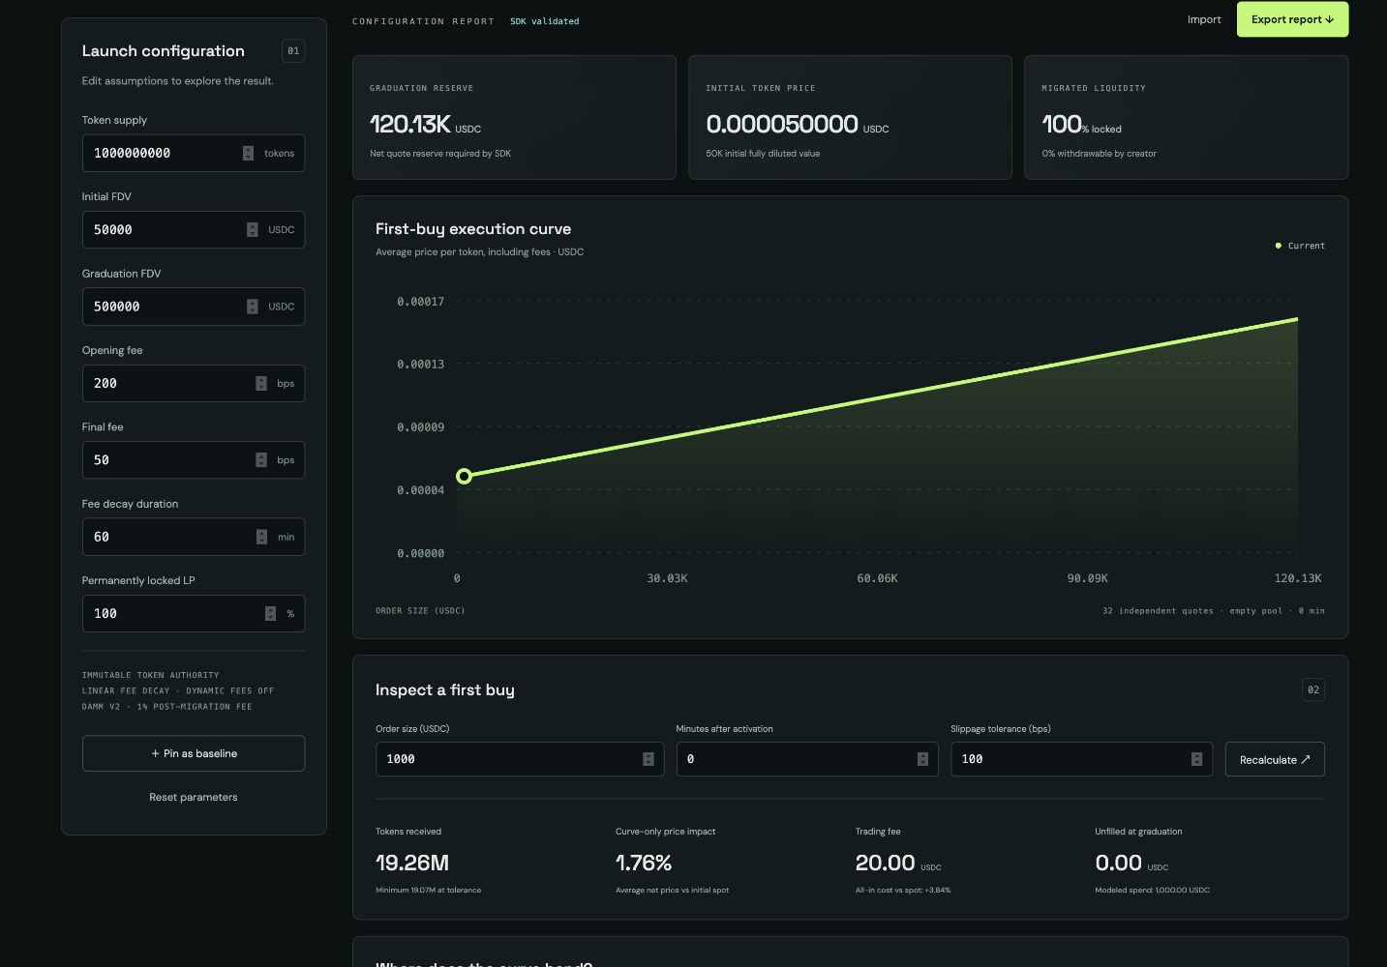
A working configuration lab
Compare a baseline
Pin a launch and inspect how a different curve changes the same order.
Export the evidence
Save versioned JSON, exact SDK integers and assumptions. Import to reproduce the report.
CurveScope / 3
Notes:
Screenshot captured from the running CurveScope application on September 30, 2026. Local prototype; all prices shown are offline SDK outputs.

Slide 4
Meteora is the calculation engine
01 Build
Generate a DBC curve from supply and initial / graduation FDV.
02 Validate
Run the official SDK configuration validator.
03 Quote
Model independent first buys, fee timing and partial fills.
04 Preserve
Export exact integer evidence with reproducible input settings.
CurveScope / 4
Notes:
SDK @meteora-ag/dynamic-bonding-curve-sdk 1.5.13. Source: https://github.com/MeteoraAg/dynamic-bonding-curve-sdk. Application code: src/engine.ts. Offline calls: buildCurveWithMarketCap, validateConfigParameters, getQuoteFromInputAmount with SwapMode.PartialFill.

Slide 5
The same 1,000 USDC order over time
20 → 5 USDC
Trading fee on the same order as the schedule decays.
19.26M → 19.55M
Modeled tokens received
Independent first buys into an empty pool. SDK output, not live market data.
CurveScope / 5
Notes:
Real offline outputs from docs/example-report.json. One billion tokens; initial FDV 50,000 USDC; graduation FDV 500,000 USDC; linear fee decay from 200 to 50 bps over 60 minutes. Each quote starts from an empty pool: this is NOT a trade sequence, market data or demand forecast.

Slide 6
From prototype to builder workflow
Available now
Next validation
SDK-backed comparison
Graduation boundary stress test
Lossless report export / import
Nine calculation tests
Test with launchpad developers.
Measure time to review a config.
Add CI report diffs and pool-state replay.
Open-source core; a possible paid workflow for shared reviews and CI gates. Demand and pricing remain unvalidated.
CurveScope / 6
Notes:
Plans and business hypotheses, not achievements. Current prototype has no production users, revenue, mainnet volume or independently verified demand. Built for the listing’s explicit developer-tooling use case. Mainnet usage is preferred by the sponsor but not claimed here.

