Slide 1
Personal Statement Workshop
Office of Career Services Harvard University
Premedical and Health Careers Advising
Dr. Oona Ceder and Dr. Emiko Morimoto

Slide 2
AMCAS®--What everyone writes
Personal statement (5300 characters, spaces count)
Activities descriptions (700 characters)
Three descriptions of most meaningful activities (an additional 1325 characters for each activity)

Slide 3
AMCAS®--What some people write
Institutional action explanation (1325 characters)
Disadvantaged status explanation (1325 characters)
MD/PhD essay—Why MD/PhD? (3000 characters)
MD/PhD essay—Significant Research (10,000 characters)

Slide 4
What you write beyond AMCAS®
Secondary applications!

Slide 5

Personal Statement

Slide 6

Activity Descriptions

Slide 7


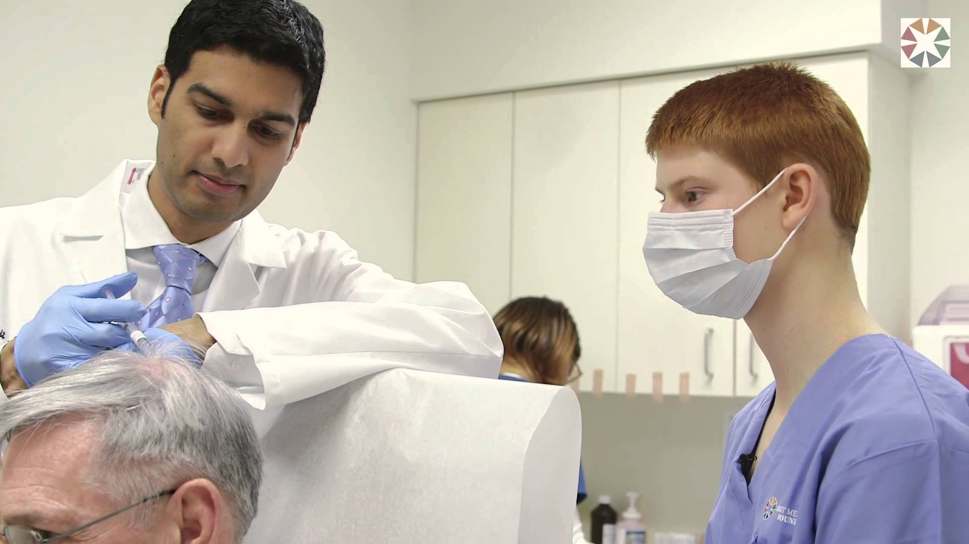

Most Meaningful

Slide 8
AMCAS®--What some people write
Institutional action explanation (1325 characters)
Disadvantaged status explanation (1325 characters)
MD/PhD essay—Why MD/PhD? (3000 characters)
MD/PhD essay—Significant Research (10,000 characters)

Slide 9

Secondary Applications

Slide 10
Image Credits
Once upon a time--HTTP://CENTRUM.ORG/PROGRAMS/WRITING/ http://theithacan.org/blogs/why-i-write-on-writing/
Extracurricular-http://infinityinstitutenewspaper.org/661/college-corner/how-joining-extracurricular-activties-help/
Paper pile--http://documentosenformatodigital.com/documentos-en-formato-digital-document-preparation-services/
Tutoring--www.ymcatriangle.org
Shadowing-SMGF2014 Careers in Medicine - Shadowing
All sites accessed 2/26/16

