Slide 1

MISP
BoB 8th Kang Seong Min

Slide 2
Contents
Ⅰ. My Events
Ⅱ. Using API
Ⅲ. MISP-Cloud
Ⅳ. Try
BoB 8th Kang Seong Min

Slide 3
Progress
Choose APT Group
Apply AWS
Create Events
Upload attributes using API
Synchronizaiotn
BoB 8th Kang Seong Min

Slide 4
Ⅰ. My Events
APT 37 APT37 has likely been active since at least 2012 and focuses on targeting the public and private sectors primarily in South Korea. In 2017, APT37 expanded its targeting beyond the Korean peninsula to include Japan, Vietnam and the Middle East, and to a wider range of industry verticals, including chemicals, electronics, manufacturing, aerospace, automotive and healthcare entities
BoB 8th Kang Seong Min

Slide 5
References
Analysis of Suspected Group123 (APT37) Attacks on Chinese and Korean Foreign Traders –Tencent
An Overview of Public Platform C2’s – Kindered Security
ScarCruft continues to evolve, introduces Bluetooth harvester – Kaspersky Labs
APT37: Finallstspy Reaping the FreeMikl – Intezer, Jay Rosenberg
Report Ties North Korean Attacks to New Malware, Linked by Word Macros
Operation Daybreak – Kaspersky labs
FreeMilk: A Higjly Targeted Spear Phising Campaign-ScarCruft continues to evolve, introduces Bluetooth harvester
Else….
BoB 8th Kang Seong Min

Slide 6
Ⅰ. My Events
2. Kimsuki
threat actor targets South Korean think tanks, industry, nuclear power operators, and the Ministry of Unification for espionage purposes.
BoB 8th Kang Seong Min

Slide 7
References
[Special Report] APT Campaign 'Konni' & 'Kimsuky' Organizations Found in Common – Alyac, East Security Response Center
Kimsuky – Council on Foreign Relations, Cyber Operations Tracker
The “Kimsuky” Operation: A North Korean APT? –Kaspersky Labs, Dmitry Tarakanov
BoB 8th Kang Seong Min

Slide 8
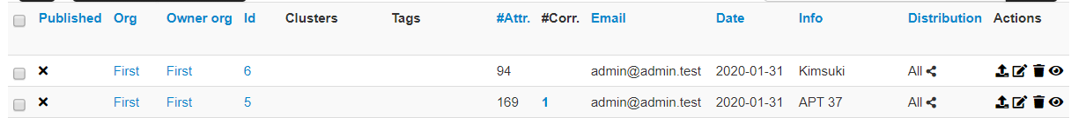
Ⅱ. Using API
Uploaded 94 Iocs to events “Kimsuki” 94, 169 Iocs to evnts APT 37 Using API
BoB 8th Kang Seong Min

Slide 9
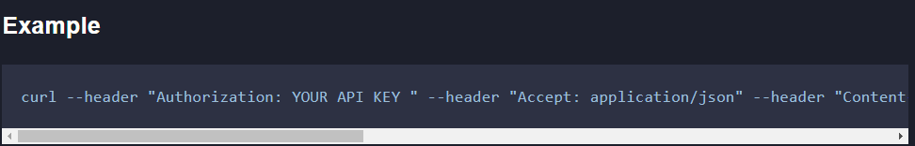
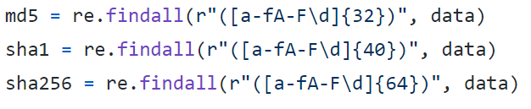
Ⅱ. Using API
Curl(use python os module) + regex
BoB 8th Kang Seong Min

Slide 10
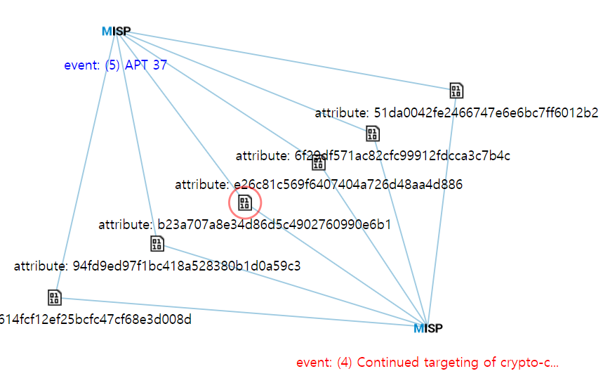
Ⅱ. Using API
Correlation Graph
BoB 8th Kang Seong Min

Slide 11
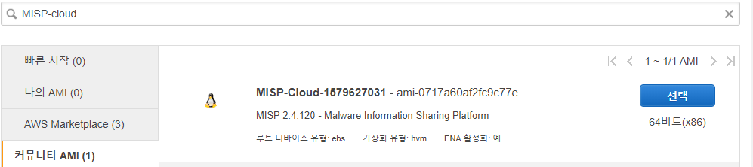
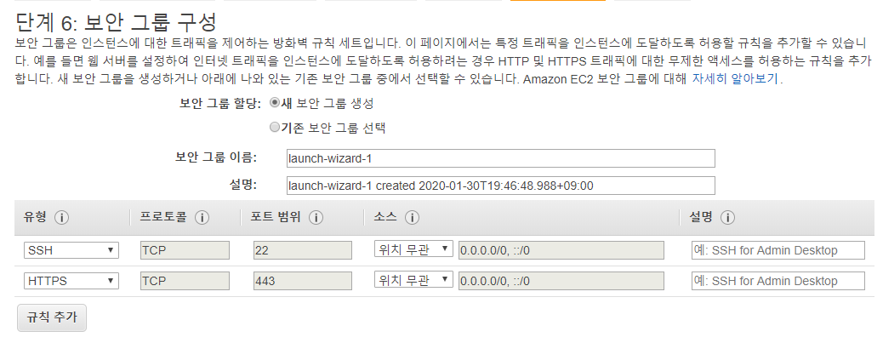
Ⅲ. MISP-Cloud
https://github.com/MISP/misp-cloud/wiki/MISP-and-Cloud-Security
BoB 8th Kang Seong Min

Slide 12
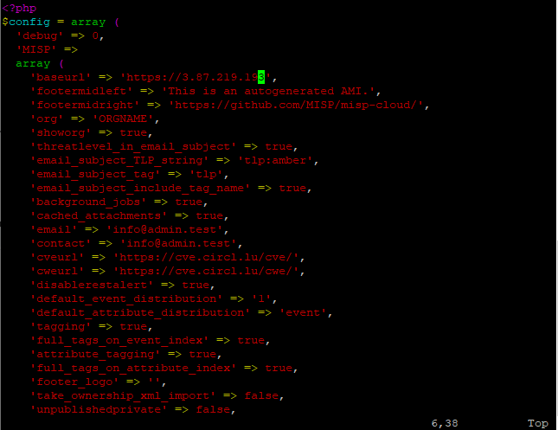
Ⅳ. Try
Redirect Problem
-> Solve by changing base url
BoB 8th Kang Seong Min

Slide 13


Ⅳ. Try
2. PyMISP error – SSL certificate error….
https://github.com/MISP/PyMISP
BoB 8th Kang Seong Min

Slide 14
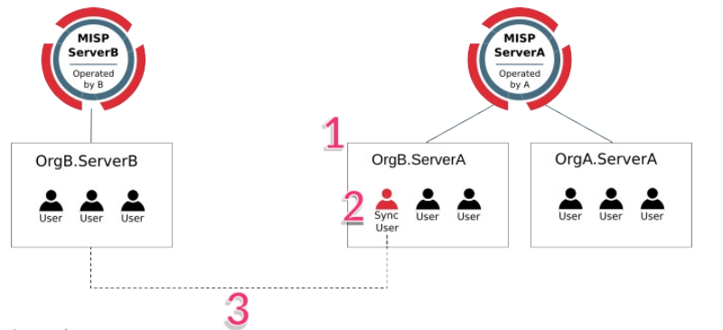
Ⅳ. Try
3. Synchronization error
https://www.circl.lu/doc/misp/sharing/
BoB 8th Kang Seong Min

Slide 15
Ⅳ. Try
3. Synchronization error
This problem is realted to SSL certification problem like PyMISP….. 세영, 일현 Solved this problem!
BoB 8th Kang Seong Min

