Slide 1
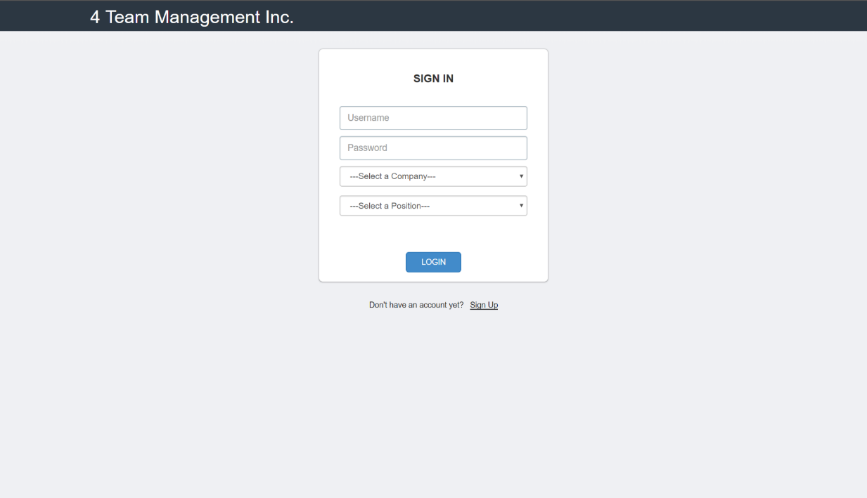
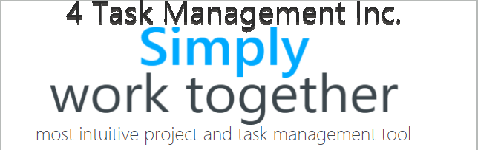
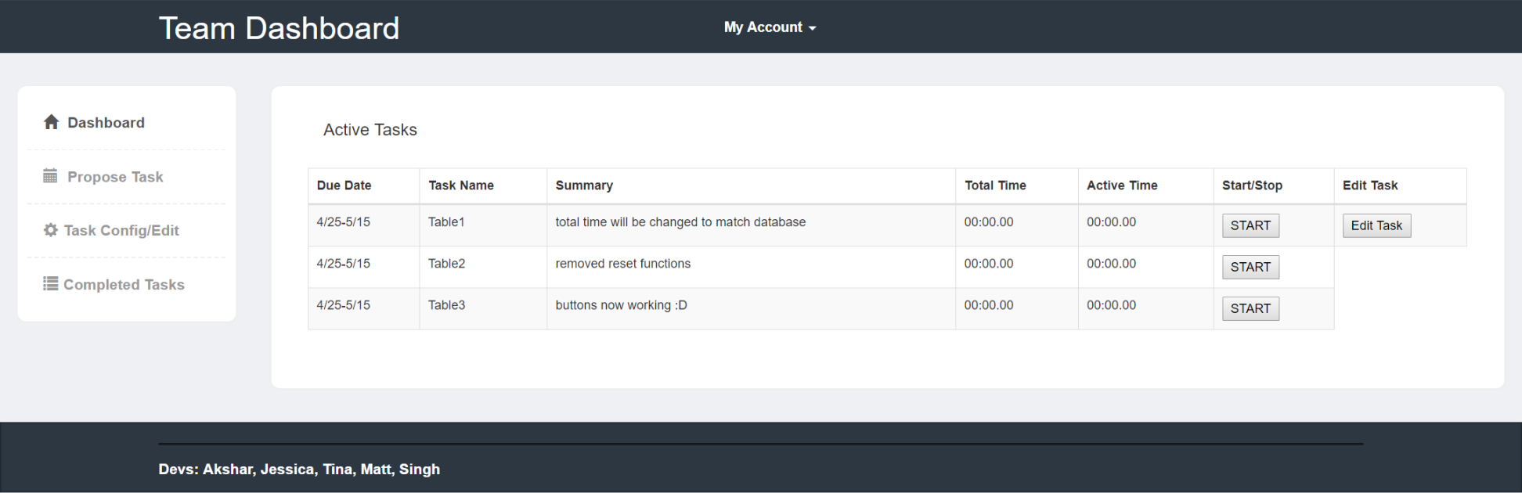
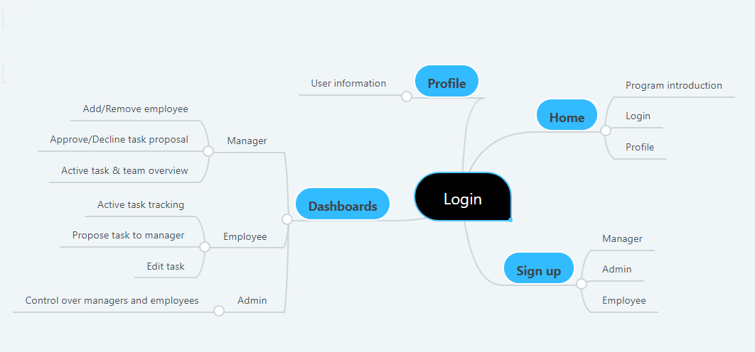
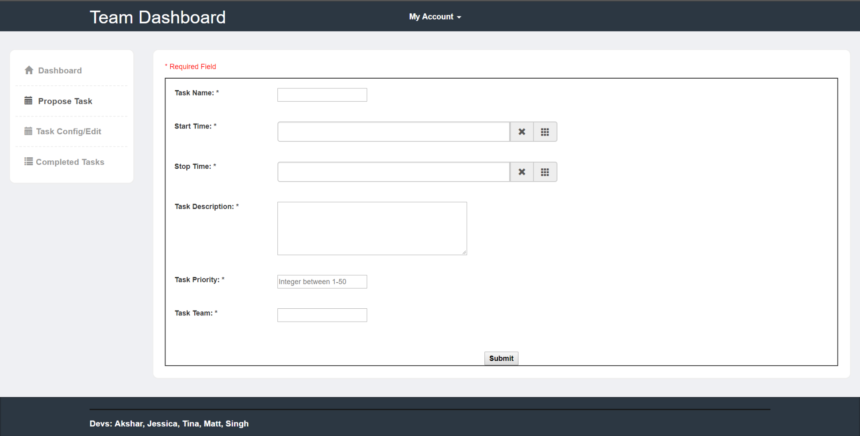
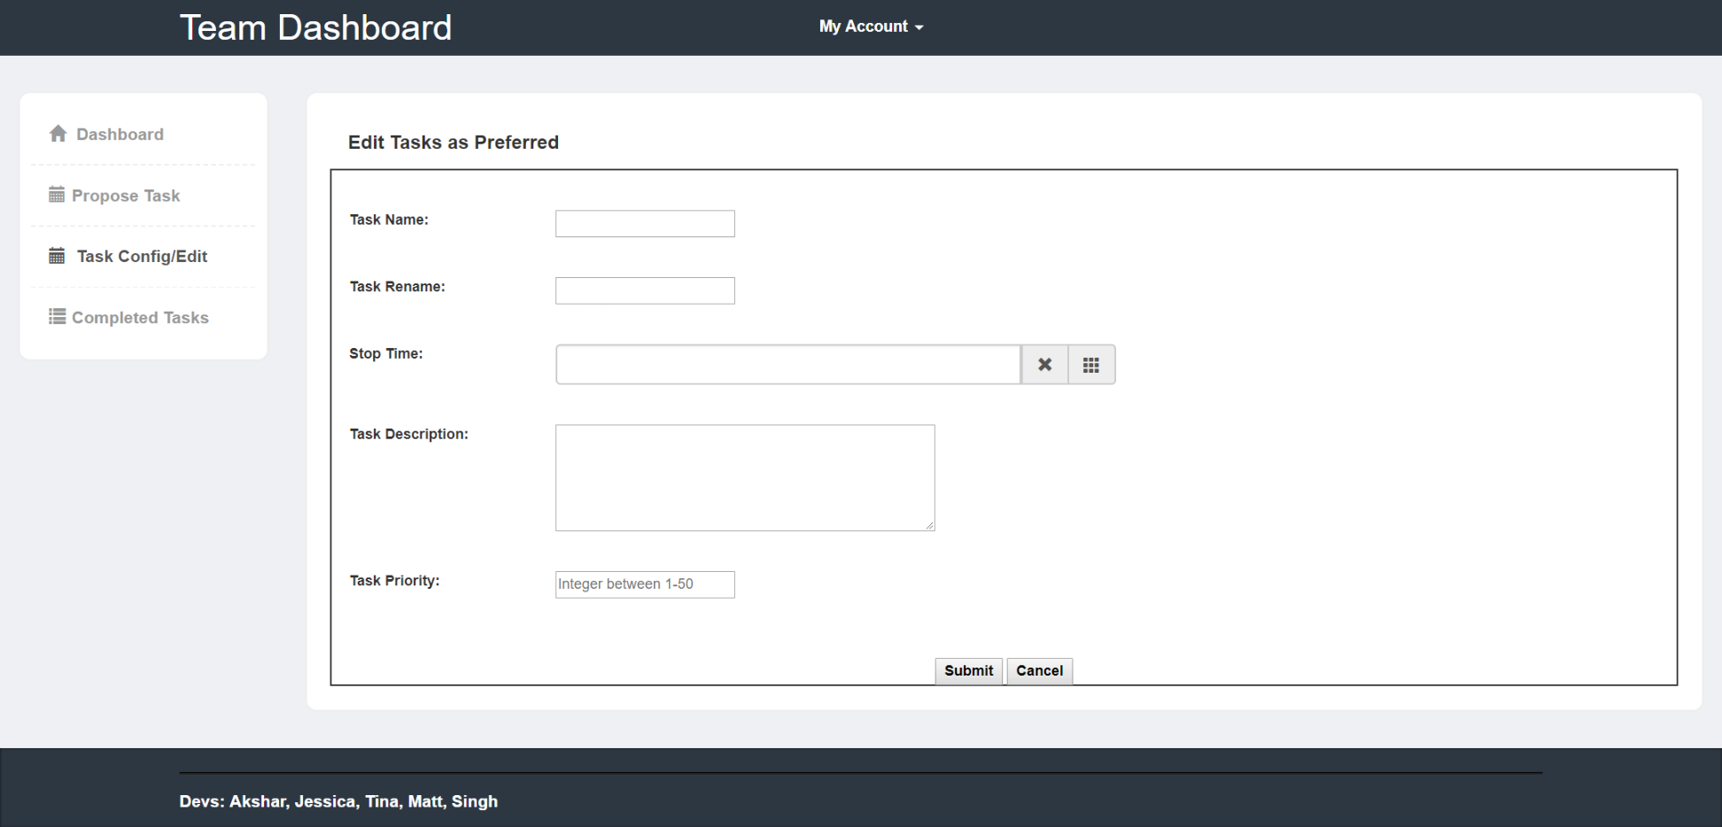
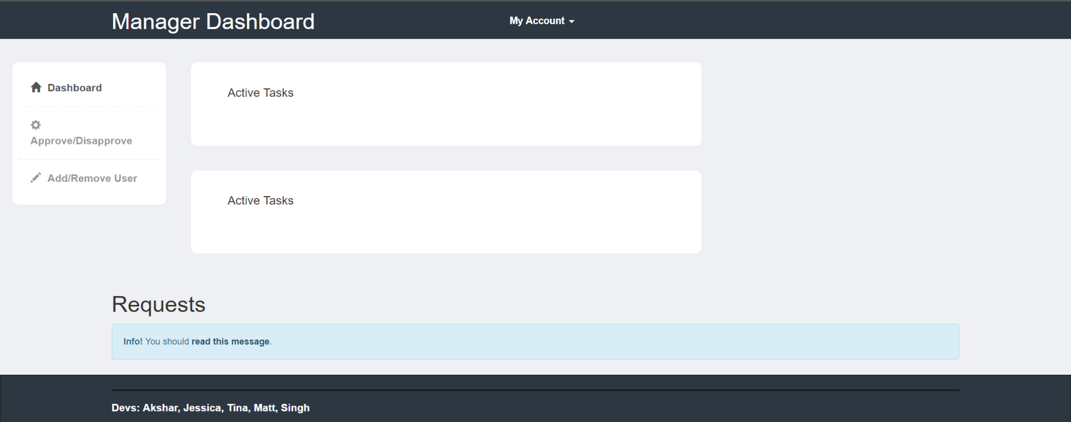
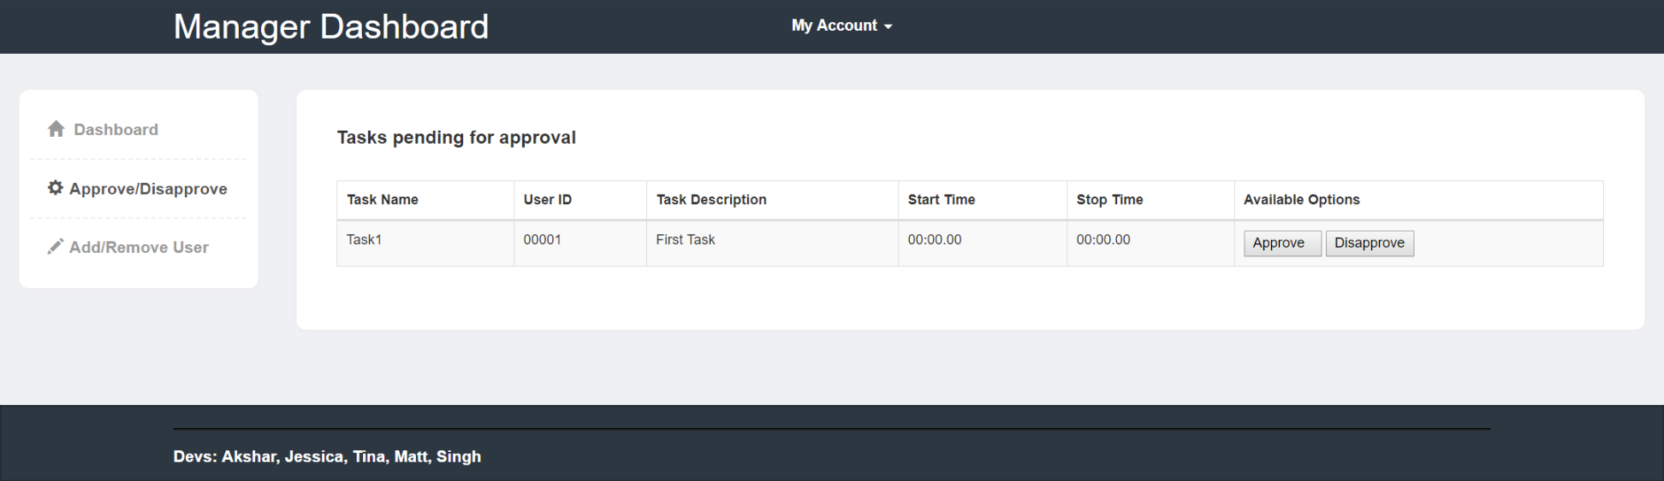
Intro Due to the influx of complex projects in the working world, it has become progressively important for today’s corporations to optimize their workload effectively to achieve each project goal. The goal of our project is to create a task management web application to assist employees of all different corporations. The app will assist employees to meet deadlines by tracking and prioritizing projects to help effectively budget all associated tasks. The main consumer of this web application will be web based corporations. This web app will allow the employees to propose certain task with its priority, start and estimated stop dates, description, and more. The proposed task will then be approved and assigned appropriately by managers. By doing this the managers can keep track of each employee’s agenda. Also it allows all users to track their progress on their respective projects as well as team and the whole corporation projects.
Project Overview
Taking into consideration the functionality of the google calendar app and a task managing app, it would be great for employees in a company to have a task managing system like the google calendar. They would have similar functions like the google calendar as well as a task timing functions to help manage their work.
* Task organizer for the average employee.
* Three accounts associated with this product; manager, employee, and dev account
* Manager can use this product to manage employee productivity.
* Employees can use this product for time management.
REQ1 | Application should generate dynamic dashboards based on the role of the person who logged in with valid credentials. For example, Manager should have admin dashboard for the tasks his/her team is working on
REQ2 | Application should allow Employees to propose the task to the manager and their teams with attributes such as start time, estimated stop time, description, priorities, etc
REQ3 | Application should enable summarizing the tasks, altering summaries for users with different roles
REQ4 | Application must validate credentials when login and must validate that certain actions are executed based on the rights of the user. For example, only manager can approve or disapprove tasks as they have admin rights.
REQ5 | Application should have different tabs for different functions like user dashboard may have tab named “Completed” which shows all completed tasks so far.
REQ6 | Application should allow employees to generate the task reports for any time period whenever needed. For example, when manager suddenly asks for the report of the progress on tasks
REQ7 | Application should allow users to prioritize tasks
REQ8 | Application should allow users to propose an estimated end date for certain task so other users on the team can trace any given task and frame their efforts that way.
REQ9 | Application should allow different users to feedback other tasks if they have access to those tasks
REQ10 | Application should allow managers to assign new task or reassign task to someone else in the team
REQ11 | Application should allow users to create and view history in form of the threads containing who worked on a given task and how and when he/she worked on it.
REQ12 | Application should allow employees to change the task attribute without any restrictions if that task has not been approved
REQ13 | Application should provide alternatives to overcome some restrictions if they are needed to.For example, if someone wants to change something about a task after it’s approved by manager then he or she must get permission from the manager to modify that task
REQ14 | Application should be able to generate summaries for all type of tasks,i.e., in progress tasks, completed tasks, and pending tasks.
REQ15 | Application should allow the successful logout.
REQ16 | Application should have timeline feature which allows users to manage their pace on tasks in progress
REQ17 | Application should display a graph for statistical data. Statistical data will be time of completion average.
REQ18 | Application should allow dynamic registration criteria for corporations
REQ19 | Application should give managers enough admin rights, such as changing due dates, deleting tasks, updating tasks, updating priorities
REQ20 | Application should allow shared working environment where users in a given team can track all tasks of that team, chat with each other, provide feedback

