Slide 1
JSystem brick development guide
essixxg
2012.12.20

Slide 2
Agenda
1. Preparation
All necessary SW and files
Installation and settings
2. CES service automation demo on SPO1410
3. Brick development guide

Slide 3
1.1 All necessary SW and files
All needed SW and files:
(file://EV78E7D1017F0A/J-System/All-needed-sw)
Exract .m2.rar file to (overwrite):
C:\Users\eXXXXXX[your ID]\.m2

Slide 4
1.2.1 install jdk
We will use jdk-6u17-windows-i586.exe for installation. Just Install to default path, then set your PC’s environment.
E.g.
JAVA_HOME=C:\Program Files\Java\jdk1.6.0_17

Slide 5
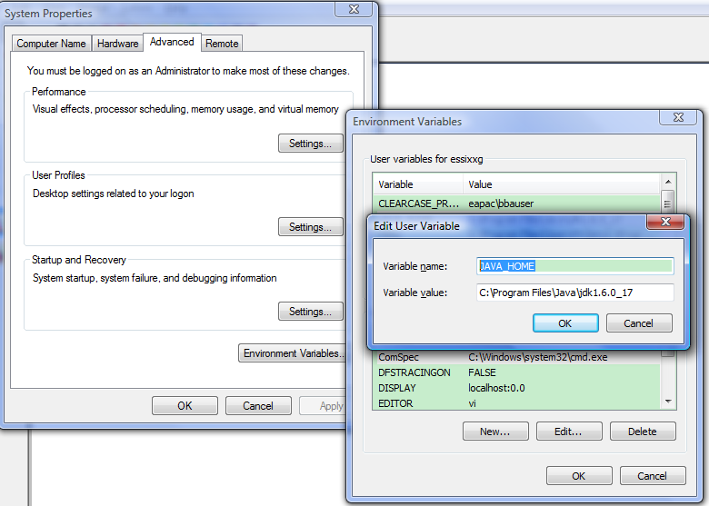

Slide 6
1.2.2. install Eclipse
https://ericoll.internal.ericsson.com/sites/EECS/Pages/EECSEclipse.aspx#Single-user%
It’s a green software, find a latest version(32bit/64bit), download then extract and then run eclipse.exe.
Mainly used for edit and compile brick source code

Slide 7
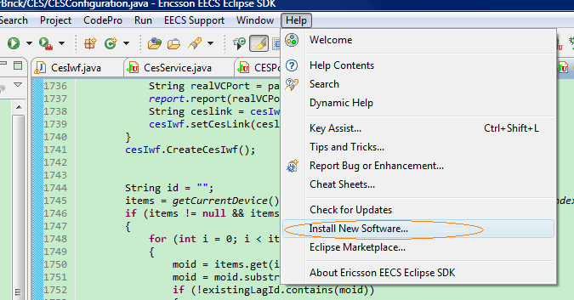

Slide 8
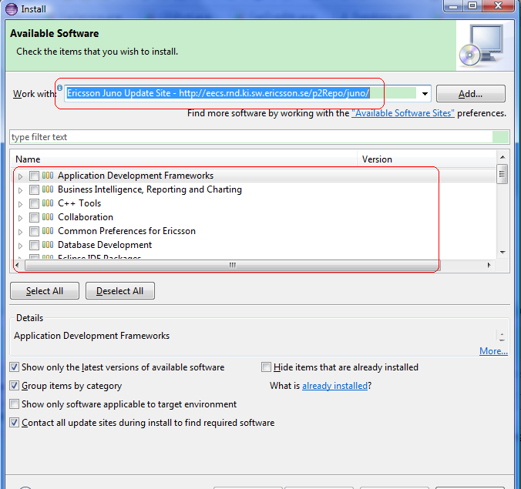
The available web site:
Ericsson Juno Update Site - http://eecs.rnd.ki.sw.ericsson.se/p2Repo/juno/

Slide 9
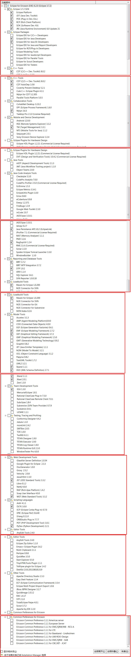

Slide 10
import 3 separate projects
Brick
including all the brick java source code
Etai
including all the test equipment and XRPC related java source code
BrickGeneratorBasedOnXML,
used for brick code auto generation based on XML files

Slide 11
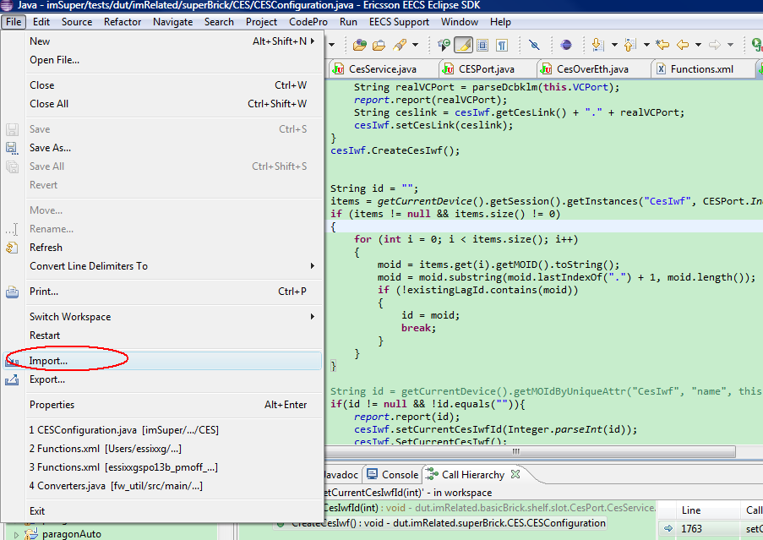

Slide 12
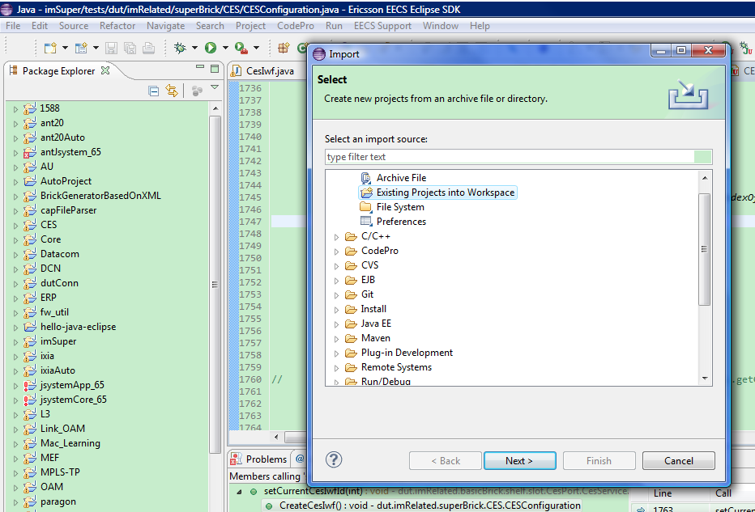

Slide 13
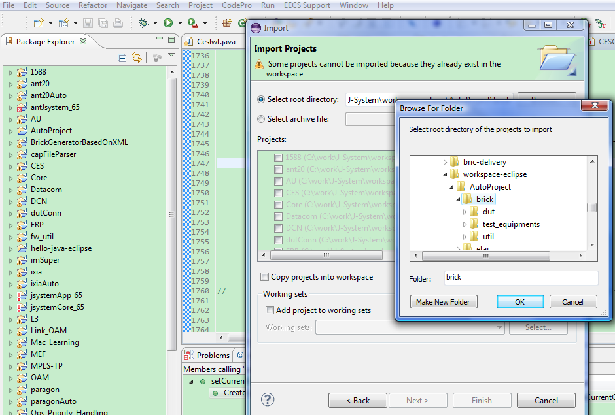

Slide 14
Setting Elipse environment
Setting jdk path

Slide 15
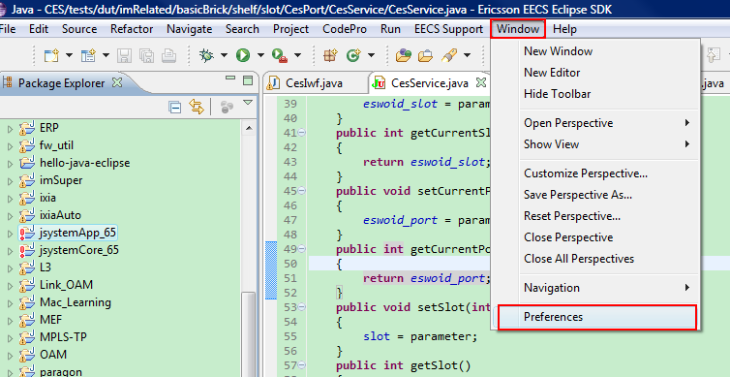
Select proper JDK

Slide 16
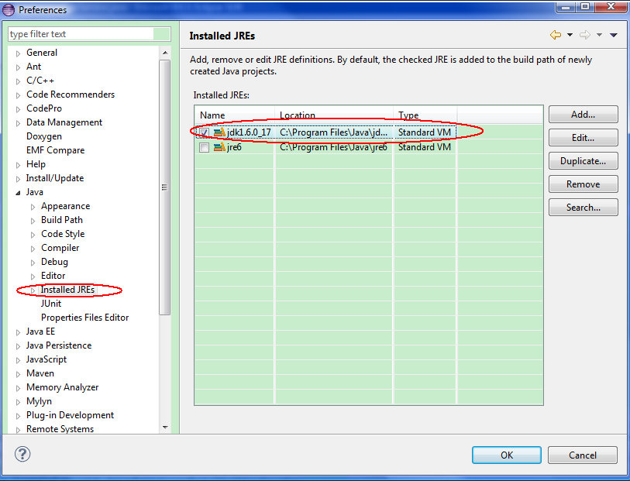

Slide 17
How to build?
By default, eclipse will auto-build project when you save the java source code. So just check below settings on eclipse if you want to confirm.

Slide 18
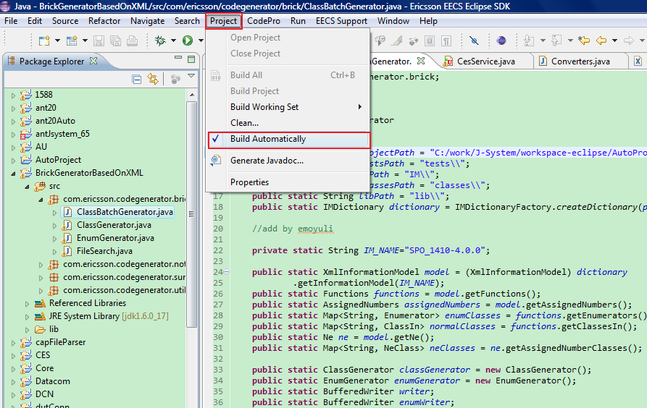

Slide 19
1.2.3. Install Jsystem
Extract jsystem_5.6.66.rar into c:\, then override its original project directory
“C:\jsystem_5.6.66\runner\projects\AutoProject”

Slide 20
2. CES service automation live demo on SPO1410

Slide 21
3. Brick development guide
Put latest IM files(the same version with your currently running ESW) into below path and modify code generator path accordingly:
C:\work\J-System\workspace-eclipse\AutoProject\brick\dut\dutConn\IM\SPO_1410-4.0.0

Slide 22
3.1 specify your IM path
import the BrickGeneratorBasedOnXML project into Eclipse(detailed in previous chapter “import 3 separate projects”
).
Modify the IM path according to your running esw.

Slide 23
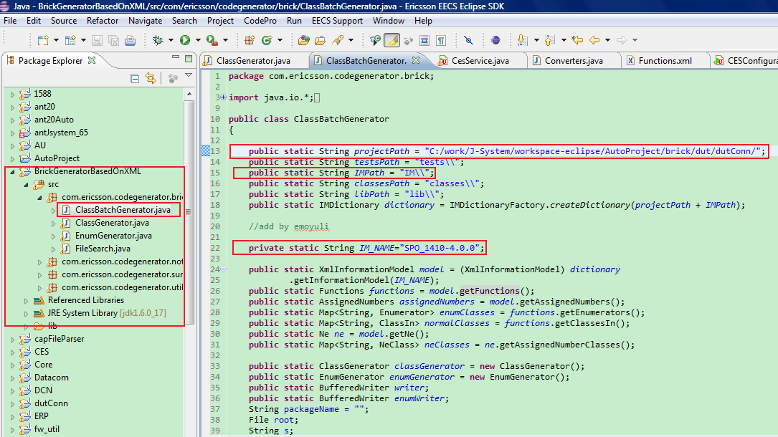

Slide 24
3.2 specify your class
Modify the class name into what you want to use.

Slide 25
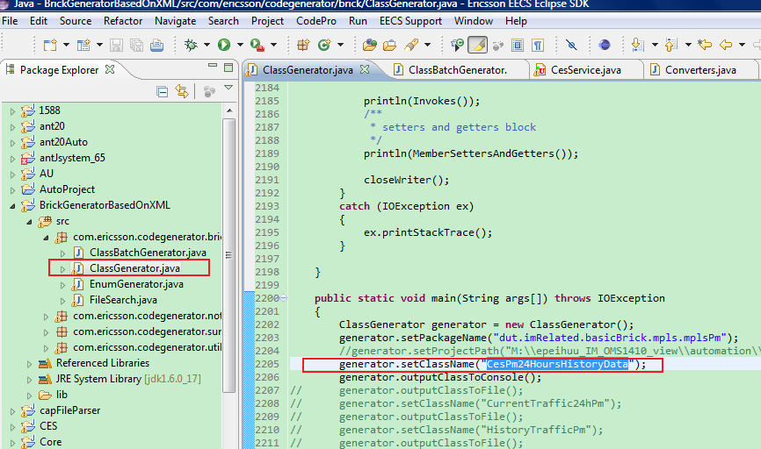

Slide 26
3.3 run and generat code
Click the “run” button on eclipse, you will see the generated source code on console.
Then you can modify them as you need.
in JSystem-style jave code ,the brick is like below:
@Test
@TestProperties(
name = "Set Current CesPm24HoursHistoryData To: ${CurrentInterval} || dut.imRelated.basicBrick.mpls.mplsPm.CesPm24HoursHistoryData.SetCurrentCesPm24HoursHistoryData",
paramsInclude = {
"CurrentInterval"
})
public void SetCurrentCesPm24HoursHistoryData()
{
report.report("Current CesPm24HoursHistoryData Set To:" + IndexOfCurrent());
assertTrue(getCurrentDevice().isExistent("CesPm24HoursHistoryData", IndexOfCurrent()));
}

Slide 27
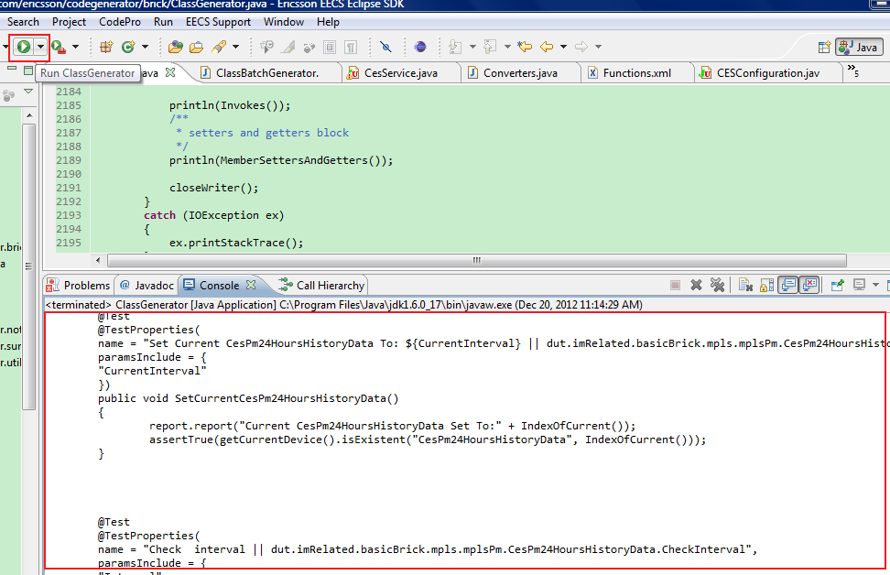

Slide 28
3.4 update the .class file in jsystem
Copy generated CesIwf.class into below directory from Eclipse work space directory.
C:\jsystem_5.6.66\runner\projects\AutoProject\classes\dut\imRelated\basicBrick\shelf\slot\CesPort\CesService\CesIwf\
Fussy? Too Complicated? See next chapter.

Slide 29
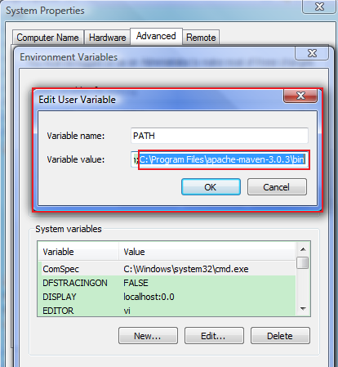
3.5 try MAVEN
To avoid fussy copy and paste, let’s try to use MAVEN.
(a) Uncompress maven package(apache-maven-3.0.3) to directory:
C:\Program Files\apache-maven-3.0.3\
(b) Then set environment varible as the right graph
(c) change the attribute “release.output.directory” (pom.xml under your Eclipse project work space) to your JSystem project’s default directory.

Slide 30
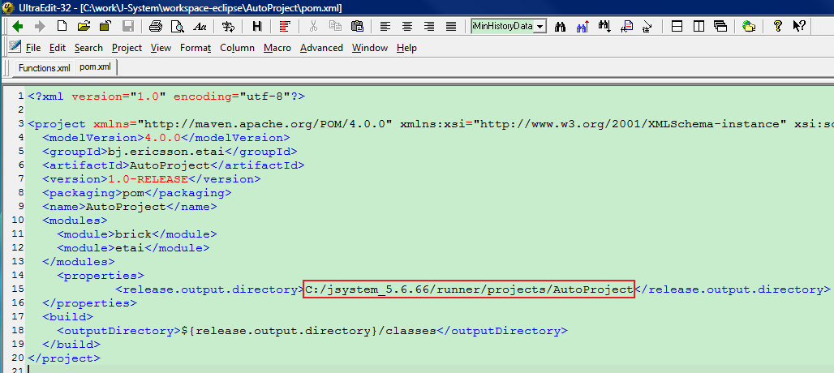

Slide 31
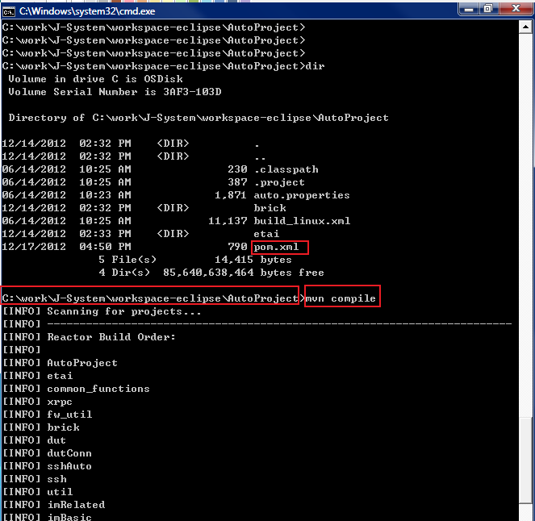
(d) run “mvn compile” under the pom.xml file’s directory via windows cmd.

Slide 32


