Slide 1

International TechNet Wiki Summit 2015
Nonki Takahashi
Session - Small Basic and TechNet (Small Basic - Part 2)

Slide 2
Agenda
Small Basic
Small Basic Community
TechNet Wiki Articles
TechNet Gallery
Synergy around Small Basic and TechNet Wiki
Conclusion

Slide 3
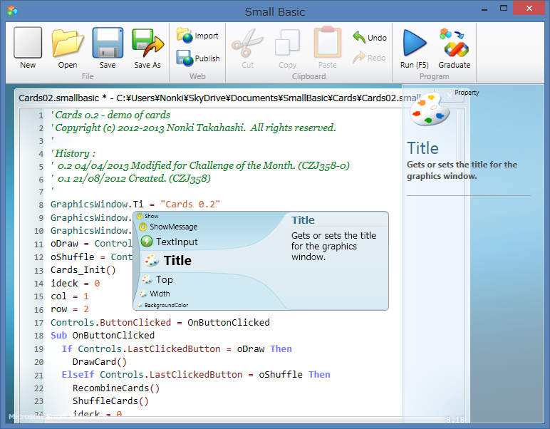
Small Basic

Slide 4
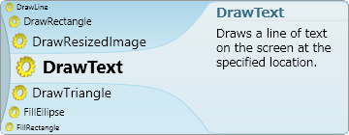
Small Basic
New BASIC for cloud era
Easy but powerful
One of .NET Framework languages
GraphicsWindow.DrawText(10, 10, "Hello TechNet!")
Long keywords?
TechNet Wiki | Features of Microsoft Small Basic v1.0

Slide 5
Small Basic – Easy but Powerful
Easy
Only 14 Keywords
Simple IDE - code and just [Run]
Powerful
Read/Write local text files
Load image files/internet files
Play audio files/MML
Controls
Shapes

Slide 6
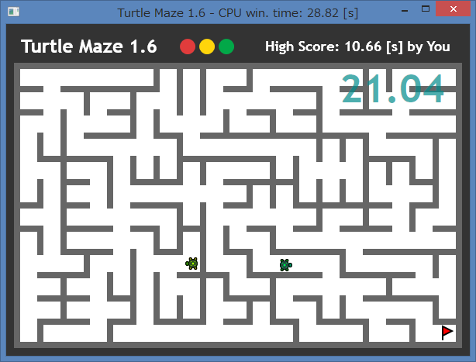
Small Basic – Easy and Fun
Demo
Smallbasic.com | Turtle Maze 1.6 (PNC833-17)

Slide 7
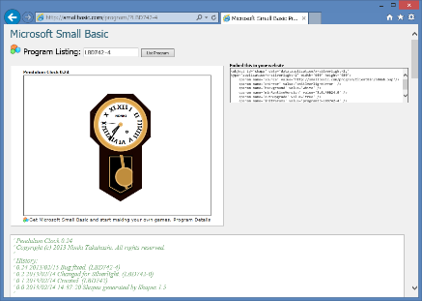
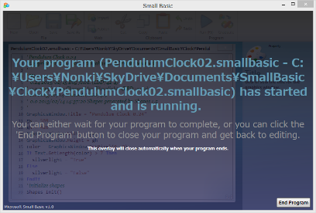
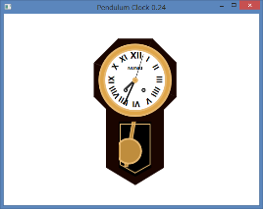
Small Basic – How to Run
smallbasic.com
Two Ways to run Small Basic programs
In Windows desktop
In an internet browser
Publish
Import
browser
Run
.exe
IDE
SmallBasicLibrary.dll
Silverlight
.NET Framework 3.5

Slide 8
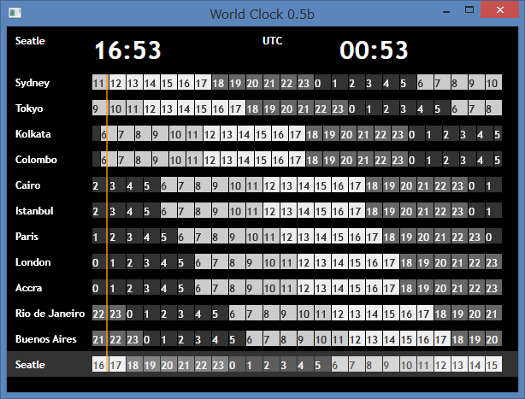
Small Basic – How to Run
Demo
Smallbasic.com | World Clock 0.5b (BSP033-4)

Slide 9
Small Basic History
2008 - 2010
Small Basic v0.1 – v0.9x (beta) released
2011
Small Basic v1.0 released
Challenge of the Month (Week) started in the forum
2012 - 2015
Small Basic blog restarted
TechNet Wiki Summit 2015
Small Basic blog started
Small Basic forum started in MSDN forums
TechNet Wiki contest started
TechNet Wiki | History of Microsoft Small Basic

Slide 10
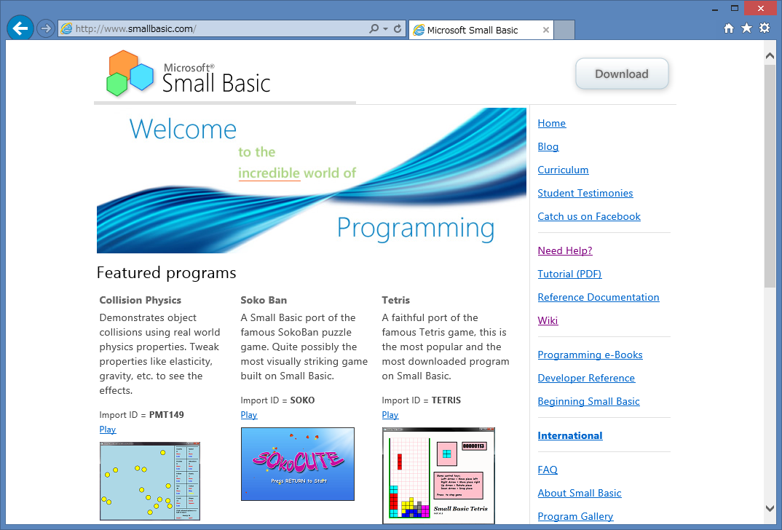
Small Basic Community

Slide 11
Small Basic Community
SB Community
TN
SB
Others
MSDN
Small Basic Community is powered by many sites
Smallbasic.com
MSDN – Blog & Forum
TechNet – Wiki & Gallery
Facebook
Twitter
YouTube
Etc.
TechNet Wiki | Community Council: Focus Areas

Slide 12
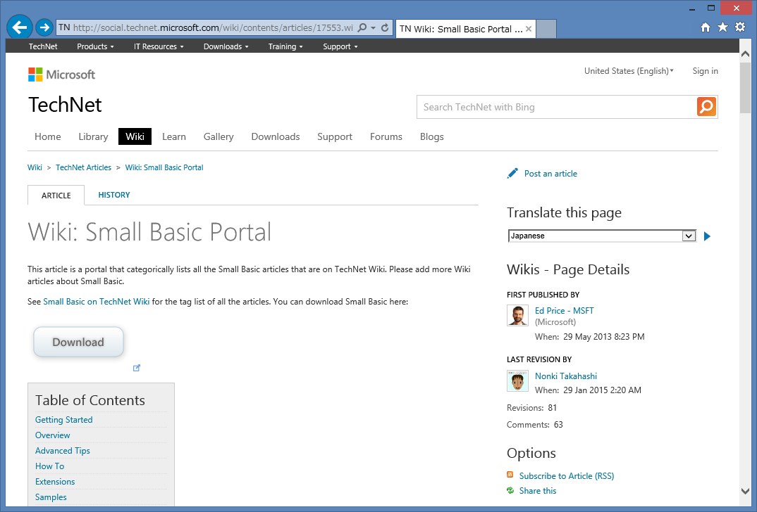
TechNet Wiki Articles

Slide 13
TechNet Wiki Articles
More than 200 articles tagged as “Small Basic”
Small Basic ☛
Small Basic FAQ ☛
Wiki: Small Basic Portal ☛
Small Basic Portal Survival Guide ☛
Small Basic: International Resources ☛
Features of Microsoft Small Basic v1.0 ☛
Small Basic: How to Use MSDN Forum ☛
TechNet Wiki is an encyclopedia for Small Basic
Small Basic Encyclopedia
TechNet Wiki | tagged as Small Basic

Slide 14
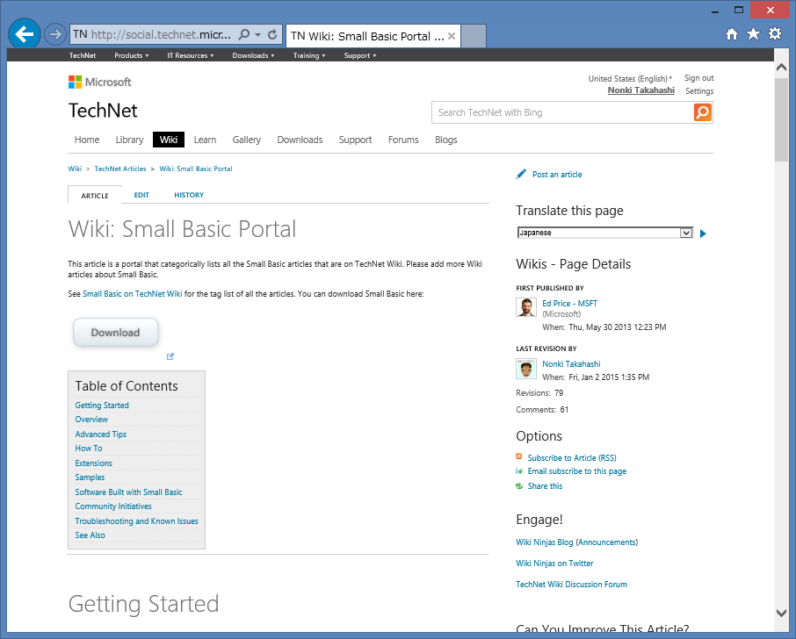
TechNet Wiki Articles (1)
Wiki: Small Basic Portal
This is very useful article which has categorized links to TechNet Wiki articles about Small Basic
For Wiki Articles
Links are to TechNet Wiki articles
MORE THAN 160 LINKS
Coverage 70% of SB articles
TechNet Wiki | Wiki: Small Basic Portal

Slide 15
TechNet Wiki Articles (2)
Small Basic Survival Guide
A Survival Guide is a list of resource links
Not for Wiki Articles
Links are for additional resources (out of TechNet Wiki)
8 CATEGOLIES
Official sites
Blogs/Sites
Galleries/Portals
Videos
Books
Downloads
Language Resources
Related Resources
TechNet Wiki | Small Basic Survival Guide

Slide 16
TechNet Wiki Articles (3)
Small Basic: How to Use MSDN Forum
This article illustrates how to use MSDN forum
PLEASE READ BEFORE POSTING
This section is from Small Basic forum
ASKING A GOOD QUESTION
ANSWERING QUESTIONS
ABOUT OFF TOPIC POST
Tree Structure in Thread
This section is about structured question and answers
m
TechNet Wiki | Small Basic: How to Use MSDN Forum

Slide 17
TechNet Wiki Articles (4)
Small Basic: International Resources
This article focuses on international resources for SB both in TechNet Wiki and out of TechNet Wiki
NOW WE HAVE 24 LANGUAGES
Supported Languages in Small Basic, Small Basic API Reference, Small Basic Getting Started Guides, Small Basic Curriculum Official resources
TechNet Wiki Articles, Blogs 5 languages for Wiki
Books, Videos
Two books were published last year in English and Korea
Twitter, Communities
🌎
TechNet Wiki | Small Basic: International Resources

Slide 18
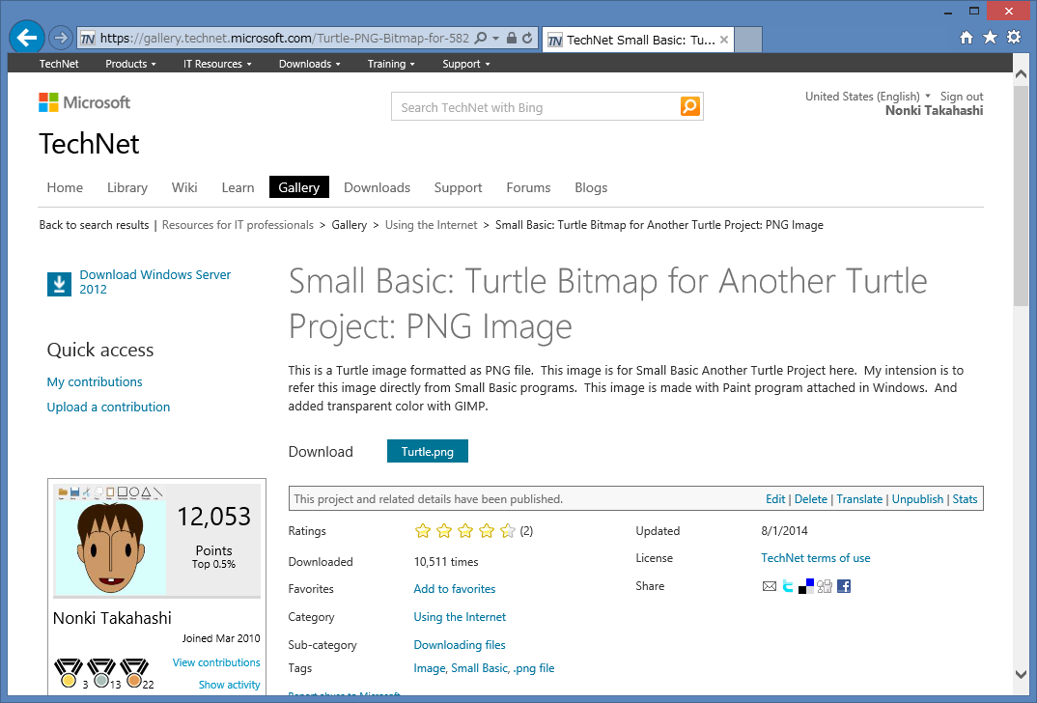
TechNet Gallery

Slide 19
TechNet Gallery
TechNet Gallery has 25 contents tagged as “Small Basic”
Programs
Too large SB programs
SB programs with files
Extension libraries
Images
Downloaded from SB programs
Excel sheets
Statistic information about Small Basic
PowerPoint presentations
SB curriculums
Images for SB programs
TN
TechNet Gallery | tagged as Small Basic

Slide 20
Synergy around Small Basic and TechNet Wiki
FROM SMALL BASIC
FROM TECHNET WIKI
Code block formatter
TN Wiki article list generator
SB blog post list generator
Sample programs
URL of published program
Information about SB
Guide for new programmer
SB Portal
About SB forum
About SB blog
About TN Gallery
About CodePlex
About YouTube
About Channel 9
FROM OTHER SITES
TN Gallery – programs and files
TN Gallery – images for SB programs
SB forum – QA and discussion
SB blog - announcement

Slide 21
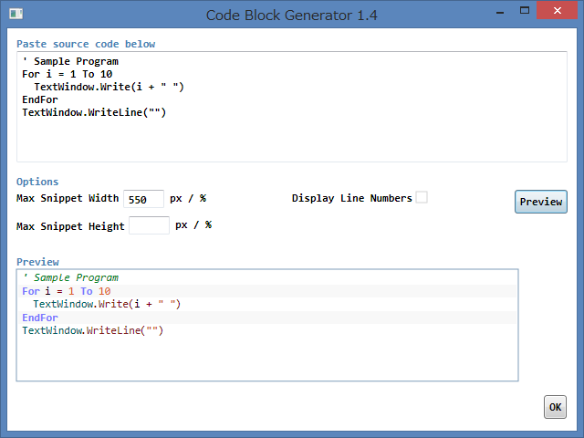
Synergy around SB and TNWiki (1)
Code Block Formatter
This is a Small Basic program
TechNet Wiki has it’s code block formatter
But doesn’t support SB
So coded in SB

Slide 22
Synergy around SB and TNWiki (1)
Code Block Formatter
Demo
Smallbasic.com | Code Block Formatter 1.4 (SKC235-2)

Slide 23
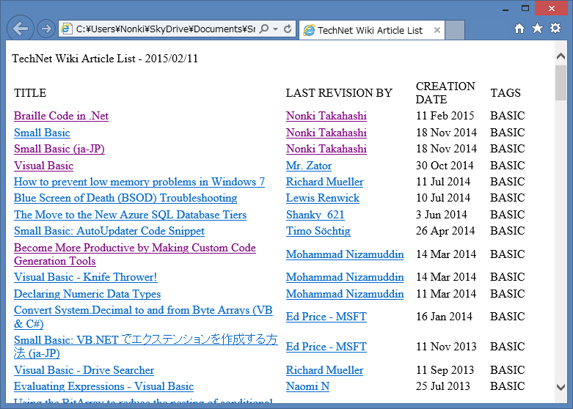
Synergy around SB and TNWiki (2)
TechNet Article List
This is a Small Basic program
This program creates a HTML file
This sample creates Visual Basic article list
You can modify this program for other topics

Slide 24
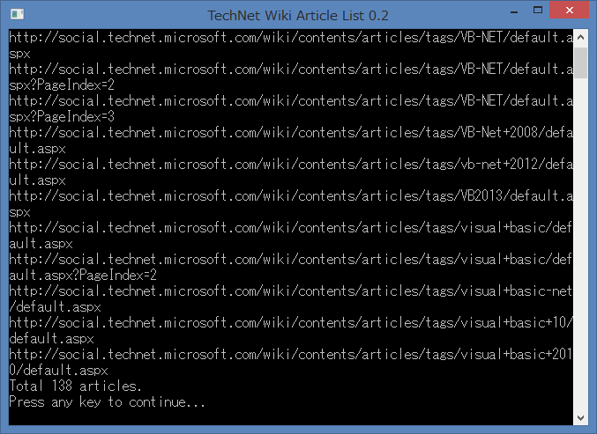
Synergy around SB and TNWiki (2)
TechNet Wiki Article List
Demo
TechNet Wiki | Small Basic: TechNet Wiki Article List

Slide 25

Conclusion

Slide 26
Conclusion
Small Basic is a simple and powerful programming language
Small Basic community is hot for new programmers
TechNet Wiki is now an encyclopedia about Small Basic
Small Basic contents in TechNet Gallery are growing
I hope much synergy around Small Basic and TechNet Wiki
Questions?

Slide 27
Thank you very much
For listening this session
For supporting via TechNet Wiki

